Slide 1


Lecture 6 –Logistic Regression
Data 119, Intro to Data Science II
Adapted from Data 119 slides for W23 and A23

Slide 2
Objectives
Motivation: Binary Classification
Generalized Linear Models
Logistic Regression vs Linear Regression
Maximum Likelihood Estimation
Model Evaluation

Slide 3
Binary Classification
Multiple Linear Regression is versatile.
  Widely used for tasks having several numerical predictors.
  Can accommodate non-linear transformations of explanatory variable within a linear combination
Not suitable for binary classification – binary target variable
Cannot model probabilities well
  Outcomes can be theoretically negative i.e. invalid for probabilities
We have seen one binary classification model: KNN
Notes:
Typically supervised learning problem

Slide 4
Logistic Regression
Logistic regression has a form that allows for a regression-like function of explanatory variables.
Regression coefficients that predict the mean of the binary variable
  Probability of outcomes
This binary variable is usually a substitute for a categorical target variable with two classes.
  Will a person develop a certain disease or not, based on specific health characteristics?
  Is a piece of email spam or not, based on different features of the email?
  Will a person default on a loan or not, based on their financial history?
Notes:
Typically supervised learning problem

Slide 5
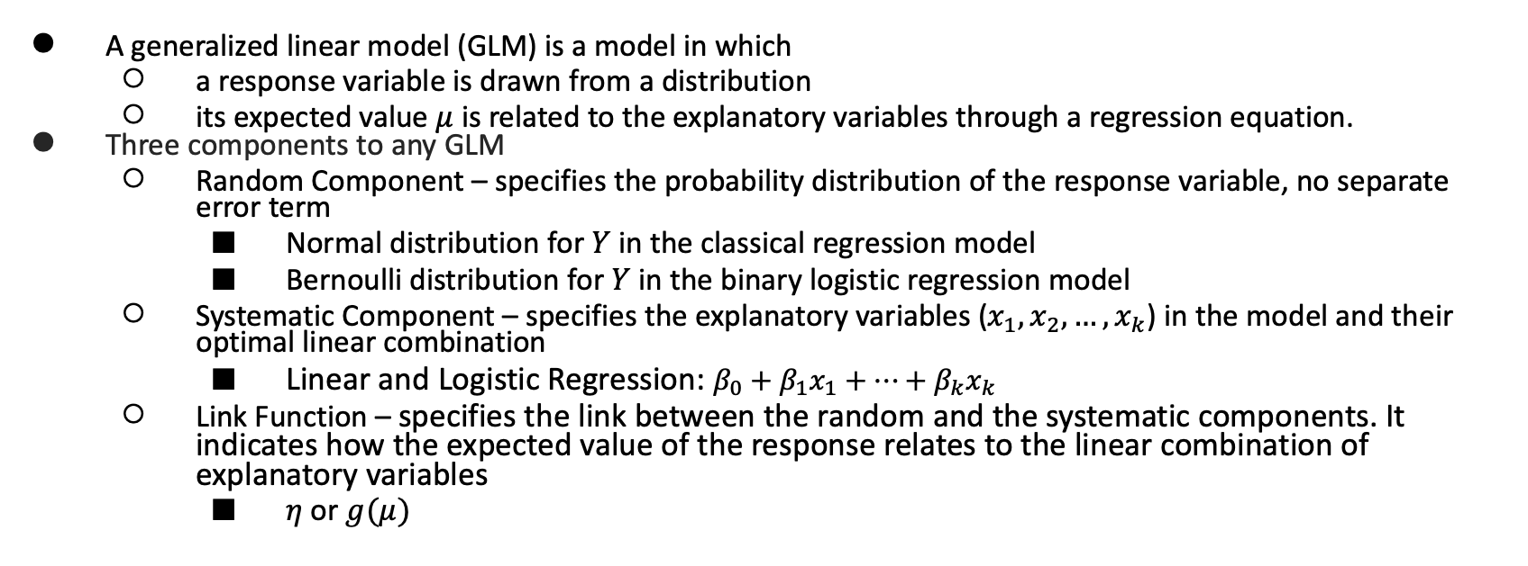
Generalized Linear Models
A generalized linear model (GLM) is a model in which
  a response variable is drawn from a distribution
  its expected value $μ$ is related to the explanatory variables through a regression equation.
Three components to any GLM
  Random Component – specifies the probability distribution of the response variable, no separate error term
    Normal distribution for $Y$ in the classical regression model
    Bernoulli distribution for $Y$ in the binary logistic regression model
  Systematic Component – specifies the explanatory variables ($x_{1},x_{2}, …{,x}_{k}$) in the model and their optimal linear combination
    Linear and Logistic Regression: $β_{0}+β_{1}x_{1}+…+β_{k}x_{k}$
  Link Function – specifies the link between the random and the systematic components. It indicates how the expected value of the response relates to the linear combination of explanatory variables
    $η$ or $g(μ)$

Slide 6
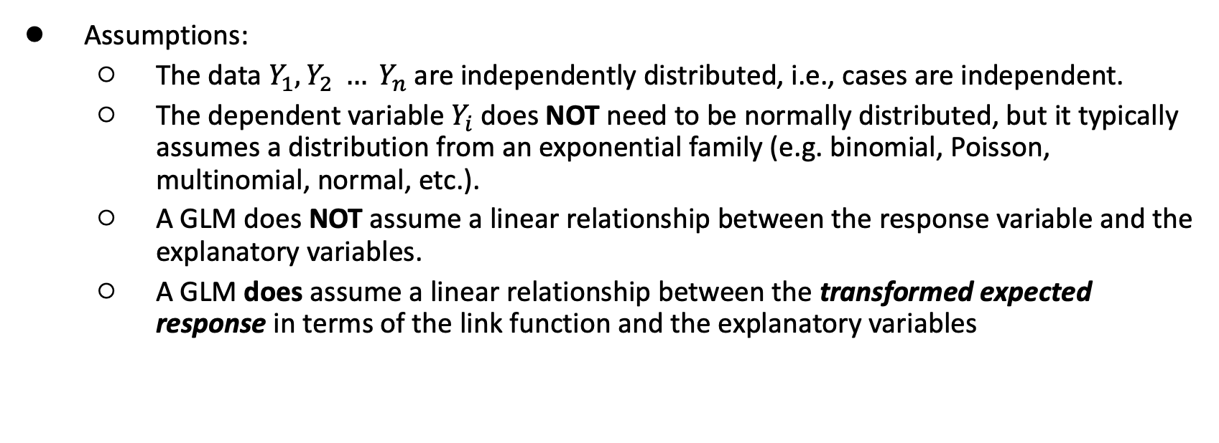
Generalized Linear Models
Assumptions:
  The data $Y_{1}, Y_{2} … Y_{n}$ are independently distributed, i.e., cases are independent.
  The dependent variable $Y_{i}$does NOT need to be normally distributed, but it typically assumes a distribution from an exponential family (e.g. binomial, Poisson, multinomial, normal, etc.).
  A GLM does NOT assume a linear relationship between the response variable and the explanatory variables.
  A GLM does assume a linear relationship between the transformed expected response in terms of the link function and the explanatory variables

Slide 7
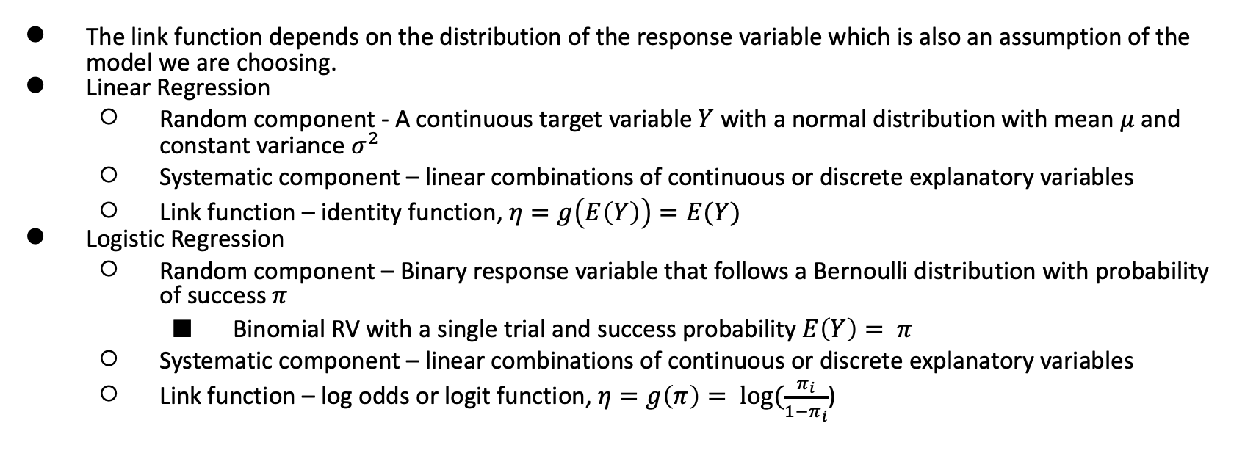
Link Functions
The link function depends on the distribution of the response variable which is also an assumption of the model we are choosing.
Linear Regression
  Random component - A continuous target variable $Y$ with a normal distribution with mean $μ$ and constant variance $σ^{2}$
  Systematic component – linear combinations of continuous or discrete explanatory variables
  Link function – identity function, $η=g\left(E\left(Y\right)\right)=E(Y)$
Logistic Regression
  Random component – Binary response variable that follows a Bernoulli distribution with probability of success $π$
    Binomial RV with a single trial and success probability $E\left(Y\right)= π$
  Systematic component – linear combinations of continuous or discrete explanatory variables
  Link function – log odds or logit function, $η=g\left(π\right)= \log{(\frac{π_{i}}{1−π_{i}}}$)

Slide 8
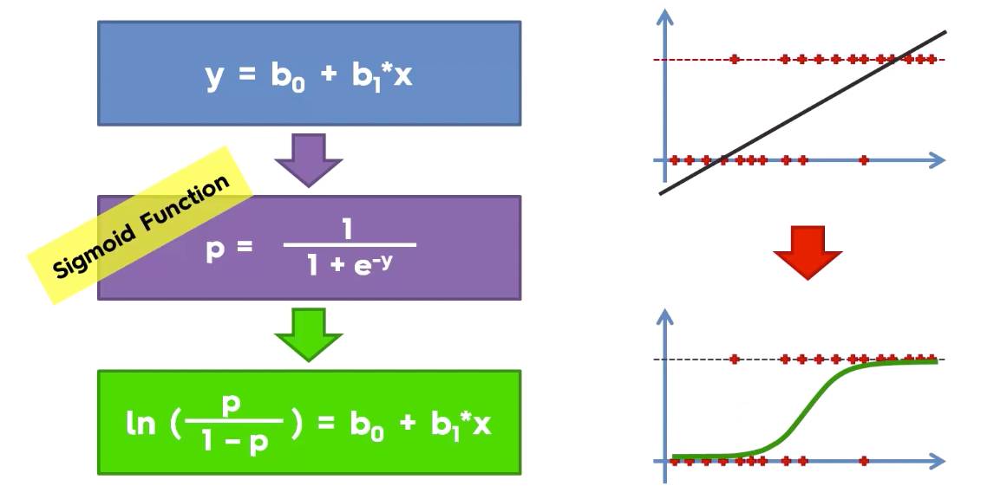
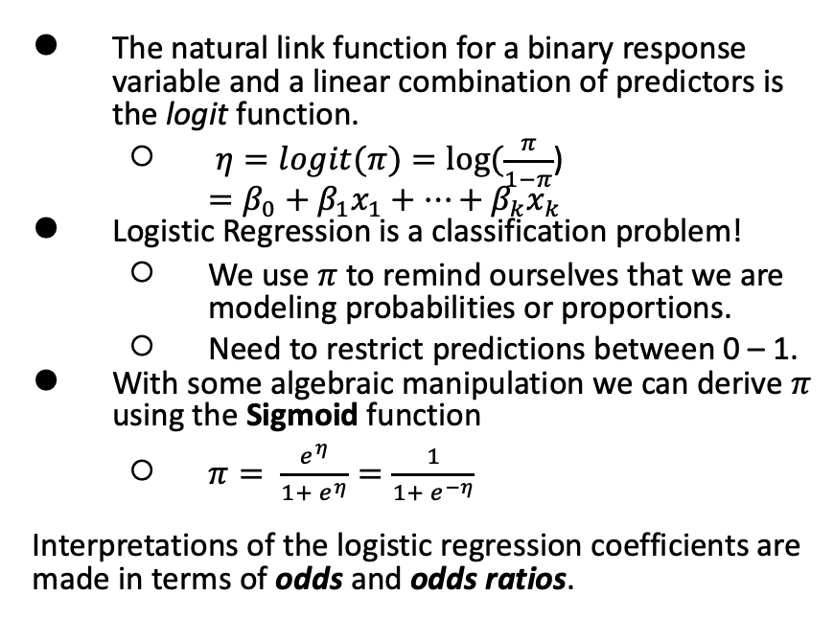
Logistic Regression vs Linear Regression
Linear Regression theoretically allows negative values
The natural link function for a binary response variable and a linear combination of predictors is the logit function.
  $η=logit{(π)}=log{(\frac{π}{1−π}}$)
  $=β_{0}+β_{1}x_{1}+…+β_{k}x_{k}$
Logistic Regression is a classification problem!
  We use $π$ to remind ourselves that we are modeling probabilities or proportions.
  Need to restrict predictions between 0 – 1.
With some algebraic manipulation we can derive $π$ using the Sigmoid function
  $π= \frac{e^{η}}{1+ e^{η}}=\frac{1}{1+ e^{−η}}$
Interpretations of the logistic regression coefficients are made in terms of odds and odds ratios.
In Logistic Regression the linear combination is used
to predict the log odds of success

Slide 9
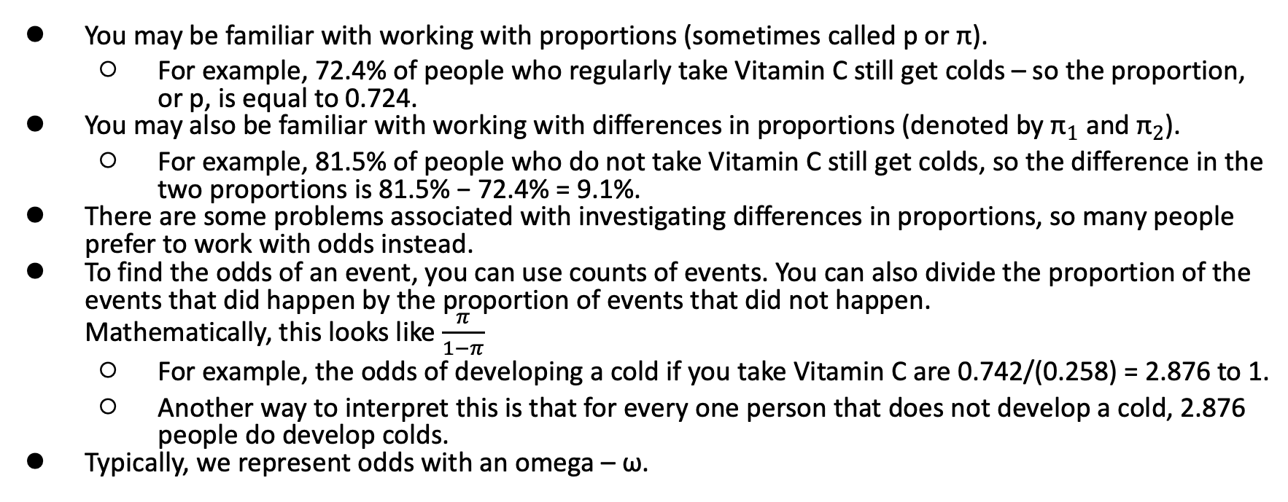
Odds
You may be familiar with working with proportions (sometimes called p or π).
  For example, 72.4% of people who regularly take Vitamin C still get colds – so the proportion, or p, is equal to 0.724.
You may also be familiar with working with differences in proportions (denoted by ${\text{π}}_{1}$ and ${\text{π}}_{2}$).
  For example, 81.5% of people who do not take Vitamin C still get colds, so the difference in the two proportions is 81.5% − 72.4% = 9.1%.
There are some problems associated with investigating differences in proportions, so many people prefer to work with odds instead.
To find the odds of an event, you can use counts of events. You can also divide the proportion of the events that did happen by the proportion of events that did not happen.
Mathematically, this looks like $\frac{π}{1−π}$
  For example, the odds of developing a cold if you take Vitamin C are 0.742/(0.258) = 2.876 to 1.
  Another way to interpret this is that for every one person that does not develop a cold, 2.876 people do develop colds.
Typically, we represent odds with an omega – ω.

Slide 10
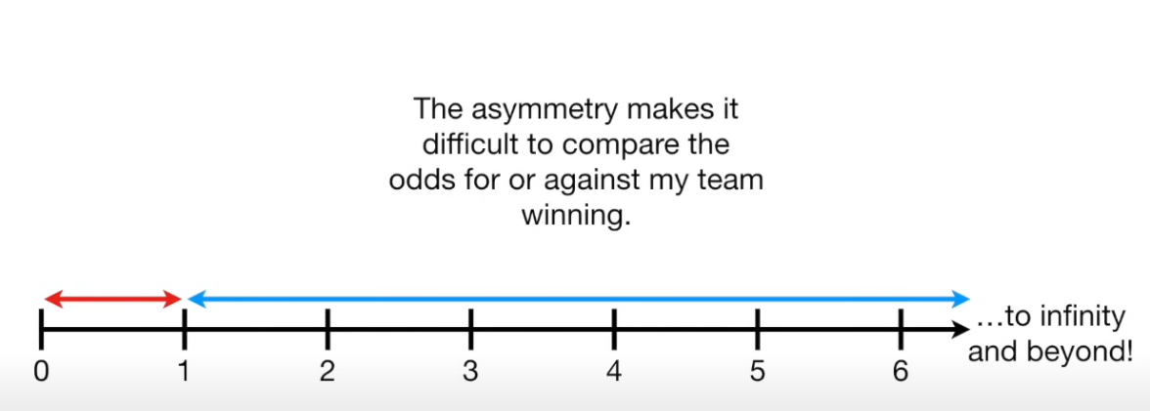
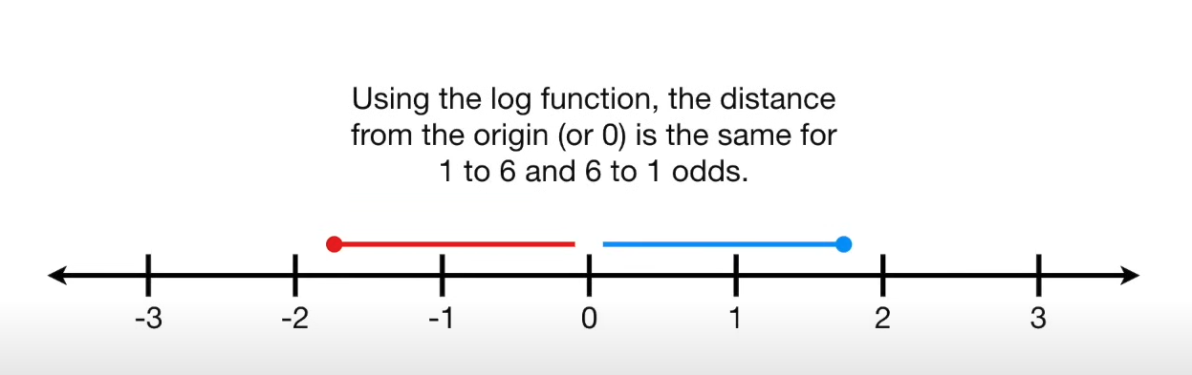
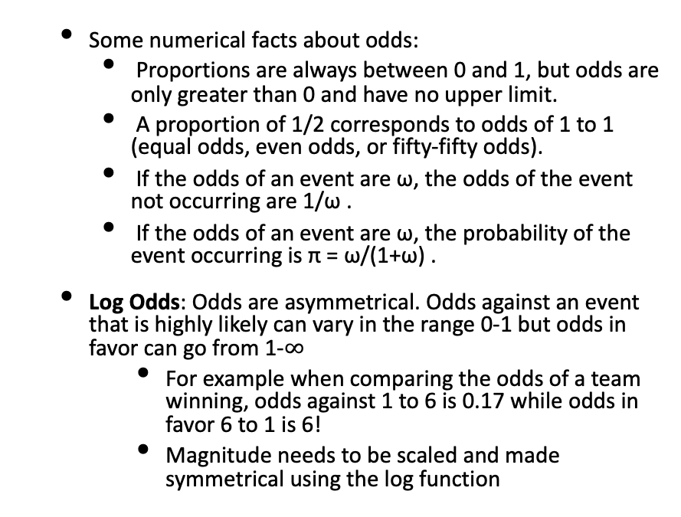
Odds and Log Odds
Some numerical facts about odds:
  Proportions are always between 0 and 1, but odds are only greater than 0 and have no upper limit.
  A proportion of 1/2 corresponds to odds of 1 to 1 (equal odds, even odds, or fifty-fifty odds).
  If the odds of an event are ω, the odds of the event not occurring are 1/ω .
  If the odds of an event are ω, the probability of the event occurring is π = ω/(1+ω) .
Log Odds: Odds are asymmetrical. Odds against an event that is highly likely can vary in the range 0-1 but odds in favor can go from 1-$∞$
  For example when comparing the odds of a team winning, odds against 1 to 6 is 0.17 while odds in favor 6 to 1 is 6!
  Magnitude needs to be scaled and made symmetrical using the log function
Nice mathematical property for interpretation

Slide 11
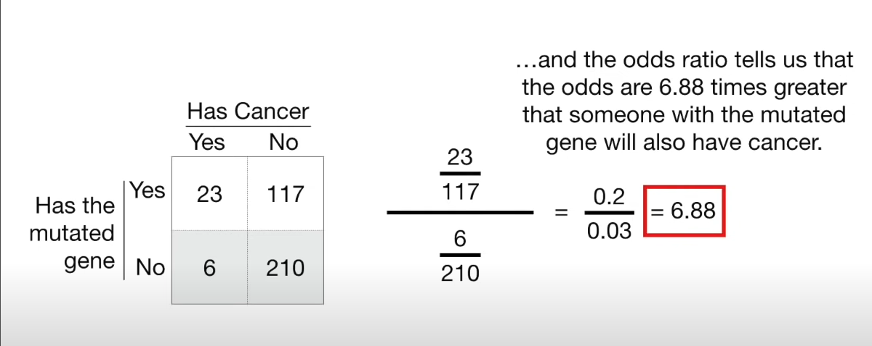
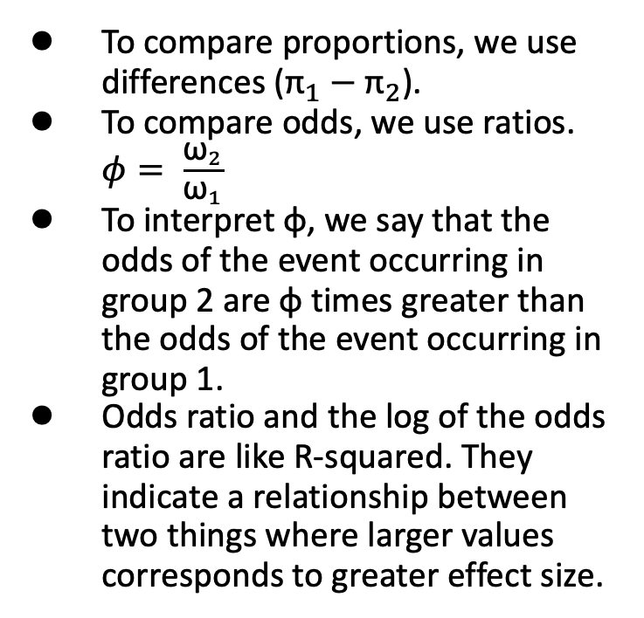
Odds and Odds Ratios
To compare proportions, we use differences (${\text{π}}_{1}−{\text{π}}_{2}$).
To compare odds, we use ratios. $φ= \frac{{\text{ω}}_{2}}{{\text{ω}}_{1}}$
To interpret φ, we say that the odds of the event occurring in group 2 are φ times greater than the odds of the event occurring in group 1.
Odds ratio and the log of the odds ratio are like R-squared. They indicate a relationship between two things where larger values corresponds to greater effect size.

Slide 12
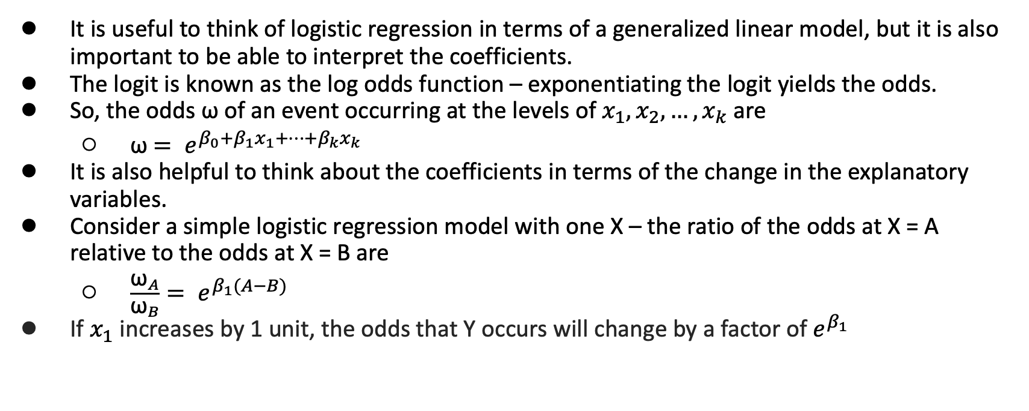
Interpretation of coefficients
It is useful to think of logistic regression in terms of a generalized linear model, but it is also important to be able to interpret the coefficients.
The logit is known as the log odds function – exponentiating the logit yields the odds.
So, the odds ω of an event occurring at the levels of $x_{1},x_{2}, …{,x}_{k}$ are
  ω $= e^{β_{0}+β_{1}x_{1}+…+β_{k}x_{k}}$
It is also helpful to think about the coefficients in terms of the change in the explanatory variables.
Consider a simple logistic regression model with one X – the ratio of the odds at X = A relative to the odds at X = B are
  $\frac{{\text{ω}}_{A}}{{\text{ω}}_{B}}= e^{β_{1}(A−B)}$
If $x_{1}$ increases by 1 unit, the odds that Y occurs will change by a factor of $e^{β_{1}}$

Slide 13
Logistic Regression vs Linear Regression
Logistic regression is a form of nonlinear regression, since the equation is not linear in the parameters.
However, the non-linearity is totally contained in the link function (which is why this is called a generalized linear model).
The implication here is that due to the structure, regression can be used in a very similar way as in linear regression.
The differences in logistic and linear regression are:
Assumptions of logistic regression
Parameter estimation techniques
Sampling distribution of parameters
Methods of comparing models

Slide 14
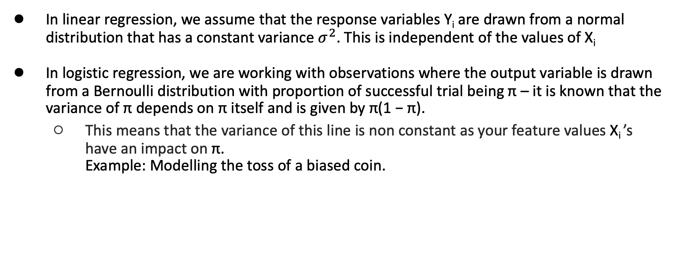
Nonconstant Variance
In linear regression, we assume that the response variables Y_{i} are drawn from a normal distribution that has a constant variance $σ^{2}$. This is independent of the values of X_{i}
In logistic regression, we are working with observations where the output variable is drawn from a Bernoulli distribution with proportion of successful trial being π – it is known that the variance of π depends on π itself and is given by π(1 − π).
  This means that the variance of this line is non constant as your feature values X_{i} ’s have an impact on π.
  Example: Modelling the toss of a biased coin.

Slide 15
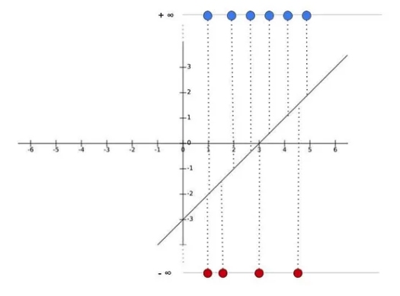
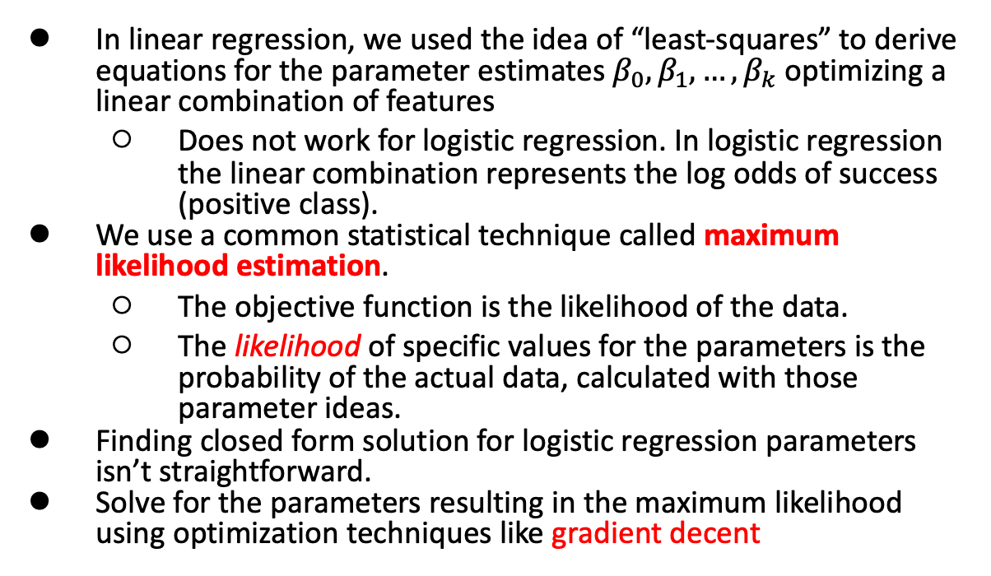
Maximum Likelihood Estimation
In linear regression, we used the idea of “least-squares” to derive equations for the parameter estimates $β_{0},β_{1}, …{,β}_{k}$ optimizing a linear combination of features
  Does not work for logistic regression. In logistic regression the linear combination represents the log odds of success (positive class).
We use a common statistical technique called maximum likelihood estimation.
  The objective function is the likelihood of the data.
  The likelihood of specific values for the parameters is the probability of the actual data, calculated with those parameter ideas.
Finding closed form solution for logistic regression parameters isn’t straightforward.
Solve for the parameters resulting in the maximum likelihood using optimization techniques like gradient decent
Notes:
Our goal in logistic regression is to draw the best fitting S-curve for given data points. And in logistic regression, we transform the y-axis from the probabilities to log(odds). The problem is that this transformation pushes the raw data points to positive and negative infinity :
log(p) – log (1-p); +$∞$ for p=1 and -$∞$ for p=0

Slide 16
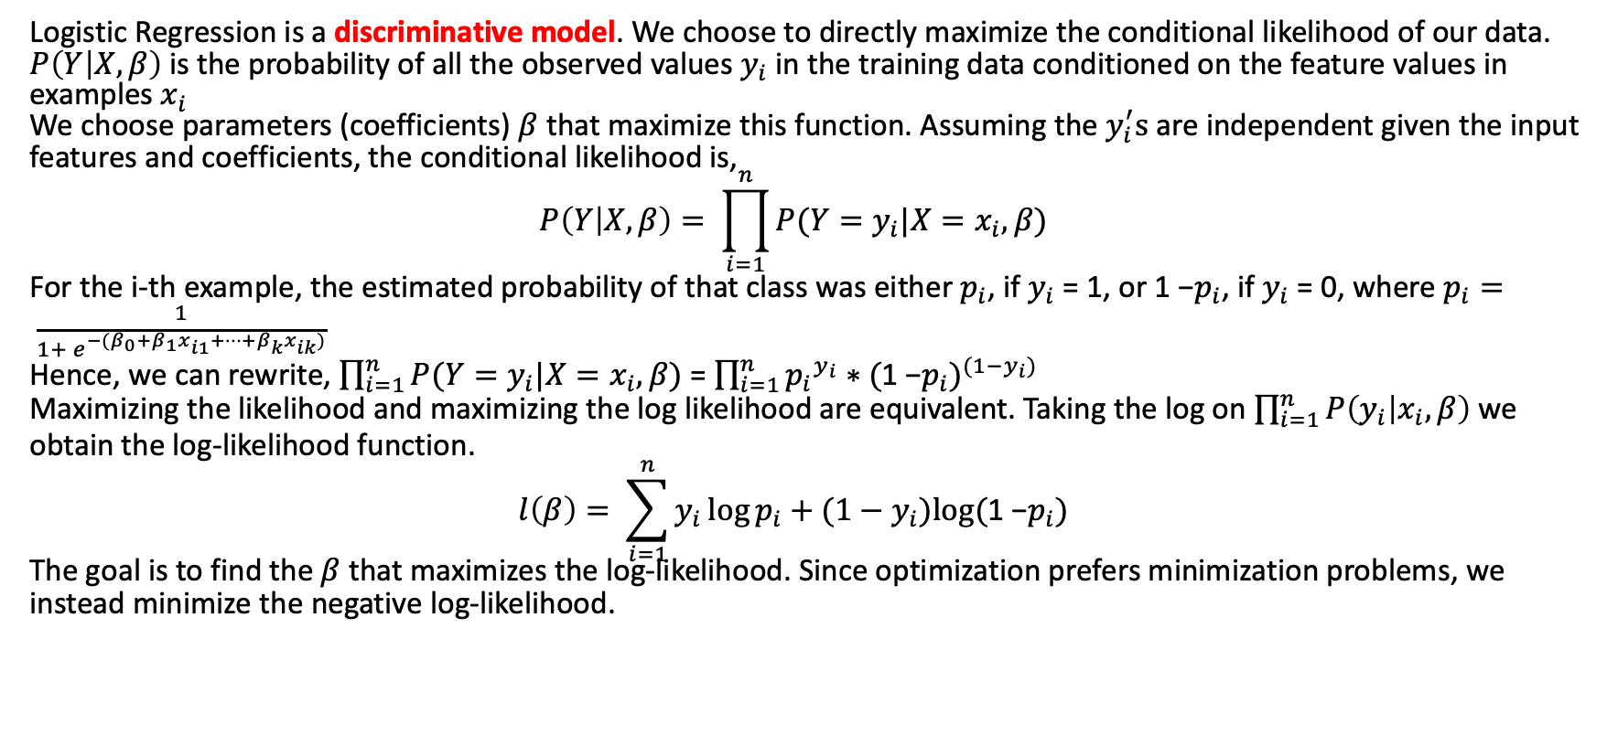
Maximum Likelihood Estimation
Logistic Regression is a discriminative model. We choose to directly maximize the conditional likelihood of our data.
$P\left(Y | X,β\right)$ is the probability of all the observed values $y_{i}$ in the training data conditioned on the feature values in examples $x_{i}$
We choose parameters (coefficients) $β$ that maximize this function. Assuming the $y_{i}^{′}s$ are independent given the input features and coefficients, the conditional likelihood is,
$$P\left(Y | X,β\right)= \prod_{i=1}^{n}{P({Y=y}_{i}|{X=x}_{i},β)}$$
For the i-th example, the estimated probability of that class was either $p_{i}$, if $y_{i}$ = 1, or 1 −$p_{i}$, if $y_{i}$ = 0, where $p_{i}= \frac{1}{1+ e^{−(β_{0}+β_{1}x_{i1}+…+β_{k}x_{ik})}}$
Hence, we can rewrite, $\prod_{i=1}^{n}{P({Y=y}_{i}|{X=x}_{i},β)}$ = $\prod_{i=1}^{n}{{p_{i}}^{y_{i}}∗{(\text{1 −}p_{i})}^{(1−y_{i})}}$
Maximizing the likelihood and maximizing the log likelihood are equivalent. Taking the log on $\prod_{i=1}^{n}{P\left(y_{i} | x_{i},β\right)}$ we obtain the log-likelihood function.
$$l\left(β\right)= \sum_{i=1}^{n}{y_{i}\log{p_{i}}+(1−y_{i})log(\text{1 −}p_{i})}$$
The goal is to find the $β$ that maximizes the log-likelihood. Since optimization prefers minimization problems, we instead minimize the negative log-likelihood.

Slide 17
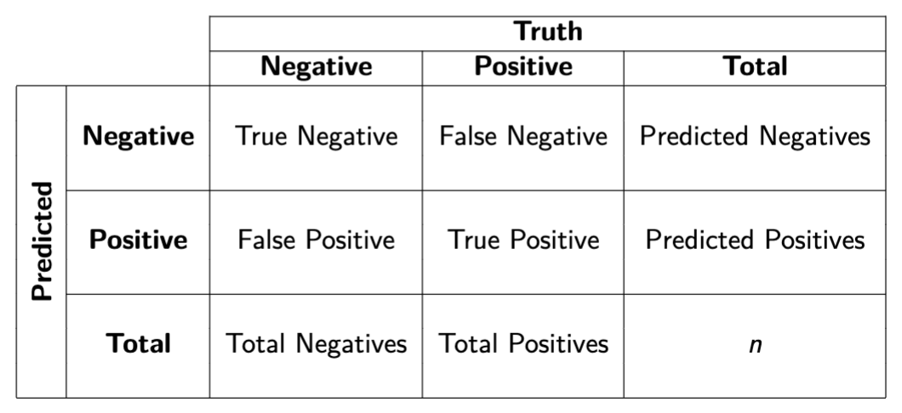
Model Evaluation
Accuracy
  (TP+TN)/n
Sensitivity/Recall/True Positive Rate
  TP/(TP+FN)
Specificity/True Negative Rate
  TN/(TN+FP)
Precision/Positive Predicted Value
  TP/(TP+FP)
ROC Curves
  Thresholds and AUC contd.
  Useful for imbalanced classes

Slide 18
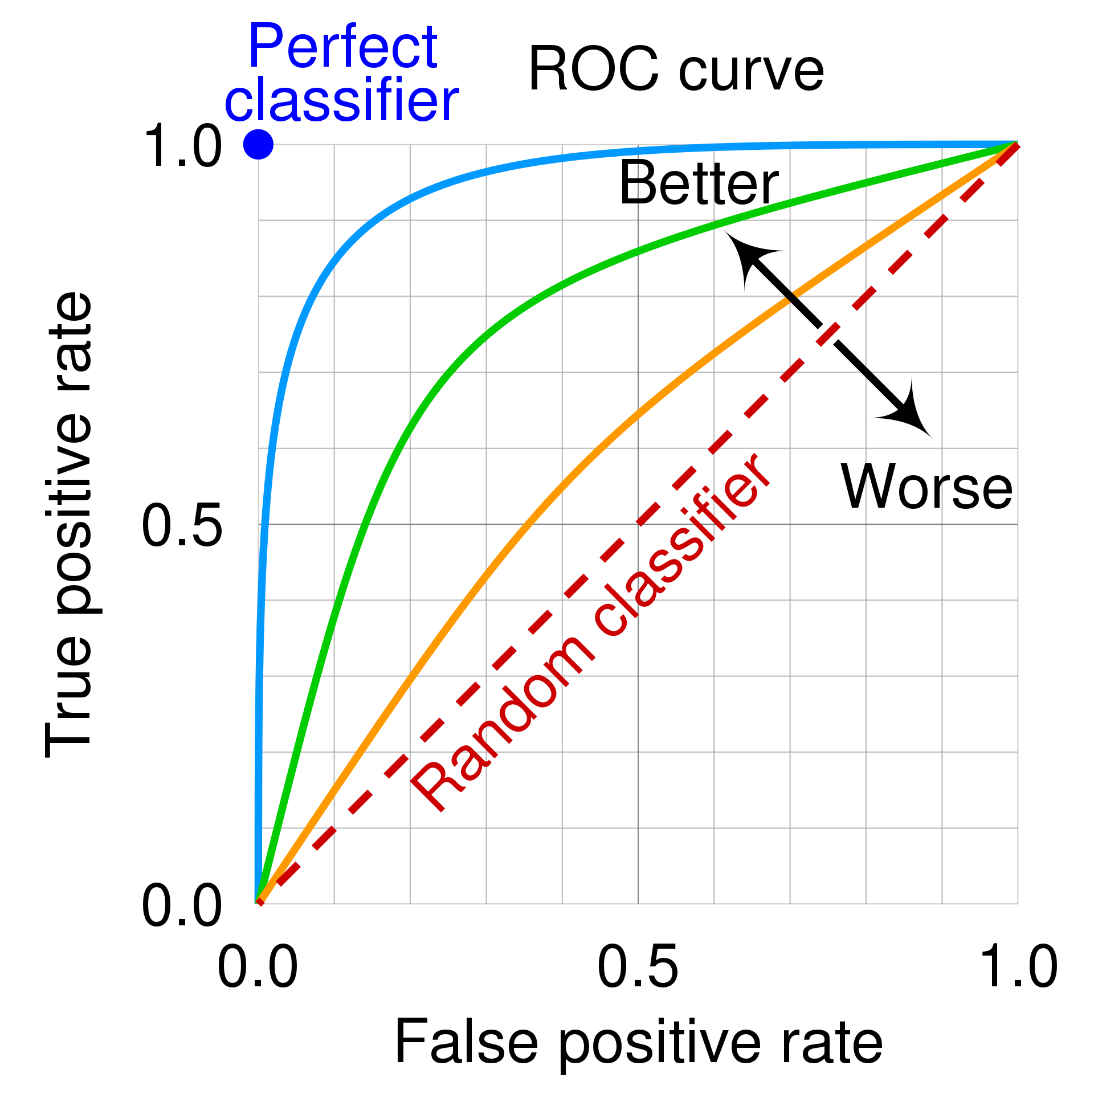
Model Evaluation – ROC Curves
Remember that for logistic regression, we do not get 0 and 1 outputs i.e. class labels but probabilities.
A common approach to “translating” probabilities is to use a threshold of 0.5.
  Anything greater than 0.5 is more likely than not to happen, so we predict that it will be a label for the positive class.
  Anything less than 0.5 is more likely to not happen, so we predict that it will be a label for the negative class.
We do not have to use 0.5 as a threshold! You could change it to be any value between 0 and 1.
AUC stands for Area Under the (receiver operating characteristic) Curve.
The ROC curve plots true positive rate (sensitivity) against false positive rate (1 - specificity) at various thresholds.
Area Under the Curve (AUC) always falls between 0 and 1, with values closer to 1 being more desirable.
Rectifier Operating Characteristic Curve

