Slide 1


Unit 5 – Prediction with
Simple Linear Regression
DS 3100, Fundamentals of Data Science

Slide 2
Objectives
Moving beyond correlation for Linear Associations
Fitting a Line to Data
Objective functions for Linear Regression
Ordinary Least Squares

Slide 3
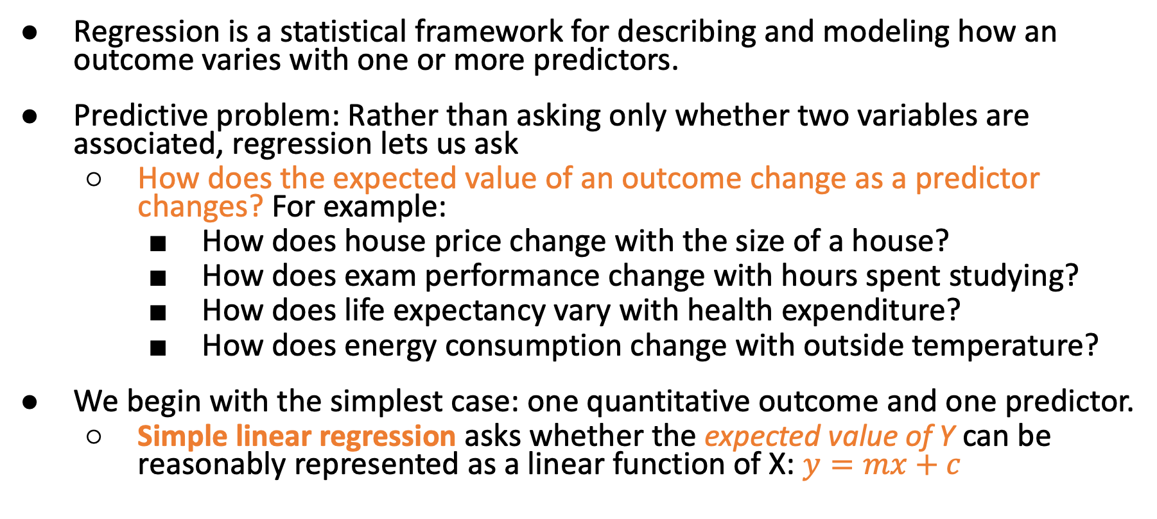
Regression
Regression is a statistical framework for describing and modeling how an outcome varies with one or more predictors.
Predictive problem: Rather than asking only whether two variables are associated, regression lets us ask
  How does the expected value of an outcome change as a predictor changes? For example:
    How does house price change with the size of a house?
    How does exam performance change with hours spent studying?
    How does life expectancy vary with health expenditure?
    How does energy consumption change with outside temperature?
We begin with the simplest case: one quantitative outcome and one predictor.
  Simple linear regression asks whether the expected value of Y can be reasonably represented as a linear function of X: $y=mx+c$

Slide 4
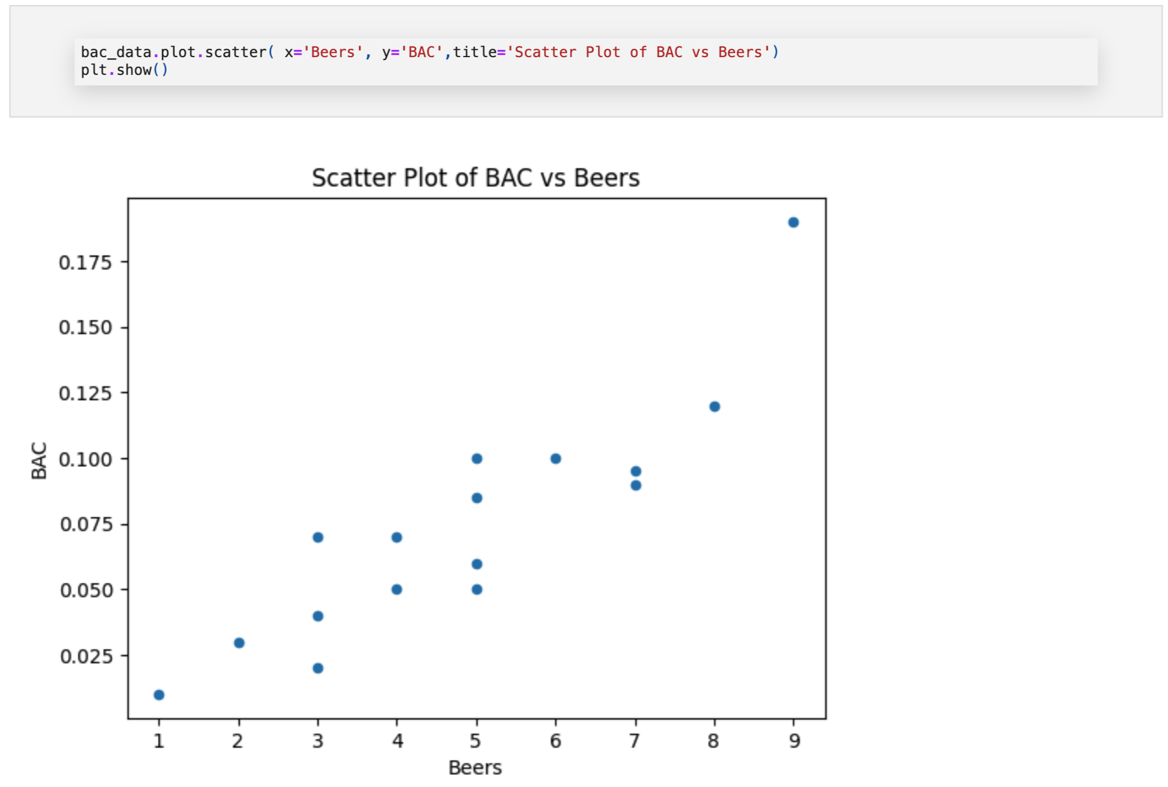

Setting the Regression scene
A simple example to set the premise for linear equations and Simple Linear Regression.
Beers and BAC
Researchers at Ohio State University had sixteen volunteers drink a randomly drawn number of 12-ounce beer cans. Thirty minutes after drinking their last beer, each subject had their blood alcohol content (BAC) measured. We want to test the relationship between BAC and the number of beer cans that each subject drank.
In a perfect world, we would be able to predict someone’s BAC just by knowing the number of beers they drank using a linear equation. However, there are very few times when such linear relationships are perfect. Rather than finding an exact solution, we typically want to find something that is close enough (an approximate solution). Plotting the data shows a general linear trend which is reassuring.

Slide 5
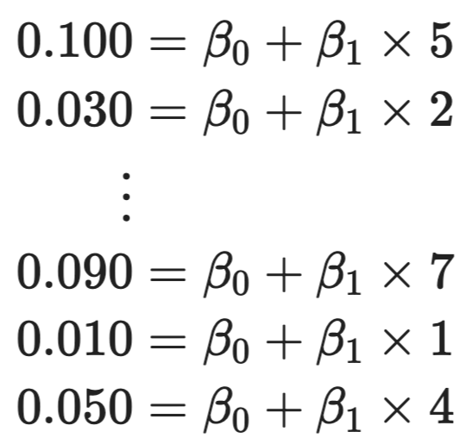
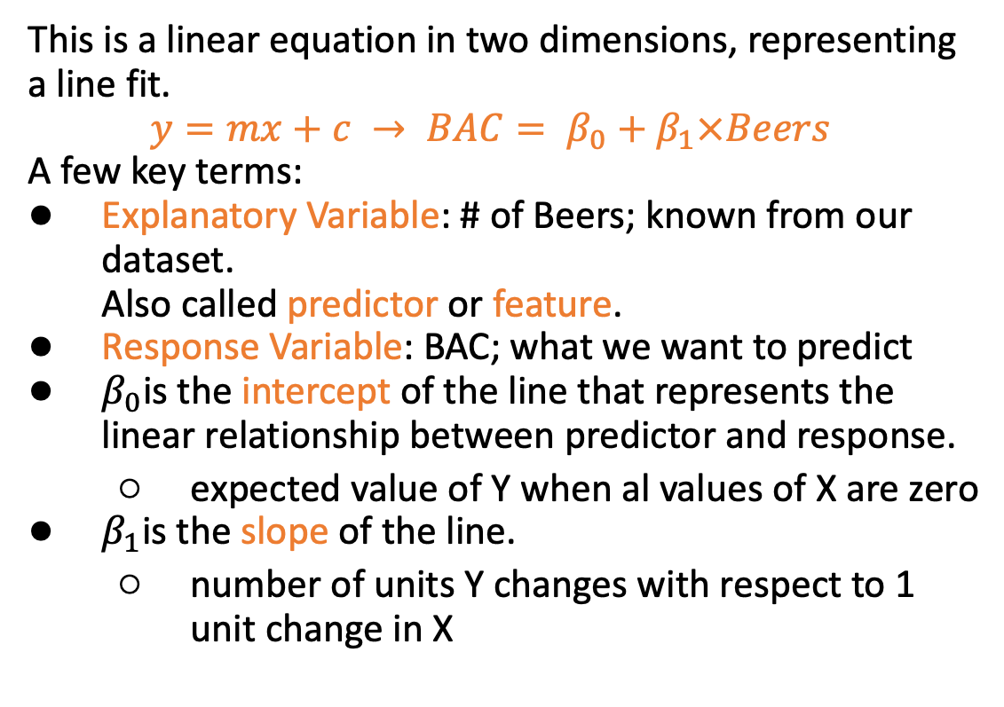
A Linear Equation
This is a linear equation in two dimensions, representing a line fit.
$$y=mx+c → BAC= β_{0}+β_{1}×Beers$$
A few key terms:
Explanatory Variable: # of Beers; known from our dataset.
Also called predictor or feature.
Response Variable: BAC; what we want to predict
$β_{0}$is the intercept of the line that represents the linear relationship between predictor and response.
  expected value of Y when al values of X are zero
$β_{1}$is the slope of the line.
  number of units Y changes with respect to 1 unit change in X
Given our dataset, we are trying to fit a system of equation.

Slide 6
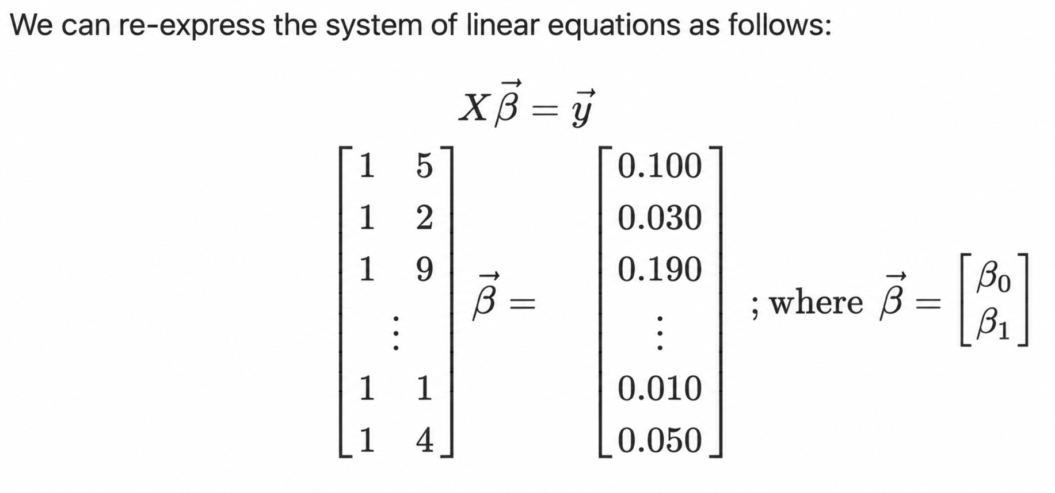
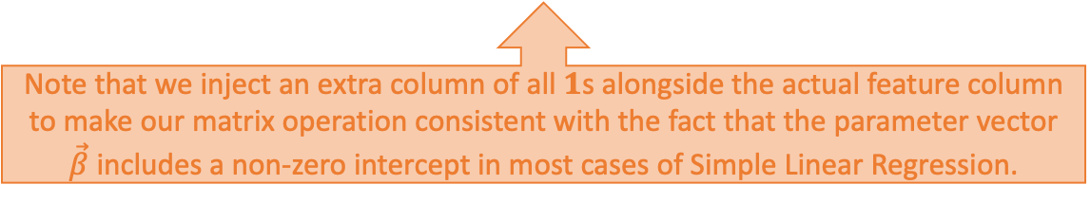
Solving a linear system of equations
Modern computational packages represent them in vectorial form. $X\vec{β}$ is a linear combination of the columns of the matrix $X$. We want to find an estimate of $\vec{β}$ that is the best approximation of $\vec{y}$
Note that we inject an extra column of all $1$s alongside the actual feature column to make our matrix operation consistent with the fact that the parameter vector $\vec{β}$ includes a non-zero intercept in most cases of Simple Linear Regression.

Slide 7
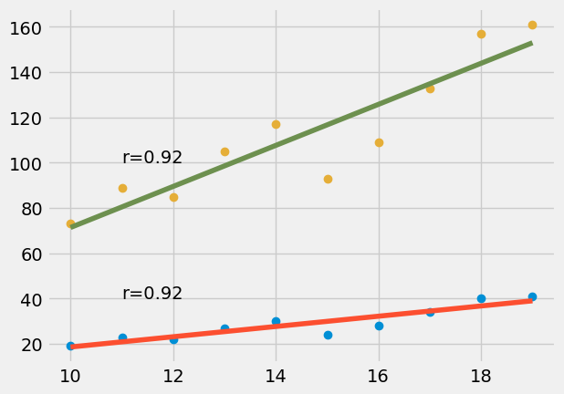
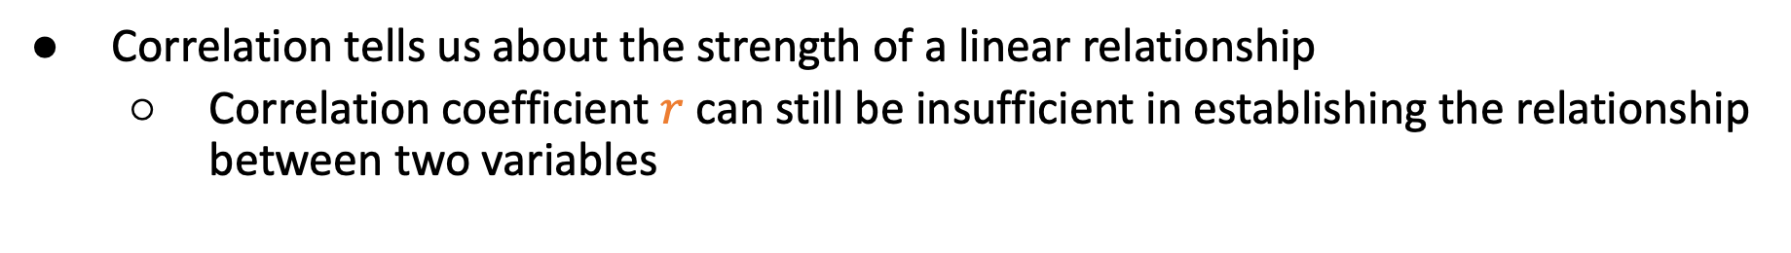
Why correlation isn’t the whole story
Correlation tells us about the strength of a linear relationship
  Correlation coefficient $r$ can still be insufficient in establishing the relationship between two variables
Same correlation coefficient between these two data spreads.
But exact relationship is different.
How do you find the linear relationship between correlated variables?
We fit a line to the data!

Slide 8
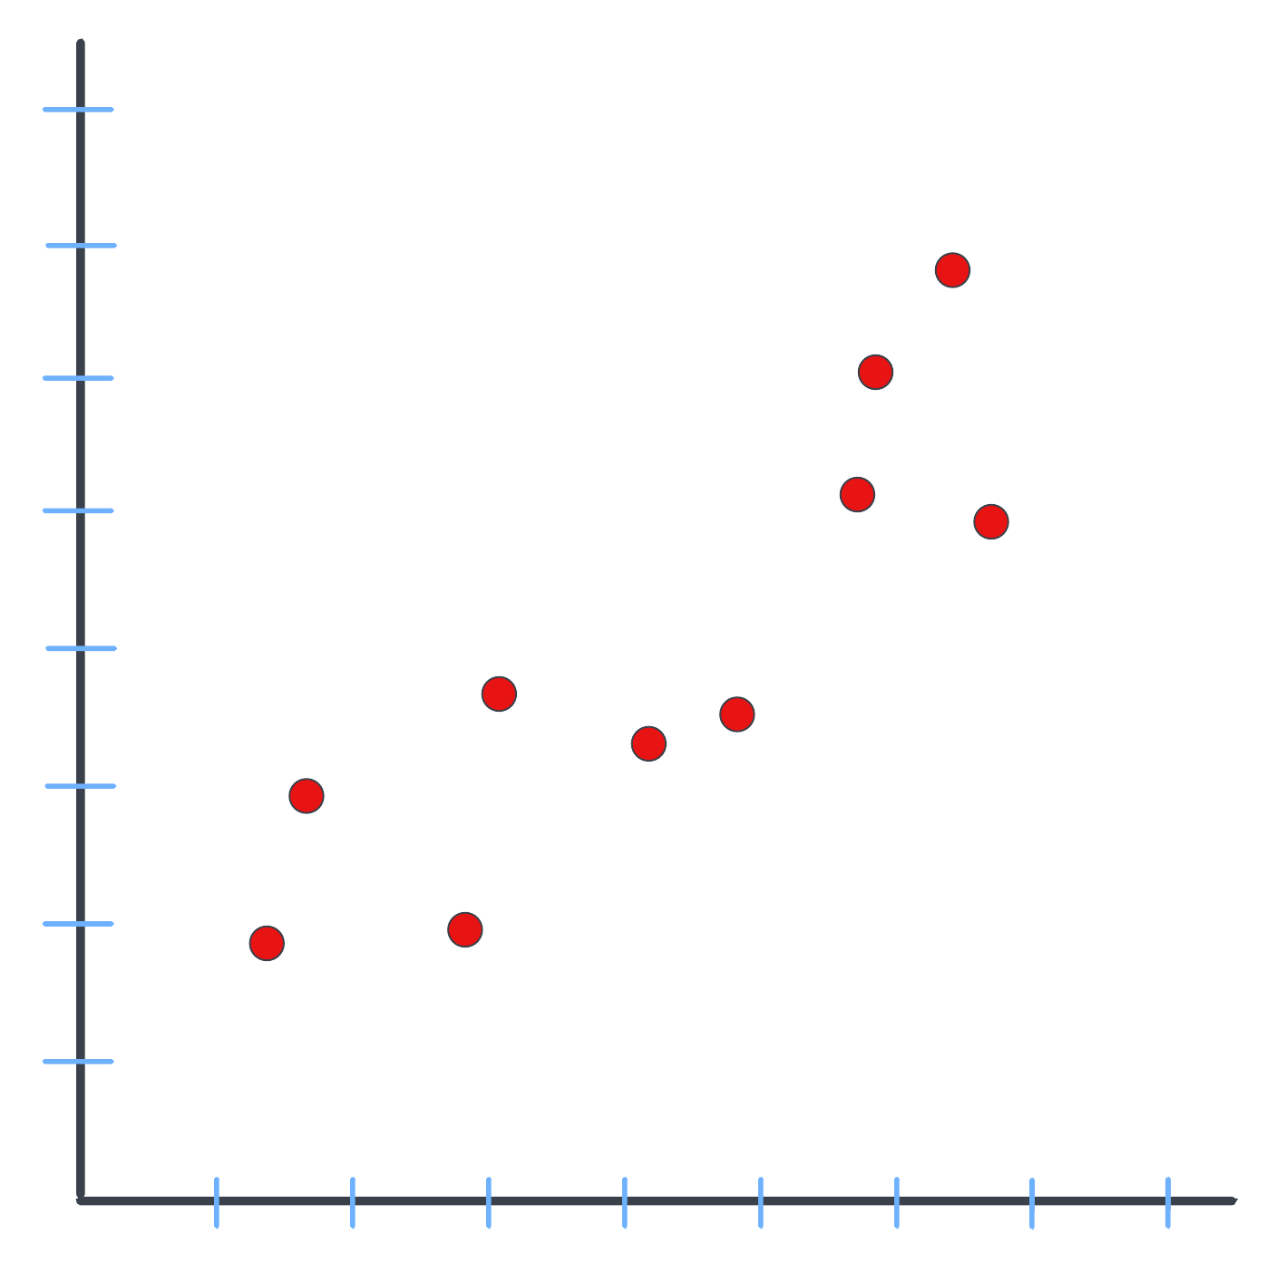
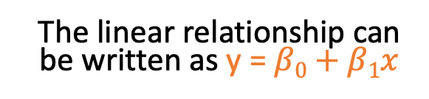
Fitting a line to the data
The linear relationship can be written as y = $β0+β1x$
Suppose we have collected some data on mice size, and we are trying to predict mice weight from it.
That is a regression problem which would be trying to make quantitative predictions.
A simple way to imagine this is to fit a line on the experimental data s.t. the equation of the line produces mouse weight when we enter the mouse size as input.
We need an algorithm for finding the best fitted line.
Mouse weight
Mouse Size

Slide 9
Fitting a line to data : Baseline
First, draw a line through data mean
Mouse weight
Mouse Size
Notes:
A baseline solution to this problem would be to draw a line through the mean of the output axis.
In our running example the mean fit would be a line that always predicts the mean sample weight for all mice sizes

Slide 10
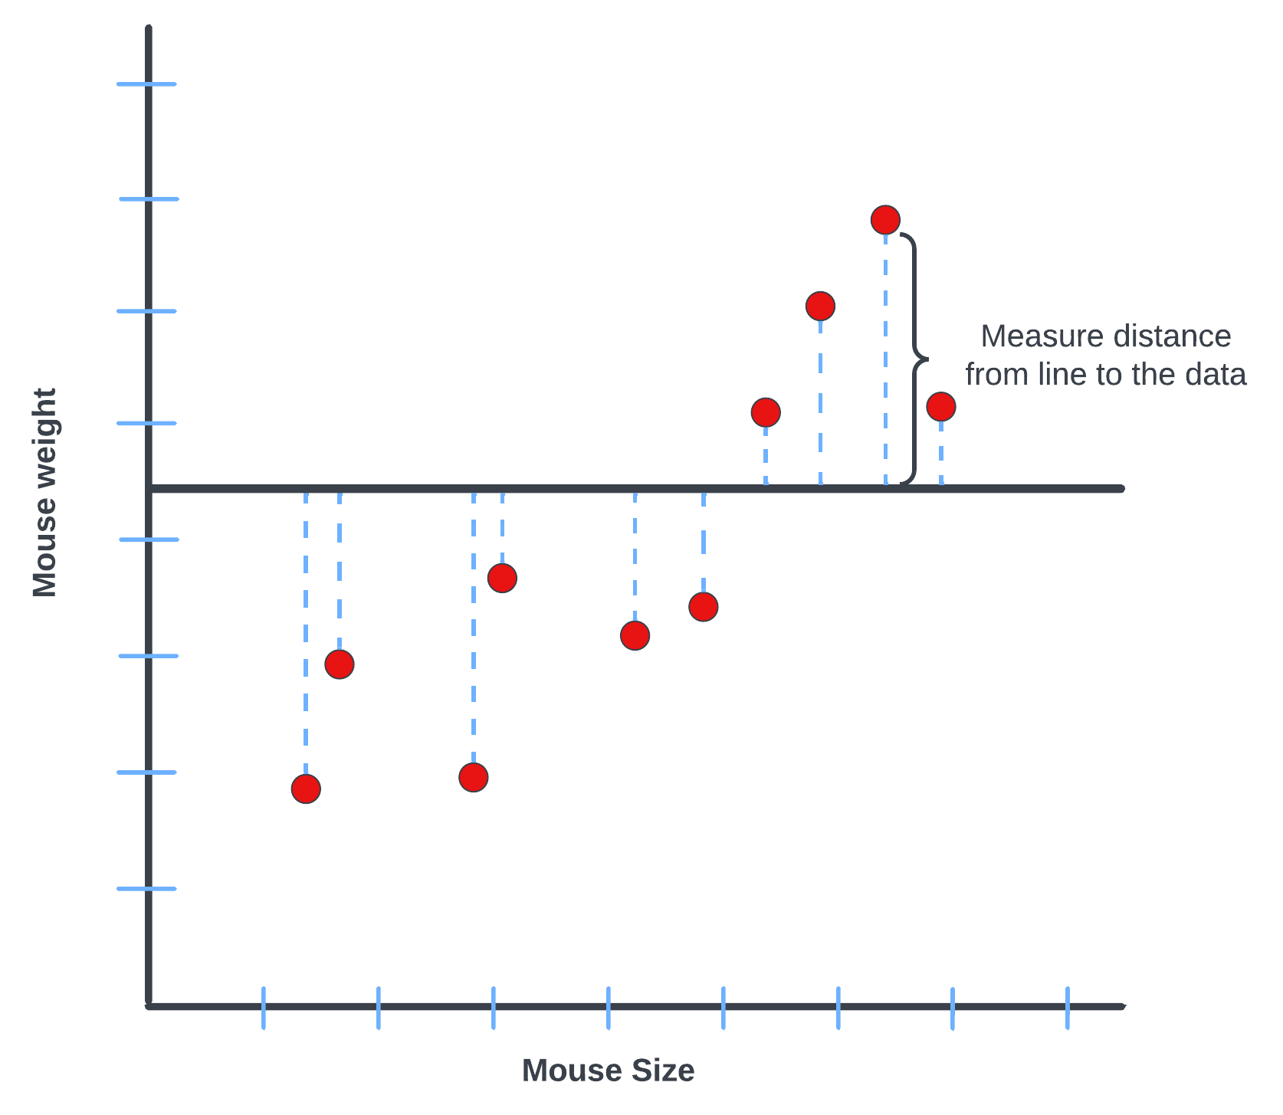
Fitting a line to data : Residuals
Next an important part of line fitting is to measure the distance between a datapoint and the predicted value.
This is essentially the length of the orthogonal distance, dropped from the point to the fitted line.
This is called a residual for a prediction, and it will be an important part of optimizing the fitted line.
Distance from a line to a data point is called “residual”

Slide 11
Fitting a line to data : Residuals
Residuals could be positive or negative depending on if the y-value is above or below the line.
Directly summing positive and negative residuals would typically lead to a misleading aggregate error.
Makes the fit appear better than it is!
Sum of absolute residuals or squared residuals fixes this.
Later is preferred to facilitate a convex function for optimization
Distance from a line to a data point is called “residual”

Slide 12
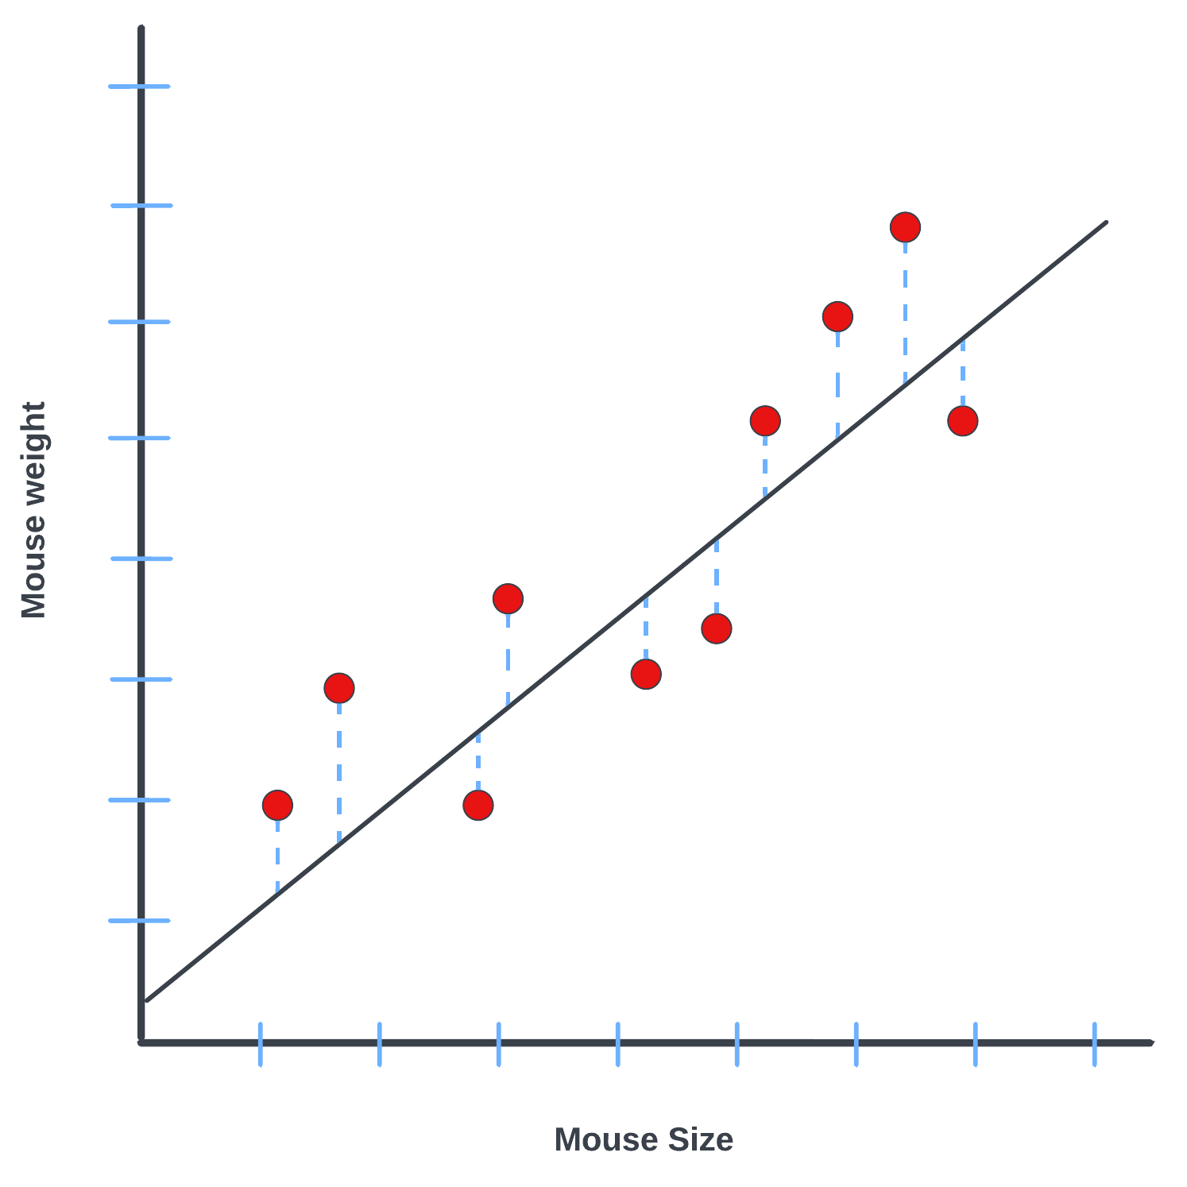
Fitting a line to data : Ordinary Least Squares
Think of the fitting as an iterative process where each iteration essentially consists of 3 steps:
Start with a line
Measure residuals for every predicted point and square them up
Sum up the squared residuals to obtain the squared loss corresponding to the current fit
Next, we rotate the line slightly and repeat all the three steps that I just described.
Rotate fitted line
Measure residuals, square them up
Sum up squared residuals

Slide 13
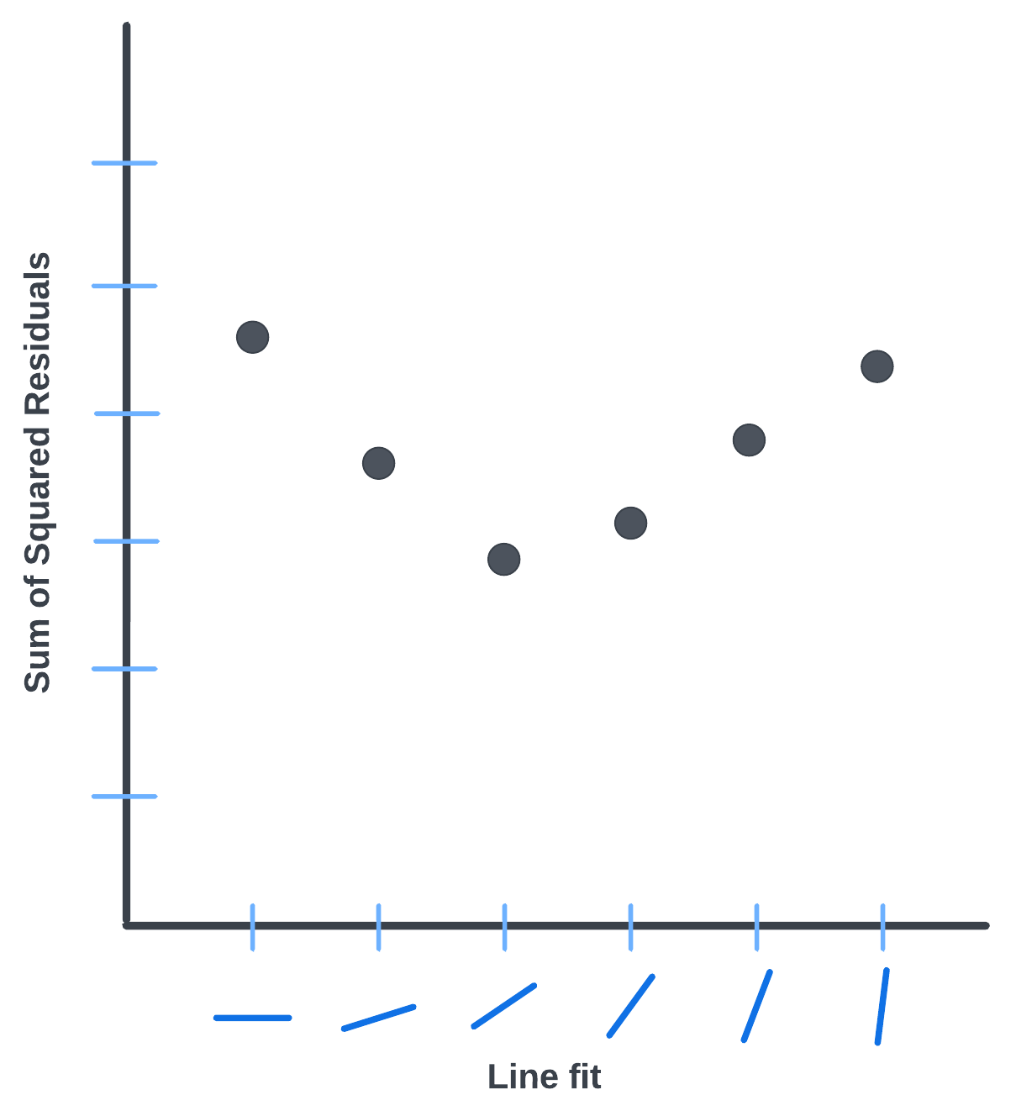
Fitting a line to data : Ordinary Least Squares
Then we plot the sum of squared residuals for every line we attempt to fit on the data.
The optimal fitted line for the data would be the one that yields the lowest sum of squared residuals.
Hence this method is called the least squares method.
Line with the “least squares” will be the best fit for the data
Find the fitted line that has the least sum of squared residuals

Slide 14
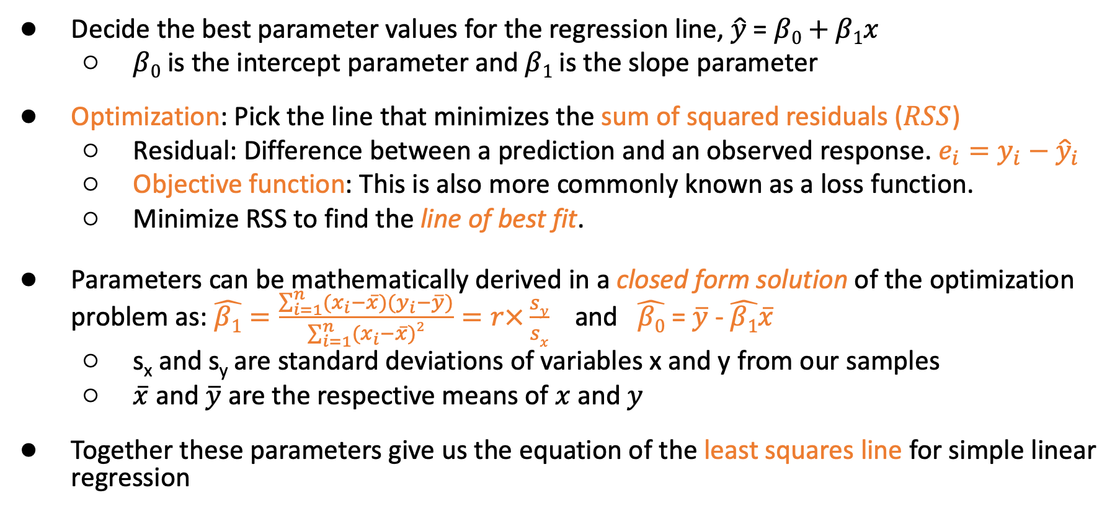
Ordinary Least Squares Regression
Decide the best parameter values for the regression line, $\hat{y}$ = $β0+β1x$
  $β0$ is the intercept parameter and $β1$ is the slope parameter
Optimization: Pick the line that minimizes the sum of squared residuals ($RSS$)
  Residual: Difference between a prediction and an observed response. $e_{i}=y_{i}−{\hat{y}}_{i}$
  Objective function: This is also more commonly known as a loss function.
  Minimize RSS to find the line of best fit.
Parameters can be mathematically derived in a closed form solution of the optimization problem as: $\hat{β1}=\frac{\sum_{i=1}^{n}{(x_{i}−\overline{x}})(y_{i}−\overline{y})}{\sum_{i=1}^{n}{(x_{i}−\overline{x}})2}=r×\frac{sy}{sx}$ and $\hat{β0}$ = $\overline{y}$ - $\hat{β1}\overline{x}$
  s_{x} and s_{y} are standard deviations of variables x and y from our samples
  $\overline{x}$ and $\overline{y}$ are the respective means of $x$ and $y$
Together these parameters give us the equation of the least squares line for simple linear regression
Notes:
Please refer to the supplementary notes at this point.

Slide 15
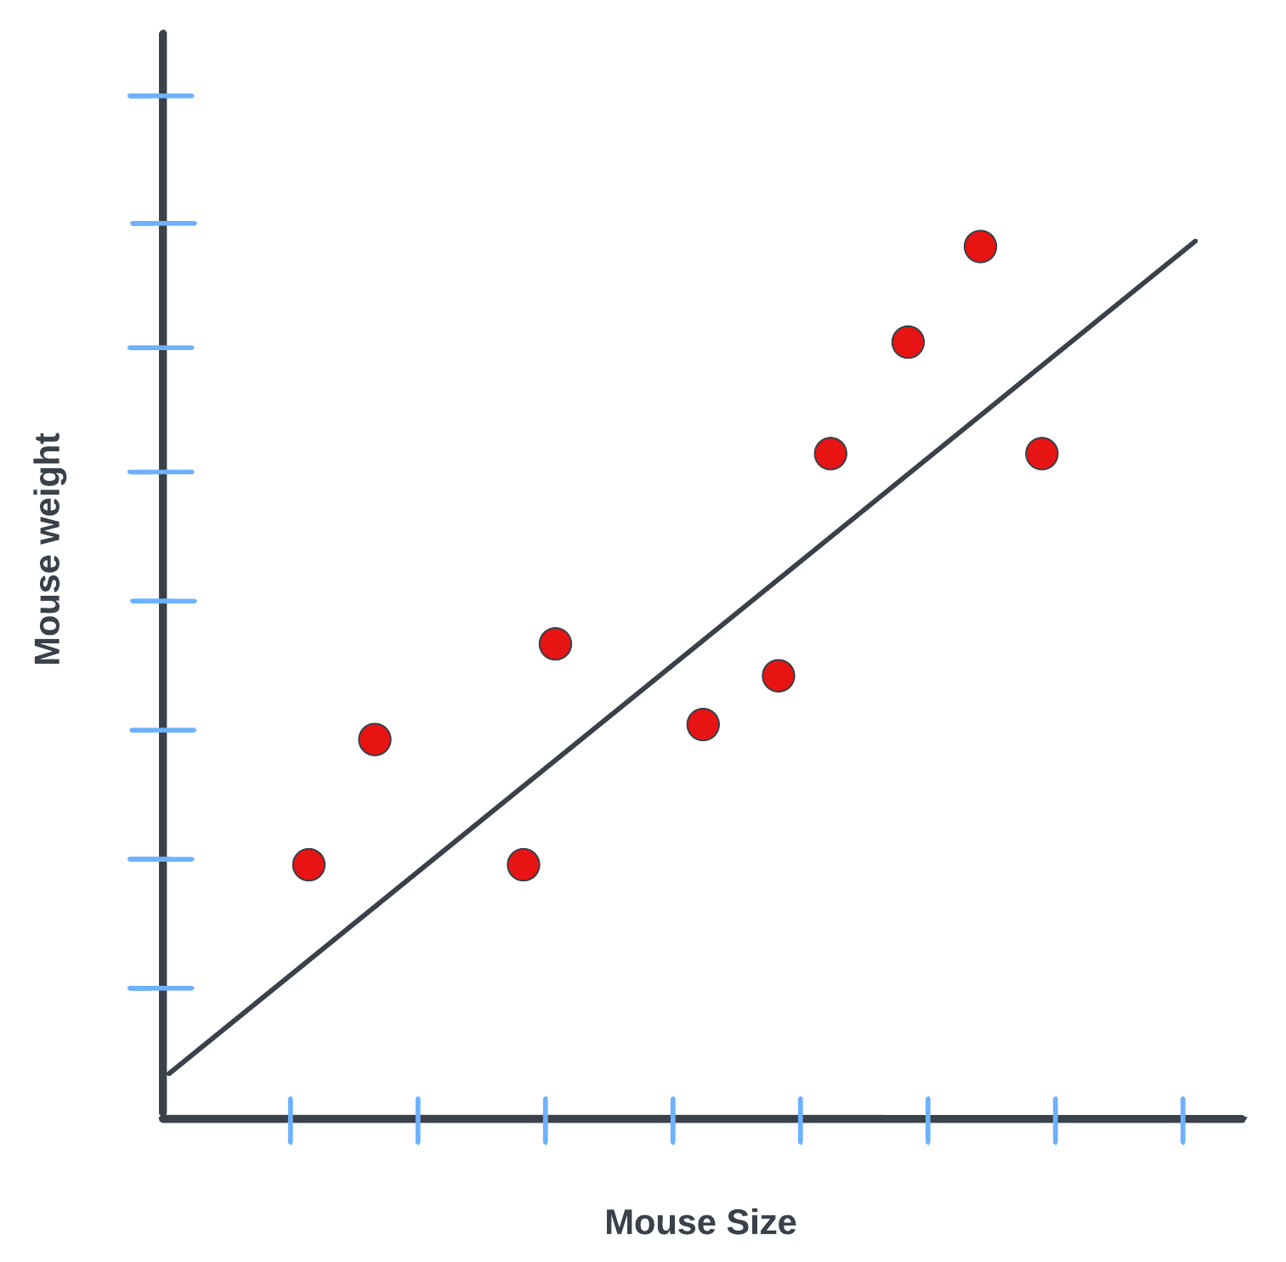
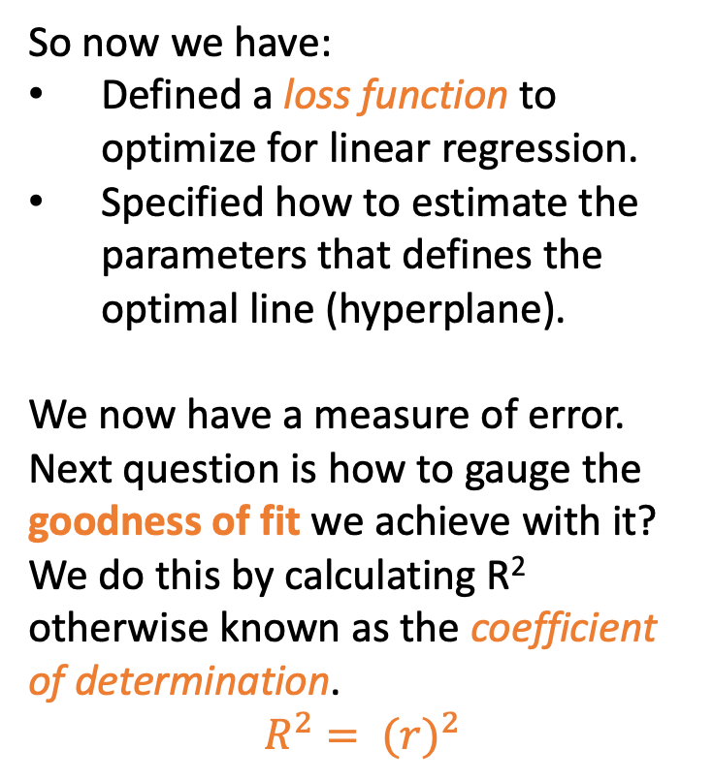
Goodness of fit
So now we have:
Defined a loss function to optimize for linear regression.
Specified how to estimate the parameters that defines the optimal line (hyperplane).
We now have a measure of error. Next question is how to gauge the goodness of fit we achieve with it?
We do this by calculating R² otherwise known as the coefficient of determination.
$$R^{2}= {(r)}^{2}$$
How good is the guess from the best fitted line?
Calculate R²
Notes:
The key difference is that the sum of squared residuals (SSR/SSE) tells us how much error the fitted model has, whereas a goodness-of-fit measure such as R^2 tells us how large that error is relative to how much variation there was to explain in the first place.

Slide 16
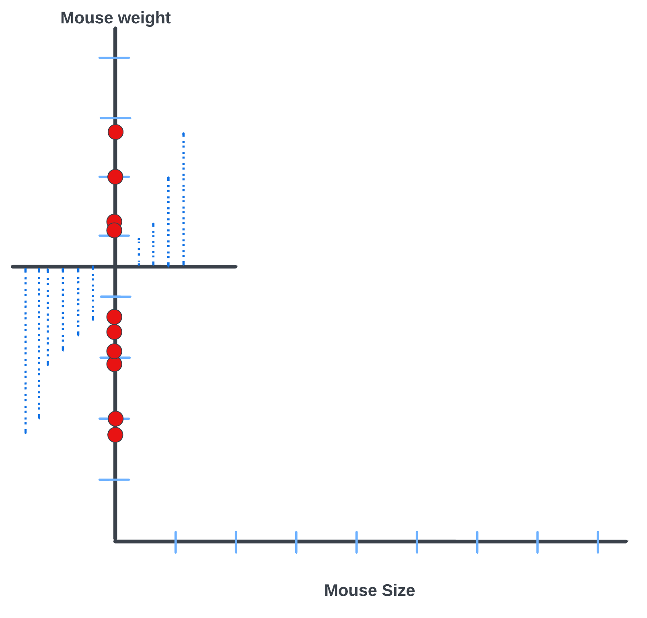
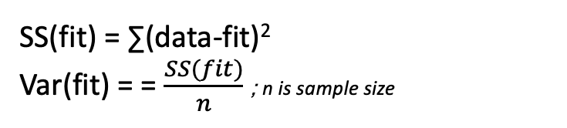
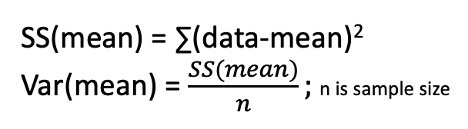
Goodness of fit: R-squared
SS here stands for sum of squared residuals
SS(mean) = ∑(data-mean)²
Var(mean) = $\frac{SS(mean)}{n};$n is sample size
SS(fit) = ∑(data-fit)²
Var(fit) = = $\frac{SS(fit)}{n}$; n is sample size
Raw variation mouse weight
Variation in predicted weight around the least squares line
Less variation around the line that we fit by least squares
Some variation in mouse weight is “explained” by mouse size
Notes:
So how do we measure R²?
We compare our fit to the mean fit that we can get. So if you recall the mean fit is predicting the mean y value that we estimate from our samples. This is the intercept only model. We calculate the sum of squared residuals from the mean fit and the variance over it.
We also calculate both of these metrics over the optimal fit. The mean fit displays the raw variation in mouse weight while we also get the variation in predicted weight around the least squares line.
As is expected an optimal fit will produce less variation around the data vs just the mean fit. Basically what it implies is that some variation in mouse weight can be explained by taking mouse size into account.

Slide 17


Goodness of fit
R² is defined as the ratio of the difference in this variation between the mean fit and the optimal fit to the mean fit’s variation. Intuitively, this tells us what percentage of variation of the dependent variable can be accounted for by using the independent variable(s).
A higher R² value implies a better fit.
R² tells how much variation in mouse weight can be explained by mouse size

Slide 18
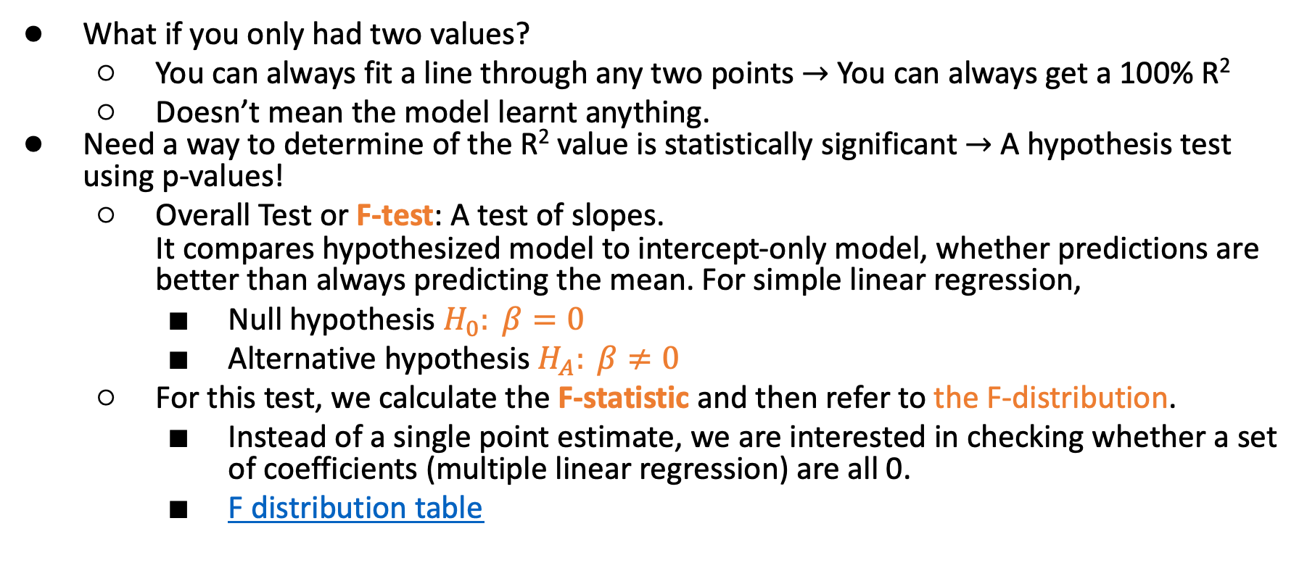
Overall significance of fit
What if you only had two values?
  You can always fit a line through any two points $→$ You can always get a 100% R²
  Doesn’t mean the model learnt anything.
Need a way to determine of the R² value is statistically significant $→$ A hypothesis test using p-values!
  Overall Test or F-test: A test of slopes.
  It compares hypothesized model to intercept-only model, whether predictions are better than always predicting the mean. For simple linear regression,
    Null hypothesis $H_{0}: β=0$
    Alternative hypothesis $H_{A}: β≠0$
  For this test, we calculate the F-statistic and then refer to the F-distribution.
    Instead of a single point estimate, we are interested in checking whether a set of coefficients (multiple linear regression) are all 0.
    F distribution table
Notes:
Consider the hypothetical case of having only two measurements in our dataset. In that case we will be able to fit any line through two data points where the sum of squared residuals will be 0 and we will achieve a perfect fit. This is great but it doesnt imply any learning. So we need a way to gauge the statistical significance of our fit or the R-squared value obtained by the fit.
In the context of multiple linear regression, an overall regression refers to testing the entire predictive model at once, rather than looking at individual predictors one by one. When you run an overall regression test (also known as the global (F)-test), you are asking: "Does this group of independent variables, working together, explain a statistically significant amount of variance in the dependent variable?” The null hypothesis states that all slope coefficients are zero

Slide 19


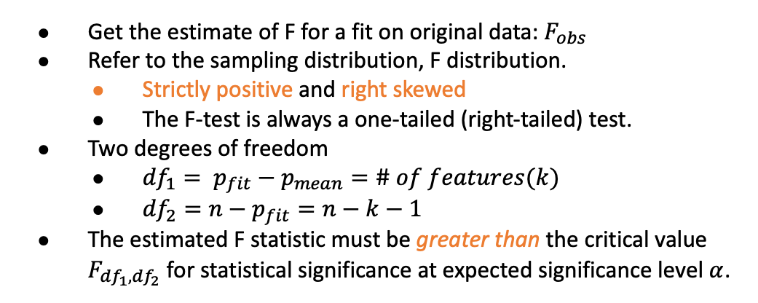
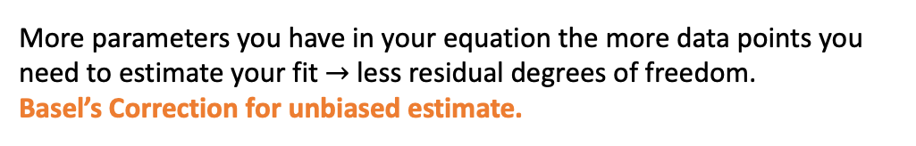
Statistical Significance of Fit
General equation to check if R² is significant
p_{mean} : number of parameters in the mean line; 1 for SLR
p_{fit} : number of parameters in the best fit line; 2 for SLR
More parameters you have in your equation the more data points you need to estimate your fit $→$ less residual degrees of freedom.
Basel’s Correction for unbiased estimate.
Why divide SS(fit) by n-p_{fit} instead of just n?
Get the estimate of F for a fit on original data: $F_{obs}$
Refer to the sampling distribution, F distribution.
  Strictly positive and right skewed
  The F-test is always a one-tailed (right-tailed) test.
Two degrees of freedom
  ${df}_{1}= p_{fit}−p_{mean}=\# of features(k)$
  ${df}_{2}=n−p_{fit}=n−k−1$
The estimated F statistic must be greater than the critical value $F_{{df}_{1},{df}_{2}}$ for statistical significance at expected significance level $α$.
Is this F statistically significant?
A good fit generates a high F value!

Slide 20
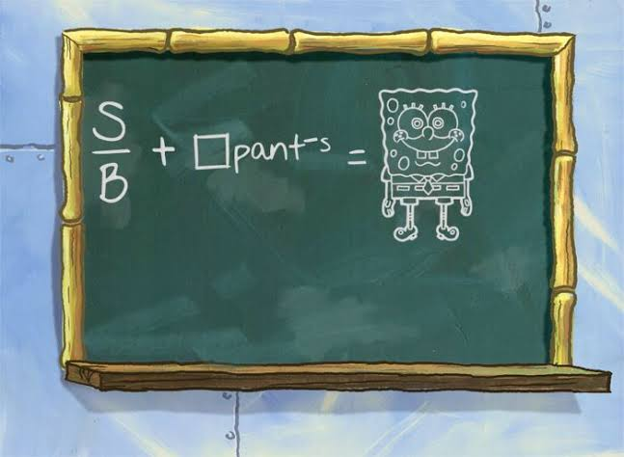
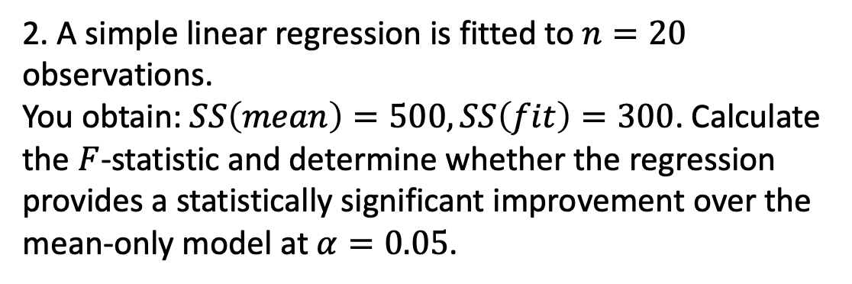
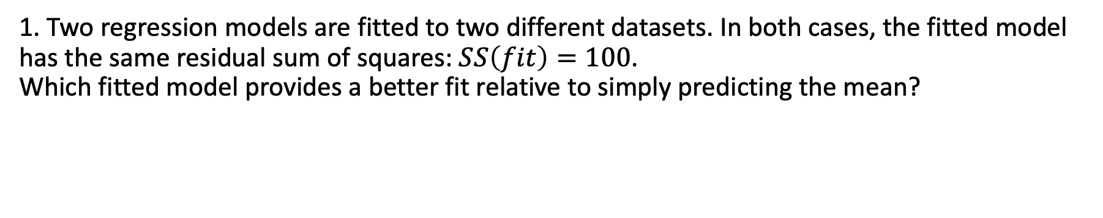
Your turn
1. Two regression models are fitted to two different datasets. In both cases, the fitted model has the same residual sum of squares: $SS\left(fit\right)=100$.
Which fitted model provides a better fit relative to simply predicting the mean?
 | SS(mean) | SS(fit)
Dataset A | 125 | 100
Dataset B | 500 | 100
2. A simple linear regression is fitted to $n=20$ observations.
You obtain: $SS\left(mean\right)=500, SS\left(fit\right)=300$. Calculate the $F$-statistic and determine whether the regression provides a statistically significant improvement over the mean-only model at $α=0.05$.

