Slide 1
Sentiment Analysis of Restaurant Reviews
Name: Satakshi Rai
Dept: CSE(DS)
Regn No. : 202300138

Slide 2
INTRODUCTION
Sentiment Analysis is a Natural Language Processing (NLP) technique used to determine the emotional tone of text.
It is widely used to analyze customer feedback, reviews, and opinions.
In this assigment, we analyze restaurant reviews to classify them into:
Positive
Negative
Neutral

Slide 3
PROBLEM STATEMENT
Customers provide reviews containing mixed opinions.
Example: “Food is good but service is bad”
Problem: Traditional models give only one overall sentiment
They fail to capture aspect-specific opinions

Slide 4
OBJECTIVE
To classify restaurant reviews into sentiment categories
To perform restaurant-wise sentiment analysis
To implement aspect-based sentiment analysis
To evaluate model performance using different parameters

Slide 5
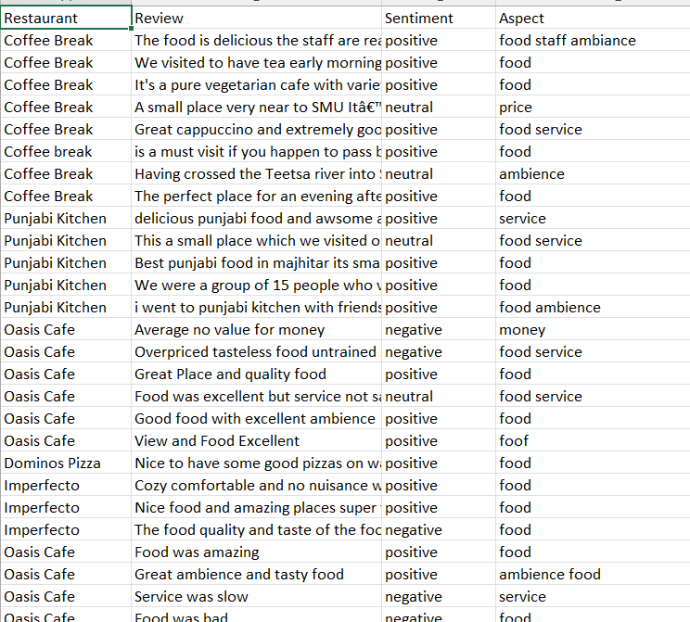
DATASET
Collected ~50 reviews from restaurants in Majitar
Dataset contains:
Restaurant Name
Review
Sentiment(Label)
Aspect (Food, Service, Ambience, Money)
Fig 1: Review dataset

Slide 6
METHODOLOGY
Data Collection
Data Preprocessing
Lowercasing
Removing punctuation
Stopword removal
Feature Extraction using TF-IDF4
Model Training using Naive Bayes

Slide 7
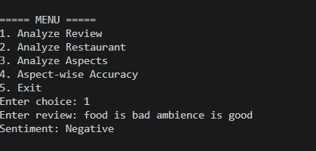
SENTIMENT ANALYSIS
The model classifies input reviews into:
Positive
Negative
Neutral
Example: “Food is bad” → Negative
Fig 2: Analyze review sentiment

Slide 8
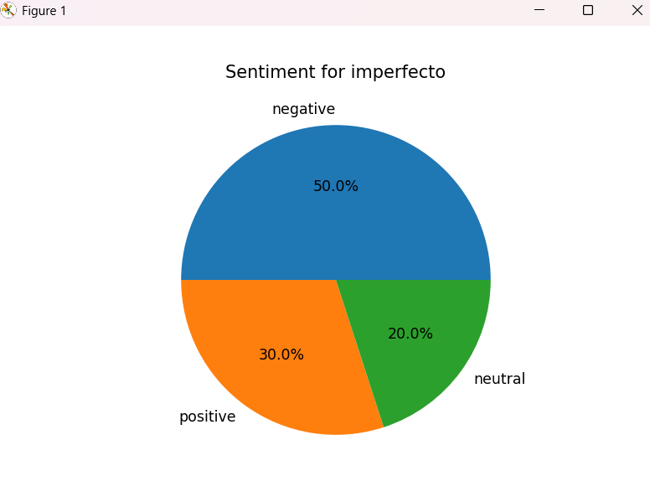
RESTAURANT WISE ANALYSIS
Aggregates all reviews of a restaurant
Counts:
Positive
Negative
Neutral
Displays:
Overall sentiment
Graph (Pie chart)
Fig 3: Pie chart for Imperfecto restro sentiment

Slide 9
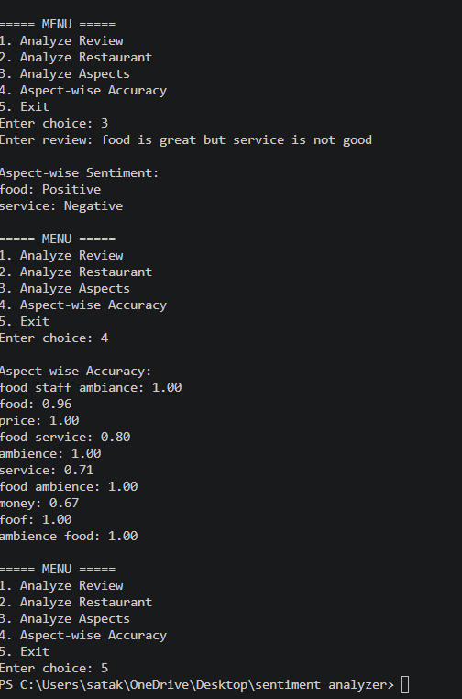
ASPECT-BASED SENTIMENT ANALYSIS
Analyzes sentiment for specific aspects: Food, Service, Ambience, Money
Example: “Ambience is good but food is bad”
Output:
Food → Negative
Ambience → Positive
Fig 4: Aspect based sentiment analysis

Slide 10
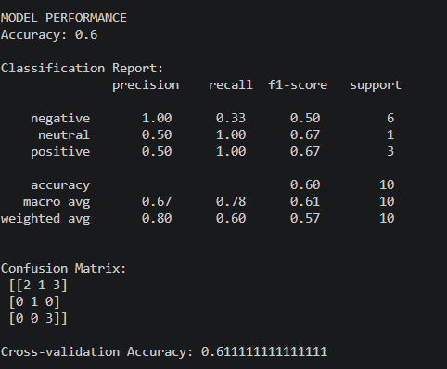
MODEL EVALUATION
Fig 5: Model accuracy
Fig 6: Accuracy with different parameters

Slide 11
CONCLUSION
Model successfully analyzes sentiments
Provides both overall and aspect-wise insights
Performance depends on dataset size and quality

Slide 12
GITHUB LINK
Github repository: satakshi25-cse/sentiment_analyzer_assignment

Slide 13
THANK YOU

