Slide 1


“Employee-CICD”
Submitted by: Shashwat Kumar
Submission type : Individual
Name: Shashwat Kumar
Batch : 1
LMS Id : shashwatkumarsk1998@gmail.com
Program : HDFC API Developement Program
Date: 28/04/2023

Slide 2

Table of contents
Introduction
Tech-Stack
Overview
Architecture
Packages and Gradle Build
Unit Testing
Service Class
CICD
Deployment
Remarks
Refrences

Slide 3

Introduction
Creating a HTTPS employee service API to access database and fetch records using spring boot.
Encryption and Decryption of data.
Linking the project to git and using jenkins for CICD
Creating docker images
Deploying docker image on kubernetes.
Using Client API created on springboot to access get data from employee service API.

Slide 4

Tech-Stack
MariaDB
Spring-Boot
Spring-web
Validations
Spring data JPA
Junit
Postman
Jenkins
Docker
Kubernetes

Slide 5
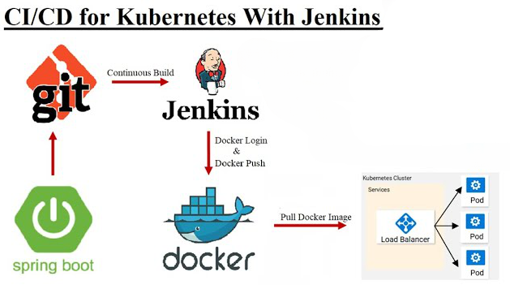
Project Overview

Slide 6
Architecture Design
DTO
Controller
Service
Repository
3
4
2
7
9
1
8
5
POSTMAN
VO
Database
9

Slide 7
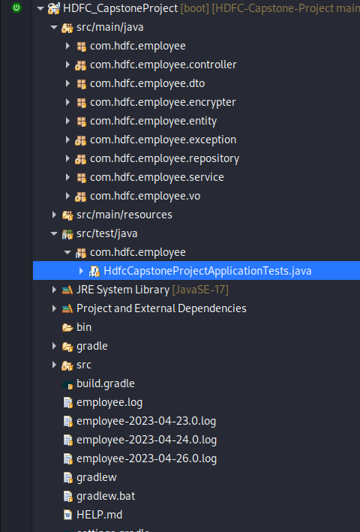
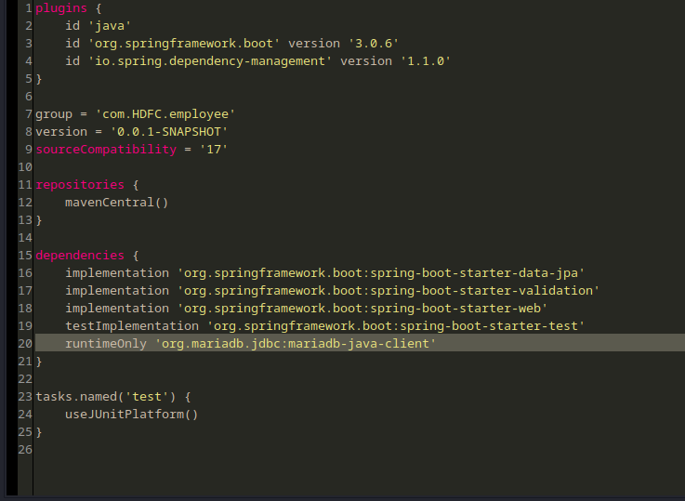
Packages and Gradle build

Slide 8
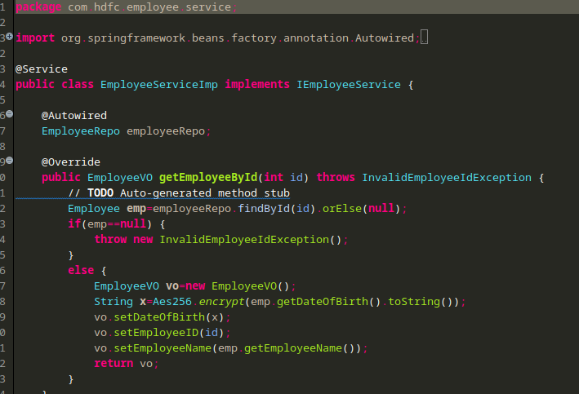
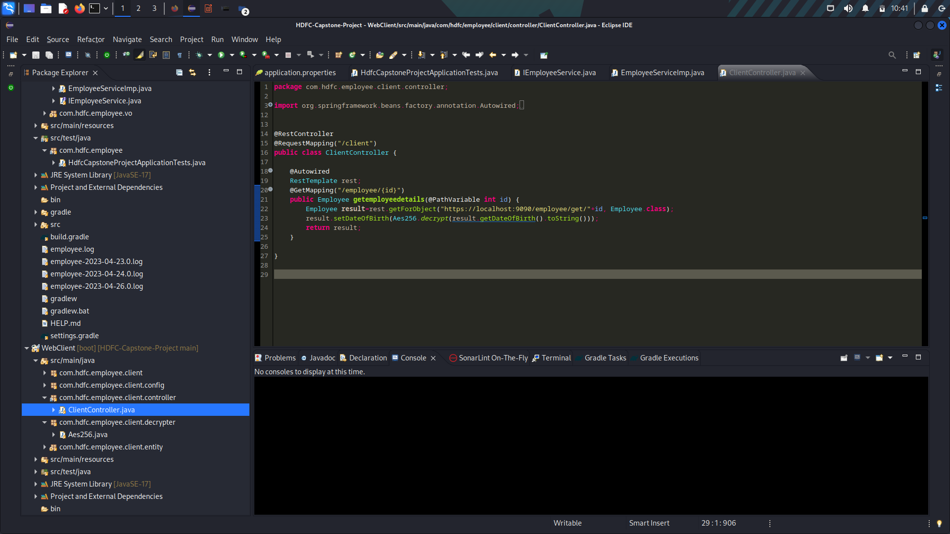
Service Class

Slide 9
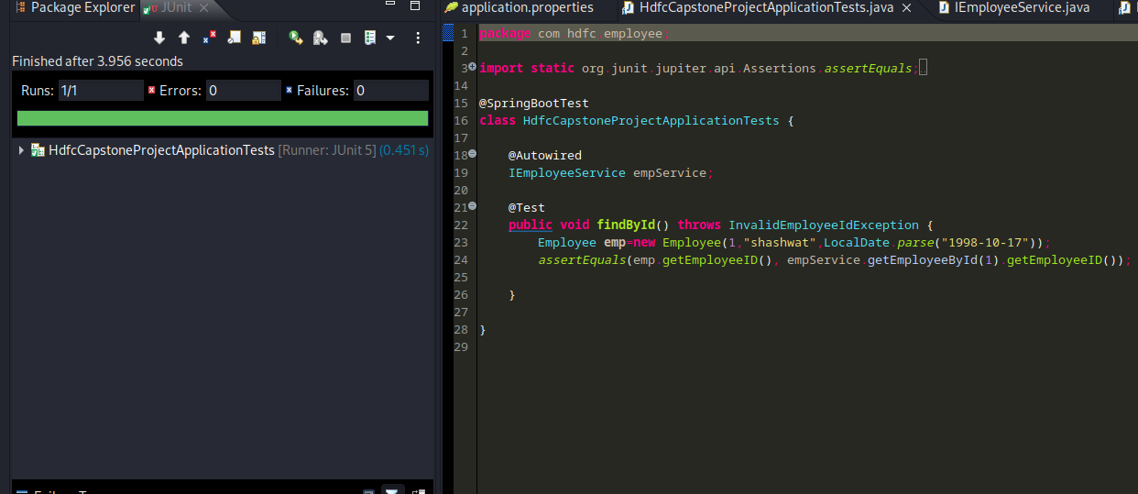
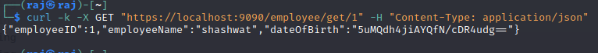
Unit-Testing

Slide 10
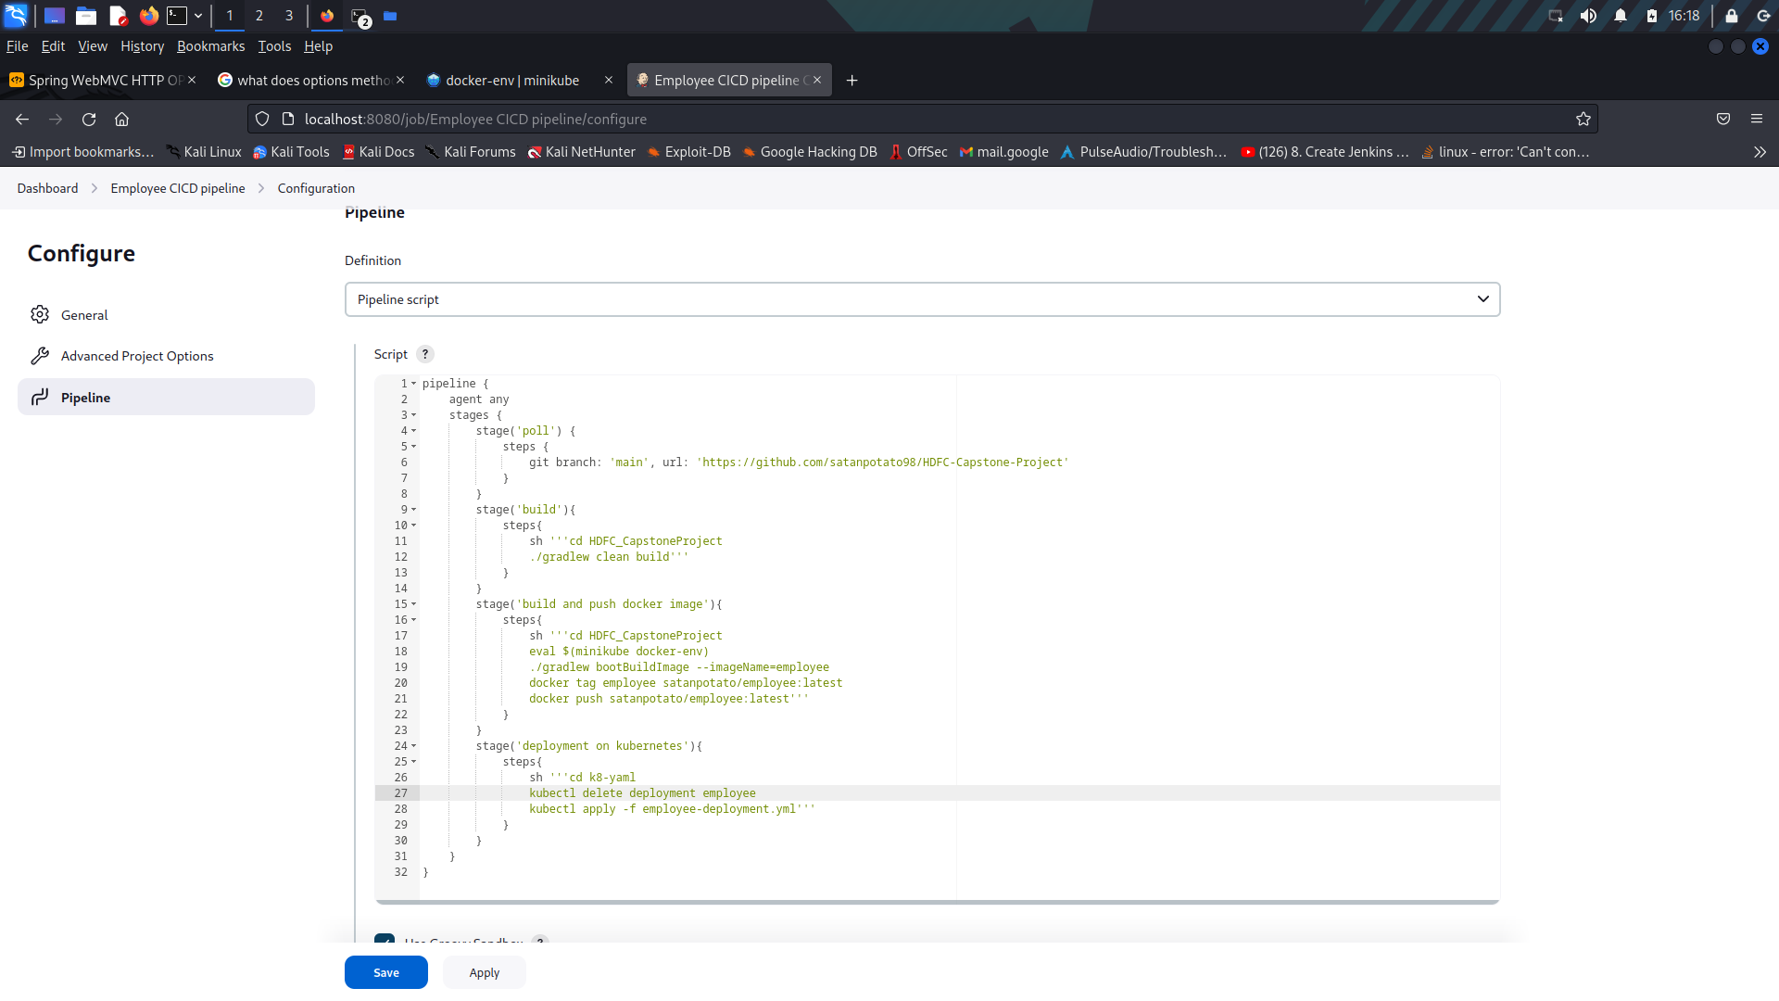
CI-CD

Slide 11
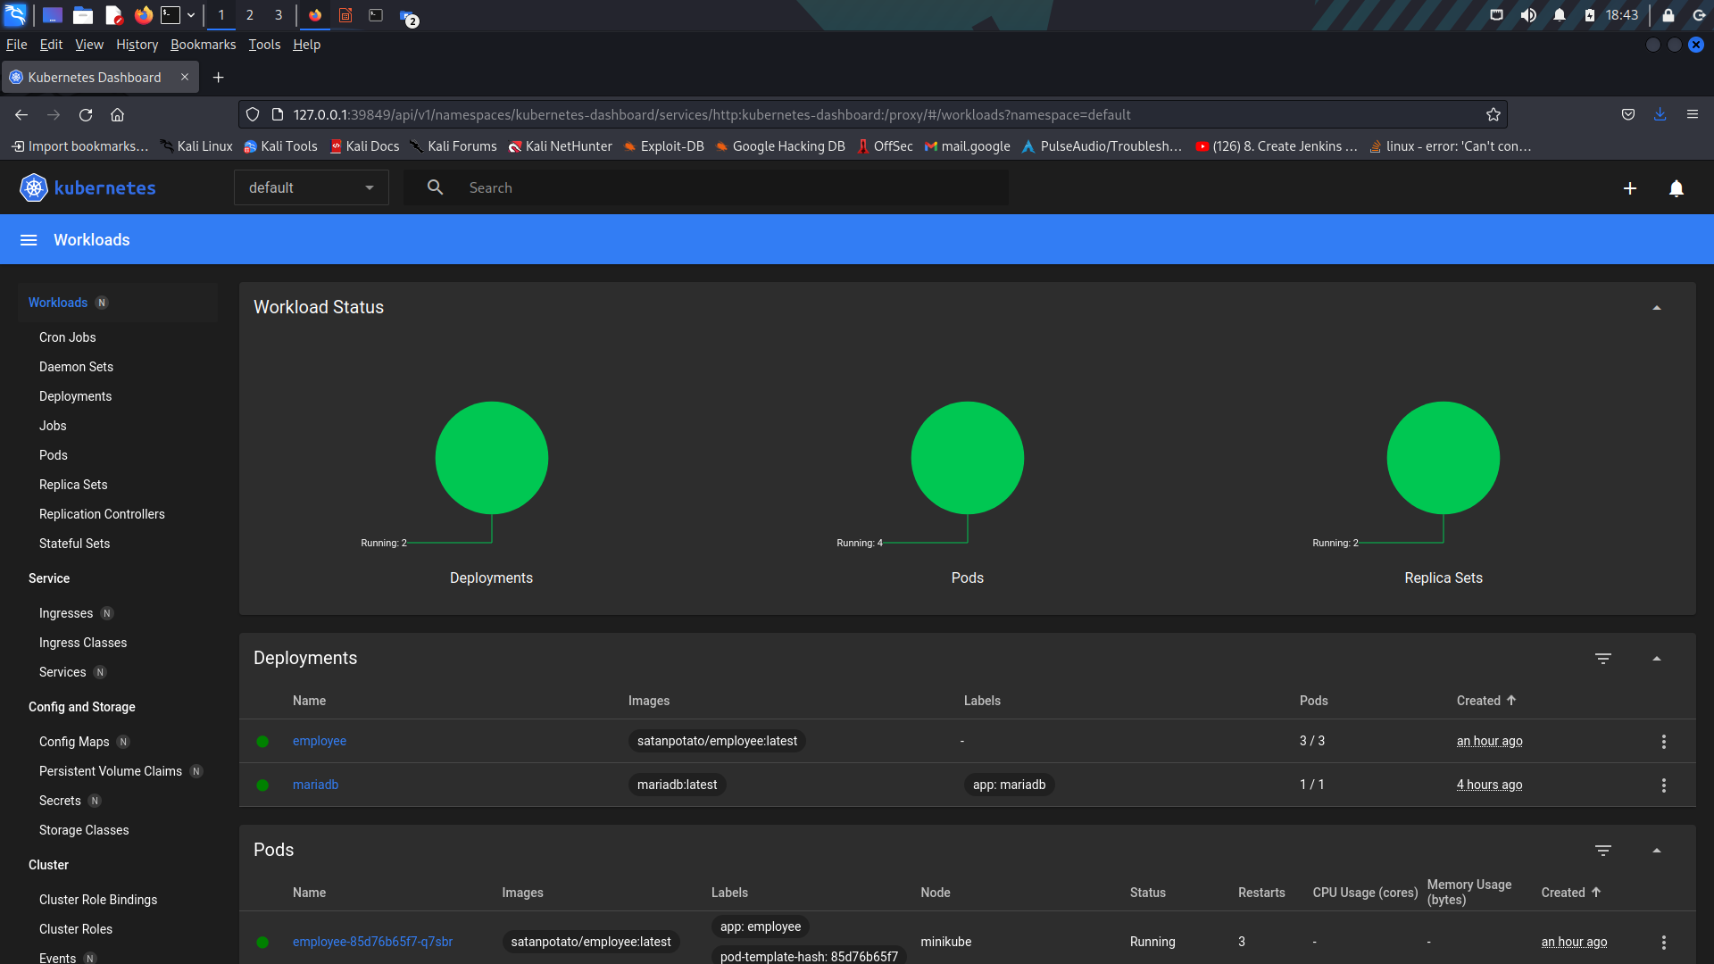
Deployment

Slide 12
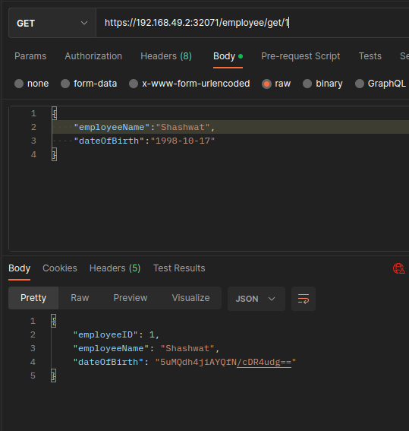
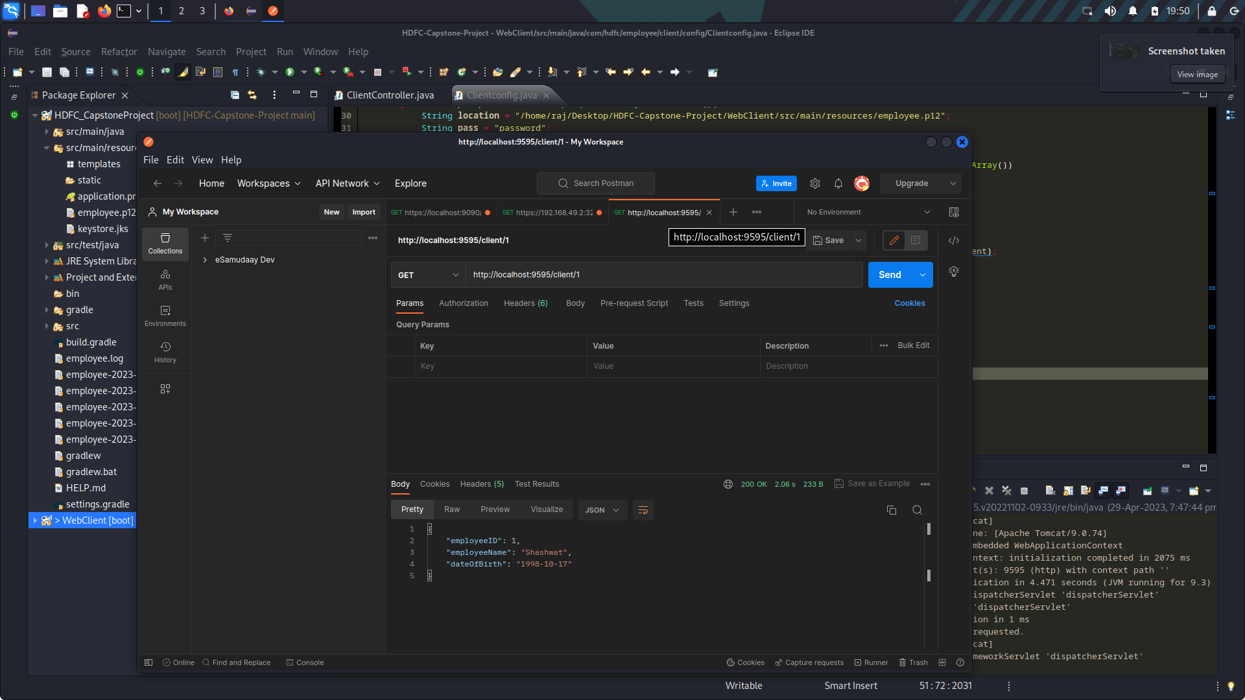
Postman-Output

Slide 13

Remarks
SSL Validation
AES-256
K8 Deployment
Journey of developing

Slide 14

References
Custom Rest Template for ssl validation: https://www.baeldung.com/spring-resttemplate-secure-https-service
AES-256 :https://www.baeldung.com/java-aes-encryption-decryption
StackOverflow

