Slide 1


“Movie Booking Platform”
Submitted by: Shashwat Kumar
Submission type : Individual
Name:Shaswat Kumar
Batch :1
LMS Id :
Program : HDFC API Dev
Date: 20/04/2023

Slide 2

Table of contents
Introduction
Project Overview
Architecture Design
User Interface Design
Back-end Development
Front-end Development
Testing
Deployment
Conclusion
Future Work
References
Appendices

Slide 3
Introduction
The Movie Ticket Booking Application is a software solution designed to make it easier for movie goers to book tickets for their favorite movies.
The objective of this system is to streamline the movie ticket booking process, reduce wait times, and improve the overall moviegoing experience.

Slide 4
Project Overview
Software Requirement
Maria DB (SQL)
Java springboot
JPA
Springweb
Validation
Postman
Swagger
Sonarqube
Grafana & Prometheus
Hardware used
Intel core-i5 processor
8GB RAM
5 gb of disk space

Slide 5
Architecture Design
Genreral flow
DTO
Controller
Service
Repository
3
4
2
7
9
1
8
5
POSTMAN
VO
Database
9

Slide 6
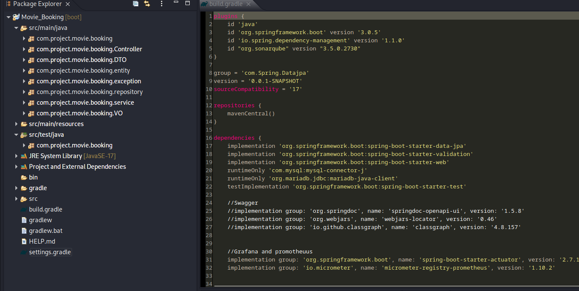
Back-end Development
Developement done using spring boot and tools as mentioned before. P4oject structutre and build is shown below

Slide 7
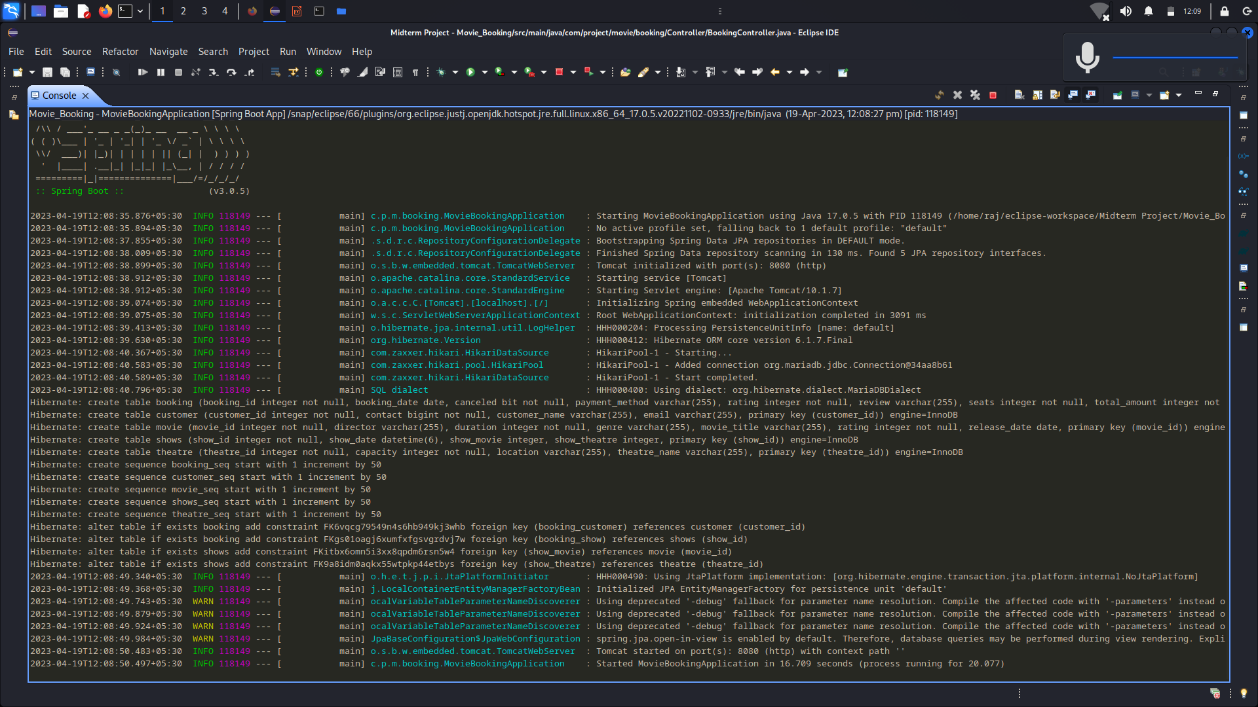
Databases Created on Run

Slide 8
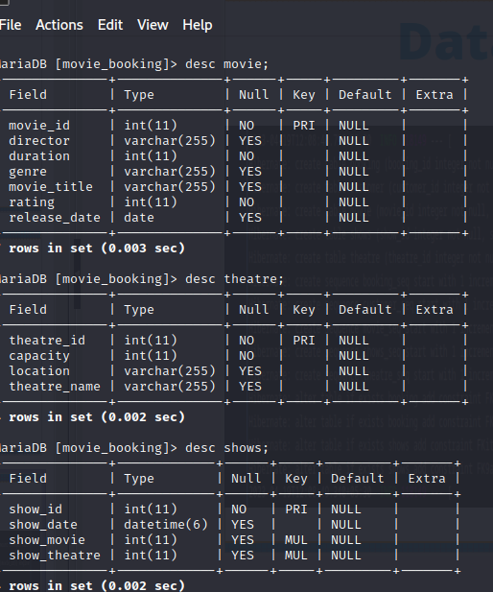
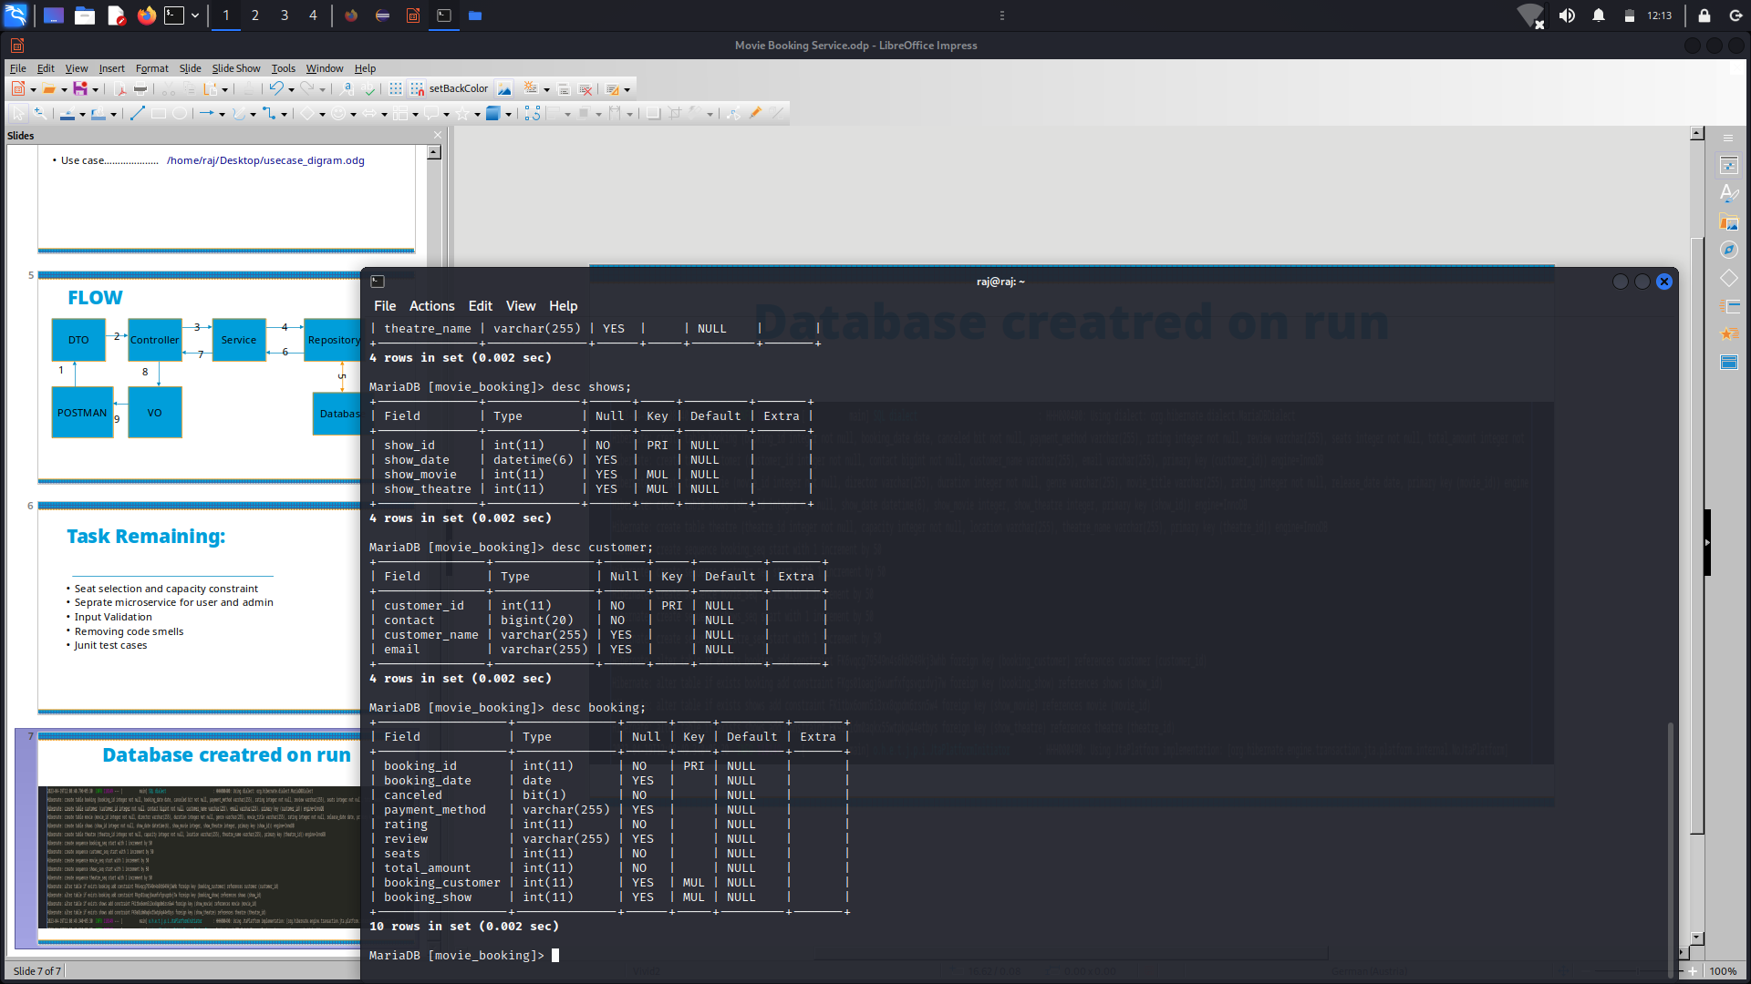
Deployment

Slide 9
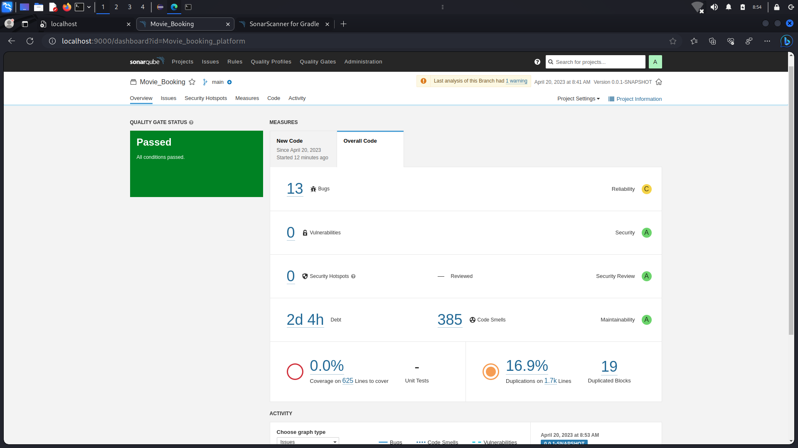
Sonarqube

Slide 10
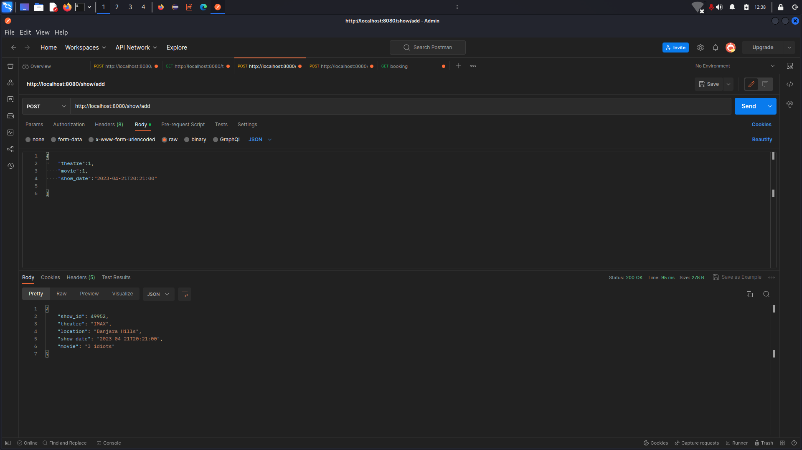
Shows ADD

Slide 11
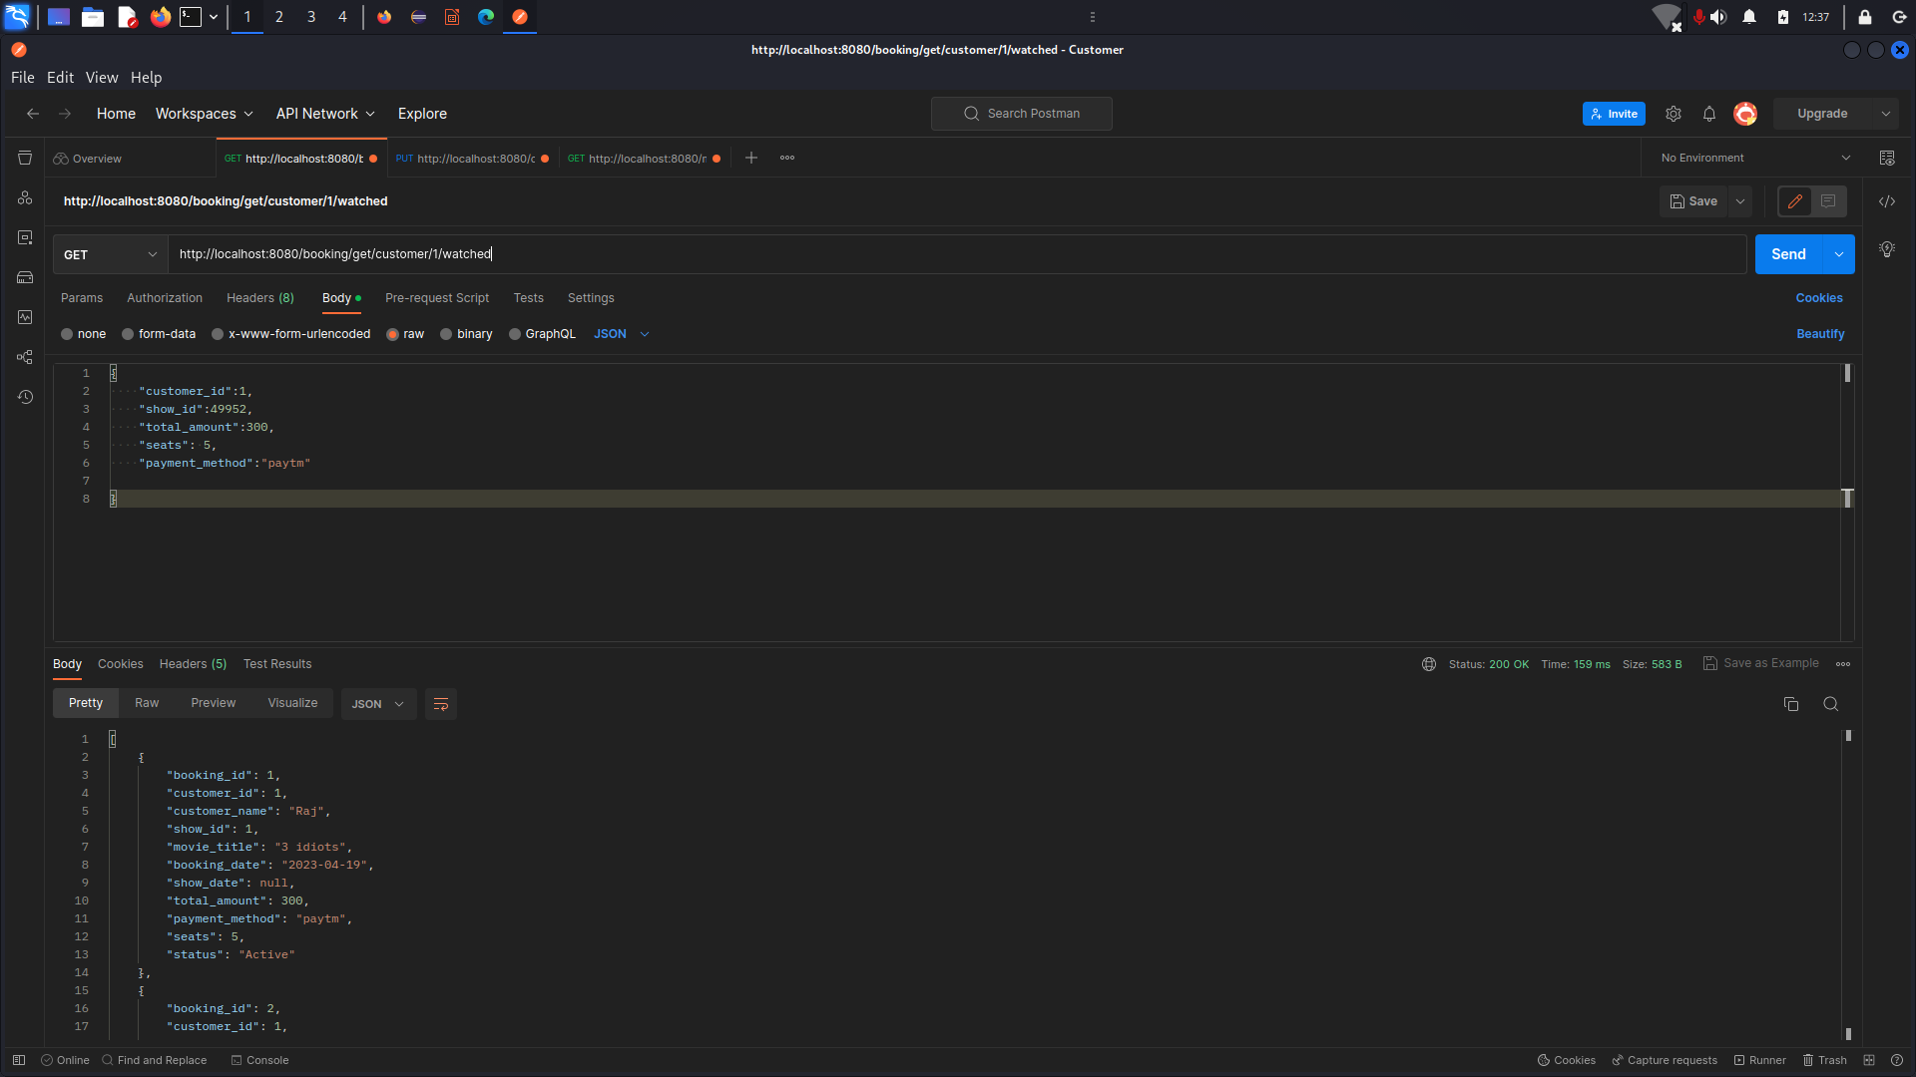
Booking ADD

Slide 12
Remarks
Mapping
seprate database/table for payment //optional
junit test case
seat selection
Amenities column for theatres
Admin and user login

Slide 13
Future Work
Seat selection and capacity constraint
Seprate microservice for user and admin
Input Validation
Removing code smells
Junit test cases.

