Slide 1
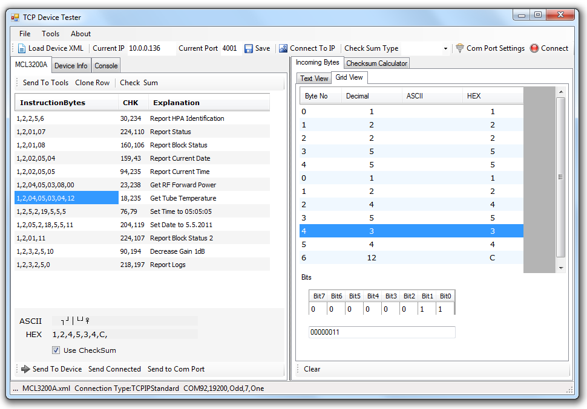
TCP Device Tester

Slide 2
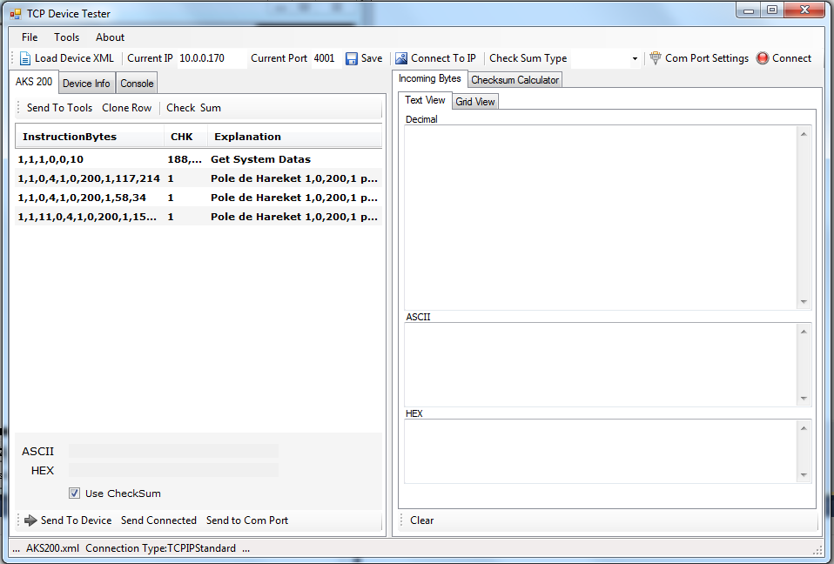
What does TCP Device Tester do?
Device Instruction
XMLs
<Instruction>
<ID>1</ID>
<Order>2</Order>
<InstructionBytes>2,100,67,65,115,63,3,43</InstructionBytes>
<Explanation>CAs: Get Status</Explanation>
<CheckSum>1</CheckSum>
</Instruction>
TCPDeviceTester
Send Command
Get Response
Device
BASIC FEATURES OF TCP Device Tester
Save device instructions in XML files
Calculate checksums
Send bytes to device via TCP/IP or Comport
Display received bytes in decimal, HEX, ASCII format
Show bits of any received byte

Slide 3
Basic Workflow
Komut Listesi
Komut Bytelarını Cihaza Gönder
Gelen Bytlerı
Göster
Komut Konsolu
TCPConnection
Com Port
Komutların
XML
Dosyaları
Cihaz

Slide 4
Basic Workflow > Send Bytes To Device
private void tsbSendBytesToDevice_Click(object sender, EventArgs e)
{
if (dgvInstructions.CurrentRow != null)
{
string bytes = dgvInstructions.CurrentRow.Cells["InstructionBytes"].Value.ToString();
if (chkUseCheckSum.Checked)
bytes += "," + dgvInstructions.CurrentRow.Cells["CheckSum"].Value.ToString();
byte[] bytesToSend = GetBytes(bytes);
SendBytesToDevice(bytesToSend);
}
}
private string SendBytesToDevice(byte[] bytesToSend)
{
switch (_currentConnectionType)
{
case ConnectionType.TCPIPStandard:
if (CheckNetworkConnection(txtIP.Text))
{
TCPConnection t = new TCPConnection(txtIP.Text, Convert.ToUInt16(txtPort.Text));
byte[] receivedBytes = new byte[10000];
receivedBytes = t.RequestData(bytesToSend);
if (receivedBytes==null)
{ txtReceivedBytes.Text = "error"; return "error"; }
else return ShowBytesInTextBoxes(receivedBytes);
}
else
{
txtReceivedBytes.Text = "IP problem.Check IP address.";
return "IP problem";
}
break;
case ConnectionType.TCPIPConnected:
//if (!serialPort1.IsOpen) serialPort1.Open();
//serialPort1.Write("deneme");
//byte[] buffer = new byte[256];
//using (SerialPort sp = new SerialPort("COM1", 19200))
//{
// sp.Open();
// //read directly
// sp.Read(buffer, 0, (int)buffer.Length);
// //read using a Stream
// sp.BaseStream.Read(buffer, 0, (int)buffer.Length);
//}
return "nothing.";
break;
case ConnectionType.ComPort: return "nothing."; break;
default: return "Connection type not specified."; break;
}
}

Slide 5
Basic Workflow > TCP Connection Class
class TCPConnection
{
int _communicationTimeOut = 500;
TcpClient _tcpClient;
NetworkStream _stream;
public TCPConnection(string IP, int port)
{
_tcpClient = new TcpClient(IP,port);
_stream = _tcpClient.GetStream();
_tcpClient.ReceiveTimeout = _communicationTimeOut;
_tcpClient.SendTimeout = _communicationTimeOut;
_stream.ReadTimeout = _communicationTimeOut;
_stream.WriteTimeout = _communicationTimeOut;
}
public byte[] RequestData(byte[] byteArrayToSend)
{
try
{
byte[] incomingByteArray = new byte[_tcpClient.ReceiveBufferSize];
if (_stream.CanWrite)
{
_stream.Write(byteArrayToSend, 0, byteArrayToSend.Length);
else _tcpClient.Close();
if (_stream.CanRead)
{
_stream.Read(incomingByteArray, 0, (int)_tcpClient.ReceiveBufferSize);
}
else _tcpClient.Close();
return incomingByteArray;
}
catch (Exception exp)
{
return null;
}
finally
{
_tcpClient.Close();
_stream.Close();
}
}
}

Slide 6
Helper Functions > GetBytes, GetBits
public static byte[] GetBytes(string byteStringWithComma)
{
if (string.IsNullOrEmpty(byteStringWithComma)) return null;
string[] bytes = byteStringWithComma.Split(',');
byte[] bytesToSend = new byte[bytes.Length];
for (int i = 0; i < bytes.Length; i++)
{
int k = Convert.ToInt16(bytes[i]);
bytesToSend[i] = (byte)k;
}
return bytesToSend;
}
public static string GetBits(byte b)
{
byte value = b;
string bits = string.Empty;
for (int i = 0; i < 8; i++)
{
if ((value & Convert.ToByte((Math.Pow(2, i)))) != 0)
{
bits= "1"+bits;
}
else
{
bits = "0"+bits;
}
}
return bits;
}

Slide 7
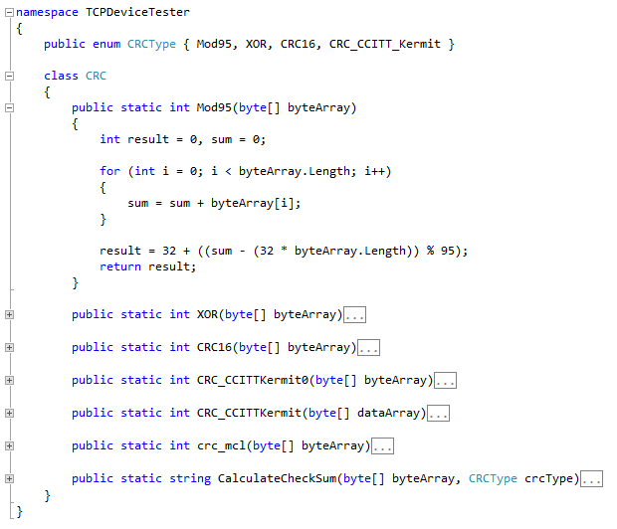
Helper Functions > Checksums, CRC Class
CRC Types
Calculate CheckSum

Slide 8
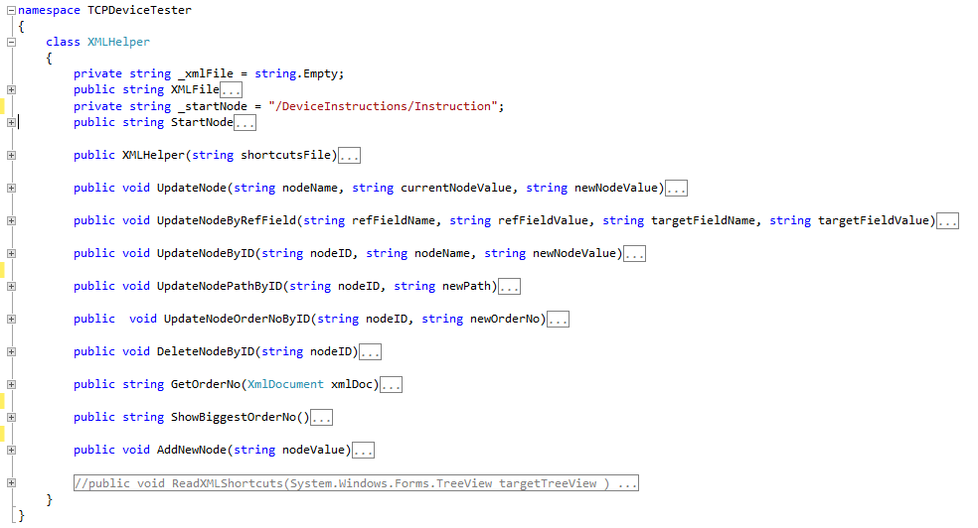
Helper Functions > XML Operations
Open XML File
Insert Node
Update Node
Find Node

Slide 9
END

