Slide 1

PROJECT PRESENTATION
Robust Multimodal Indian Sign Language Fingerspelling Recognition
Hybrid Late Fusion | Explainable AI | Gemini Sign Guidance
PRESENTED BY
GUIDED BY
Sarmishatha satapatthy
Dr. Chinmayee Dora

Slide 2
Contents
AGENDA
Introduction
Methodology
1
2
Block Diagram
Model Implementation
3
4
Output and Results
Explainability and Guidance
5
6
Conclusion
References
7
8

Slide 3
Problem and Objective
1 INTRODUCTION
The Problem
Our Objective
Existing models report 97–100% accuracy
Test data shares the same signers and backgrounds as training
Real users are new people in new places
Test on unseen signers and unseen backgrounds
Combine image (CNN) with hand landmarks
Explain predictions and guide learners
35
17,292
3
Sign classes (1–9, A–Z)
Images in the dataset
Evaluation protocols
Notes:
Papers report 97 to 100 percent accuracy, but test images share signers and backgrounds with training. Our goal is to test on new signers and new rooms, and to add explainability and guidance.

Slide 4
Dataset, Preprocessing and Protocols
2 METHODOLOGY
Dataset
Preprocessing
3 Protocols
17,292 images
35 classes: 1–9, A–Z
Many signers, sessions, rooms
Hand found in 98.32%
MediaPipe crops the hand
Resize to 224 × 224
21 landmarks give 42 numbers
Normalized for size and position
Standard: random split
Signer-independent: new signers
Background-independent: new room
Test: 5,188 / 5,368 / 5,368
Goal: measure true generalization, not memorization
Notes:
Dataset has 17,292 images and 35 classes. MediaPipe crops the hand and gives 21 landmarks. Three protocols: standard, signer independent, background independent.

Slide 5
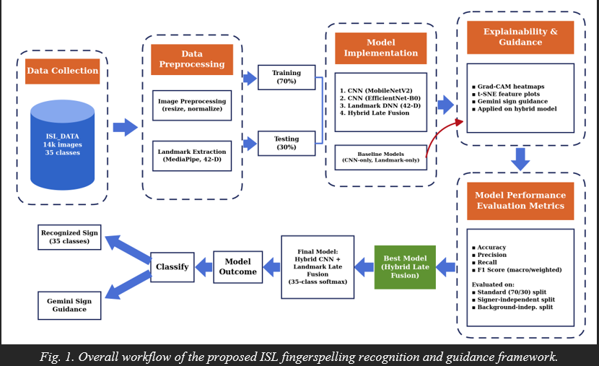
Overall Workflow of the Framework
3 BLOCK DIAGRAM
Collect ISL images
Preprocess: crop, landmarks
Train four models
Explain: Grad-CAM, t-SNE
Evaluate: three protocols
Output: sign and Gemini tips
Notes:
Walk left to right: data collection, preprocessing, training and testing, model implementation, explainability, evaluation, best model and final output with Gemini guidance.

Slide 6
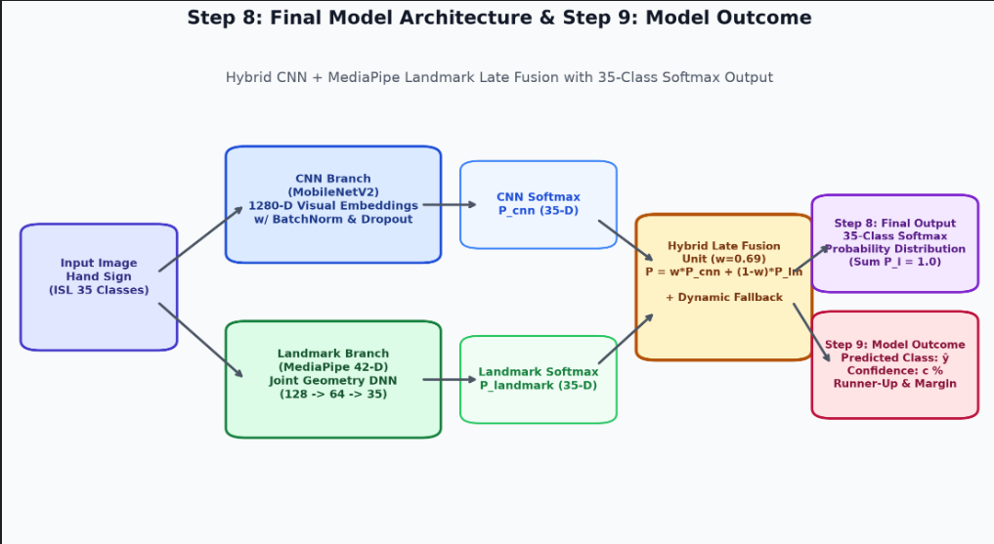
Hybrid Late Fusion Model
4 MODEL IMPLEMENTATION
CNN 1: MobileNetV2, 3.50M params
CNN 2: EfficientNet-B0, 5.29M
Landmark DNN: 42 → 128 → 64 → 35
Hybrid: 0.69 × CNN + 0.31 × Landmark
Falls back to CNN if no hand found
Final model: 13.43 MB, runs on CPU
Notes:
Two branches: MobileNetV2 on the image and a small DNN on 42 landmark values. Their probabilities are blended with weight 0.69 and 0.31. If no hand is found it falls back to the CNN.

Slide 7
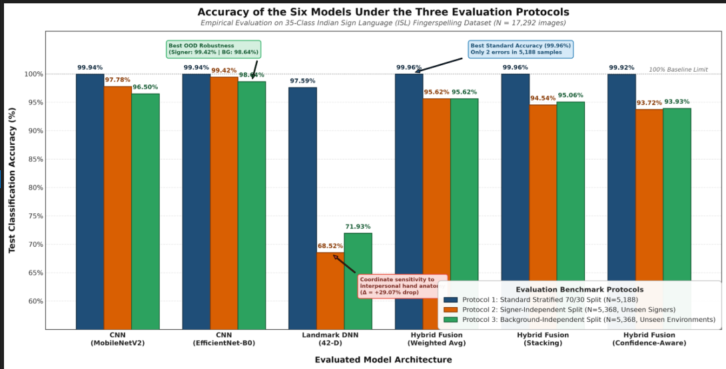
Accuracy on Three Protocols
5 OUTPUT AND RESULTS
Standard: Hybrid 99.96%, only 2 errors
New signers: EfficientNet-B0 99.42%
New rooms: EfficientNet-B0 98.64%
Landmark-only falls to 68–72%
High standard accuracy alone can mislead: unseen data shows the real picture
Notes:
Standard split: hybrid 99.96 percent with only 2 errors. On new signers and rooms EfficientNet-B0 is best. Landmark-only drops to about 70 percent.

Slide 8
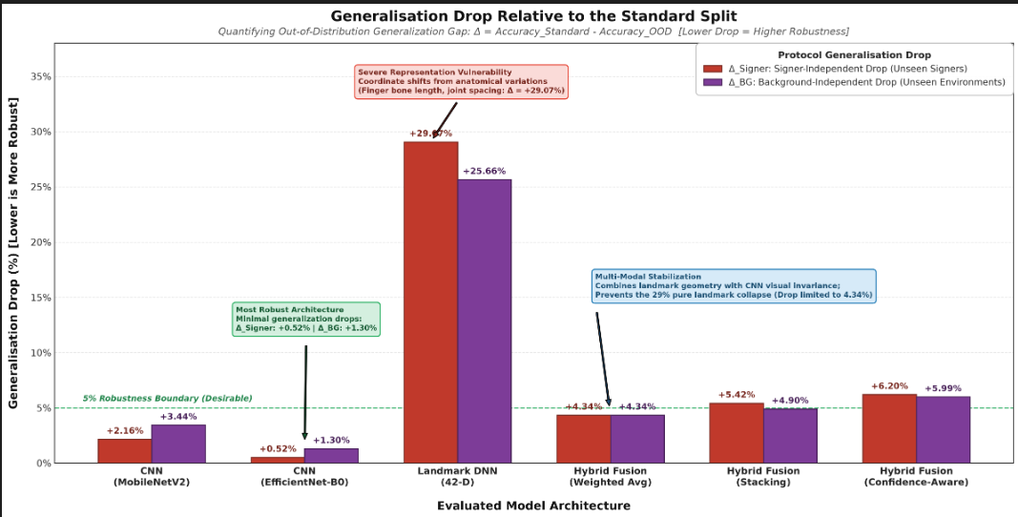
Generalization Drop (Lower is Better)
5 OUTPUT AND RESULTS
Drop = standard minus unseen accuracy
EfficientNet-B0: smallest, 0.52 and 1.30 points
Hybrid: 4.34 points, within 5%
Landmark-only: 29.07 points
Fusion rescues the weak landmark branch and keeps the drop small
Notes:
Drop equals standard accuracy minus unseen accuracy. EfficientNet-B0 drops least. Hybrid drops 4.34 points. Landmark-only collapses by 29 points.

Slide 9
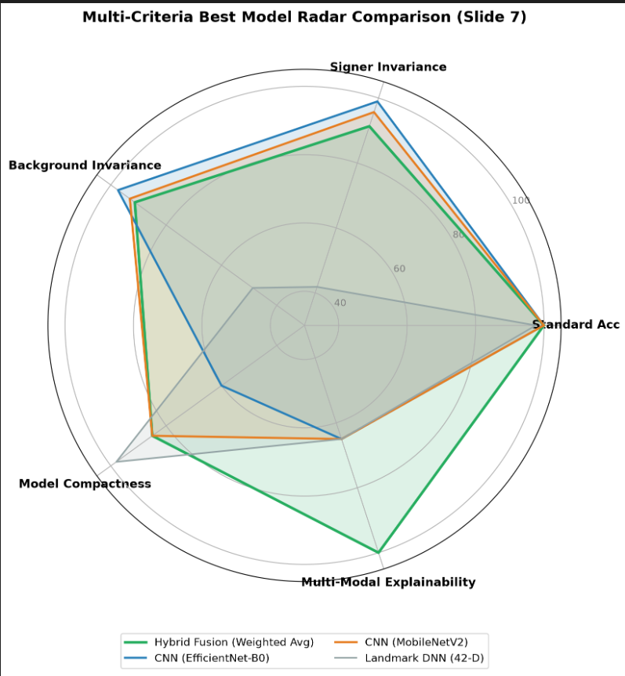
Best Model Selection
5 OUTPUT AND RESULTS
Ranked on accuracy, signer, background, robustness, size
Rank 1: Hybrid (weighted average), score 92.61
Most robust: EfficientNet-B0
Smallest: Landmark DNN, but weak accuracy
Only hybrid gives explainability and guidance
Selected model: Hybrid Late Fusion
Notes:
Models ranked on accuracy, signer, background, robustness and size. Hybrid weighted average ranks first with 92.61 and is the only one giving explainability and guidance.

Slide 10
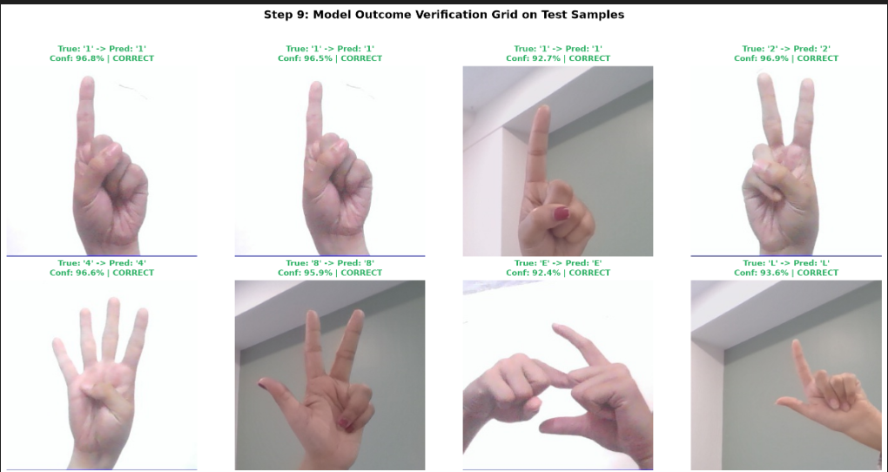
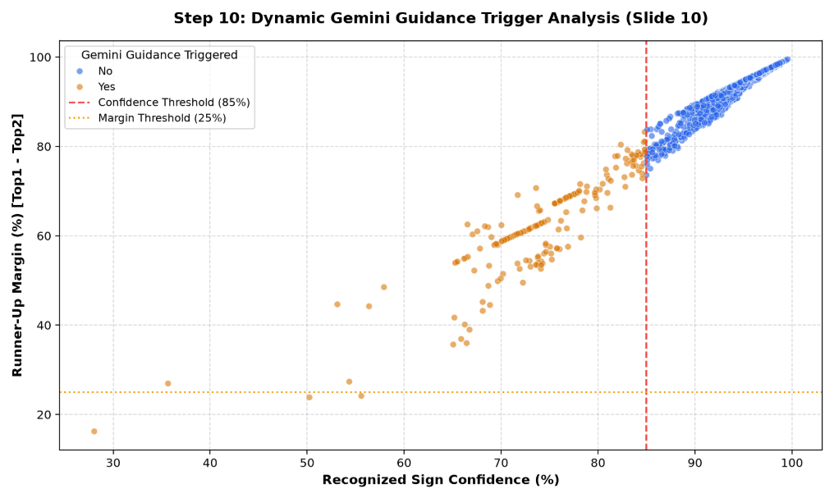
Final Output: Predictions and Gemini Guidance
6 EXPLAINABILITY AND GUIDANCE
Sample predictions with confidence
Correct signs at 92–97% confidence
Works on plain and room backgrounds
Gemini guidance when confidence is below 85%
Orange dots: guidance triggered
Grad-CAM: focus on fingers and palm
Notes:
Left: sample test predictions with confidence. Right: Gemini guidance is triggered when confidence is below 85 percent or the margin to the runner-up is 25 percent or less.

Slide 11
References and Related Work
8 REFERENCES
Ref | Study | Approach | Reported result
[1] | Nath et al. | ConvNeXtXLarge, ASL | 99.81%
[2] | Kirandevraj et al. | BiLSTM with CTC, fingerspelling video | CER 4.87% → 16.8% on new signers
[3] | Ingoley and Bakal | MediaPipe crop + MobileNetV2, ISL | 99.69%
[5] | Bhagyawant et al. | CNN-LSTM, ISL videos | 84% train / 100% validation
[7] | Sharma et al. | CNN + SVM, ISL | 97% alphabets
Ours | This work | Hybrid late fusion, three protocols, explainable | 99.96% standard; 99.42% / 98.64% best CNN on new signers / rooms
Reference numbers follow the project report. Full citations are in the report.
Notes:
Related work numbers are taken from the project report. Our work adds three protocols, fusion and explainability.

Slide 12
Key Takeaways
7 CONCLUSION
Hybrid model: 99.96% accuracy, only 2 errors
EfficientNet-B0 is the most robust to new signers and rooms
Fusion is significantly better than landmarks alone
Grad-CAM and Gemini make results explainable and useful
Compact 13.43 MB model runs on CPU
Thank You
Questions are welcome
Notes:
Summarize: best accuracy, most robust model, fusion beats landmarks, explainability and guidance, compact CPU model.

