Slide 1

CE144 project
PRESENTATION
SUBMITTED BY : Deep Satasiya (22CE114)

Slide 2

Presentation Outline
1. Project Title
2.
Problem Statement
3.
How We Approached
4.
What we have learnt
5.
Limitations

Slide 3
PROJECT TITLE
MARKETING COMPANY MANEGMENT SYSTEM

Slide 4

PROBLEM STATEMENT
We have to make database management system for marketing company.
5

Slide 5
PROBLEM STATEMENT
In which various e-commerce company introduce their products to our company for their marketing. And also, those company decide a commission rate of particular product for us.
In our company we promote their products to targeted customers. When those customers buy any product through our company, we made a small amount of profit from seller company (that is our commission).
This type of marketing is also known as “Affiliate Marketing”.

Slide 6

How we approached
2-D linked list
Stack
O(1) T.C. for Insertion

Slide 7
How we approached
We don’t want contagious memory allocation of database of company and customers in our memory, therefore we have not used “ ARRAY ” but we used concept of “ LINKED LIST ”.
We have used 2 “2-D LINKED LIST” , one for company database and one for customers database.

Slide 8
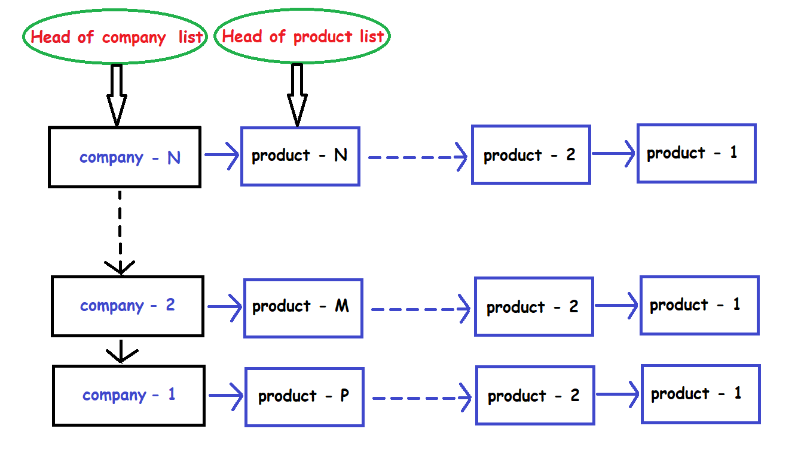
How we approached (for company)
In company’s database we used 2D linked list

Slide 9
How we approached (for company)
In the main linked list, every node contains basic details of company like…
Name of company
Total number of products we have sold of that company
Total amount of sale we have made of that company
Total amount of Profit we have earned from that company
and pointer of its own list of their product and each node of product list contains details of particular product like…
Product name
Product price
Commission rate on product
Total sale we have made of that product
Our total profit by that product.

Slide 10
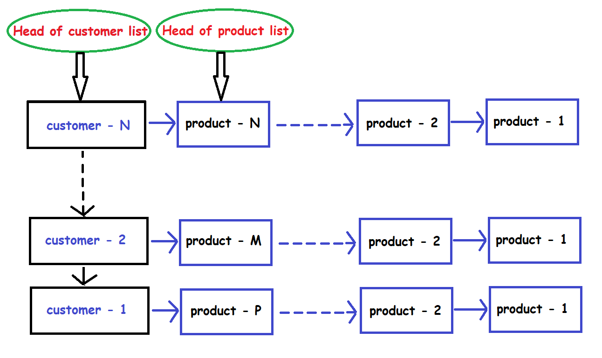
How we approached (for customers)
In customer’s database we used 2D linked list

Slide 11
How we approached (for customers)
In the main linked list, every node contains basic details of customers like…
Name
Gmail ID
Mobile Numbers.
Total Buying of that customer
Total profit from that customer
Total products that customer buy
and pointer of its own list of their product and each node of product list contains details of particular product like…
Product name
Company of product
Price of product
Quantity of product
Total coast.

Slide 12
O(1) Time complexity
We have used O (1) time complexity concept for inserting new company, new product of company, new customer, new product for customer. (Means new product display first)
When New customer arrives, first we search if that customer is in our database or not, by customer’s phone number. If we’ll find that customer is already in our database, we’ll not create a new node for that, but we’ll add their new buying in the list of product of that customer which is already in our database with time complexity O (1) .
Otherwise, we will create a new node in Customer list for that customer with time complexity O (1). And create new product list for that customer node and add their buying in it.
5

Slide 14
What we have learnt
The main thing that we have learnt is 2-Dimension linked list to approach this type of scenario.
We learnt more about how to use object-oriented programming especially friend class and inheritance.
We learnt how Data Structure can be used to ease our real-life problems.
We learnt to use system(“CLS”) for better appearance of the screen.

Slide 15
LIMITATIONS
The main limitation of our project is: we are not storing our data in files therefore if we exit from our program, we cannot access our old data.
In today’s world this type of console based DBMS is rarely used by any company.
5

Slide 16
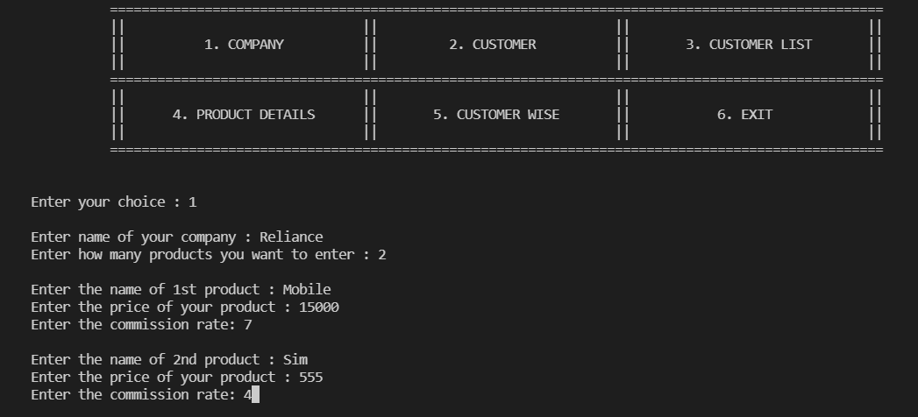
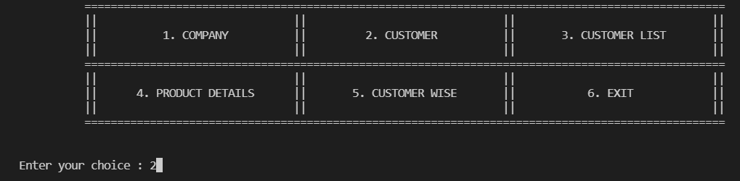

Slide 17
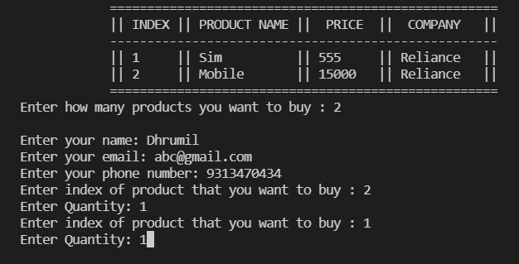
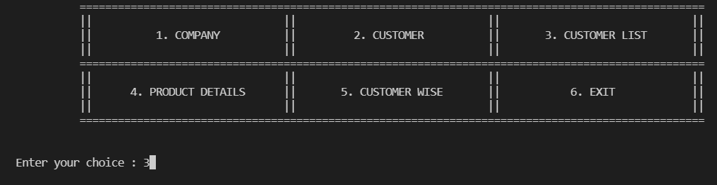

Slide 18
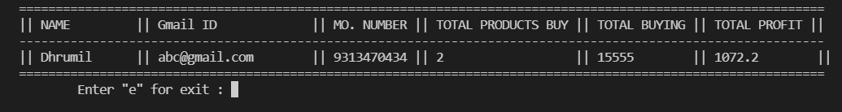
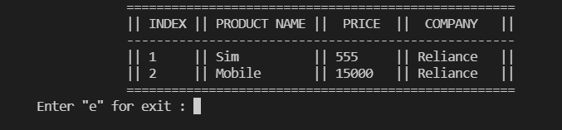
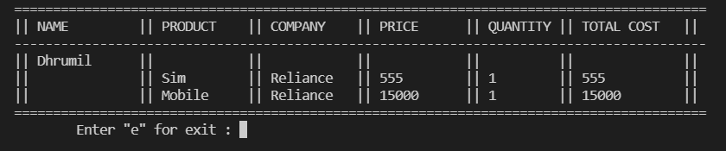

Slide 19
THANK YOU

