Slide 1

Outliers Detection

Slide 2

To understand the concepts taking Bahubali Movie as example

Slide 3
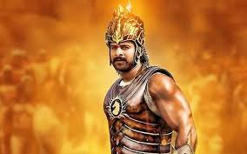
Identify Outliers in Business Data
Bahubali is a technic using to identify Outliers in Time Series Data

Slide 4
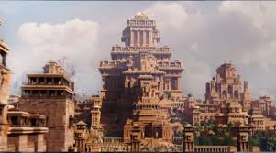
Time Series
Before knowing Bahubali first we should know about Mahismathi , nothing but Time Series

Slide 5
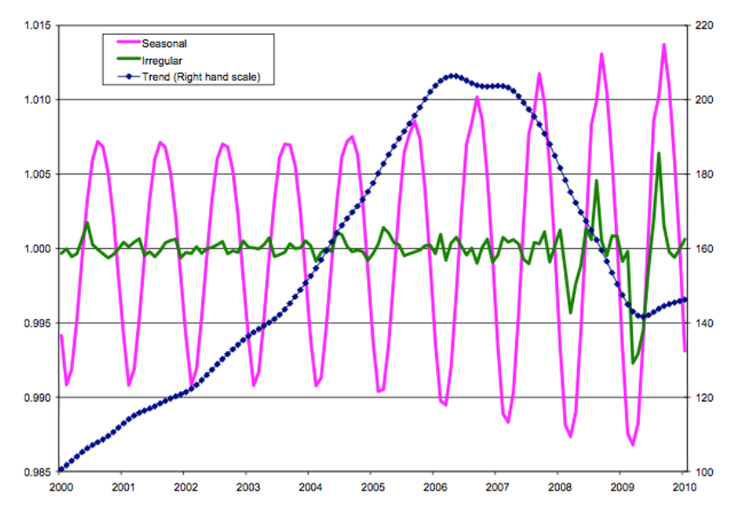
Components of time series
We use different techniques for time series with different characteristics
Trend
Seasonality
Random stationary

Slide 6
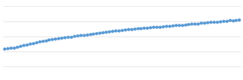


Real world Examples
By looking into data plots, it’s easy to identify time series characteristics

Slide 7
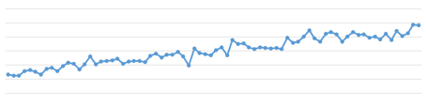
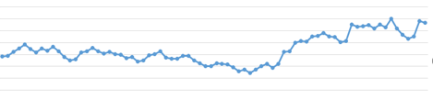
Real World Examples
By looking into data plots, it’s difficult to identify time series characteristics.

Slide 8

Correlation
Katappa – He doesn’t have direct relation to Bahubali but he plays major role.
Similar Correlation also doesn’t have direct relation but need to understand it.

Slide 9



Correlation Coefficient:
Correlation Coefficient gives the strength and direction of the relationship between two variables.
With the below data, let us calculate the correlation between the hours of sunshine and attendees for the concert
Consider Sunshine hours and concert attendance are x values and y values respectively.
S_{x} is the standard deviation of x values and S_{Y} is the standard deviation of y values in the sample
Correlation Coefficient where b is the slope of the liner regression equation (y = bx + c).
Sunshine(hours) | 1.9 | 2.5 | 3.2 | 3.8 | 4.7 | 5.5 | 5.9 | 7.2
Concert attendance(100s) | 22 | 33 | 30 | 42 | 38 | 49 | 42 | 55

Slide 10
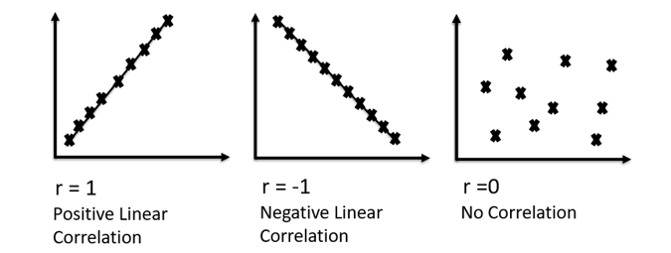
Correlation Coefficient:
Correlation Coefficient is a number between -1 and 1 and tells us how well a regression line fits the data.
For sample data Correlation Coefficient is 0.916

Slide 11

ACF & PACF

Slide 12

Autocorrelation (ACF) and Partial ACF (PACF)
In time series descriptive statistics, order of observations is of primary importance and so autocorrelation, etc. paly a vital role in identifying the models and their characteristics.
Autocorrelation is a metric that allows us to understanded the strength of order in the time series.
Autocorrelation (ACF): n^{th} lag of ACF is the correlation between a day and n days before that.
Partial ACF (PACF): The same as ACF with all intermediate correlations removed. It is the kth coefficient of the ordinary least squares regression.
[𝑦𝑡] is the input time series, k is the lag order and 𝛽𝑖 is the i th coefficient of the linear multiple regression.

Slide 13
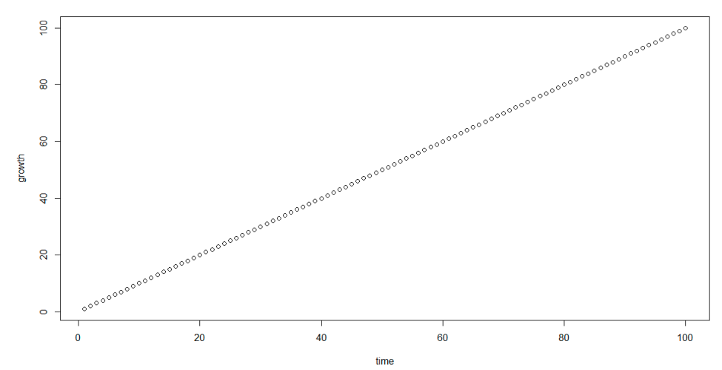
ACF and PACF – Idealized Trend

Slide 14
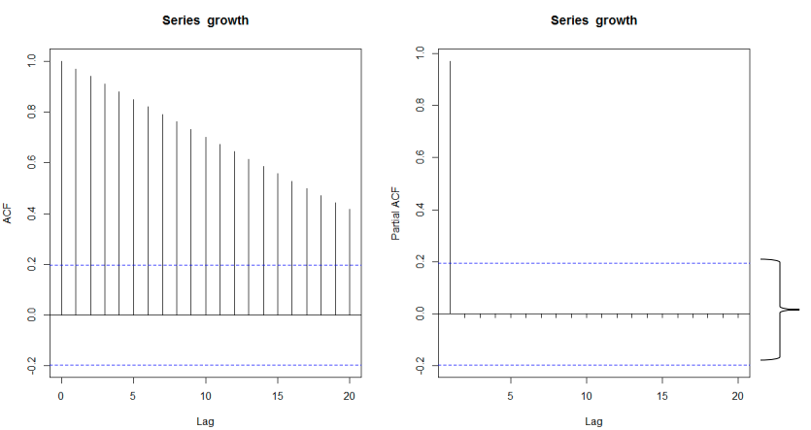

ACF and PACF – Idealized Trend
ACF is a bar chart of correlation coefficients of the time series and its lags.
PACF is a plot of the partial correlation coefficients of the time series and its lags.

Slide 15
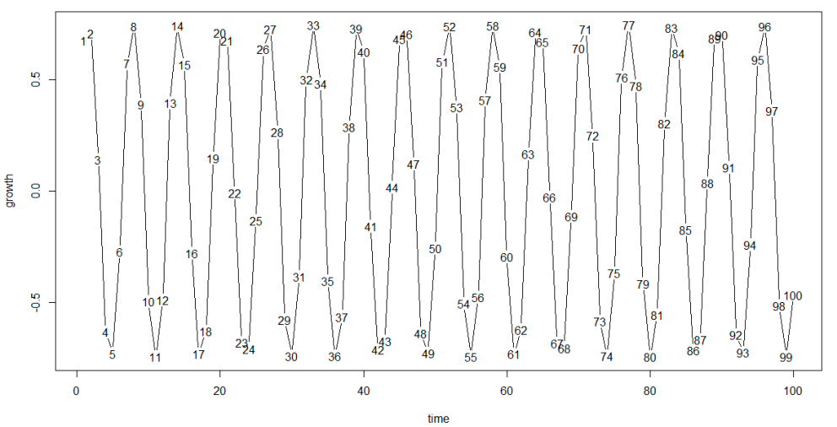
ACF and PACF – Idealized Seasonality

Slide 16
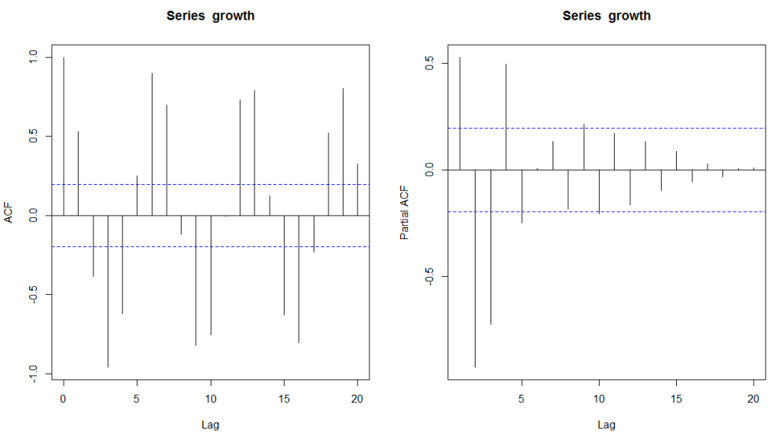
ACF and PACF – Idealized Seasonality

Slide 17
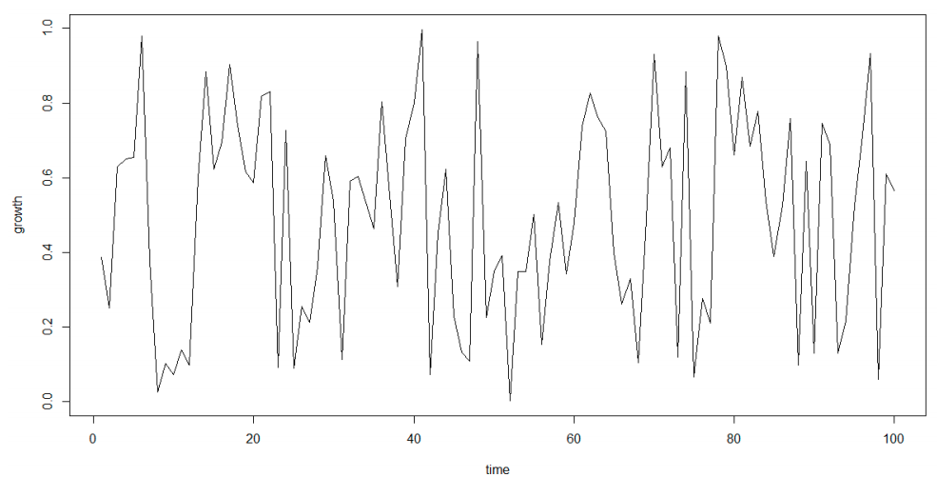
ACF and PACF – Idealized Randomness

Slide 18
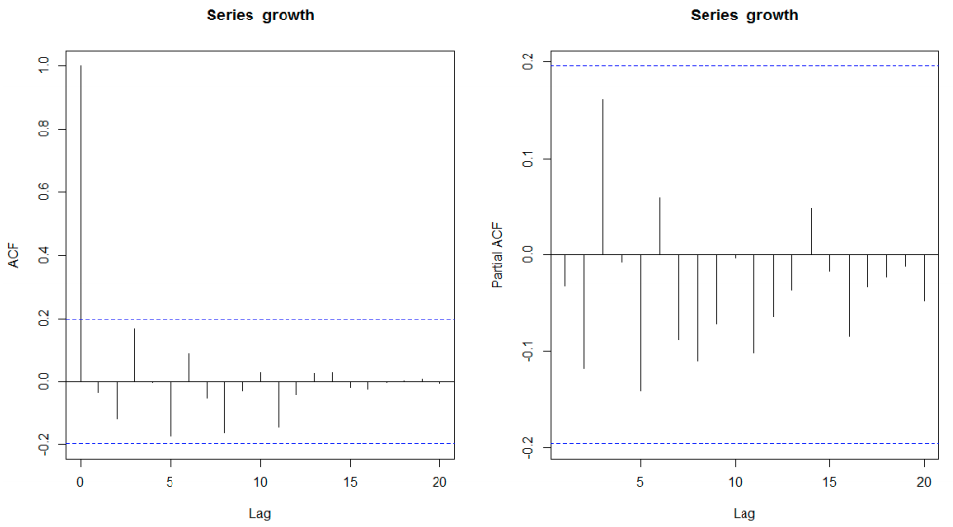
ACF and PACF – Idealized Randomness

Slide 19

Forecasting
Devasena forecasted about villain die.

Slide 20
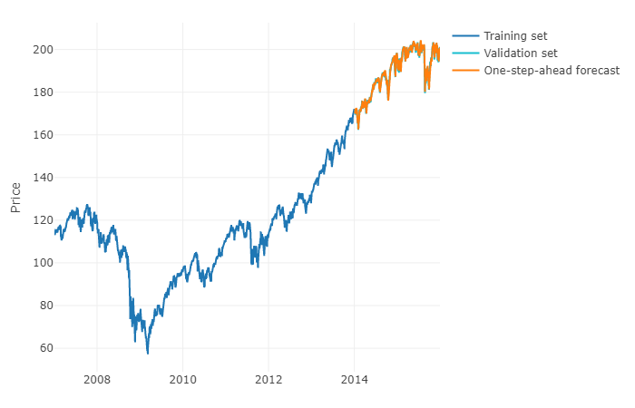
Forecasting

Slide 21

Mean Absolute Percentage Error (MAPE)
When Ballaladeva power decrease Bahubali power increase.
Less MAPE value can give better Forecast and correct outliers.

Slide 22
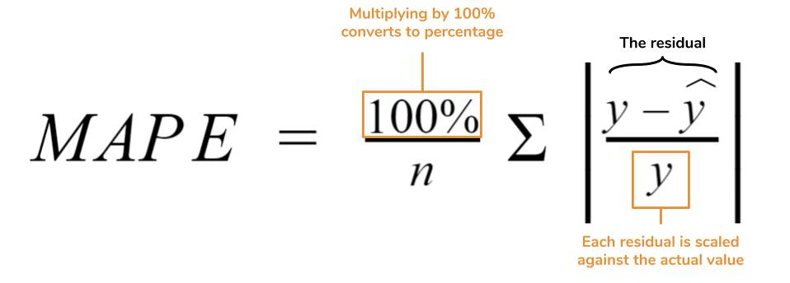
MAPE

Slide 23
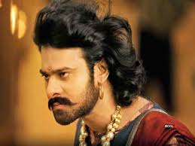
Identifying Outlies
Bahubali can identify who is friend and who is enemies.

Slide 24

Identifying Outliers
MTH | Actual | Predicted | Lower Boundary (95% CI) | Upper Boundary (95% CI) | Anomaly
01-11-2018 | 30196 | 34833 | 24431 | 45235 | FALSE
01-12-2018 | 23501 | 31209 | 21675 | 40743 | FALSE
01-01-2019 | 32090 | 24361 | 10744 | 37978 | FALSE
01-02-2019 | 15000 | 31647 | 15823 | 47472 | TRUE
01-03-2019 | 19763 | 28243 | 9092 | 47395 | FALSE
01-04-2019 | 9576 | 23150 | 2122 | 44178 | FALSE

Slide 25
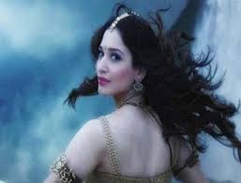
Data Visualization

Slide 26
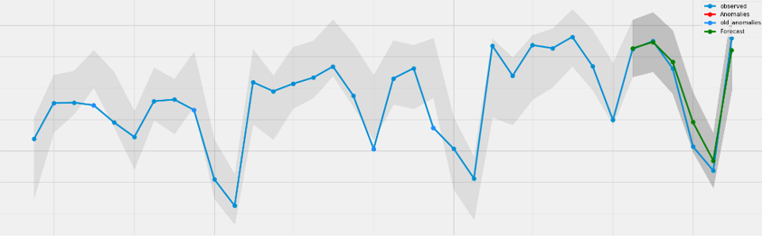
Data Visualization

Slide 27
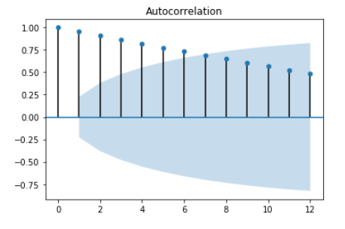
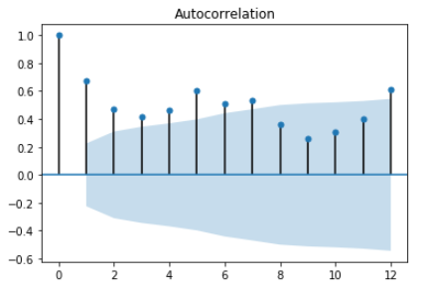
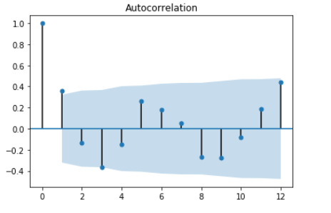
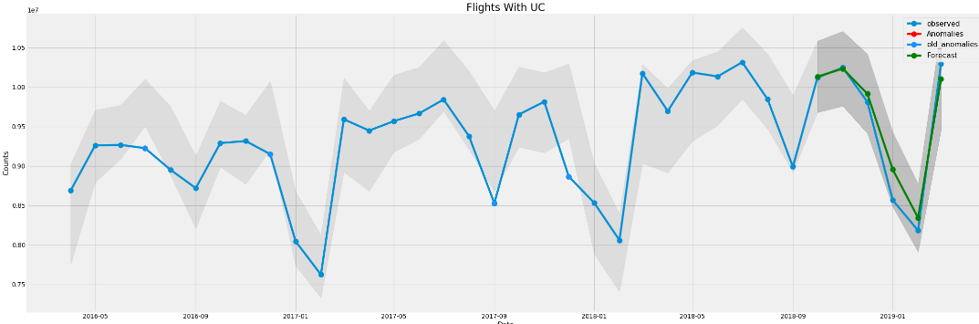
Outliers Analysis
Execute SQL to fetch last 72 months data
Statistical understanding of data using ACF
Use appropriate time series algorithms
Select algorithm which has less error percentage (MAPE)
Plot Identify anomalies and last 36 months data
Trend
Seasonal
Random

Slide 28

Basic Design Idea
If Seasonal
Apply all the Seasonal algorithms & choose the Algorithm with min MAPE value
Fetch required data
Cannot find the Algorithm from the Data pattern
NO
Identify the data pattern using Line plot, ACF and PACF
Less MAPE value?
Apply all the Trend algorithms & choose the Algorithm with min MAPE value
Get Forecast values by choosing the best Algorithm
If Trend
YES
Statistically pull all peeks and valley
Find Anomalies
If Random
Plot the Obtained Results

Slide 29


