Slide 1
Employee Over-Time prediction
Sathish K Billa

Slide 2
Problem statement

Slide 3
Problem statement
Predict employee over time using several hr metrics
Benefit of a good predication model?
Reduce project costs
Improve employee morale
Improve employee productivity

Slide 4
Business hypothesis
What parameters might be impacting overtime

Slide 5
Business hypothesis
Are employees staying back for overtime due to distance to their home?
Are lower joblevel employees doing more overtime
Due to extra pay?
Are men doing more overtime than women?
Younger employees doing more overtime?
Do they need training to improve planning…
Employees who rate ‘work life balance’ poorly are doing more overtime?
If true need to investigate more (data analysis)

Slide 6
Understanding data

Slide 7
Understanding data
Train set
40k rows – reasonably large dataset
Test set
10k rows
No na values
Some fields have zero values but not considered as na values
Numeric features
10 features
Categoric features
18 features
There is no class imbalance in target
54:46 split between yes:no

Slide 8
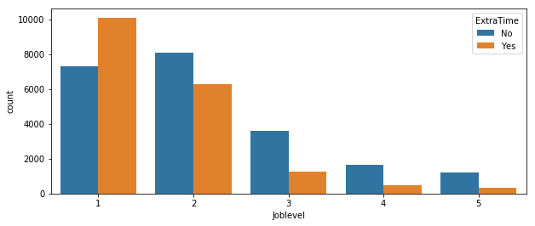
Potentially important features
Any joblevel results in more yes values?
ExtraTime | No | Yes
Joblevel
1 | 0.419596 | 0.580404
2 | 0.562804 | 0.437196
3 | 0.741376 | 0.258624
4 | 0.772158 | 0.227842
5 | 0.794137 | 0.205863

Slide 9
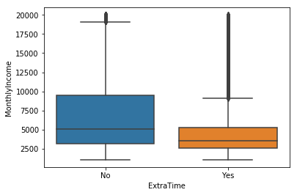
Potentially important features
Low income leading to extra time?
Mean salary of yes is lower!

Slide 10
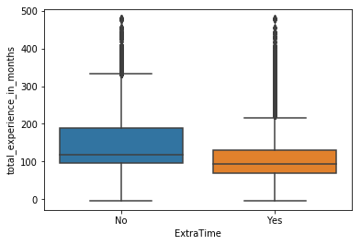
Potentially important features
Any dependence on experience?
Mean experience is lower for yes people

Slide 11
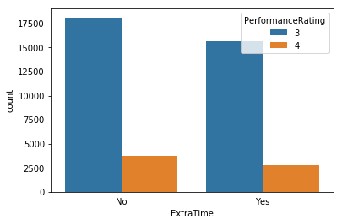
Not so important features
Any dependence on performance rating?
Same ratio of yes:no as global. No impact?
ExtraTime | No | Yes
PerformanceRating
3 | 0.536615 | 0.463385
4 | 0.5711 | 0.4289

Slide 12
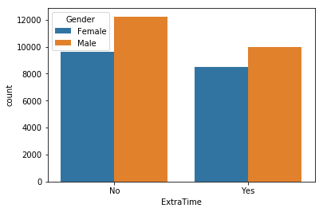
Not so important features
Any dependence on gender
Similar ratio as global
ExtraTime | No | Yes
Gender
Female | 0.530948 | 0.469052
Male | 0.55137 | 0.44863

Slide 13
Understanding data
Used cross tabs and pivot tables in pandas to see if there is any obvious influence of any features
Apart from previous ones nothing more could be identified
ExtraTime | No | Yes
Division
Human Resources | 0.591711 | 0.408289
Research & Development | 0.518742 | 0.481258
Sales | 0.612764 | 0.387236
ExtraTime | No | Yes
Education
1 | 0.605383 | 0.394617
2 | 0.497858 | 0.502142
3 | 0.506656 | 0.493344
4 | 0.614325 | 0.385675
5 | 0.725639 | 0.274361

Slide 14
Data preprocessing

Slide 15
Data pre-processing
Ran profile_csv.py library to generate comprehensive report on data
Using datacollected (assumed it is the date data collected) and ‘date of joining current company’ created ‘months_in_current_company’
Created total_months_experience using datacollected and ‘firstjobdate’
Dropped columns
Extracted information
'FirstJobDate','DateOfjoiningintheCurrentCompany’
Zero variance or id columns
'EmployeeID', 'Over18’, 'EmployeeCount’, 'StandardHours’, 'datacollected’

Slide 16
Data pre-processing
There are around 1k rows of ‘date joined company’, which seem to be after ‘date date collected’
Resulted in negative numbers – made them to zero
Similarly for total experience in months (80+)
‘Emolument_in_percentage’
Has 12+ levels, but did not merge infrequent levels (23,24,25) as they have higher proportion of ‘no’ values
Distance to home and years in current role considered them as numeric, possible to make them into categoric
Split train set into train and validation
Train set – 30k rows
Validation set – 10k rows
Test set – 10k rows

Slide 17
Data pre-processing
Three sets of train, validation and test sets are created
SEt1
Categoric data LABEL ENCODED
Total features 28 + 1 target
Used in random forest , Naïve Bayes
Set 2
Set 1 steps +
Dummify categoric data (ONE HOT ENCODING)
Total features 104 + 1 target
ADAboost
Set 3
Set 2 steps +
Scale (std:1, mean:0) (x-x_mean)/STD
Total features 104 + 1 target
Svm, MLP

Slide 18
Data pre-processing
Additional sets on demand
Set4
Removed unimportant features obtained from random forest and attempted models
Removed joblevel (highly correlated with monthly income 0.94 correlation)
Notes:
What is pearson correlation – read the formula

Slide 19
Model selection and execution

Slide 20
Random forest
Random forest with parameters
Estimators: 1000
Criterion: entropy
Max_features: SQRT (sqrt of number of reatures ~5
Min samples split: 20
3 fold cross validation – no hyper parameter tuning
Accuracy – 0.76 on validation set
Notes:
Read up entropy, min samples split etc,.

Slide 21
Random forest
Random forest grid search for hyper parameter tuning
Tuned parameters
Entropy, max depth: 20, max_features: 6, min_samples_split: 40, n_estimators: 1500
Did this on cloud server to save time (paper space)
XGBoost classifier
Objective: binary-logistic, learning_rate:0.01 and other parameters
Did simple and grid search based tuning
Resulted in similar accuracy scores
Notes:
Read up entropy, min samples split etc,.

Slide 22
Random forest
Keras – tensorflow
Dummified and scaled data set is used
104 input nodes, 1 hidden layer with 12 nodes, 2 output nodes
Categorical cross entropy loss function
Optimizer: adam
Gave similar scores as random forest (500 epochs) with batch size 100
SVC
On cloud server did grid search
Best parameters
C: 0.9, gamma: 0.02, kernel: rbf
Gave similar results as random forest
Notes:
Read up entropy, min samples split etc,.

Slide 23
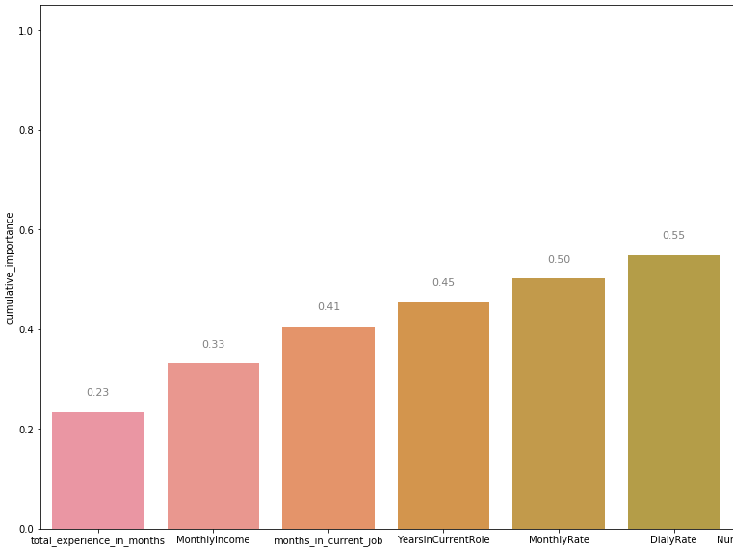
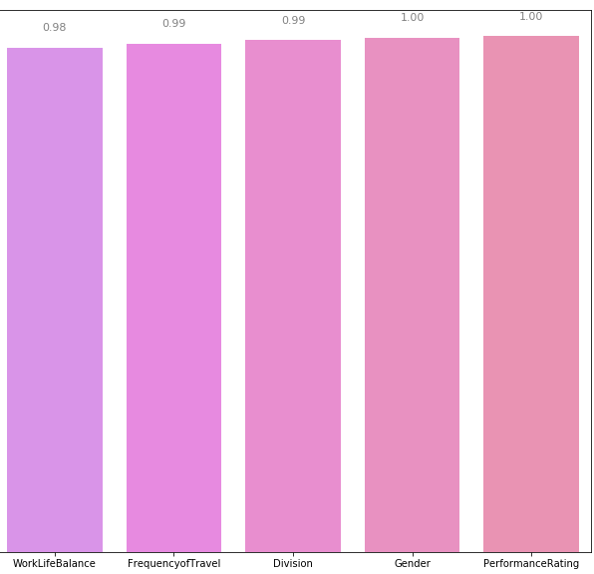
Random forest
Feature importance (using random forest)
Notes:
Read up entropy, min samples split etc,.

Slide 24
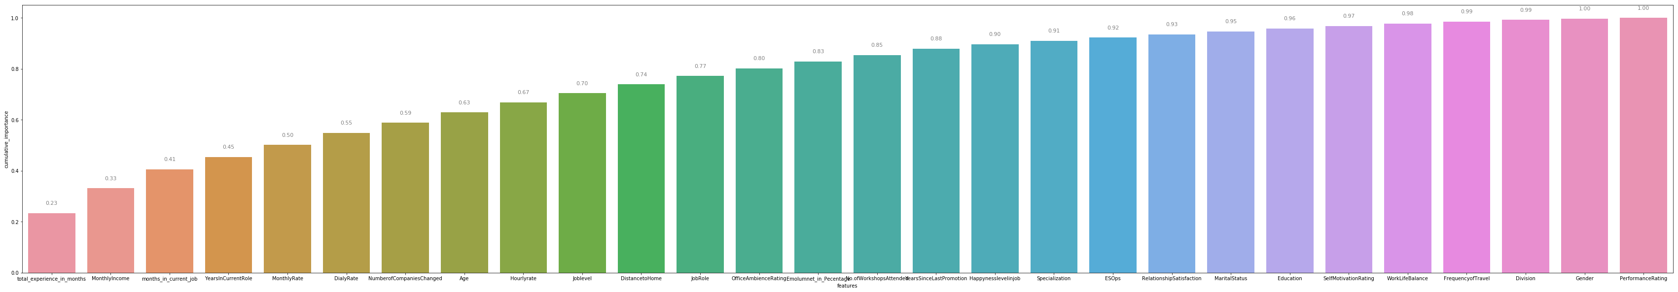
Random forest
Feature importance (using random forest)
Notes:
Read up entropy, min samples split etc,.

Slide 25
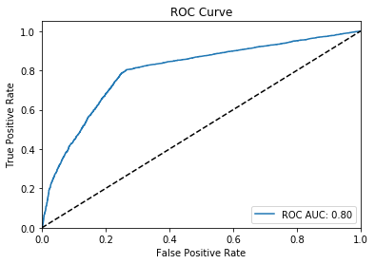
Random forest
Attempted naïve bayes gave poor results
Removed features less than 3.5% importance (using output from random forest)
Results did not improve much
Notes:
Read up entropy, min samples split etc,. ROC curve

Slide 26
Results and conclusion

Slide 27
metrics
Model name | Metric Type | Kappa | Accuracy | Recall | F1 Score
RF - simple | train | 0.670464545 | 0.836933867 | 0.802344089 | 0.818178465
RF - simple | val | 0.523346812 | 0.762207225 | 0.770360769 | 0.748530647
XGB - simple | train | 0.602972885 | 0.802593708 | 0.795181595 | 0.786503989
XGB - simple | val | 0.518590579 | 0.76022231 | 0.757399006 | 0.743742045
RF - Final with tuned parameters | train | 0.586558747 | 0.793959043 | 0.800390682 | 0.780348452
RF - Final with tuned parameters | val | 0.528449705 | 0.764688368 | 0.774897386 | 0.751597695
Keras-TF1 | train | 0.52897817 | 0.766235485 | 0.743669512 | 0.744207935
Keras-TF1 | val | 0.490335841 | 0.747221119 | 0.715057248 | 0.722155558
Naive Bayes Multinomial | train | 0.165675896 | 0.576107454 | 0.686441904 | 0.596936047
Naive Bayes Multinomial | val | 0.156936827 | 0.571655419 | 0.68632534 | 0.595501406
RF - reduced features | train | 0.586558747 | 0.793959043 | 0.800390682 | 0.780348452
RF - reduced features | val | 0.528449705 | 0.764688368 | 0.774897386 | 0.751597695
RF - reduced features2 | train | 0.593302178 | 0.797631257 | 0.794602807 | 0.782181391
RF - reduced features2 | val | 0.516855828 | 0.759428345 | 0.754590624 | 0.7424017
RF - categorical data only | train | 0.567124763 | 0.784034142 | 0.796628563 | 0.771348511
RF - categorical data only | val | 0.52443442 | 0.762604208 | 0.774897386 | 0.749947732
AdaBoost | train | 0.822503946 | 0.912296953 | 0.875488352 | 0.901277325
AdaBoost | val | 0.379923763 | 0.691345772 | 0.678332253 | 0.668796592
Notes:
Read up kappa, accuracy, recall, F1 score

Slide 28
conclusion
Important features
Total years of experience is the most important feature to determine extra time
Less experienced employees seem to be doing more over time
Train them on time management, productivity improving methods?
Monthly income seems to be the second important feature
Lesser salary employees seem to have higher proportion of extra time
Dis-Incentivize over time? Are they doing for income? Find out more and address their financial concerns using alternate mechanism
Model improvement
Try stacked learning model using predictions from earlier models
Reduce levels of some of the categorical variables?
Type of project might be an important feature to predict over time, try to collect data
Manager might also be an influencing factor, try to get information by project by manager. Are any managers lack of training leading to higher extra time?
Notes:
Read up entropy, min samples split etc,. ROC curve

