Slide 1
TIME SERIES
PRICE PREDICTION OF THE IMAGINARY PRODUCT.

Slide 2
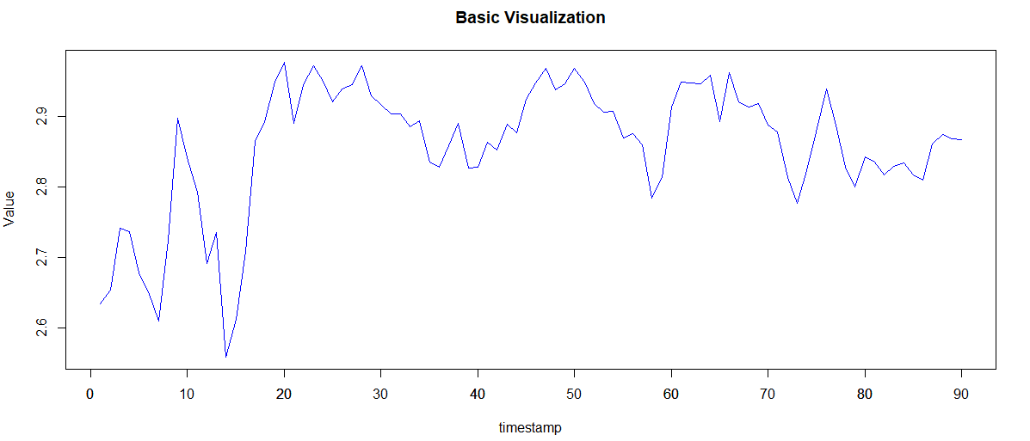
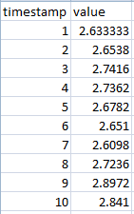
Time Series
Problem
Price prediction of the imaginary product for the next 7 periods.
Source
Variables: timestamp and value
90 data points, without any missing timestamps

Slide 3
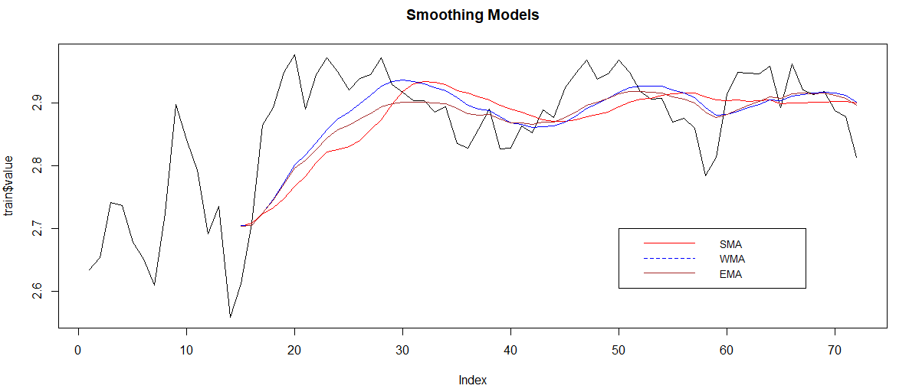
Smoothing Models

Slide 4

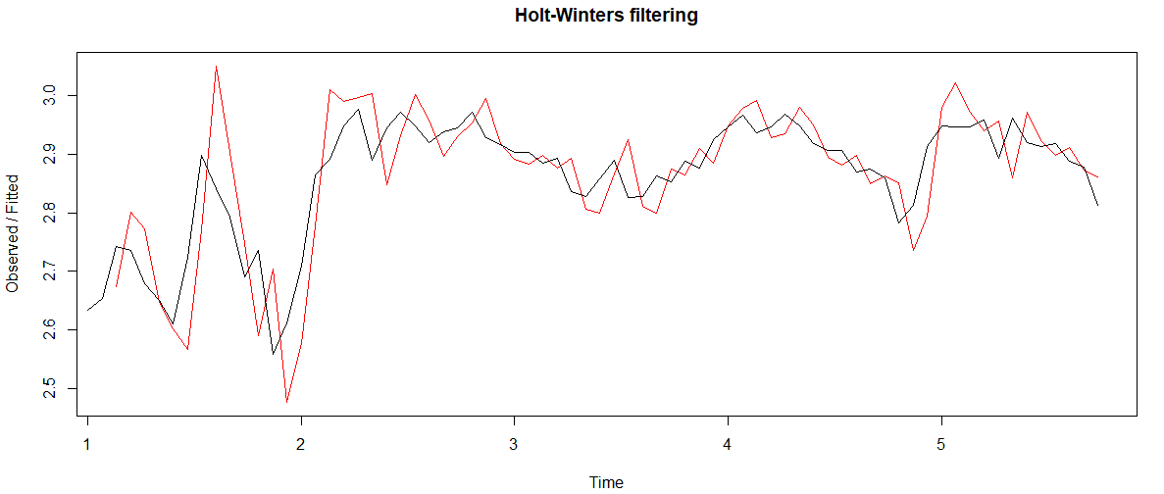
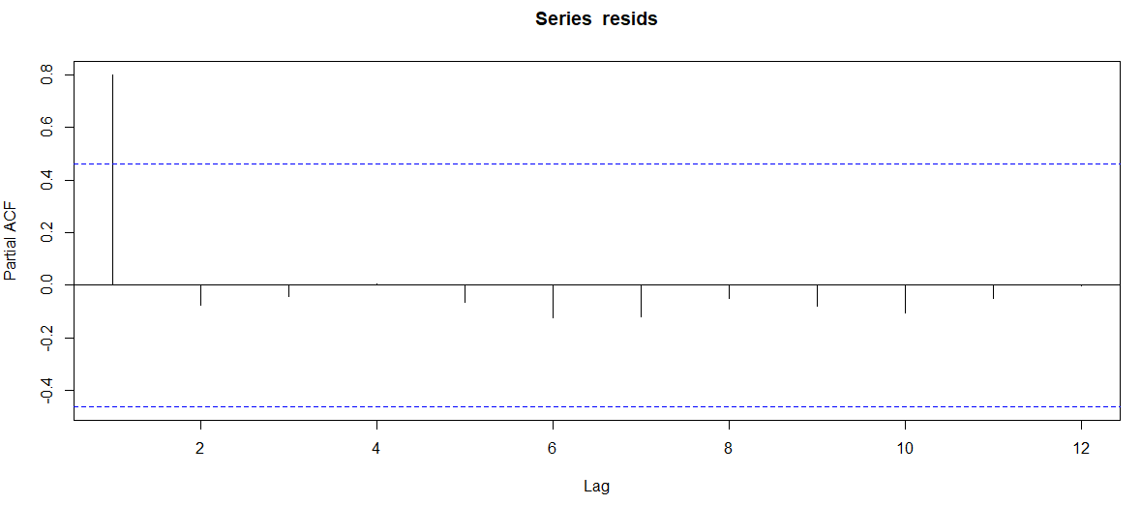
Holt winter's Model Trend

Slide 5

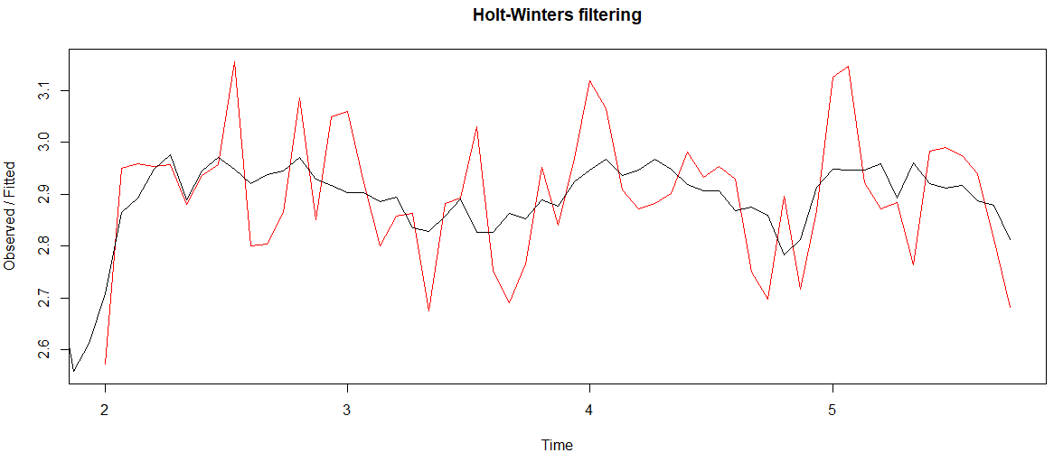
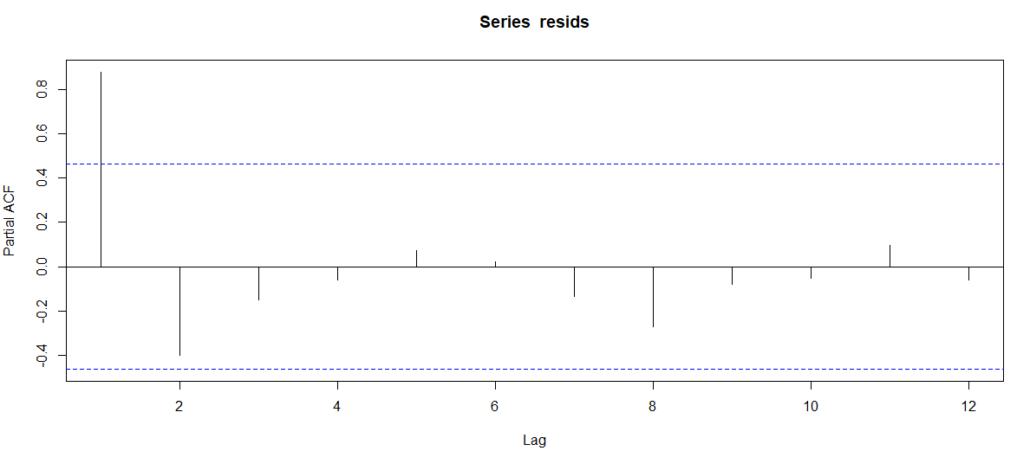
Holt winter's Model Trend Seasonal

Slide 6
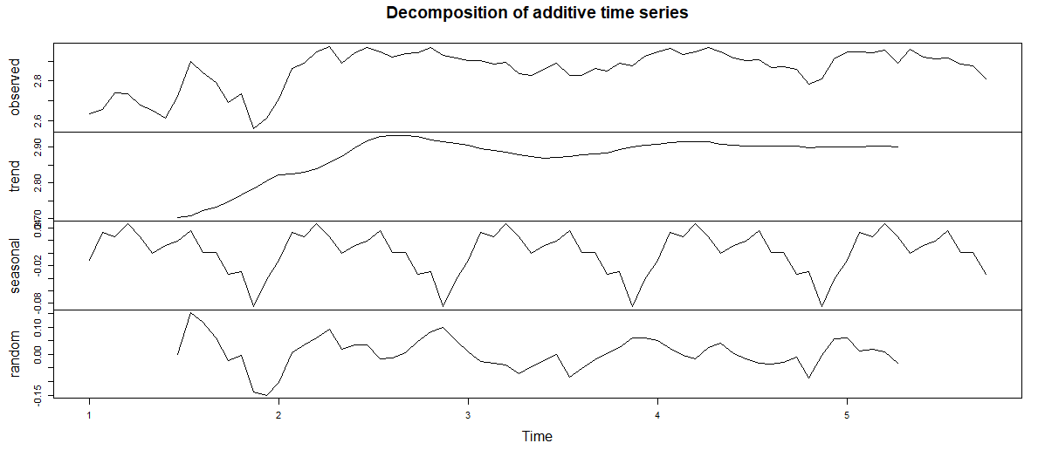
Decomposition

Slide 7

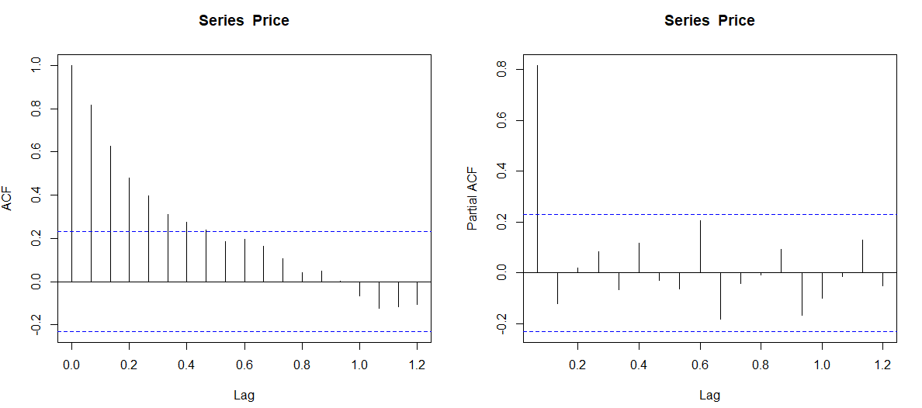
Strong Trend

Slide 8

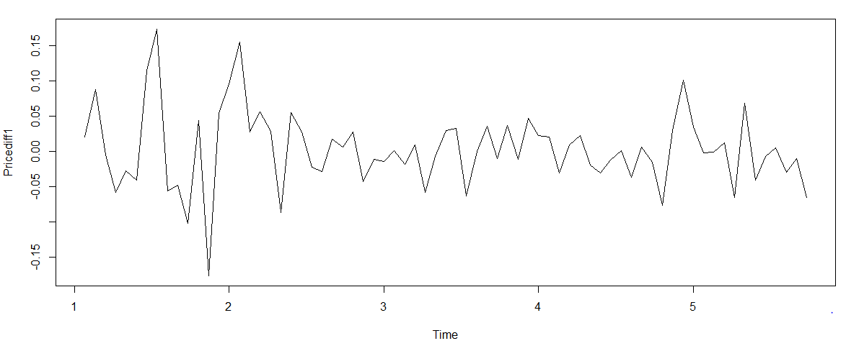
Perform non-seasonal difference
It is same as an ARIMA(0,1,0) model

Slide 9
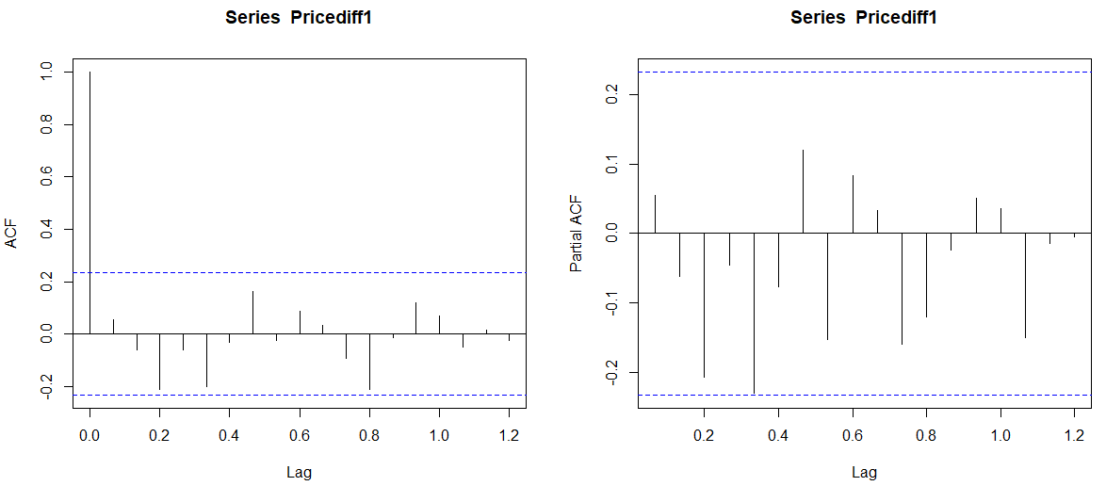
Check ACF, PACF of differenced data to explore remaining dependencies.

Slide 10
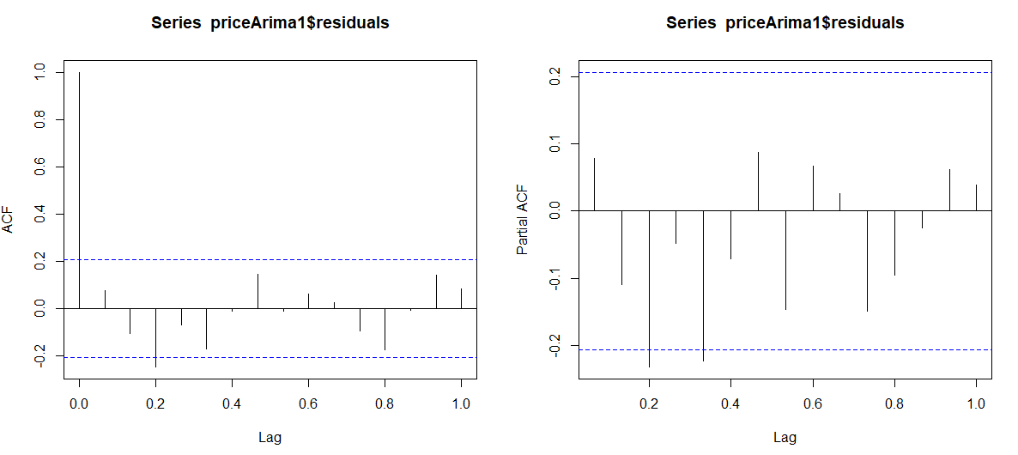

Evaluation Phase
The residuals indicates white noise. Indicates a good model that can be used for forecasting.

Slide 11
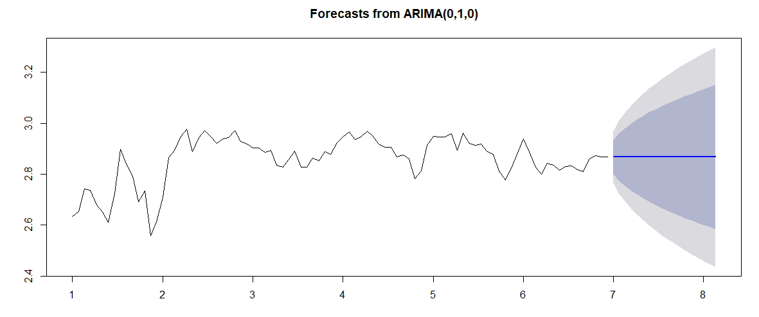
Forecasting Phase

Slide 12

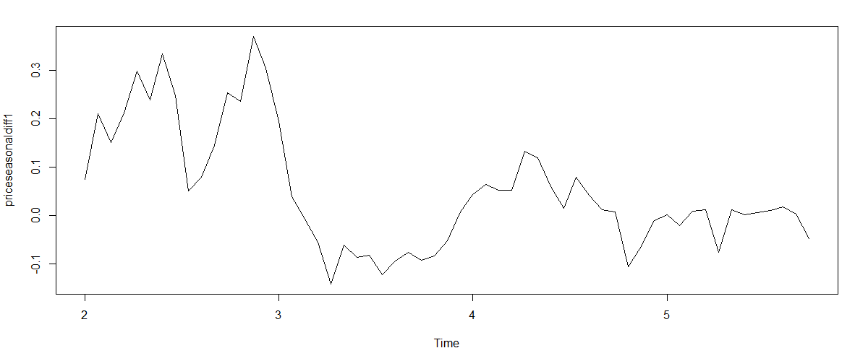
Identification Phase
The differenced series looks stationary but looks like seasonal lags perform a seasonal differencing on the original time series

Slide 13
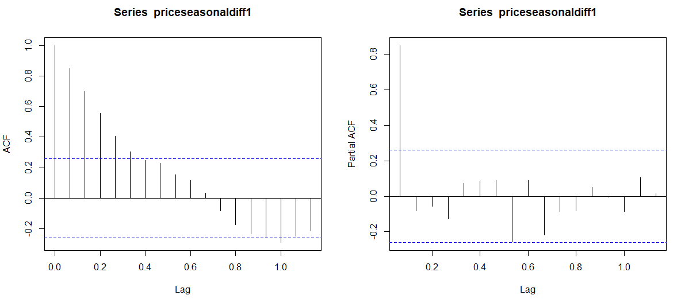
Identification Phase
Strong positive autocorrelation indicates need for either an AR component or a non-seasonal differencing. Perform AR Component (ARIMA(0,1,0)(1,0,0)15)

Slide 14
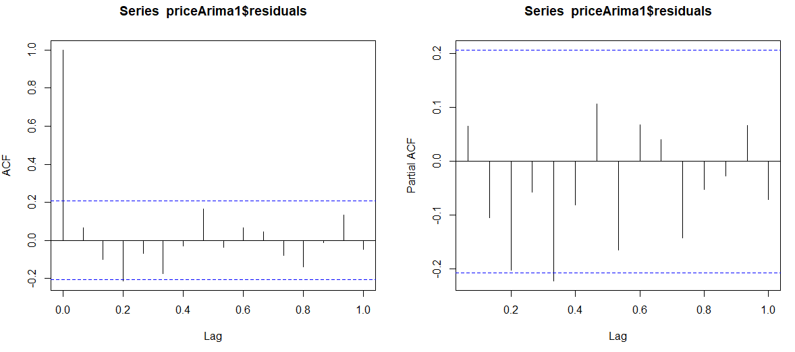
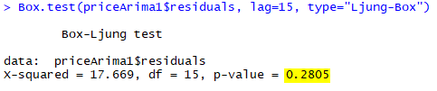
Identification Phase
The residuals indicates white noise. Indicates a good model that can be used for forecasting.

Slide 15
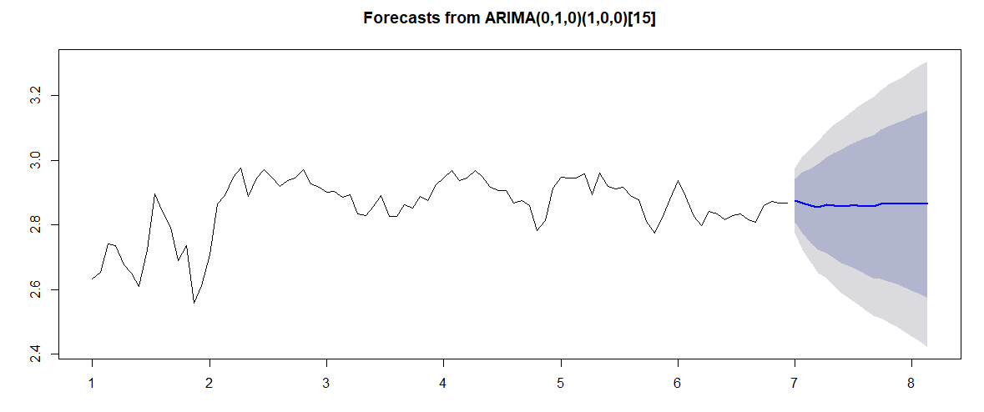
Identification Phase

Slide 16
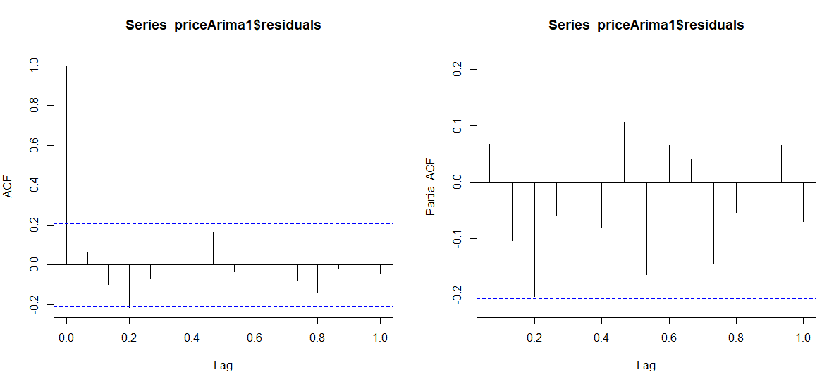

ARIMA(010)(100) with Drift

Slide 17
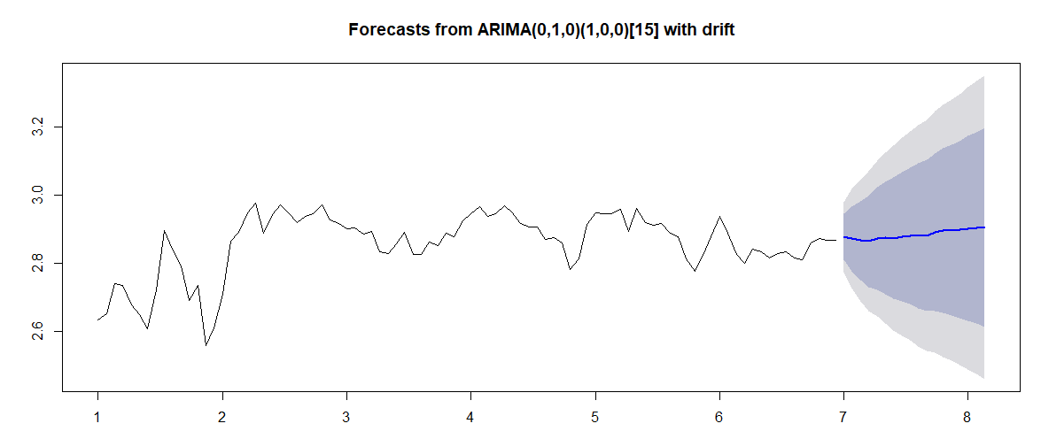
ARIMA(010)(100) with Drift

Slide 18
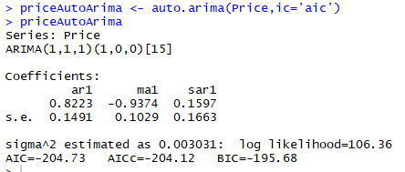
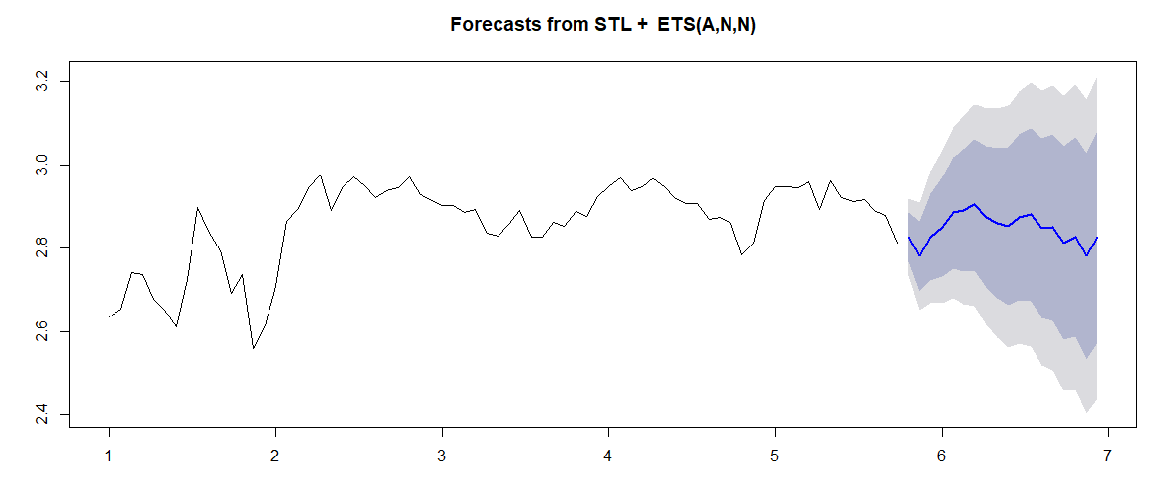

Auto ARIMA

Slide 19
Comparison

Slide 20
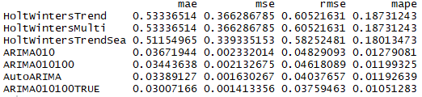
Conclusion
Each model Errors list

Slide 21
THANK YOU

