Slide 1

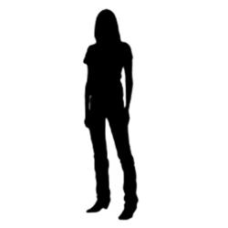


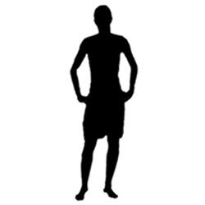

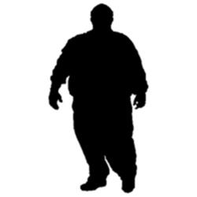
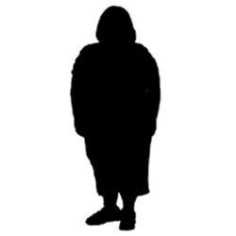
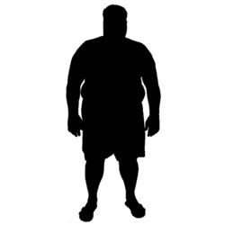
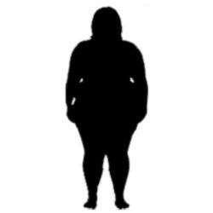
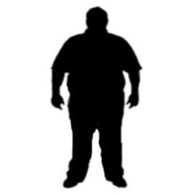
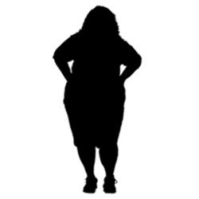
THIN-FAT BIAT
Please look at these pictures. All pictures on the top belong to the category “THIN PEOPLE”, all pictures on the bottom belong to the category “FAT PEOPLE”.
Listen to the gut reactions that you have RIGHT NOW, AT THIS EXACT MOMENT while you look at the pictures. What is your implicit attitude toward these categories right now? What will the BIAT that you will take in just a minute show?
Remember, you should base your predictions on the gut reactions you feel toward THIN PEOPLE and FAT PEOPLE right now, at this exact moment.
I predict that the BIAT comparing my gut reactions to THIN PEOPLE vs. FAT PEOPLE right now, at this exact moment, will show that my current implicit attitude is…

