Slide 1
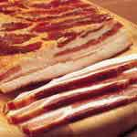
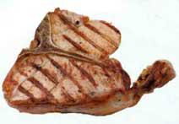
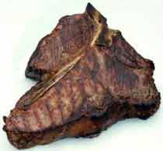
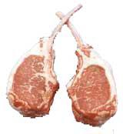
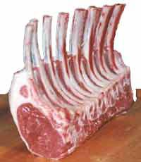
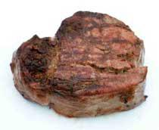
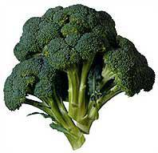
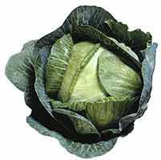
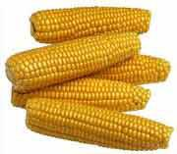
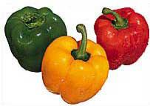
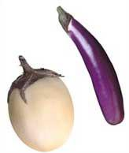
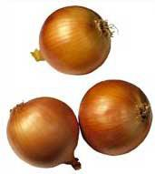
VEGETABLES-MEAT BIAT
Please look at these pictures. All pictures on the top belong to the category “VEGETABLES”, all pictures on the bottom belong to the category “MEAT”.
Listen to the gut reactions that you have RIGHT NOW, AT THIS EXACT MOMENT while you look at the pictures. What is your implicit attitude toward these categories right now? What will the BIAT that you will take in just a minute show?
Remember, you should base your predictions on the gut reactions you feel toward VEGETABLES and MEAT right now, at this exact moment.
I predict that the BIAT comparing my gut reactions to VEGETABLES vs. MEAT right now, at this exact moment, will show that my current implicit attitude is…

