Slide 1
Mira: AI-Powered Project Intelligence Assistant
Sathish Doraiswamy | Nexora Pvt. Ltd.
Applied Agentic AI for PMs/TPMs, capstone project

Slide 2
PMs lose hours to plans and reports, and the biggest AI risk is invention
PMs manage several projects at once with little tool support
A project plan takes 3 to 4 hours; a weekly status report takes 1 to 2 hours
Risk assessments come in inconsistent formats
Missed milestones are found in retrospectives, not in time
Biggest AI risk: invented milestones, risks or task statuses

Slide 3
Code computes the facts, the model only writes the narrative
An Orchestrator classifies each request and checks there is enough data
Five specialists: Planner, Risk Assessor, Status Reporter, Milestone Tracker, Stakeholder Updater
Code nodes compute counts, dates and filters, so numbers are never guessed
Vague requests get a fixed reply asking for scope, goals, timeline and team, with no AI call

Slide 4
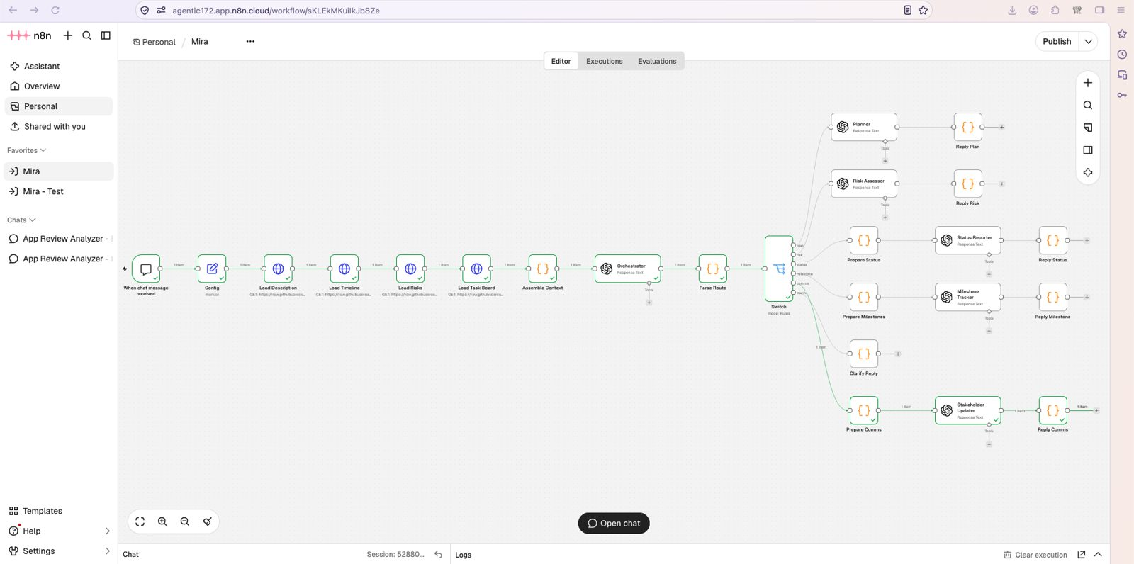
A router sends each request to one specialist and traces it
Router / Dispatcher pattern
Switch picks one of six branches
Every branch ends in one Langfuse trace
n8n workflow canvas

Slide 5
Four tools, each chosen for a reason
Tool | Role | Why
n8n Cloud | Workflow | Visual router, CSV loading, Code nodes for exact counts
OpenAI gpt-4o-mini | LLM | Cheap and fast for structured writing from supplied data
Langfuse | Observability | One trace per request with input, output and route
GitHub raw files | Data | Four project files, no authentication needed

Slide 6
All 12 tests pass with zero invented items
12 of 12
0
100%
tests pass
hallucinated items in 12 traced runs
task counts accurate
Task board: 5 Done, 3 In Progress, 1 Blocked, 16 To Do. All 4 vague inputs asked for more detail instead of guessing.

Slide 7
Tests exposed six problems, and each got a fix
Test | What went wrong | Fix
T1 | Plan missed the Week 1 start-date assumption | Prompt rule added
T3 | Unrequested top 3 risks printed | Answer only what was asked
T7 | Top 3 risks generic and inconsistent | Rank by task evidence
T10 | Blocker and To Do list missing | Pass description through; list every status
T12 | Overdue task missing under Risks | Rule added
Tracing | Legacy endpoint showed nothing | Moved to OTLP; added Final Reply node

Slide 8
A typical user costs about 20 cents a month
$0.00008
~$0.001
~$0.20
vague request (Orchestrator only)
heaviest request: status report, 25 tasks
per user per month
A typical day of 15 requests costs about $0.0093 (gpt-4o-mini, $0.15 per 1M input and $0.60 per 1M output tokens).

Slide 9
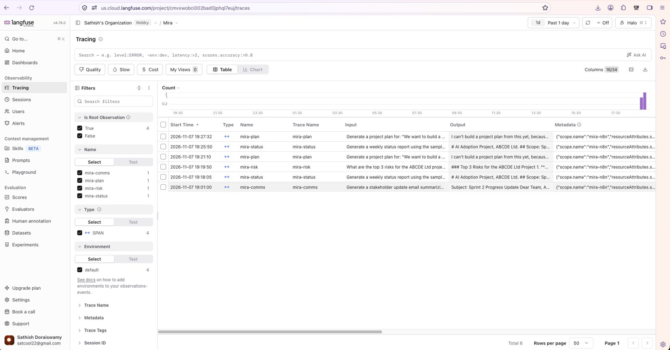
Every request leaves one trace, tagged by route
Input, output and route per request
Routes: mira-plan, risk, status, milestone, comms
Used to find and fix the failures

Slide 10
Rollout: pilot with 3 PMs, then widen behind a quality gate
Weeks 1 to 4: pilot with 3 PMs, every output reviewed
Weeks 5 to 8: expand to 10 PMs, live task board, approval step for emails
Week 9 onward: monthly metric review
Gate to widen: 0 fabricated items reaching a stakeholder, status accuracy 100%, satisfaction 4 of 5 or higher

Slide 11
Lesson: compute facts in code and let the model explain
The loop that worked: evaluate, find the failure, fix the prompt, re-run
Next: lower temperature for steadier answers
Next: code-ranked risks, automated regression tests
Next: live Trello connection and a human approval step

