Slide 1




Slide 2
Features Covered in Project / Problem Statement
Our web Application provides the following features
Has two users – one is Admin Kirana Merchant and Customers
It mainly consists of Banking,Loan,Insurance,Grocery modules
Services Provided by these modules:
    One stop solution for Bank Products
    Grocery Shopping
    Loan Payment
    Sell insurance
    Give Loan
    Transfer money
    Account Balance
    View Statement
Intuitive Catalogues for Kirana Merchants
Ratings and Review of Products
Secure Authentication and Authorization
Uses Open Source technologies

Slide 3
Solution Overview: Kirana Mode - One Stop Solution for Bank Products and other Services
The Web Application mode for Kirana Shop (KS) authenticates the KS as Agent to the IndusInd Bank. Once the KS has logged in, he accepts the Customer's Aadhar Number to login to access the customer account page. The KS can see the IndusInd SB Account and Loan Account of the customer. Based on the Service Request initiated by the customer , the KS provides Savings Account Inquiry, Loan Account Inquiry, Cash Withdrawal, Cash Deposit, Grocery Shopping, Bill / EMI Payment and Recharges.

Slide 4
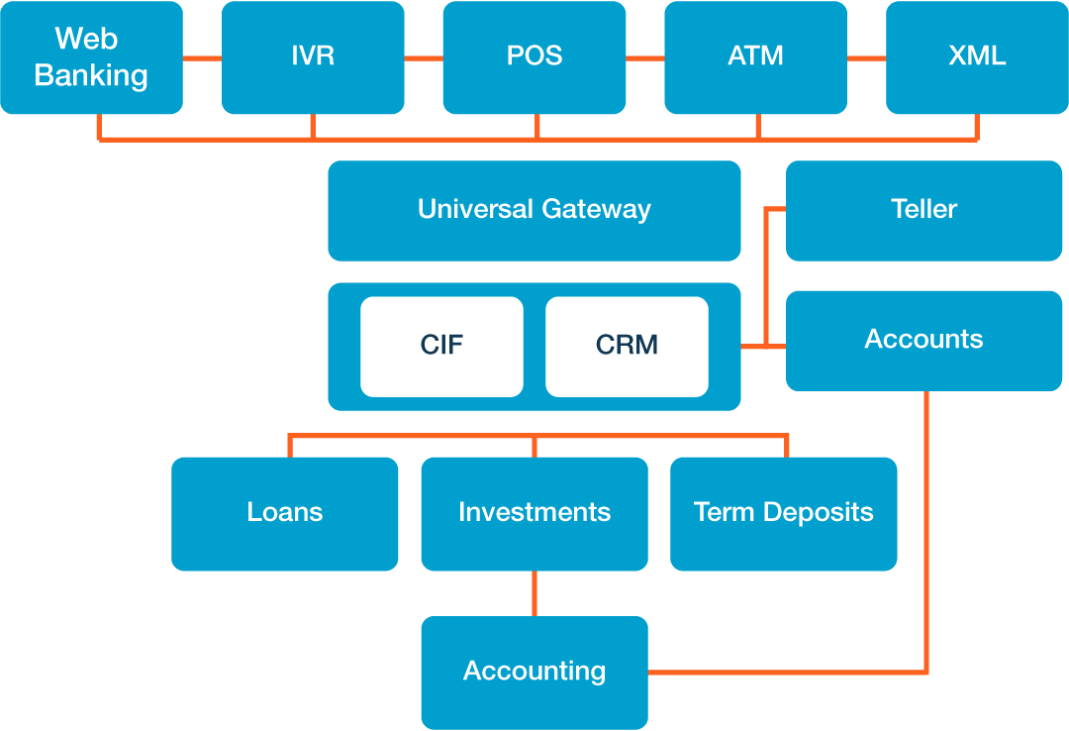
Overall Solution Architecture

Slide 5
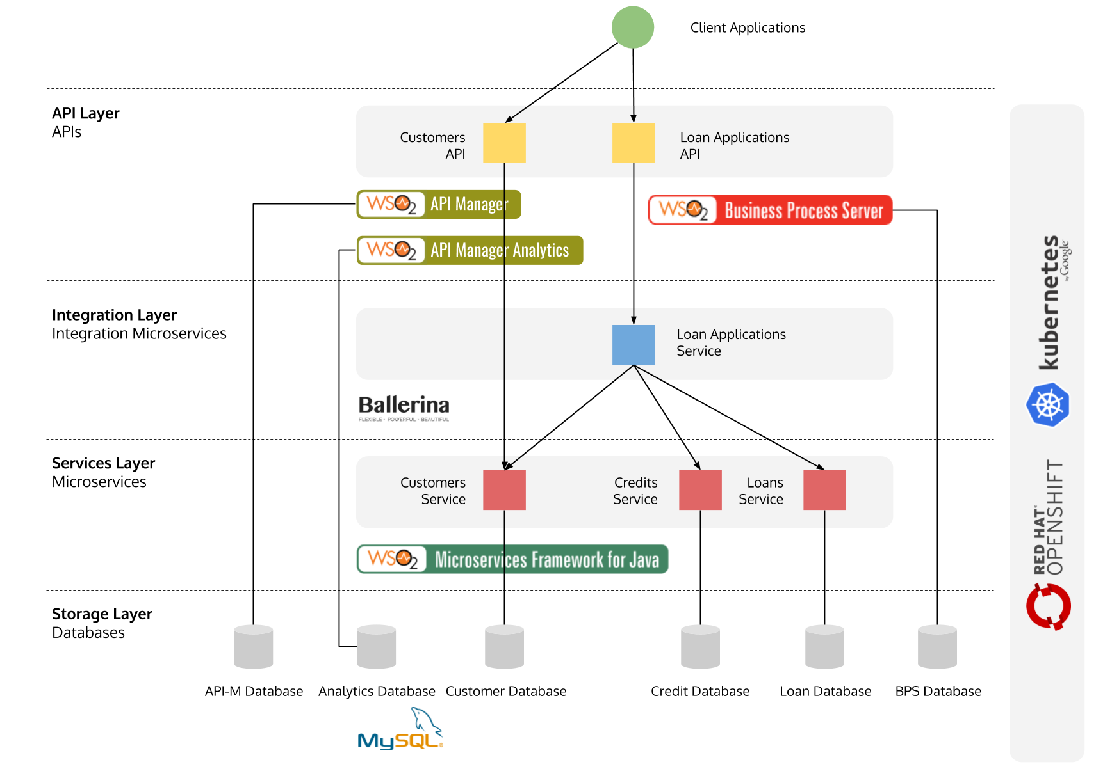
Solution Architecture of Loan Module
24/05/19

Slide 6
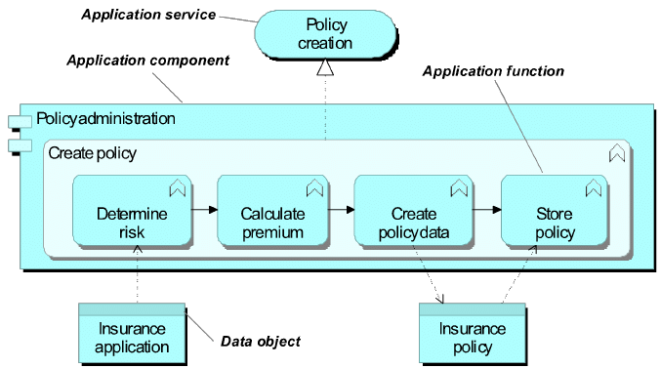
Solution Architecture of Insurance Module
24/05/19

Slide 7
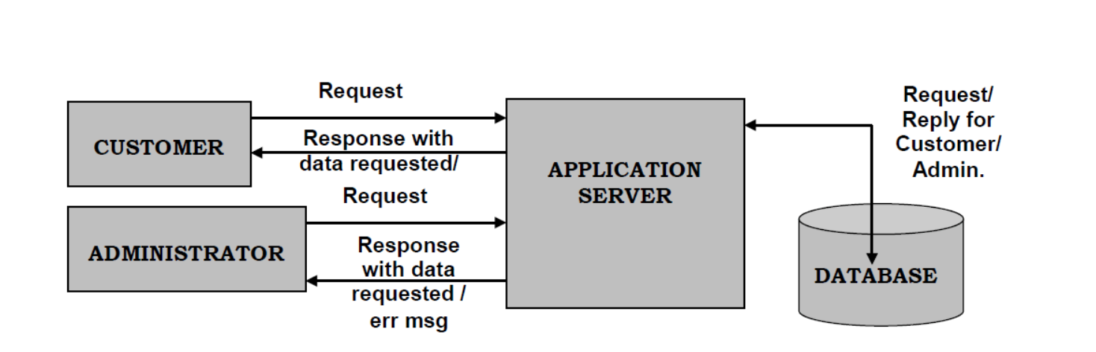
Solution Architecture of Banking Module
24/05/19

Slide 8
Data Collection/ Crawling: Kirana Merchant
From the Kirana Merchant, the following data can be collected
The customer preferences, favorite product, spend pattern, customer monthly budget, investment and risk profile, loan requirement.
Based on the data collected, the app should intuitively produce the catalogue to Kirana Shop for the particular customer being serviced.

Slide 9
Business Rule: Overview
Explanation of how customer journey will make customer authentication and transaction safe and convenient
Process of how information will be mashed up from different sources and considered for screening/credit decision

Slide 10
Solution Overview: Customer
Customer can review his Bank / Loan Account balance and the past Services availed.
Customer can rate and review the Kirana Shop based on the service provided and the satisfaction level of the shopping experience.
The map location services will provide the customer with nearby Kirana Shop in his locality.

Slide 11
Data Collection/ Crawling: Customer
The following data can be collected - the popular Kirana Shop destination for customers, profile of Customers visiting the Kirana Shop, Popular Services availed, trends in Products, facilities and infrastructure bottleneck.

Slide 12
Business Rule/Algorithms: Overview
Self Service Features - The user will get notifications of any new products , fast moving products and pre-order/order them.
Apps will have rating engine added to it from cloud subscription.
Location based services availability will be displayed on map services.
Analytics / ML will be subscribed from cloud based vendor.

Slide 13
Technologies and Frameworks Used
Front End-HTML5,CSS3,Javascript,Jquery,Bootstrap
Backend-Firebase
Application type-Web Application

Slide 14
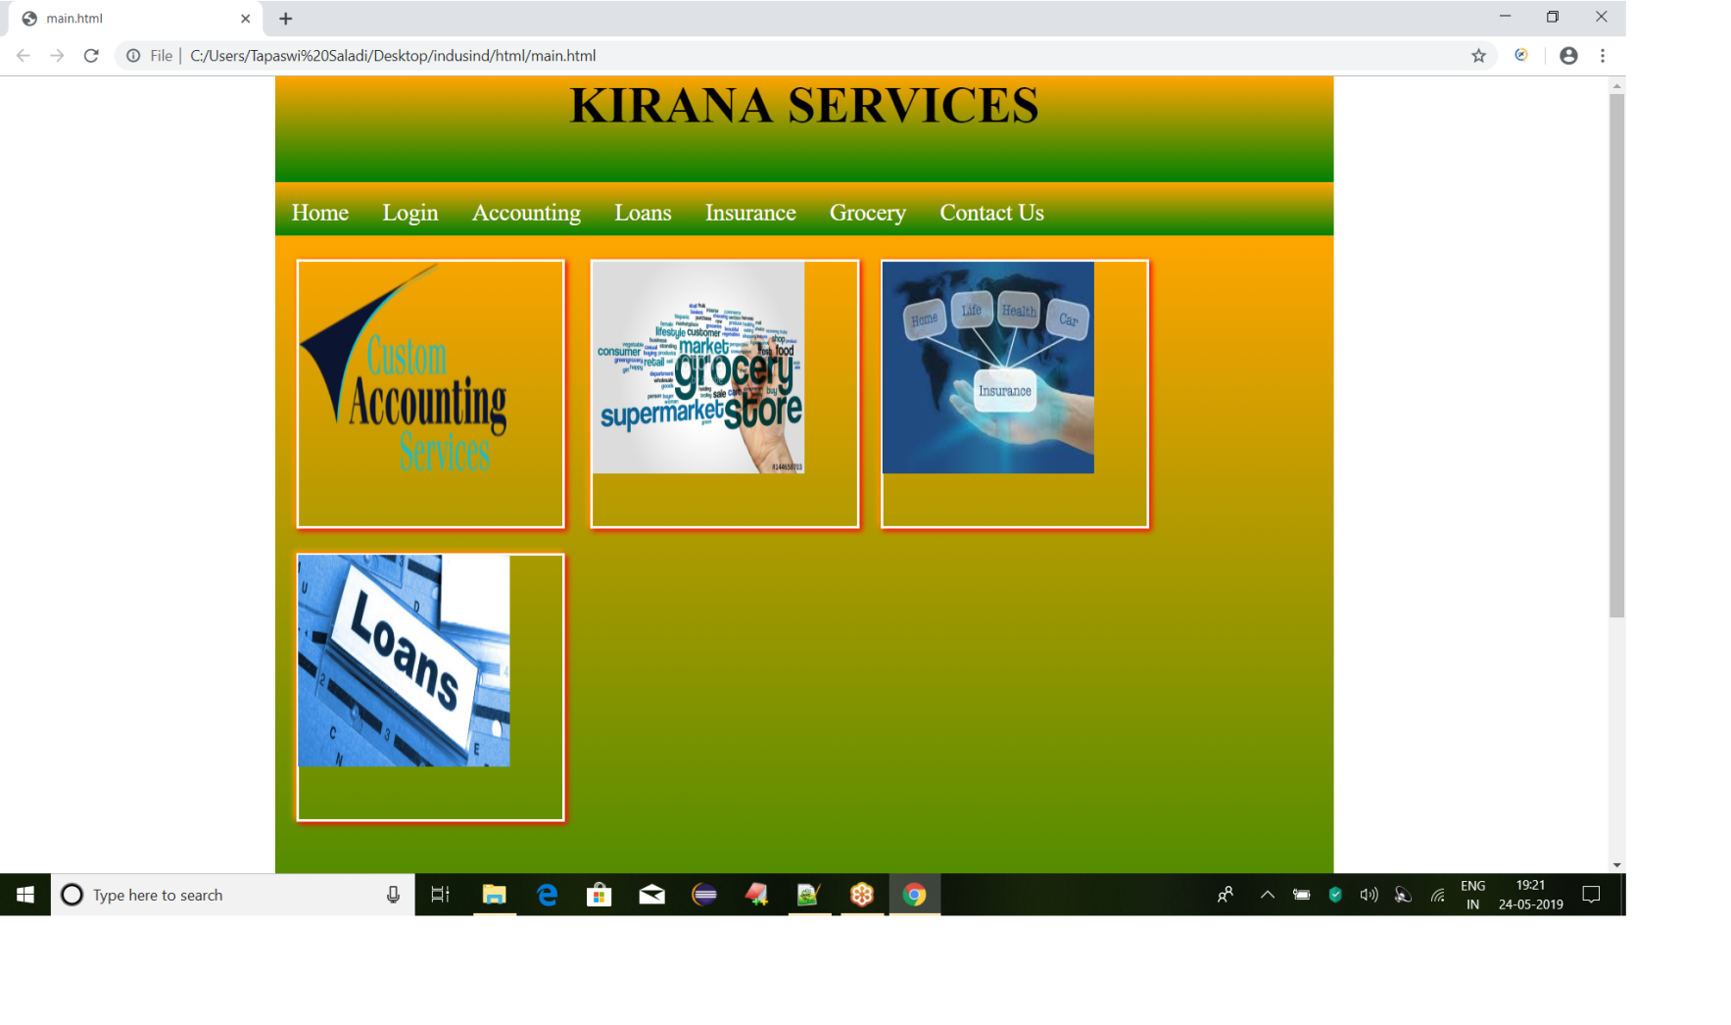
Screenshots of prototype developed:(Main Page of prototype)

Slide 15
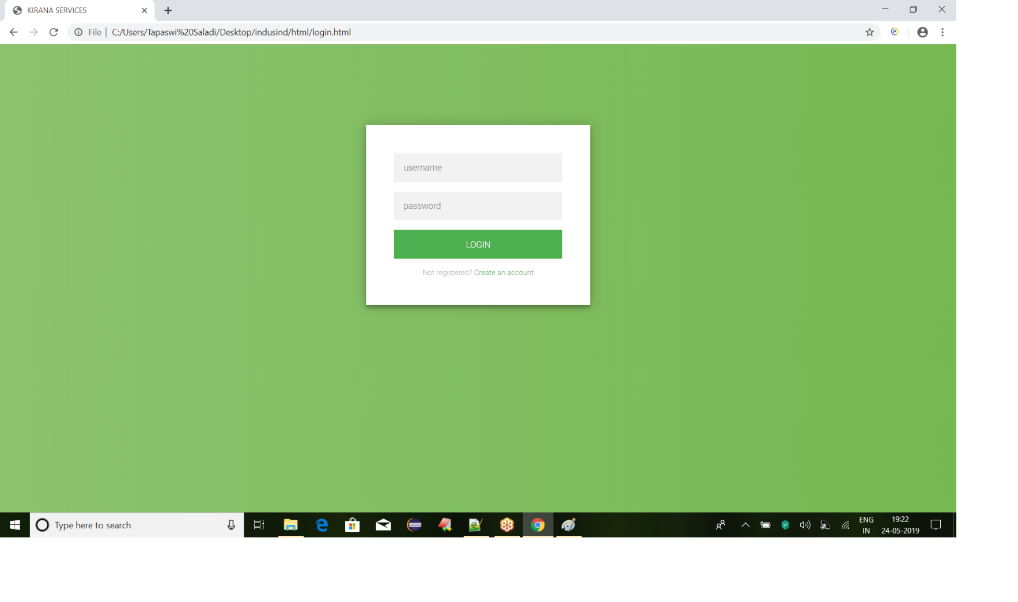
Login Page of Prototype

Slide 16
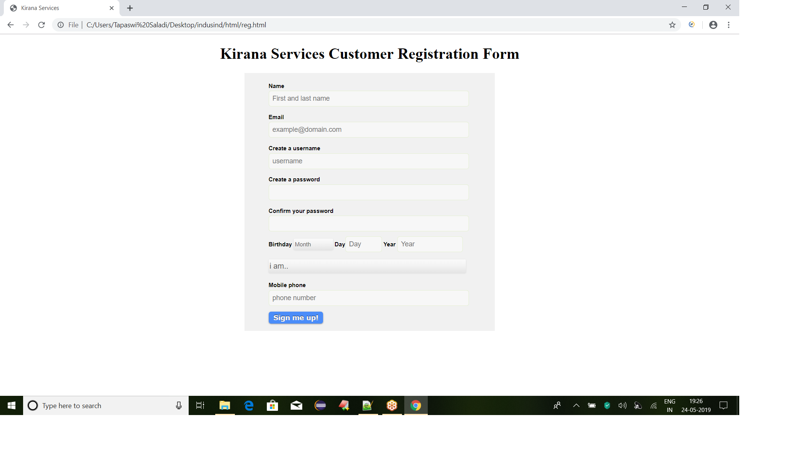
Customer Registration page of prototype
24/05/19

Slide 17
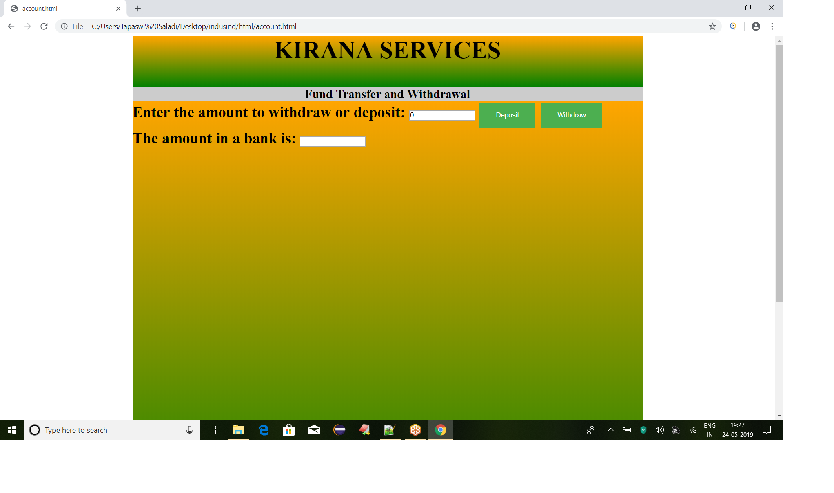
Page related to withdraw and deposit
24/05/19

Slide 18
Prototype Link
https://github.com/sateesh-kumar/Indusind.git

