Slide 1
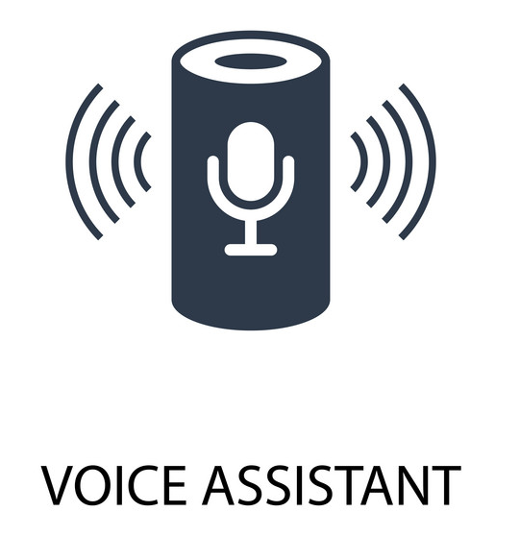
Virtual Desktop Assistant

Slide 2
Presented By:
Mr. Satej Balaso Patil (URN NO : 20131081)
Mr. Aniket Subhash Patil (URN NO : 20131074)
Mr. Satyajit Martand Jagadale (URN NO : 20131128)

Slide 3
Problem statement: . To create and develop a virtual desktop assistant application to perform basic tasks on the desktop to reduce human efforts and perform multitasking.
1. Ideal: To build an application to reduce human efforts and operate machines on voice commands. 2. Reality: To perform multiple tasks as per human commands. 3. Consequences: Only a few languages are understood by an assistant and While speaking with the assistant the noise in the surroundings must be low. Otherwise, fruitful results will not occur. 4. Proposal: The project aim is to design and develop an application that recognizes the human voice and perform tasks according to it

Slide 4
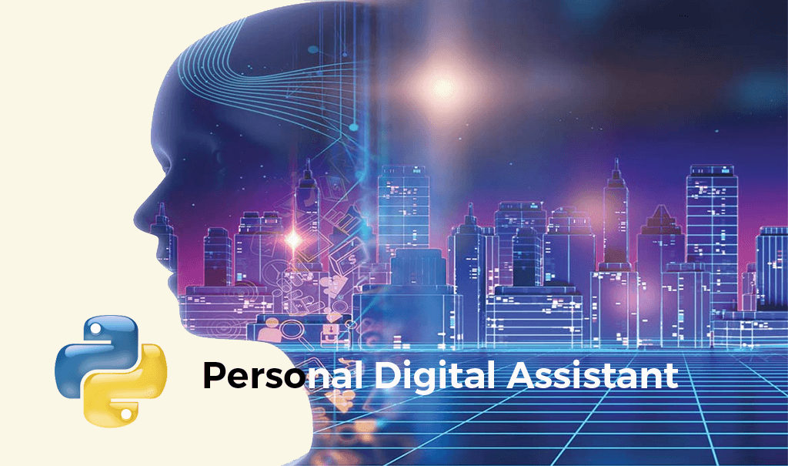

Slide 5
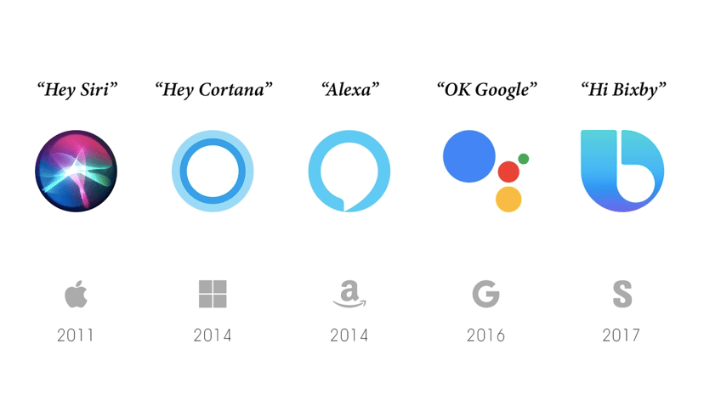
What is a Virtual Assistant?
A virtual assistant, also called an AI assistant or digital assistant, is an application program that understands natural language voice commands and completes tasks for the user.

Slide 6
Purpose:
The purpose of a virtual assistant is to be capable of voice interaction, music playback, setting alarms, streaming podcasts, playing audiobooks, and providing weather, traffic, sports, and other real-time information, such as news.

Slide 7
This application will take the voice as input through the microphone (Bluetooth and wired microphone) and it converts our voice into computer-understandable language and gives the required solutions and answers which are asked by the user. This application connects the world wide web to provide results. Natural Language Processing algorithm helps computer machines to engage in communication using natural human language in many forms. The reason behind starting this project was that data present on the web is sufficient and is openly available that can be used to build a virtual assistant that can make an intelligent decision for the user.

Slide 8
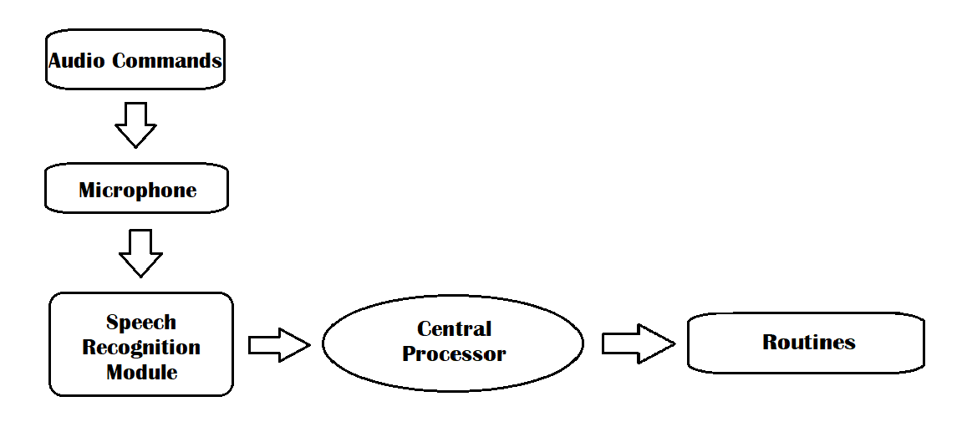
Workflow of the Basic Process:

Slide 9
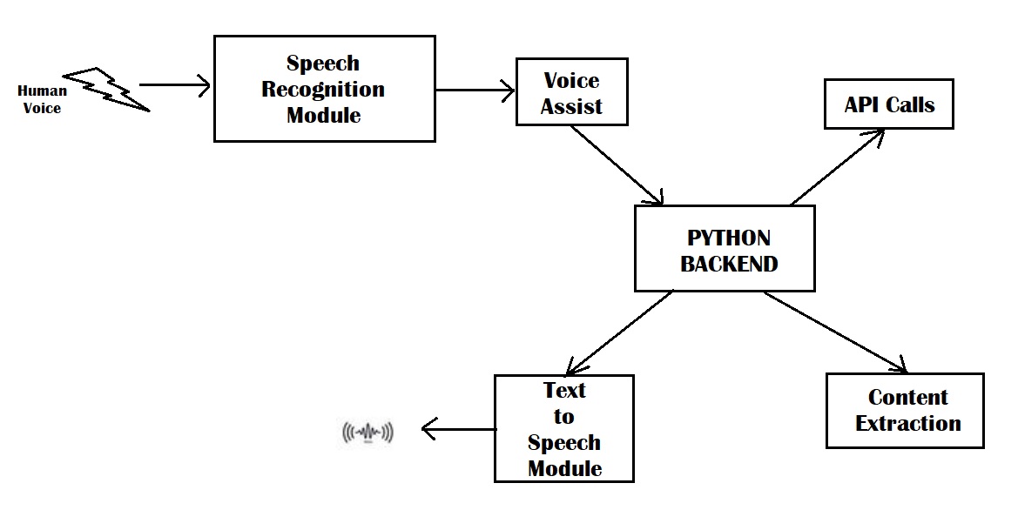
Detailed workflow:

Slide 10
Advantages:
1. This application reduces human efforts. 2. Multitasking is possible by using this application. 3. The virtual assistant can help to eliminate time-consuming tasks by performing them for you. 4. It controls various applications of devices. 5. The application will allow to export and import of data.

Slide 11
Functions:
Opens Google.
Sends E-Mail.
Plays Music.
Open all Office Apps.
Opens Chrome.
Opens Microsoft Edge.
Opens YouTube.
Opens Hackerrank.

