Slide 1

Face Recognition Attendance System
The Face Recognition Attendance System project represents a transformative endeavour at the intersection of technological innovation and educational enhancement. It aims to revolutionise traditional attendance management methods by harnessing advanced facial recognition technology and machine learning algorithms.
By automating the attendance capture process, this system liberates educators from the burdensome task of manual data entry, allowing them to redirect their time towards student engagement and academic support. The system's dedication to accuracy and reliability serves as a cornerstone in ensuring the integrity of attendance records within educational institutions.
Through its innovative approach and unwavering commitment to excellence, this project aims to usher in a new era of efficiency, effectiveness, and student success.

Slide 2
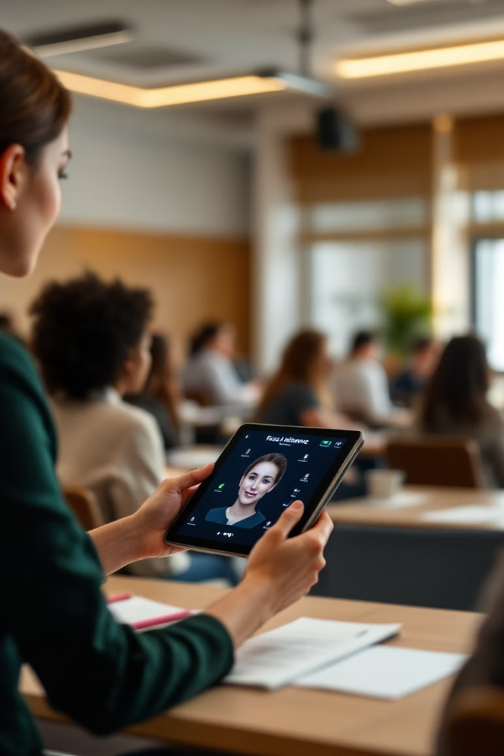




Motivation and Objectives
Enhance Efficiency
Traditional methods are time-consuming and prone to inaccuracies. With classrooms becoming increasingly larger, accurately recording attendance becomes tedious for teachers.
Ensure Accuracy
Manual processes are susceptible to errors and fraud, leading to unreliable attendance records. Advanced facial recognition technology provides greater reliability.
Real-time Insights
Traditional methods lack the capability to provide real-time insights into attendance patterns, hampering institutions' ability to monitor attendance effectively.
User-Friendly Design
The system aims to seamlessly integrate into existing institutional workflows, providing a solution that is both powerful and accessible to users.

Slide 3
Existing Attendance Systems
Manual Attendance Register
Biometric Systems
Involves marking attendance on paper. Highly time-consuming and prone to human errors. Easy to manipulate or forge.
Require physical contact for authentication. Can be affected by dirt, cuts, or moisture on fingers. Maintenance issues due to hardware wear and tear.
RFID Card Systems
Mobile App Check-ins
Attendance is marked by scanning an ID card. Cards can be lost, stolen, or used by someone else. Requires regular maintenance of RFID readers and cards.
Can be manipulated using location spoofing apps. Not reliable in poor GPS connectivity zones. Raises privacy concerns among users.
All these systems have limitations in terms of security, user-friendliness, and scalability. They often require physical interaction, making them less effective in post-pandemic or contactless environments.

Slide 4










Scope of the System
Secure Storage
Automated Recording
Store attendance data in a secure database with robust protection measures.
Record attendance of individuals automatically using facial recognition technology.
Reporting
Generate comprehensive reports for specific timeframes and departments.
Analytics
Provide administrative insights and analytics dashboards for attendance trends.
Scalability
Support multiple departments or classes within a single institution and be deployable across distributed campuses.

Slide 5





Key Features
Face Recognition
Face Similarity Scoring
Machine Learning Integration
Identifies and matches faces from a dataset using deep learning-based facial recognition. Supports real-time and batch processing of face images.
Computes similarity between two or more faces based on extracted facial features. Uses cosine similarity or Euclidean distance for measuring facial resemblance.
Employs deep learning models like Convolutional Neural Networks (CNNs) and Siamese Networks for feature extraction. Utilizes pre-trained models like FaceNet, Dlib, and OpenCV.
Real-time Processing
Capable of processing and recommending faces in real-time using optimized face detection and recognition techniques. Supports live camera feeds and video streams.

Slide 6
Feasibility and System Design
Technical Feasibility
Economic Feasibility
Operational Feasibility
Utilizes mature and reliable technologies like OpenCV and Python that are widely supported and documented. Compatible with various hardware and software platforms, making it highly adaptable.
Significantly reduces the cost compared to traditional biometric devices which require expensive hardware. Development cost is minimal due to the use of open-source tools and libraries.
Easy-to-use system with a minimal learning curve for staff and administrators.
Can be deployed in educational institutions, businesses, and remote settings.
Lower maintenance cost since the system requires only standard computing equipment. Automation leads to long-term savings by reducing administrative overhead.
Scalable architecture allows deployment across multiple branches or departments. Integration with machine learning libraries enables continual improvement in accuracy.
Supports automation of routine tasks like report generation and data backup.
Enhances accountability and transparency in attendance monitoring.
Reduces chances of proxy attendance and manual errors.

Slide 7
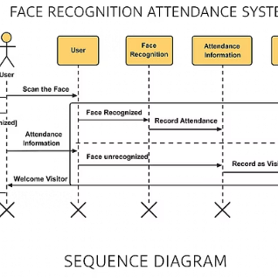
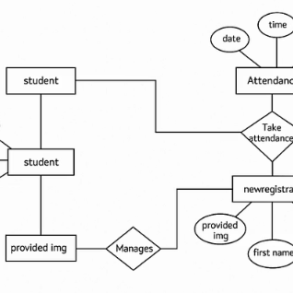
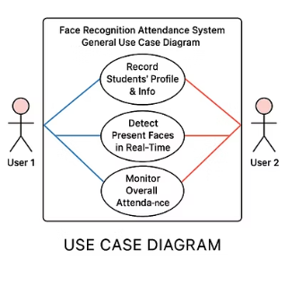
System Architecture
The system architecture illustrates the comprehensive workflow of the Face Recognition Attendance System. It showcases the integration of various components including image capture, preprocessing, feature extraction, and database management.
The diagrams demonstrate how facial data flows through the system, from initial capture to final attendance recording. The architecture is designed to be scalable and adaptable, allowing for deployment across various institutional settings while maintaining robust performance and security.
Each component has been carefully designed to work in harmony with others, ensuring efficient processing and accurate recognition even in challenging environments.

Slide 8





System Limitations and Drawbacks
Technical Challenges
Camera quality dependency and lighting conditions impact
Infrastructure Dependencies
Network reliability and initial setup costs
Privacy Concerns
Biometric data storage and compliance requirements
Algorithmic Limitations
System bias and false positives/negatives
Environmental Factors
Performance in crowded areas and outdoor settings
The system faces challenges related to environmental conditions such as inconsistent lighting, which can significantly reduce recognition accuracy. Facial obstructions like masks or sunglasses can obscure features, making authentication difficult. Additionally, the system's effectiveness depends heavily on camera quality and network reliability.
Privacy concerns regarding biometric data storage must be addressed to comply with regulations like GDPR. The system may also exhibit bias toward specific demographic groups, resulting in unequal accuracy across different populations.

Slide 9



Conclusion
Technological Achievement
Successfully implemented Haar cascade classifier and frontal facial recognition
Challenge Navigation
Overcame lighting variations and facial occlusions
Continuous Improvement
Room for enhancement in algorithms and system performance
Our project represents a significant leap forward in attendance management systems through the creation of an Automatic Face Recognition Attendance Management System. By harnessing sophisticated technologies such as the Haar cascade classifier and frontal facial recognition algorithm, we have successfully showcased the system's robust capabilities in detecting and recognizing individual students' faces from video frames.
Throughout implementation, we encountered and navigated through challenges ranging from variations in lighting conditions to facial occlusions. Through our relentless pursuit of innovation, we integrated advanced image processing techniques that bolstered the system's accuracy and reliability across diverse environmental conditions.

Slide 10




Future Enhancements
Advanced Algorithms
Multi-modal Biometrics
AR/VR Integration
Improved AI Models
Exploring deep learning approaches for more sophisticated and adaptive recognition capabilities, particularly in challenging conditions.
Integrating fingerprint or iris recognition to enhance the system's security and reliability.
Implementing augmented reality for enhanced user experience and system interaction.
Experimenting with Swin Transformers and Vision Transformers (ViTs) for higher accuracy in recognition.
Despite the achievements of our project, there are several areas for future exploration and enhancement. One potential avenue is the further refinement of face detection and recognition algorithms to improve performance in challenging conditions.
Optimizing the system for real-time performance and improving the user interface could facilitate easier adoption by educators and administrators. By addressing these key areas of improvement, we can contribute to the ongoing evolution of attendance tracking technology, ultimately benefiting educational institutions as a whole.

