Slide 1
파이썬 형성평가
김태헌

Slide 2
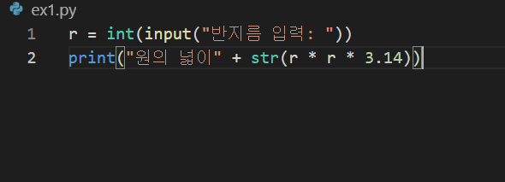
1번문제(ex1.py)

Slide 3
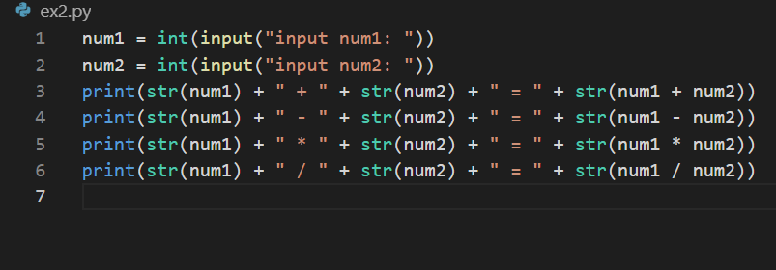
2번문제(ex2.py)

Slide 4
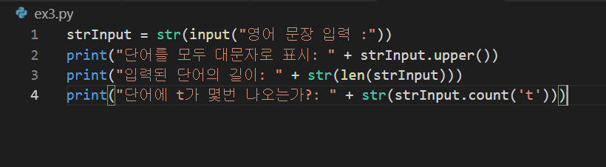
3번문제(ex3.py)

Slide 5
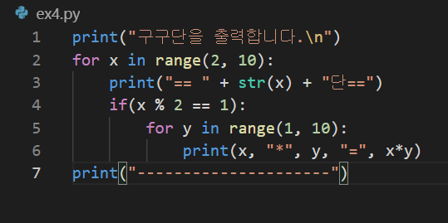
4번문제(ex4.py)

Slide 6
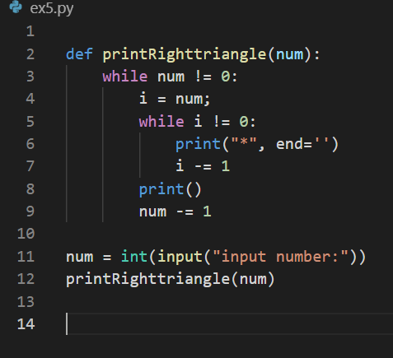
5번문제(ex5.py)

Slide 7
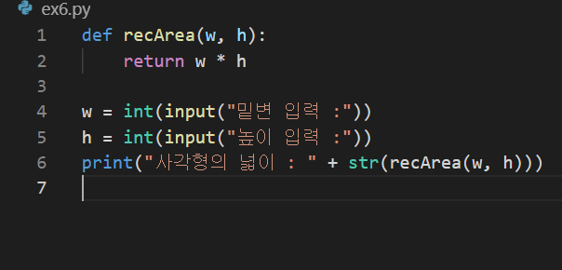
6번문제(ex6.py)

Slide 8
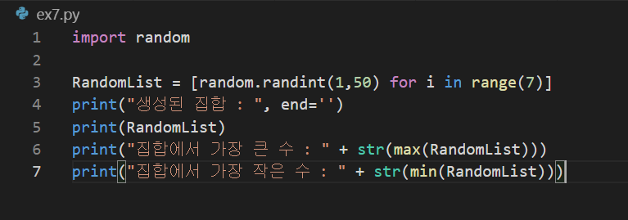
7번문제(ex7.py)

Slide 9
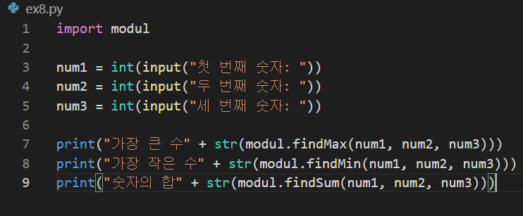
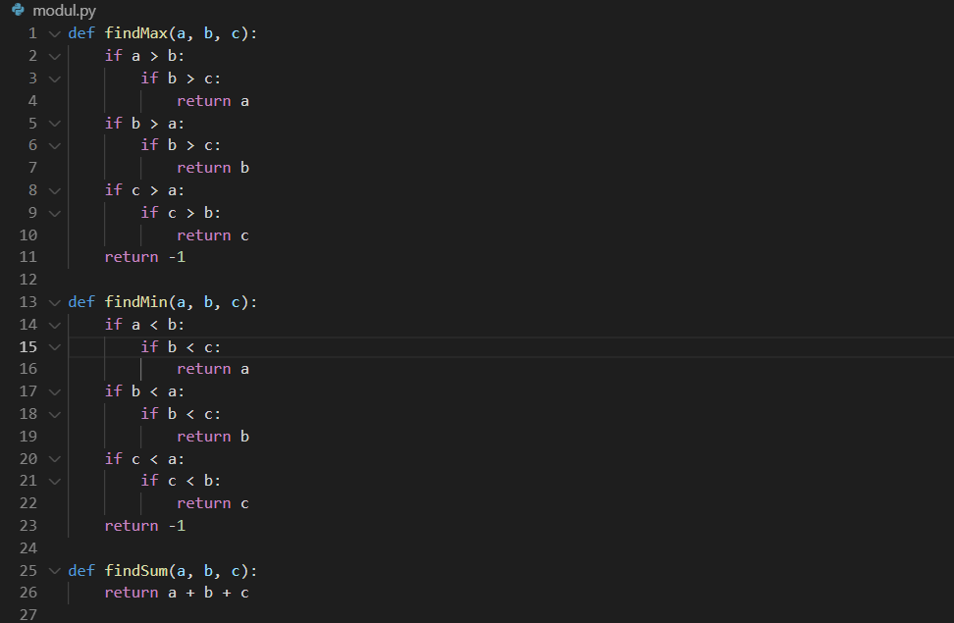
8번문제(ex8.py)

Slide 10
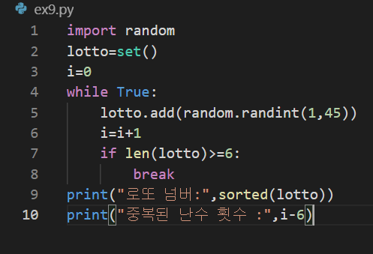
9번문제(ex9.py)

Slide 11
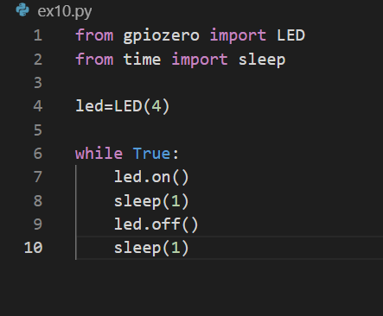
10번문제(ex10.py)

