Slide 1




Spin your business
From SPACE to EARTH
From EARTH to SPACE
esabic.fi
Kimmo Isbjörnssund
ESA Business Incubation Centre Finland

Slide 2


ESA BUSINESS INCUBATION CENTRES
WHAT
To help member state start-ups build successful space business opportunities
Programme managed by ESA’s Technology Transfer Programme Office (TTPO)
“Spin-in and Spin-off”
We provide start-ups with initial funding, contacts, technical and business support
6-24 months incubation

Slide 3
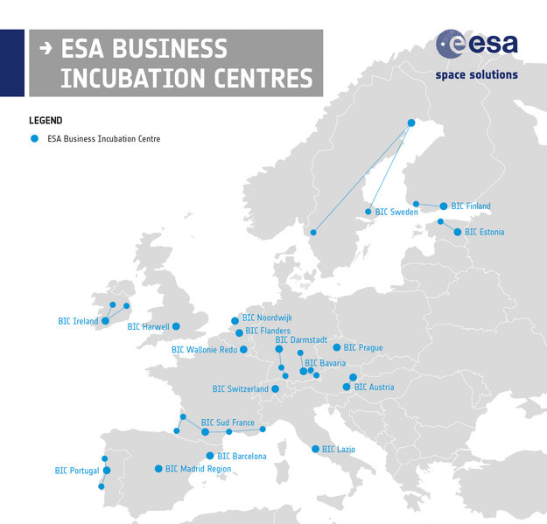
ESA BUSINESS INCUBATION CENTRES
WHERE
ESA BIC Noordwijk
ESA BIC Darmstadt
ESA BIC Lazio
ESA BIC Bavaria
ESA BIC Harwell
ESA BIC Redu
ESA BIC Flanders
ESA BIC Sud France
ESA BIC Barcelona
ESA BIC Portugal
ESA BIC Madrid
ESA BIC Sweden
ESA BIC Prague
ESA BIC Austria
ESA BIC Ireland
ESA BIC Switzerland
ESA BIC Estonia
ESA BIC Finland
Greece (to be opened)
15 countries,
18 centres
140 new start-ups
per year
Over 500
Graduated
Start-ups

Slide 4

ESA BIC FINLAND
Founded 2017
SITES
Main: Aalto University
SatelliteTurku Science Park
Turku Site

Slide 5



















OUR PARTNERS
esabic.fi

Slide 6
OUR OFFER
Incentive Funding up to 50.000 EURO for product development and IPR
Access to venture capital partners and business development loans
Up to 80 hours of technical support by world-class partners
Financial and Administrative support (e.g. office space, mentoring, business planning)
Business matchmaking, market testing, marketing advice, labs and other facilities
Right to use the ESA BIC brand to promote your business
Access to the international ESA BICs community

Slide 7
10 start-ups/year
ACCESS CRITERIA TO ESA BIC FINLAND
Innovative product or service uses space tech or
proposes new solutions for space (Spin-off or Spin-in)
Company registered in Finland & less than 5 years old
Resident in Finland / will be resident in Finland
Company HQ at ESA BIC Finland during incubation
Company is an SME by EU definition
Company fullfils the EU De Minimis aid limits
Funding granted for IPR and product development
esabic.fi

Slide 8
ESA BUSINESS INCUBATION PROGRAMME
FUNDING (NO EQUITY), LOANS
TECHNICAL AND BUSINESS SUPPORT
OFFICE SPACE
ESA CONTACTS
BUSINESS OPPORTUNITIES
ESA BIC EUROPEAN NETWORK
Spin your business
From SPACE to EARTH
From EARTH to SPACE
First Call Opening by early February
esabic.fi

