Slide 1

Drone Fish
Satender Kumar Tiwari
Department of Information Technology
2nd Year
ABES Engineering College , Ghaziabad

Slide 2
Table of contents
1 ) Introduction Of The Project.
2 ) Brief Technical Aspects.
3 ) Relevance To Indian Navy.
4 ) Prospective Implementation Requirements.
5 ) Conclusion.

Slide 3
Introduction of the project
=> My Idea consist of Following three parts:
1 . Rechargeable Drone Fish.
2 . Drone Fish to Deploy Explosives.
3 . Drone Fish as SONAR detector.

Slide 4
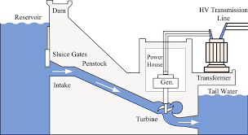
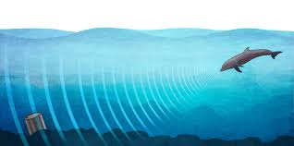
Brief Technical Aspects
=> Hydro Power Generation using Turbine => Sound Navigation And Ranging
In this process of generation of electricity,
The flow of water apply a torque force on
turbine blade which force him to rotate and
start moving.
This turbine converts the mechanical energy
of water to electrical energy.
This turbine is directly attached to the power
battery of Drone Fish which results in enhancing
the battery backup up to some extent.
( SONAR )
is a technology that uses acoustical waves to sense the location of objects in the ocean.
The simplest sonar devices send out a sound pulse from a transducer, and then measure the time it takes for the sound pulses to be reflected back to the transducer.
We use sonar directly in Drone Fish to enhance the precision in detection.

Slide 5
Relevance to Indian Navy
It enhances the battery backup of Drone Fish up to some extent which is a major problem Indian Navy faced on their mission.
we can also implement this technique on underwater Submarine’s surface to generate electricity.
We use Drone Fish to deploy the explosives on enemy’s side without having any physical causalities of soldiers.
After using sonar on Drone fish’s eyes , we can precisely verify the small , complex obstacles.

Slide 6
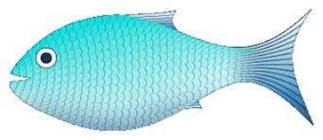



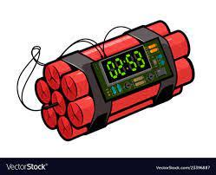
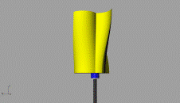
Prospective implementation requirements
We place a Time Bomb at Drone Fish Stomach After getting touch with enemy’s ship we can swells out this bomb on its surface and came back .
Then we explode the explosive through remote control at our submarine safely.
At same time we can place a sonar transducer at Drone Fish’s eyes to take precision measurement about the complex obstacles .
As illustrated in above image .
We place a Turbine at Drone Fish Tale which is Directly connected to power battery .
As , illustrated in above image .
When the flow of water apply the force on Turbine blades it start moving due to which
Battery start recharging .
In this way we can , Enhance the Battery Backup of our Drone Fish .

Slide 7
Conclusion
This Project solves the major problem faced by Indian Navy i.e. limited power supply up to some extent .
Conclusive Point :
=> Combination of three Ideas illustrated will results a better and efficient Drone Fish .
=> This project would provide a precise & reliable information about
the obstacles , which helps the officer take more appropriate decision .

