Slide 1



SMART INDIA HACKATHON 2026
SAMUDRA -3D
  Problem Statement ID: SIH26067
  Problem Statement Title: Develop a web-based, interactive 3D visualization platform that integrates numerical ocean model outputs and in situ observations.
  Theme: Disaster Management
  PS Category: Software
  Team ID:
  Team Name: Nexus Nova

Slide 2
SAMUDRA-3D
3D Ocean Digital Twin Platform
Nexus Nova
Proposed Solution :
  SAMUDRA-3D Platform: Browser-based 3D Ocean Digital Twin with no installation.
  Ocean Data Visualization: Shows temperature, salinity, and ocean currents in 3D.
  Instrument Tracking: Displays paths of Argo floats and underwater gliders.
  Interactive Workspace: Combines ocean data and maps into a single, smooth 3D environment.
Addressing the problem :
  Unified Data: Combines ocean models and real-time instrument data in one place.
  Quick Validation: Easily compares model predictions with real ocean measurements.
  No Installation: Works directly in common web browsers.
  Low Hardware Needs: Does not require expensive GIS software or powerful computers.
2
Notes:
2

Slide 3
Nexus Nova
TECHNICAL APPROACH
  3D Ocean Visualization: Three.js/CesiumJS creates an interactive 3D ocean using latitude, longitude, and depth. Users can rotate, zoom, and explore the ocean.
  Ocean Data Processing: Python + xarray processes large NetCDF datasets, while FastAPI sends only the required data to the browser.
  Sensor Integration: Argo and Glider sensors appear as clickable points; selecting one displays its temperature and salinity data as charts.
  Interactive Analysis: Users can switch between Temperature, Salinity, and Currents, change depth, play time-based animations, and compare model data with sensor observations.
3
Notes:
3

Slide 4
FEASIBILITY AND VIABILITY
Nexus Nova
Challenges
Solutions
Huge 3D Data & Slow Web Performance
  Ocean models contain massive datasets that are slow to load and can overload browsers.
Different Model & Sensor Data
  Models use regular grids, while sensors follow irregular paths, making comparison difficult.
Different Formats & Data Quality
  Ocean sensors provide data in different formats with missing or unreliable readings.
  Load only the required data using chunking, LOD, and GPU rendering.
  Use spatial indexing and interpolation to match model data with sensor observations.
  Standardize data formats and automatically filter poor-quality measurements using QC flags.
4
Notes:
4

Slide 5
IMPACT AND BENEFITS
Nexus Nova
Target Users & Impact
  Ocean Forecasters: Faster 3D visualization and easier model-vs-observation comparison.
  Disaster Management: Faster assessment of cyclones, storm surges, and coastal risks.
  Researchers: Better understanding of subsurface ocean conditions.
  Students & Policymakers: Simple, interactive visualization of complex ocean data.
Key Benefits
  Fisheries: Better fishing-zone identification, saving time and fuel.
  Navigation & Rescue: Improved route planning with real-time ocean current data.
  Environment: Early detection of marine heatwaves and faster pollution-spill response.
  Cost & Scalability: Free/open-source solution with low infrastructure requirements.
5
Notes:
5

Slide 6
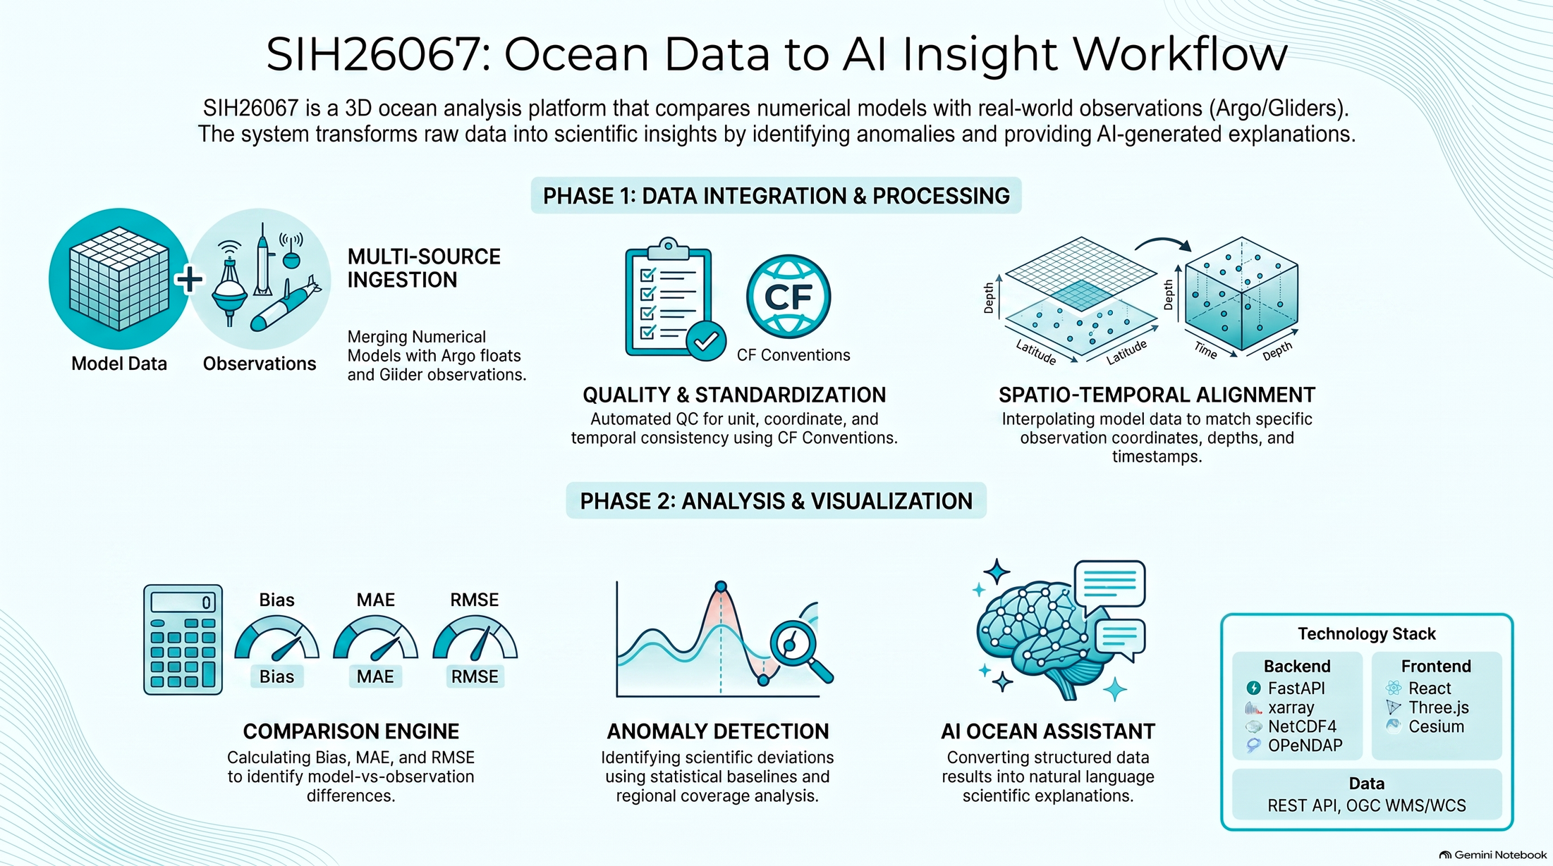
Nexus Nova
SYSTEM WORKFLOW
6
Notes:
6

Slide 7
Nexus Nova
RESEARCH AND REFERENCES
INCOIS Live Access Server (LAS):
  URL: https://las.incois.gov.in/
Copernicus Marine Service (CMEMS):
  Product ID: GLOBAL_MULTIYEAR_PHY_001_030
  URL: https://data.marine.copernicus.eu/
Argo Global Data Assembly Centre (GDAC):
  FTP: ftp://ftp.ifremer.fr/ifremer/argo
OceanGliders Global Data Repository:
  FTP: ftp://ftp.ifremer.fr/ifremer/glider/v2/
6
Notes:
6

