Slide 1



Understanding Big Data
Welcome to the expansive world of big data, where the tsunami of information generated every second transforms the landscape of technology and business. Let's embark on a journey to understand the complex facets of big data and how they are reshaping the future.
by sathar gullapalli

Slide 2
The Three V's of Big Data
1
2
3
Volume
Velocity
Variety
Reflecting the massive amount of data generated across the globe, volume stands tall as a fundamental characteristic of big data.
The rapid rate at which data flows into repositories marks the velocity of big data, from social feeds to sensor outputs.
The diverse forms of data, structured to unstructured, constitute the variety, adding complexity to data processing.

Slide 3
Volume Challenges and Opportunities
Storage Solutions
Data Engineering
Data Valuation
Conquering the immense volume of data requires advanced and robust storage solutions to keep pace with the ever-growing datasets.
Data engineering crafts the architecture that not only supports the volume but also allows for intelligent management and retrieval.
The enormous volume holds untapped potential for insights, demanding cutting-edge analytical tools for data valuation.

Slide 4
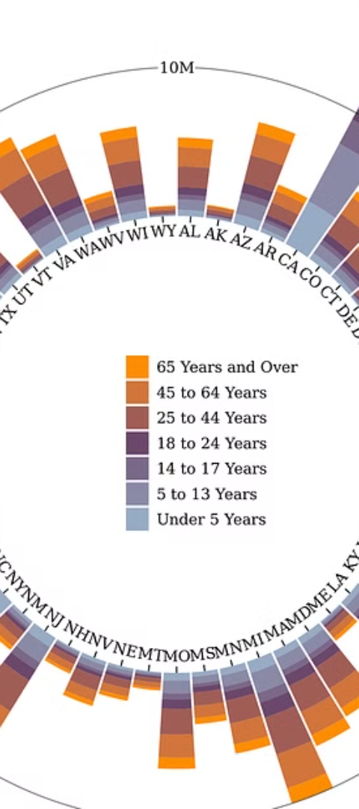



Keeping Pace with Velocity
Real-Time Processing
Technologies like stream processing ensure that the velocity of incoming data is matched by prompt analysis and action.
Ingestion Frameworks
A framework that can handle multiple data streams simultaneously is essential to manage velocity.
Instant Insights
Businesses aim to convert the speed of data into instant insights for competitive advantage.

Slide 5
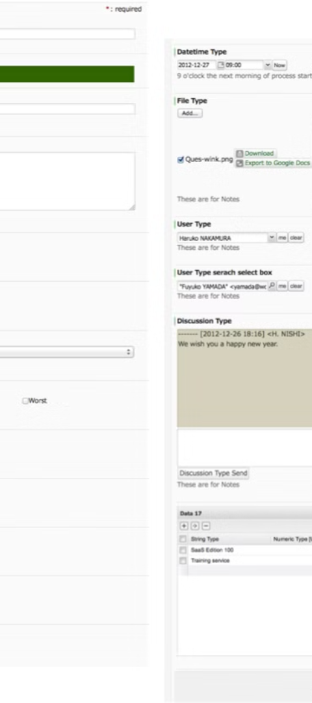
Navigating Data Variety
1
Structured Data
Relational databases provide organized data ready for analytical processing.
2
Semi-Structured Data
XML and JSON formats offer flexible structure, bridging the gap between structured and unstructured.
3
Unstructured Data
Natural language processing (NLP) and computer vision help interpret text and images, two common forms of unstructured data.

Slide 6
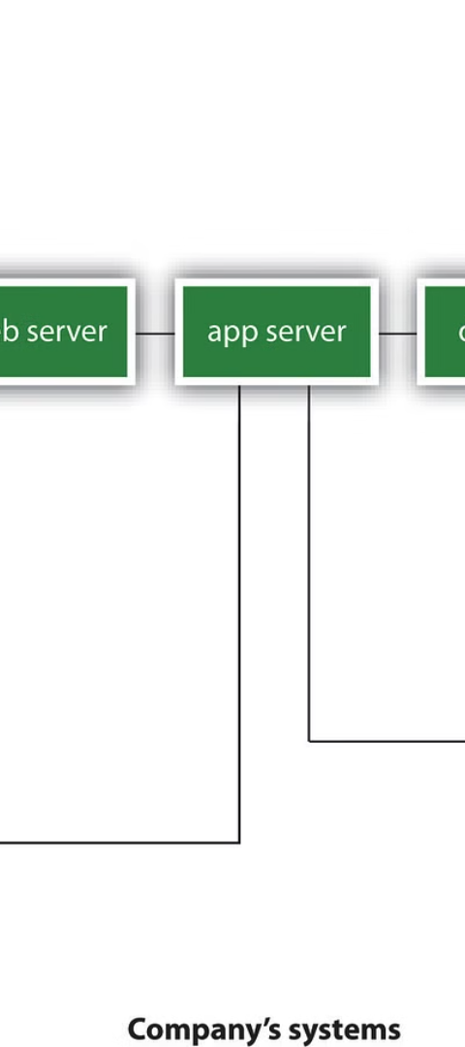
Essential Features of Big Data Solutions
1
Scalability
2
Parallel Processing
Big data solutions must scale out to accommodate the explosive growth in data without performance loss.
Dividing tasks across systems, parallel processing makes data analysis scalable and efficient.
3
Distributed Computing
The heart of big data, distributed computing spreads data and tasks across a network of interconnected nodes.

Slide 7
Big Data Analytics & Mining
Advanced Analytics
Machine Learning
Data Mining Techniques
High-level tools uncover deep patterns in data, powering predictive modeling and decision support systems.
Machine learning algorithms learn from data, automating complex analytical tasks and generating insights.
Data mining digs beneath the surface to discover hidden correlations and trends that inform strategy.

Slide 8

Data Storage Solutions for Big Data
HDFS
NoSQL Databases
The Hadoop Distributed File System (HDFS) allows big data to be stored redundantly across multiple nodes, ensuring data safety and accessibility.
Wait-free and schema-less, NoSQL databases offer flexibility and performance for various types of data.
Cloud Storage
Cloud storage services provide scalable, on-demand data storage solutions with global accessibility.

