Slide 1
Clustering: Exercises

Slide 2
Exercise 1 Theoretical Questions

Slide 3
Theoretical Questions
What is the difference between k-means and k-medoids? Give a typical data definition, where one of the two is not applicable
Name two quality measures for k-means / k-medoid clustering. Include a short definition and explanation of both.
Can these two quality measures be used to determine the k in k-Means? Why?
The Expectation Maximization algorithms has the drawback that it can converge to a local maximum likelihood:
Why is it a drawback?
Why is a local maximum bad?
Why can the local maximum happen?

Slide 4
1. k-Means and k-Medoids
What is the difference between k-means and k-medoids?
Give a typical data definition, where one of the two is not applicable
In k-means the central point is calculated as the mean of all points in the cluster. This center is usually not a real data point in the training set.
In k-medoids the central point is that one point, located most centrally in the cluster, that is having the smallest distance to all other points in the cluster. This central point is called medoid and is a real data point in the training set.
If the mean of a data set cannot not calculated, then k-means cannot be used. In this case, k-medoids can be used.
This is the case of categorical data, e.g. where an attribute contains strings. We cannot calculate its mean value. We could define a distance function, e.g. 1 for equal strings and 0 otherwise. But there is no mean value.

Slide 5
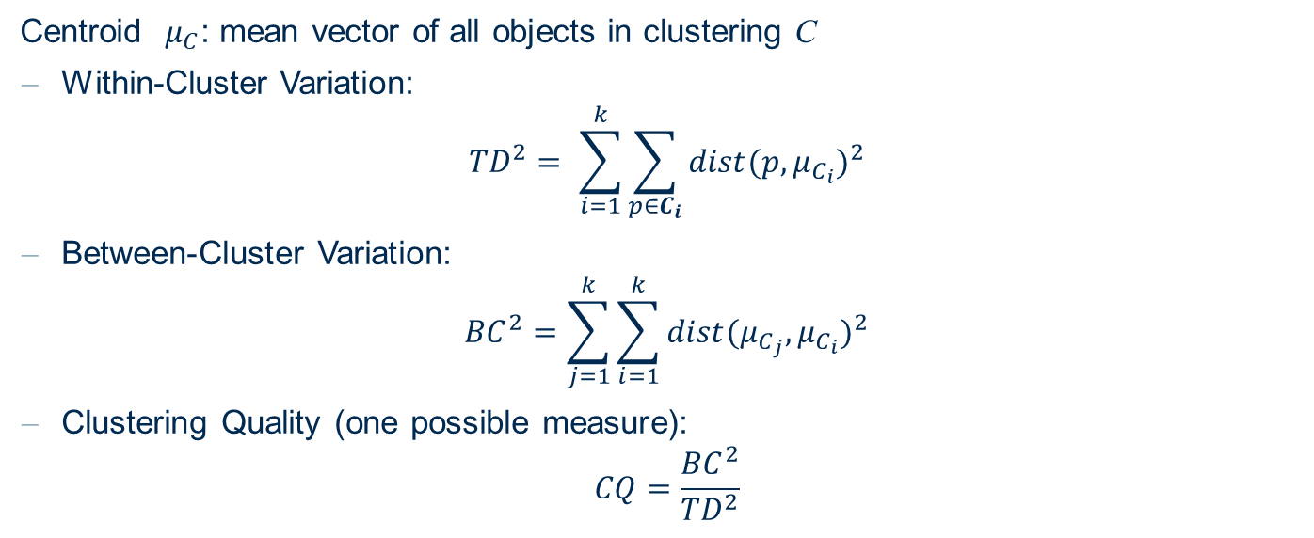
2. Cluster Quality Measures
Name two quality measures for k-means / k-medoid clustering. Include a short definition and explanation of both.
Centroid $μ_{C}$: mean vector of all objects in clustering C
Within-Cluster Variation:
$${TD}^{2}= \sum_{i=1}^{k}{\sum_{p∈C_{i}}{{dist(p, μ_{C_{i}})}^{2}}}$$
Between-Cluster Variation:
$${BC}^{2}=\sum_{j=1}^{k}{\sum_{i=1}^{k}{{dist(μ_{C_{j}}, μ_{C_{i}})}^{2}}}$$
Clustering Quality (one possible measure):
$$CQ=\frac{{BC}^{2}}{{TD}^{2}}$$

Slide 6
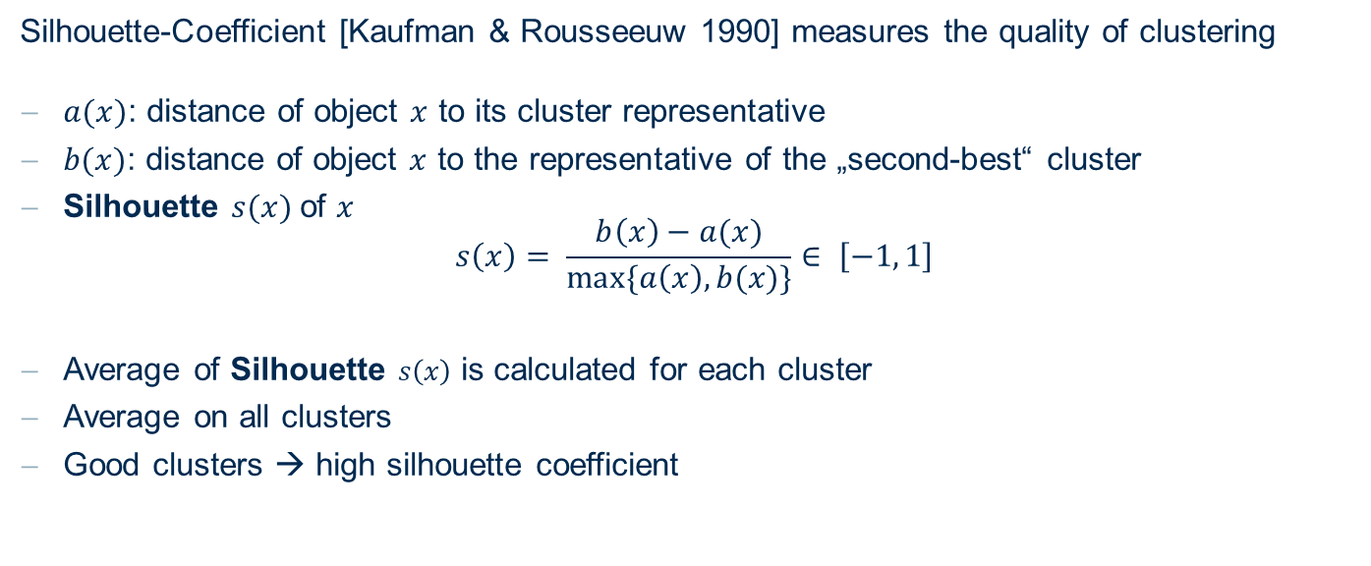
2. Silhouette-Coefficient for object $x$
Name two quality measures for k-means / k-medoid clustering. Include a short definition and explanation of both.
Silhouette-Coefficient [Kaufman & Rousseeuw 1990] measures the quality of clustering
$a(x)$: distance of object $x$ to its cluster representative
$b(x)$: distance of object $x$ to the representative of the „second-best“ cluster
Silhouette $s(x)$of $x$ $s\left(x\right)= \frac{b\left(x\right)−a(x)}{max⁡\{a\left(x\right),b(x)\}}∈ \left[−1, 1\right]$
Average of Silhouette $s\left(x\right)$ is calculated for each cluster
Average on all clusters
Good clusters → high silhouette coefficient

Slide 7
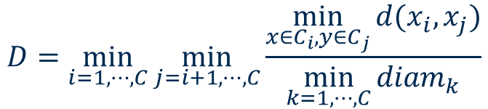
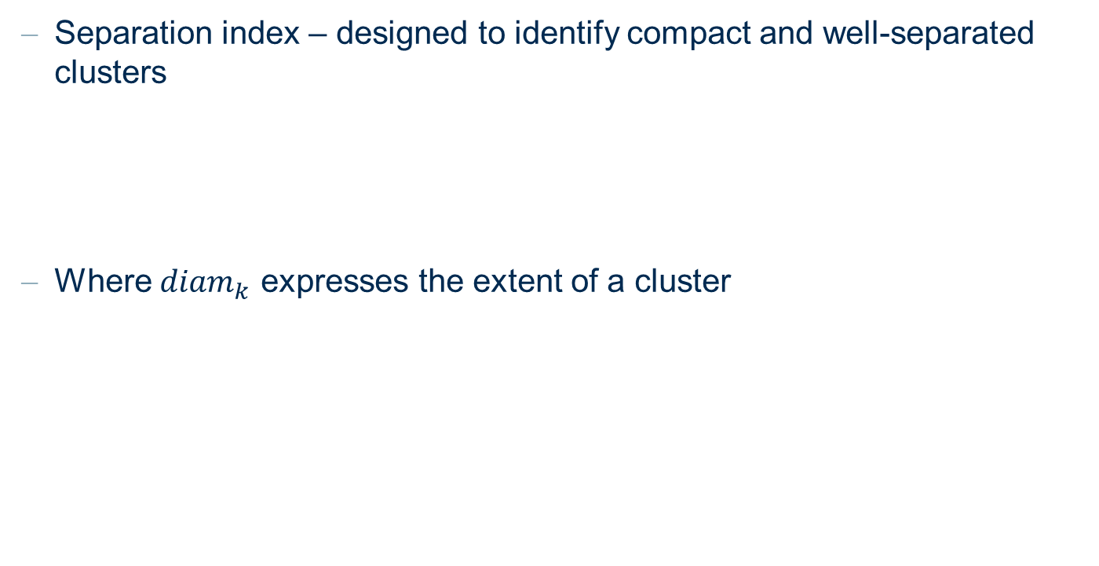
2. Separation Index
Name two quality measures for k-means / k-medoid clustering. Include a short definition and explanation of both.
Separation index – designed to identify compact and well-separated clusters
Where ${diam}_{k}$ expresses the extent of a cluster
$$D=\min_{i=1,⋯,C}{\min_{j=i+1,⋯,C}{\frac{\min_{x∈C_{i}, y∈C_{j}}{d(x_{i},x_{j})}}{\min_{k=1,⋯,C}{{diam}_{k}}}}}$$

Slide 8
3. Quality Measures and k
Can these two quality measures be used to determine the k in k-Means? Why?
Both measures can be used to determine k. However, we have to keep in mind that both of them negatively correlate with the value of k.
The more you increase k the smaller the measurement gets, until k equals the number of training points.
They could definitely be used to compare different runs with similar k

Slide 9
4. Local maximum drawback
The Expectation Maximization algorithms has the drawback that it can converge to a local maximum likelihood:
Why is it a drawback?
Why is a local maximum bad?
Why can the local maximum happen?
As the name Expectation Maximization is indicating our goal is to find a maximum of clustering quality.
Local: Typically it's a drawback because the main goal is to find a global maximum in which we can assure that all other points in the space are smaller or equal. In a local maximum we can assure this only for an area, which can be very small, around this local maximum.

Slide 10
Exercise 2 k-Means

Slide 11
1. Hands-on k-Means
The following two-dimensional dataset is given:
Apply the k-means clustering algorithm with k = 3 (3 Clusters).
Use the first 3 data tuples as initial cluster centroids
Track the movement of the cluster centers (e.g. by painting the movement into the diagram).
Determine the Voronoi regions of the final clustering and draw the final cluster centers, all data points, and the Voronoi regions into a diagram.
x | 3 | 6 | 8 | 1 | 2 | 2 | 6 | 6 | 7 | 7 | 8 | 8
y | 5 | 2 | 3 | 5 | 4 | 6 | 1 | 8 | 3 | 6 | 1 | 7

Slide 12
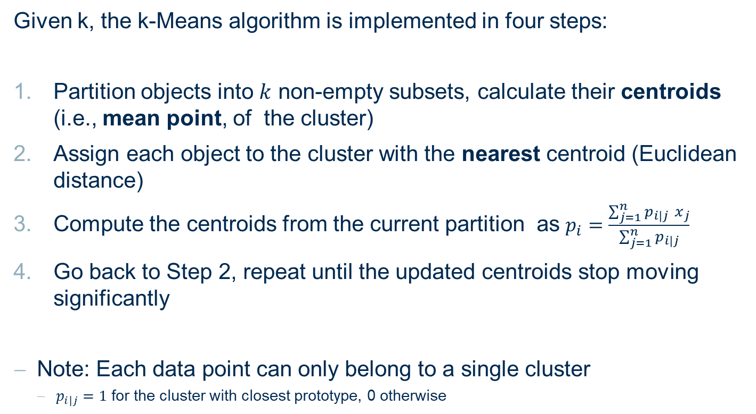
1. Hands-on k-Means
Given k, the k-Means algorithm is implemented in four steps:
Partition objects into $k$ non-empty subsets, calculate their centroids (i.e., mean point, of the cluster)
Assign each object to the cluster with the nearest centroid (Euclidean distance)
Compute the centroids from the current partition as $p_{i}=\frac{\sum_{j=1}^{n}{p_{i|j}{ x}_{j}}}{\sum_{j=1}^{n}{p_{i|j}}}$
Go back to Step 2, repeat until the updated centroids stop moving significantly
Note: Each data point can only belong to a single cluster
$p_{i|j}=1$ for the cluster with closest prototype, 0 otherwise

Slide 13
1. Hands-on k-Means
y
10
9
x | 3 | 6 | 8 | 1 | 2 | 2 | 6 | 6 | 7 | 7 | 8 | 8
y | 5 | 2 | 3 | 5 | 4 | 6 | 1 | 8 | 3 | 6 | 1 | 7
8
7
6
Use the first 3 data tuples as initial cluster centroids
5
4
k=3
Start – Iteration # 0
3
2
1
0
0
1
2
3
4
5
6
7
8
9
10
x

Slide 14
1. Hands-on k-Means
y
10
9
x | 3 | 6 | 8 | 1 | 2 | 2 | 6 | 6 | 7 | 7 | 8 | 8
y | 5 | 2 | 3 | 5 | 4 | 6 | 1 | 8 | 3 | 6 | 1 | 7
8
7
6
Use the first 3 data tuples as initial cluster centroids
5
4
k=3
Iteration # 0
3
2
1
0
0
1
2
3
4
5
6
7
8
9
10
x

Slide 15
1. Hands-on k-Means
y
10
9
x | 3 | 6 | 8 | 1 | 2 | 2 | 6 | 6 | 7 | 7 | 8 | 8
y | 5 | 2 | 3 | 5 | 4 | 6 | 1 | 8 | 3 | 6 | 1 | 7
8
7
6
Use the first 3 data tuples as initial cluster centroids
5
4
k=3
Iteration # 1
3
2
1
0
0
1
2
3
4
5
6
7
8
9
10
x

Slide 16
1. Hands-on k-Means
y
10
9
x | 3 | 6 | 8 | 1 | 2 | 2 | 6 | 6 | 7 | 7 | 8 | 8
y | 5 | 2 | 3 | 5 | 4 | 6 | 1 | 8 | 3 | 6 | 1 | 7
8
7
6
Use the first 3 data tuples as initial cluster centroids
5
4
k=3
Iteration # 2
3
2
1
0
0
1
2
3
4
5
6
7
8
9
10
x

Slide 17
1. Hands-on k-Means
y
10
9
x | 3 | 6 | 8 | 1 | 2 | 2 | 6 | 6 | 7 | 7 | 8 | 8
y | 5 | 2 | 3 | 5 | 4 | 6 | 1 | 8 | 3 | 6 | 1 | 7
8
7
6
Use the first 3 data tuples as initial cluster centroids
5
4
k=3
Iteration # 3
3
2
1
0
0
1
2
3
4
5
6
7
8
9
10
x

Slide 18
1. Hands-on k-Means
y
10
9
x | 3 | 6 | 8 | 1 | 2 | 2 | 6 | 6 | 7 | 7 | 8 | 8
y | 5 | 2 | 3 | 5 | 4 | 6 | 1 | 8 | 3 | 6 | 1 | 7
8
7
6
Use the first 3 data tuples as initial cluster centroids
5
4
k=3
Iteration # 4
3
2
1
0
0
1
2
3
4
5
6
7
8
9
10
x

Slide 19
1. Hands-on k-Means
y
10
9
x | 3 | 6 | 8 | 1 | 2 | 2 | 6 | 6 | 7 | 7 | 8 | 8
y | 5 | 2 | 3 | 5 | 4 | 6 | 1 | 8 | 3 | 6 | 1 | 7
8
7
6
Use the first 3 data tuples as initial cluster centroids
5
4
k=3
Iteration # 5
3
2
1
0
0
1
2
3
4
5
6
7
8
9
10
x

Slide 20
1. Hands-on k-Means
y
The k-means algorithm needs 3 iterations to reach a stable state, meaning that all cluster centroids have reached a stable position (or 4 iterations if you consider the last test where the cluster assignment did not change).
The end positions of the cluster centroids are C1(2; 5), C2(7; 2) and C3(7; 7).
10
9
8
7
6
5
4
3
2
1
0
0
1
2
3
4
5
6
7
8
9
10
x

Slide 21
1. Hands-on k-Means
y
Voronoi regions
The k-means algorithm needs 3 iterations to reach a stable state, meaning that all cluster centroids have reached a stable position (or 4 iterations if you consider the last test where the cluster assignment did not change).
The end positions of the cluster centroids are C1(2; 5), C2(7; 2) and C3(7; 7).
10
9
8
7
6
5
4
3
2
1
0
0
1
2
3
4
5
6
7
8
9
10
x

Slide 22
2. K-Means drawbacks
The following two-dimensional dataset is given:
Which problem arises when this dataset is clustered with the k-means algorithm with k = 2 clusters?
Describe the difference between the desired behaviour and the result of the k-means algorithm.
Which clustering algorithm could better fit the data and why?
x | 3 | 3 | 4 | 4 | 5 | 6 | 7 | 7 | 8 | 9 | 1 | 2 | 2 | 3 | 4 | 5 | 5 | 6 | 7 | 7
y | 1 | 2 | 2 | 3 | 3 | 4 | 4 | 6 | 5 | 7 | 3 | 4 | 5 | 6 | 6 | 7 | 8 | 8 | 8 | 9

Slide 23
2. K-Means drawbacks
Which problem arises when this dataset is clustered with the k-means algorithm with k = 2 clusters?
k=2
x | 3 | 3 | 4 | 4 | 5 | 6 | 7 | 7 | 8 | 9 | 1 | 2 | 2 | 3 | 4 | 5 | 5 | 6 | 7 | 7
y | 1 | 2 | 2 | 3 | 3 | 4 | 4 | 6 | 5 | 7 | 3 | 4 | 5 | 6 | 6 | 7 | 8 | 8 | 8 | 9
There are two ellipsoidal clusters in the dataset. The k-means algorithm with
Euclidean distance is not able to detect these cluster shapes.

Slide 24
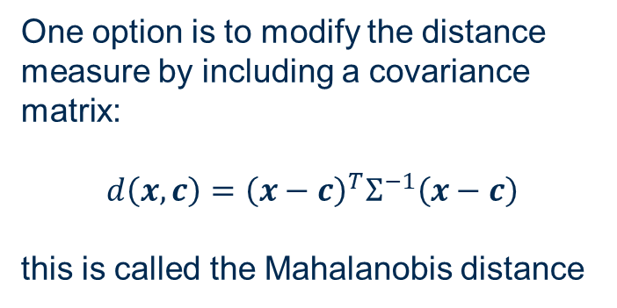
2. K-Means drawbacks
Which problem arises when this dataset is clustered with the k-means algorithm with k = 2 clusters?
k=2
x | 3 | 3 | 4 | 4 | 5 | 6 | 7 | 7 | 8 | 9 | 1 | 2 | 2 | 3 | 4 | 5 | 5 | 6 | 7 | 7
y | 1 | 2 | 2 | 3 | 3 | 4 | 4 | 6 | 5 | 7 | 3 | 4 | 5 | 6 | 6 | 7 | 8 | 8 | 8 | 9
One option is to modify the distance measure by including a covariance matrix:
$$d\left(x, c\right)={\left(x−c\right)}^{T}Σ^{−1}\left(x−c\right)$$
this is called the Mahalanobis distance

Slide 25
2. K-Means drawbacks
Which clustering algorithm could better fit the data and why?
k=2
x | 3 | 3 | 4 | 4 | 5 | 6 | 7 | 7 | 8 | 9 | 1 | 2 | 2 | 3 | 4 | 5 | 5 | 6 | 7 | 7
y | 1 | 2 | 2 | 3 | 3 | 4 | 4 | 6 | 5 | 7 | 3 | 4 | 5 | 6 | 6 | 7 | 8 | 8 | 8 | 9
Another option is to use the EM Clustering algorithm with a normal probability density distribution, which also includes a covariance matrix.

Slide 26
Gaussian Mixture Model – EM Clustering
Assumption: Data were generated by sampling a set of normal distributions. (The probability density is a mixture of normal distributions.)
Aim: Find the parameters for the normal distributions and how much each normal distribution contributes to the data.
Algorithm: EM clustering (expectation maximisation).
Alternating scheme in which the parameters of the normal distributions and the likelihoods of the data points to be generated by the corresponding normal distributions are estimated.

Slide 27
Exercise 3 Agglomerative Hierarchical Clustering

Slide 28
Hierarchical Clustering
The following one-dimensional dataset is given:
Cluster this dataset with agglomerative clustering using:
the centroid method
the single-linkage method
the complete-linkage method
Draw a dendrogram for each of the methods (a)-(c).
x | 2 | 12 | 16 | 25 | 29 | 45

Slide 29
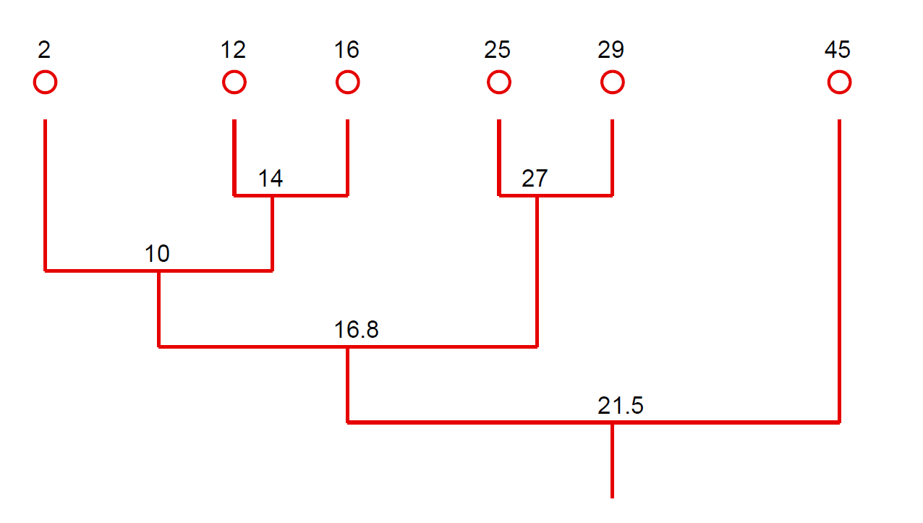
Hierarchical Clustering: Centroid Method
x | 2 | 12 | 16 | 25 | 29 | 45
4
4
4
4
Centroid Method
12
Cluster distance
17
New centroid
28.2

Slide 30
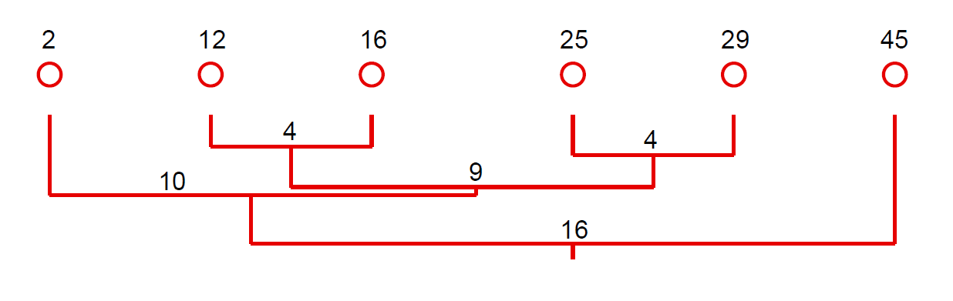
Hierarchical Clustering: Single Linkage
x | 2 | 12 | 16 | 25 | 29 | 45
Single Linkage
Cluster distance
There is no cluster representative

Slide 31
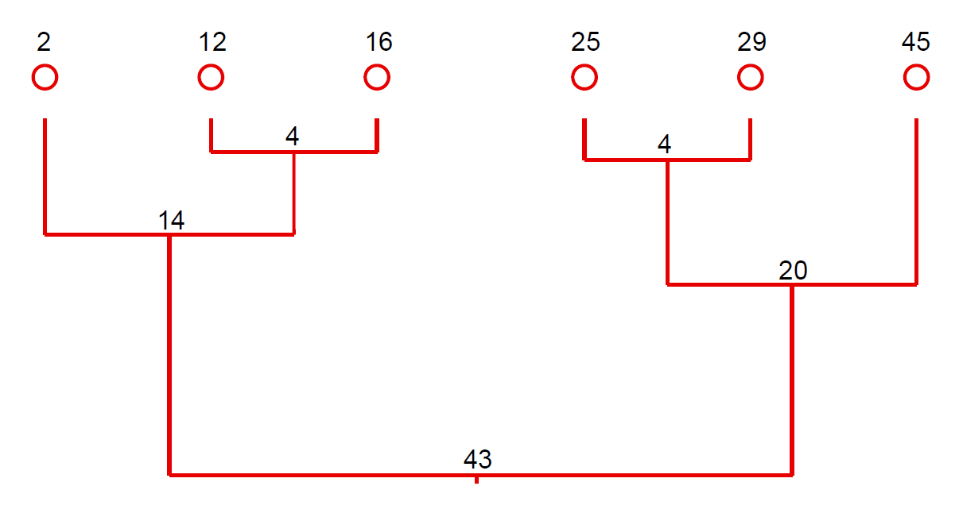
Hierarchical Clustering: Complete Linkage
x | 2 | 12 | 16 | 25 | 29 | 45
Complete Linkage
Cluster distance
There is no cluster representative

Slide 32
Exercise 4 DBSCAN

Slide 33
1. Hands-on DBSCAN
The following two-dimensional dataset is given:
Use the DBSCAN algorithm to cluster the data
With ε = 1.2 and MinPoints = 2
With ε = 1.5 and MinPoints = 5
Draw the clusters in a diagram
Determine the core, directly density-reachable and direct-connected objects.
x | 3 | 3 | 4 | 4 | 5 | 6 | 7 | 7 | 8 | 9 | 1 | 2 | 2 | 3 | 4 | 5 | 5 | 6 | 7 | 7
y | 1 | 2 | 2 | 3 | 3 | 4 | 4 | 6 | 5 | 7 | 3 | 4 | 5 | 6 | 6 | 7 | 8 | 8 | 8 | 9

Slide 34
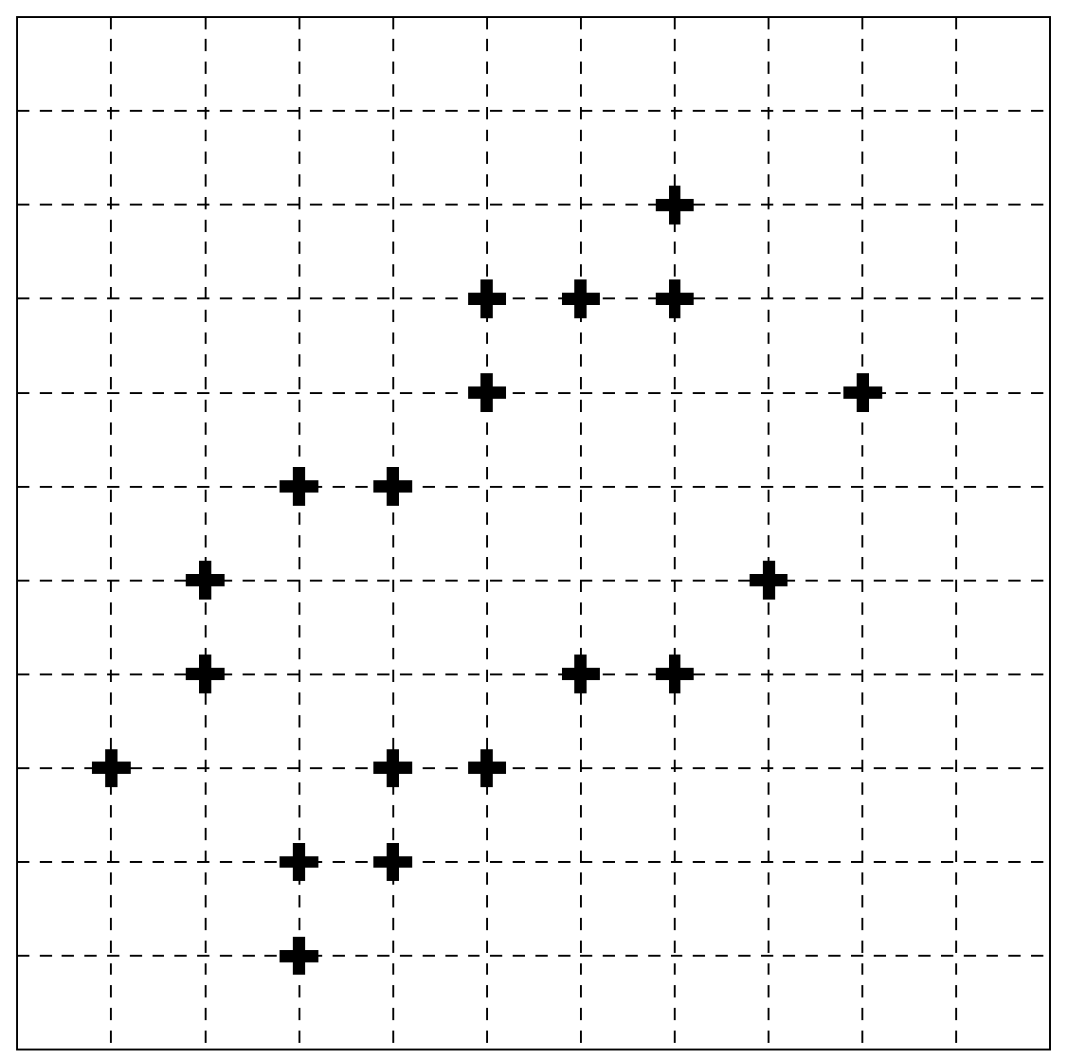

1. Hands-on DBSCAN
Use the DBSCAN algorithm to cluster the data
With ε = 1.2 and MinPoints = 2
x | 3 | 3 | 4 | 4 | 5 | 6 | 7 | 7 | 8 | 9 | 1 | 2 | 2 | 3 | 4 | 5 | 5 | 6 | 7 | 7
y | 1 | 2 | 2 | 3 | 3 | 4 | 4 | 6 | 5 | 7 | 3 | 4 | 5 | 6 | 6 | 7 | 8 | 8 | 8 | 9
T
ε = 1.2
Q
R
S
P
J
N
O
H
Let’s draw and name the data points
M
I
L
F
G
K
D
E
B
C
A

Slide 35
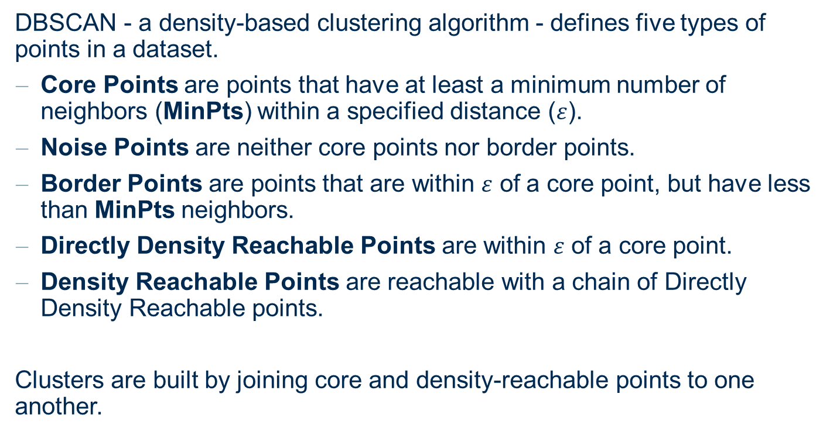
Clustering: DBSCAN
DBSCAN - a density-based clustering algorithm - defines five types of points in a dataset.
Core Points are points that have at least a minimum number of neighbors (MinPts) within a specified distance ($ε$).
Noise Points are neither core points nor border points.
Border Points are points that are within $ε$ of a core point, but have less than MinPts neighbors.
Directly Density Reachable Points are within $ε$ of a core point.
Density Reachable Points are reachable with a chain of Directly Density Reachable points.
Clusters are built by joining core and density-reachable points to one another.

Slide 36
1. Hands-on DBSCAN
Use the DBSCAN algorithm to cluster the data
With ε = 1.2 and MinPoints = 2
x | 3 | 3 | 4 | 4 | 5 | 6 | 7 | 7 | 8 | 9 | 1 | 2 | 2 | 3 | 4 | 5 | 5 | 6 | 7 | 7
y | 1 | 2 | 2 | 3 | 3 | 4 | 4 | 6 | 5 | 7 | 3 | 4 | 5 | 6 | 6 | 7 | 8 | 8 | 8 | 9
T
ε = 1.2
Q
R
S
P
J
N
O
H
Let’s look for core points.
We center the circle on each point.
Is MinPts=2 satisfied?
M
I
L
F
G
K
D
E
B
C
A

Slide 37
1. Hands-on DBSCAN
Use the DBSCAN algorithm to cluster the data
With ε = 1.2 and MinPoints = 2
All Core Points
x | 3 | 3 | 4 | 4 | 5 | 6 | 7 | 7 | 8 | 9 | 1 | 2 | 2 | 3 | 4 | 5 | 5 | 6 | 7 | 7
y | 1 | 2 | 2 | 3 | 3 | 4 | 4 | 6 | 5 | 7 | 3 | 4 | 5 | 6 | 6 | 7 | 8 | 8 | 8 | 9
T
ε = 1.2
Q
R
S
All points in a red circle are core points. After placing the circle on each point, you always get at least another point in it (MinPoints=2 satisfied).
All points in a grey circle are noise points. There is no other point in the circle.
P
J
N
O
H
M
I
L
F
G
K
D
E
B
C
No MinPoints
A

Slide 38
1. Hands-on DBSCAN
Use the DBSCAN algorithm to cluster the data
With ε = 1.2 and MinPoints = 2
x | 3 | 3 | 4 | 4 | 5 | 6 | 7 | 7 | 8 | 9 | 1 | 2 | 2 | 3 | 4 | 5 | 5 | 6 | 7 | 7
y | 1 | 2 | 2 | 3 | 3 | 4 | 4 | 6 | 5 | 7 | 3 | 4 | 5 | 6 | 6 | 7 | 8 | 8 | 8 | 9
T
ε = 1.2
Q
R
S
P
J
Final Solution.
Start from any point, till you find a core point.
Then from there reach all density reachable points to form the cluster.
N
O
H
M
I
L
F
G
K
D
E
B
C
A

Slide 39
1. Hands-on DBSCAN
Use the DBSCAN algorithm to cluster the data
With ε = 1.5 and MinPoints = 5
x | 3 | 3 | 4 | 4 | 5 | 6 | 7 | 7 | 8 | 9 | 1 | 2 | 2 | 3 | 4 | 5 | 5 | 6 | 7 | 7
y | 1 | 2 | 2 | 3 | 3 | 4 | 4 | 6 | 5 | 7 | 3 | 4 | 5 | 6 | 6 | 7 | 8 | 8 | 8 | 9
T
ε = 1.5
Q
R
S
P
J
N
O
H
Larger radius, but more MinPoints required.
Core points are just C and R.
M
I
L
F
G
K
D
E
B
C
A

Slide 40
1. Hands-on DBSCAN
Use the DBSCAN algorithm to cluster the data
With ε = 1.5 and MinPoints = 5
x | 3 | 3 | 4 | 4 | 5 | 6 | 7 | 7 | 8 | 9 | 1 | 2 | 2 | 3 | 4 | 5 | 5 | 6 | 7 | 7
y | 1 | 2 | 2 | 3 | 3 | 4 | 4 | 6 | 5 | 7 | 3 | 4 | 5 | 6 | 6 | 7 | 8 | 8 | 8 | 9
T
ε = 1.5
Q
R
S
P
J
Final Solution.
From point C directly density-reachable are: A, B, D and E.
From point R directly density-reachable are: P, Q, S and T.
All points within a cluster are density-connected.
N
O
H
M
I
L
F
G
K
D
E
B
C
A

Slide 41
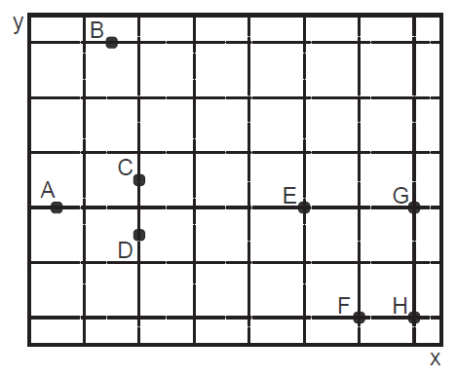

2. DBSCAN for outlier detection
The two-dimensional data points A;B;C;D;E; F; G;H with $(x; y) ∈ ℝ^{2}$are given.
Find the clusters, using the DBSCAN algorithm with Euclidian distance, and MinPoints = 2, using ε = 1.5, ε = 2.1, and ε = 10.
Which objects are not covered by each clustering solution?

Slide 42
2. DBSCAN for outlier detection
ε = 1.5 and MinPoints = 2
ε = 1.5
No MinPoints
Outlier = A, B, E, G
Cluster = {C;D}, {F;H}

Slide 43
2. DBSCAN for outlier detection
ε = 2.1 and MinPoints = 2
ε = 2.1
No MinPoints
Outlier = B
Cluster = {A;C;D}, {E;F; G; H}

Slide 44
2. DBSCAN for outlier detection
ε = 10 and MinPoints = 2
ε = 10
Outlier = none
Cluster = {A; B; C; D; E; F; G; H}

Slide 45
Exercise 5 Practice with KNIME

Slide 46
1. k-Means Clustering
Use the k-Means algorithm to cluster location data.
Read the dataset location_data.table
Filter to entries from California (region_code = CA)
Train a k-means model with k=3. Use only position data for clustering (latitude and longitude)
Calculate the Silhoutte Coefficients using the Silhouette Coefficient node
Plot latitude and longitude in a view (OSM Map or Scatter Plot) and use that to help you visually optimize k

Slide 47
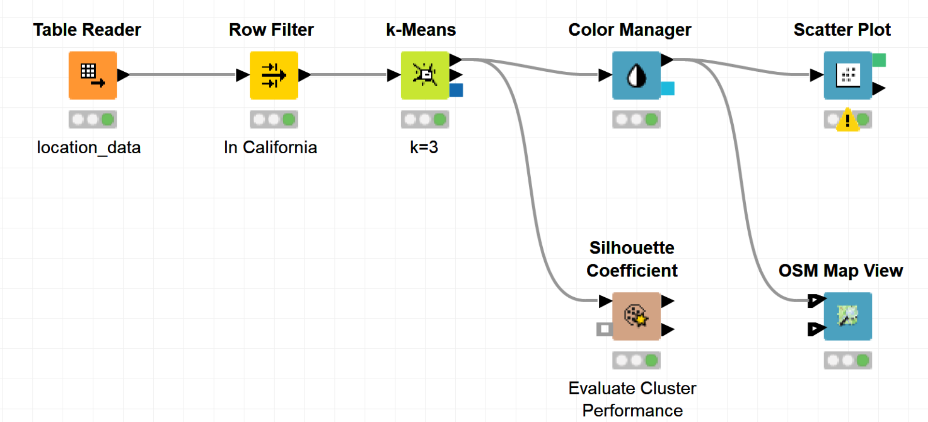
1. k-Means Clustering
Use the k-Means algorithm to cluster location data

Slide 48
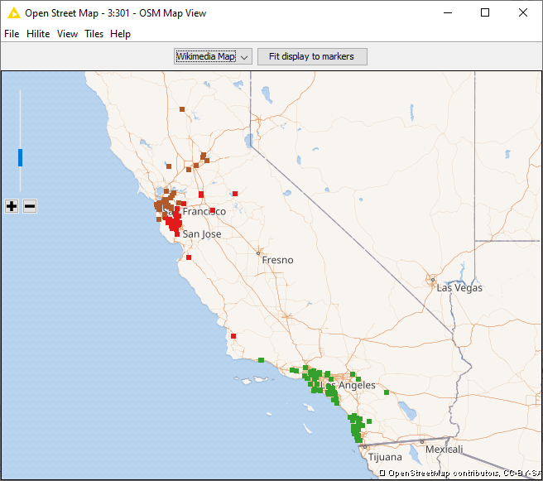
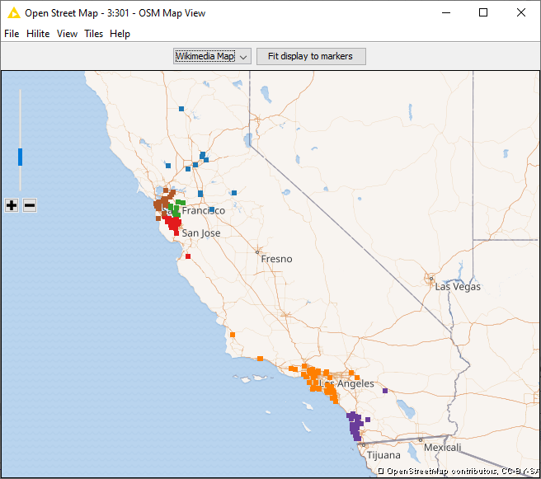

1. k-Means Clustering
Plot latitude and longitude in a view (OSM Map or Scatter Plot) and use that to help you visually optimize k
k = 3
k = 6
k = 10
Avg Silhouette Coeff. 0.6
Avg Silhouette Coeff. 0.571
Avg Silhouette Coeff. 0.496

Slide 49
Thank you

