Slide 1
Decision and Regression Trees: Exercise

Slide 2
Exercise 1 Theoretical Questions

Slide 3
Theoretical Questions
What are the differences among ID3, CART, and C4.5?
How can we avoid overfitting in decision tree training?
Describe some commonly used pruning techniques for decision trees
Describe differences and similarities between regression trees and linear regression

Slide 4
1. Decision Tree Algorithms
What are the differences among ID3, CART, and C4.5?
 | Splitting | Attributes | Missing values | Pruning | Outliers
ID3 | Information Gain | Only Categorical | Not handled | No pruning | Susceptible
CART | Gini index / Towing Criteria | Categorical and Numeric | Handled | Cost-complexity pruning | Handled
C4.5 | Gain Ratio | Categorical and Numeric | Handled | Error-based pruning | Susceptible
Source: https://citeseerx.ist.psu.edu/viewdoc/download?doi=10.1.1.685.4929&rep=rep1&type=pdf

Slide 5
2. Overfitting
How can we avoid overfitting in decision tree training?
Goal: A tree that generalizes to new data and doesn’t overfit
Pruning
Idea: Cut branches that seem to overfit
Techniques
Reduced Error Pruning
Pessimistic Pruning
Confidence Level Pruning
Minimum description length
Early stopping
Idea: Define a minimum size for the tree leaves

Slide 6
3. Pruning
Describe some commonly used pruning techniques for decision trees
Reduced Error Pruning
Pessimistic Pruning
Confidence Level Pruning
Minimum description length

Slide 7
3. Reduced Error Pruning
Classify a set of new example cases with the decision tree. (These cases must not have been used for the learning!)
Determine the number of errors for all leaves.
The number of errors of a subtree is the sum of the errors of all of its leaves.
Determine the number of errors for leaves that replace subtrees.
If such a leaf leads to the same or fewer errors than the subtree, replace the subtree by the leaf.
If a subtree has been replaced, recompute the number of errors of the subtrees it is part of.

Slide 8
3. Reduced Error Pruning
Advantage:
Very good pruning, effective avoidance of overfitting.
Disadvantage:
Additional example cases needed. Number of cases in a leaf has no influence.

Slide 9
3. Pessimistic Pruning
Classify a set of example cases with the decision tree. (These cases may or may not have been used for the learning.)
Determine the number of errors for all leaves and increase this number by a fixed, user-specified amount r.
The number of errors of a subtree is the sum of the errors of all of its leaves.
Determine the number of errors for leaves that replace subtrees (also increased by r).
If such a leaf leads to the same or fewer errors than the subtree, replace the subtree by the leaf and recompute subtree errors.

Slide 10
3. Pessimistic Pruning
Advantage:
No additional example cases needed.
Disadvantage:
Number of cases in a leaf has no influence.

Slide 11
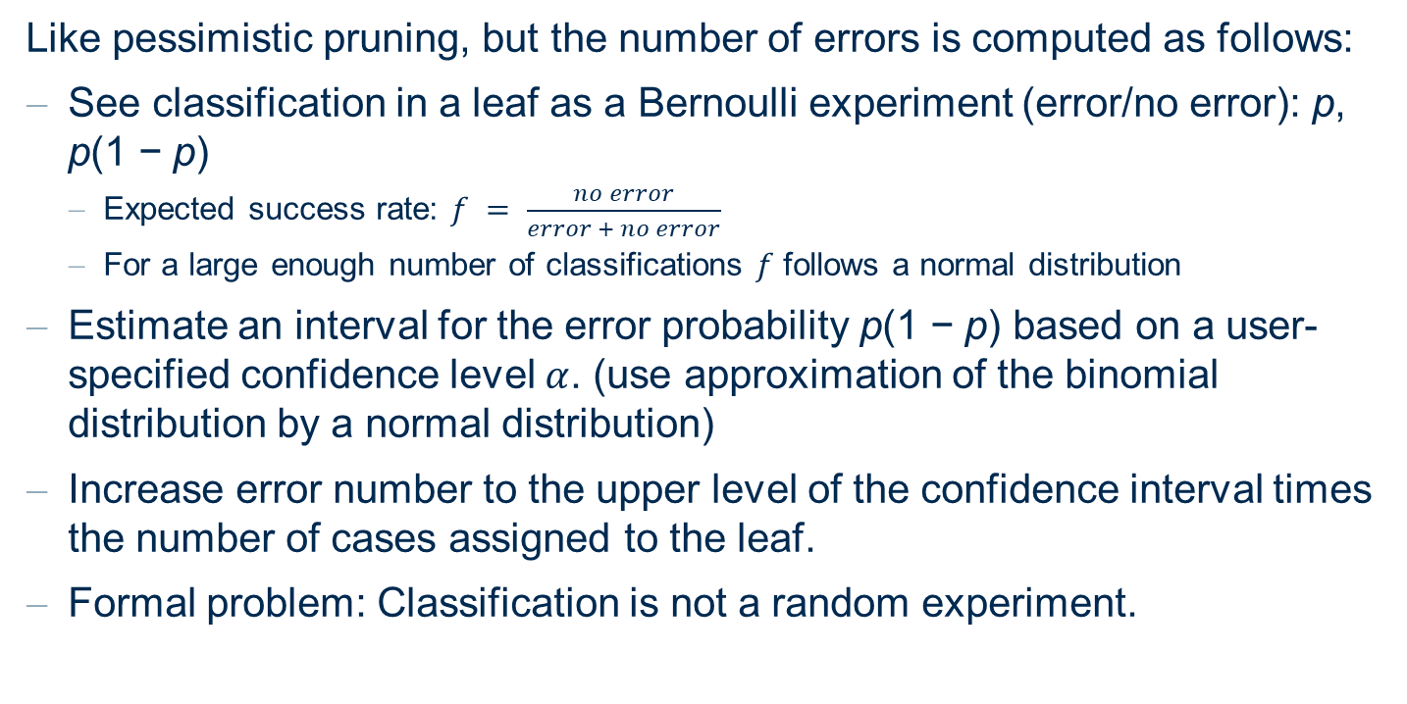
3. Confidence Level Pruning
Like pessimistic pruning, but the number of errors is computed as follows:
See classification in a leaf as a Bernoulli experiment (error/no error): p, p(1 − p)
Expected success rate: $f = \frac{no error}{error + no error}$
For a large enough number of classifications $f$ follows a normal distribution
Estimate an interval for the error probability p(1 − p) based on a user-specified confidence level $α$. (use approximation of the binomial distribution by a normal distribution)
Increase error number to the upper level of the confidence interval times the number of cases assigned to the leaf.
Formal problem: Classification is not a random experiment.

Slide 12
3. Confidence Level Pruning
Advantage:
No additional example cases needed. Good pruning.
Disadvantage:
Statistically dubious foundation.

Slide 13
3. Minimum Description Length Pruning (MDL)
Description length = #bits(tree) + #bits(misclassified samples)
Tree 1
Tree 2
Note
wind
wind
Many misclassified in samples in tree 1
=> DL(Tree 1) > DL(Tree 2)
=> Select Tree 2
Example 1
temp
12
0
6
7
12
0
wind
wind
Only 1 misclassified sample in tree 1
=> DL(Tree 1) < DL(Tree 2)
=> Select Tree 1
Example 2
temp
12
0
1
13
12
0

Slide 14
4. Regression Trees
Describe differences and similarities between regression trees and linear regression
Similarities: both implement solutions to numerical prediction tasks
Differences:
Closed form solution for linear regression; heuristic solution for regression tree
Linear regression uses a linear function to fit the data
Regression tree uses a step-wise function to fit the data

Slide 15
Exercise 2 Hands-on Decision Tree

Slide 16
Hands-on Decision Tree
Check the examples from dataset in the table below
Three boolean values A1; A2; A3
Class attribute C.
Use the ID3-algorithm (by hand, no tools) to construct a decision tree. The solution should contain all necessary calculations for building the decision tree.
Why is the resulting decision tree too complex? How can this be prevented?
A1 | F | W | F | W | F | F | W | W
A2 | F | W | F | W | W | W | F | F
A3 | W | W | W | F | F | F | W | F
C | W | W | W | W | F | F | F | F

Slide 17

Hands-on Decision Tree
Use the ID3-algorithm (by hand, no tools) to construct a decision tree
C = {4 W , 4 F}
$$H\left(C\right)=−\frac{4}{8}\log_{2}\frac{4}{8} −\frac{4}{8}\log_{2}\frac{4}{8}=\frac{4}{8}+\frac{4}{8}=1$$
A1 | F | W | F | W | F | F | W | W
A2 | F | W | F | W | W | W | F | F
A3 | W | W | W | F | F | F | W | F
C | W | W | W | W | F | F | F | F

Slide 18

Hands-on Decision Tree
Use the ID3-algorithm (by hand, no tools) to construct a decision tree
$C|A1$:
for $A1=F⇒C^{′}=\{2W, 2F\}$
for $A1=W⇒C^{′′}=\{2W, 2F\}$
Same values for $C|A2$
$$H\left(C|A1\right)=H\left(C|A2\right)=\frac{4}{8}\left(−\frac{2}{4}\log_{2}\frac{2}{4}−\frac{2}{4}\log_{2}\frac{2}{4}\right)+\frac{4}{8}\left(−\frac{2}{4}\log_{2}\frac{2}{4}−\frac{2}{4}\log_{2}\frac{2}{4}\right)=1$$
$$I_{gain}\left(C, A1\right)=I_{gain}\left(C, A2\right)=1−1=0$$
A1 | F | W | F | W | F | F | W | W
A2 | F | W | F | W | W | W | F | F
A3 | W | W | W | F | F | F | W | F
C | W | W | W | W | F | F | F | F

Slide 19

Hands-on Decision Tree
Use the ID3-algorithm (by hand, no tools) to construct a decision tree
$C|A3$:
for $A3=F⇒C^{′}=\{1W, 3F\}$
for $A3=W⇒C^{′′}=\{3W, 1F\}$
$$H\left(C|A3\right)=\frac{4}{8}\left(−\frac{3}{4}\log_{2}\frac{3}{4}−\frac{1}{4}\log_{2}\frac{1}{4}\right)+\frac{4}{8}\left(−\frac{1}{4}\log_{2}\frac{1}{4}−\frac{3}{4}\log_{2}\frac{3}{4}\right)=\left(0.311+0.5\right)=0.811$$
$$I_{gain}\left(C, A3\right)=1−0.811=0.189$$
A1 | F | W | F | W | F | F | W | W
A2 | F | W | F | W | W | W | F | F
A3 | W | W | W | F | F | F | W | F
C | W | W | W | W | F | F | F | F

Slide 20
Hands-on Decision Tree
4W, 4F
A1 | F | W | F | W
A2 | F | W | F | F
A3 | W | W | W | W
C | W | W | W | F
A3
A3=W
A3=F
A3=W
3W, 1F
1W, 3F
A1 | W | F | F | W
A2 | W | W | W | F
A3 | F | F | F | F
C | W | F | F | F
A3=F

Slide 21
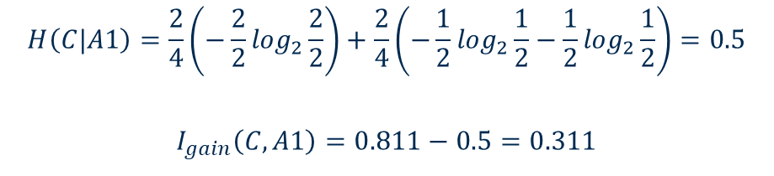
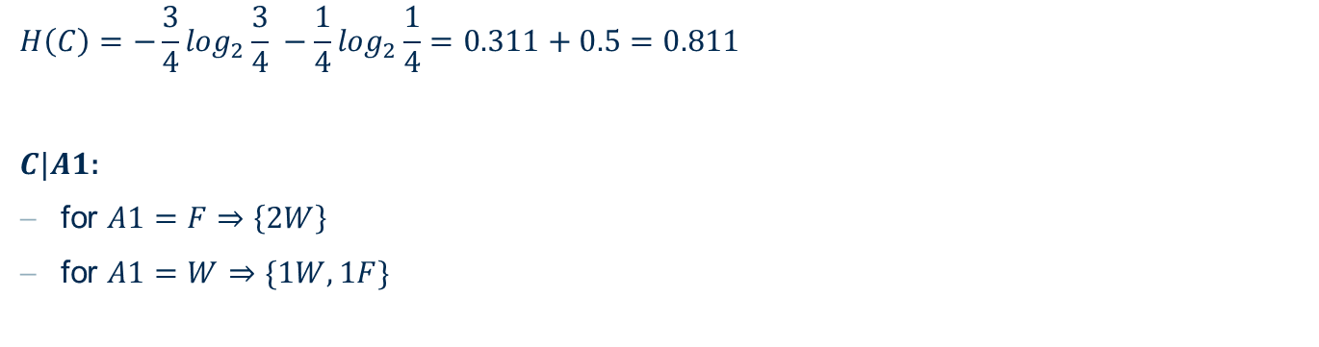
Hands-on Decision Tree
4W, 4F
A1 | F | W | F | W
A2 | F | W | F | F
A3 | W | W | W | W
C | W | W | W | F
A3
A3=W
A3=F
A3=W
3W, 1F
1W, 3F
$$H\left(C\right)=−\frac{3}{4}\log_{2}\frac{3}{4} −\frac{1}{4}\log_{2}\frac{1}{4}=0.311+0.5=0.811$$
$C|A1$:
for $A1=F⇒\left\{2W\right\}$
for $A1=W⇒\{1W, 1F\}$
$$H\left(C|A1\right)=\frac{2}{4}\left(−\frac{2}{2}\log_{2}\frac{2}{2}\right)+\frac{2}{4}\left(−\frac{1}{2}\log_{2}\frac{1}{2}−\frac{1}{2}\log_{2}\frac{1}{2}\right)=0.5$$
$$I_{gain}\left(C, A1\right)=0.811−0.5=0.311$$

Slide 22
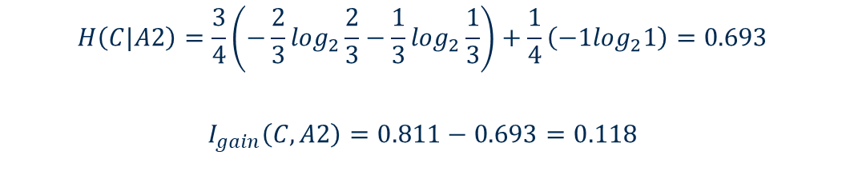
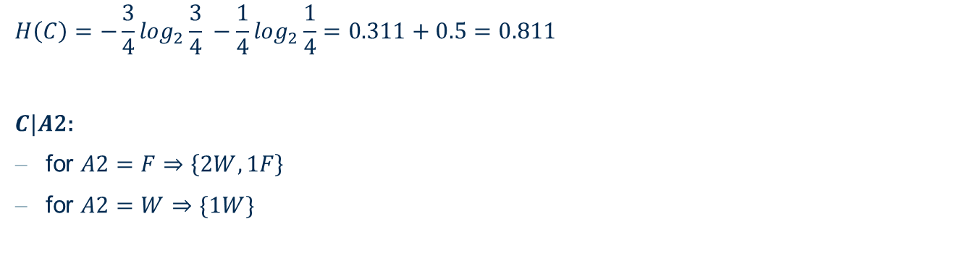
Hands-on Decision Tree
4W, 4F
A1 | F | W | F | W
A2 | F | W | F | F
A3 | W | W | W | W
C | W | W | W | F
A3
A3=W
A3=F
A3=W
3W, 1F
1W, 3F
$$H\left(C\right)=−\frac{3}{4}\log_{2}\frac{3}{4} −\frac{1}{4}\log_{2}\frac{1}{4}=0.311+0.5=0.811$$
$C|A$2:
for $A2=F⇒\left\{2W, 1F\right\}$
for $A2=W⇒\{1W\}$
$$H\left(C|A2\right)=\frac{3}{4}\left(−\frac{2}{3}\log_{2}\frac{2}{3}−\frac{1}{3}\log_{2}\frac{1}{3}\right)+\frac{1}{4}\left(−1\log_{2}1\right)=0.693$$
$$I_{gain}\left(C, A2\right)=0.811−0.693=0.118$$

Slide 23
Hands-on Decision Tree
4W, 4F
A1 | F | W | F | W
A2 | F | W | F | F
A3 | W | W | W | W
C | W | W | W | F
A3
A3=W
A3=F
3W, 1F
1W, 3F
A1=W
A1
A1=F
1W, 1F
W
A1 | W | W
A2 | W | F
A3 | W | W
C | W | F
A1 | F | F
A2 | F | F
A3 | W | W
C | W | W

Slide 24
Hands-on Decision Tree
4W, 4F
A1 | F | W | F | W
A2 | F | W | F | F
A3 | W | W | W | W
C | W | W | W | F
A3
A3=W
A3=F
A3=W
3W, 1F
1W, 3F
A1=W
A1
A1=F
A1=W
A1
A1=F
1W, 1F
W
1W, 1F
F
A2=W
A2=F
A2=W
A2
A2=F
A1 | W | F | F | W
A2 | W | W | W | F
A3 | F | F | F | F
C | W | F | F | F
A2
W
F
W
F
A3=F

Slide 25
Hands-on Decision Tree
Why is the resulting decision tree too complex? How can this be prevented?
From the previous slide, because there are redundant examples in the training data, the attribute A3 is overrated (high information gain). If the duplicates are removed, the decision tree becomes simpler and more intuitive.
The decision tree describes the function of NOT XOR. This example shows that the ID3 algorithm does not always construct the smallest decision tree. However, with respect to the distribution of training examples the algorithm is correct.
A1
A1=W
A1=F
A2
A2
A2=W
A2=F
A2=W
A2=F
W
F
W
F

Slide 26
Exercise 3 Entropy and Information Gain

Slide 27

1. Entropy and Information Gain
Given the following examples of a binary task with input attributes A1, A2.
Calculate the entropy H(C) of the class distribution.
Calculate the expected entropy H(C | A1) and H(C | A2) of the class distribution when A1 or A2 are known.
Calculate the information gain $I_{gain}\text{(}\text{C}\text{; }\text{A}\text{1)}$ and $I_{gain}\text{(}\text{C}\text{; }\text{A}\text{2}\text{)}$
X | 1 | 2 | 3 | 4 | 5 | 6
A1 | T | T | T | F | F | F
A2 | T | T | F | F | T | T
C | + | + | - | + | - | -

Slide 28
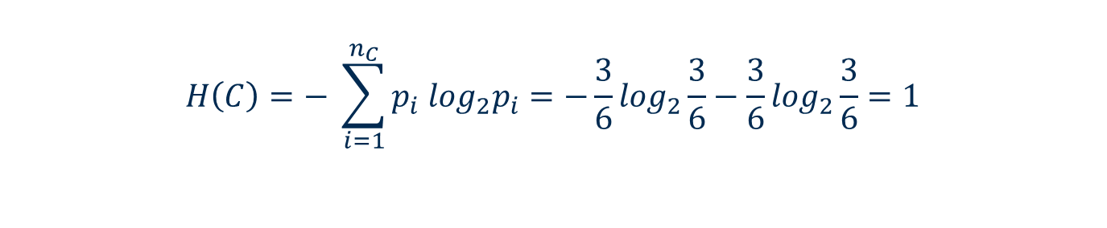
1. Entropy and Information Gain
Calculate the entropy H(C) of the class distribution.
X | 1 | 2 | 3 | 4 | 5 | 6
A1 | T | T | T | F | F | F
A2 | T | T | F | F | T | T
C | + | + | - | + | - | -
$$H\left(C\right)=− \sum_{i=1}^{n_{C}}{p_{i} \log_{2}p_{i}}=−\frac{3}{6}\log_{2}\frac{3}{6}−\frac{3}{6}\log_{2}\frac{3}{6}=1$$

Slide 29
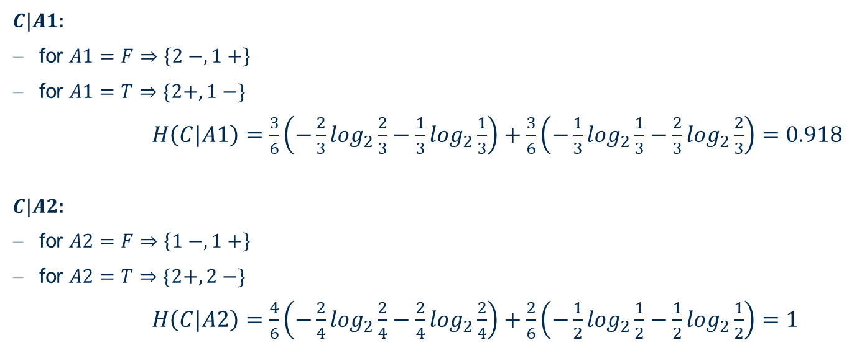
1. Entropy and Information Gain
Calculate the expected entropy H(C | A1) and H(C | A2) of the class distribution when A1 or A2 are known.
$C|A1$:
for $A1=F⇒\left\{2 −, 1+\right\}$
for $A1=T⇒\{2+, 1 −\}$
$H\left(C|A1\right)=\frac{3}{6}\left(−\frac{2}{3}\log_{2}\frac{2}{3}−\frac{1}{3}\log_{2}\frac{1}{3}\right)+\frac{3}{6}\left(−\frac{1}{3}\log_{2}\frac{1}{3}−\frac{2}{3}\log_{2}\frac{2}{3}\right)=0.918$
$C|A2$:
for $A2=F⇒\left\{1 −, 1+\right\}$
for $A2=T⇒\{2+, 2 −\}$
$H\left(C|A2\right)=\frac{4}{6}\left(−\frac{2}{4}\log_{2}\frac{2}{4}−\frac{2}{4}\log_{2}\frac{2}{4}\right)+\frac{2}{6}\left(−\frac{1}{2}\log_{2}\frac{1}{2}−\frac{1}{2}\log_{2}\frac{1}{2}\right)=1$

Slide 30
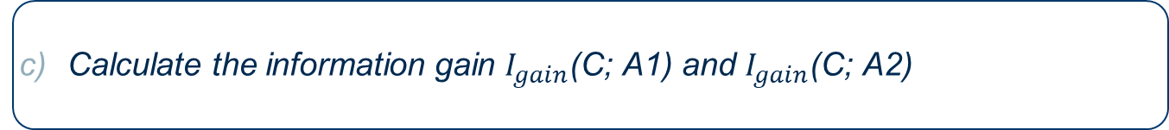
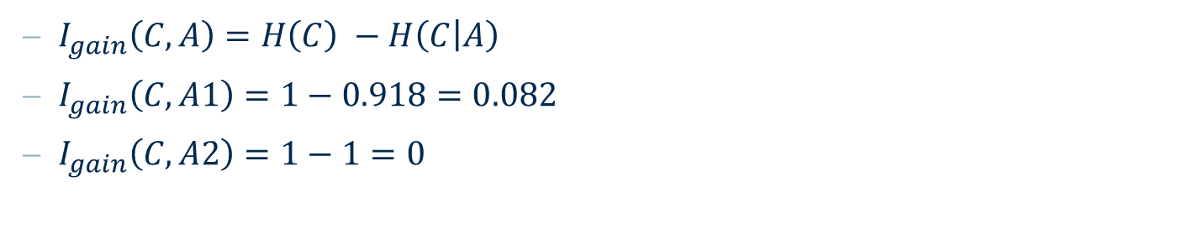
1. Entropy and Information Gain
Calculate the information gain $I_{gain}\text{(}\text{C}\text{; }\text{A}\text{1)}$ and $I_{gain}\text{(}\text{C}\text{; }\text{A}\text{2}\text{)}$
X | 1 | 2 | 3 | 4 | 5 | 6
A1 | T | T | T | F | F | F
A2 | T | T | F | F | T | T
C | + | + | - | + | - | -
$I_{gain}\left(C, A\right)=H\left(C\right) −H\left(C | A\right)$
$I_{gain}\left(C, A1\right)=1−0.918=0.082$
$I_{gain}\left(C, A2\right)=1−1=0$

Slide 31
2. Information Gain
Given the following table, calculate the original information gain and the information gain for all 5 possible splits. What do you notice?
X | 1 | 2 | 3 | 4 | 5 | 6 | 7 | 8 | 9 | 10 | 11 | 12 | 13 | 14
C | - | - | + | - | - | + | + | + | + | - | + | + | + | +
Split 1
Split 2
Split 3
Split 4
Split 5

Slide 32
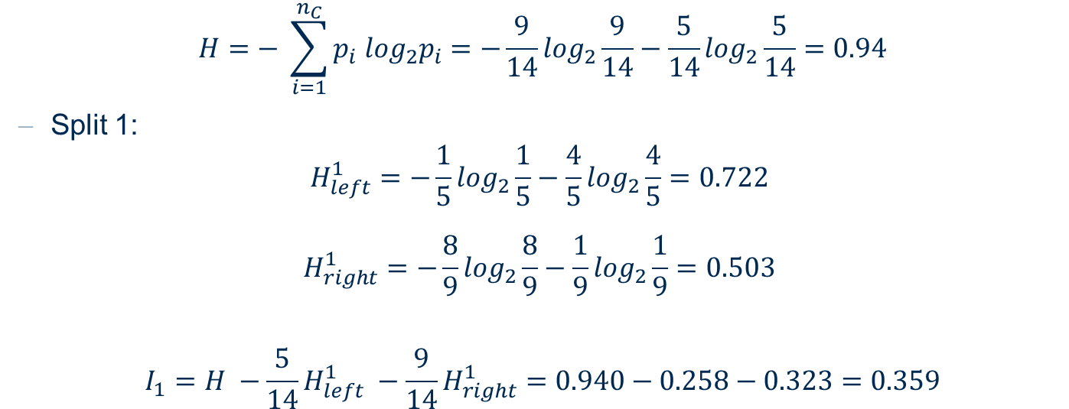
2. Information Gain: Split 1
X | 1 | 2 | 3 | 4 | 5 | 6 | 7 | 8 | 9 | 10 | 11 | 12 | 13 | 14
C | - | - | + | - | - | + | + | + | + | - | + | + | + | +
Split 1
$$H=− \sum_{i=1}^{n_{C}}{p_{i} \log_{2}p_{i}}=−\frac{9}{14}\log_{2}\frac{9}{14}−\frac{5}{14}\log_{2}\frac{5}{14}=0.94$$
Split 1:
$$H_{left}^{1}=−\frac{1}{5}\log_{2}\frac{1}{5}−\frac{4}{5}\log_{2}\frac{4}{5}=0.722$$
$$H_{right}^{1}=−\frac{8}{9}\log_{2}\frac{8}{9}−\frac{1}{9}\log_{2}\frac{1}{9}=0.503$$
$$I_{1}=H −\frac{5}{14}H_{left}^{1} −\frac{9}{14}H_{right}^{1}=0.940−0.258−0.323=0.359$$

Slide 33

2. Information Gain: Split 2
X | 1 | 2 | 3 | 4 | 5 | 6 | 7 | 8 | 9 | 10 | 11 | 12 | 13 | 14
C | - | - | + | - | - | + | + | + | + | - | + | + | + | +
Split 2
$$H=− \sum_{i=1}^{n_{C}}{p_{i} \log_{2}p_{i}}=−\frac{9}{14}\log_{2}\frac{9}{14}−\frac{5}{14}\log_{2}\frac{5}{14}=0.94$$
Split 2:
$$H_{left}^{2}=−\frac{2}{6}\log_{2}\frac{2}{6}−\frac{4}{6}\log_{2}\frac{4}{6}=0.918$$
$$H_{right}^{2}=−\frac{7}{8}\log_{2}\frac{7}{8}−\frac{1}{8}\log_{2}\frac{1}{8}=0.544$$
$$I_{2}=H −\frac{6}{14}H_{left}^{2} −\frac{8}{14}H_{right}^{2}=0.940−0.393−0.311=0.236$$

Slide 34
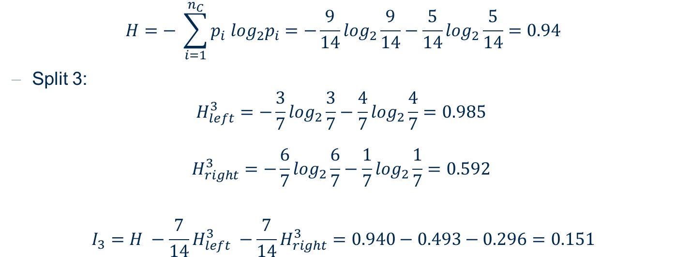
2. Information Gain: Split 3
X | 1 | 2 | 3 | 4 | 5 | 6 | 7 | 8 | 9 | 10 | 11 | 12 | 13 | 14
C | - | - | + | - | - | + | + | + | + | - | + | + | + | +
Split 3
$$H=− \sum_{i=1}^{n_{C}}{p_{i} \log_{2}p_{i}}=−\frac{9}{14}\log_{2}\frac{9}{14}−\frac{5}{14}\log_{2}\frac{5}{14}=0.94$$
Split 3:
$$H_{left}^{3}=−\frac{3}{7}\log_{2}\frac{3}{7}−\frac{4}{7}\log_{2}\frac{4}{7}=0.985$$
$$H_{right}^{3}=−\frac{6}{7}\log_{2}\frac{6}{7}−\frac{1}{7}\log_{2}\frac{1}{7}=0.592$$
$$I_{3}=H −\frac{7}{14}H_{left}^{3} −\frac{7}{14}H_{right}^{3}=0.940−0.493−0.296=0.151$$

Slide 35
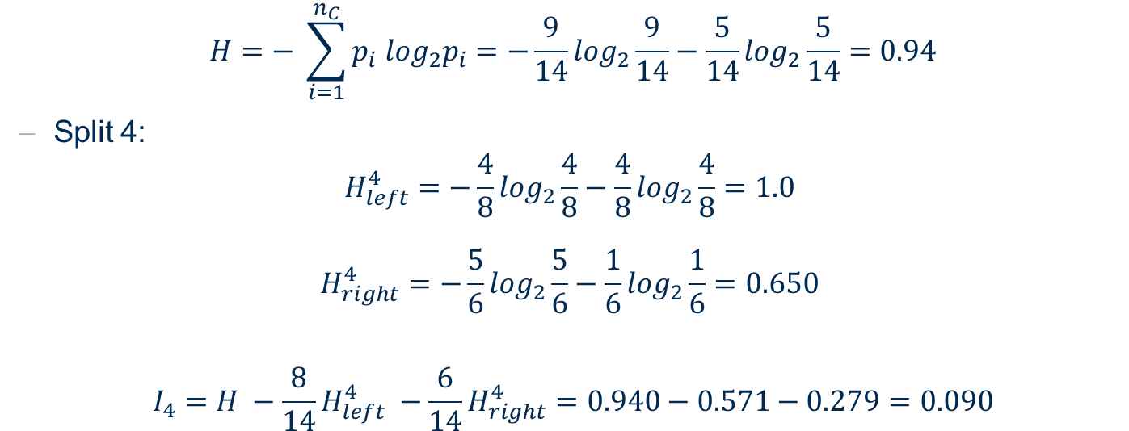
2. Information Gain: Split 4
X | 1 | 2 | 3 | 4 | 5 | 6 | 7 | 8 | 9 | 10 | 11 | 12 | 13 | 14
C | - | - | + | - | - | + | + | + | + | - | + | + | + | +
Split 4
$$H=− \sum_{i=1}^{n_{C}}{p_{i} \log_{2}p_{i}}=−\frac{9}{14}\log_{2}\frac{9}{14}−\frac{5}{14}\log_{2}\frac{5}{14}=0.94$$
Split 4:
$$H_{left}^{4}=−\frac{4}{8}\log_{2}\frac{4}{8}−\frac{4}{8}\log_{2}\frac{4}{8}=1.0$$
$$H_{right}^{4}=−\frac{5}{6}\log_{2}\frac{5}{6}−\frac{1}{6}\log_{2}\frac{1}{6}=0.650$$
$$I_{4}=H −\frac{8}{14}H_{left}^{4} −\frac{6}{14}H_{right}^{4}=0.940−0.571−0.279=0.090$$

Slide 36
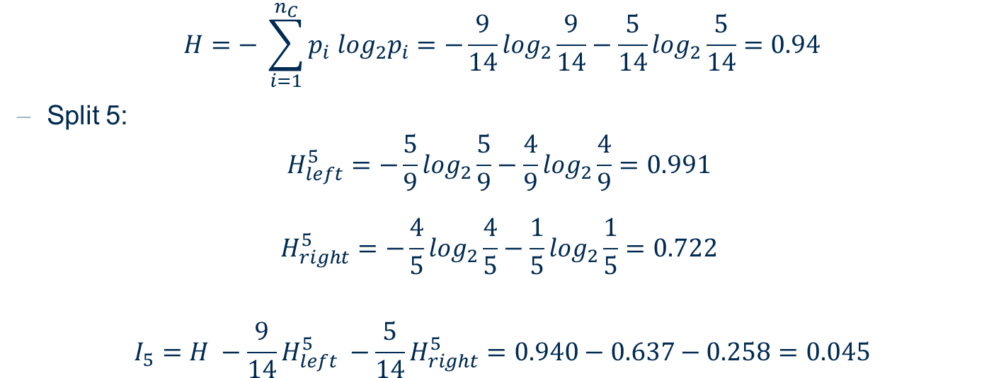
2. Information Gain: Split 5
X | 1 | 2 | 3 | 4 | 5 | 6 | 7 | 8 | 9 | 10 | 11 | 12 | 13 | 14
C | - | - | + | - | - | + | + | + | + | - | + | + | + | +
Split 5
$$H=− \sum_{i=1}^{n_{C}}{p_{i} \log_{2}p_{i}}=−\frac{9}{14}\log_{2}\frac{9}{14}−\frac{5}{14}\log_{2}\frac{5}{14}=0.94$$
Split 5:
$$H_{left}^{5}=−\frac{5}{9}\log_{2}\frac{5}{9}−\frac{4}{9}\log_{2}\frac{4}{9}=0.991$$
$$H_{right}^{5}=−\frac{4}{5}\log_{2}\frac{4}{5}−\frac{1}{5}\log_{2}\frac{1}{5}=0.722$$
$$I_{5}=H −\frac{9}{14}H_{left}^{5} −\frac{5}{14}H_{right}^{5}=0.940−0.637−0.258=0.045$$

Slide 37
Exercise 4 Practice with KNIME

Slide 38
1. Decision Tree
Train a binary classification model that predicts the overall condition of a house (either “high” or “low”).
Read the AmesHousing.csv file. It describes the sale of individual residential properties in Ames, Iowa (USA). One of the columns is the overall condition ranking, with values between 1 and 10.
Create a new column "rank" using the Rule Engine node.
An house will have rank "Low" if the value of the attribute "Overall Cond" is <= 5. Otherwise it will be ranked as "High".
Remove the following column
PID
MS SubClass
Overall Cond
Use a Partitioning node to split data into training (70%) e test set (30%)
Use stratified sampling based on the column rank, to retain the distribution of the class values in both output tables.
Train a Decision Tree model to predict the overall condition of a house (high/low) (Decision Tree Learner node)
Select the "rank" column as the class column
Use the trained model to predict the rank of the houses in the test set (Decision Tree Predictor node)
Evaluate the accuracy of the decision tree model (Scorer (Java Script) node)
What is the accuracy of the model?
Visualize the ROC curve (ROC Curve node)
Make sure that checkbox "append columns with normalized class distribution" in the Decision Tree Predictor node is activated
Select "rank" as Class column and "High" as Positive class value. Include only the "P (rank=High)" column
Try different setting options for the decision tree algorithm. Can you improve the model performance?

Slide 39
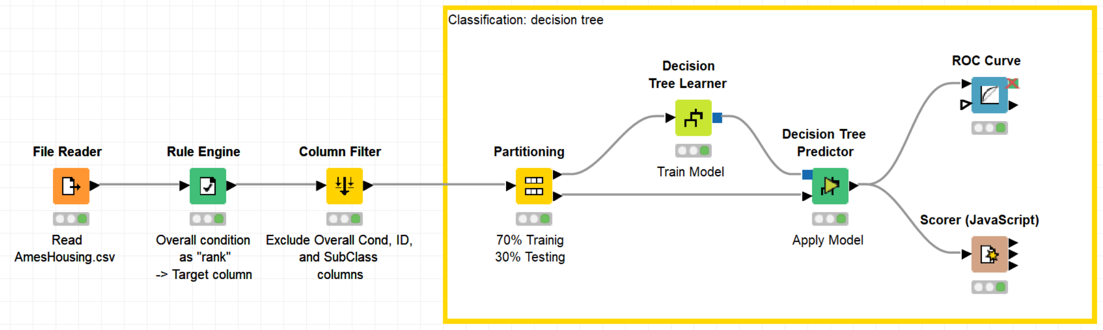
1. Decision Tree
Train a binary classification model that predicts the overall condition of a house (either “high” or “low”).

Slide 40
2. Regression Tree
Predict the price of an house in Ames (Iowa, USA) given a number of features (size, neighborhood, heating...) using a Regression Tree.
Read the dataset AmesHousing_simple.csv. It contains information about houses sold in Ames (only numerical values) as well as the SalePrice.
Add Partitioning node to File Reader output
Top port should have 70 % of the rows
Draw randomly such rows
Add Simple Regression Tree Learner to top output port of Partitioning node
Select price column to be learned
Execute the node and open its decision tree view. Which column is used in the beginning of the tree?
Add Simple Regression Tree Predictor
Predict test set (remaining 30% rows) by simply connecting the remaining unconnected output ports
Remove rows with missing values
Add Numeric Scorer to Regression Predictor Output
Reference Column: the column you learned
Predicted Column: the new column created by the predictor node

Slide 41
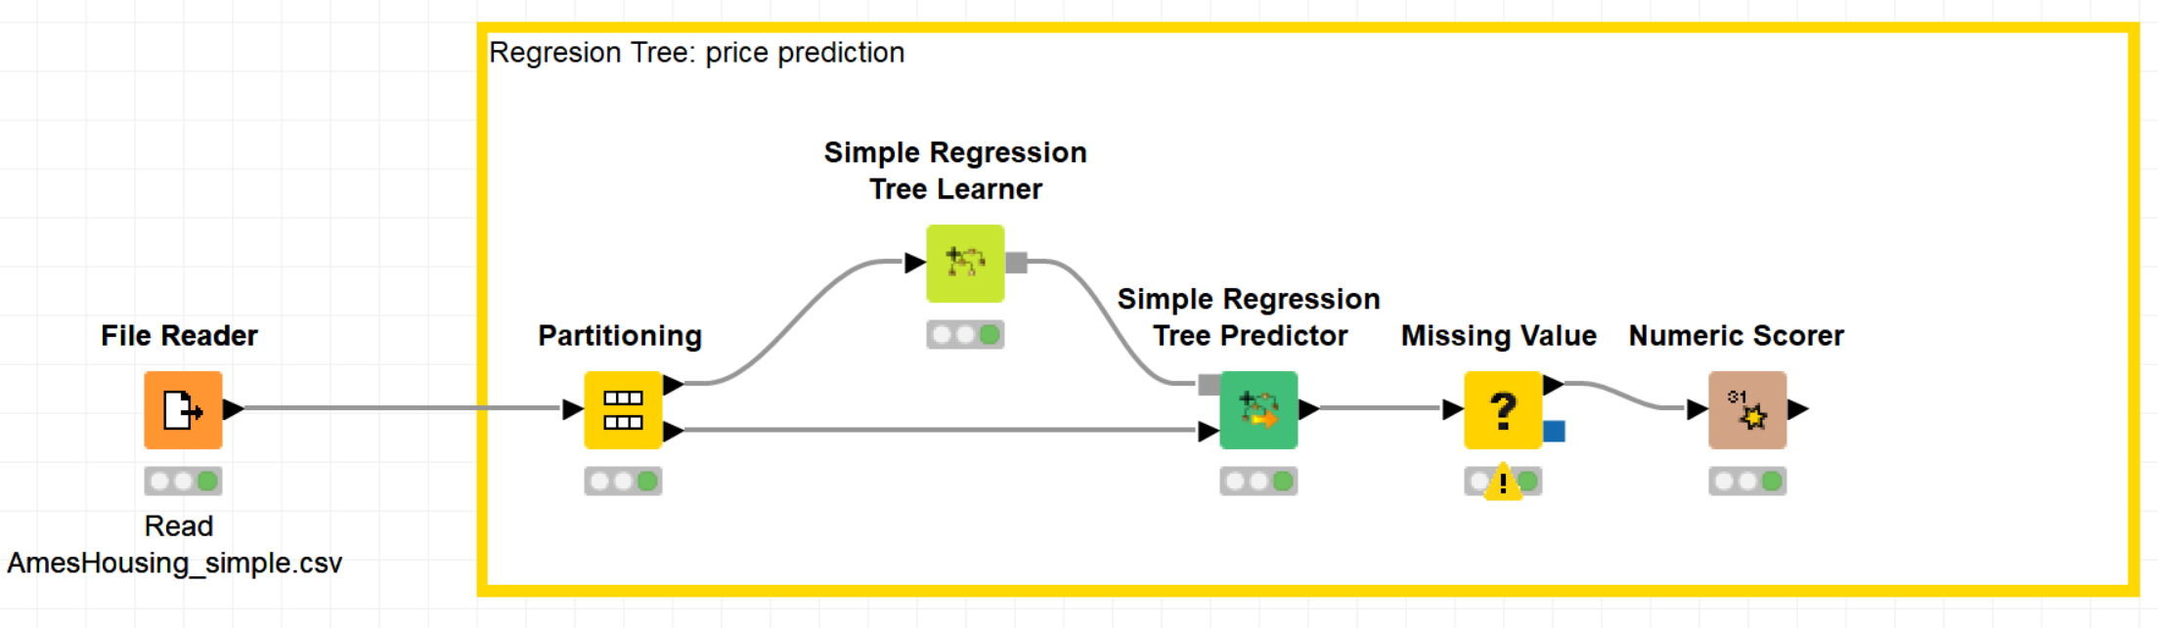
2. Regression Tree
Predict the price of an house in Ames (Iowa, USA) given a number of features (size, neighborhood, heating...) using a Regression Tree.

Slide 42
Thank you

