Slide 1
Support Vector Machines: Exercise

Slide 2
Exercise 1

Slide 3
1. SVM
Given is a one dimensional data set in R. Data points for +1 are at {-3, -2, 3} and data points for -1 are at {-1, 0, 1}
Can this data set in its current feature space be separated using a linear separator? Why/why not?
Define a kernel function to transform the data points in a space where the transformed data points are linearly parable
-3 -2 -1 0 +1 +2 +3

Slide 4
1. SVM
Can this data set in its current feature space be separated using a linear separator? Why/why not?
From the plot of the data is clear that the two classes cannot be separate using a single straight line
-3 -2 -1 0 +1 +2 +3

Slide 5
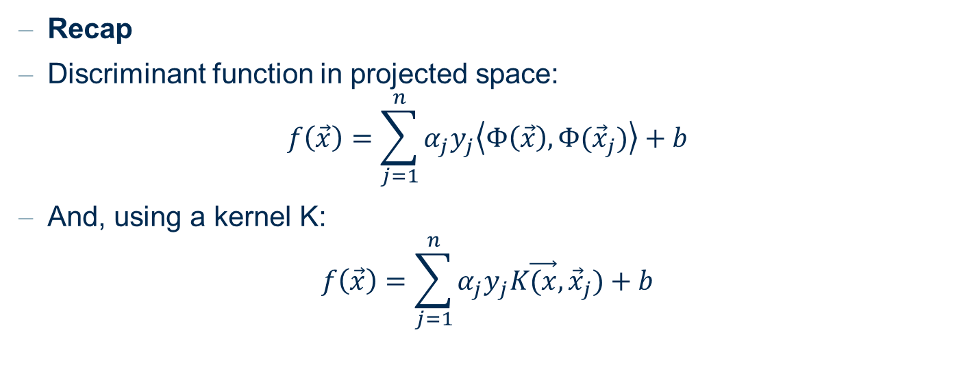
1. SVM
Define a kernel function to transform the data points in a space where the transformed data points are linearly parable
Recap
Discriminant function in projected space:
$$f\left(\vec{x}\right)=\sum_{j=1}^{n}{α_{j}y_{j}\left\langle Φ\left(\vec{x}\right),Φ({\vec{x}}_{j})\right\rangle +b}$$
And, using a kernel K:
$$f\left(\vec{x}\right)=\sum_{j=1}^{n}{α_{j}y_{j}K\vec{(x},{\vec{x}}_{j})+b}$$

Slide 6
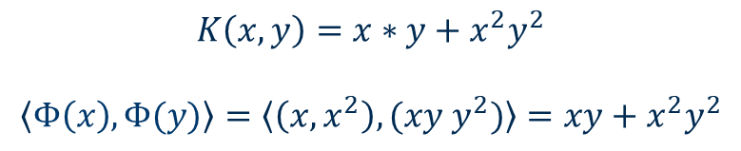
1. SVM
Define a kernel function to transform the data points in a space where the transformed data points are linearly parable
9
4
1
φ(x)=(x,x²)
-3 -2 -1 0 +1 +2 +3
$$K\left(x,y\right)=x∗y+x^{2}y^{2}$$
$$\left\langle Φ\left(x\right),Φ(y)\right\rangle =\left\langle \left(x, x^{2}\right),(xy y^{2})\right\rangle =xy+x^{2}y^{2}$$
-3 -2 -1 +1 +2 +3

Slide 7
Exercise 2

Slide 8
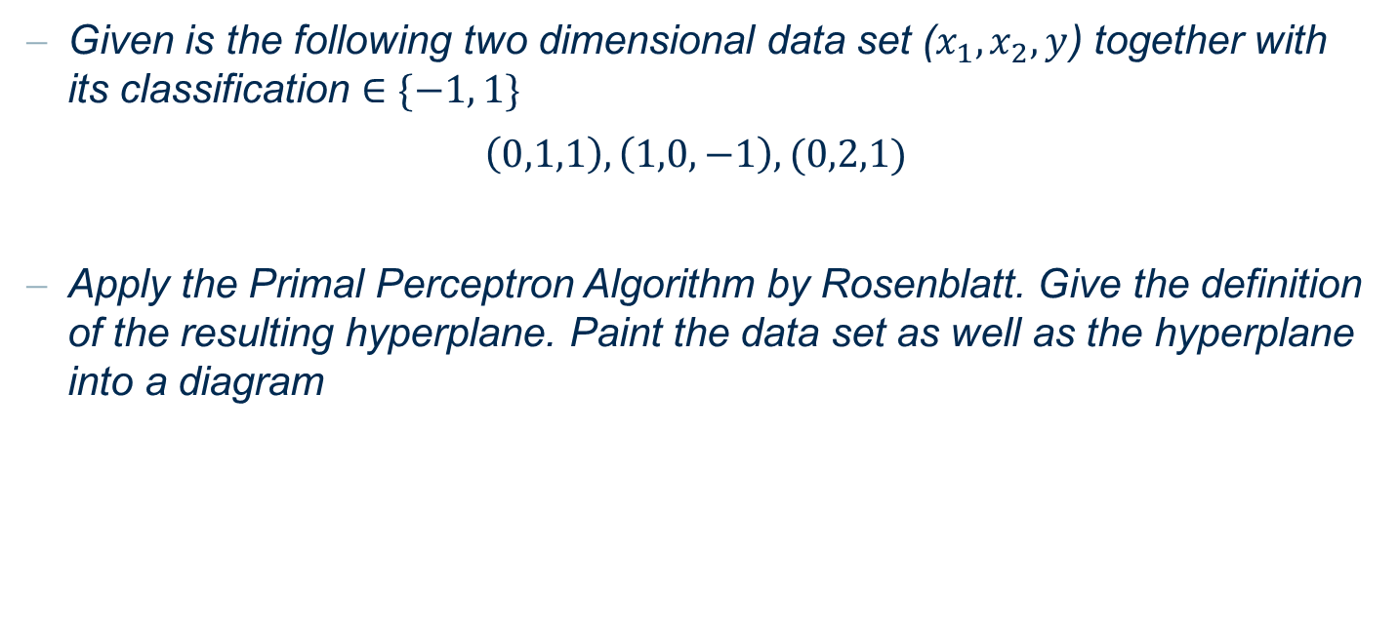
2. SVM
Given is the following two dimensional data set ($x_{1}, x_{2}, y$) together with its classification $∈\{−1, 1\}$
$\left(0,1,1\right),\left(1,0,−1\right), (0,2,1)$
Apply the Primal Perceptron Algorithm by Rosenblatt. Give the definition of the resulting hyperplane. Paint the data set as well as the hyperplane into a diagram

Slide 9

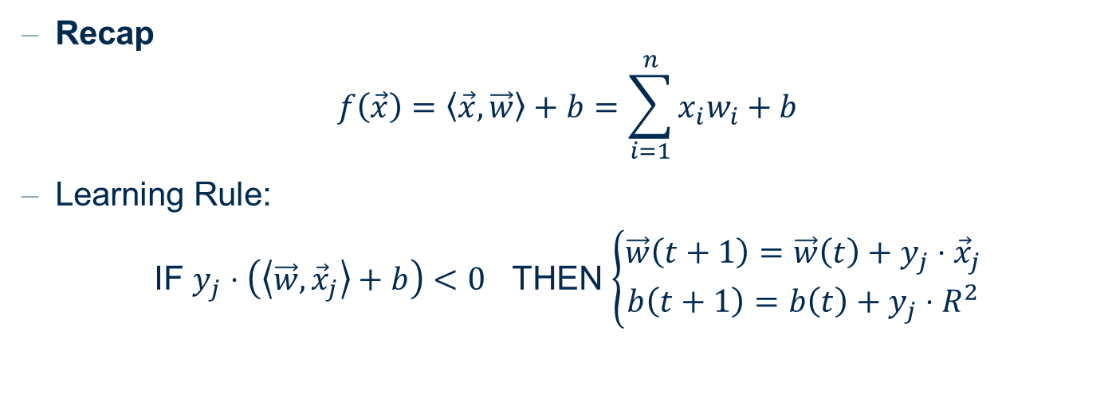
2. SVM
Apply the Primal Perceptron Algorithm by Rosenblatt.
$\left(0,1,1\right),\left(1,0,−1\right), (0,2,1)$
Recap
$$f\left(\vec{x}\right)=\left\langle \vec{x}, \vec{w}\right\rangle +b=\sum_{i=1}^{n}{x_{i}w_{i}+b}$$
Learning Rule:
IF $y_{j}⋅\left(\left\langle \vec{w}, {\vec{x}}_{j}\right\rangle +b\right)<0$ THEN $\left\{\begin{aligned}\vec{w}\left(t+1\right)=\vec{w}\left(t\right)+y_{j}⋅{\vec{x}}_{j} \\ b\left(t+1\right)=b\left(t\right)+y_{j}⋅R^{2}\end{aligned}\right.$

Slide 10
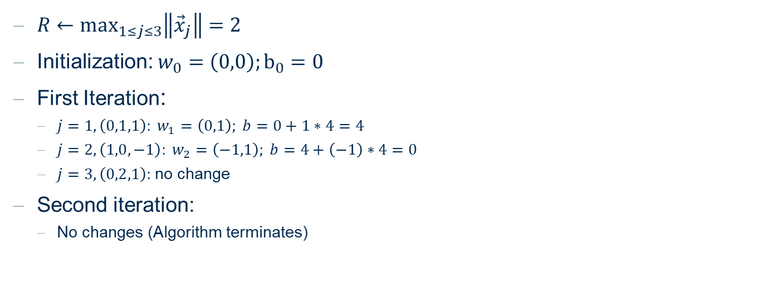
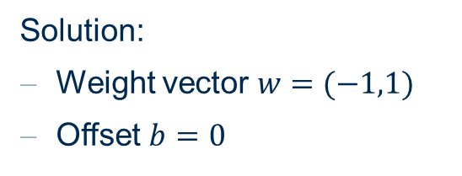
2. SVM
Apply the Primal Perceptron Algorithm by Rosenblatt.
$\left(0,1,1\right),\left(1,0,−1\right), (0,2,1)$
Solution:
Weight vector $w=(−1,1)$
Offset $b=0$
$R←\max_{1≤j≤3}\left\|{\vec{x}}_{j}\right\|=2$
Initialization: $w_{0}=\left(0,0\right);b_{0}=0$
First Iteration:
$j=1, \left(0,1,1\right): w_{1}=\left(0,1\right); b=0+1∗4=4$
$j=2, \left(1,0,−1\right): w_{2}=\left(−1,1\right); b=4+\left(−1\right)∗4=0$
$j=3, \left(0,2,1\right):$ no change
Second iteration:
No changes (Algorithm terminates)
3
2
1
-1
0
1
2
3

Slide 11
Exercise 3

Slide 12

3. SVM
Given are two training data in $R^{1}$ as in the following figure. What is the separating hyperplane? Define the weight vector and b in a way that the distance between the two hyperplanes is maximal.
0
1

Slide 13
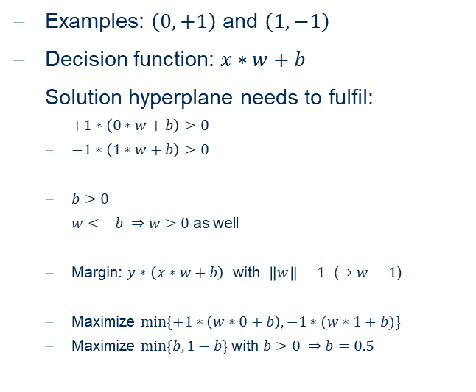
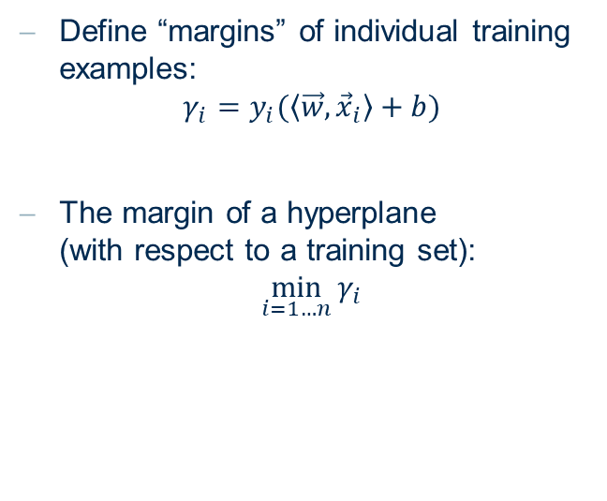
3. SVM
What is the separating hyperplane?
0
1
Define “margins” of individual training examples:
$$γ_{i}=y_{i}(\left\langle \vec{w},{\vec{x}}_{i}\right\rangle +b)$$
The margin of a hyperplane (with respect to a training set):
$$\min_{i=1…n}{γ_{i}}$$
Examples: $\left(0,+1\right)$ and $\left(1,−1\right)$
Decision function: $x∗w+b$
Solution hyperplane needs to fulfil:
$+1∗\left(0∗w+b\right)>0$
$−1∗\left(1∗w+b\right)>0$
$b>0$
$w<−b ⇒w>0$ as well
Margin: $y∗\left(x∗w+b\right)$ with $\left\|w\right\|=1$ ($⇒w=1$)
Maximize $min\{+1∗\left(w∗0+b\right), −1∗(w∗1+b)\}$
Maximize $min⁡\{b, 1−b\}$ with $b>0 ⇒b=0.5$

Slide 14
Exercise 4 Practice with KNIME

Slide 15
SVM in KNIME
Train a classifier to predict the vehicle type. The attributes are numerical, and have been normalized to [0,1] scale. Use a support vector machine (SVM) as a classification model. Explore an optimal parameter for the SVM setting.
Read the data (vehicle.table) with a Table Reader node. This dataset contains 2D attributes of silhouettes created by different types of vehicles. The last column is the target column, describing the 4 types of vehicles (bus, Opel, Saab, and van)
Split the data with a Partitioning node into the training (80%) and testing (20%) data sets.
Use stratified sampling to preserve the target distribution on Col18.
Train an SVM classifier with the SVM Learner node. Use the RBF kernel with sigma=0.5.
Use the trained model to predict the vehicle type with the SVM Predictor node
Assess the classification outcome by examining the confusion matrix with the Scorer node.
Determine the optimal margin hardness by varying the Overlapping penalty in the SVM learner node with a Parameter Optimization Loop.
For the Parameter Optimization Loop Start, create a parameter “c” ranging from 1 to 25, with the step size of 2.
Use the parameter c to control “c_parameter” in the SVM Learner flow variable.
Connect the flow variable output from the Scorer node to the Parameter Optimization Loop End. Maximize the Accuracy.

Slide 16
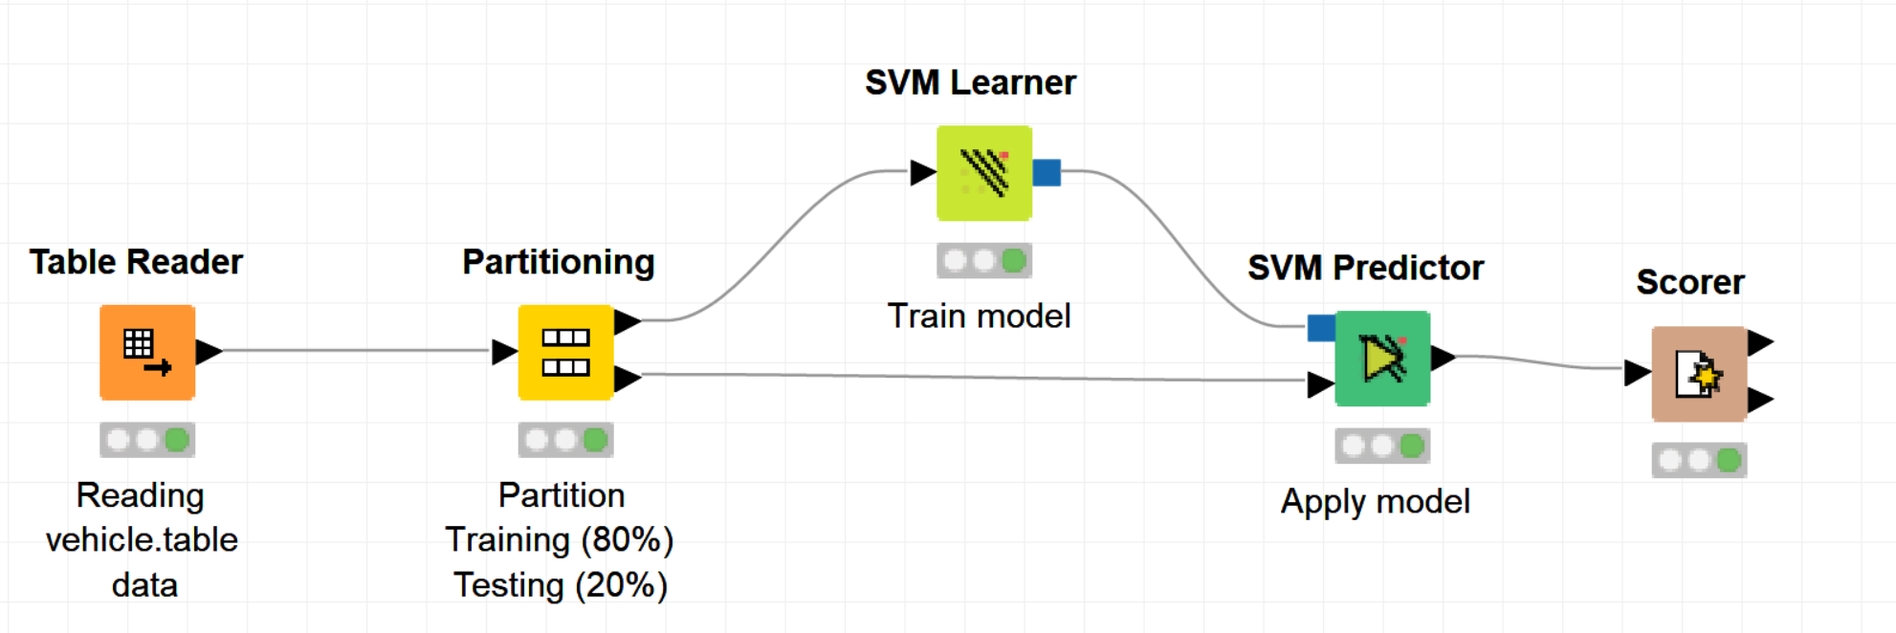
SVM in KNIME
Train a classifier to predict the vehicle type. The attributes are numerical, and have been normalized to [0,1] scale. Use a support vector machine (SVM) as a classification model.

Slide 17
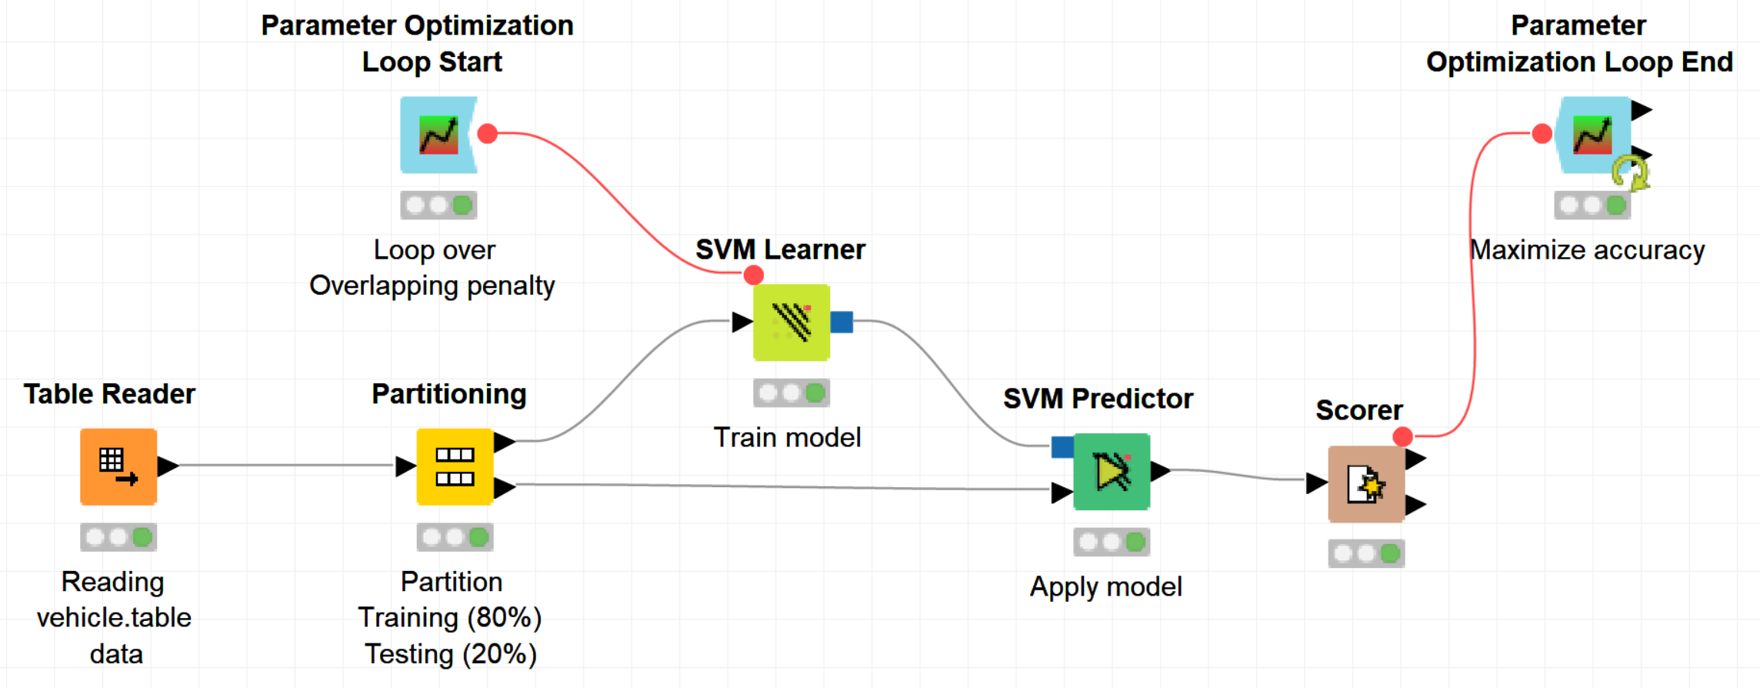
SVM in KNIME
Determine the optimal margin hardness by varying the Overlapping penalty in the SVM learner node with a Parameter Optimization Loop.

Slide 18
Thank you

