Slide 1
Basic Principles of Machine Learning

Slide 2
Summary of this lesson
„Machine intelligence is the last invention that humanity will ever need to make“
-Nick Bostrom
What are common aspects of every Machine Learning algorithm?
*This lesson refers to chapter 5 of the GIDS book

Slide 3
Content of this lesson
Basic strategies for ML algorithms
Close form solutions
Gradient descent
Search strategies
Error measures to validate models
Confusion matrix
Class statistics measures
Accuracy measures
ROC curves
Cohen‘s kappa
Numeric error measures
Model validation
Types of model errors
Strategies for more reliable model evaluation
Cross-validation
Bootstrapping
Coping with unbalanced datasets
Measures for model complexity

Slide 4
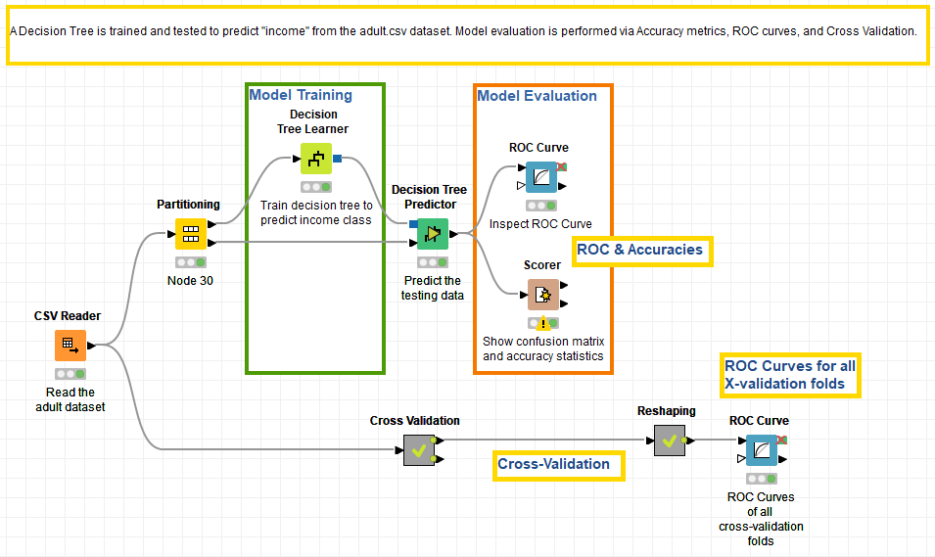
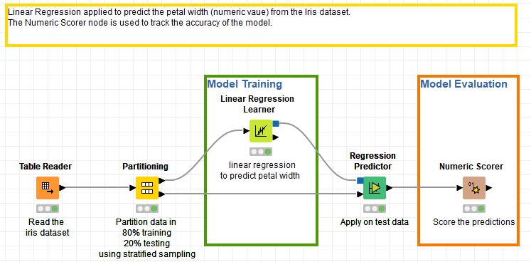
Datasets
Datasets used : adult dataset and iris dataset
Example Workflows:
„Training and testing a model (decision tree)“ https://kni.me/w/-0nN9BzUOCI6vCXl
confusion matrix
accuracy measures
ROC curve
cross-validation
„Numeric Error Measures to score numeric predictions“ https://kni.me/w/KGDqtyTZ4FPCgXrH
Partitioning
Numeric error measures

Slide 5
Select the Model

Slide 6
What‘s the best model to use?
Finding the “best” model is not a trivial task at all, since the question what a good (or best) model means is not always easy to answer.
From the Data:
Classification vs. Numerical
Supervised vs. Unsupervised
From the business case:
Performances: what is acceptable?
Simplicity: do not use a cannon for a simple problem
Interpretability: do I need to know the decision process?
Computational costs: it must be trainable and applicable in a reasonable time with reasonable hardware

Slide 7
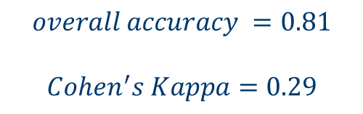
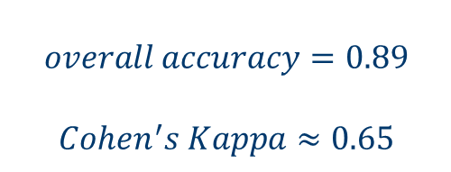
Performances
Acceptable performances depend on:
The adopted score function
Our tolerance to errors
True class | Predicted class
 | Positive | Negative
Positive | 14 | 6
Negative | 5 | 75
True class | Predicted class
 | Positive | Negative
Positive | 6 | 14
Negative | 5 | 75
Similar overall accuracy
But different Cohen‘s Kappa
$$overall accuracy=0.89$$
$Cohen^{′}s Kappa≈0.65$
$$overall accuracy =0.81$$
$Cohen^{′}s Kappa=0.29$

Slide 8
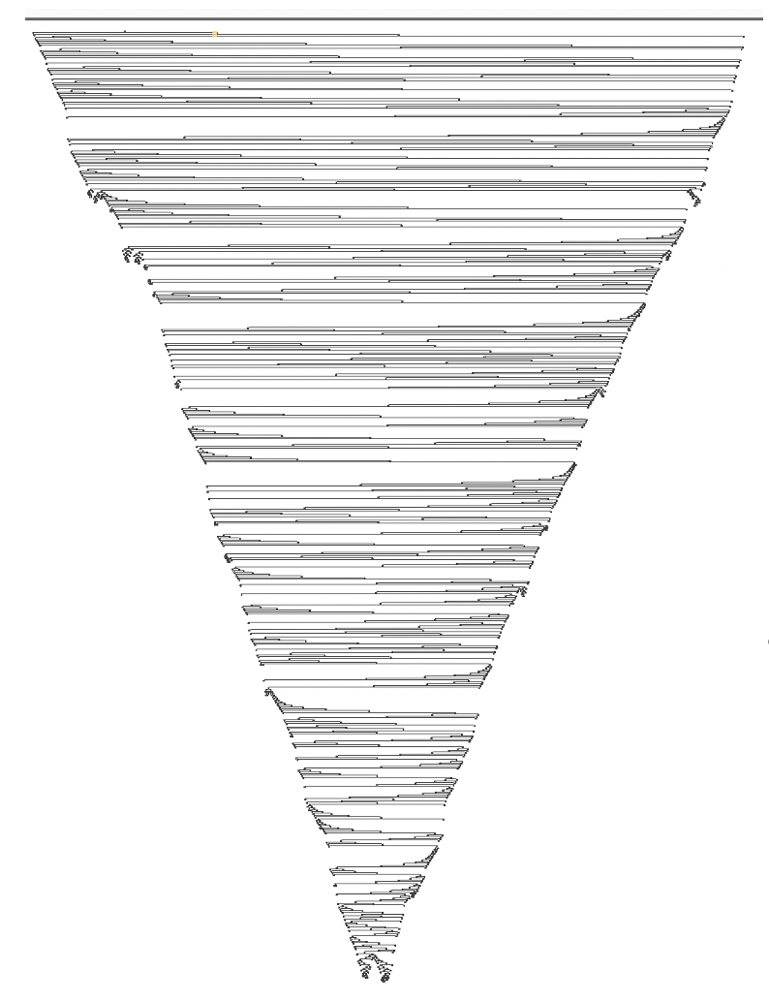
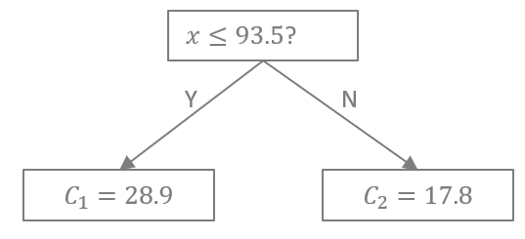
Simplicity
Do not use a cannon to shoot a fly!
Simple models are usually easier to understand and to interpret.
Their computational complexity is lower.
Too complex models often lead to overfitting.
vs.

Slide 9
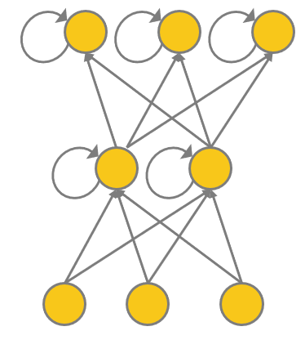
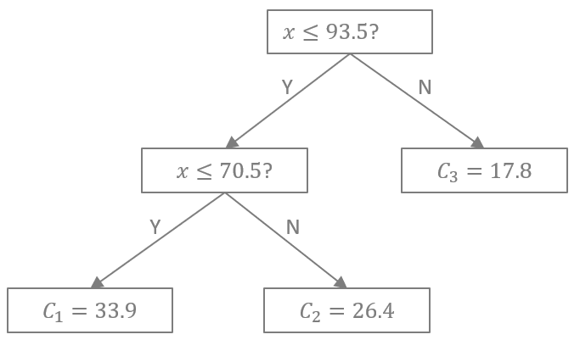
Interpretability
For some use cases interpretability is a must
For some other use cases interpretabilty is not necessary
Interpretable model vs. Black-box
vs.

Slide 10
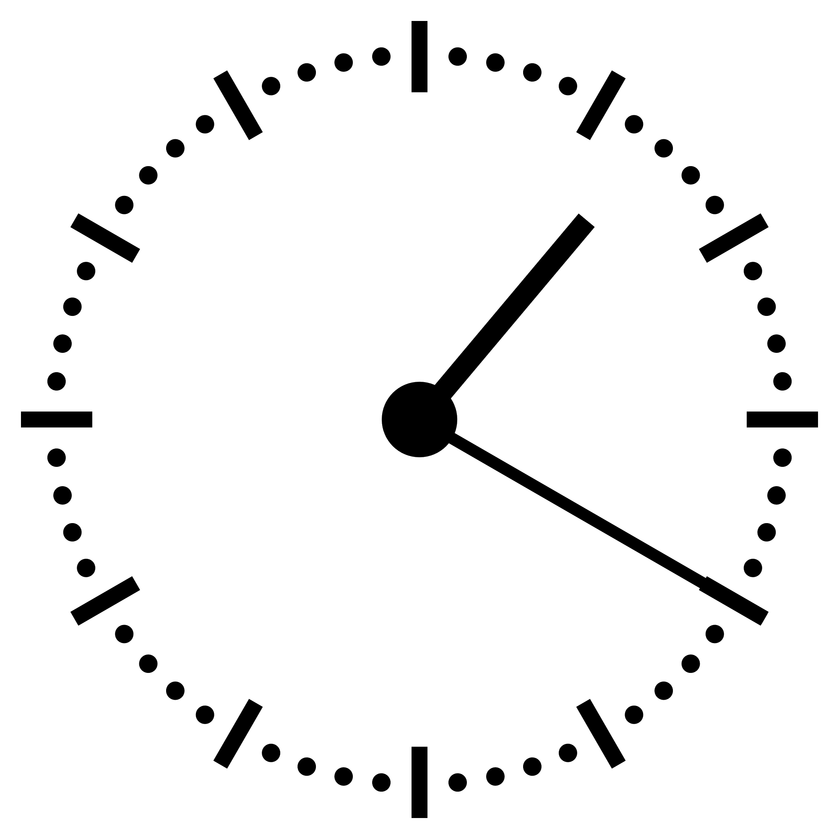
Computational Costs
Computational costs mean:
More advanced (and expensive) hardware
More time spent on training the model (possibly multiple times)

Slide 11
Select the score function

Slide 12
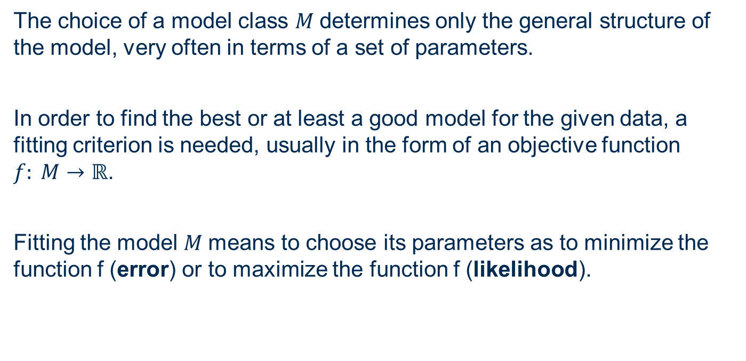
Loss / Likelihood functions
The choice of a model class $M$determines only the general structure of the model, very often in terms of a set of parameters.
In order to find the best or at least a good model for the given data, a fitting criterion is needed, usually in the form of an objective function $f: M→ℝ$.
Fitting the model $M$means to choose its parameters as to minimize the function f (error) or to maximize the function f (likelihood).

Slide 13
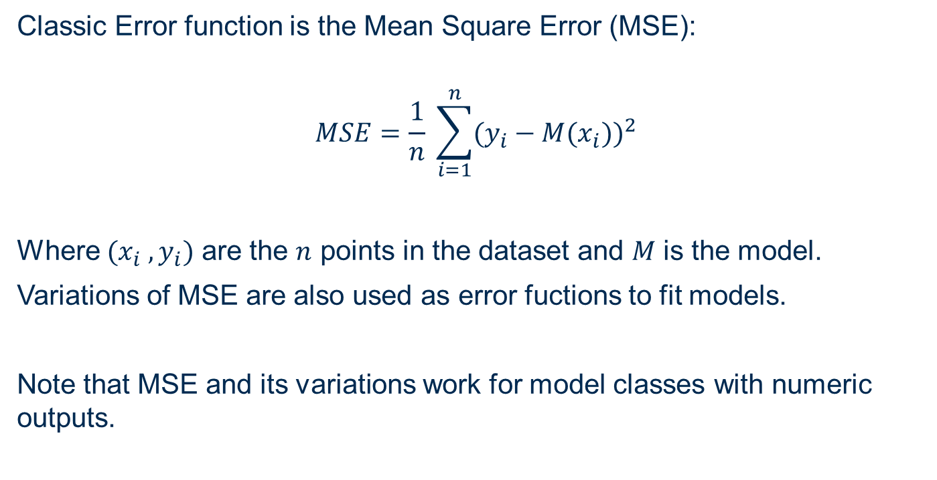
Loss Functions for Numeric Models
Classic Error function is the Mean Square Error (MSE):
$$MSE=\frac{1}{n} \sum_{i=1}^{n}{{(y_{i}−M(x_{i}))}^{2}}$$
Where ${(x}_{i}{ ,y}_{i})$ are the $n$ points in the dataset and $M$ is the model.
Variations of MSE are also used as error fuctions to fit models.
Note that MSE and its variations work for model classes with numeric outputs.

Slide 14
Cost Matrix
Classic Error function for classification is the misclassification rate.
Misclassification rate is the proportion of records wrongly assigned to a class.
Misclassification rate can be associated to a cost matrix
Tea cup misclassification cost matrix:
c1 = cost of misclassification of good cup for broken cup, i.e. cost of cup to be trashed
c2 = cost of misclassification of broken cup for good cup, i.e. new cup + unhappy customer
True class | Predicted class
 | OK | broken
OK | 0 | c1
broken | c2 | 0

Slide 15


Loss Functions for Classification
Classic loss function for classification:
$$Loss\left(c_{j} | x\right)=\sum_{j=1}^{m}{P{\left(c_{j} | x\right) c}_{ji}}$$
Where:
$(x{ ,c}_{k})$ is a point in the dataset with input features $x$ and true class $c_{k}$
$P\left(c_{j} | x\right)$ the probability of input vector $x$ to be assigned to class $c_{j}$
$c_{ji}$ the misclassification cost of assigning input vector $x$to class $c_{i}$ instead of the correct class $c_{j}$
$m$ the number of classes
The loss function can be extended to the sum on all samples in the dataset

Slide 16
Algorithms for model fitting

Slide 17
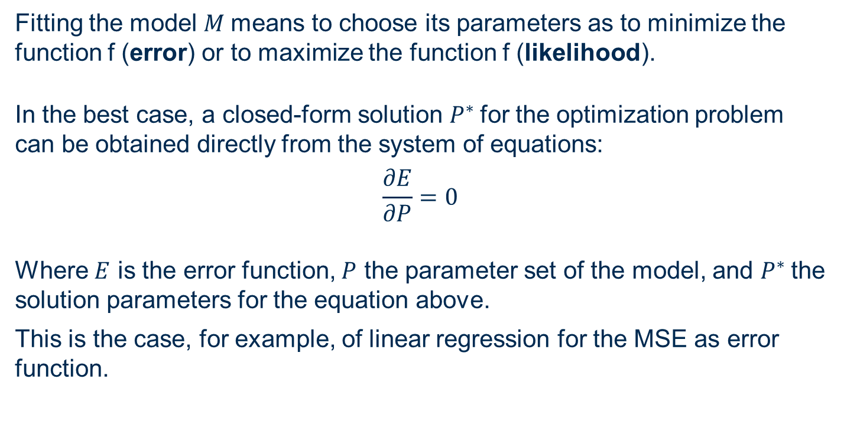
Algorithms for model fitting: closed-form solutions
Fitting the model $M$means to choose its parameters as to minimize the function f (error) or to maximize the function f (likelihood).
In the best case, a closed-form solution $P^{∗}$for the optimization problem can be obtained directly from the system of equations:
$$\frac{∂E}{∂P}=0$$
Where $E$ is the error function, $P$ the parameter set of the model, and $P^{∗}$the solution parameters for the equation above.
This is the case, for example, of linear regression for the MSE as error function.

Slide 18
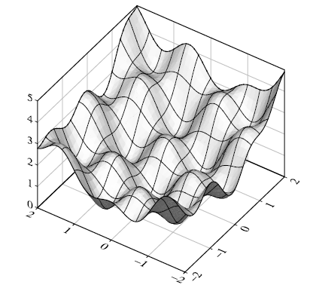
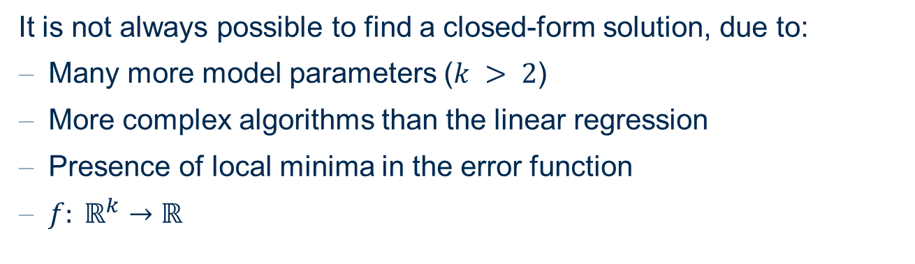
Algorithms for model fitting: gradient descent based solutions
It is not always possible to find a closed-form solution, due to:
Many more model parameters ($k > 2$)
More complex algorithms than the linear regression
Presence of local minima in the error function
$f: ℝ^{k}→ℝ$
Error function
When the objective function is differentiable, a gradient method can be applied.
parameters

Slide 19


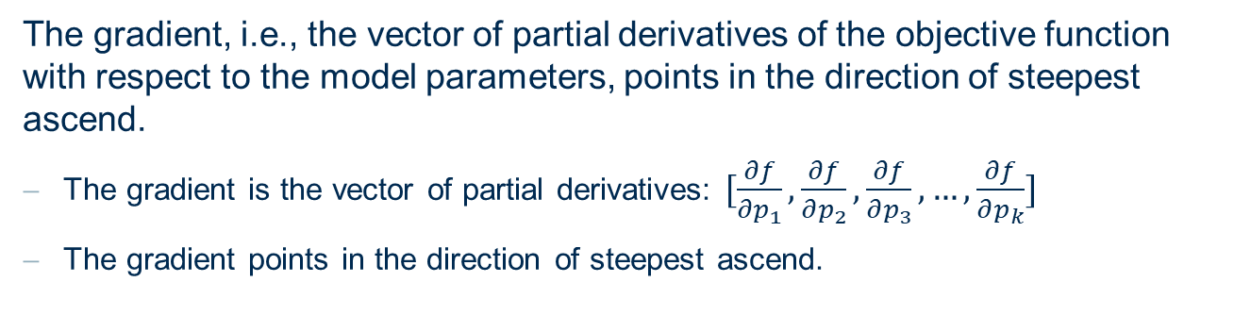


Algorithms for model fitting: gradient descent based solutions
The gradient, i.e., the vector of partial derivatives of the objective function with respect to the model parameters, points in the direction of steepest ascend.
The gradient is the vector of partial derivatives: $[\frac{∂f}{∂p_{1}},\frac{∂f}{∂p_{2}},\frac{∂f}{∂p_{3}}, …,\frac{∂f}{∂p_{k}}]$
The gradient points in the direction of steepest ascend.
$$f$$
$$\frac{∂f}{∂p}(p_{0})$$
$$p_{0}$$
$$p$$

Slide 20
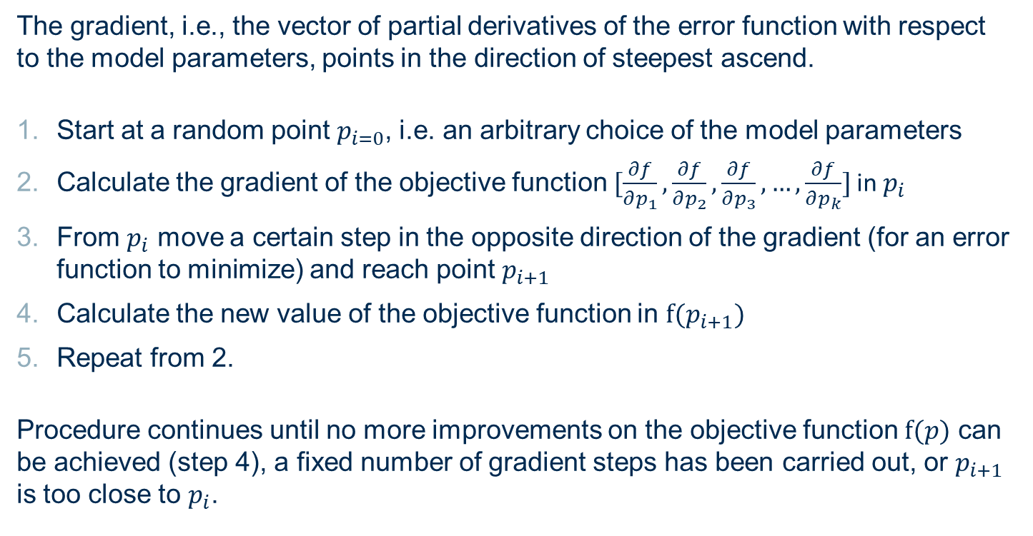
Algorithms for model fitting: gradient descent based solutions
The gradient, i.e., the vector of partial derivatives of the error function with respect to the model parameters, points in the direction of steepest ascend.
Start at a random point $p_{i=0}$, i.e. an arbitrary choice of the model parameters
Calculate the gradient of the objective function $[\frac{∂f}{∂p_{1}},\frac{∂f}{∂p_{2}},\frac{∂f}{∂p_{3}}, …,\frac{∂f}{∂p_{k}}]$ in $p_{i}$
From $p_{i}$ move a certain step in the opposite direction of the gradient (for an error function to minimize) and reach point $p_{i+1}$
Calculate the new value of the objective function in $f(p_{i+1})$
Repeat from 2.
Procedure continues until no more improvements on the objective function $f(p)$ can be achieved (step 4), a fixed number of gradient steps has been carried out, or $p_{i+1}$ is too close to $p_{i}$.

Slide 21
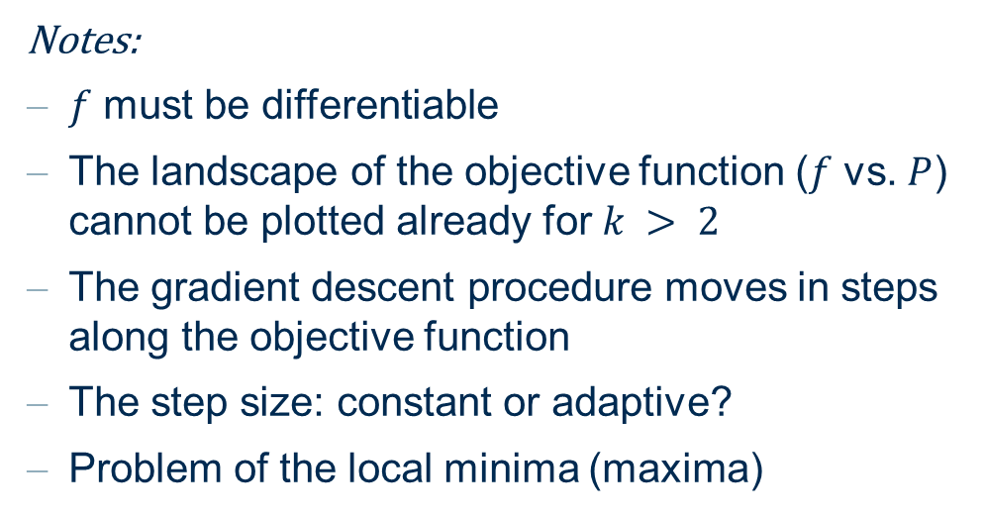
Algorithms for model fitting: gradient descent based solutions
Notes:
$f$ must be differentiable
The landscape of the objective function ($f$ vs. $P$) cannot be plotted already for $k > 2$
The gradient descent procedure moves in steps along the objective function
The step size: constant or adaptive?
Problem of the local minima (maxima)
It is recommended to run a gradient method repeatedly, starting with different initial points to increase the chance to find the global or at least a good local optimum.

Slide 22
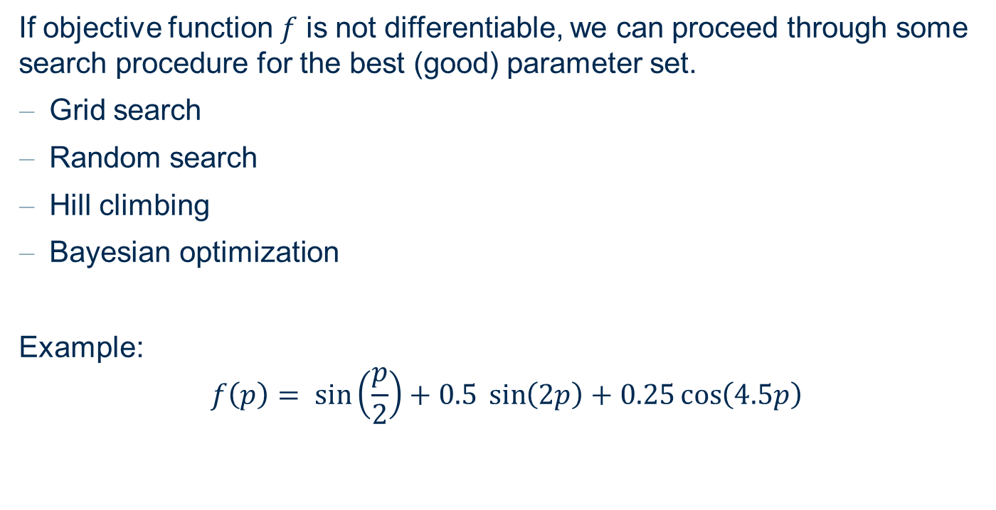
Algorithms for model fitting: search strategies
If objective function $f$ is not differentiable, we can proceed through some search procedure for the best (good) parameter set.
Grid search
Random search
Hill climbing
Bayesian optimization
Example:
$$f\left(p\right)= \sin\left(\frac{p}{2}\right)+0.5 \sin\left(2p\right)+0.25\cos\left(4.5p\right)$$

Slide 23
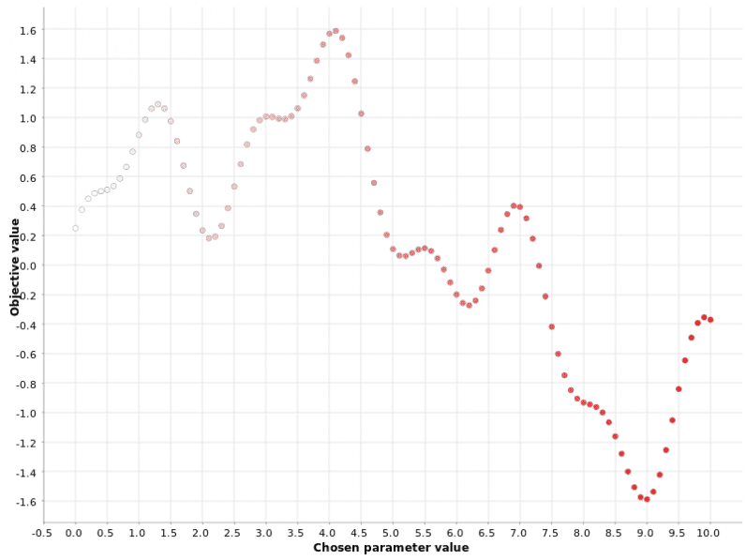
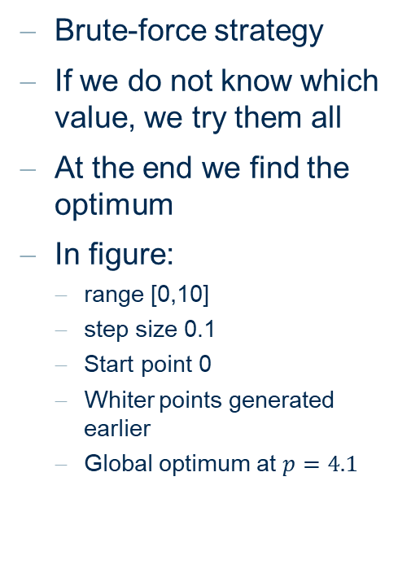
Grid Search
Brute-force strategy
If we do not know which value, we try them all
At the end we find the optimum
In figure:
range [0,10]
step size 0.1
Start point 0
Whiter points generated earlier
Global optimum at $p=4.1$
Grid

Slide 24
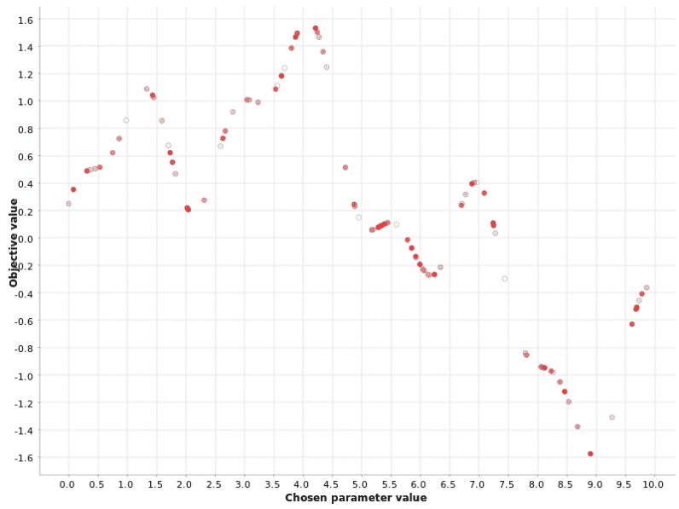
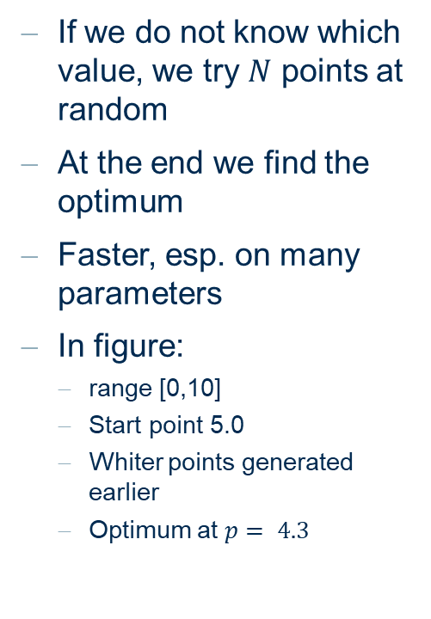
Random Search
If we do not know which value, we try $N$ points at random
At the end we find the optimum
Faster, esp. on many parameters
In figure:
range [0,10]
Start point 5.0
Whiter points generated earlier
Optimum at $p= 4.3$
Random

Slide 25
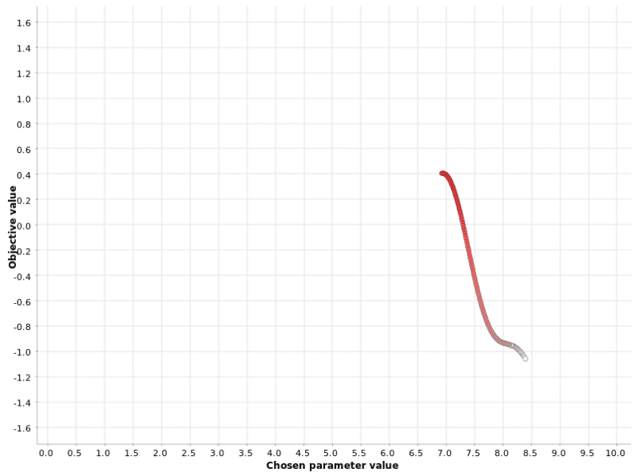
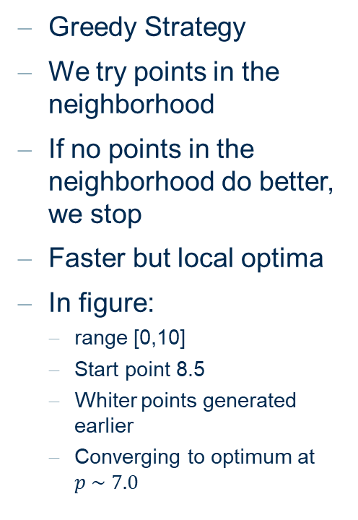
Hill Climbing
Greedy Strategy
We try points in the neighborhood
If no points in the neighborhood do better, we stop
Faster but local optima
In figure:
range [0,10]
Start point 8.5
Whiter points generated earlier
Converging to optimum at $p \sim 7.0$
Hill Climbing

Slide 26
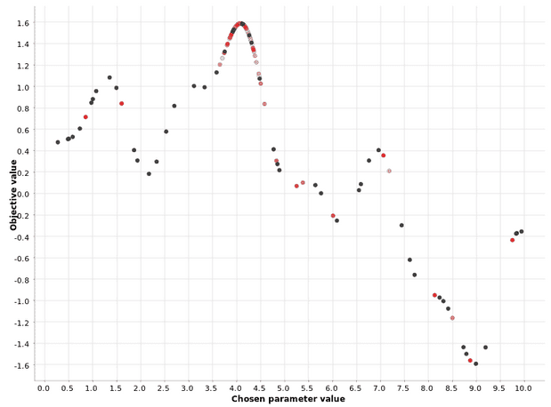

Bayesian Optimization
Phase 1 (warm up): Random points
Phase 2: surrogate model from random points $P(output| past points)$
Optimize surrogate model
In figure:
range [0,10]
Gray points in warm up phase
Whiter points generated earlier
Converging to optimum at $p \sim 4.0$
Bayesian

Slide 27
Validate Results: Errors

Slide 28
Types of Errors
Pure / Experimental / Intrinsic Error (Bayes Error)
The pure error or experimental error is inherent in the data and is due to noise, random variations, imprecise measurements, or the influence of hidden variables that cannot be observed.
Sample Error
The sample error is caused by the fact that a finite sample, especially when its size is quite small, will seldom exactly reflect the true distribution of the probability distribution generating the data (example of throwing a dice).
Model Error
A large error may be caused by a lack of fit. When the set of considered models is too simple for the structure inherent in the data, no model will yield a small error. Too complex models might run into overfitting.
Algorithmic Error
The algorithmic error is caused by the method that is used to fit the model. Usually this is ignored.

Slide 29
Machine Learning: Bias and Variance
Pure / Experimental / Intrinsic Error (Bayes Error)
The pure error or experimental error is inherent in the data and is due to noise, random variations, imprecise measurements, or the influence of hidden variables that cannot be observed.
Sample Error
The sample error is caused by the fact that a finite sample, especially when its size is quite small, will seldom exactly reflect the true distribution of the probability distribution generating the data (example of throwing a dice).
Model Error
A large error may be caused by a lack of fit. When the set of considered models is too simple for the structure inherent in the data, no model will yield a small error. Too complex models might run into overfitting.
Algorithmic Error
The algorithmic error is caused by the method that is used to fit the model. Usually this is ignored.
Variance
Machine Learning Bias

Slide 30
Confusion Matrix for Classification
Confusion matrix is a matrix-like representation of the correctness of the classification model
A binary classification problem: yes / no classes
The matrix below summarizes the model predictions
True class | Predicted class
 | yes | no
yes | 22 | 3
no | 12 | 328
Correct predictions

Slide 31
Confusion Matrix for Classification
Arbitrarely we take one class as the POSITIVE class and the remaining class as the NEGATIVE class, then:
Correct predictions
TRUE POSITIVES (TP): True and predicted class is positive
TRUE NEGATIVES (TN): True and predicted class is negative
FALSE NEGATIVES (FN): True class is positive and predicted negative
FALSE POSITIVES (FP): True class is negative and predicted positive
True class | Predicted class
 | POSITIVE | NEGATIVE
POSITIVE | TRUE POSITIVES | FALSE NEGATIVES
NEGATIVE | FALSE POSITIVES | TRUE NEGATIVES
Most evaluation metrics are based on the confusion matrix

Slide 32

Class Statistics
Sensitivity vs. Specificity
$sensitivity= \frac{TP}{TP+FN}$ $specificity= \frac{TN}{TN+FP}$
Precision vs. Recall
$$recall=\frac{TP}{TP+FN} precision= \frac{TP}{TP+FP}$$
Ratio of samples in the positive class correctly classified
Ratio of samples in the negative class correctly classified
Same as sensitivity
Ratio of samples correctly classified among those assigned to the positive class
Both measures must be high!

Slide 33

Accuracy Measures
F-Measure
$$F=2\frac{precision ∙recall}{precision+recall}$$
Overall Accuracy
$$accuracy=\frac{TP+TN}{TP+TN+FP+FN}= \frac{TP+TN}{n}$$
Cohen‘s Kappa
$$\text{κ}=\frac{p_{o}−p_{e}}{1−p_{e}}$$
All correctly classified samples
All samples

Slide 34

Cohen‘s Kappa
Overall accuracy
$$\text{κ}=\frac{p_{o}−p_{e}}{1−p_{e}}$$
$$p_{e}=p_{pos}+p_{neg}$$
$$p_{pos}= \frac{TP+FN}{n} ∙\frac{TP+FP}{n}$$
$$p_{neg}=\frac{TN+FP}{n} ∙\frac{TN+FN}{n}$$
Introduces the a priori probabilities of the classes
All samples in the positive class
All samples assigned to the positive class
All samples in the negative class
All samples assigned to the negative class
Perfectly correct classification κ = 1
Perfectly wrong classification κ = 0

Slide 35


Cohen‘s Kappa (κ) vs. Overall accuracy
 | Positive | Negative
Positive | 14 | 6
Negative | 5 | 75
 | Positive | Negative
Positive | 6 | 14
Negative | 5 | 75
$$p_{e1}=\frac{19}{100}×\frac{20}{100}$$
$$p_{e2}=\frac{81}{100}×\frac{80}{100}$$
$$p_{e}=p_{e1}+p_{e2}=0.686$$
$$p_{0}=\frac{89}{100}=0.89$$
$κ=\frac{p_{0}−p_{e}}{1−p_{e}}=\frac{0.204}{0.314}≈0.65$
$$p_{e1}=\frac{11}{100}×\frac{20}{100}$$
$$p_{e2}=\frac{89}{100}×\frac{80}{100}$$
$$p_{e}=p_{e1}+p_{e2}=0.734$$
$$p_{0}=\frac{81}{100}=0.81$$
$κ=\frac{p_{0}−p_{e}}{1−p_{e}}=\frac{0.076}{0.266}=0.29$
Overall accuracy
κ = 1: perfect model performance
κ = 0: the model performance is equal to a random classifier

Slide 36
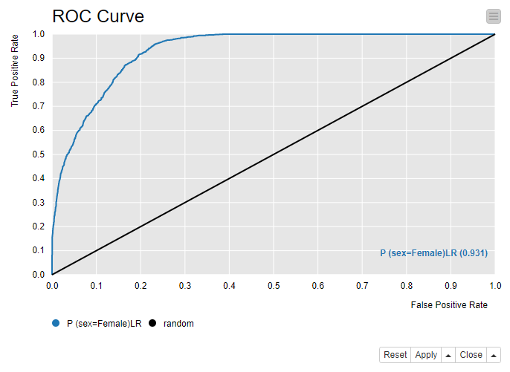



ROC curve
True classs | Predicted class
 | POSITIVE | NEGATIVE
POSITIVE | TRUE POSITIVES | FALSE NEGATIVES
NEGATIVE | FALSE POSITIVES | TRUE NEGATIVES
Classification model performance as reported by:
False positive rate (FPR)
negative events incorrectly classified as positive
True positive rate (TPR)
positive events correctly classified as positive
Perfect model
Thr =0.0
Optimal threshold
AuC = Area under the Curve
$$TPR= \frac{TP}{TP+FN}$$
Thr =0.8
Random choice
Thr =0.9
Thr =1.0
$$FPR= \frac{FP}{FP+TN}$$
$$P\left(pos | x\right)>threshold ⇒class pos$$

Slide 37
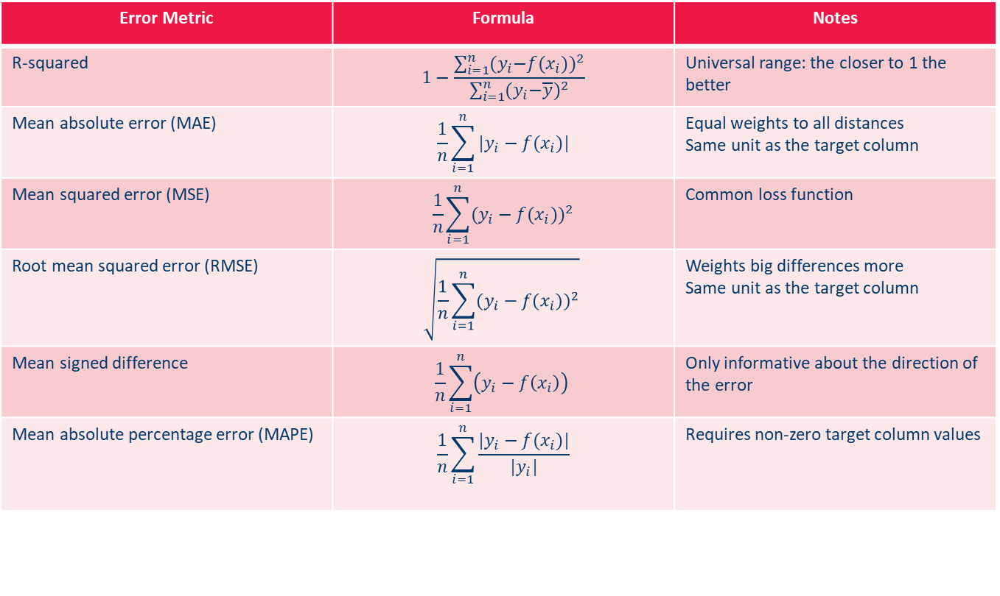
Numeric Error Measures
Error Metric | Formula | Notes
R-squared | $$1−\frac{\sum_{i=1}^{n}{{{(y}_{i}−f(x_{i}))}^{2}}}{\sum_{i=1}^{n}{{{(y}_{i}−\overline{y})}^{2}}}$$ | Universal range: the closer to 1 the better
Mean absolute error (MAE) | $$\frac{1}{n}\sum_{i=1}^{n}{|y_{i}−f(x_{i})|}$$ | Equal weights to all distances Same unit as the target column
Mean squared error (MSE) | $$\frac{1}{n}\sum_{i=1}^{n}{{(y_{i}−f(x_{i}))}^{2}}$$ | Common loss function
Root mean squared error (RMSE) | $$\sqrt{\frac{1}{n}\sum_{i=1}^{n}{{(y_{i}−f(x_{i}))}^{2}}}$$ | Weights big differences more Same unit as the target column
Mean signed difference | $$\frac{1}{n}\sum_{i=1}^{n}{\left(y_{i}−f\left(x_{i}\right)\right)}$$ | Only informative about the direction of the error
Mean absolute percentage error (MAPE) | $$\frac{1}{n}\sum_{i=1}^{n}{\frac{|y_{i}−f(x_{i})|}{|y_{i}|}}$$ | Requires non-zero target column values

Slide 38
Validate Results: Model Validation

Slide 39
Training set and test set
The most common principle to estimate a realistic performance of the model for unknown or future data is separating the data set for training and testing purposes:
Training phase: the algorithm trains a model using the data in the training set
Testing phase: a metric measures how well the model is performing on data in a new dataset (the test set)
Training Set
Evaluation Set*
Test Set
* sometimes

Slide 40
Cross-Validation
By chance, we might be lucky and the test set contains easy examples leading to an overoptimistic evaluation of the model. Or we might be unlucky and the test set contains difficult examples and the performance of the model is underestimated.
We can get a more realistic estimation of the model quality, by repeating the test many times on different test sets.
For k-fold cross-validation, the data set is partitioned into k subsets of approximately equal size
The first of the k subsets is used as a test set, and the other (k − 1) sets are used as training data for the model
This procedure is repeated by using each of the other k subsets as test data and the remaining (k − 1) subsets as training data
Altogether, we obtain k estimates for the model error. The average of these values is taken as the estimate for the model error. The variance is taken as an estimate for the quality of the underlying data.
Typically, k = 10 is chosen.

Slide 41
Sampling Techniques: Bootstrapping
Bootstrapping is a resampling technique from statistics aiming at estimating the variance of the model parameters.
Like in cross-validation, the model is computed multiple (k) times on different data sets.
k bootstrap samples, each of size n, are drawn randomly with replacement from the original data set with n records.
The model is then fitted to each one of these bootstrap samples, so that we obtain k estimates for the model parameters.
Based on these k estimates, the empirical standard deviation is computed for each parameter to provide information on how reliable the estimate of the parameter is.

Slide 42
Coping with unbalanced data
Sampling with stratification means that random assignments of the data to the test and training sets are carried out per class and not simply for the whole data set. This is to ensure that the relative class frequency in the original data set, the training, and the test set are the same.
Sometimes we want to force a model to represent the classes in the datasets equally even though they are not equally represented. Under-sampling and over-sampling techniques can produce a new dataset with equally distributed classes, though with unrealistic a priori probabilities.
Under-sampling techniques randomly remove samples from the majority class to have as many samples as the minority class. Attention! It may discard potentially useful information!
Over-sampling supplements the datasets with multiple copies of samples from the minority class – with or without replacement - as to reach the same number as in the majority class. Instead of using just copies of existing samples, some oversampling techniques create synthetic samples from the same statistical distribution of the minority class. The most common technique is called SMOTE (Synthetic Minority Oversampling Technique).

Slide 43
Generalization and Overfitting
Considering a data set as a collection of examples - describing the dependency between the predictor variables and the dependent variable - the model should “learn” this dependency from the data and generalize it in order to make correct predictions on new data.
To achieve this, the model must be universal (flexible) enough to be able to learn the dependency.
This does not mean that a more complex model with more parameters leads to better generalization than a simple one.
Complex models can lead to overfitting.

Slide 44
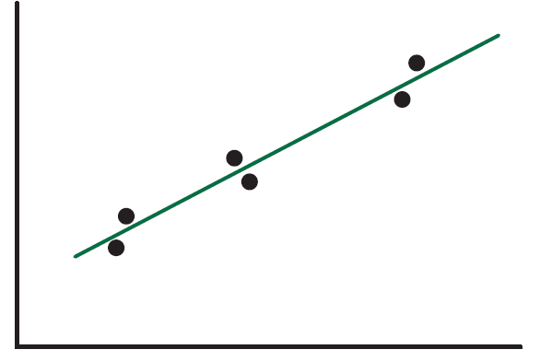
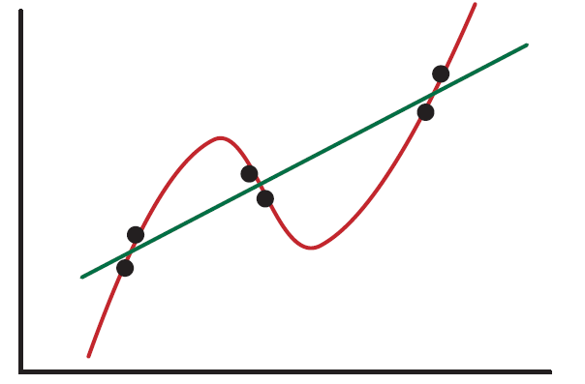
Keep it simple!
Generalized
Overfitted
The model must “learn” a description of the data, not of the details and noise inherent in the data.
The prediction using a complex function can be worse than for a simpler model.

Slide 45
Overfitting vs Underfitting
Overfitting | Underfitting
Model that fits the training data too well, including details and noise Negative impact on the model’s ability to generalize | A model that can neither fit the training data nor generalize to new data
Underfitted
Generalized
Overfitted

Slide 46
Validate Results: Model Complexity

Slide 47
Regularization Terms
Based on the principle of Occam’s razor, one should choose the simplest model that “explains” the data. If a linear function fits the data well enough, one should prefer the linear function and not a quadratic or cubic function.
There is a need for a trade-off between model simplicity and model fit.
Regularization is a general mathematical concept that introduces additional information in order to solve an otherwise ill-posed problem.
Here a penalty term for more complex models is incorporated into the pure measure for model fit as a regularization term.
By favouring simpler models, regularization also leads to avoiding overfitting.

Slide 48
Minimum Description Length (MDL)
The minimum description length principle (MDL) attempts to join measures for model fit and complexity into one single measure.
The basic idea behind MDL is to understand modelling as a technique for data compression.
To recover the original data, the compressed data and decompression rule are needed. Therefore, the overall size of the compressed data file is the sum of the bits needed for the compressed data and the bits needed to encode the decompression rule.
The model can be interpreted as a compression or decompression scheme. That is, to represent it we need the (binary) coding of the model and the compressed (binary) coding of the data (or of the errors).
Models with smallest MDL offer the best compromise between model error and model size.

Slide 49
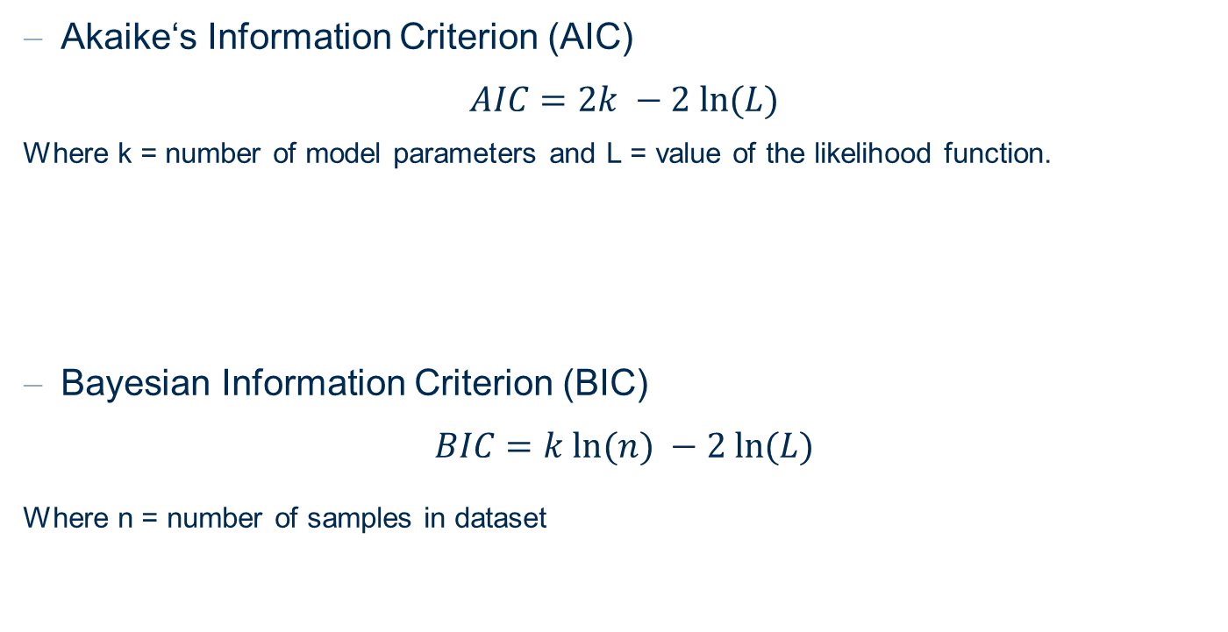
Other measures for model complexity
Akaike‘s Information Criterion (AIC)
$$AIC=2k −2 ln⁡(L)$$
Where k = number of model parameters and L = value of the likelihood function.
Bayesian Information Criterion (BIC)
$$BIC=k ln⁡(n) −2 ln⁡(L)$$
Where n = number of samples in dataset

Slide 50
What you have learned
Basic strategies for ML algorithms
Closed form solutions
Gradient descent
Search strategies
Error measures to validate models
Confusion matrix
Class statistics measures
Accuracy measures
ROC curves
Cohen‘s kappa
Numeric error measures
Model validation
Types of model errors
Strategies for more reliable model evaluation
Cross-validation
Bootstrapping
Coping with unbalanced datasets
Measures for model complexity

Slide 51
Scoring in Practice

Slide 52
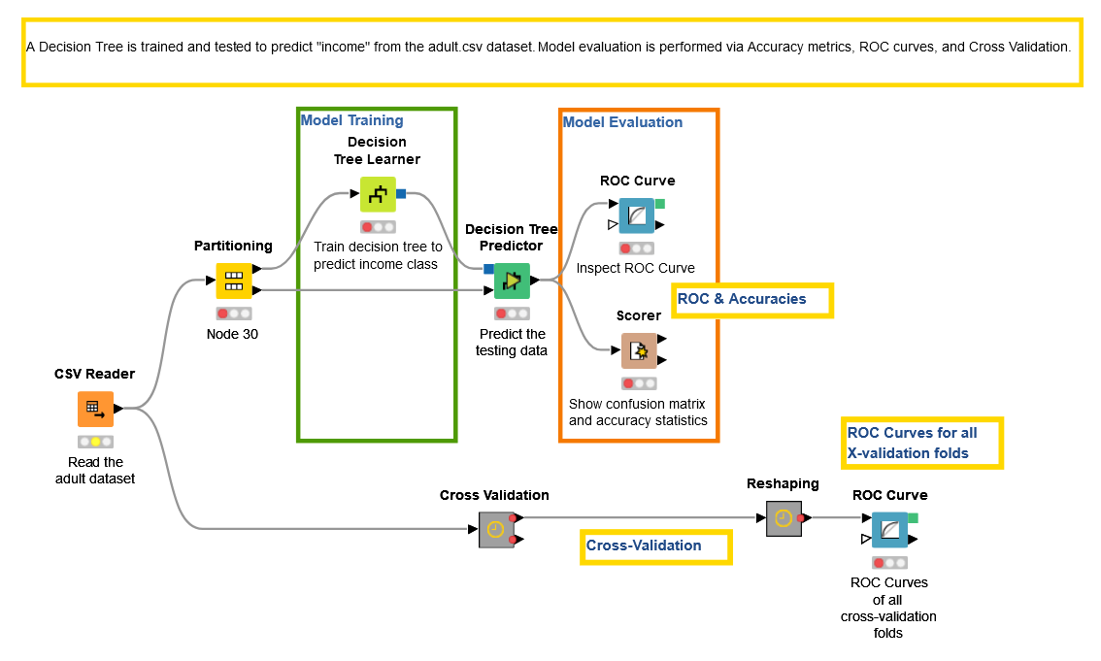
KNIME Workflows
Training and testing a classification model (decision tree)

Slide 53
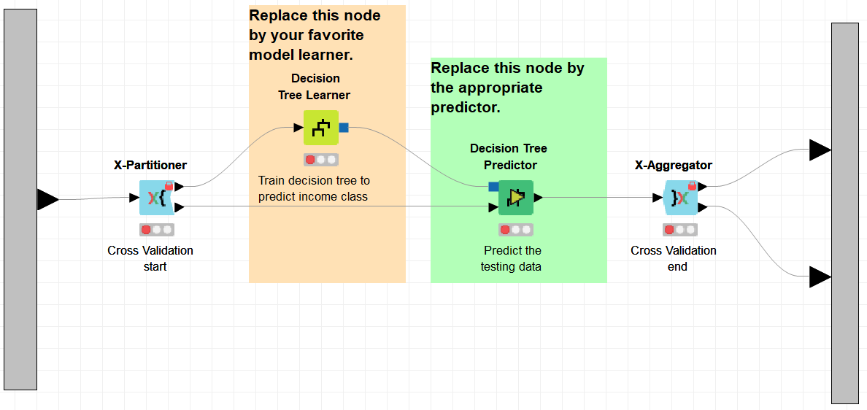
KNIME Workflows
Cross-validation metanode

Slide 54
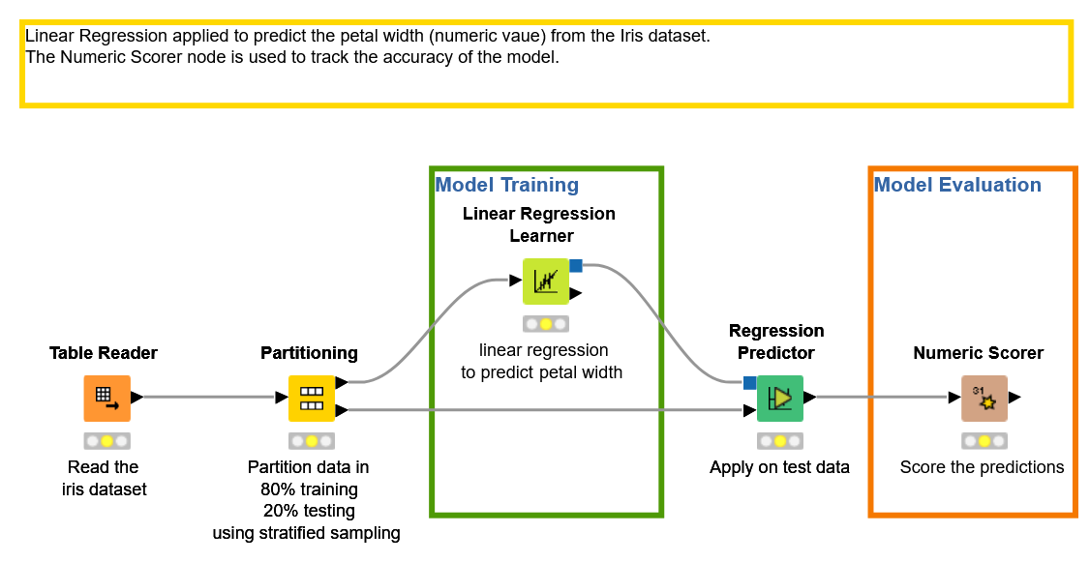
KNIME Workflows
Numeric errors on a linear regression model

Slide 55
Thank you

