Slide 1
Support Vector Machines (SVM)

Slide 2
Summary of this lesson
“The key to artificial intelligence has always been the representation” -Jeff Hawkins
What are Support Vector Machines?
*This lesson refers to chapter 9 of the GIDS book

Slide 3
What you will learn
Support Vector Machines (SVM)
Overview
Dual Representation
Kernel Functions
Margin of Error

Slide 4
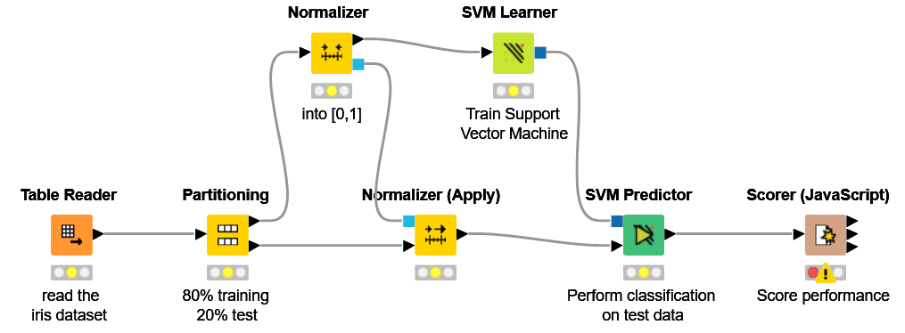
Datasets
Datasets used : iris dataset
Example Workflows:
„SVM on iris dataset “ https://kni.me/w/DTfbNITUngKQVF8v
Normalization
SVM

Slide 5
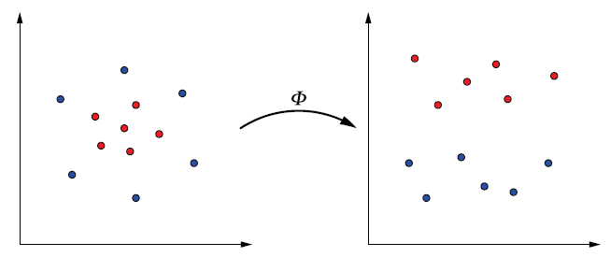
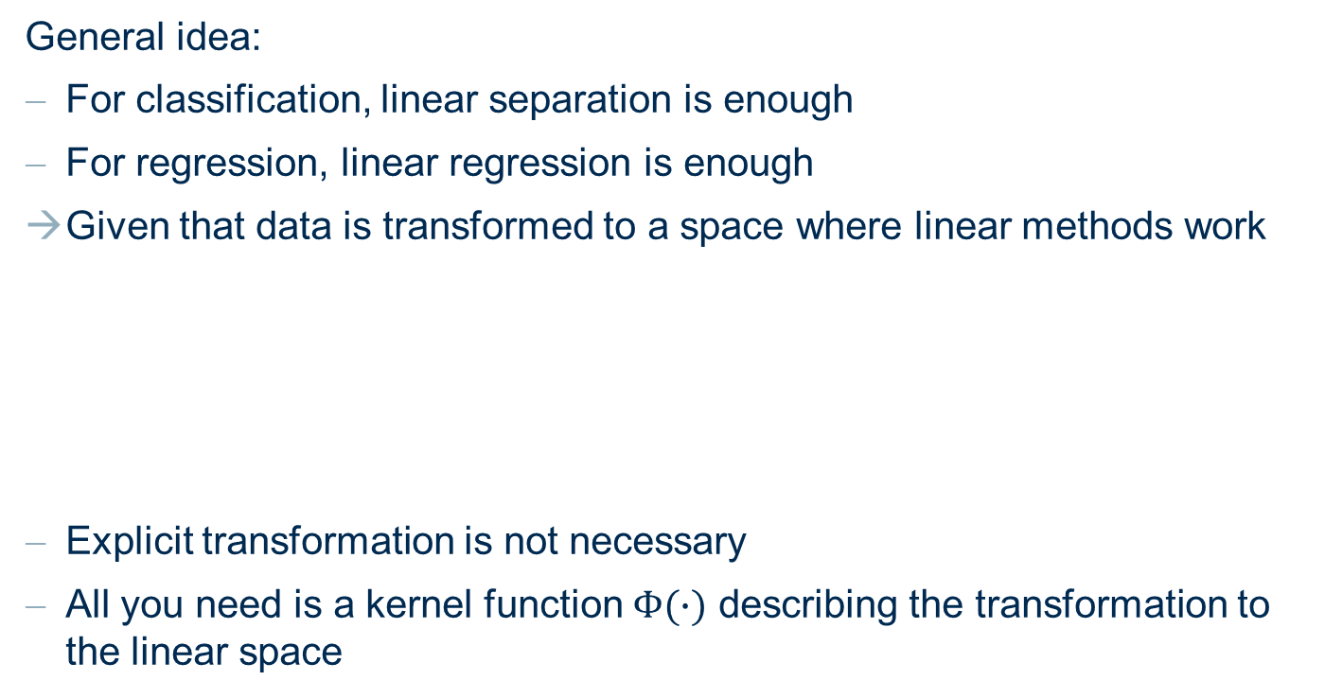
Overview
General idea:
For classification, linear separation is enough
For regression, linear regression is enough
Given that data is transformed to a space where linear methods work
Explicit transformation is not necessary
All you need is a kernel function $Φ(∙)$ describing the transformation to the linear space

Slide 6
Overview

Slide 7
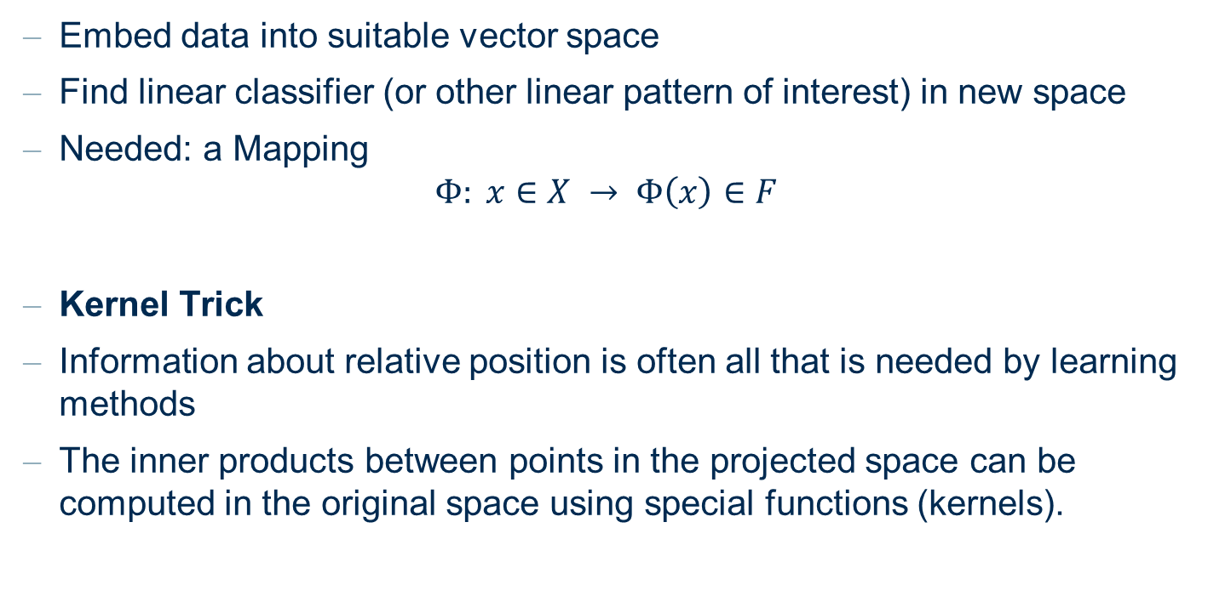
Main idea of Kernel Methods
Embed data into suitable vector space
Find linear classifier (or other linear pattern of interest) in new space
Needed: a Mapping
$$Φ: x∈X → Φ\left(x\right)∈F$$
Kernel Trick
Information about relative position is often all that is needed by learning methods
The inner products between points in the projected space can be computed in the original space using special functions (kernels).

Slide 8
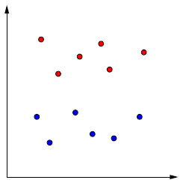
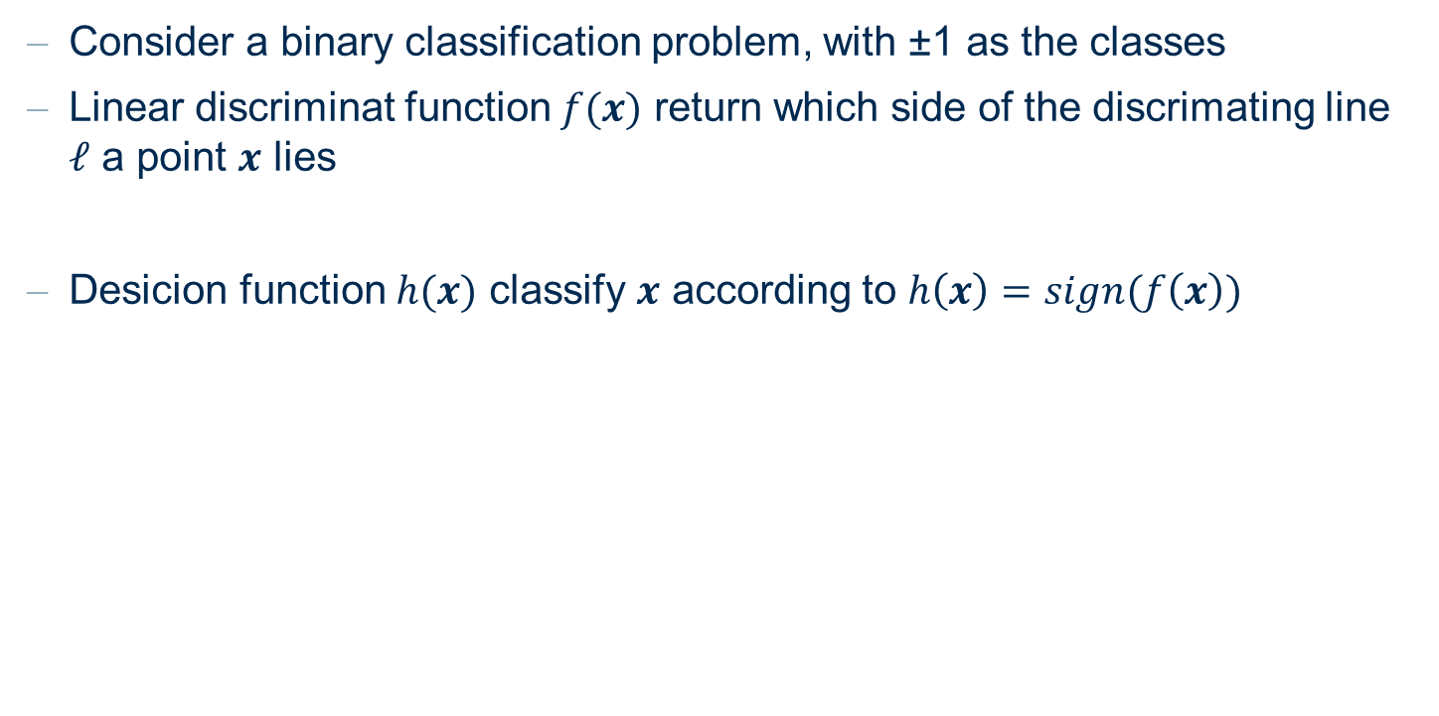

Linear Discriminant Function
Consider a binary classification problem, with ±1 as the classes
Linear discriminat function $f(x)$ return which side of the discrimating line $ℓ$ a point $x$ lies
Desicion function $h(x)$ classify $x$ according to $h\left(x\right)=sign(f\left(x\right))$
$$f\left(x\right)=w^{T}x+b=b+\left\|w\right\|\left\|x\right\|cos⁡(∠\left(w,x\right))$$
$$ℓ$$

Slide 9
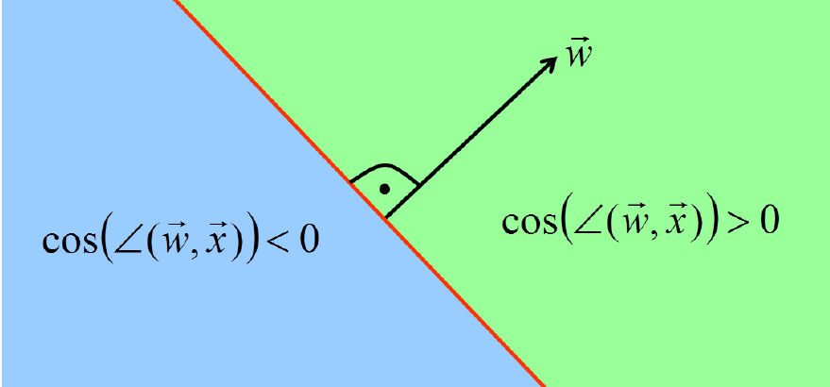




Linear Discriminant Function
Linear discriminants represent hyperplanes in feature space
$$f\left(x\right)=w^{T}x+b=b+\left\|w\right\|\left\|x\right\|cos⁡(∠\left(w,x\right))$$
$$ℓ$$
$$w$$
$\cos\left(∠\left(w,x\right)\right)<$0
$cos⁡(∠\left(w,x\right))$>0

Slide 10





Linear Discriminant Function
$x$ lies either side of the discriminant function depending on the angle $∠\left(w,x\right)$
$$ℓ$$
$$w$$
$$x$$
$∠\left(w,x′\right)$ $≤−\frac{π}{2}$
or $∠\left(w,x′\right)$ $≥\frac{π}{2}$
$−\frac{π}{2}≤$ $∠\left(w,x\right)$ $≤\frac{π}{2}$
$$x′$$

Slide 11
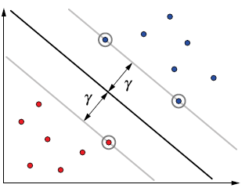

Support Vectors
To represent $w$, we only need points which lie closest to the separating hyperplane ➔ known as support vectors
The margin $γ$ – distance between the hyperplane and a support vector
The margin $γ$ is calculated as: $γ=\max_{w}{\min_{j}{w^{T}x_{j}}}$

Slide 12
Dual Representation

Slide 13
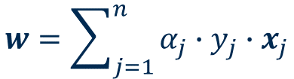
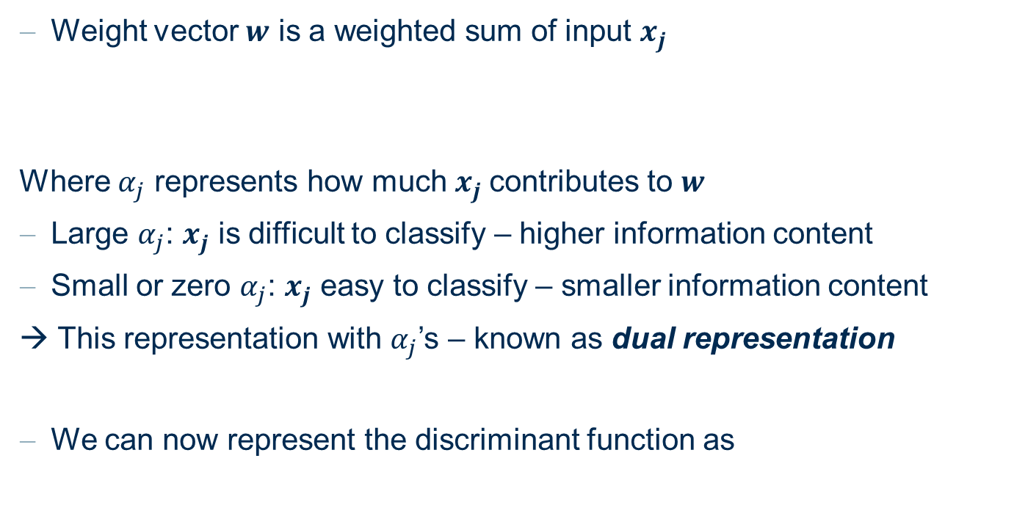
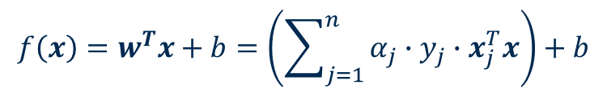
Dual Representation
Weight vector $w$ is a weighted sum of input $x_{j}$
Where $α_{j}$ represents how much $x_{j}$contributes to $w$
Large $α_{j}$: $x_{j}$ is difficult to classify – higher information content
Small or zero $α_{j}$: $x_{j}$ easy to classify – smaller information content
→ This representation with $α_{j}$’s – known as dual representation
We can now represent the discriminant function as
$$w=\sum_{j=1}^{n}{α_{j}∙y_{j}∙x_{j}}$$
$$f\left(x\right)=w^{T}x+b=\left(\sum_{j=1}^{n}{α_{j}∙y_{j}∙x_{j}^{T}x}\right)+b$$

Slide 14

Dual Representation Learning Algorithm
Both $α_{j}$ and $b$ can be updated iteratively
At iteration $t$,
IF:
$$y_{j}∙\left(\sum_{j^{′}}{α_{j^{′}}∙y_{j^{′}}∙{x_{j^{′}}^{T}x}_{j}}+b\right) <0$$
THEN:
$$α_{j}^{(t+1)}=α_{j}^{(t)}+y_{j}$$
$$b_{j}^{(t+1)}=b_{j}^{(t)}+y_{j}∙R^{2}$$
Where $R=\max_{j}\left\|x_{j}\right\|$

Slide 15
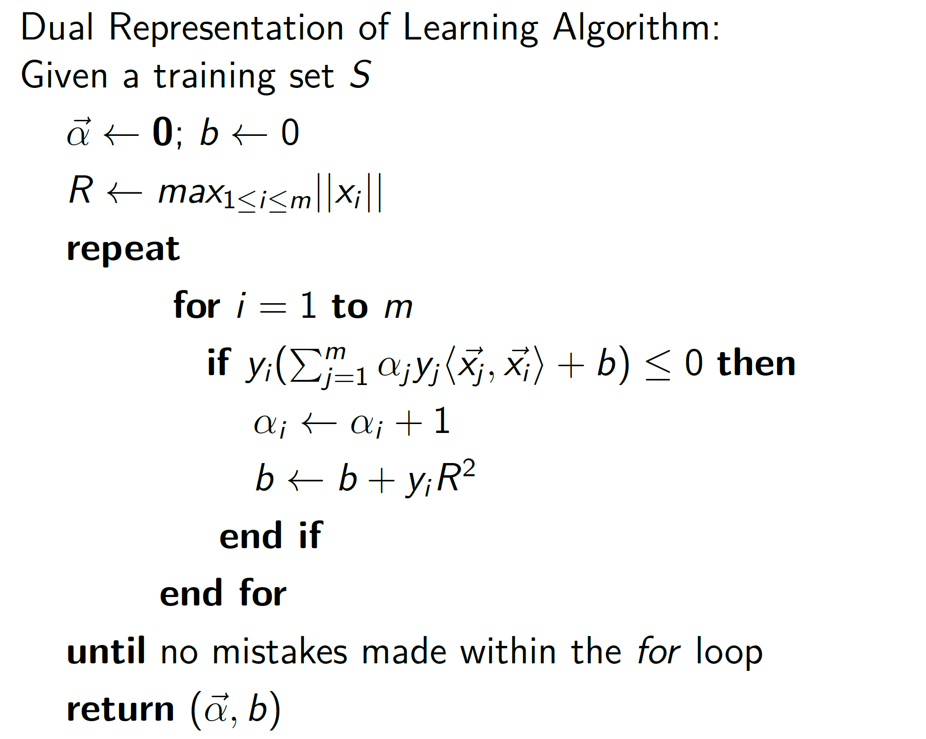
Dual Representation

Slide 16

Projection to Other Spaces
So far, we have seen training via computation of inner products
→ Indicating which side of the linear decision boundary $x$ falls into
Say, it is hard to find a linear boundary in the original space
Solution: project to another space, find the linear boundary in the projected space, classify in the projected space
Original space
Projected space
Linear boundary

Slide 17
Kernel Functions

Slide 18

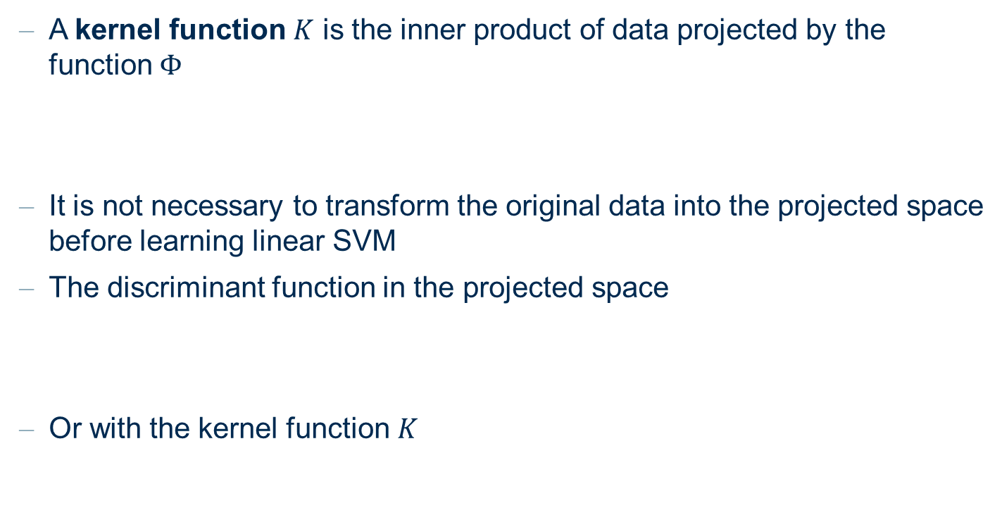
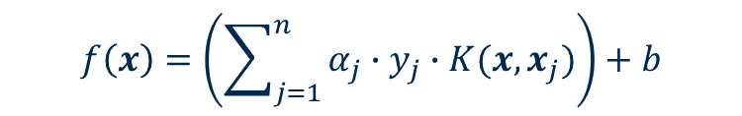
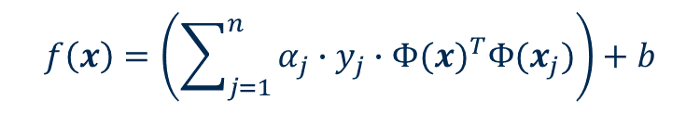
Kernel Functions
A kernel function $K$ is the inner product of data projected by the function $Φ$
It is not necessary to transform the original data into the projected space before learning linear SVM
The discriminant function in the projected space
Or with the kernel function $K$
$$K\left(x_{1},x_{2}\right)={Φ(x_{1})}^{T}Φ(x_{2})$$
$$f\left(x\right)=\left(\sum_{j=1}^{n}{α_{j}∙y_{j}∙{Φ(x)}^{T}Φ(x_{j})}\right)+b$$
$$f\left(x\right)=\left(\sum_{j=1}^{n}{α_{j}∙y_{j}∙K(x,x_{j})}\right)+b$$

Slide 19
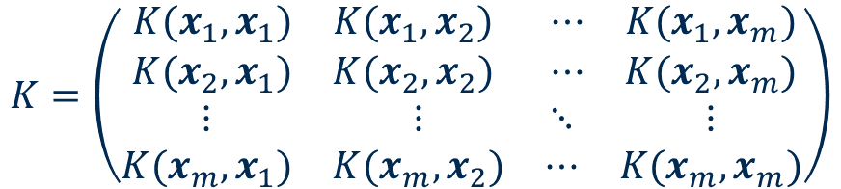

Gram Matrix
All data necessary for
The decision function $h(x)$
The training of the coefficients
Can be pre-computed using a Gram matrix $K$
$$K=\left(\begin{matrix}\begin{matrix}K(x_{1},x_{1}) & K(x_{1},x_{2}) \\ K(x_{2},x_{1}) & K(x_{2},x_{2})\end{matrix} & \begin{matrix}⋯ & K(x_{1},x_{m}) \\ ⋯ & K(x_{2},x_{m})\end{matrix} \\ \begin{matrix}⋮ & ⋮ \\ K(x_{m},x_{1}) & K(x_{m},x_{2})\end{matrix} & \begin{matrix}⋱ & ⋮ \\ ⋯ & K(x_{m},x_{m})\end{matrix}\end{matrix}\right)$$

Slide 20
Rules for a Gram Matrix
For Gram Matrices, interesting observations hold
Symmetric
Positive definite
Eigenvectors of the matrix correspond to the input vectors
Moreover,
Every positive definite & symmetric matrix is a Gram matrix

Slide 21
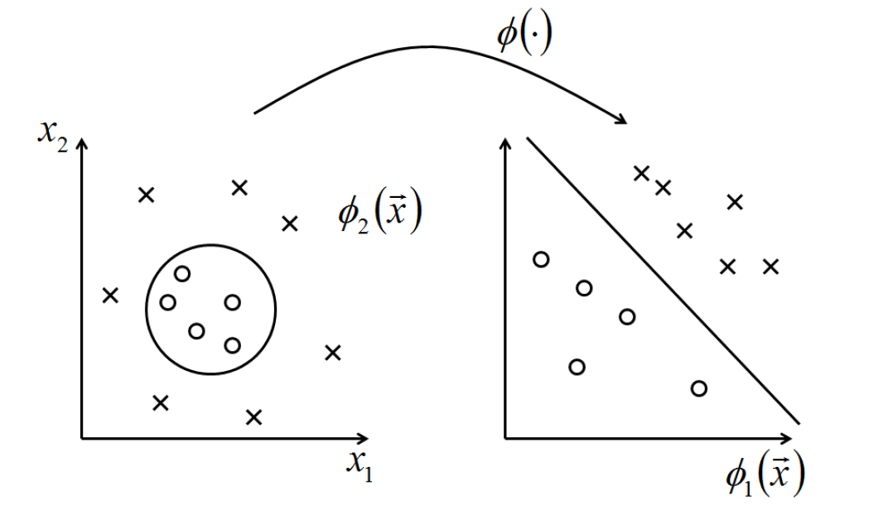


Examples of Kernels
Polynomial kernel of degree $d$
$$K\left(x,y\right)={\left(x^{T}y+c\right)}^{d}$$

Slide 22
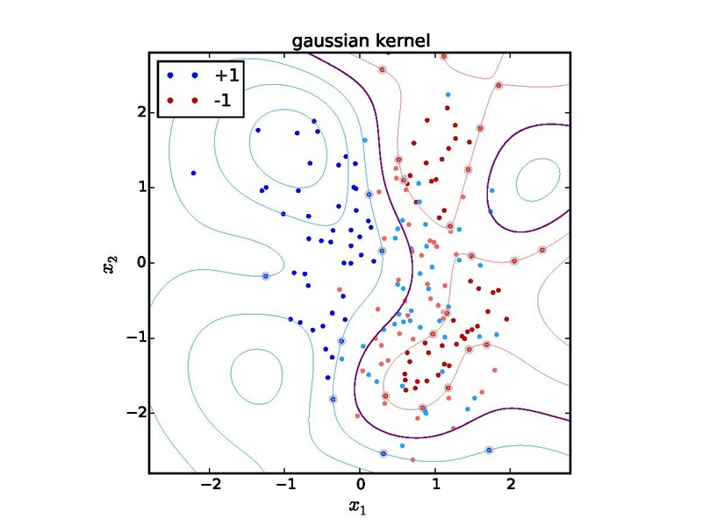

Examples of Kernels
Gaussian kernel
Also known as radial basis function (RBF) kernel
$$K\left(x,y\right)=e^{−\frac{{\left\|x−y\right\|}^{2}}{2σ^{2}}}$$

Slide 23

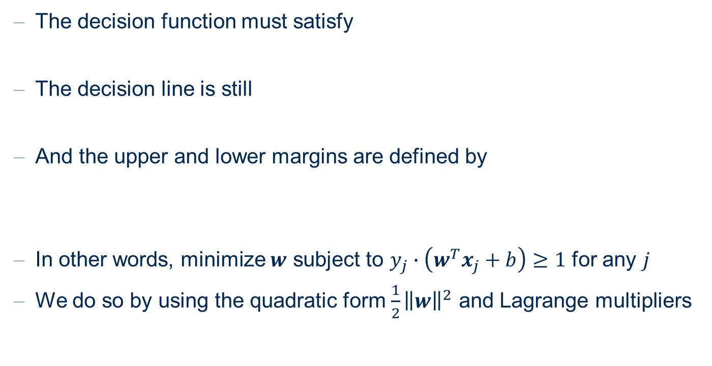


Construction
The decision function must satisfy
The decision line is still
And the upper and lower margins are defined by
In other words, minimize $w$ subject to $y_{j}∙\left(w^{T}x_{j}+b\right)≥1$ for any $j$
We do so by using the quadratic form $\frac{1}{2}{\left\|w\right\|}^{2}$ and Lagrange multipliers
$$y_{j}∙\left(w^{T}x_{j}+b\right)≥1$$
$$w^{T}x_{j}+b=0$$
$$w^{T}x_{j}+b=±1$$

Slide 24
Margin of Error

Slide 25
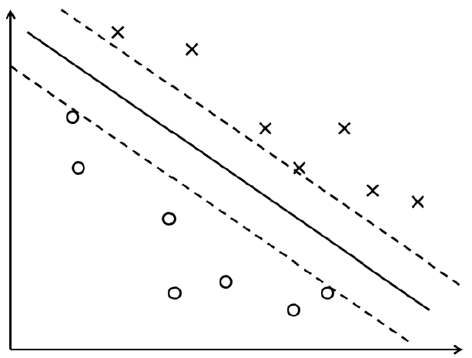
Soft and Hard Margin Classifiers
What can we do if no linear separating hyperplane exists?
Solution: allow minor violations – also known as soft margins
→ In contrast, avoiding any misclassifications ≡ hard margins
Hard margins
Soft margins

Slide 26
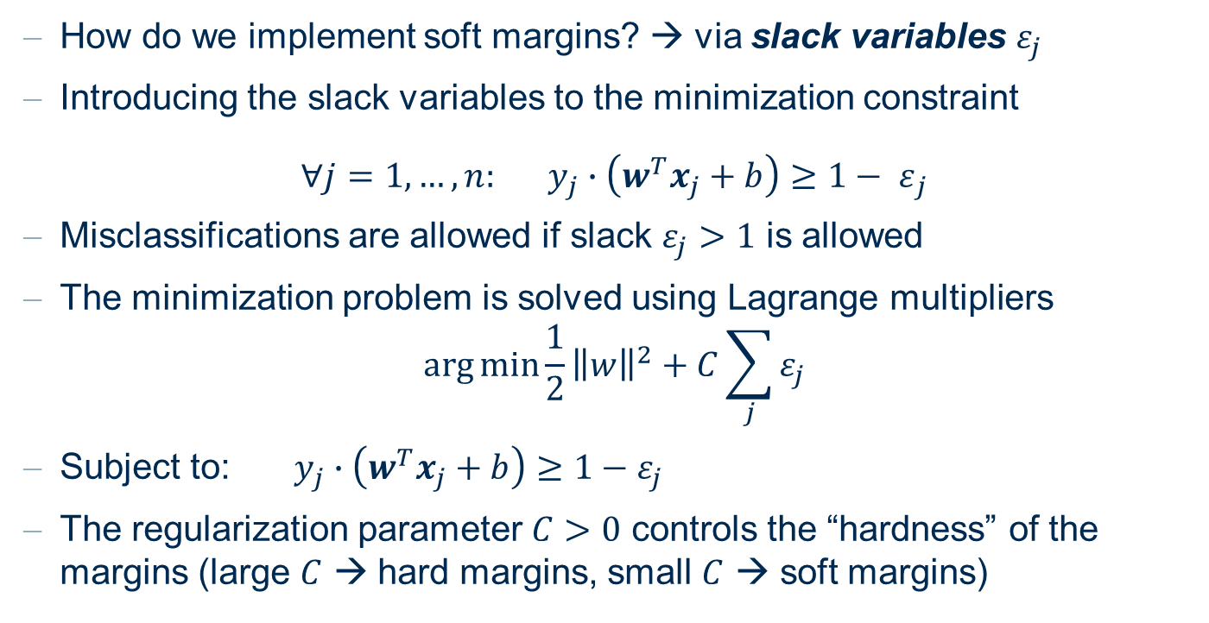
Soft and Hard Margin Classifiers
How do we implement soft margins? → via slack variables $ε_{j}$
Introducing the slack variables to the minimization constraint
$${∀j=1, …, n: y_{j}∙\left(w^{T}x_{j}+b\right)≥1− ε}_{j}$$
Misclassifications are allowed if slack $ε_{j}>1$ is allowed
The minimization problem is solved using Lagrange multipliers
$$\arg{\min{\frac{1}{2}}}{\left\|w\right\|}^{2}+C\sum_{j}{ε_{j}}$$
Subject to:$y_{j}∙\left(w^{T}x_{j}+b\right)≥1−ε_{j}$
The regularization parameter $C>0$ controls the “hardness” of the margins (large $C$ → hard margins, small $C$ → soft margins)

Slide 27
Multi-Class SVM
How do we separate more than two classes?
Transform the problem into a set of binary classification problems
One class vs. all other classes
One class vs. another class, for all possible class pairs
The class with the farthest distance from the hyperplane wins

Slide 28
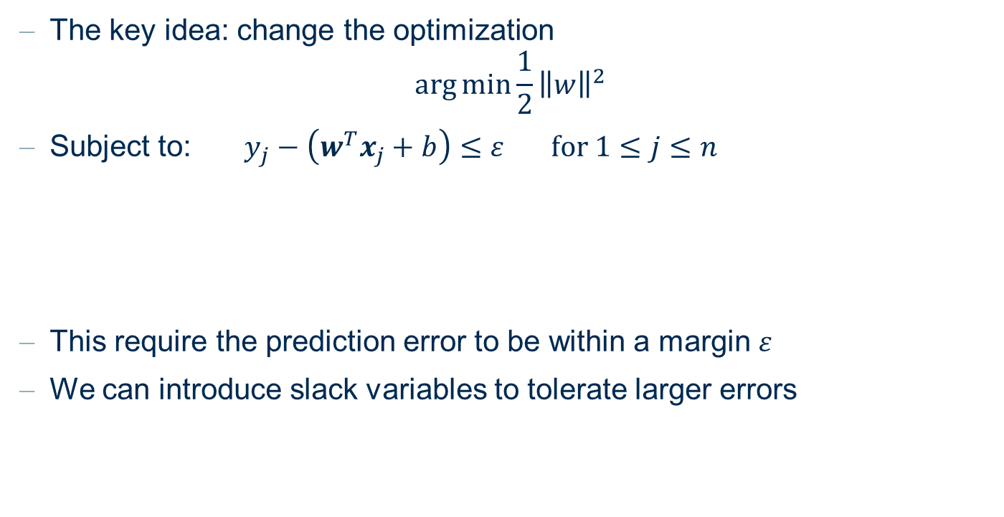
Support Vector Regression
The key idea: change the optimization
$$\arg{\min{\frac{1}{2}}}{\left\|w\right\|}^{2}$$
Subject to:$y_{j}−\left(w^{T}x_{j}+b\right)≤ε for 1≤j≤n$
This require the prediction error to be within a margin $ε$
We can introduce slack variables to tolerate larger errors

Slide 29
Support Vector Machines
Support Vector Machine
Classifier as weighted sum over inner products of training pattern (or only support vectors) and the new pattern.
Training analog
Kernel-Induced feature space
Transformation into higher-dimensional space (where we will hopefully be able to find a linear separation plane).
Representation of solution through few support vectors ( > 0).
Maximum Margin Classifier
Reduction of Capacity (Bias) via maximization of margin (and not via reduction of degrees of freedom).
Efficient parameter estimation.
Relaxations
Soft Margin for non separable problems.

Slide 30
Practical Examples with KNIME Analytics Platform

Slide 31
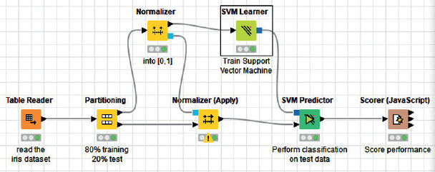
SVM on the Iris Data
Workflow training an SVM model to classify the iris data set

Slide 32
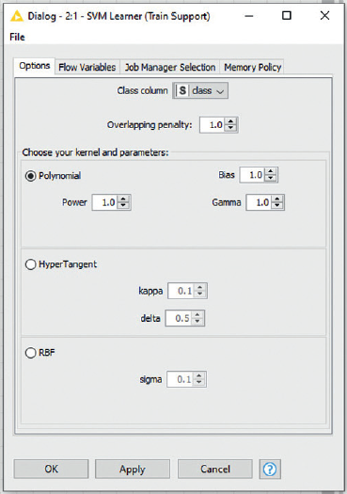
SVM on the Iris Data
The configuration window of the SVM Learner node
Allows a selection of a kernel and the associated parameters
Overlapping penalty controls the margin hardness

