Slide 1
Bayes Classifiers

Slide 2
Summary of this lesson
“Science is the systematic classification of experience” -George Henry Lewes
What is the simplest classifier?
*This lesson refers to chapter 8 of the GIDS book

Slide 3
Content of this lesson
Bayes Classifiers
Motivation
Naive Bayes classifiers
Full Bayes classifiers
Naive vs. Full Bayes classifiers

Slide 4
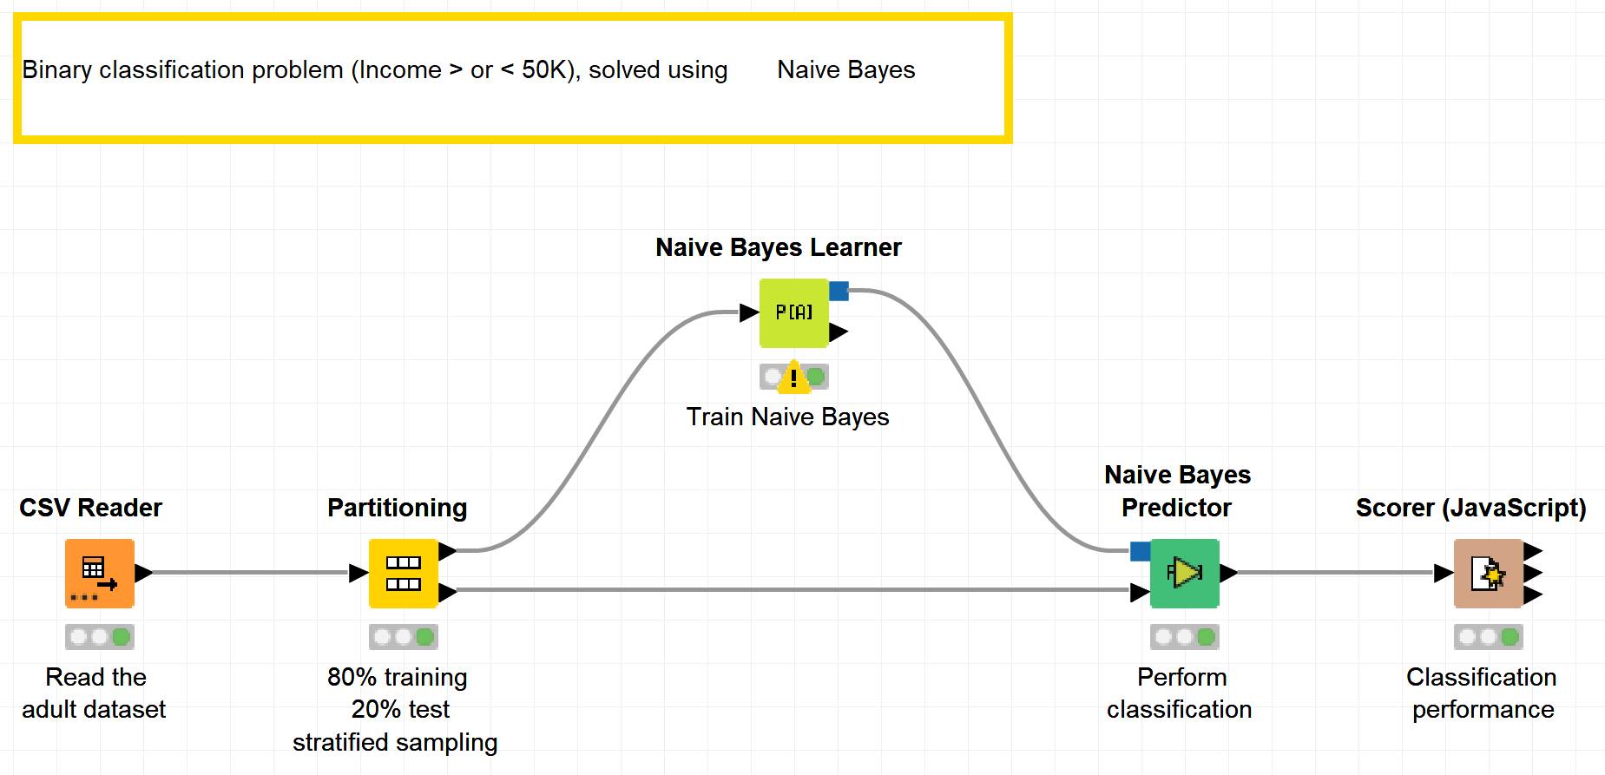
Datasets
Datasets used : adult dataset
Example Workflows:
„Naive Bayes“ https://kni.me/w/0oyhMdWYK5w19xGj
Naive Bayes classifier

Slide 5
Bayes Classifiers

Slide 6



Motivation
Given data
Instead of finding structure in a data set, let’s focus on (unknow) dependency among attributes
Bayes classifiers express their model as simple probabilities
Can be used as a gold standard for evaluating other learning methods
➔ Any model should perform the same or better than a Naïve Bayes classifier
$$𝒟=\left\{\left(x_{i},Y_{i}\right) | i=1,2,…,n\right\}$$
$x_{i}$: Object description
$Y_{i}$: Target attribute

Slide 7
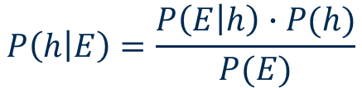
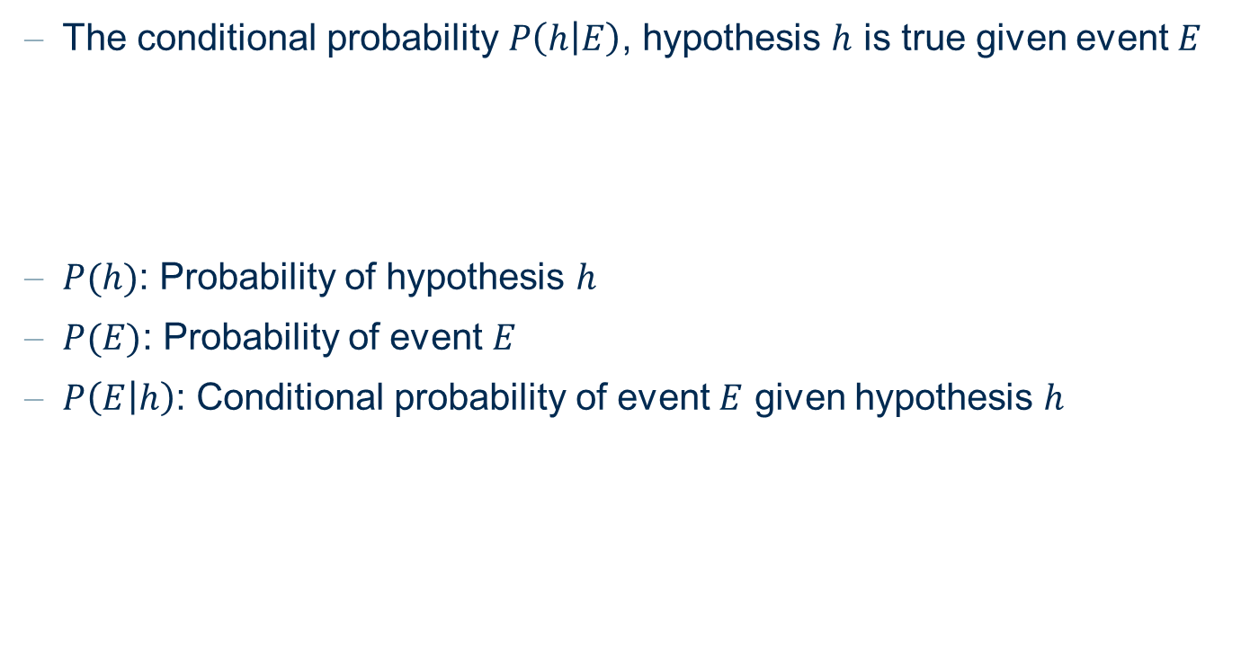
Bayes Theorem
The conditional probability $P\left(h | E\right)$, hypothesis $h$ is true given event $E$
$P(h)$: Probability of hypothesis $h$
$P(E)$: Probability of event $E$
$P\left(E | h\right)$: Conditional probability of event $E$ given hypothesis $h$
$$P\left(h | E\right)=\frac{P\left(E | h\right)∙P(h)}{P(E)}$$

Slide 8


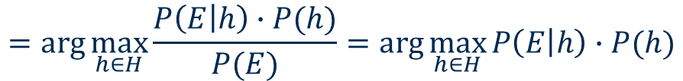
Choosing Hypotheses
We want the most probable hypothesis $h∈H$ for a given event $E$
➔ Maximum a posteriori hypothesis (MAP):
$$h_{MAP}=\arg{\max_{h∈H}{P\left(h | E\right)}}$$
$$=\arg{\max_{h∈H}{\frac{P\left(E | h\right)∙P(h)}{P(E)}=\arg{\max_{h∈H}{P\left(E | h\right)∙P(h)}}}}$$

Slide 9


Maximum Likelihood Hypothesis
If we can assume that every hypothesis $h∈H$ is equally likely
In other words, $P\left(h_{i}\right)=P\left(h_{j}\right)$ for all $h_{i}$, $h_{j}$ $∈H$
Then we can get the maximum likelihood hypothesis
$$h_{ML}=\arg{\max_{h∈H}{P\left(E | h\right)}}$$

Slide 10
Naïve Bayes Classifiers

Slide 11


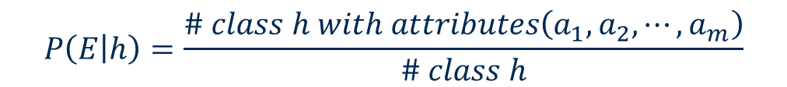
Bayes Classifiers
Probability $P(h)$ can be estimated based given data $𝒟$
Probability $P\left(E | h\right)$ can be determined based on attributes $A_{1},A_{2},⋯,A_{m}$being $E=\left(a_{1},a_{2},⋯,a_{m}\right)$
$$P\left(h\right)=\frac{\# class h}{\# total}$$
$$P\left(E | h\right)=\frac{\# class h with attributes\left(a_{1},a_{2},⋯,a_{m}\right)}{\# class h}$$

Slide 12
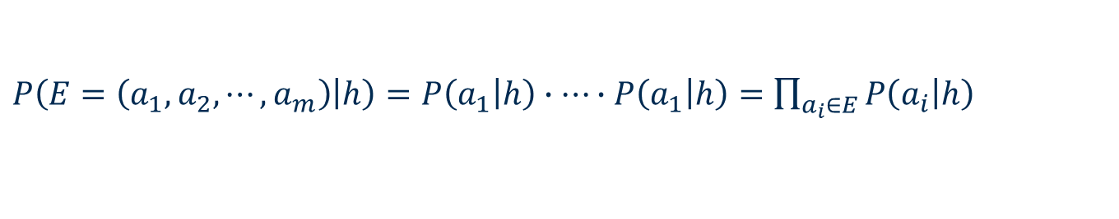
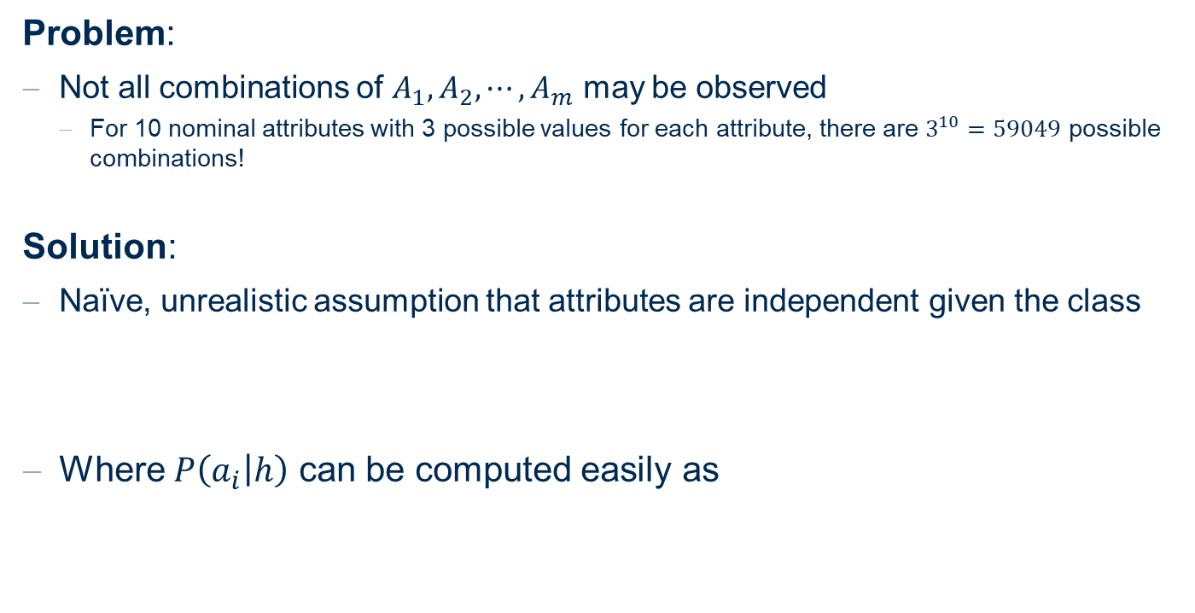
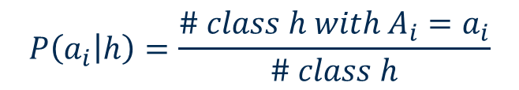
Bayes Classifiers
Problem:
Not all combinations of $A_{1},A_{2},⋯,A_{m}$ may be observed
For 10 nominal attributes with 3 possible values for each attribute, there are $3^{10}=59049$ possible combinations!
Solution:
Naïve, unrealistic assumption that attributes are independent given the class
Where $P\left(a_{i} | h\right)$ can be computed easily as
$P\left(E=\left(a_{1},a_{2},⋯,a_{m}\right) | h\right)=P\left(a_{1} | h\right)∙$ $⋯∙P\left(a_{1} | h\right)=\prod_{a_{i}∈E}{P\left(a_{i} | h\right)}$
$$P\left(a_{i} | h\right)=\frac{\# class h with A_{i}=a_{i}}{\# class h}$$

Slide 13
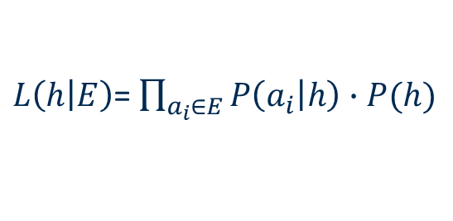
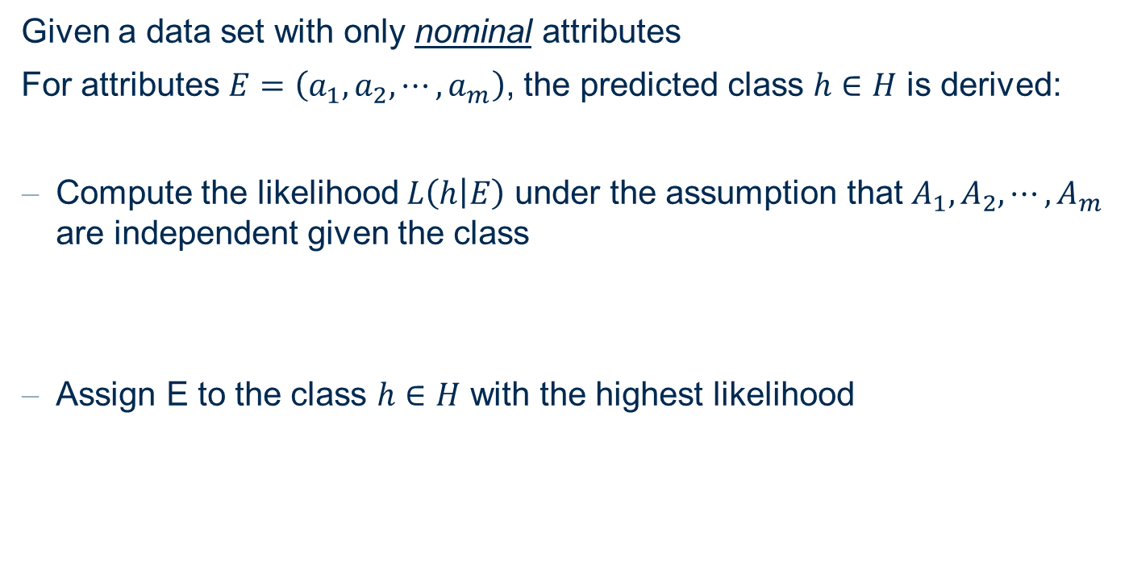

Naïve Bayes Classifiers
Given a data set with only nominal attributes
For attributes $E=\left(a_{1},a_{2},⋯,a_{m}\right)$, the predicted class $h∈H$ is derived:
Compute the likelihood $L\left(h | E\right)$ under the assumption that $A_{1},A_{2},⋯,A_{m}$ are independent given the class
Assign E to the class $h∈H$ with the highest likelihood
$L\left(h | E\right)$= $\prod_{a_{i}∈E}{P\left(a_{i} | h\right)}∙P(h)$
$pred(E)$= $\arg{\max_{h∈H}{L\left(E | h\right)}}$

Slide 14
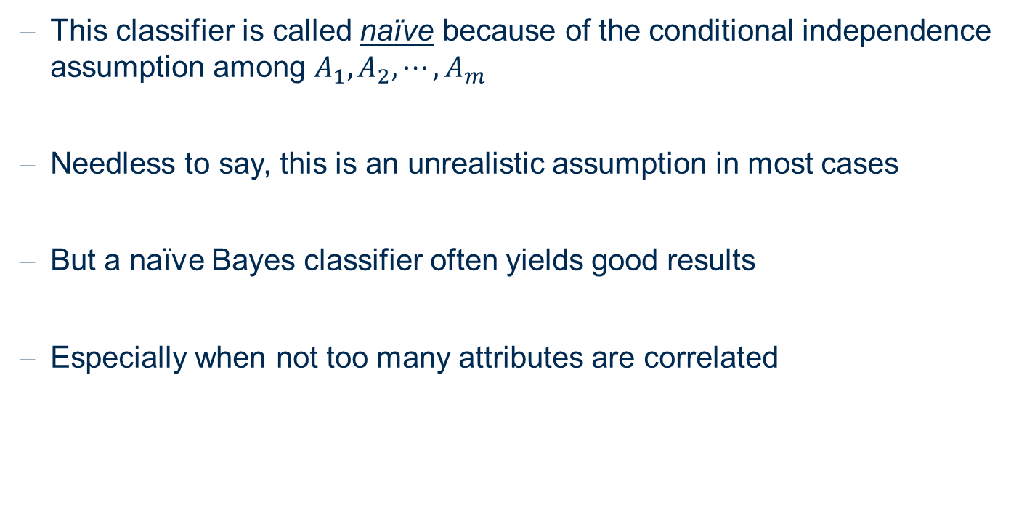
Naïve Bayes Classifiers
This classifier is called naïve because of the conditional independence assumption among $A_{1},A_{2},⋯,A_{m}$
Needless to say, this is an unrealistic assumption in most cases
But a naïve Bayes classifier often yields good results
Especially when not too many attributes are correlated

Slide 15
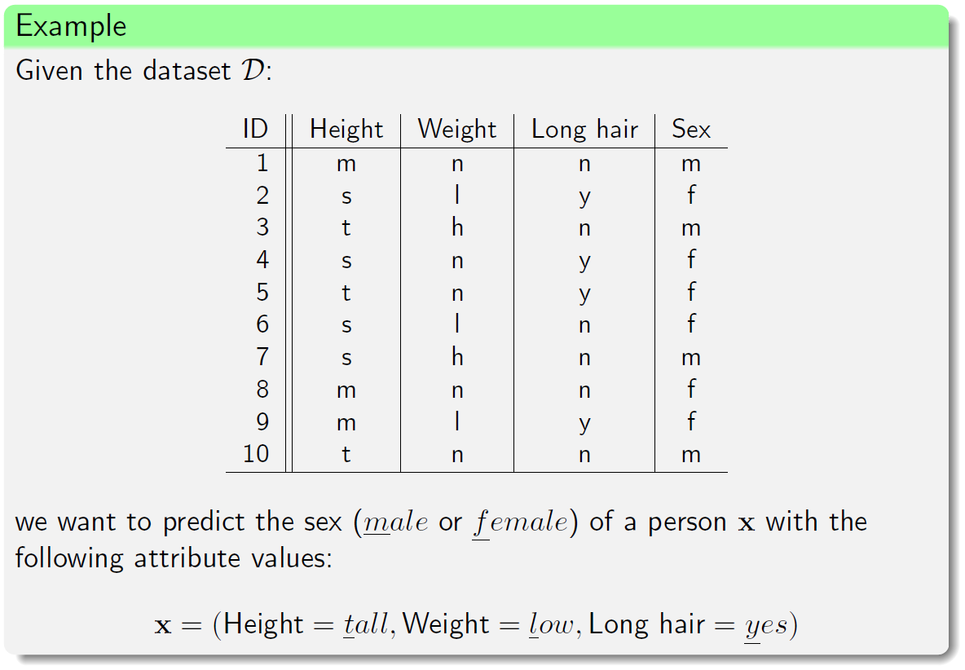
Example: Naïve Bayes Classifier

Slide 16
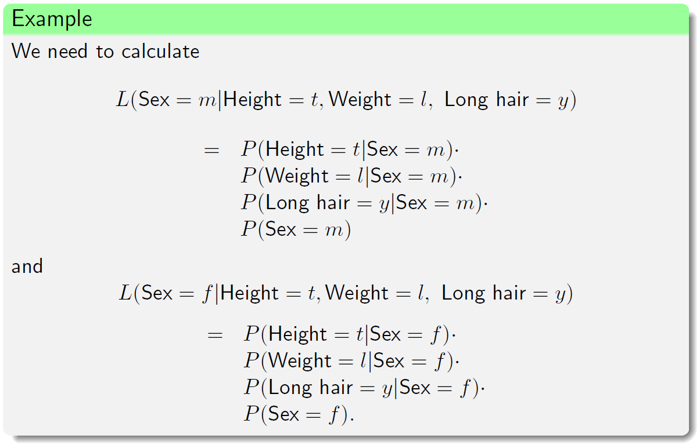
Example: Naïve Bayes Classifier

Slide 17
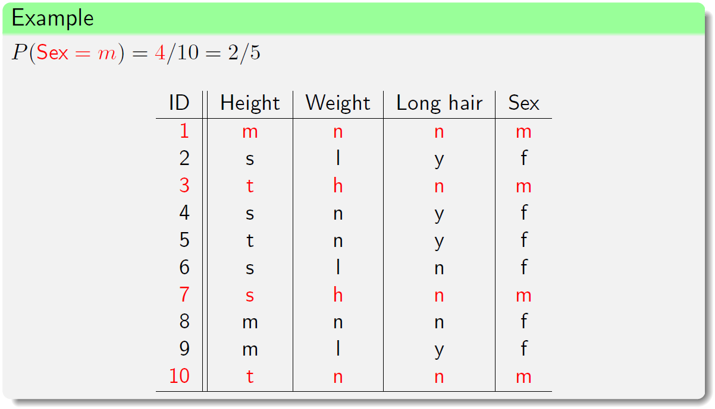
Example: Naïve Bayes Classifier

Slide 18
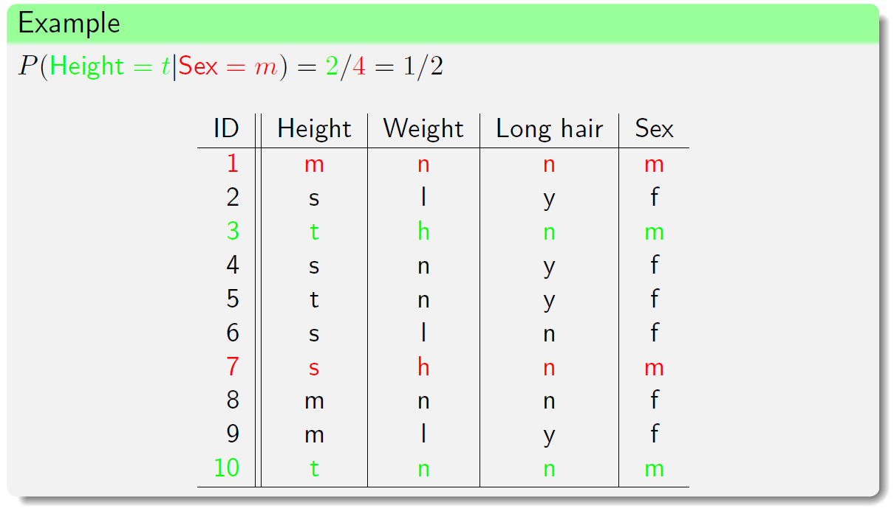
Example: Naïve Bayes Classifier

Slide 19
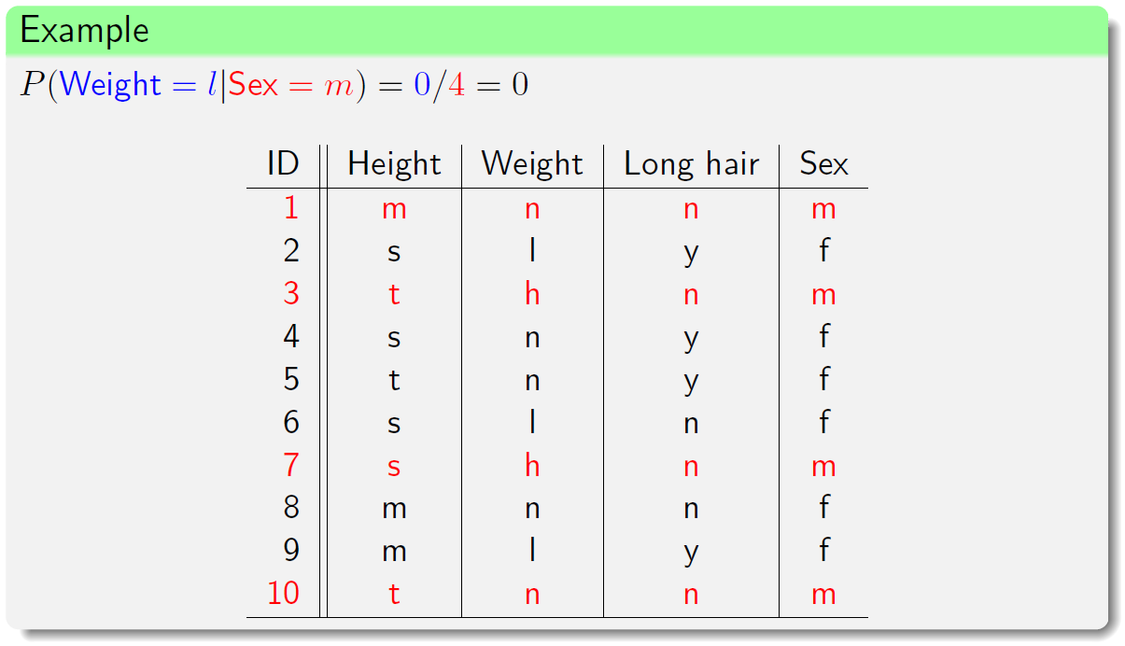
Example: Naïve Bayes Classifier

Slide 20
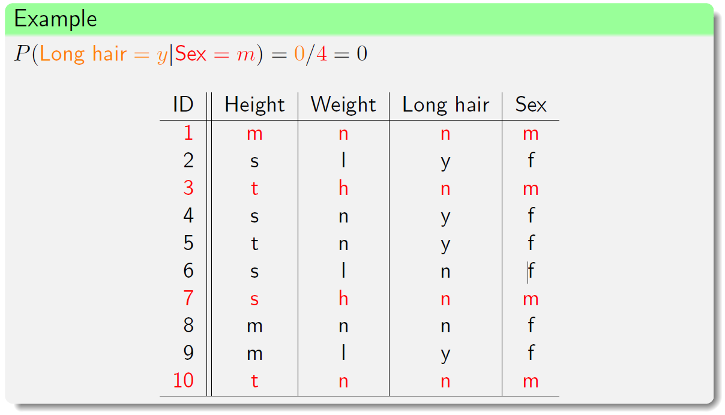
Example: Naïve Bayes Classifier

Slide 21
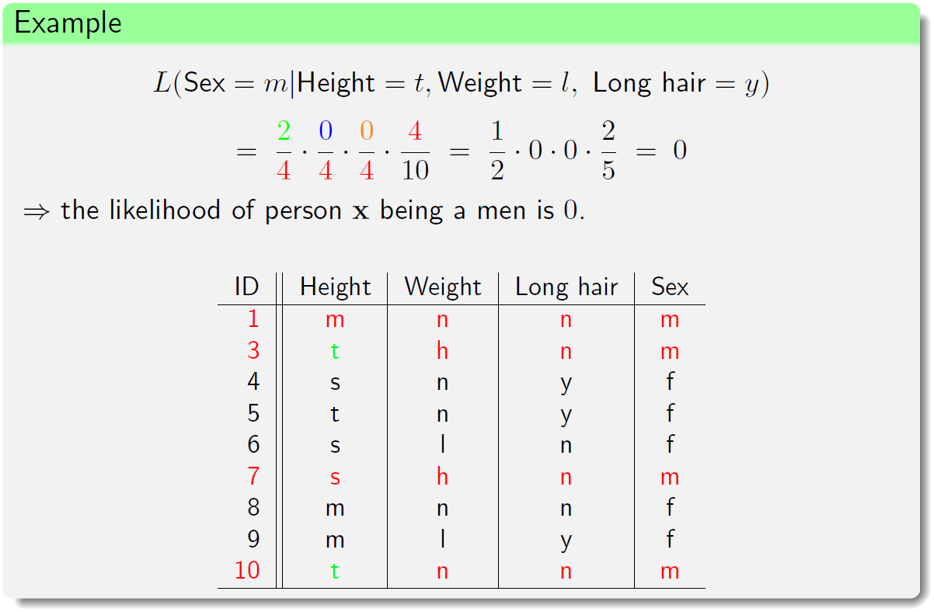
Example: Naïve Bayes Classifier

Slide 22
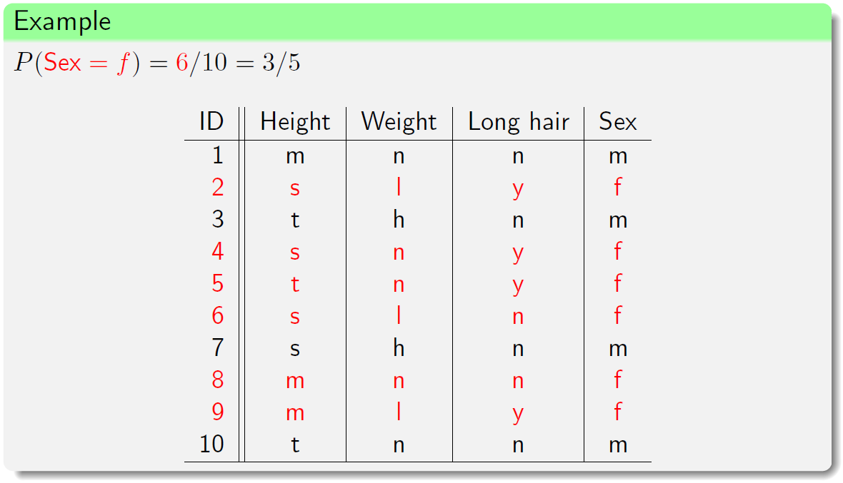
Example: Naïve Bayes Classifier

Slide 23
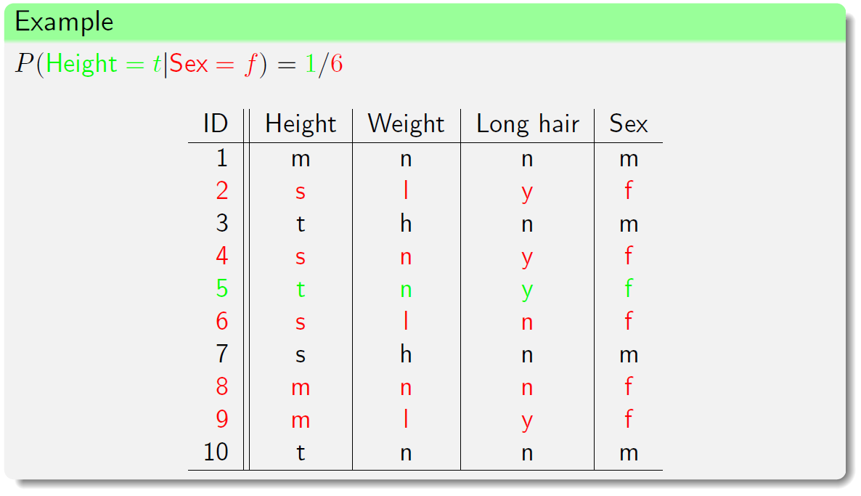
Example: Naïve Bayes Classifier

Slide 24
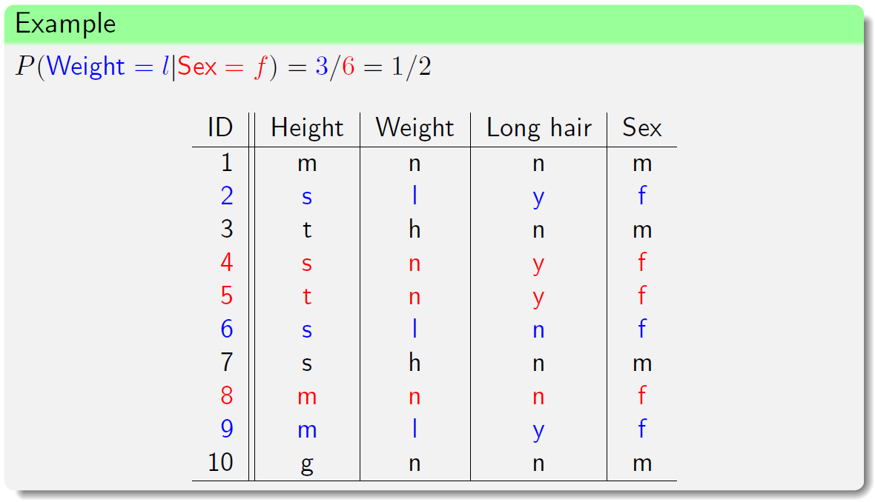
Example: Naïve Bayes Classifier

Slide 25
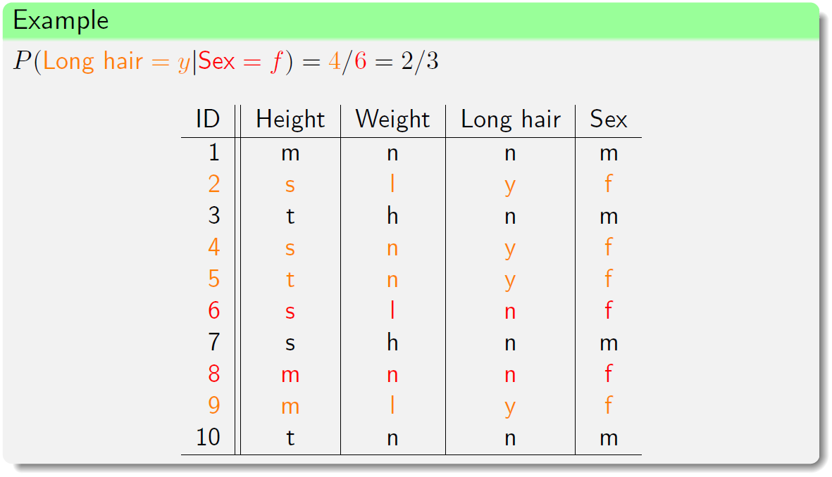
Example: Naïve Bayes Classifier

Slide 26
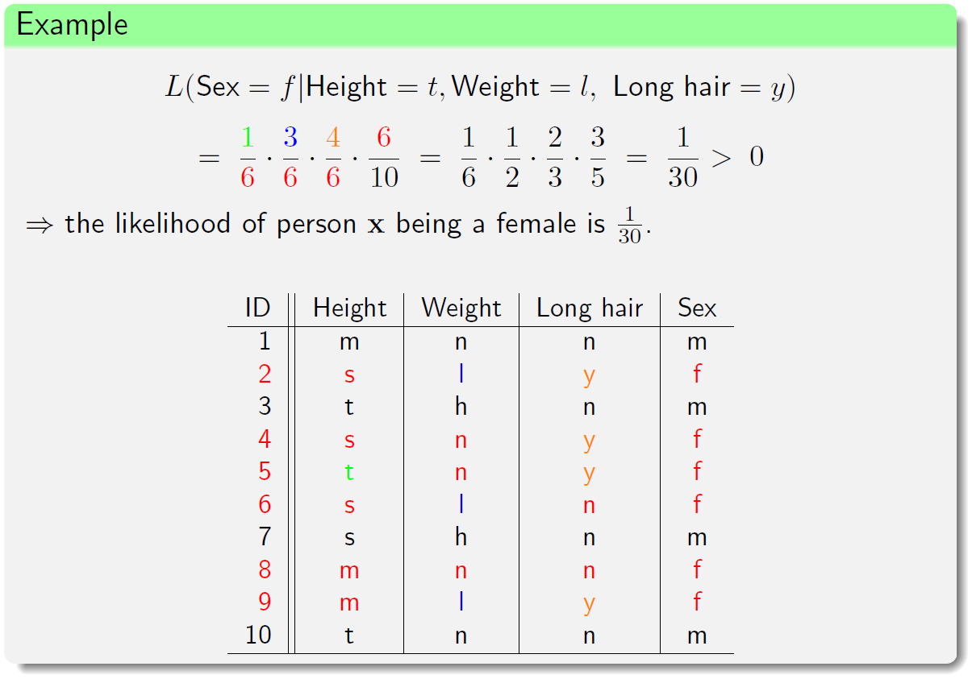
Example: Naïve Bayes Classifier

Slide 27
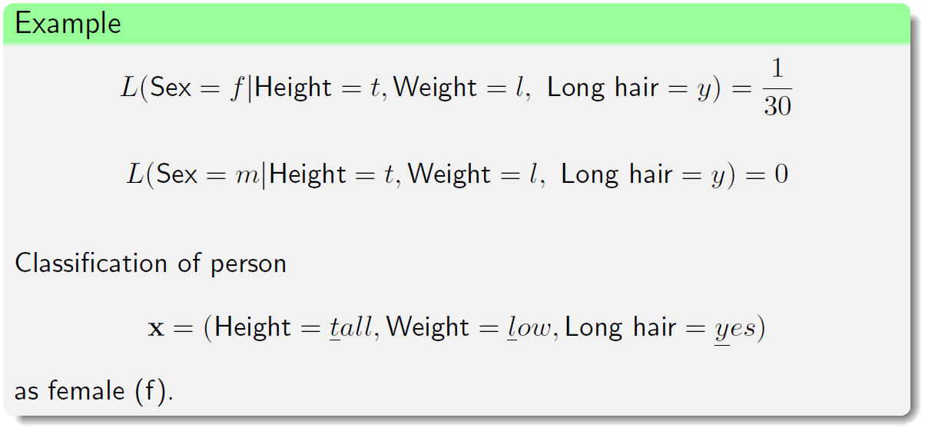
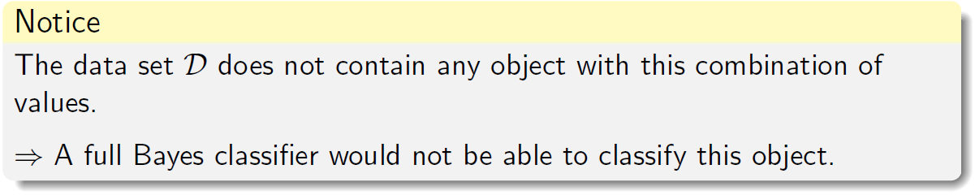
Example: Naïve Bayes Classifier

Slide 28
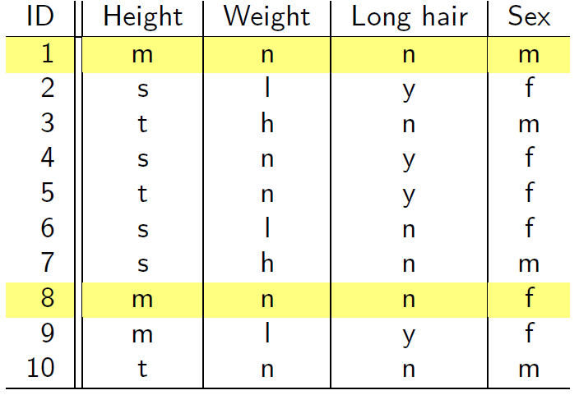
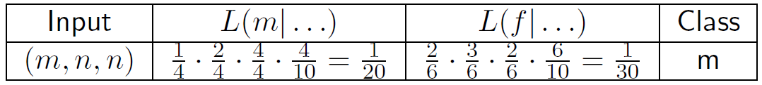

Example: Naïve Bayes Classifier
The object ($m, n, n$) is classified as $m$ although the data sets contains two such objects, one from class $m$ and one from class $f$.
The main impact comes from the attribute Long hair = $n$, having probability 1 in class $m$, but a low probability in class $f$.

Slide 29
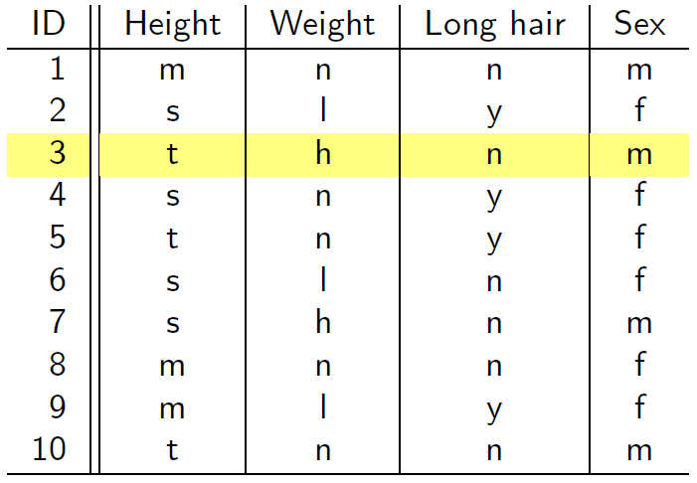
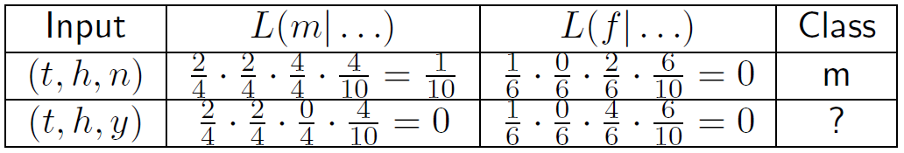

Example: Naïve Bayes Classifier
The object ($t, h, y$) cannot be classified since the likelihood is zero for both classes

Slide 30
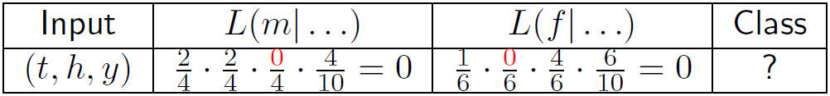
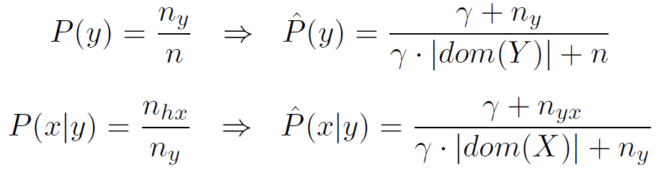

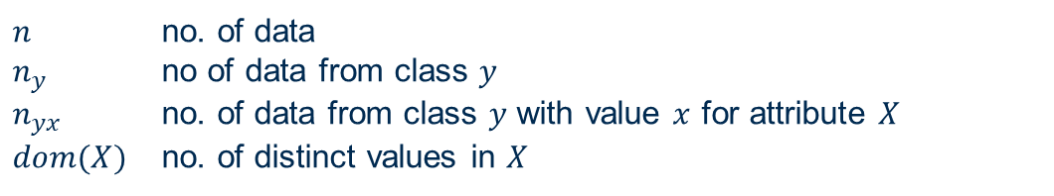
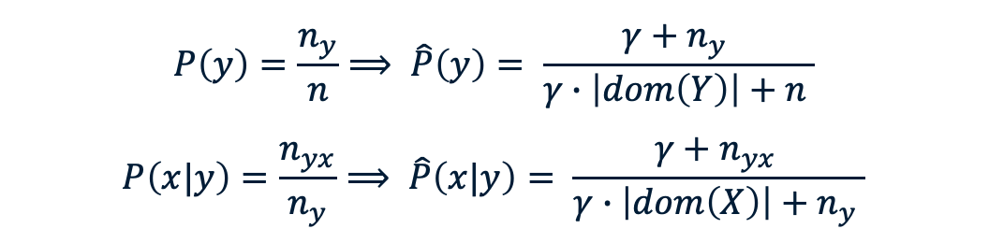
Laplace Correction
If a single likelihood is zero, then the overall likelihood is zero automatically, even then when the other likelihoods are high
Solution: Laplace correction $γ$
$$P\left(y\right)=\frac{n_{y}}{n}⟹ \hat{P}\left(y\right)= \frac{γ+n_{y} }{γ∙\left|dom\left(Y\right)\right|+n }$$
$$P\left(x|y\right)=\frac{n_{yx}}{n_{y}}⟹ \hat{P}\left(x|y\right)= \frac{γ+n_{yx} }{γ∙\left|dom\left(X\right)\right|+n_{y} }$$
$n$ no. of data
$n_{y}$ no of data from class $y$
$n_{yx}$ no. of data from class $y$ with value $x$ for attribute $X$
$dom(X)$ no. of distinct values in $X$

Slide 31
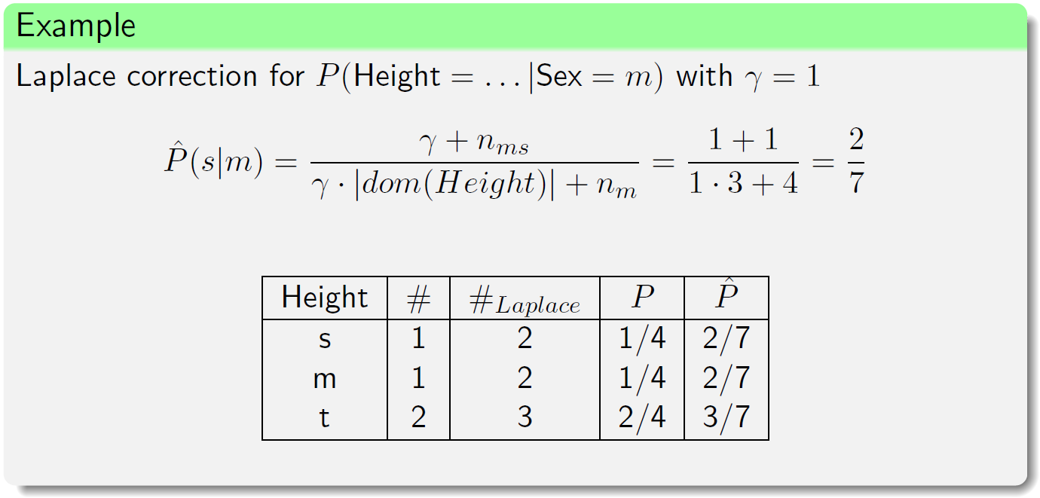

Laplace Correction

Slide 32
Naïve Bayes Classifier: Implementation
Frequency tables are generated when constructing a naïve Bayes classifier
Probability distribution of each attribute can be obtained from the frequency table
To learn from a naïve Bayes classifier, corresponding frequencies are multiplied from the tables

Slide 33
Treatment of Missing Values
During learning: The missing values are simply not counted for the frequencies of the corresponding attribute.
During classification: Only the probabilities (likelihoods) of those attributes are multiplied for which a value is available.

Slide 34
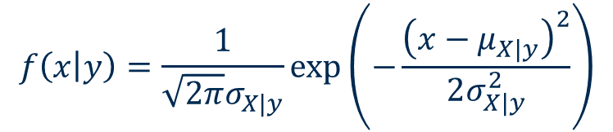
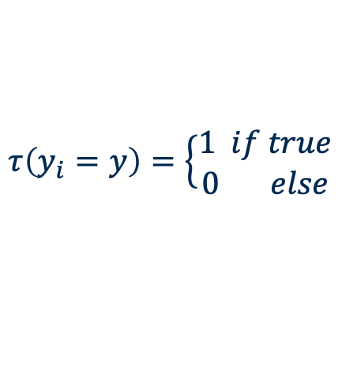

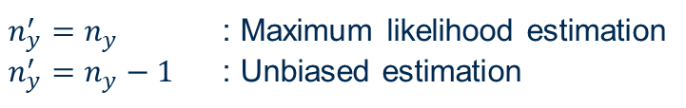
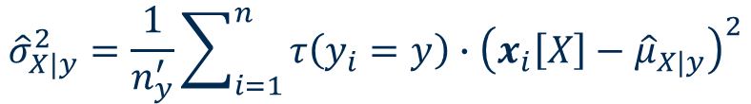
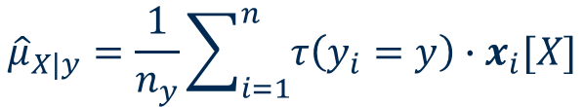
Numerical Attributes
Assume a normal distribution for a numerical attribute $X$
Estimation of the mean value
Estimation of the variance
$$f\left(x | y\right)=\frac{1}{\sqrt{2π}σ_{X|y}}\exp\left(−\frac{{\left(x−μ_{X|y}\right)}^{2}}{2σ_{X|y}^{2}}\right)$$
$${\hat{μ}}_{X|y}=\frac{1}{n_{y}}\sum_{i=1}^{n}{τ\left(y_{i}=y\right)∙x_{i}[X]}$$
$${\hat{σ}}_{X|y}^{2}=\frac{1}{n_{y}^{′}}\sum_{i=1}^{n}{τ\left(y_{i}=y\right)∙{\left(x_{i}\left[X\right]−{\hat{μ}}_{X|y}\right)}^{2}}$$
$$τ\left(y_{i}=y\right)=\left\{\begin{aligned}1 if true \\ 0 else\end{aligned} \right.$$
$n_{y}^{′}=n_{y}$ : Maximum likelihood estimation
$n_{y}^{′}=n_{y}−1$ : Unbiased estimation

Slide 35
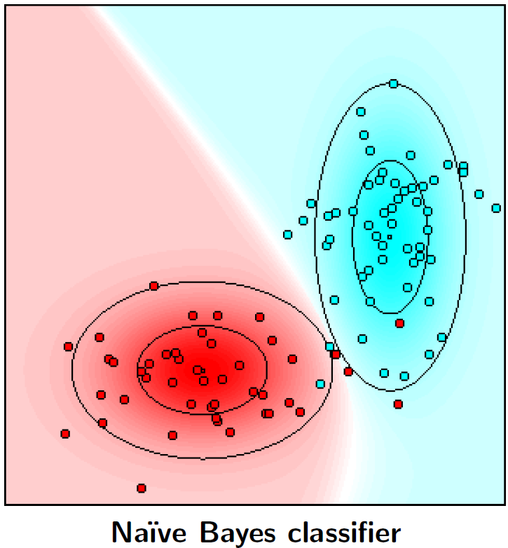
Example: Numerical Attributes
100 data points, 2 classes
Small squares: class mean
Inner ellipses: 1 s.d. from the mean
Outer ellipses: 2 s.d. from the mean
Classes overlap ➔ classification is not perfect

Slide 36
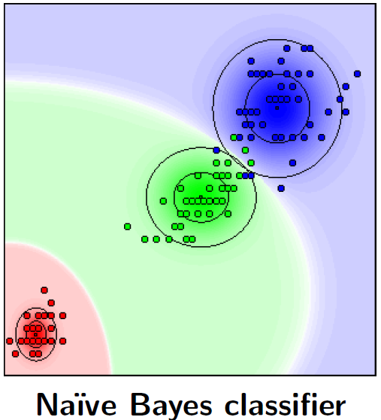
Naïve Bayes Classifier: Iris Data
150 data points, 3 classes
Iris setosa (red)
Iris versicolor (green)
Iris virginica (blue)
4 numerical attributes
Sepal length
Sepal width
Petal length (shown on x-axis)
Petal width (shown on y-axis)
6 mis-classification on the training data

Slide 37
Full Bayes Classifiers

Slide 38
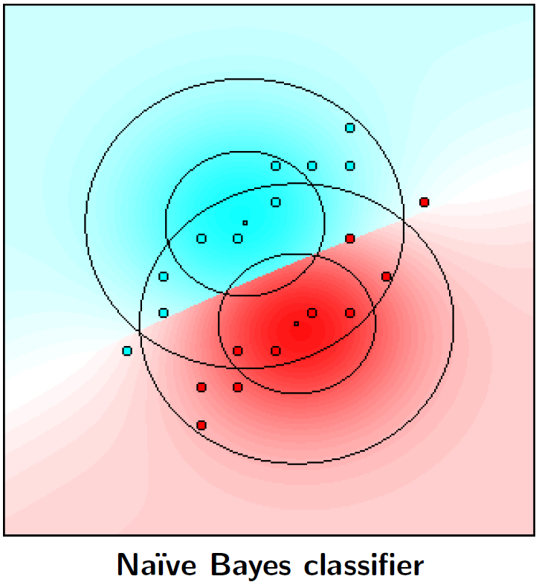
Example: Numerical Attributes
20 data points, 2 classes
Small squares: class mean
Inner ellipses: 1 s.d. from the mean
Outer ellipses: 2 s.d. from the mean
Attributes are not conditionally independent given the class

Slide 39
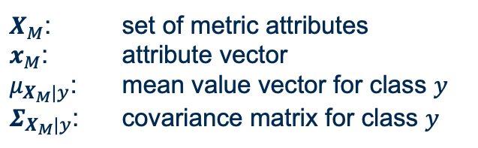

Full Bayes Classifiers
Restricted to numeric or metric attributes – only the target is nominal
Each class can be described by a multivariate normal distribution:
Joint distribution with covariance among attributes
→ Conditional independence no longer holds
$$f(x_{M}|y)=\frac{1}{\sqrt{{\left(2π\right)}^{m}\left|Σ_{X_{M}|y}\right|}}\exp\left(−\frac{{\left(x_{M}−μ_{X_{M}|y}\right)}^{Τ}Σ_{X_{M}|y}^{−1}\left(x_{M}−μ_{X_{M}|y}\right)}{2}\right)$$
$X_{M}$: set of metric attributes
$x_{M}$: attribute vector
$μ_{X_{M}|y}$: mean value vector for class $y$
$Σ_{X_{M}|y}$: covariance matrix for class $y$

Slide 40


Full Bayes Classifiers
Estimation of the (class-conditional) mean value vector
Estimation of the (class-conditional) covariance matrix
$${\hat{μ}}_{X|y}=\frac{1}{n_{y}}\sum_{i=1}^{n}{τ\left(y_{i}=y\right)∙x_{i}[X_{M}]}$$
$${\hat{Σ}}_{X_{M}|y}=\frac{1}{{n′}_{y}}\sum_{i=1}^{n}{τ\left(y_{i}=y\right)×\left(x_{i}\left[X_{M}\right]−{\hat{μ}}_{X_{M}|y}\right){\left(x_{i}\left[X_{M}\right]−{\hat{μ}}_{X_{M}|y}\right)}^{T}}$$
$n_{y}^{′}=n_{y}$ : Maximum likelihood estimation
$n_{y}^{′}=n_{y}−1$ : Unbiased estimation

Slide 41

Full Bayes Classifiers
Iris data revisited
150 data points, 3 classes
Iris setosa (red)
Iris versicolor (green)
Iris virginica (blue)
4 numerical attributes
Sepal length
Sepal width
Petal length (shown on x-axis)
Petal width (shown on y-axis)
2 mis-classification on the training data

Slide 42
Naive vs. Full Bayes Classifiers

Slide 43

Naïve vs. Full Bayes Classifiers
Naïve Bayes classifiers for numerical data → full Bayes classifiers with diagonal covariance matrices

Slide 44


Naïve vs. Full Bayes Classifiers
Iris data

Slide 45
Summary
Pros:
Gold standard for comparison with other classifiers
High classification accuracy in many applications
Classifier can easily be adapted to new training objects
Integration of domain knowledge
Cons:
The conditional probabilities my not be available
Independence assumptions might not hold for data set

Slide 46
Practical Examples with KNIME Analytics Platform

Slide 47
KNIME Workflow
Naïve Bayes classification of the income on the adult data

Slide 48

KNIME Workflow
Naïve Bayes Learner node showing conditional probabilities and distributions involved in the decision process

Slide 49
Thank you

