Slide 1
Support Vector Machines (SVM)

Slide 2
Summary of this lesson
“The key to artificial intelligence has always been the representation” -Jeff Hawkins
What are Support Vector Machines?
*This lesson refers to chapter 9 of the GIDS book

Slide 3
Content of this lesson
Support Vector Machines (more generally – Kernel Machines)
Motivation
Linear Classifiers
Rosenblatt Learning Rule
Kernel Methods and Support Vector Machines
Dual Representation
Maximal Margins
Kernels
Margin of Error and Variations
Soft and Hard Margin Classifiers
Multi-Class SVM
Support Vector Regression

Slide 4
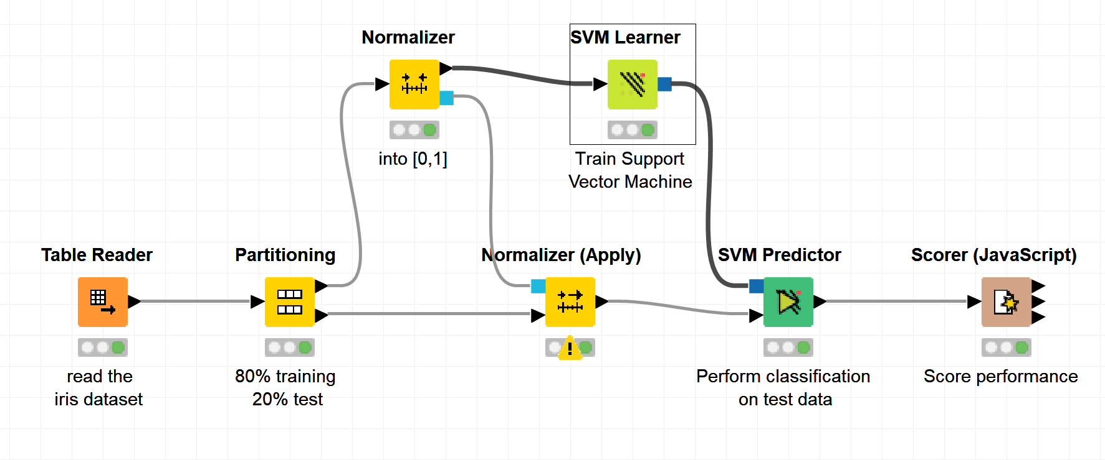
Datasets
Datasets used : iris dataset
Example Workflows:
„SVM on iris dataset “ https://kni.me/w/DTfbNITUngKQVF8v
Normalization
SVM

Slide 5
Motivation

Slide 6
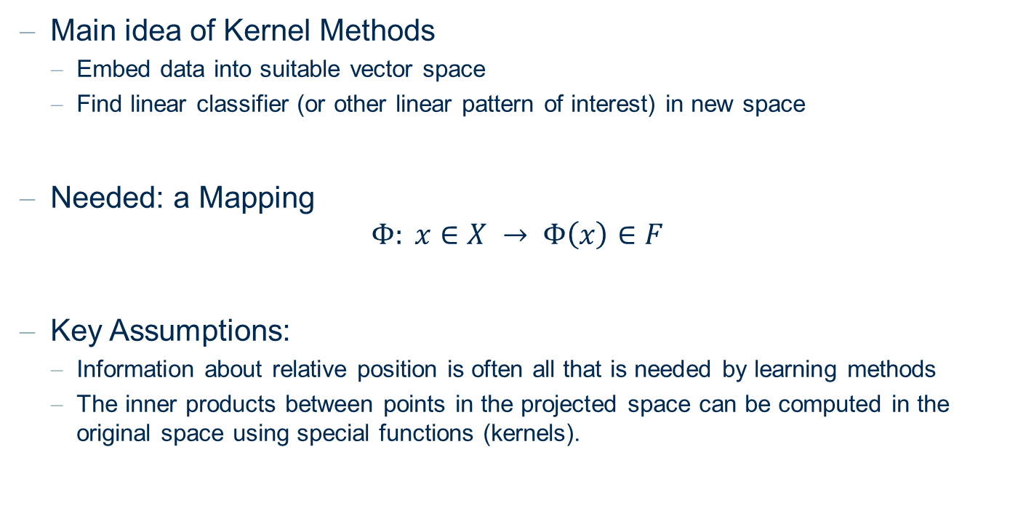
Motivation
Main idea of Kernel Methods
Embed data into suitable vector space
Find linear classifier (or other linear pattern of interest) in new space
Needed: a Mapping
$$Φ: x∈X → Φ\left(x\right)∈F$$
Key Assumptions:
Information about relative position is often all that is needed by learning methods
The inner products between points in the projected space can be computed in the original space using special functions (kernels).

Slide 7
Linear Classifiers

Slide 8
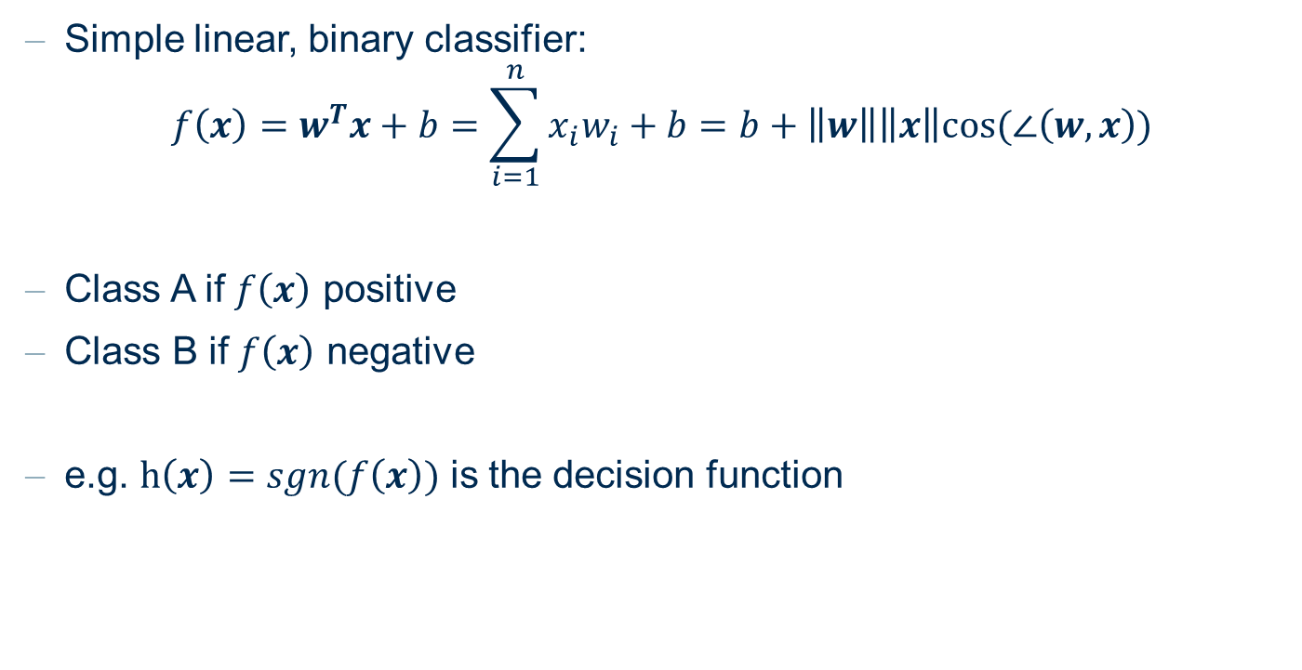
Linear Discriminant
Simple linear, binary classifier:
$$f\left(x\right)=w^{T}x+b=\sum_{i=1}^{n}{x_{i}w_{i}+b}=b+\left\|w\right\|\left\|x\right\|cos⁡(∠\left(w,x\right))$$
Class A if $f\left(x\right)$ positive
Class B if $f\left(x\right)$ negative
e.g. $h\left(x\right)=sgn(f\left(x\right))$ is the decision function

Slide 9
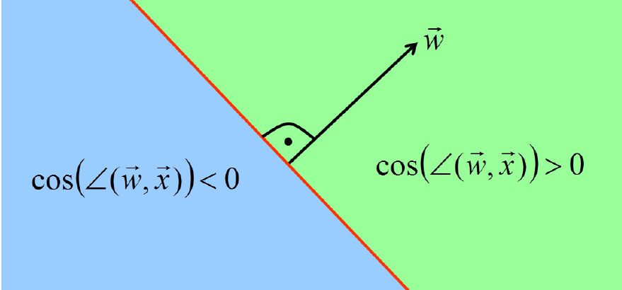



Linear Discriminant Function
Linear discriminants represent hyperplanes in feature space
$$f\left(x\right)=w^{T}x+b=b+\left\|w\right\|\left\|x\right\|cos⁡(∠\left(w,x\right))$$
$$w$$
$\cos\left(∠\left(w,x\right)\right)<$0
$cos⁡(∠\left(w,x\right))$>0

Slide 10
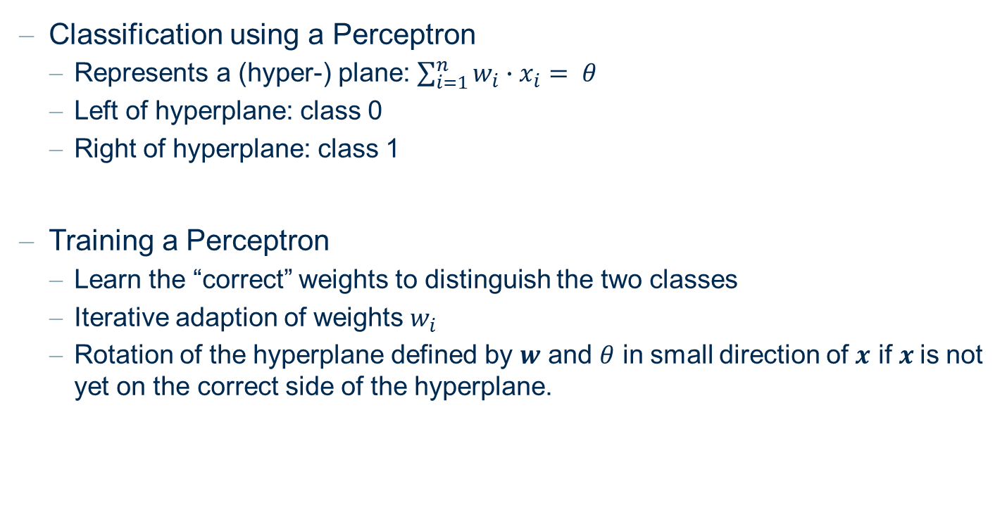
Training a “Perceptron”
Classification using a Perceptron
Represents a (hyper-) plane: $\sum_{i=1}^{n}{w_{i}∙x_{i}= θ}$
Left of hyperplane: class 0
Right of hyperplane: class 1
Training a Perceptron
Learn the “correct” weights to distinguish the two classes
Iterative adaption of weights $w_{i}$
Rotation of the hyperplane defined by $w$ and $θ$ in small direction of $x$ if $x$is not yet on the correct side of the hyperplane.

Slide 11
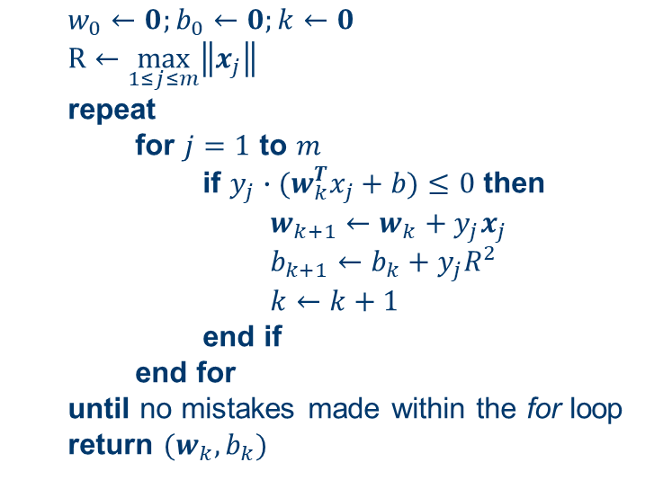
Primal Perceptron
Rosenblatt (1959) introduced a simple learning algorithm for linear discriminants ("perceptrons"):
Given a linearly separable training set S
$w_{0}←0;b_{0}←0;k←0$
$R←\max_{1≤j≤m}\left\|x_{j}\right\|$
repeat
for $j=1$ to $m$
if $y_{j}∙(w_{k}^{T}x_{j}+b)≤0$ then
$w_{k+1}←w_{k}+y_{j}x_{j}$
$b_{k+1}←b_{k}+y_{j}R^{2}$
$k←k+1$
end if
end for
until no mistakes made within the for loop
return $(w_{k}, b_{k})$

Slide 12
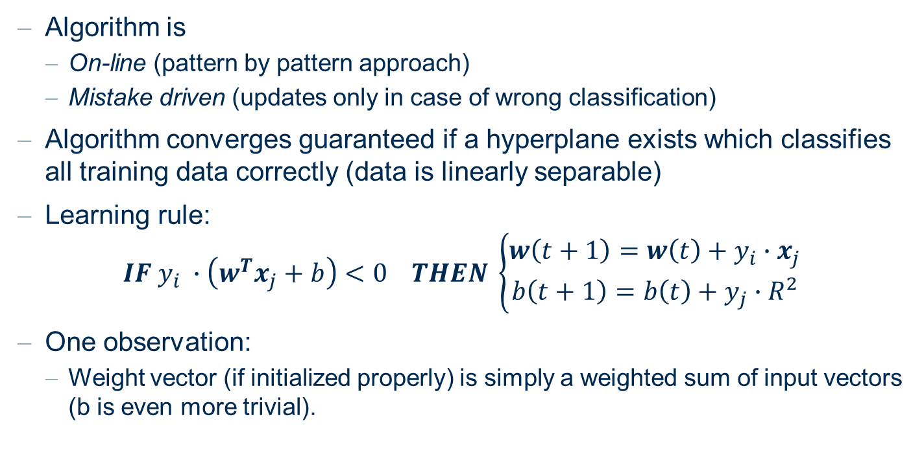
Rosenblatt Algorithm
Algorithm is
On-line (pattern by pattern approach)
Mistake driven (updates only in case of wrong classification)
Algorithm converges guaranteed if a hyperplane exists which classifies all training data correctly (data is linearly separable)
Learning rule:
$$IF y_{i} ∙\left(w^{T}x_{j}+b\right)<0 THEN \left\{\begin{aligned}w\left(t+1\right)=w\left(t\right)+y_{i}∙x_{j} \\ b\left(t+1\right)=b\left(t\right)+y_{j}∙R^{2}\end{aligned}\right.$$
One observation:
Weight vector (if initialized properly) is simply a weighted sum of input vectors (b is even more trivial).

Slide 13
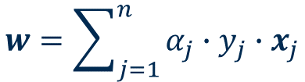
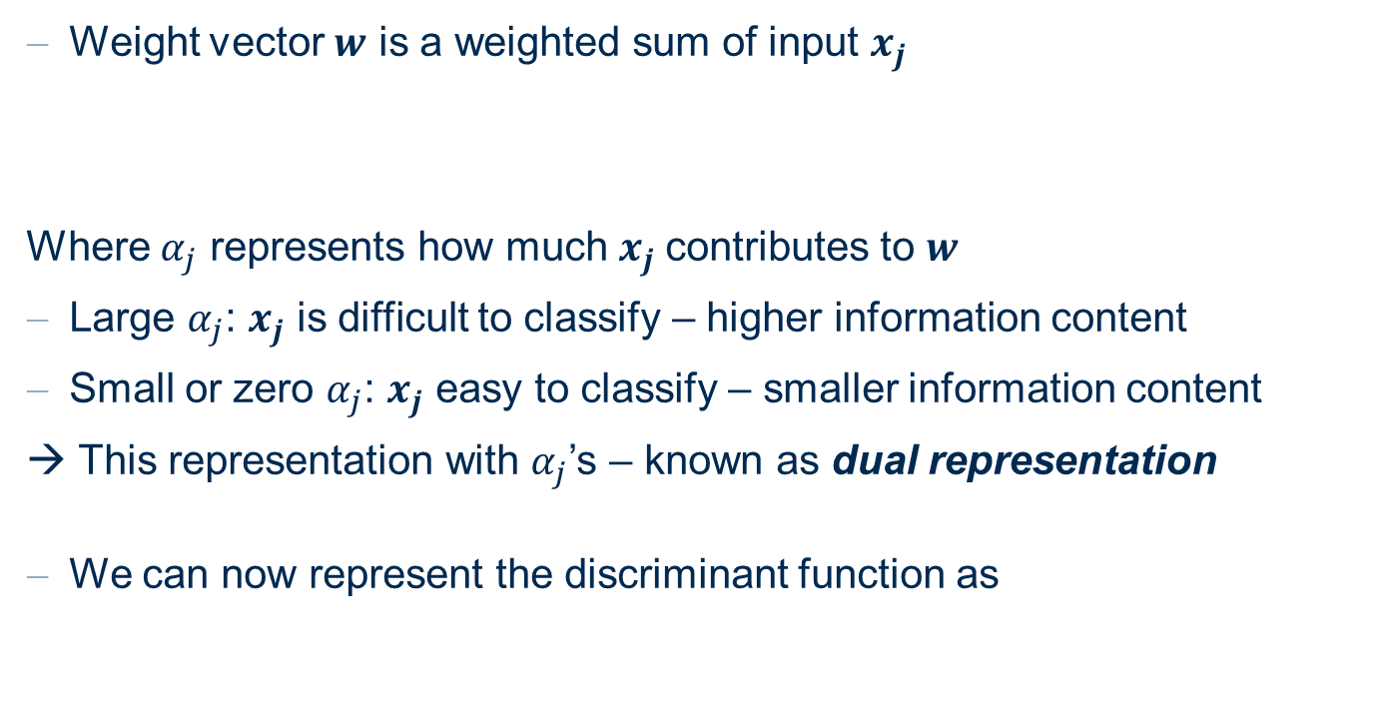
Dual Representation (of discriminant function)
Weight vector $w$ is a weighted sum of input $x_{j}$
Where $α_{j}$ represents how much $x_{j}$contributes to $w$
Large $α_{j}$: $x_{j}$ is difficult to classify – higher information content
Small or zero $α_{j}$: $x_{j}$ easy to classify – smaller information content
→ This representation with $α_{j}$’s – known as dual representation
We can now represent the discriminant function as
$$w=\sum_{j=1}^{n}{α_{j}∙y_{j}∙x_{j}}$$
$$f\left(x\right)=w^{T}x+b=\left(\sum_{j=1}^{n}{α_{j}∙y_{j}∙x_{j}^{T}x}\right)+b$$

Slide 14
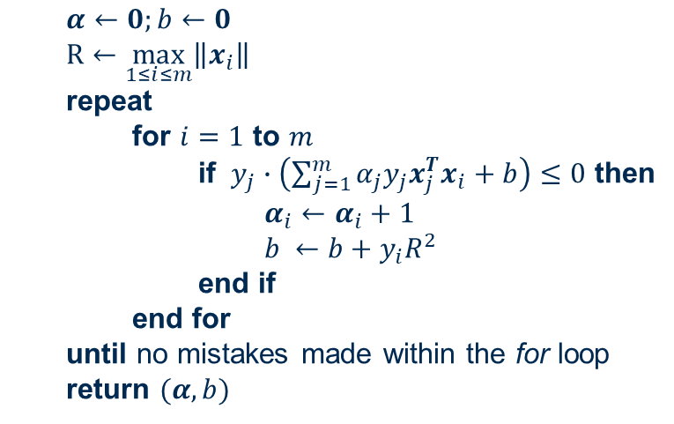
Dual Representation
Dual Representation of Learning Algorithm:
Given a training set S
$α←0;b←0$
$R←\max_{1≤i≤m}\left\|x_{i}\right\|$
repeat
for $i=1$ to $m$
if $y_{j}∙\left(\sum_{j=1}^{m}{α_{j}y_{j}x_{j}^{T}x_{i}+b}\right)≤0$ then
$α_{i}←α_{i}+1$
$b ←b+y_{i}R^{2}$
end if
end for
until no mistakes made within the for loop
return $(α,b)$

Slide 15
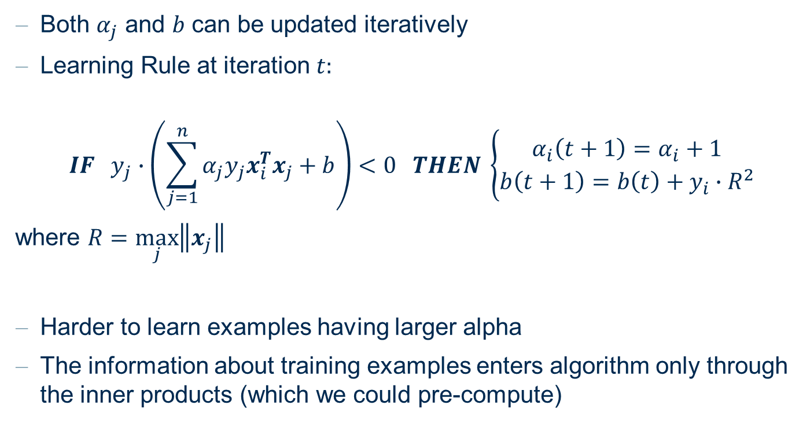
Dual Representation
Both $α_{j}$ and $b$ can be updated iteratively
Learning Rule at iteration $t:$
$${IF y}_{j}∙\left(\sum_{j=1}^{n}{α_{j}y_{j}x_{i}^{T}x_{j}+b}\right)<0 THEN \left\{\begin{aligned}α_{i}\left(t+1\right)=α_{i}+1 \\ b\left(t+1\right)=b\left(t\right)+y_{i}∙R^{2}\end{aligned}\right.$$
where $R=\max_{j}\left\|x_{j}\right\|$
Harder to learn examples having larger alpha
The information about training examples enters algorithm only through the inner products (which we could pre-compute)

Slide 16
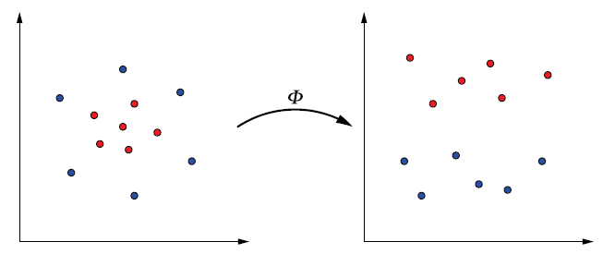

Projection to Other Spaces
So far, we have seen training via computation of inner products
→ Indicating which side of the linear decision boundary $x$ falls into
Say, it is hard to find a linear boundary in the original space
Solution: project to another space, find the linear boundary in the projected space, classify in the projected space
Original space
Projected space
Linear boundary

Slide 17
Kernel Methods and Support Vector Machines

Slide 18
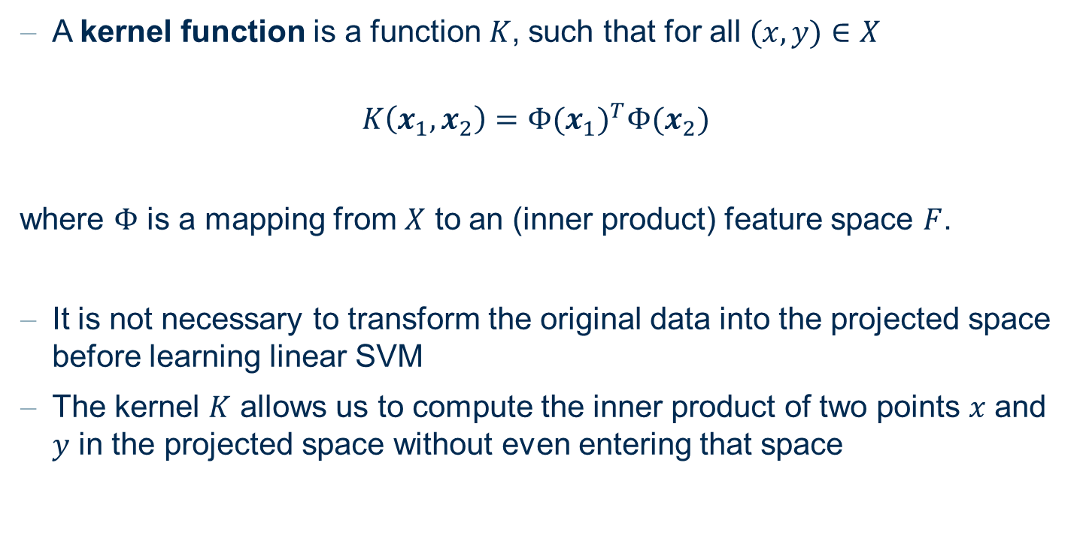
Kernel Functions
A kernel function is a function $K$, such that for all $(x,y)∈X$
$$K\left(x_{1},x_{2}\right)={Φ(x_{1})}^{T}Φ(x_{2})$$
where $Φ$ is a mapping from $X$ to an (inner product) feature space $F$.
It is not necessary to transform the original data into the projected space before learning linear SVM
The kernel $K$ allows us to compute the inner product of two points $x$ and $y$ in the projected space without even entering that space

Slide 19

…in Kernel Land…
The discriminant function in the projected space
$$f\left(x\right)=\left(\sum_{j=1}^{n}{α_{j}∙y_{j}∙{Φ(x)}^{T}Φ(x_{j})}\right)+b$$
Or with the kernel function $K$
$$f\left(x\right)=\left(\sum_{j=1}^{n}{α_{j}∙y_{j}∙K(x,x_{j})}\right)+b$$

Slide 20
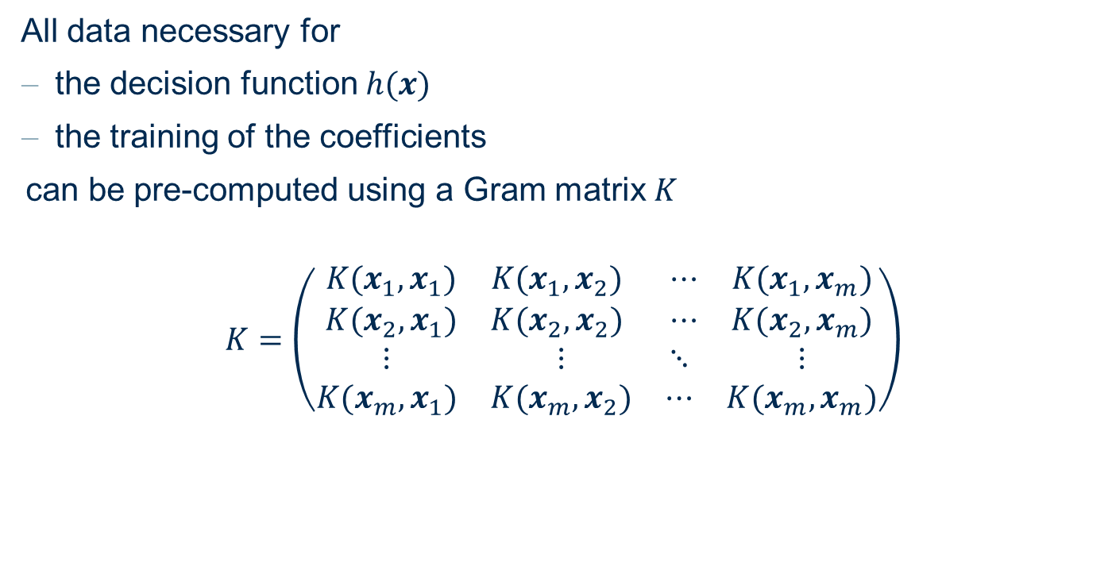
Gram Matrix
All data necessary for
the decision function $h(x)$
the training of the coefficients
can be pre-computed using a Gram matrix $K$
$$K=\left(\begin{matrix}\begin{matrix}K(x_{1},x_{1}) & K(x_{1},x_{2}) \\ K(x_{2},x_{1}) & K(x_{2},x_{2})\end{matrix} & \begin{matrix}⋯ & K(x_{1},x_{m}) \\ ⋯ & K(x_{2},x_{m})\end{matrix} \\ \begin{matrix}⋮ & ⋮ \\ K(x_{m},x_{1}) & K(x_{m},x_{2})\end{matrix} & \begin{matrix}⋱ & ⋮ \\ ⋯ & K(x_{m},x_{m})\end{matrix}\end{matrix}\right)$$

Slide 21
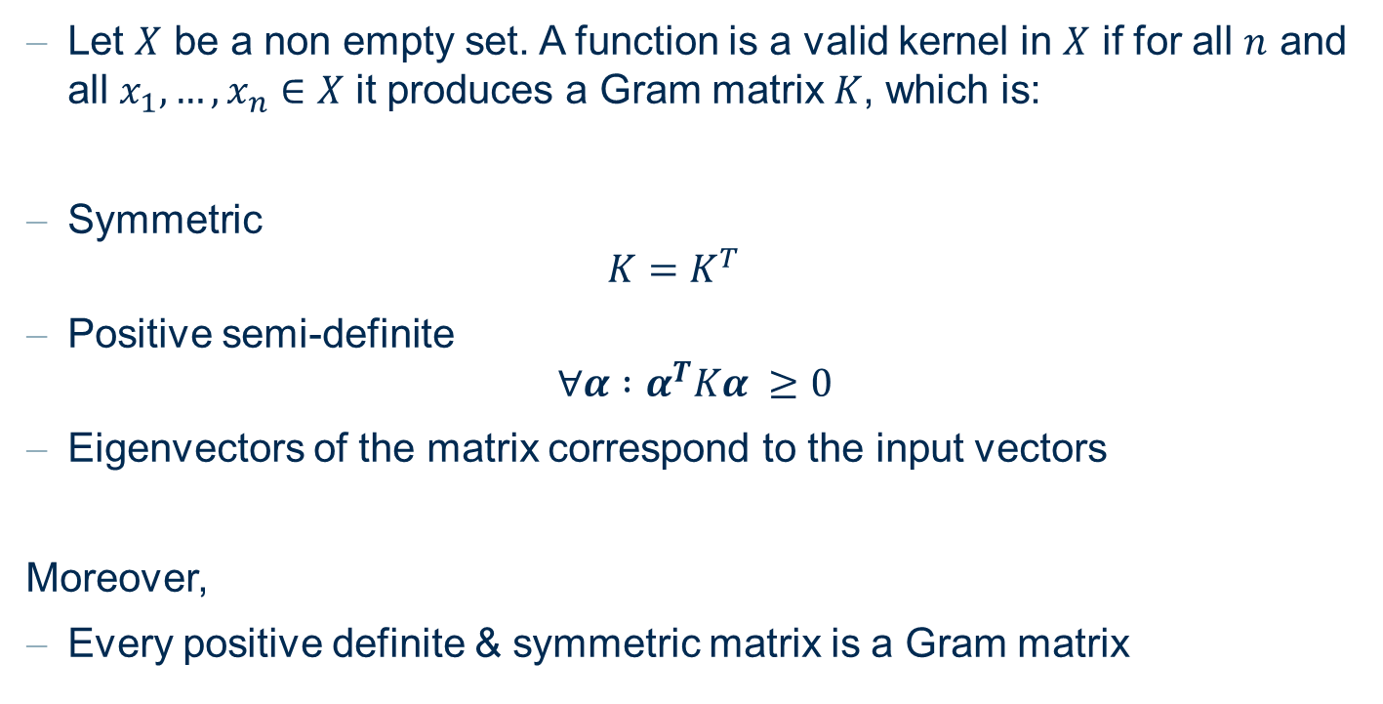
Rules for a Gramm Matrix
Let $X$ be a non empty set. A function is a valid kernel in $X$ if for all $n$ and all $x_{1},…,x_{n}∈X$ it produces a Gram matrix $K$, which is:
Symmetric
$$K=K^{T}$$
Positive semi-definite
$$∀α :α^{T}Kα ≥0$$
Eigenvectors of the matrix correspond to the input vectors
Moreover,
Every positive definite & symmetric matrix is a Gram matrix

Slide 22
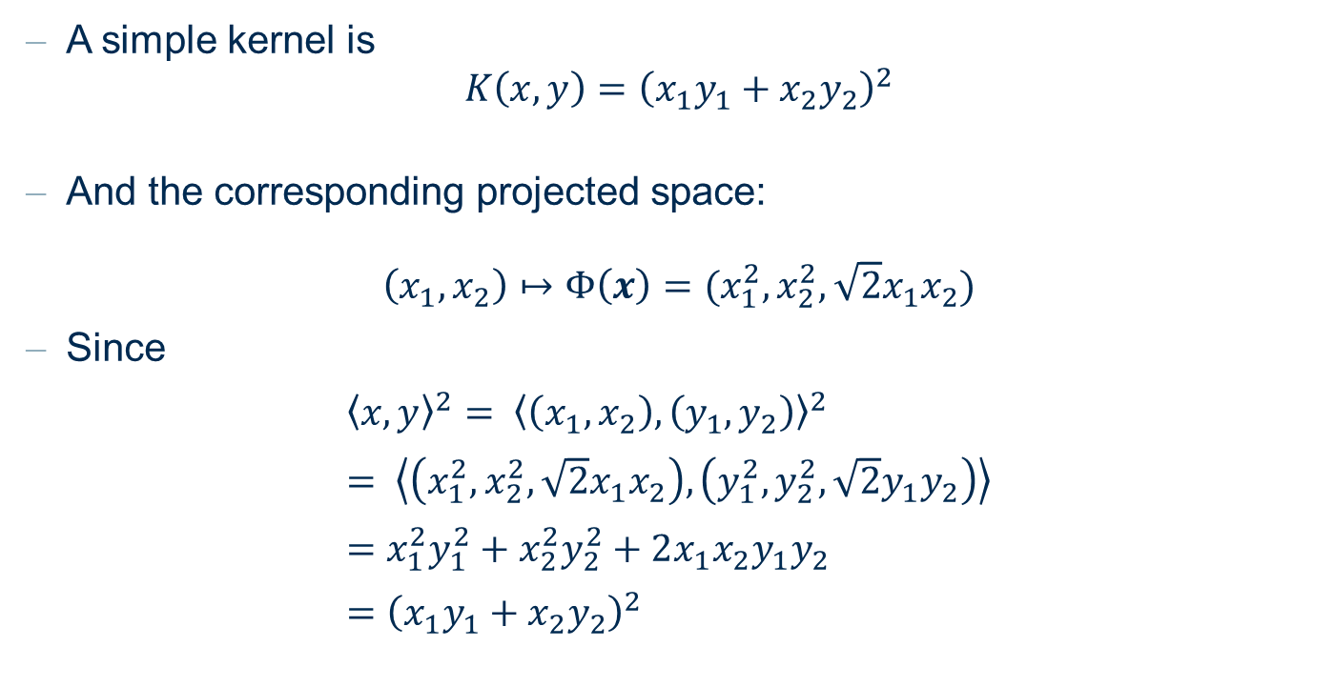
Kernels
A simple kernel is
$$K\left(x,y\right)={\left(x_{1}y_{1}+x_{2}y_{2}\right)}^{2}$$
And the corresponding projected space:
$$\left(x_{1},x_{2}\right)↦Φ\left(x\right)=(x_{1}^{2},x_{2}^{2}, \sqrt{2}x_{1}x_{2})$$
Since
${\left\langle x,y\right\rangle }^{2}= {\left\langle \left(x_{1}, x_{2}\right), \left(y_{1}, y_{2}\right)\right\rangle }^{2}$
$= \left\langle \left(x_{1}^{2},x_{2}^{2}, \sqrt{2}x_{1}x_{2}\right),\left(y_{1}^{2},y_{2}^{2}, \sqrt{2}y_{1}y_{2}\right)\right\rangle$
$=x_{1}^{2}y_{1}^{2}+x_{2}^{2}y_{2}^{2}+2x_{1}x_{2}y_{1}y_{2}$
$={\left(x_{1}y_{1}+x_{2}y_{2}\right)}^{2}$

Slide 23
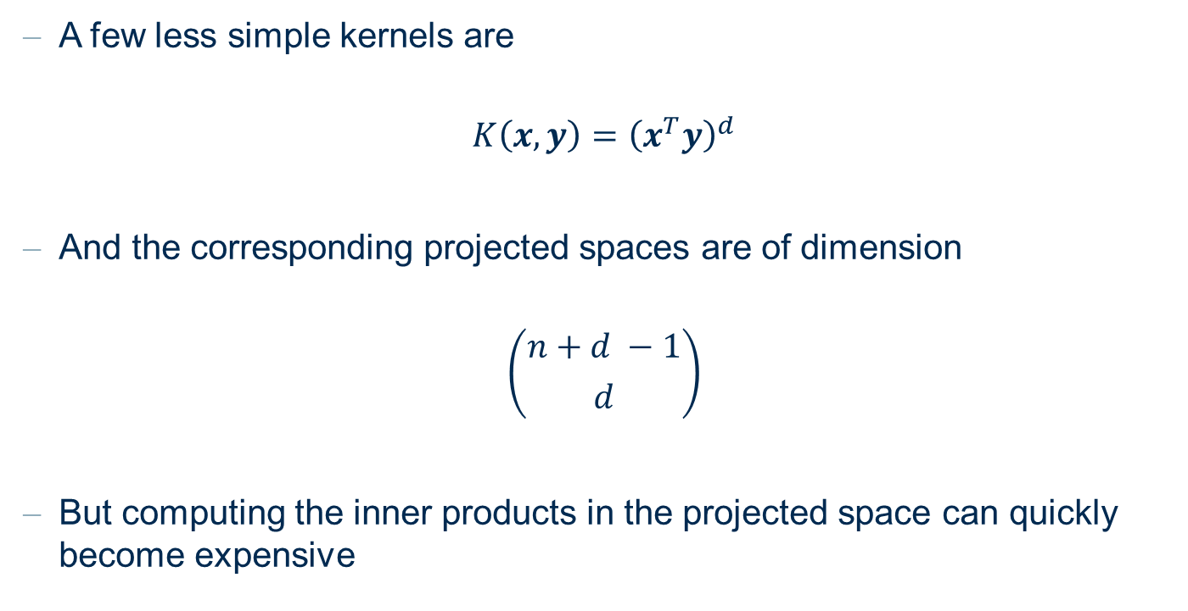
Kernels
A few less simple kernels are
$$K\left(x, y\right)={\left(x^{T}y\right)}^{d}$$
And the corresponding projected spaces are of dimension
$$\left({n+d −1 \atop d}\right)$$
But computing the inner products in the projected space can quickly become expensive

Slide 24
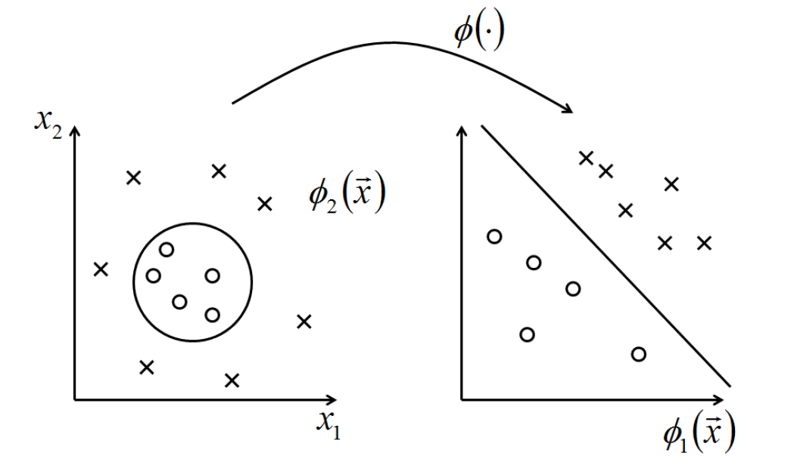


More Kernels
Polynomial kernel of degree $d$
$$K\left(x,y\right)={\left(x^{T}y+c\right)}^{d}$$

Slide 25
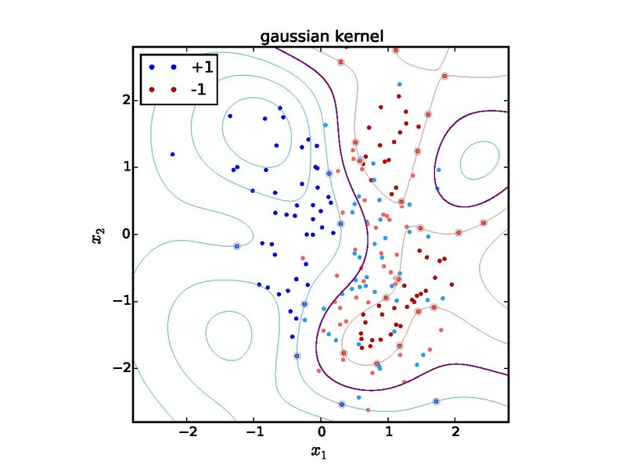
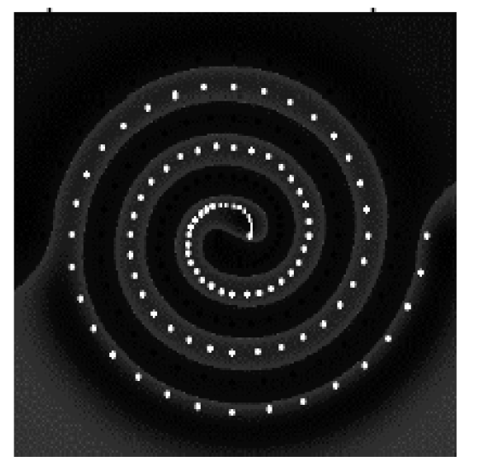

More Kernels
Gaussian kernel
Also known as radial basis function (RBF) kernel
$$K\left(x,y\right)=e^{−\frac{{\left\|x−y\right\|}^{2}}{2σ^{2}}}$$

Slide 26
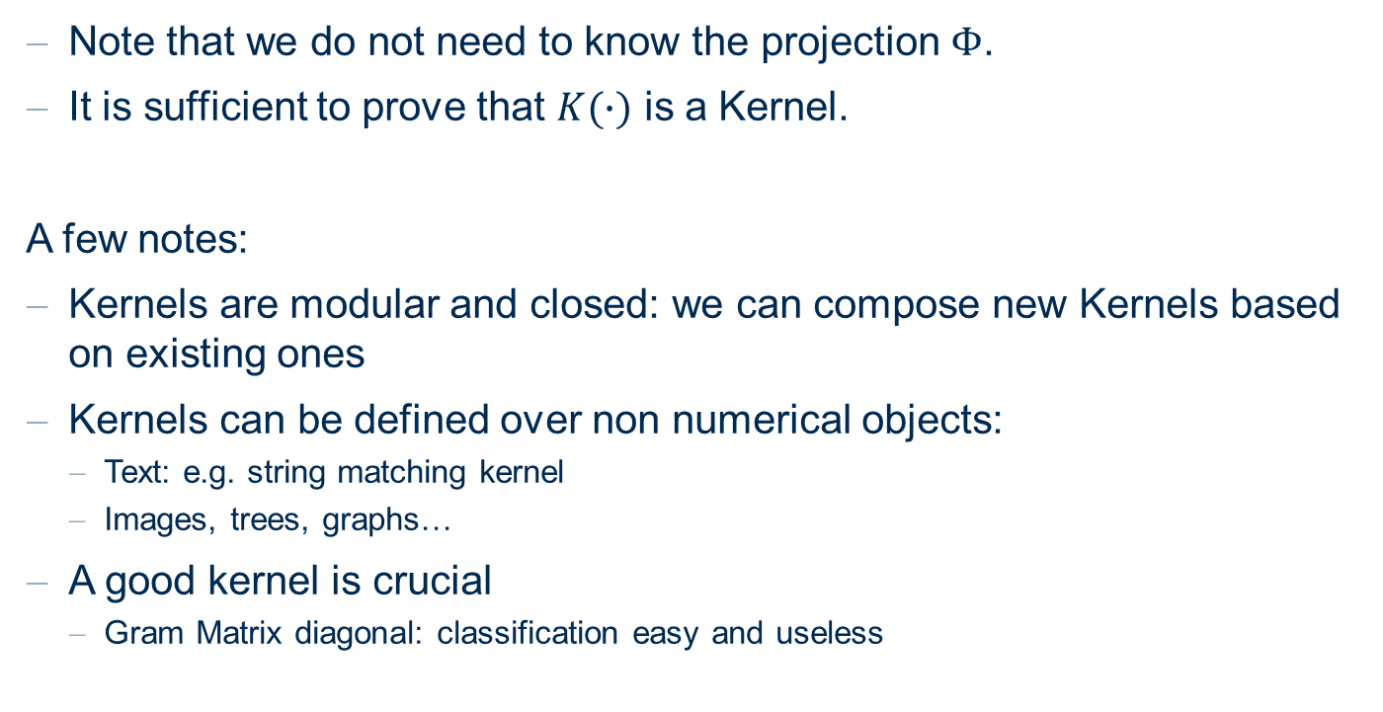
Kernels
Note that we do not need to know the projection $Φ$.
It is sufficient to prove that $K(∙)$ is a Kernel.
A few notes:
Kernels are modular and closed: we can compose new Kernels based on existing ones
Kernels can be defined over non numerical objects:
Text: e.g. string matching kernel
Images, trees, graphs…
A good kernel is crucial
Gram Matrix diagonal: classification easy and useless

Slide 27
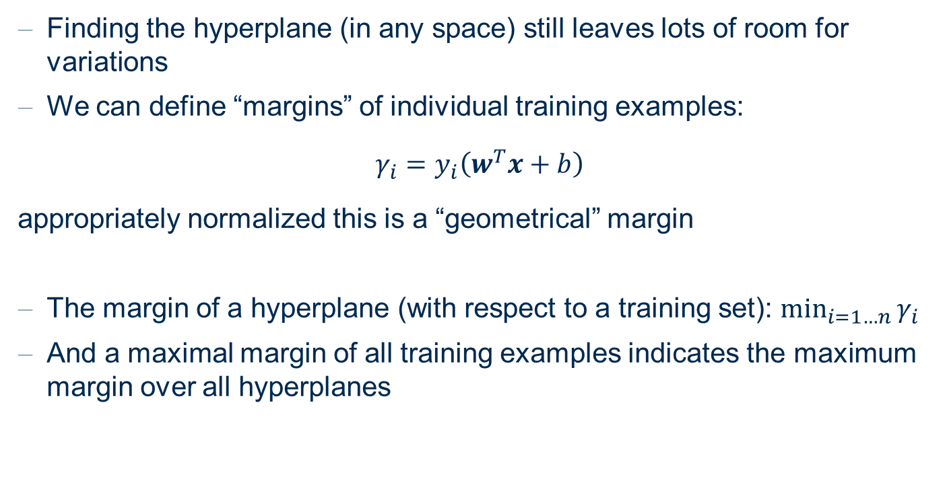
Finding Linear Discriminants
Finding the hyperplane (in any space) still leaves lots of room for variations
We can define “margins” of individual training examples:
$$γ_{i}=y_{i}\left(w^{T}x+b\right)$$
appropriately normalized this is a “geometrical” margin
The margin of a hyperplane (with respect to a training set): $\min_{i=1…n}{γ_{i}}$
And a maximal margin of all training examples indicates the maximum margin over all hyperplanes

Slide 28
(maximum) Margin of a Hyperplane

Slide 29
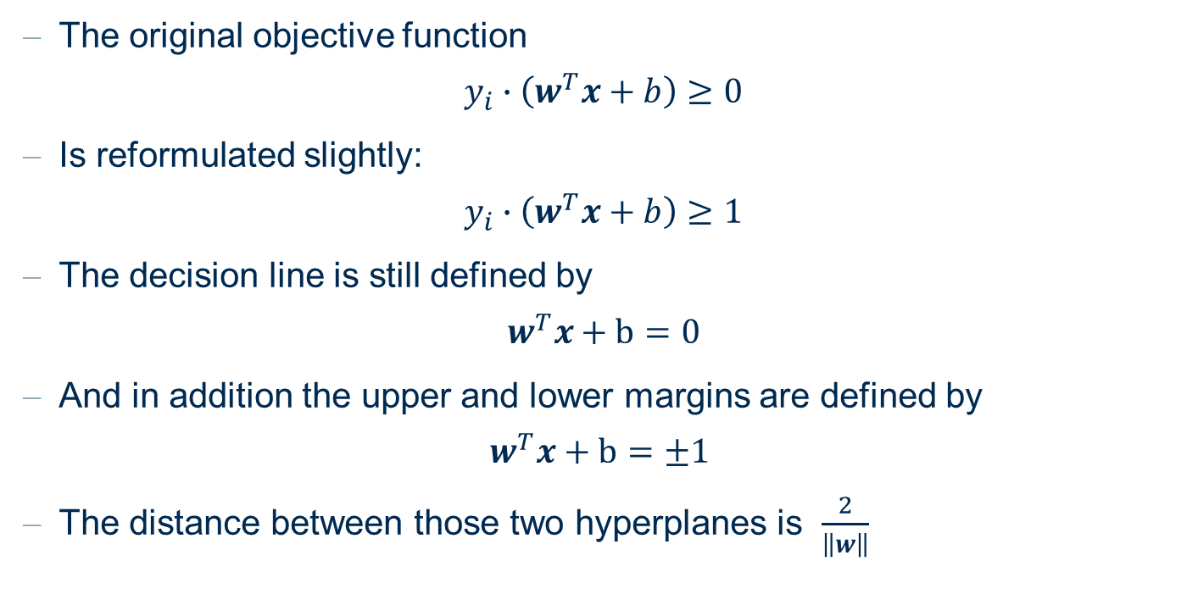
Finding Linear Discriminants
The original objective function
$$y_{i}∙\left(w^{T}x+b\right)≥0$$
Is reformulated slightly:
$$y_{i}∙\left(w^{T}x+b\right)≥1$$
The decision line is still defined by
$$w^{T}x+b=0$$
And in addition the upper and lower margins are defined by
$$w^{T}x+b=±1$$
The distance between those two hyperplanes is $\frac{2}{\left\|w\right\|}$

Slide 30
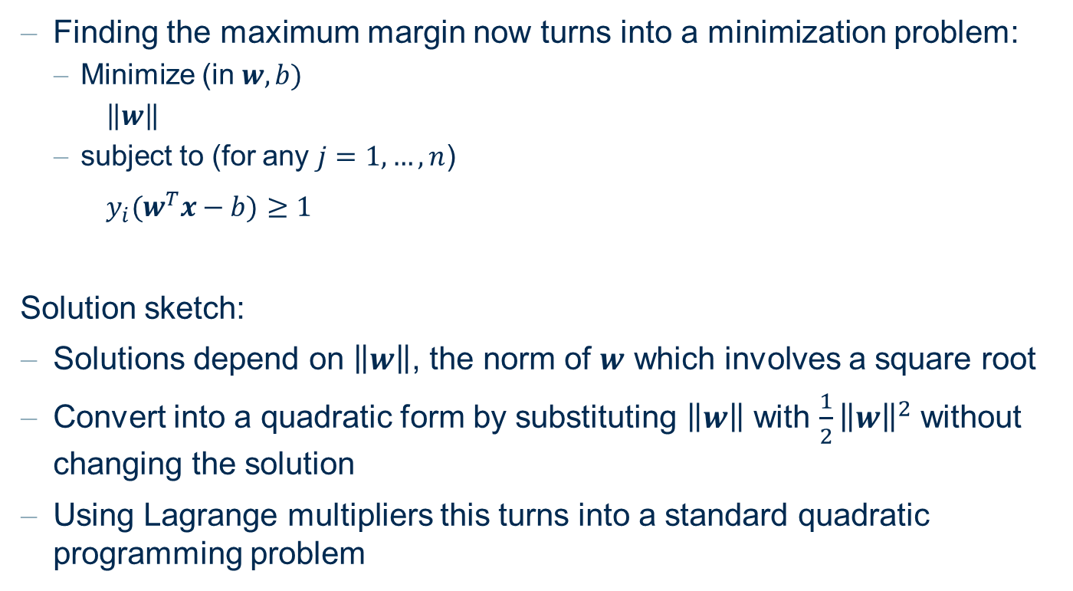
Finding Linear Discriminants
Finding the maximum margin now turns into a minimization problem:
Minimize (in $w, b)$
$\left\|w\right\|$
subject to (for any $j=1,…,n$)
$y_{i}(w^{T}x−b)≥1$
Solution sketch:
Solutions depend on $\left\|w\right\|$, the norm of $w$ which involves a square root
Convert into a quadratic form by substituting $\left\|w\right\|$ with $\frac{1}{2}{\left\|w\right\|}^{2}$ without changing the solution
Using Lagrange multipliers this turns into a standard quadratic programming problem

Slide 31
Margin of Error and Variations

Slide 32
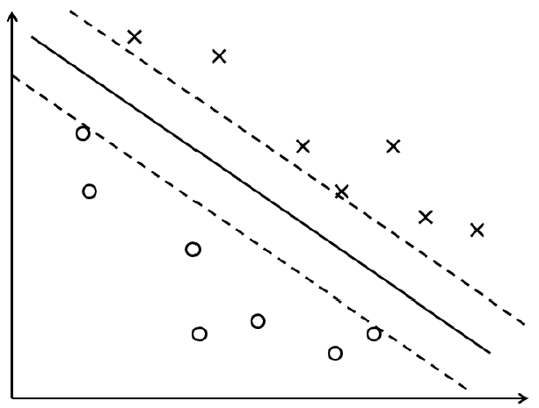
Soft and Hard Margin Classifiers
What can we do if no linear separating hyperplane exists?
Solution: allow minor violations – also known as soft margins
→ In contrast, avoiding any misclassifications ≡ hard margins
Hard margins
Soft margins

Slide 33
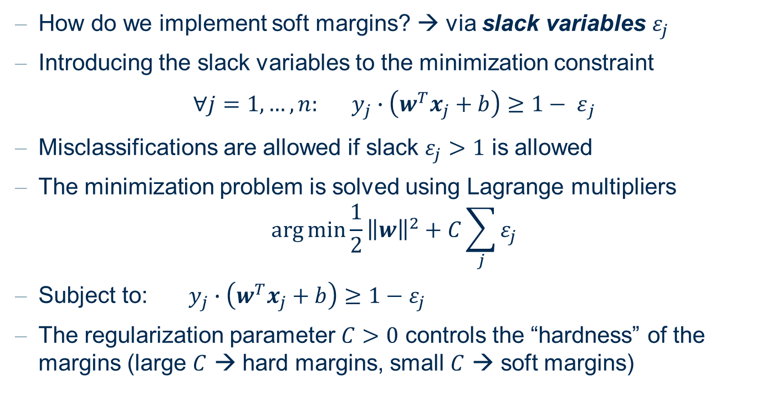
Soft and Hard Margin Classifiers
How do we implement soft margins? → via slack variables $ε_{j}$
Introducing the slack variables to the minimization constraint
$${∀j=1, …, n: y_{j}∙\left(w^{T}x_{j}+b\right)≥1− ε}_{j}$$
Misclassifications are allowed if slack $ε_{j}>1$ is allowed
The minimization problem is solved using Lagrange multipliers
$$\arg{\min{\frac{1}{2}}}{\left\|w\right\|}^{2}+C\sum_{j}{ε_{j}}$$
Subject to:$y_{j}∙\left(w^{T}x_{j}+b\right)≥1−ε_{j}$
The regularization parameter $C>0$ controls the “hardness” of the margins (large $C$ → hard margins, small $C$ → soft margins)

Slide 34
Multi-Class SVM
How do we separate more than two classes?
Transform the problem into a set of binary classification problems
One class vs. all other classes
One class vs. another class, for all possible class pairs
The class with the farthest distance from the hyperplane wins

Slide 35
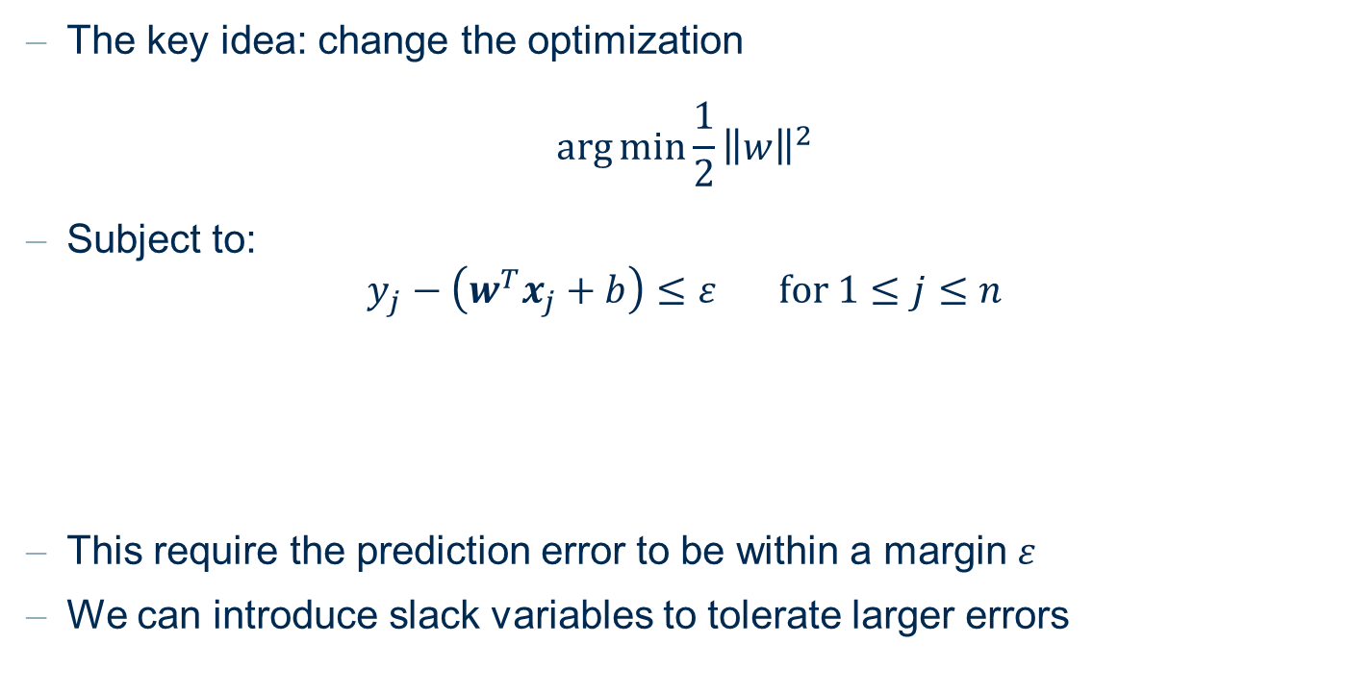
Support Vector Regression
The key idea: change the optimization
$$\arg{\min{\frac{1}{2}}}{\left\|w\right\|}^{2}$$
Subject to:
$$y_{j}−\left(w^{T}x_{j}+b\right)≤ε for 1≤j≤n$$
This require the prediction error to be within a margin $ε$
We can introduce slack variables to tolerate larger errors

Slide 36
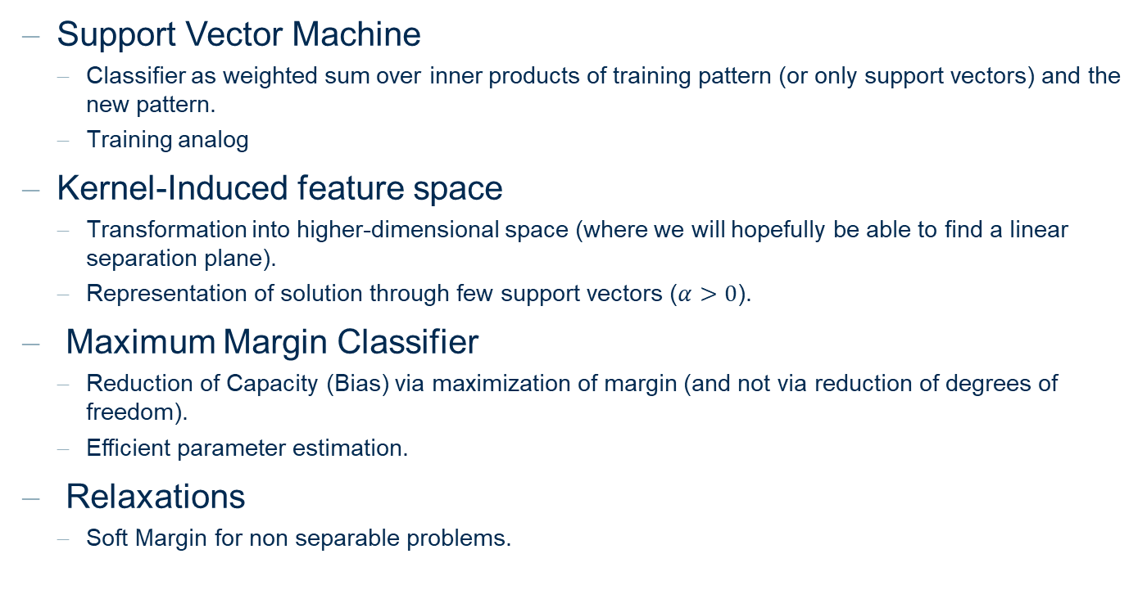
Support Vector Machines
Support Vector Machine
Classifier as weighted sum over inner products of training pattern (or only support vectors) and the new pattern.
Training analog
Kernel-Induced feature space
Transformation into higher-dimensional space (where we will hopefully be able to find a linear separation plane).
Representation of solution through few support vectors ($α>0$).
Maximum Margin Classifier
Reduction of Capacity (Bias) via maximization of margin (and not via reduction of degrees of freedom).
Efficient parameter estimation.
Relaxations
Soft Margin for non separable problems.

Slide 37
Practical Examples with KNIME Analytics Platform

Slide 38

SVM on the Iris Data
Workflow training an SVM model to classify the iris data set

Slide 39
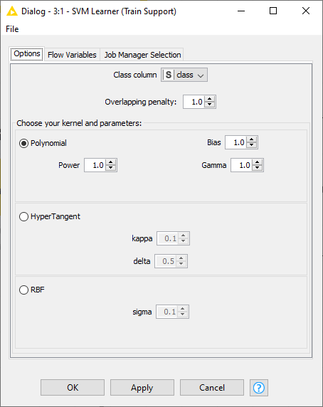
SVM on the Iris Data
The configuration window of the SVM Learner node
Allows a selection of a kernel and the associated parameters
Overlapping penalty controls the margin hardness

Slide 40
Thank you

