Slide 1
Dimensionality Reduction

Slide 2
Summary of this lesson
„The more you know, the less you need“ -Yvon Chouinard
Can we condense information?
*This lesson refers to chapter 4 of the GIDS book

Slide 3
Content of this lesson
Methods for Dimensionality Reduction
Principal Component Analysis (PCA)
Linear discriminant Analysis (LDA)
Multidimensional Scaling (MDS)
t-distributed Stochastic Neighbor Embedding (t-SNE)

Slide 4
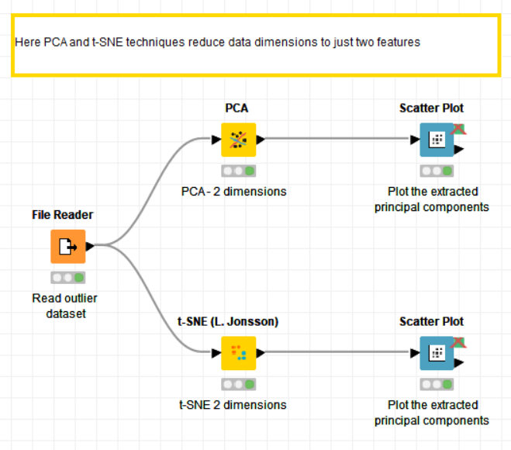
Datasets
Datasets used : adult dataset and outliers dataset
Example Workflows:
„Dimensionality Reduction“ https://kni.me/w/EnmfIBCuLOFpYvc2
PCA
t-SNE

Slide 5
PCA: Principal Component Analysis

Slide 6
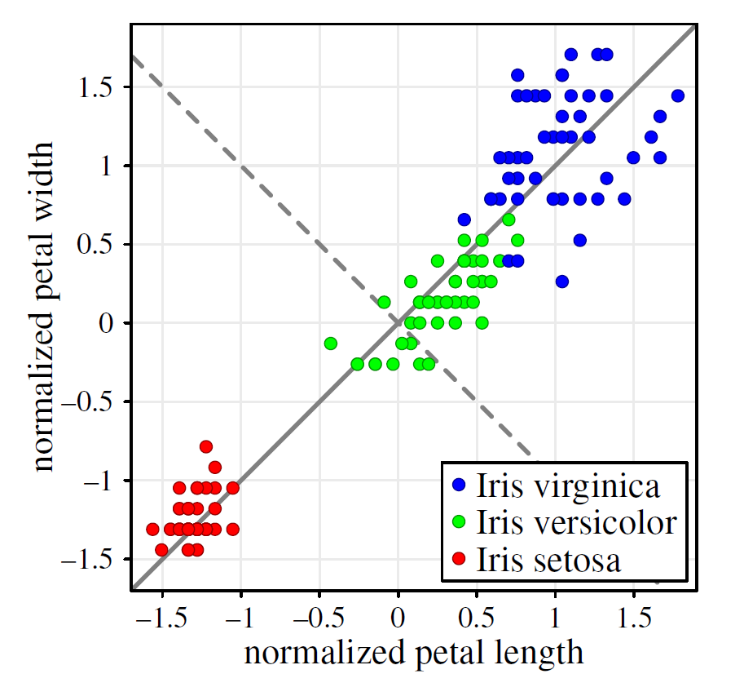
Principal Component Analysis: Goal
Method from statistics to construct a projection from the high-dimensional space to a lower-dimensional space
Uses the variance in the data as structure preservation criterion
Projection must be to a linear subspace which preserves as much as possible of the original variance of the data
First PC (solid line) in the direction of maximum variance; second PC (dashed line) in the direction of second max. variance and orthogonal to first PC.

Slide 7
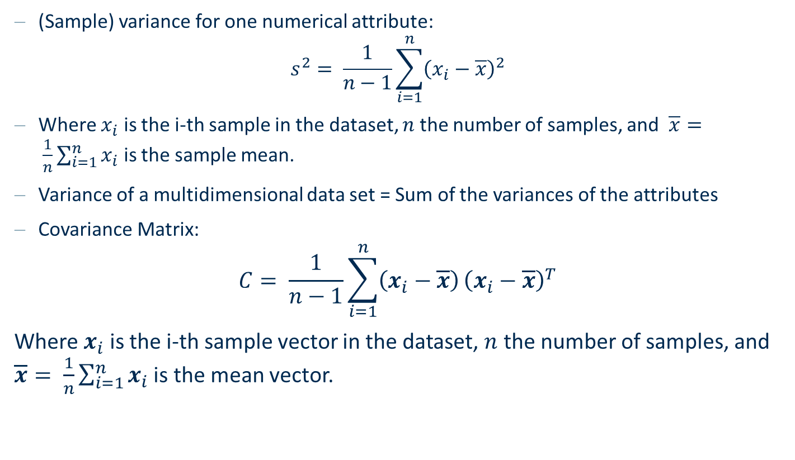
Mean and Variance
(Sample) variance for one numerical attribute:
$$s^{2}= \frac{1}{n−1}\sum_{i=1}^{n}{{\left(x_{i}−\overline{x}\right)}^{2}}$$
Where $x_{i}$ is the i-th sample in the dataset, $n$ the number of samples, and $\overline{x}= \frac{1}{n}\sum_{i=1}^{n}{x_{i}}$ is the sample mean.
Variance of a multidimensional data set = Sum of the variances of the attributes
Covariance Matrix:
$$C= \frac{1}{n−1}\sum_{i=1}^{n}{\left(x_{i}−\overline{x}\right)}{\left(x_{i}−\overline{x}\right)}^{T}$$
Where $x_{i}$ is the i-th sample vector in the dataset, $n$ the number of samples, and $\overline{x}= \frac{1}{n}\sum_{i=1}^{n}{x_{i}}$ is the mean vector.

Slide 8
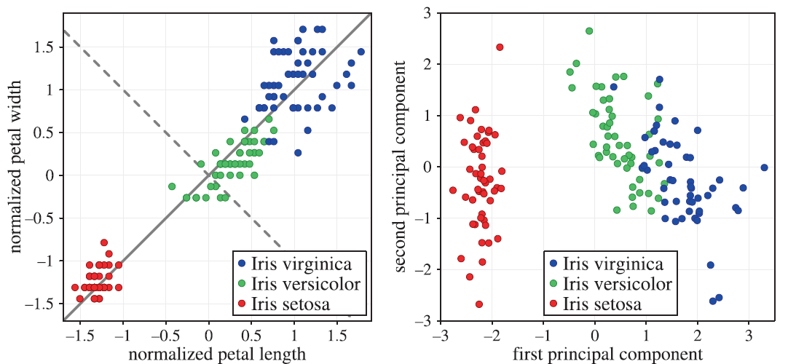
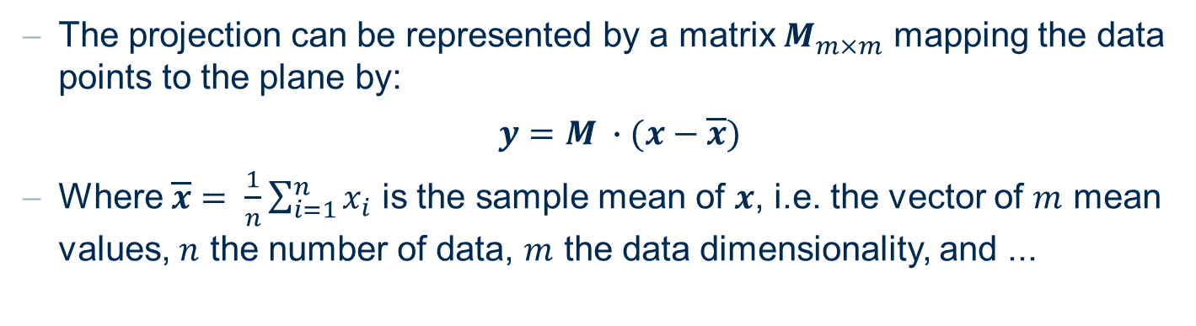
Principal Component Analysis: Projection
M
The projection can be represented by a matrix $M_{m×m}$ mapping the data points to the plane by:
$y=M ∙(x−\overline{x})$
Where $\overline{x}= \frac{1}{n}\sum_{i=1}^{n}{x_{i}}$ is the sample mean of $x$, i.e. the vector of $m$ mean values, $n$ the number of data, $m$ the data dimensionality, and ...

Slide 9
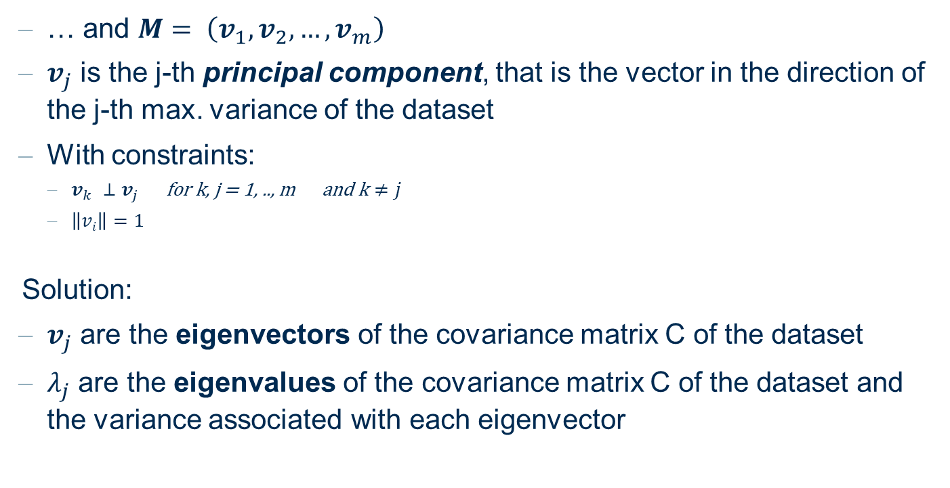
Principal Component Analysis: Eigenvalues and Eigenvectors
… and $M= \left(v_{1}, v_{2}, …, v_{m}\right)$
$v_{j}$ is the j-th principal component, that is the vector in the direction of the j-th max. variance of the dataset
With constraints:
$v_{k} ⊥v_{j} \text{for} \text{k}\text{, }\text{j}\text{ = 1, .., }\text{m} \text{and} \text{k}≠j$
$\left\|vi\right\|=1$
Solution:
$v_{j}$ are the eigenvectors of the covariance matrix C of the dataset
$λ_{j}$ are the eigenvalues of the covariance matrix C of the dataset and the variance associated with each eigenvector

Slide 10
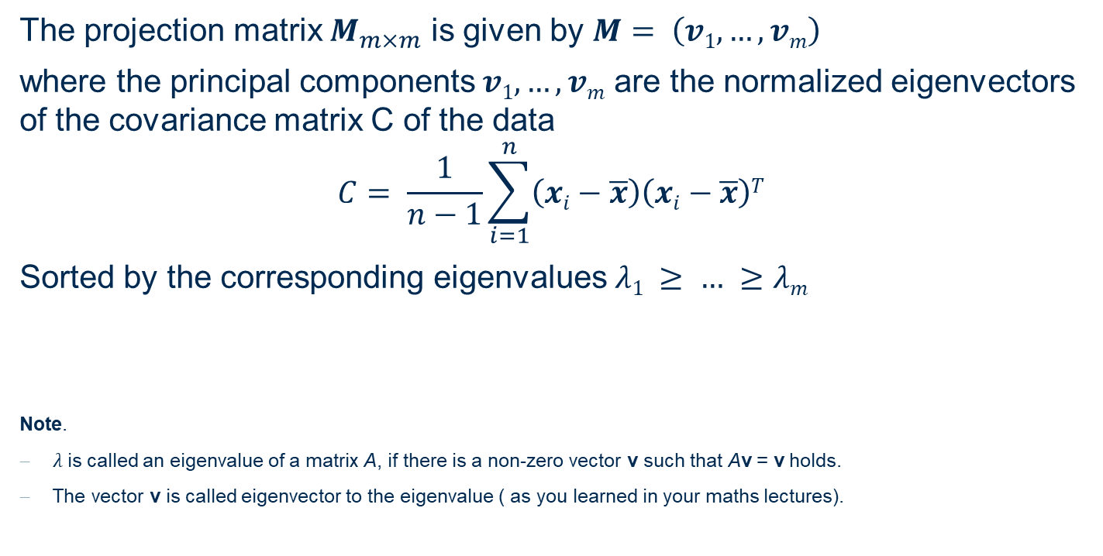
Principal Component Analysis: Summary
The projection matrix $M_{m×m}$ is given by $M= \left(v1, …,vm\right)$
where the principal components$v1, …,vm$ are the normalized eigenvectors of the covariance matrix C of the data
$$C= \frac{1}{n−1}\sum_{i=1}^{n}{\left(xi−\overline{x}\right)\left(xi−\overline{x}\right)T}$$
Sorted by the corresponding eigenvalues $λ1 ≥ … ≥λm$
Note.
$λ$is called an eigenvalue of a matrix A, if there is a non-zero vector v such that Av = v holds.
The vector v is called eigenvector to the eigenvalue ( as you learned in your maths lectures).

Slide 11
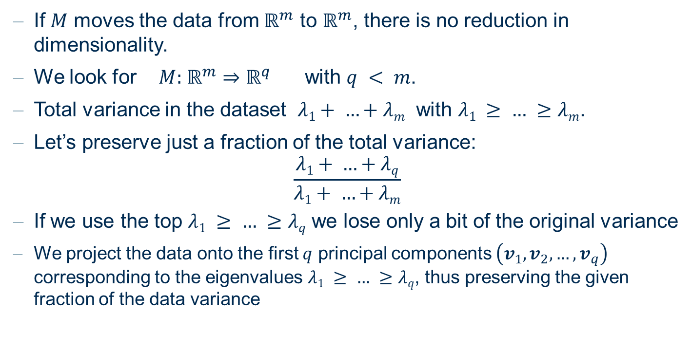
Principal Component Analysis: Dimensionality Reduction
If $M$ moves the data from $ℝ^{m}$ to $ℝ^{m}$, there is no reduction in dimensionality.
We look for $M:$ $ℝ^{m}⇒ℝ^{q}$ with $q < m$.
Total variance in the dataset $λ1+ …+λm$ with $λ1 ≥ … ≥λm$.
Let’s preserve just a fraction of the total variance:
$$\frac{λ1+ …+λq}{λ1+ …+λm}$$
If we use the top $λ1 ≥ … ≥λq$ we lose only a bit of the original variance
We project the data onto the first $q$ principal components $\left(v_{1}, v_{2}, …, v_{q}\right)$ corresponding to the eigenvalues $λ1 ≥ … ≥λq$, thus preserving the given fraction of the data variance

Slide 12
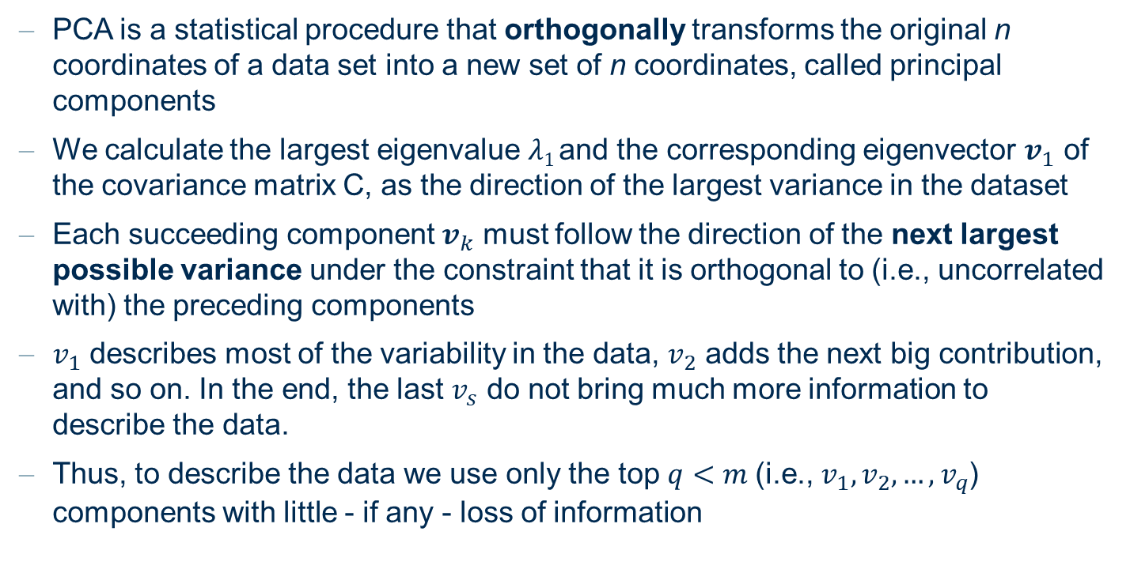
Principal Component Analysis
PCA is a statistical procedure that orthogonally transforms the original n coordinates of a data set into a new set of n coordinates, called principal components
We calculate the largest eigenvalue $λ1$and the corresponding eigenvector $v_{1}$ of the covariance matrix C, as the direction of the largest variance in the dataset
Each succeeding component $v_{k}$ must follow the direction of the next largest possible variance under the constraint that it is orthogonal to (i.e., uncorrelated with) the preceding components
$v_{1}$ describes most of the variability in the data, $v_{2}$ adds the next big contribution, and so on. In the end, the last $v_{s}$ do not bring much more information to describe the data.
Thus, to describe the data we use only the top $q<m$(i.e., $v_{1}, v_{2}, …, v_{q}$) components with little - if any - loss of information

Slide 13
Principal Component Analysis
 | Prinicipal Components
 | PC1 | PC2 | PC3 | PC4
Proportion of variance | 0.73 | 0.229 | 0.0367 | 0.00518
Cumulative Proportion | 0.73 | 0.958 | 0.9948 | 1.0000
Preservation of the variance of the Iris data set depending on the number of principal components.
Caveats:
Results of PCA are quite difficult to interpret
Data normalization is required (z-score normalization)
Only effective on numeric columns

Slide 14
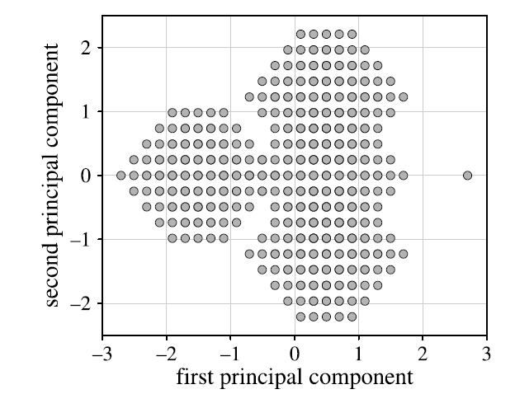
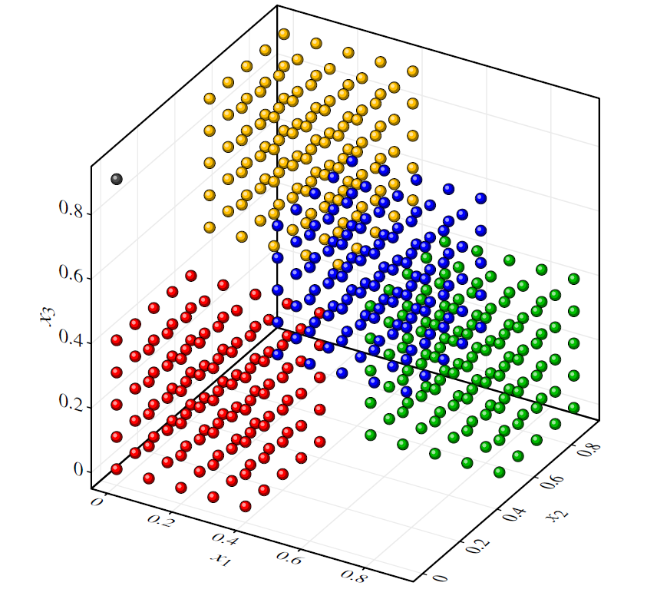
Principal Component Analysis: the „Cube“ data
PCA
Impression that the data are uniformly distributed over a grid
Outlier not represented
Data are visibly not uniformly distributed
Outlier is visible

Slide 15
LDA: Linear Discriminant Analysis

Slide 16
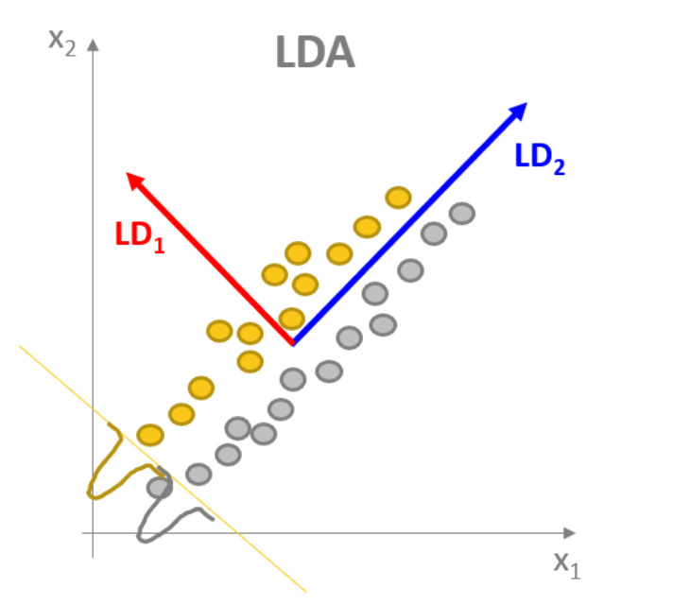
Linear Discriminant Analysis: Goal
LDA is a classification algorithm based on class statistics
It can also be used as a method to construct a projection from the high-dimensional space to a lower-dimensional space
Uses the class separation as structure preservation criterion
Projection must be to a linear subspace which preserves as much as possible of the original separation of the classes in the data
First LD (red line) in the direction of maximum discriminability between classes; second LD (blue line) in the direction of second max. discriminability and orthogonal to first LD.

Slide 17
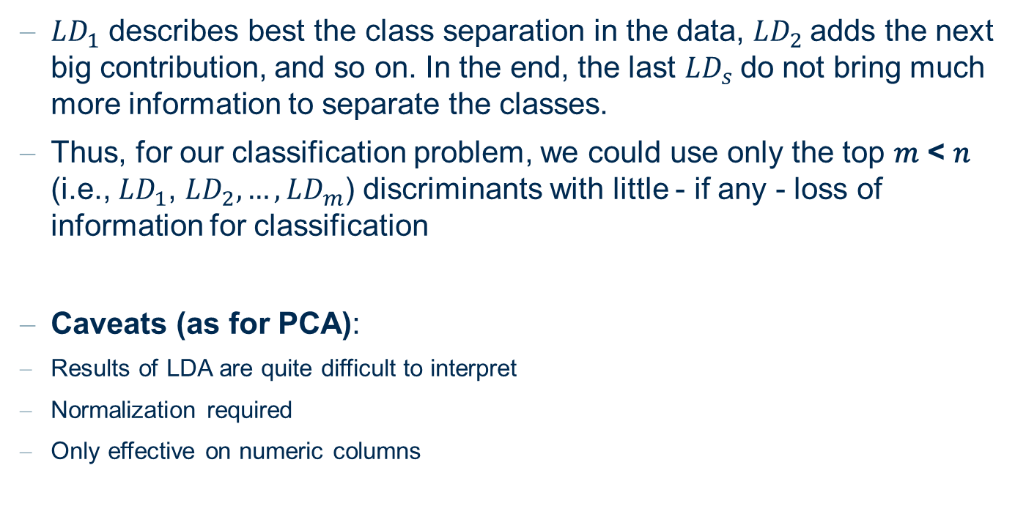
Linear Discriminant Analysis
$LD_{1}$ describes best the class separation in the data, $LD_{2}$adds the next big contribution, and so on. In the end, the last $LD_{s}$do not bring much more information to separate the classes.
Thus, for our classification problem, we could use only the top 𝑚 < 𝑛 (i.e., $LD_{1}$, $LD_{2},…,LD_{m}$) discriminants with little - if any - loss of information for classification
Caveats (as for PCA):
Results of LDA are quite difficult to interpret
Normalization required
Only effective on numeric columns

Slide 18
Linear Discriminant Analysis vs. Principal Component Analysis
LDA and PCA are both statistical procedures that orthogonally transform the original n coordinates of a data set into a new set of n coordinates, called linear discriminants (LD) or Principal Components (PC).
Discriminants maximize the separation between classes, components maximize the variance in the data
PCA: unsupervised
LDA: supervised

Slide 19
MDS: Multidimensional Scaling

Slide 20
Multi-Dimensional Scaling
Is not constructing an explicit mapping from the high-dimensional space into the low-dimensional space
Only positions data points in the low-dimensional space
Uses the distance between the high dimensional data points as structure preservation criterion (not the variance, not the class separability)
Notes:
Normalization required, as in PCA
Visualization oriented => Projection to two or three dimensions

Slide 21
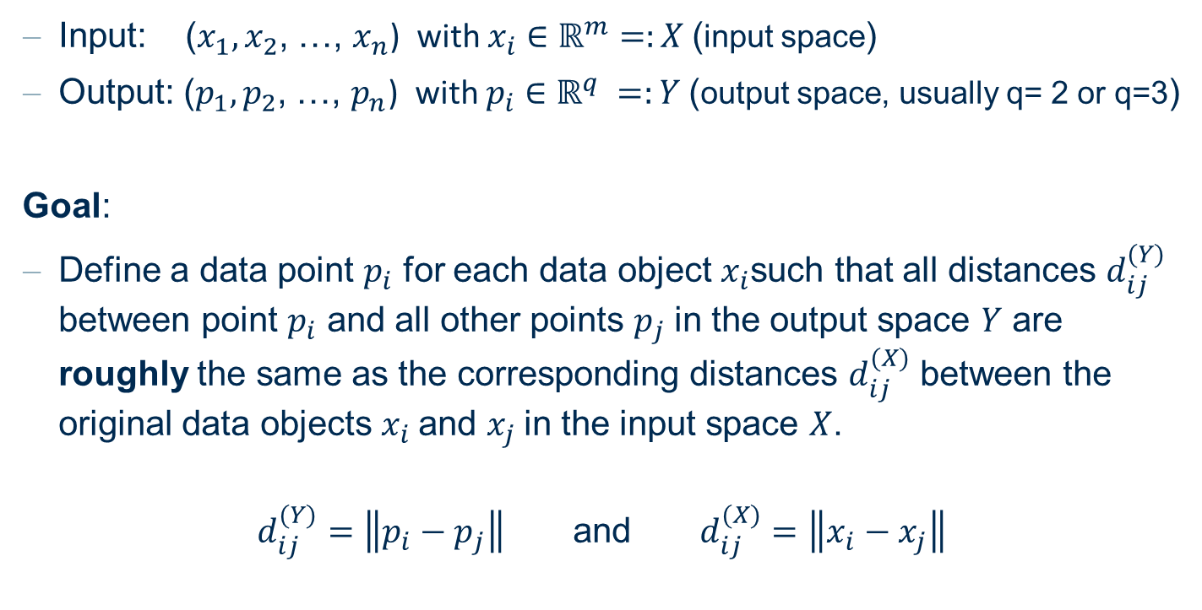
Multi-Dimensional Scaling: Goal
Input: ($x_{1},x_{2}$, …, $x_{n}$) with $x_{i}∈$ $ℝ^{m}=:X$(input space)
Output: ($p_{1},p_{2}$, …, $p_{n}$) with $p_{i}∈$ $ℝ^{q} =:Y$(output space, usually q= 2 or q=3)
Goal:
Define a data point $p_{i}$ for each data object $x_{i}$such that all distances $d_{ij}^{(Y)}$ between point $p_{i}$ and all other points $p_{j}$in the output space $Y$ are roughly the same as the corresponding distances $d_{ij}^{(X)}$ between the original data objects $x_{i}$and $x_{j}$in the input space $X$.
$d_{ij}^{(Y)}=\left\|p_{i}−p_{j}\right\|$ and $d_{ij}^{(X)}=\left\|x_{i}−x_{j}\right\|$

Slide 22
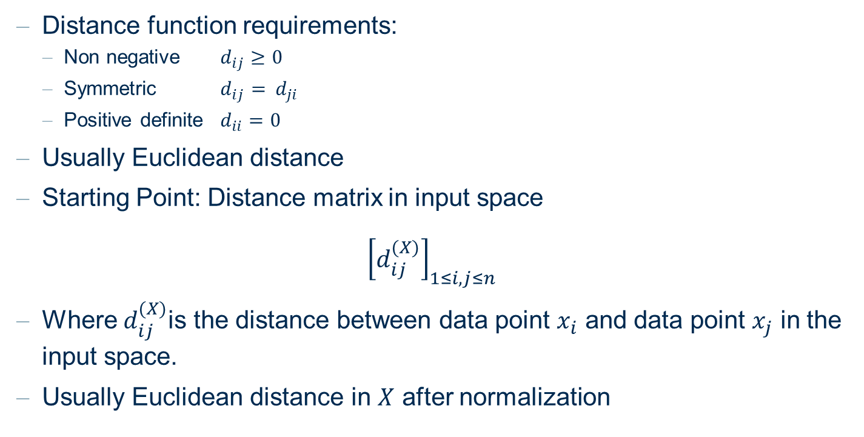
Multi-Dimensional Scaling: Distance
Distance function requirements:
Non negative $d_{ij}≥0$
Symmetric $d_{ij}$ $= { d}_{ji}$
Positive definite $d_{ii}=0$
Usually Euclidean distance
Starting Point: Distance matrix in input space
$${\left[d_{ij}^{(X)}\right]}_{1≤i,j≤n}$$
Where $d_{ij}^{(X)}$is the distance between data point $x_{i}$ and data point $x_{j}$ in the input space.
Usually Euclidean distance in $X$ after normalization
Notes:
Normalization required, as in PCA
Visualization oriented => Projection to two or three dimensions

Slide 23
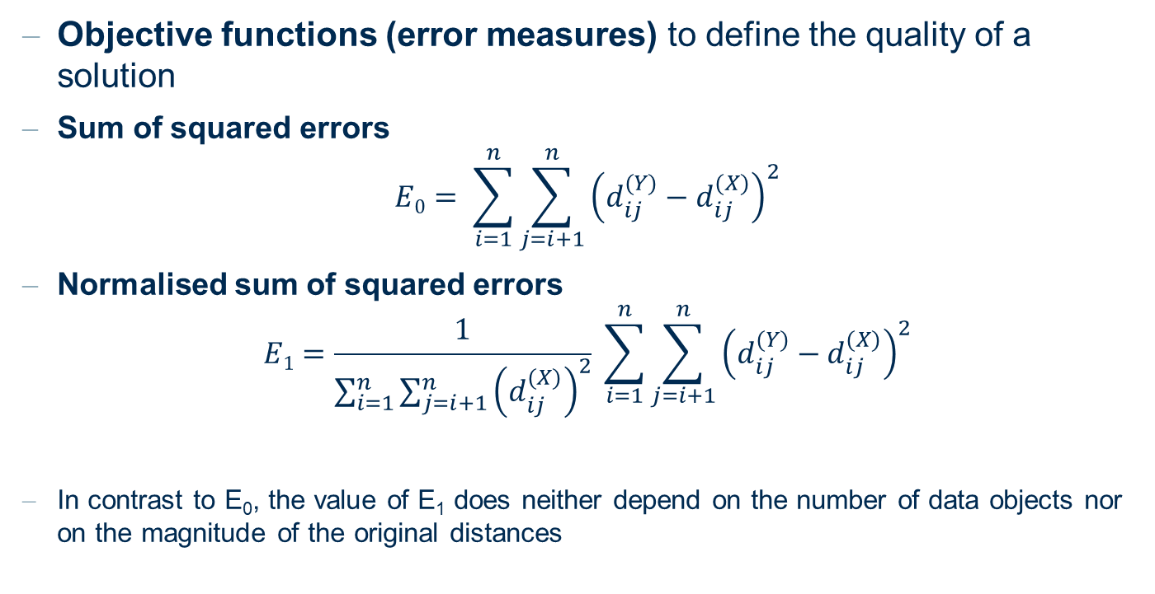
Multi-Dimensional Scaling: Objective functions
Objective functions (error measures) to define the quality of a solution
Sum of squared errors
$$E0= \sum_{i=1}^{n}{\sum_{j=i+1}^{n}{{\left(d_{ij}^{(Y)}−d_{ij}^{(X)}\right)}^{2}}}$$
Normalised sum of squared errors
$$E1=\frac{1}{\sum_{i=1}^{n}{\sum_{j=i+1}^{n}{{\left(d_{ij}^{(X)}\right)}^{2}}}} \sum_{i=1}^{n}{\sum_{j=i+1}^{n}{{\left(d_{ij}^{(Y)}−d_{ij}^{(X)}\right)}^{2}}}$$
In contrast to E₀, the value of E₁ does neither depend on the number of data objects nor on the magnitude of the original distances
The normalization factor does not influence the location of the minimum of the objective function

Slide 24
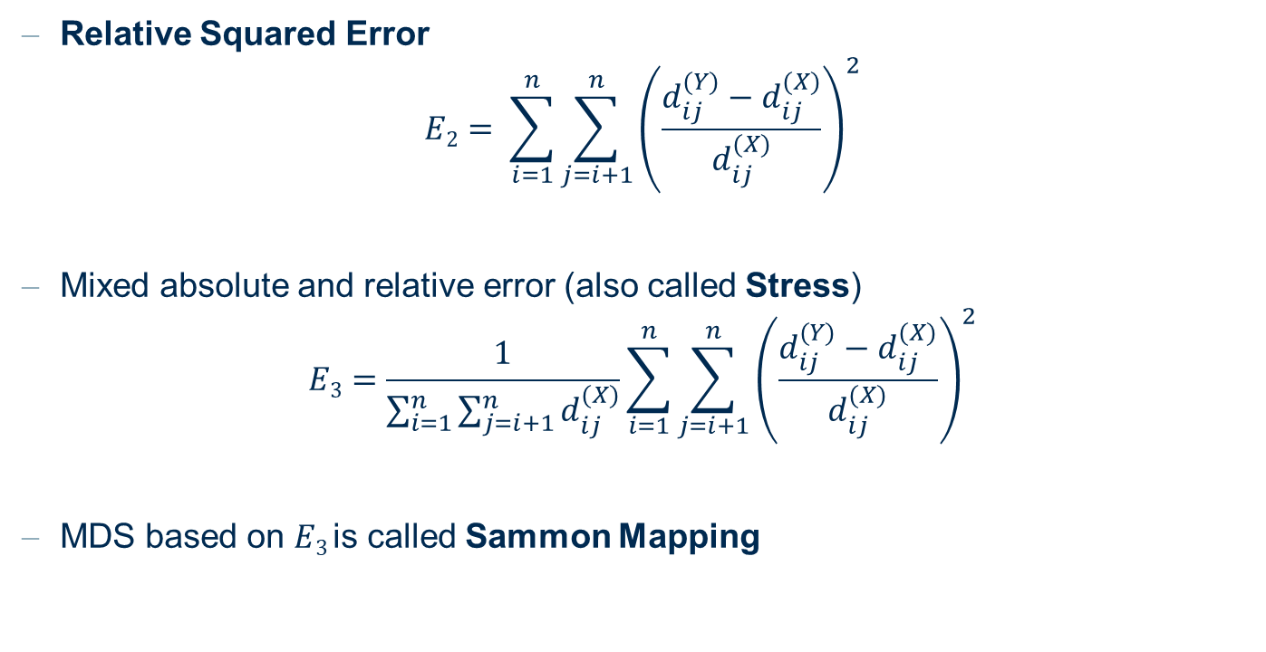
Multi-Dimensional Scaling: Objective functions
Relative Squared Error
$$E2= \sum_{i=1}^{n}{\sum_{j=i+1}^{n}{{\left(\frac{d_{ij}^{(Y)}−d_{ij}^{(X)}}{d_{ij}^{(X)}}\right)}^{2}}}$$
Mixed absolute and relative error (also called Stress)
$$E3=\frac{1}{\sum_{i=1}^{n}{\sum_{j=i+1}^{n}{d_{ij}^{(X)}}}}\sum_{i=1}^{n}{\sum_{j=i+1}^{n}{{\left(\frac{d_{ij}^{(Y)}−d_{ij}^{(X)}}{d_{ij}^{(X)}}\right)}^{2}}}$$
MDS based on $E3$is called Sammon Mapping

Slide 25
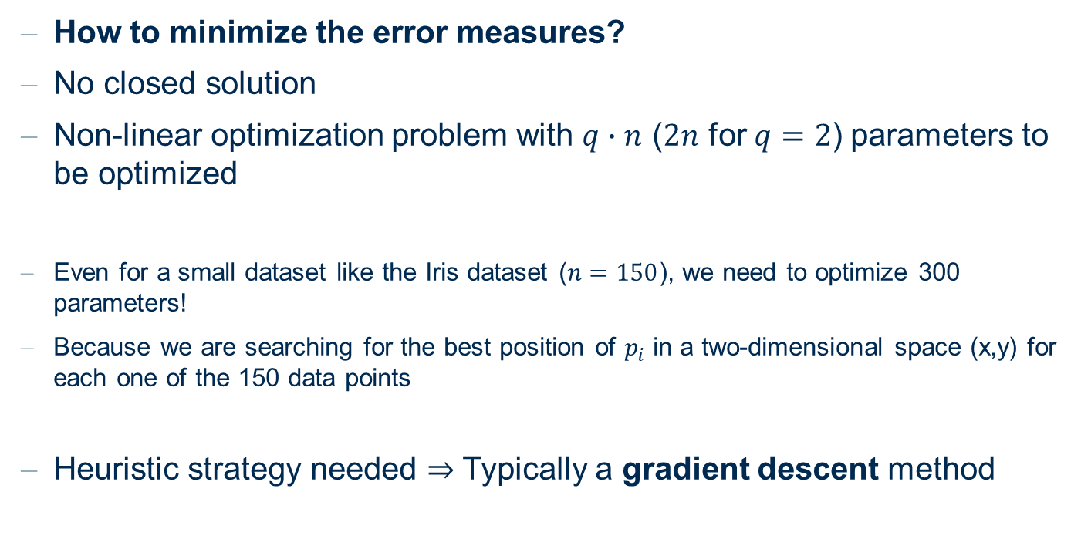
Multi-Dimensional Scaling: Solution
How to minimize the error measures?
No closed solution
Non-linear optimization problem with $q∙n$ ($2n$ for$q=2$) parameters to be optimized
Even for a small dataset like the Iris dataset ($n=150$), we need to optimize 300 parameters!
Because we are searching for the best position of $p_{i}$ in a two-dimensional space (x,y) for each one of the 150 data points
Heuristic strategy needed $⇒$ Typically a gradient descent method

Slide 26


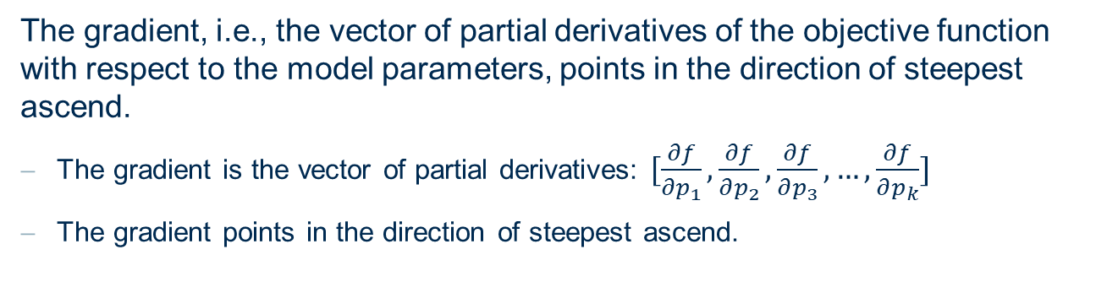


Reminder: gradient descent based solutions
The gradient, i.e., the vector of partial derivatives of the objective function with respect to the model parameters, points in the direction of steepest ascend.
The gradient is the vector of partial derivatives: $[\frac{∂f}{∂p_{1}},\frac{∂f}{∂p_{2}},\frac{∂f}{∂p_{3}}, …,\frac{∂f}{∂p_{k}}]$
The gradient points in the direction of steepest ascend.
$$f$$
$$\frac{∂f}{∂p}(p_{0})$$
$$p_{0}$$
$$p$$

Slide 27
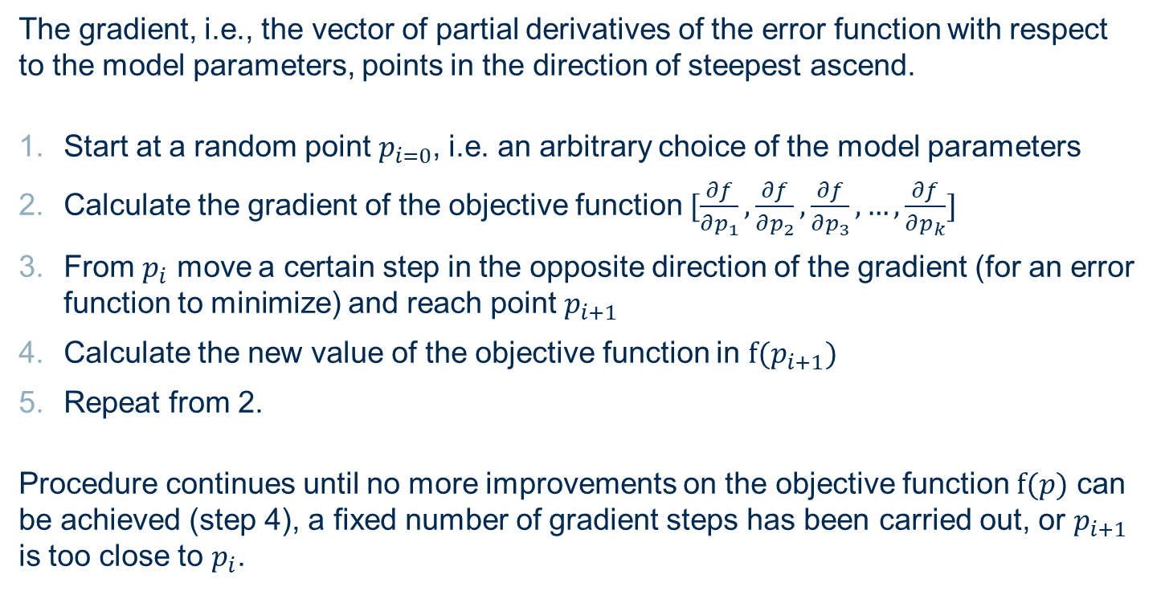
Reminder: gradient descent based solutions
The gradient, i.e., the vector of partial derivatives of the error function with respect to the model parameters, points in the direction of steepest ascend.
Start at a random point $p_{i=0}$, i.e. an arbitrary choice of the model parameters
Calculate the gradient of the objective function $[\frac{∂f}{∂p_{1}},\frac{∂f}{∂p_{2}},\frac{∂f}{∂p_{3}}, …,\frac{∂f}{∂p_{k}}]$
From $p_{i}$ move a certain step in the opposite direction of the gradient (for an error function to minimize) and reach point $p_{i+1}$
Calculate the new value of the objective function in $f(p_{i+1})$
Repeat from 2.
Procedure continues until no more improvements on the objective function $f(p)$ can be achieved (step 4), a fixed number of gradient steps has been carried out, or $p_{i+1}$ is too close to $p_{i}$.

Slide 28
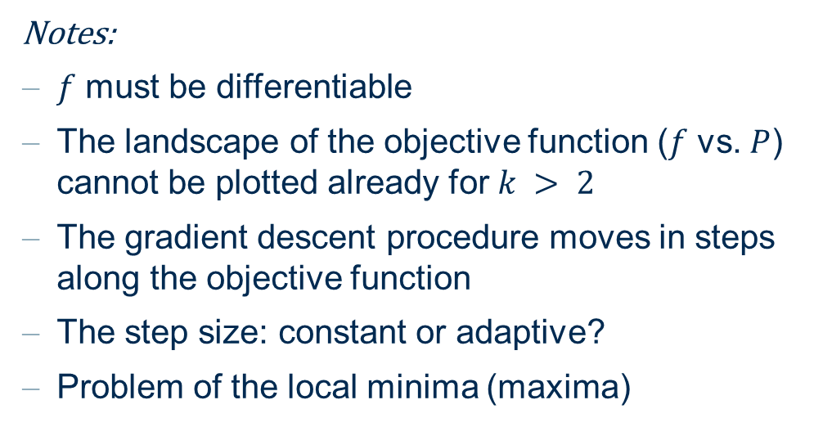
Reminder: gradient descent based solutions
Notes:
$f$ must be differentiable
The landscape of the objective function ($f$ vs. $P$) cannot be plotted already for $k > 2$
The gradient descent procedure moves in steps along the objective function
The step size: constant or adaptive?
Problem of the local minima (maxima)
It is recommended to run a gradient method repeatedly, starting with different initial points to increase the chance to find the global or at least a good local optimum.

Slide 29
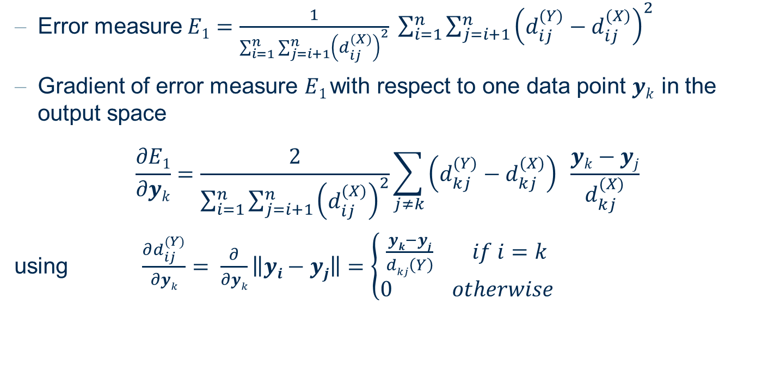
Multi-Dimensional Scaling: gradient descent example
Error measure$E1=\frac{1}{\sum_{i=1}^{n}{\sum_{j=i+1}^{n}{{\left(d_{ij}^{(X)}\right)}^{2}}}} \sum_{i=1}^{n}{\sum_{j=i+1}^{n}{{\left(d_{ij}^{(Y)}−d_{ij}^{(X)}\right)}^{2}}}$
Gradient of error measure $E1$with respect to one data point $yk$ in the output space
$$\frac{∂E1}{∂yk}=\frac{2}{\sum_{i=1}^{n}{\sum_{j=i+1}^{n}{{\left(d_{ij}^{(X)}\right)}^{2}}}}\sum_{j≠k}{\left(d_{kj}^{(Y)}−d_{kj}^{(X)}\right) \frac{yk−yj}{d_{kj}^{(X)}}}$$
using $\frac{∂d_{ij}^{(Y)}}{∂yk}= \frac{∂}{∂yk}\left\|yi−yj\right\|=\left\{\begin{aligned}\frac{yk−yj}{dkj\left(Y\right)} if i=k \\ 0 otherwise\end{aligned}\right.$

Slide 30
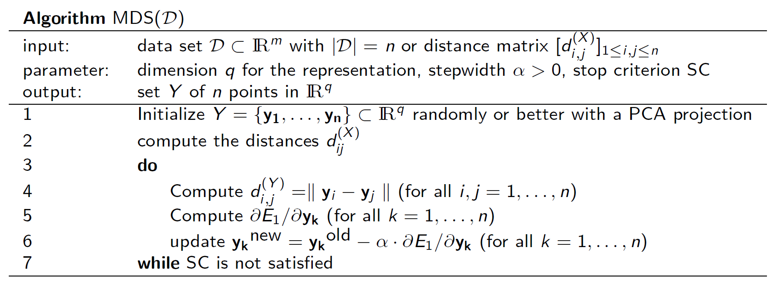
Multidimensional Scaling: Algorithm
Caveats:
Normalization before computing the distances
Assure that no distance between two data objects is 0 before applying MDS algorithm

Slide 31
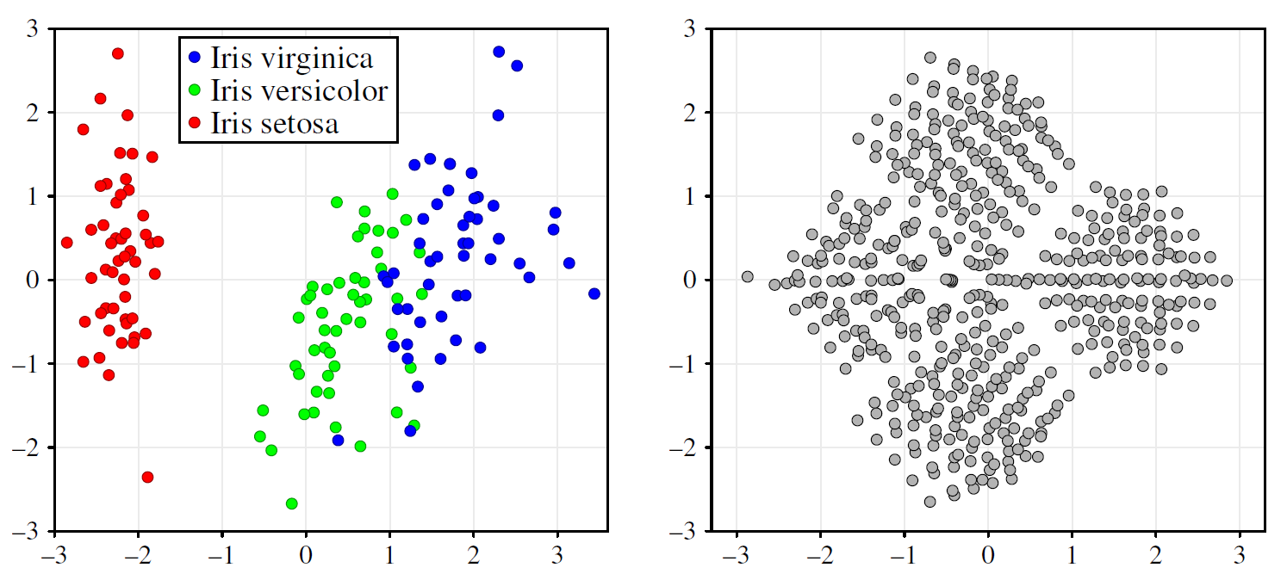
Multidimensional Scaling
MDS (Sammon Mapping) for the Iris and the „cube“ datasets

Slide 32
PCA vs. MDS vs. LDA
PCA
Preserves the variance of the dataset
Provides explicit mapping to the lower-dimensional space
easier insertion of new data
Lower computational complexity
Covariance matrix can be calculated in linear time
MDS
Preserves the distances between data objects
Does not provide explicit mapping
New data cannot be projected
Higher computational complexity
Quadratic for the pairwise distance
Complexity problems partially overcomed by sampling or variations of the error measures
LDA
Preserves the separation among classes
Provides explicit mapping to the lower-dimensional space
easier insertion of new data
Lower computational complexity

Slide 33
t-SNE: t-distributed Stochastic Neighbor Embedding

Slide 34
t-distributed Stochastic Neighbor Embedding
Nonlinear dimensionality reduction technique based on nonlinear relationships among the data points
Primarily used for visualization from very high-dimensional data to 2 or 3 coordinates
Works with probabilities of two data points being neighbours
As for MDS, new data cannot be projected. All data must be used to find the new points.

Slide 35
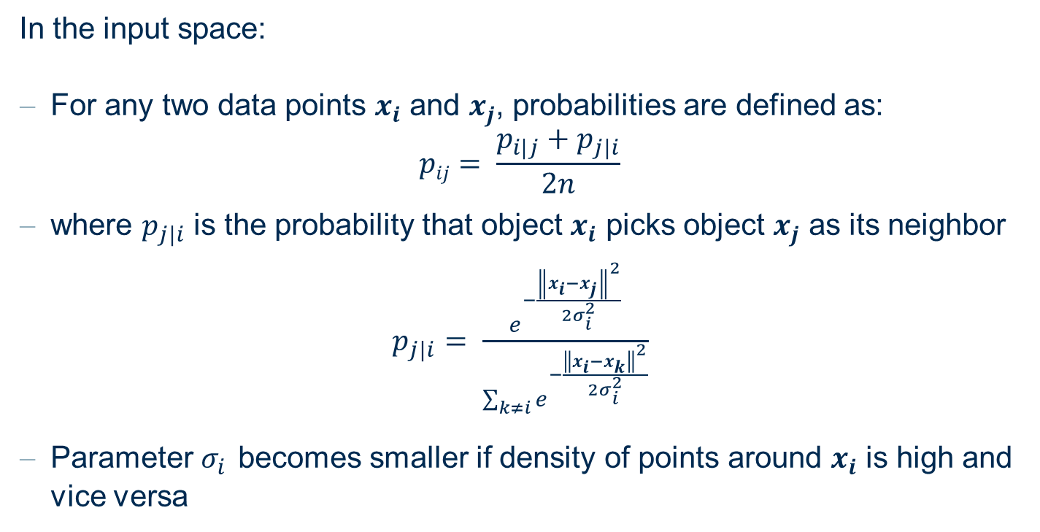
t-distributed Stochastic Neighbor Embedding
In the input space:
For any two data points $x_{i}$ and $x_{j}$, probabilities are defined as:
$$pij= \frac{p_{i|j}+p_{j|i}}{2n}$$
where $p_{j|i}$ is the probability that object $x_{i}$ picks object $x_{j}$ as its neighbor
$p_{j|i}= \frac{e^{−\frac{{\left\|x_{i}−x_{j}\right\|}^{2}}{2σ_{i}^{2}}}}{\sum_{k≠i}{e^{−\frac{{\left\|x_{i}−x_{k}\right\|}^{2}}{2σ_{i}^{2}}}}}$
Parameter $σ_{i}$ becomes smaller if density of points around $x_{i}$ is high and vice versa

Slide 36
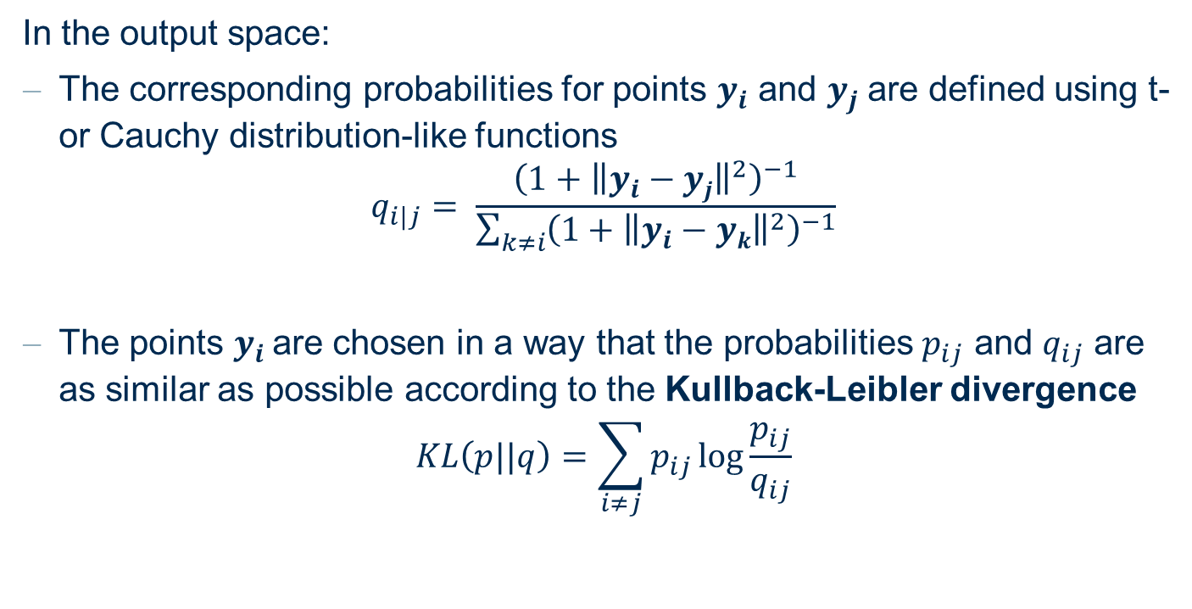
t-distributed Stochastic Neighbor Embedding
In the output space:
The corresponding probabilities for points $y_{i}$ and $y_{j}$are defined using t- or Cauchy distribution-like functions
$$q_{i|j}= \frac{{\left(1+{\left\|y_{i}−yj\right\|}^{2}\right)}^{−1}}{\sum_{k≠i}{{\left(1+{\left\|y_{i}−yk\right\|}^{2}\right)}^{−1}}}$$
The points $y_{i}$ are chosen in a way that the probabilities $p_{ij}$ and $q_{ij}$ are as similar as possible according to the Kullback-Leibler divergence
$$KL\left(p||q\right)=\sum_{i≠j}{p_{ij}\log{\frac{p_{ij}}{q_{ij}}}}$$

Slide 37
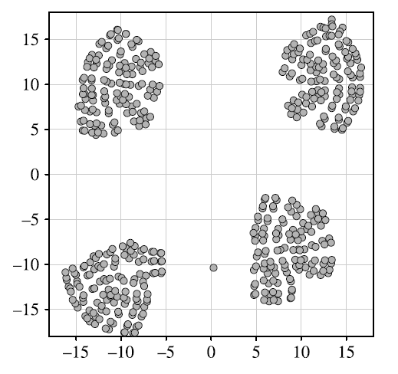
t-distributed Stochastic Neighbor Embedding
t-SNE is mainly used for visualization because:
Aggressive dimensionality reduction
Transformation of likelihood of pairs into visual proximity
Capability to represent strange shapes of data
t-SNE applied to the „cube“ dataset.
The four original clusters are well preserved in the two-dimensional
representation and the outlier is also clearly visible.

Slide 38
Practical Examples

Slide 39
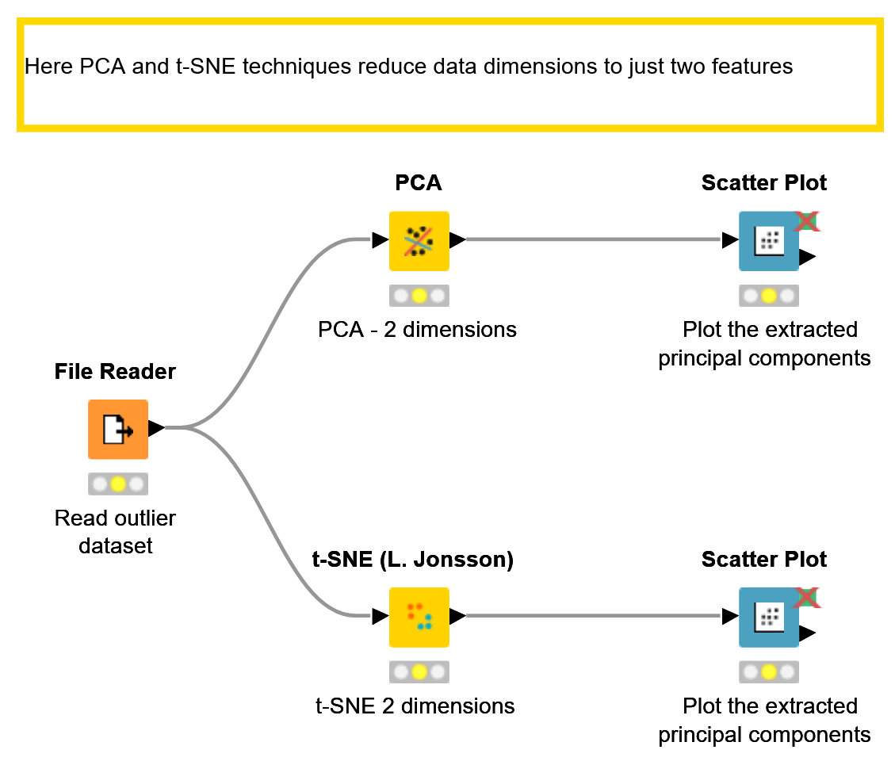
KNIME Workflow
PCA and t-SNE techniques for data reduction to 2D space

Slide 40
Thank you

