Slide 1
Rule Learning

Slide 2
Summary of this lesson
“All models are wrong but some are useful.” -George Box
Can we use rules as models?
*This lesson refers to chapter 8 of the GIDS book

Slide 3
What you will learn
Rule Learning
Propositional Rules
Rule Learners
Geometrical Rule Learners
Heuristic Rule Learners

Slide 4
Propositional Rules

Slide 5
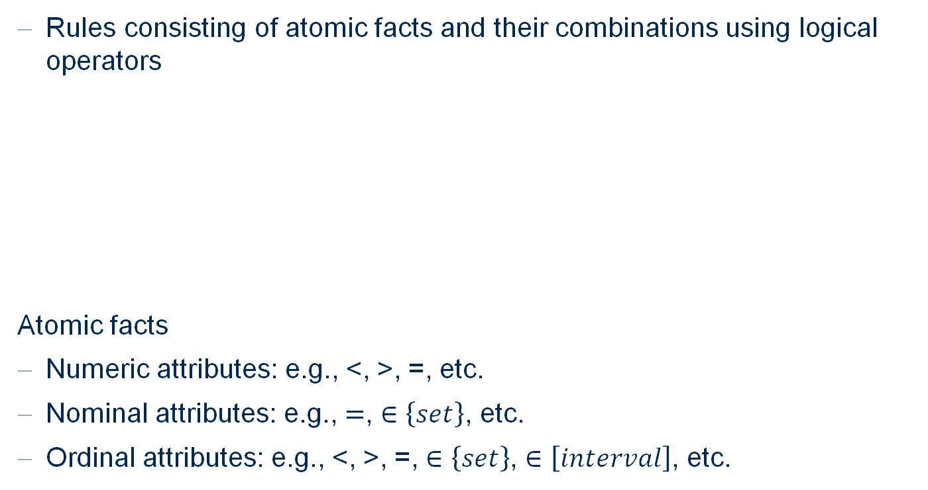
Propositional Rules
Rules consisting of atomic facts and their combinations using logical operators
Atomic facts
Numeric attributes: e.g., <, >, =, etc.
Nominal attributes: e.g., $=$, $∈\left\{set\right\}$, etc.
Ordinal attributes: e.g., <, >, =, $∈\left\{set\right\}$, $∈\left[interval\right]$, etc.
$$IF x_{1}≤10 AND x_{3}=red THEN class A$$
Antecedent
→ Indicating conditions to be fulfilled
Consequent
→ True when conditions are met

Slide 6
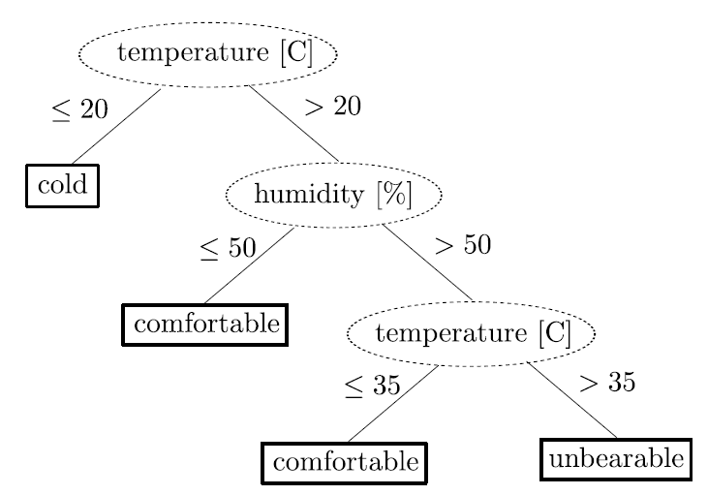
Extracting Rules from Decision Trees
Consider a decision tree:

Slide 7
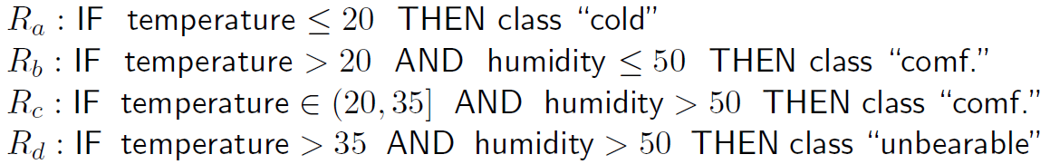
Extracting Rules from Decision Trees
Rules can be extracted from a decision tree

Slide 8
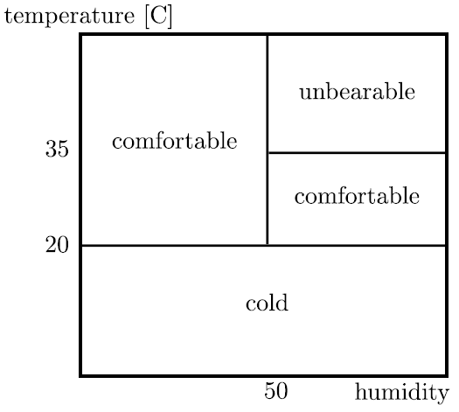
Extracting Rules from Decision Trees
Rules from a decision tree are:
Mutually exclusive (no overlap)
Unordered
Complete (covers the entire data)
Problems with rules from a decision tree:
Instability (due to recursive nature of the trees)
Redundancy (splitting constraints appear in multiple rules)

Slide 9
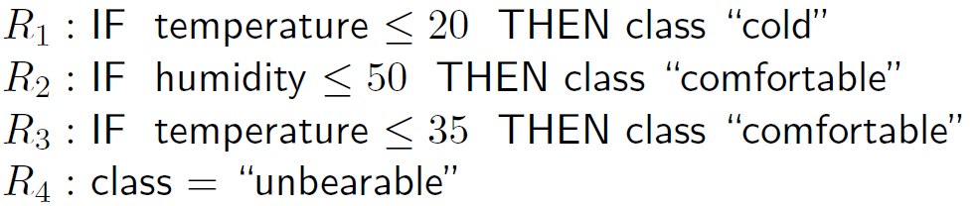
Ordered Rules from Decision Trees
Non-redundant and ordered rule set:
Rules have to be examined in the order

Slide 10
Rule Learners

Slide 11
Learning Propositional Rules
Categorization of propositional rule learners:
Supported attribute types
Nominal only ➔ relatively small hypothesis space
Numerical only ➔ geometrical rule learners
Mixed attrigutes ➔ more complex heuristics needed
Learning strategies
Specializing
Generalizing

Slide 12
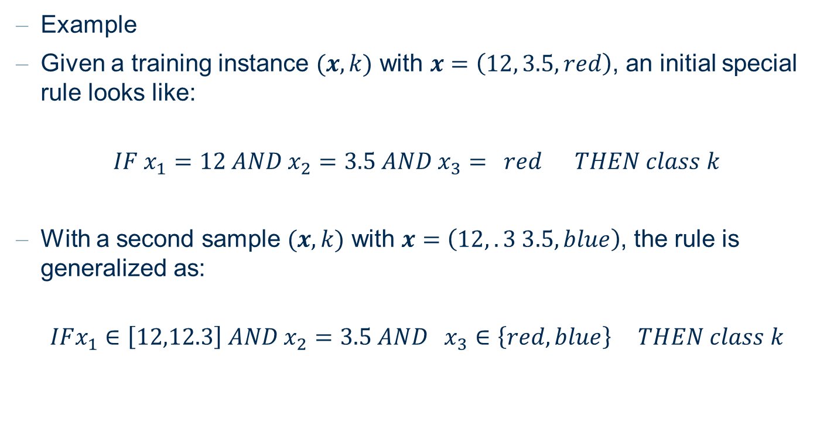
Learning Propositional Rules: Generalizing
Example
Given a training instance $(x,k)$ with $x=\left(12, 3.5, red\right)$, an initial special rule looks like:
$$IF x_{1}=12 AND x_{2}=3.5 AND x_{3}{= }^{ }red THEN class k$$
With a second sample $(x,k)$ with $x=\left(12,.3 3.5, blue\right)$, the rule is generalized as:
$$IFx_{1}∈\left[12,12.3\right] AND x_{2}=3.5 AND{ x}_{3}∈\left\{red, blue\right\} THEN class k$$

Slide 13
Learning Propositional Rules: Generalizing
Two main options for generalization exist:
Generalize existing rule to cover one more pattern
Merge two existing rules
The resulting training algorithms generally are:
Greedy
Complete search of merge tree is infeasible
Differ in
The choice of rules / patterns to merge
The used stopping criteria

Slide 14
Learning Propositional Rules: Specializing
Specialization follows the same principle
Start with very general rules
IF true THEN class k
Iteratively specialize the rule

Slide 15
Finding a Set of Rules
So far we only generalized/specialized one rule.
Most real world data sets are too complex to be explained by one rule only.
Many rule learning algorithms wrap the learning of one rule into an outer loop based on set covering strategy (sequential covering):
attempts to build most important rules first
iteratively adds smaller / less important rules

Slide 16
Geometrical Rule Learners

Slide 17
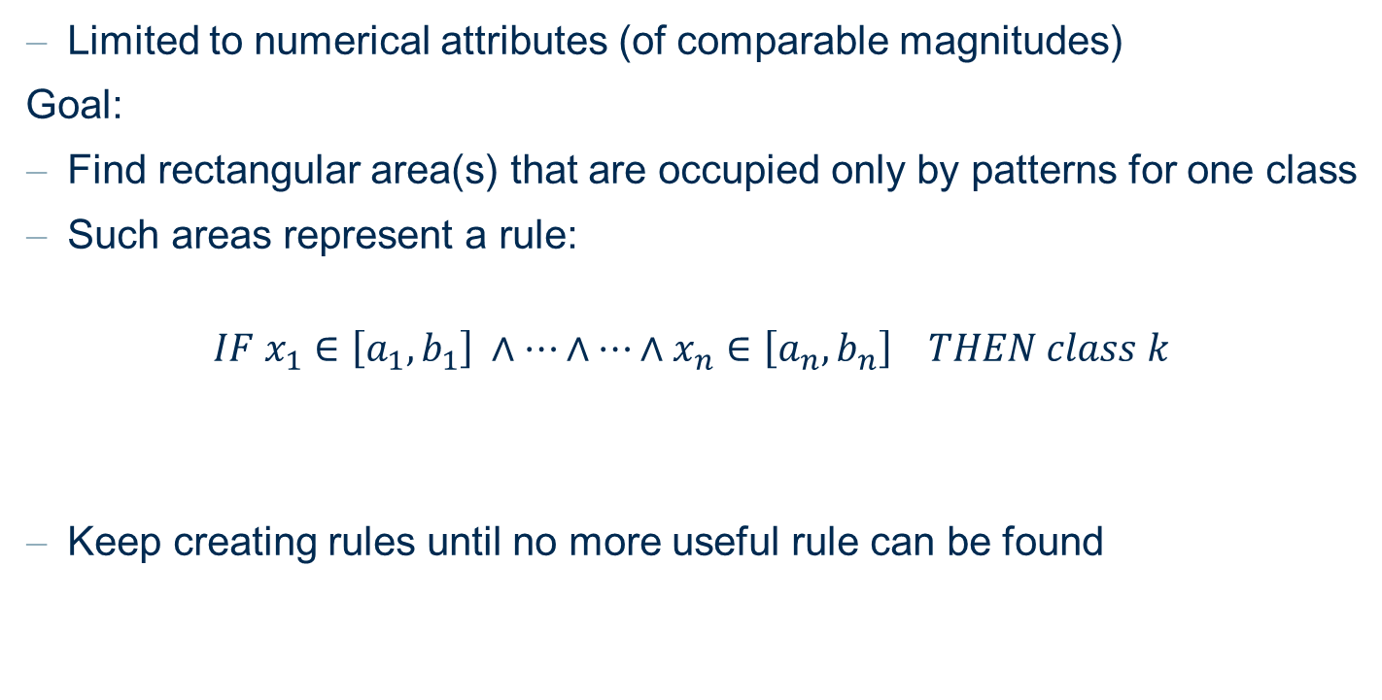
Geometrical Rule Learners
Limited to numerical attributes (of comparable magnitudes)
Goal:
Find rectangular area(s) that are occupied only by patterns for one class
Such areas represent a rule:
$$IF x_{1}∈\left[a_{1},b_{1}\right] ∧…∧…∧x_{n}∈\left[a_{n},b_{n}\right] THEN class k$$
Keep creating rules until no more useful rule can be found

Slide 18
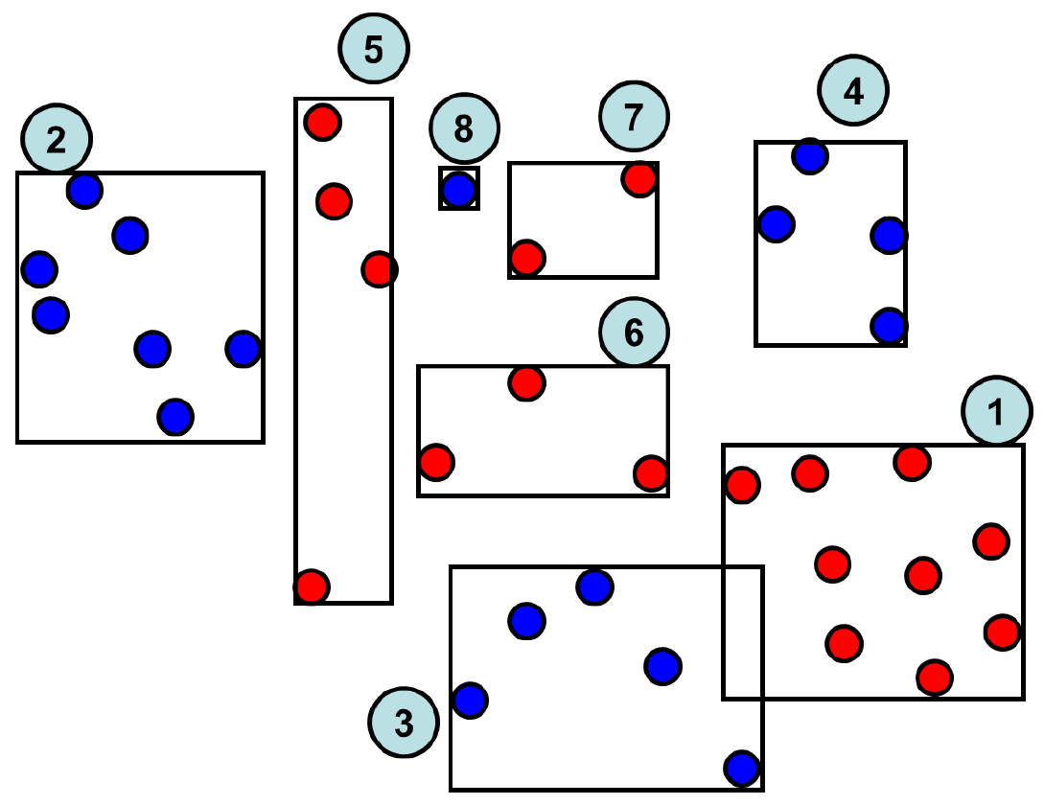
Example – Geometric Rule Learners

Slide 19
Geometric Rule Learners
To find a rule:
Draw a random starting point
Find a rectangular area around the point, with points belonging to the same class
When possible
Find nearest neighbors of the same class
Generalize rectangles to includes this point

Slide 20
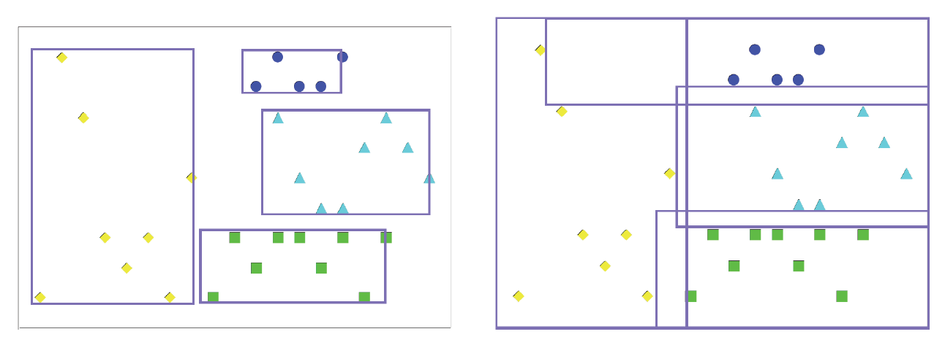
Geometric Rule: Specialized and Generalized
Specialized
Generalized

Slide 21
CN2 Rule Learning Algorithm
Prominent, early example of rule learning algorithm
Set covering approach
Greedy algorithm rule specialization
Simple heuristic for most important rule selection

Slide 22
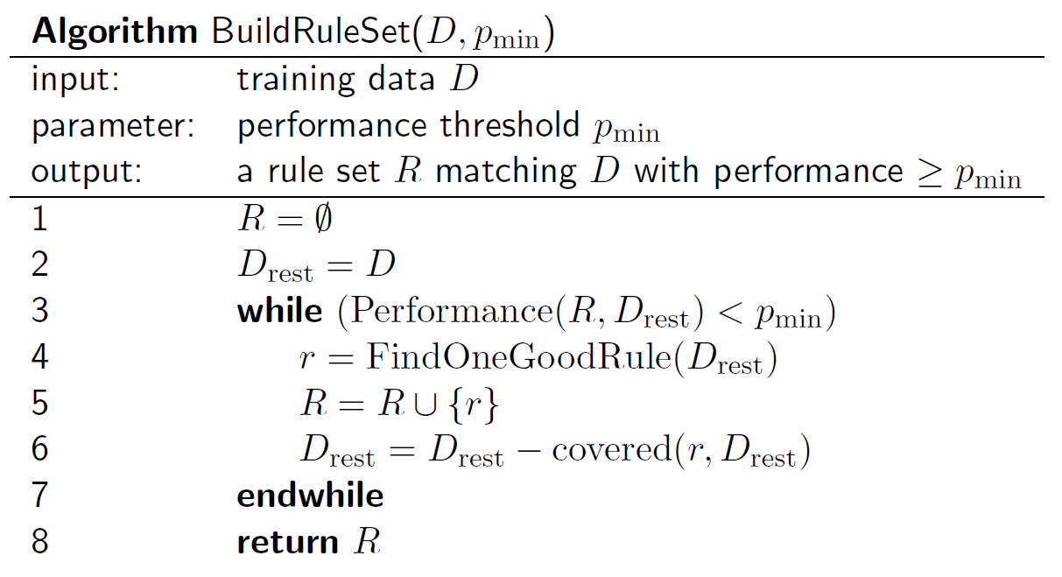
BuildRuleSet

Slide 23
Heuristic Rule Learners

Slide 24
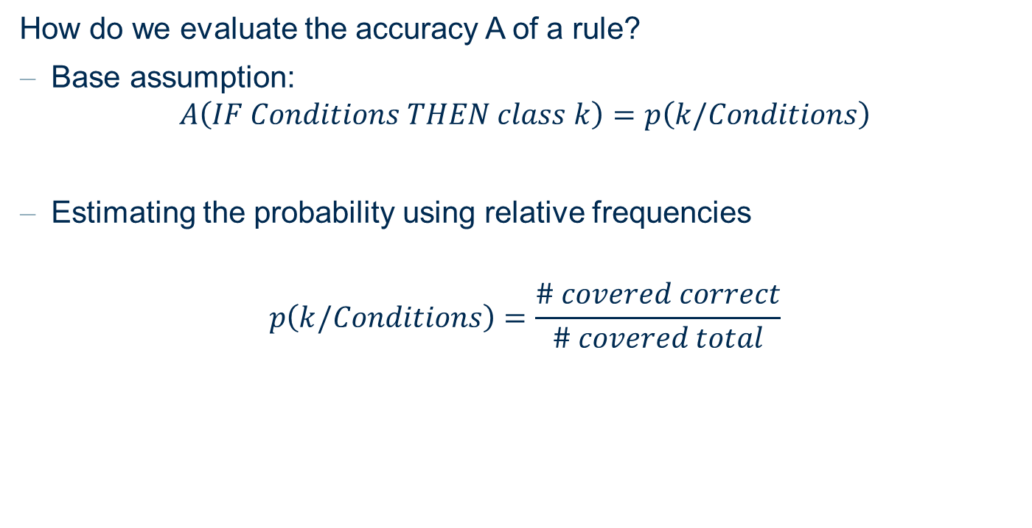
Heuristics for FindOneGoodRule
How do we evaluate the accuracy A of a rule?
Base assumption:
$$A\left(IF Conditions THEN class k\right)=p\left(k/Conditions\right)$$
Estimating the probability using relative frequencies
$$p\left(k/Conditions\right)=\frac{\# covered correct}{\# covered total}$$

Slide 25
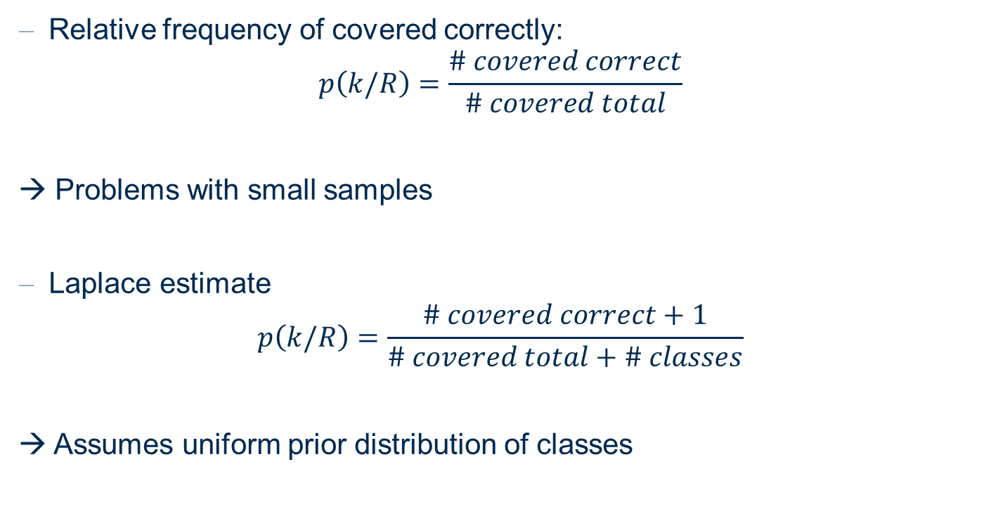
Probability Estimates
Relative frequency of covered correctly:
$$p\left(k/R\right)=\frac{\# covered correct}{\# covered total}$$
→ Problems with small samples
Laplace estimate
$$p\left(k/R\right)=\frac{\# covered correct+1}{\# covered total+\# classes}$$
→ Assumes uniform prior distribution of classes

Slide 26
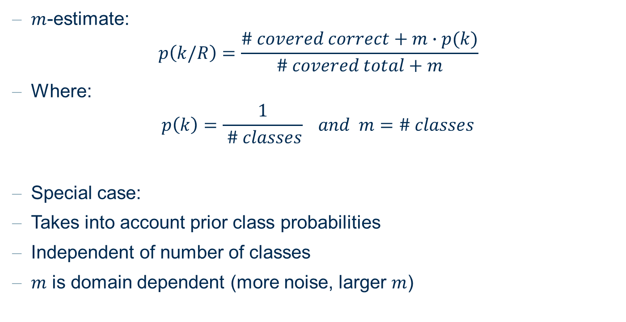
Probability Estimates
$m$-estimate:
$$p\left(k/R\right)=\frac{\# covered correct+m∙p(k)}{\# covered total+m}$$
Where:
$$p\left(k\right)=\frac{1}{ \# classes} and m=\# classes$$
Special case:
Takes into account prior class probabilities
Independent of number of classes
$m$ is domain dependent (more noise, larger $m$)

Slide 27
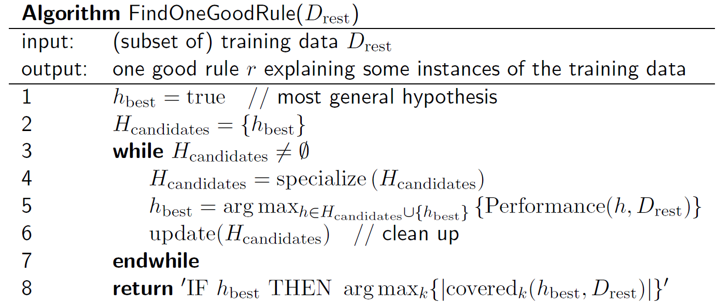
FindOneGoodRule

Slide 28
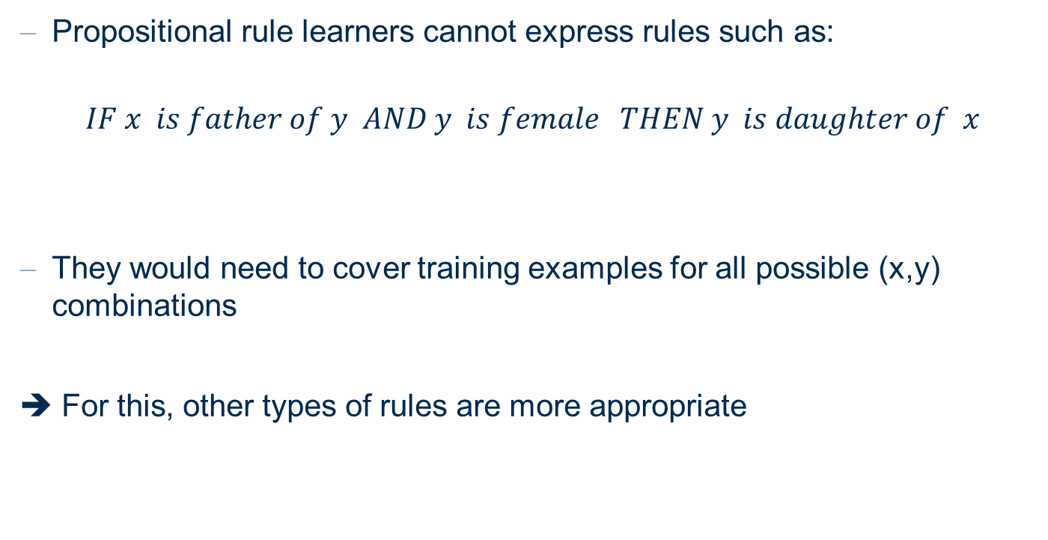
Limitations of Propositional Rules
Propositional rule learners cannot express rules such as:
$$IF x is father of y AND y is female THEN y is daughter of x$$
They would need to cover training examples for all possible (x,y) combinations
➔ For this, other types of rules are more appropriate

Slide 29
Thank you

