Slide 1
Nearest Neighbor Predictors

Slide 2
Summary of this lesson
“Good fences make good neighbors” -Robert Frost
Can we learn from surrounding elements?
*This lesson refers to chapter 9 of the GIDS book

Slide 3
What you will learn
Nearest Neighbors Predictors
Lazy learners vs eager learners
k-nearest neighbor (kNN) predictors
Weighting & prediction functions
Choosing parameter k

Slide 4
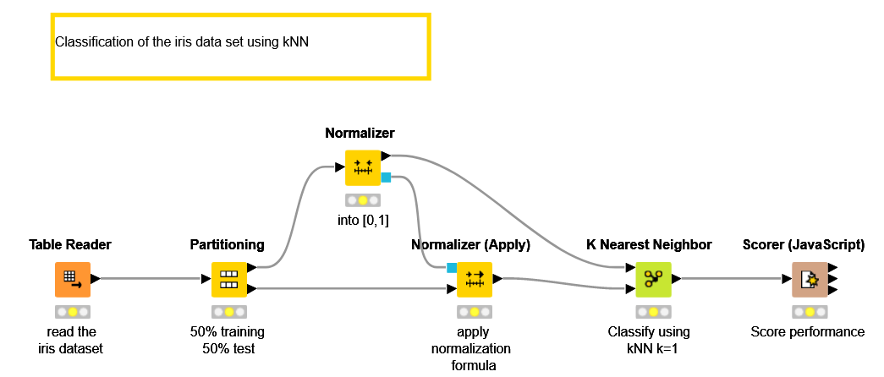
Datasets
Datasets used : iris dataset
Example Workflow:
„Classification of the iris data using kNN“ https://kni.me/w/ZVkD_W8LnSh_t9Na
normalization
kNN with k=1

Slide 5
Lazy and Eager Learners

Slide 6
Nearest-Neighbor Predictors
One of the simplest learning methods
Predict class labels or target values from nearest neighbors
Majority voting – classification
Averaging – numeric prediction
An example of lazy learners, in contrast to eager learners
Lazy learners: Save all data from training, use it for classifying
(The learner was lazy, classifier had to do the work)
Eager learners: Build a (compact) model/structure during training, use the model for classification.
(The learner was eager/worked harder, classifier had simple life)

Slide 7
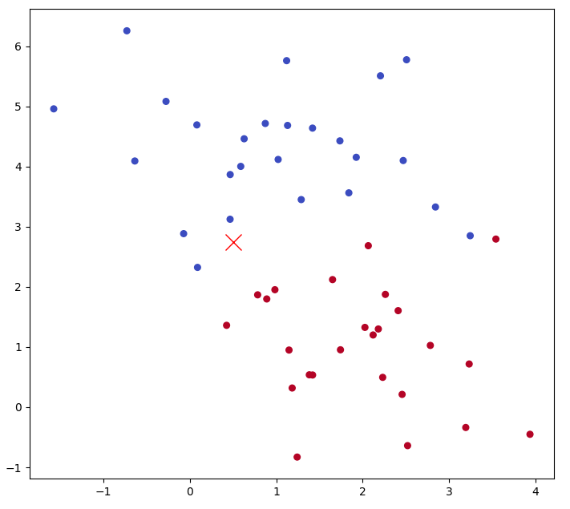
Motivation
How to classify a new observation (red X)? Blue or red?
Solution: the majority vote of its neighbors,

Slide 8
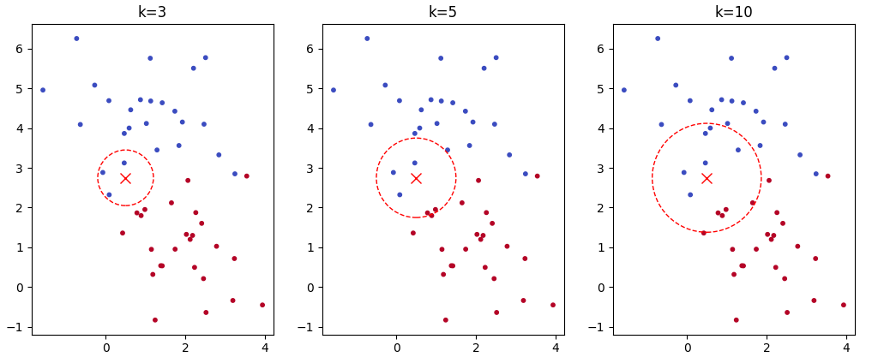
Motivation
Examining k-nearest neighbors, decided based on the majority vote
k=3: 3 blues ➔ classified as blue
k=5: 3 blues, 2 reds ➔ classified as blue
k=10: 6 blues, 4 reds ➔ classified as blue

Slide 9
Nearest-Neighbor Predictors
An example of lazy learners, in contrast to eager learners
Lazy learners: Save all data from training, use it for classifying
(The learner was lazy, classifier had to do the work)
Eager learners: Build a (compact) model/structure during training, use the model for classification.
(The learner was eager/worked harder, classifier had simple life)

Slide 10
k-Nearest Neighbor Predictors

Slide 11
Nearest-Neighbor Predictors
Nearest neighbor predictors are special case of instance-based learning
Instead of constructing a model that generalizes beyond the training data, the training examples are merely stored.
Predictions for new cases are derived directly from these stored examples and their (known) classes or target values.

Slide 12
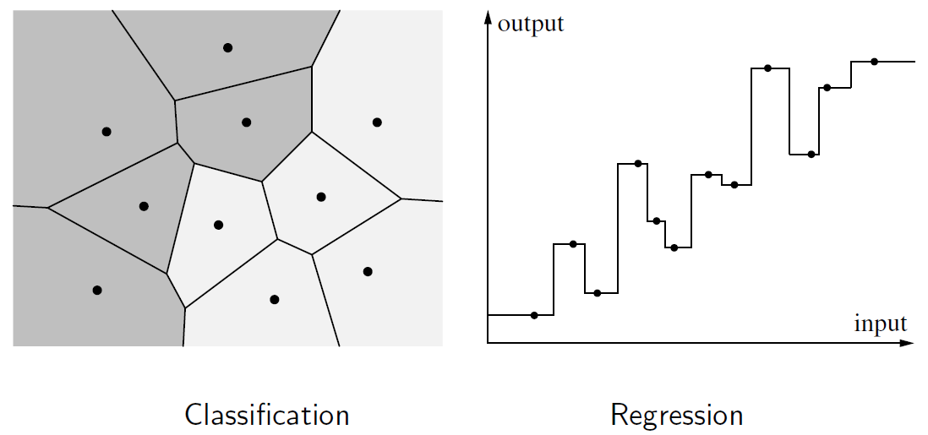
Simple Nearest Neighbor Predictors
For a new instance, use the target value of the closest neighbor in the training set

Slide 13
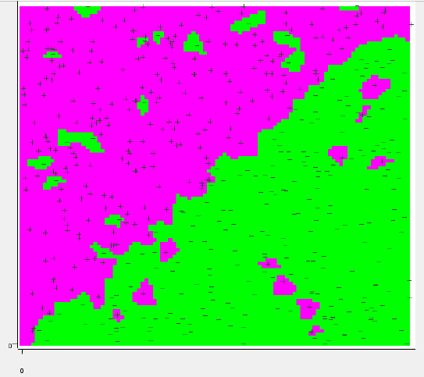
Nearest Neighbor Predictor: Issues
Nearest neighbor predictors are sensitive to noises
→ How can we overcome this?

Slide 14
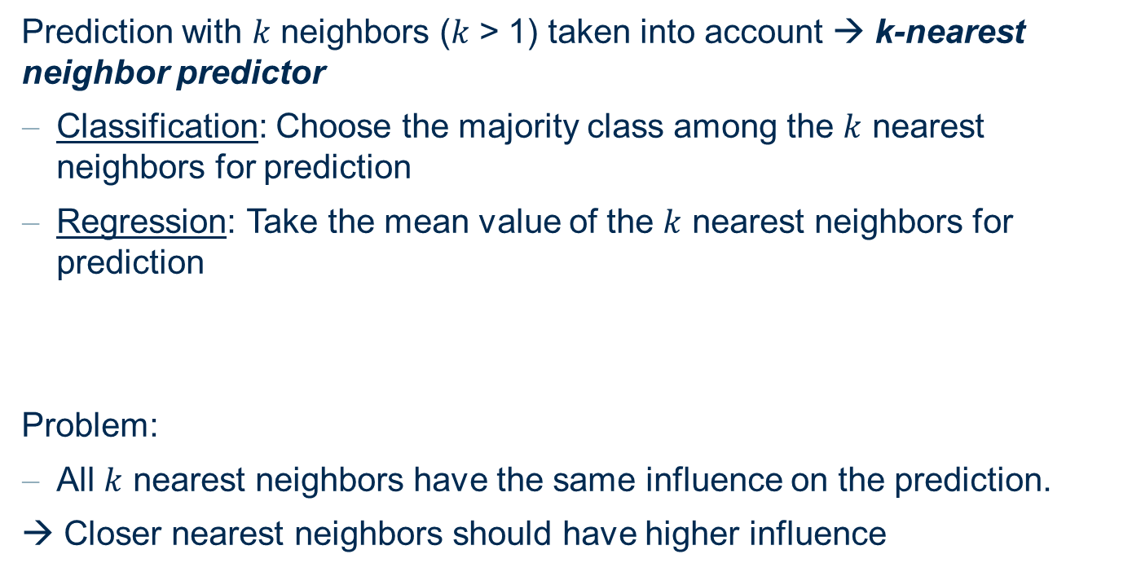
k-Nearest Neighbor Predictor
Prediction with $k$ neighbors ($k$ > 1) taken into account → k-nearest neighbor predictor
Classification: Choose the majority class among the $k$ nearest neighbors for prediction
Regression: Take the mean value of the $k$ nearest neighbors for prediction
Problem:
All $k$ nearest neighbors have the same influence on the prediction.
→ Closer nearest neighbors should have higher influence

Slide 15
Ingredients of kNN

Slide 16
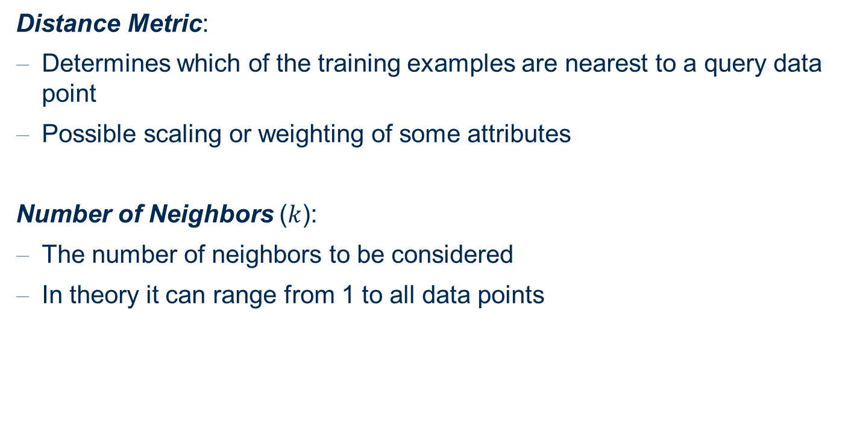
Ingredients for k-Nearest Neighbor Predictor
Distance Metric:
Determines which of the training examples are nearest to a query data point
Possible scaling or weighting of some attributes
Number of Neighbors ($k$):
The number of neighbors to be considered
In theory it can range from 1 to all data points

Slide 17
Ingredients for k-Nearest Neighbor Predictor
Weighting function:
Weighting function defined from the query point
Higher (lower) values for smaller (larger) distances
Prediction function:
A way to compute the prediction from the neighbors
Neighbors may differ from each other → may not produce a unique prediction

Slide 18
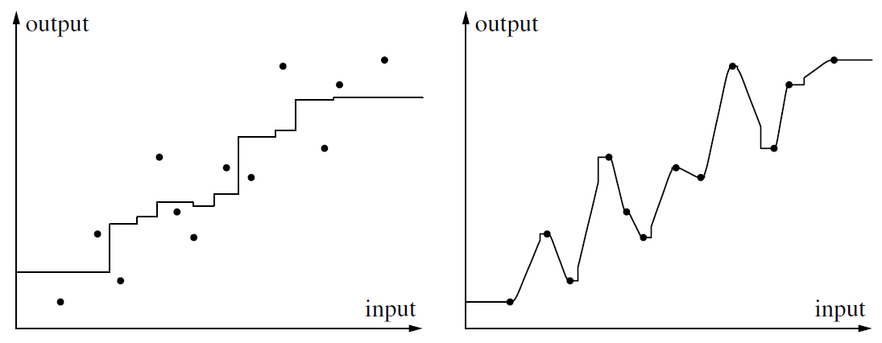
Ingredients for k-Nearest Neighbor Predictor
Distance weighted
(2 nearest neighbors)
Average (3 nearest neighbors)

Slide 19
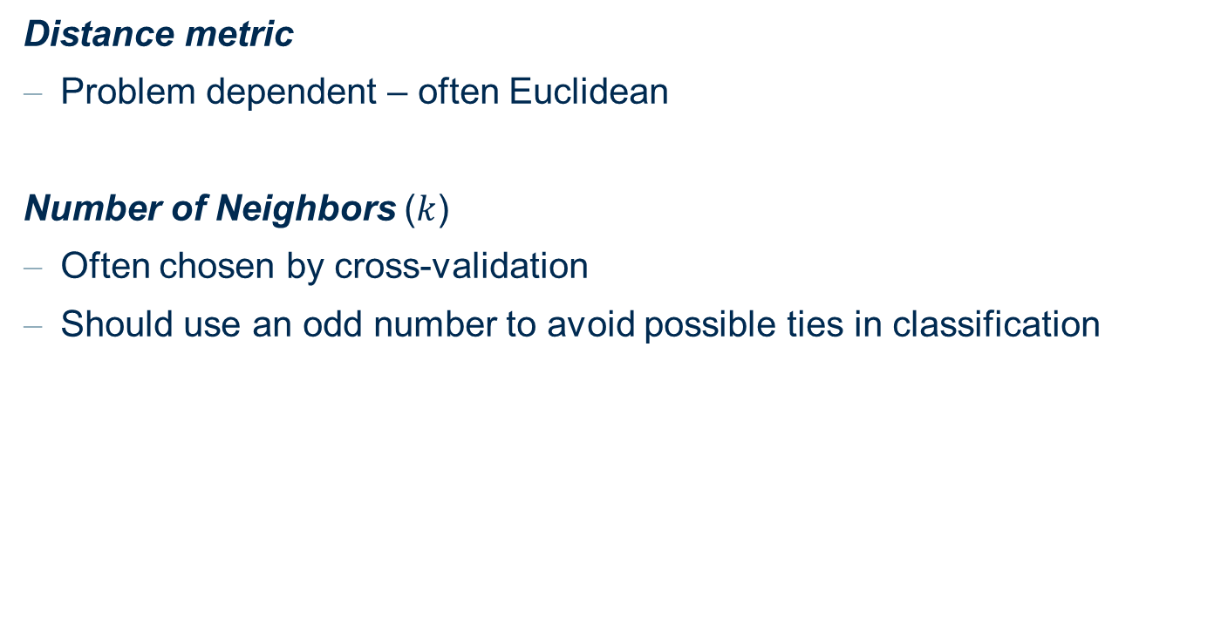
Choosing the Right Ingredients
Distance metric
Problem dependent – often Euclidean
Number of Neighbors ($k$)
Often chosen by cross-validation
Should use an odd number to avoid possible ties in classification

Slide 20
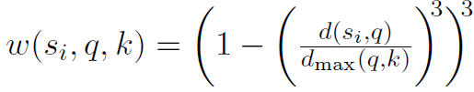
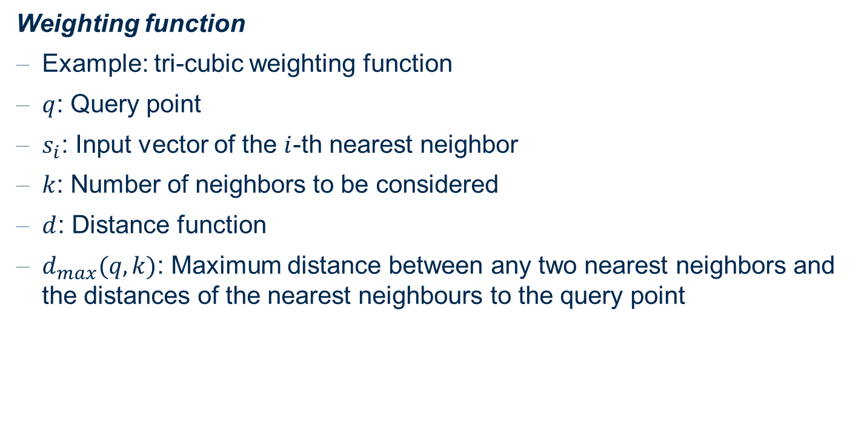
Choosing the Right Ingredients
Weighting function
Example: tri-cubic weighting function
$q$: Query point
$s_{i}$: Input vector of the $i$-th nearest neighbor
$k$: Number of neighbors to be considered
$d$: Distance function
$d_{max}(q,k)$: Maximum distance between any two nearest neighbors and the distances of the nearest neighbours to the query point

Slide 21
Choosing the Right Ingredients
Prediction function
Regression
weighted average of the target of the nearest neighbors
Classification
Sum up the weights for each class among the nearest neighbors.
Choose the class with the highest weighted sum

Slide 22
Kernel Functions
A k-nearest neighbor predictor with a weighting function
Interpreted as an n-nearest neighbor predictor with a modified weighting function
The modified weighting function simply assigns 0 to all instances not belonging to the k nearest neighbors.
More general approach
Use a kernel function assigning distance-dependent weights to all instances in the training data set.

Slide 23

Kernel Functions
A kernel function $K(∙)$:
$K(d)$ a function of distance $d$ (originating from a query point)
$K\left(d\right)≥0$
$K\left(0\right)=1$ (or it peaks at 0)
$K(d)$ decreases monotonically as $d$ incerases

Slide 24

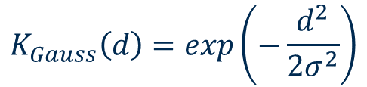

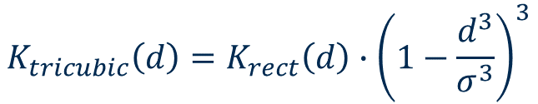
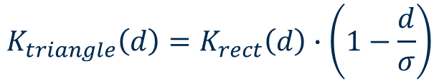

Kernel Function Examples
Typical examples for kernel functions
Where $σ>0$ is a predefined constant
$$K_{rect}\left(d\right)=\left\{\begin{matrix}1 \\ 0\end{matrix}\right.$$
if $d≤σ$
otherwise
$$K_{triangle}\left(d\right)=K_{rect}\left(d\right)∙\left(1−\frac{d}{σ}\right)$$
$$K_{tricubic}\left(d\right)=K_{rect}\left(d\right)∙{\left(1−\frac{d^{3}}{σ^{3}}\right)}^{3}$$
$$K_{Gauss}\left(d\right)=exp\left(−\frac{d^{2}}{2σ^{2}}\right)$$

Slide 25
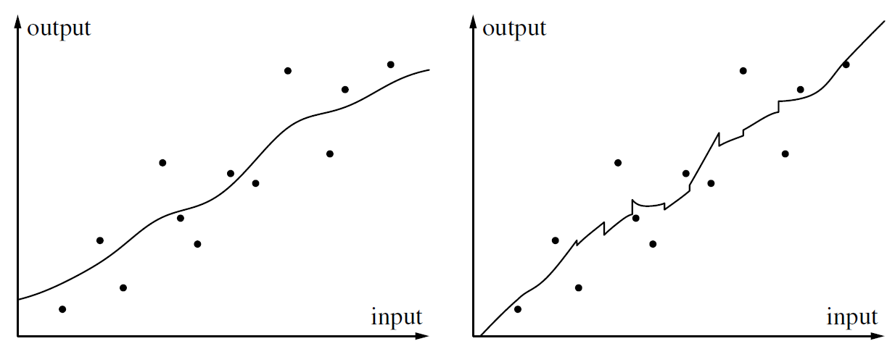
Locally Weighted (Polynomial) Regression
For regression, we can use weighted averaging of the target
Alternatively, we can also compute a local weighed-regression function at the query point
Distance-weighted local regression (k=4, tricubic)
Kernel weighted regression

Slide 26
Adjusting the Distance Function
Choice of a distance function → crucial in nearest neighbor methods
Weighted features in a distance function → more emphasis on important features
Feature weights can be found based on heuristic strategies
Hill climbing, simulated annealing, evolutionary algorithms, etc.
Can be evaluated via cross-validation

Slide 27
Data Reduction – Prototype Building
Nearest neighbor methods
Pro: no training is needed
Con: prediction on a large data set is computationally demanding
Solutions:
Smaller subset of the training data for the nearest neighbor predictor
Prototypes by merging close instances, e.g., by averaging
→ Can be carried out based on cross-validation and using heuristic
optimization strategies

Slide 28
Choice of Parameter k

Slide 29
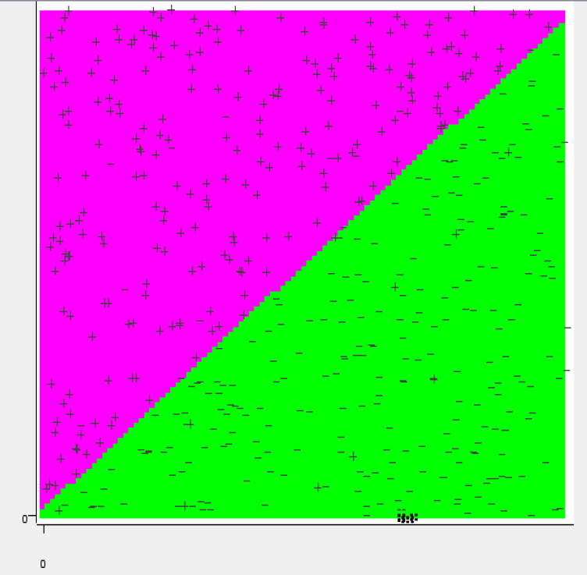
Choice of Parameter k
Linear classification problem (with some noise)

Slide 30
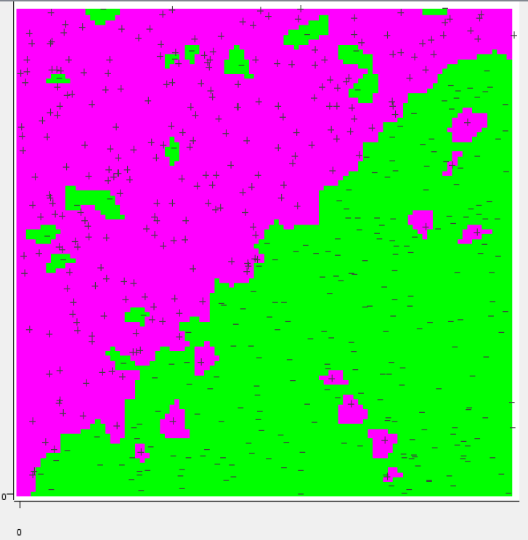
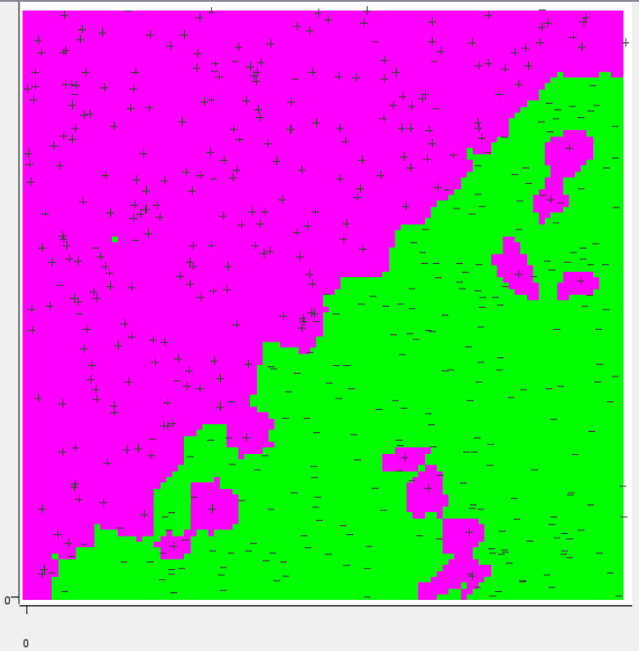
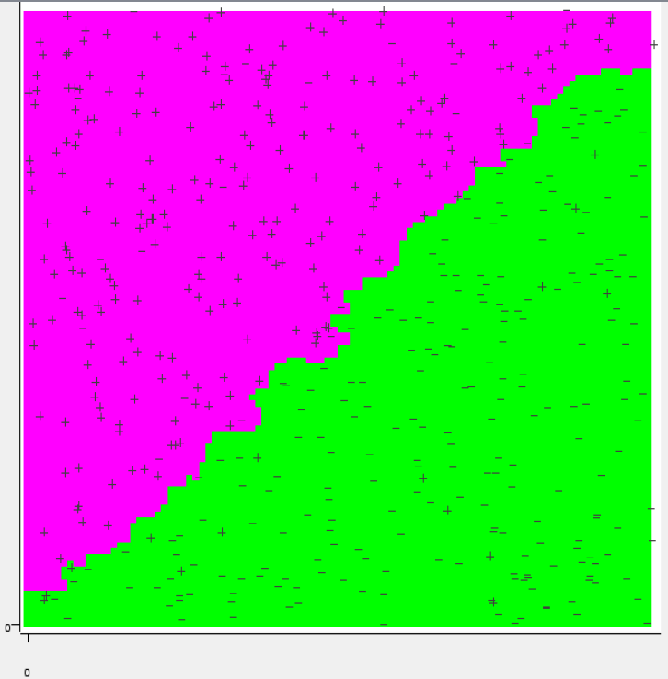
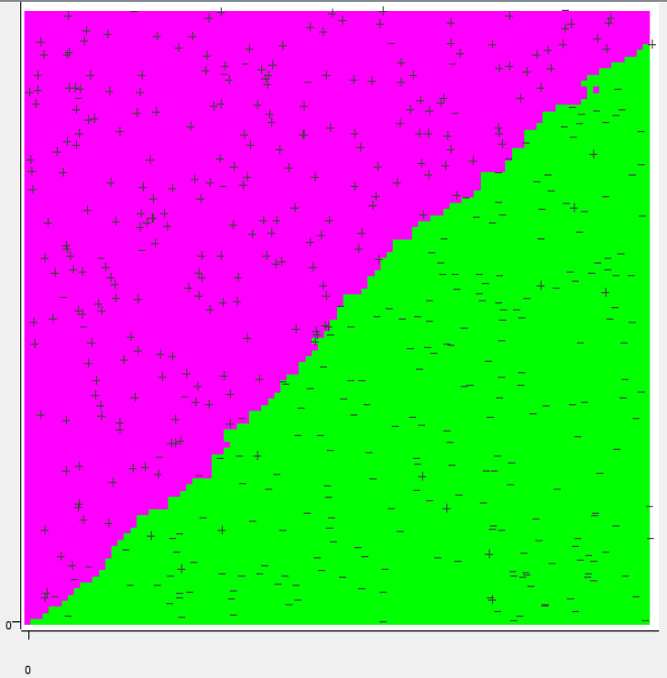
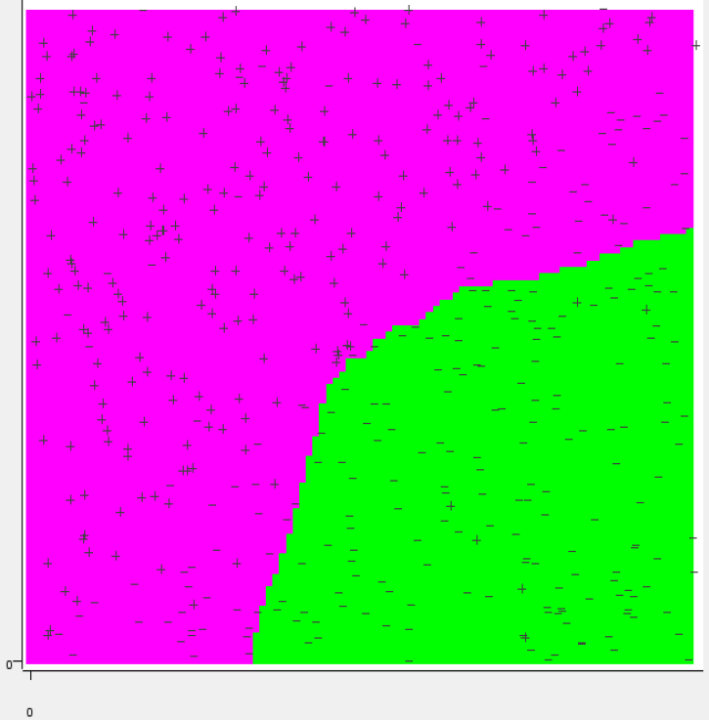
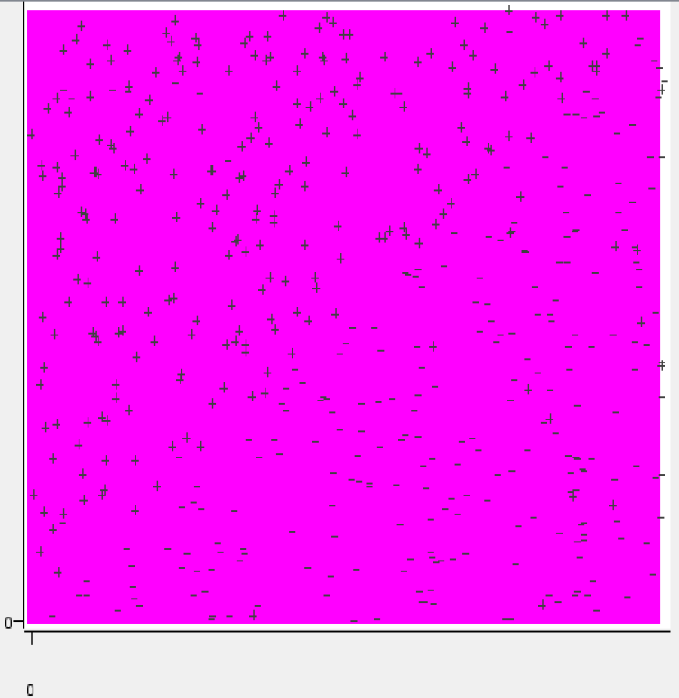
Choice of Parameter k
Decision boundaries with different k
k=1
k=2
k=5
Truth
k=50
k=470
k=500

Slide 31
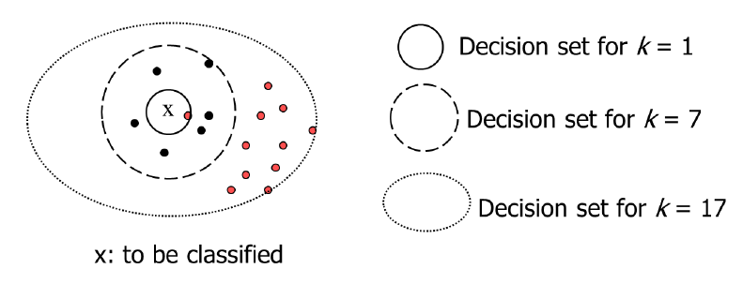
Choice of Parameter k
k=1: y=piecewise constant labeling
k too small: very sensitive to outliers
k too large: many objects from other classes in the decision set
k = N: y=globally constant (majority) label
➔ k can be determined manually, or heuristically (such as cross-validation)

Slide 32
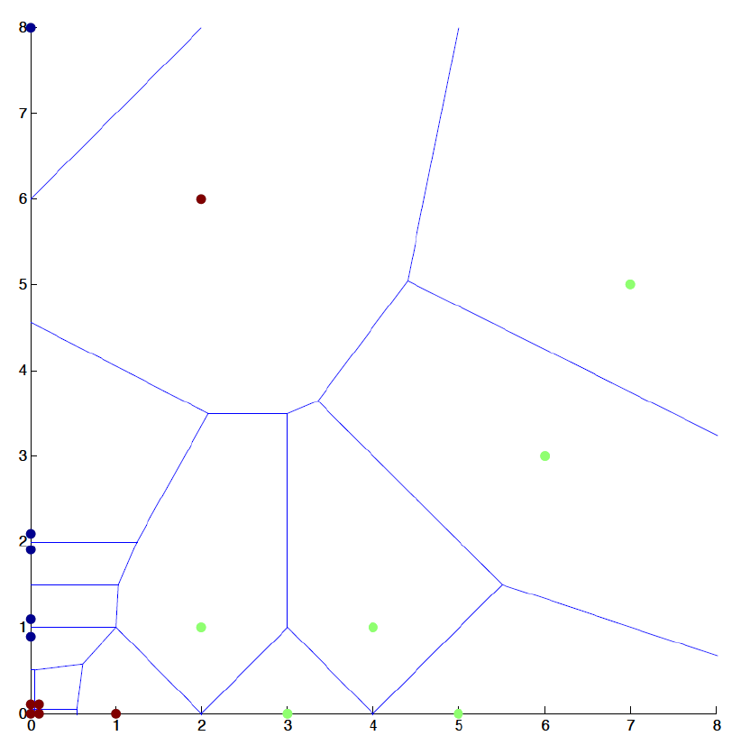
Special Case, k=1
Simple classifier, k=1. Voronoi tessellation of input space

Slide 33
Special Case, k=1
Highly localized classifier, perfectly fits separable training data
Bias of the Learning Algorithm?
No variations in search: simple store all examples
Model Bias?
Classification via Nearest Neighbor
Hypothesis Space?
One hypothesis only: Voronoi partitioning of space

Slide 34
Summary
Nearest neighbor classifiers are:
Instance-based classifiers → remember all training cases
Sensitive to neighborhood – things to consider:
Number of neighbors k
Distance function
Weighting function
Prediction function

Slide 35
Practical Examples with KNIME Analytics Platform

Slide 36
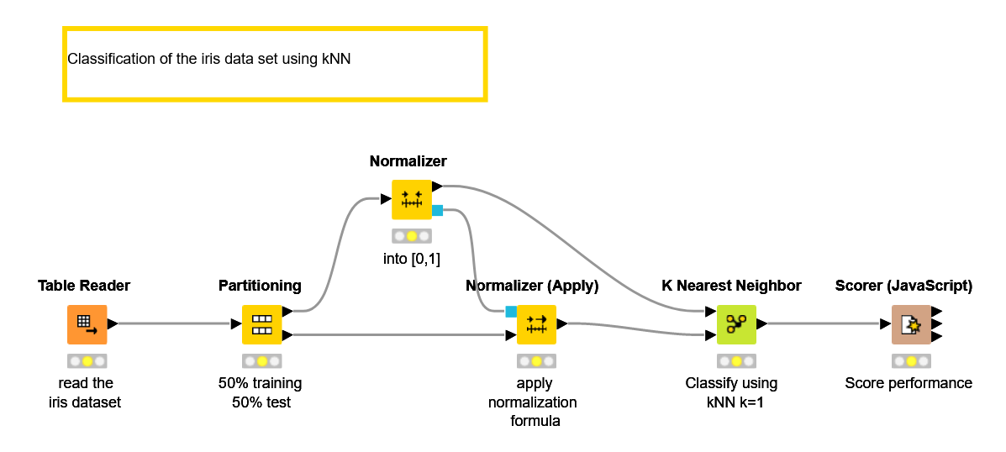
KNIME Workflow
Classification of the iris data using kNN

