Slide 1
Basic Principles: Exercises

Slide 2
Exercise 1 Evaluation Metrics

Slide 3
Evaluation Metrics
Explain the meaning of the following terms:
True positive, true negative, false positive, false negative
Sensitivity and specificity
Precision and recall
Overall accuracy and Cohen's kappa.
When is it preferable to use the overall accuracy? When the Cohen's kappa?

Slide 4
1. Error metrics for classification
Explain the meaning of the following terms:
True positive, true negative, false positive, false negative
All terms are based on a two-class decision problem. Arbitrarily, take one class as the POSITIVE class and the remaining class as the NEGATIVE class.
TRUE POSITIVES (TP): Original class is positive and predictor class is also positive (correct)
TRUE NEGATIVES (TN): Original class is negative and predictor class is also negative (correct)
FALSE NEGATIVES (FN): Original class is positive and predictor class is negative (wrong)
FALSE POSITIVES (FP): Original class is negative and predictor class is positive (wrong)
Correct predictions
True class | Predicted class
 | POSITIVE | NEGATIVE
POSITIVE | TRUE POSITIVES | FALSE NEGATIVES
NEGATIVE | FALSE POSITIVES | TRUE NEGATIVES

Slide 5

1. Error metrics for classification
Explain the meaning of the following terms:
Sensitivity and specificity
Sensitivity vs. Specificity
$sensitivity= \frac{TP}{TP+FN}$ $specificity= \frac{TN}{TN+FP}$
Fraction of positive events correctly classified
Fraction of negative events correctly classified
Both measures must be high!

Slide 6

1. Error metrics for classification
Explain the meaning of the following terms:
Precision and recall
Precision vs. Recall
$$recall=\frac{TP}{TP+FN} precision= \frac{TP}{TP+FP}$$
F-Measure
$$F=2\frac{precision ∙recall}{precision+recall}$$
Same as sensitivity
Fraction of predicted positives that are actually positive

Slide 7

1. Error metrics for classification
Explain the meaning of the following terms:
Overall accuracy and Cohen's kappa.
Overall Accuracy
$$accuracy=\frac{TP+TN}{TP+TN+FP+FN}= \frac{TP+TN}{n}$$
Cohen‘s Kappa
$$\text{κ}=\frac{p_{o}−p_{e}}{1−p_{e}}$$
Fraction of correctly classified data
Given the a priori probability of the class and given the probability of the model to choose the class, how much better is overall accuracy with respect to just following the pure probabilities

Slide 8
2. Overall accuracy vs. Cohen‘s kappa
When is it preferable to use the overall accuracy? When the Cohen's kappa?
The more the classes in the dataset are unevenly distributed, the more it is advisable to use Cohen‘s kappa instead of Overall Accuracy.
An alternative is to artificially produce a dataset with equally distributed classes and calculate the Overall Accuracy for it.

Slide 9
Exercise 2 ROC Curve

Slide 10
ROC curve
The adult data set was classified using two models (see the classification results in the image below).
The correct classification can be found in the attribute income. The columns P(income=<= 50K)M1 and P(income=<= 50K)M2 contain the probability that this person belongs to the positive class <= 50K according to the prediction of models M1 and M2, respectively.
Draw in one diagram (by hand) the ROC curve for the two models and explain how the ROC curve has been drawn.
Where would the perfect curve be, where is the random guess, and which area under the curve is supposed to be worse than random?
Which of the algorithms better classified the data and why?

Slide 11
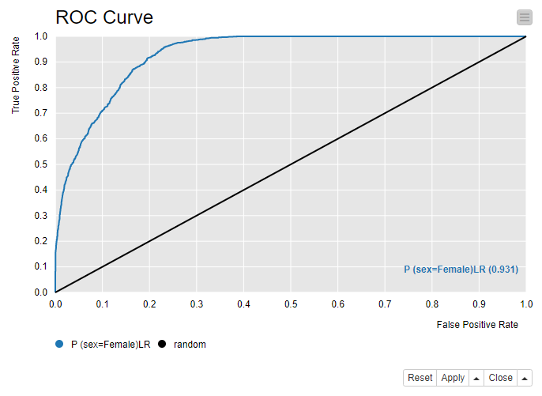



ROC curve
True classs | Predicted class
 | POSITIVE | NEGATIVE
POSITIVE | TRUE POSITIVES | FALSE NEGATIVES
NEGATIVE | FALSE POSITIVES | TRUE NEGATIVES
Classification model performance as reported by:
False positive rate (FPR)
negative events incorrectly classified as positive
True positive rate (TPR)
positive events correctly classified as positive
Perfect model
Thr =0.0
Optimal threshold
AuC = Area under the Curve
$$TPR= \frac{TP}{TP+FN}$$
Thr =0.8
Random choice
Thr =0.9
Thr =1.0
$$FPR= \frac{FP}{FP+TN}$$
$$P\left(pos | x\right)>threshold ⇒class pos$$

Slide 12





Threshold = 1.0
Positive event = <=50K - Threshold = 1.0 - If P (pos. Event) > threshold => positive
Model 1
Model 2
$$TPR= \frac{TP}{TP+FN}$$
 | Positive | Negative
Positive | 0 | 7
Negative | 0 | 3
 | Positive | Negative
Positive | 0 | 7
Negative | 0 | 3
$$FPR= \frac{FP}{FP+TN}$$
$TPR= \frac{0}{0+7}$ = 0.00
$TPR= \frac{0}{0+7}$ = 0.00
$FPR= \frac{0}{0+3}$ = 0.00
$FPR= \frac{0}{0+3}$ = 0.00

Slide 13


Threshold = 0.9
Positive event = <=50K - Threshold = 0.9 - If P (pos. Event) > threshold => positive
Model 1
Model 2
$$TPR= \frac{TP}{TP+FN}$$
 | Positive | Negative
Positive | 1 | 6
Negative | 0 | 3
 | Positive | Negative
Positive | 1 | 6
Negative | 0 | 3
$$FPR= \frac{FP}{FP+TN}$$
$TPR= \frac{1}{1+6}$ = 0.14
$TPR= \frac{1}{1+6}$ = 0.14
$FPR= \frac{0}{0+3}$ = 0.00
$FPR= \frac{0}{0+3}$ = 0.00

Slide 14
Threshold = 0.8
Positive event = <=50K - Threshold = 0.8 - If P (pos. Event) > threshold => positive
Model 1
Model 2
$$TPR= \frac{TP}{TP+FN}$$
 | Positive | Negative
Positive | 1 | 6
Negative | 0 | 3
 | Positive | Negative
Positive | 1 | 6
Negative | 0 | 3
$$FPR= \frac{FP}{FP+TN}$$
$TPR= \frac{1}{1+6}$ = 0.14
$TPR= \frac{1}{1+6}$ = 0.14
$FPR= \frac{0}{0+3}$ = 0.00
$FPR= \frac{0}{0+3}$ = 0.00

Slide 15


Threshold = 0.7
Positive event = <=50K - Threshold = 0.7 - If P (pos. Event) > threshold => positive
Model 1
Model 2
$$TPR= \frac{TP}{TP+FN}$$
 | Positive | Negative
Positive | 5 | 2
Negative | 0 | 3
 | Positive | Negative
Positive | 2 | 5
Negative | 0 | 3
$$FPR= \frac{FP}{FP+TN}$$
$TPR= \frac{5}{5+2}$ = 0.71
$TPR= \frac{2}{2+5}$ = 0.28
$FPR= \frac{0}{0+3}$ = 0.00
$FPR= \frac{0}{0+3}$ = 0.00

Slide 16



Threshold = 0.6
Positive event = <=50K - Threshold = 0.6 - If P (pos. Event) > threshold => positive
Model 1
Model 2
$$TPR= \frac{TP}{TP+FN}$$
 | Positive | Negative
Positive | 5 | 2
Negative | 1 | 2
 | Positive | Negative
Positive | 3 | 4
Negative | 2 | 3
$$FPR= \frac{FP}{FP+TN}$$
$TPR= \frac{5}{5+2}$ = 0.71
$TPR= \frac{3}{3+4}$ = 0.42
$FPR= \frac{1}{1+2}$ = 0.33
$FPR= \frac{2}{2+1}$ = 0.66

Slide 17
Threshold = 0.5
Positive event = <=50K - Threshold = 0.5 - If P (pos. Event) > threshold => positive
Model 1
Model 2
$$TPR= \frac{TP}{TP+FN}$$
 | Positive | Negative
Positive | 5 | 2
Negative | 1 | 2
 | Positive | Negative
Positive | 3 | 4
Negative | 2 | 3
$$FPR= \frac{FP}{FP+TN}$$
$TPR= \frac{5}{5+2}$ = 0.71
$TPR= \frac{3}{3+4}$ = 0.42
$FPR= \frac{1}{1+2}$ = 0.33
$FPR= \frac{2}{2+1}$ = 0.66

Slide 18


Threshold = 0.4
Positive event = <=50K - Threshold = 0.4 - If P (pos. Event) > threshold => positive
Model 1
Model 2
$$TPR= \frac{TP}{TP+FN}$$
 | Positive | Negative
Positive | 6 | 1
Negative | 1 | 2
 | Positive | Negative
Positive | 4 | 3
Negative | 2 | 3
$$FPR= \frac{FP}{FP+TN}$$
$TPR= \frac{6}{6+1}$ = 0.86
$TPR= \frac{4}{4+3}$ = 0.57
$FPR= \frac{1}{1+2}$ = 0.33
$FPR= \frac{2}{2+1}$ = 0.66

Slide 19


Threshold = 0.3
Positive event = <=50K - Threshold = 0.3 - If P (pos. Event) > threshold => positive
Model 1
Model 2
$$TPR= \frac{TP}{TP+FN}$$
 | Positive | Negative
Positive | 6 | 1
Negative | 1 | 2
 | Positive | Negative
Positive | 6 | 1
Negative | 3 | 0
$$FPR= \frac{FP}{FP+TN}$$
$TPR= \frac{6}{6+1}$ = 0.86
$TPR= \frac{6}{6+1}$ = 0.86
$FPR= \frac{1}{1+2}$ = 0.33
$FPR= \frac{3}{3+0}$ = 1.00

Slide 20

Threshold = 0.2
Positive event = <=50K - Threshold = 0.2 - If P (pos. Event) > threshold => positive
Model 1
Model 2
$$TPR= \frac{TP}{TP+FN}$$
 | Positive | Negative
Positive | 6 | 1
Negative | 2 | 1
 | Positive | Negative
Positive | 7 | 0
Negative | 3 | 0
$$FPR= \frac{FP}{FP+TN}$$
$TPR= \frac{6}{6+1}$ = 0.86
$TPR= \frac{7}{7+0}$ = 1.00
$FPR= \frac{2}{2+1}$ = 0.66
$FPR= \frac{3}{3+0}$ = 1.00

Slide 21

Threshold = 0.1
Positive event = <=50K - Threshold = 0.1 - If P (pos. Event) > threshold => positive
Model 1
Model 2
$$TPR= \frac{TP}{TP+FN}$$
 | Positive | Negative
Positive | 6 | 1
Negative | 2 | 1
 | Positive | Negative
Positive | 7 | 0
Negative | 3 | 0
$$FPR= \frac{FP}{FP+TN}$$
$TPR= \frac{7}{7+0}$ = 1.00
$TPR= \frac{7}{7+0}$ = 1.00
$FPR= \frac{3}{3+0}$ = 1.00
$FPR= \frac{3}{3+0}$ = 1.00

Slide 22
Threshold = 0.0
Positive event = <=50K - Threshold = 0.0 - If P (pos. Event) > threshold => positive
Model 1
Model 2
$$TPR= \frac{TP}{TP+FN}$$
 | Positive | Negative
Positive | 6 | 1
Negative | 2 | 1
 | Positive | Negative
Positive | 7 | 0
Negative | 3 | 0
$$FPR= \frac{FP}{FP+TN}$$
$TPR= \frac{7}{7+0}$ = 1.00
$TPR= \frac{7}{7+0}$ = 1.00
$FPR= \frac{3}{3+0}$ = 1.00
$FPR= \frac{3}{3+0}$ = 1.00

Slide 23
ROC Curve
Draw in one diagram (by hand) the ROC curve for the two models and explain how the ROC curve has been drawn
 | Model 1 |  | Model 2
threshold | TPR | FPR | TPR | FPR
1.0 | 0.00 | 0.00 | 0.00 | 0.00
0.9 | 0.14 | 0.00 | 0.14 | 0.00
0.8 | 0.14 | 0.00 | 0.14 | 0.00
0.7 | 0.71 | 0.00 | 0.28 | 0.00
0.6 | 0.71 | 0.33 | 0.42 | 0.66
0.5 | 0.71 | 0.33 | 0.42 | 0.66
0.4 | 0.86 | 0.33 | 0.57 | 0.66
0.3 | 0.86 | 0.33 | 0.86 | 1.00
0.2 | 0.86 | 0.66 | 1.00 | 1.00
0.1 | 1.00 | 1.00 | 1.00 | 1.00
0.0 | 1.00 | 1.00 | 1.00 | 1.00
TPR
1.0
0.9
0.8
0.7
0.6
0.5
0.4
0.3
0.2
0.1
0.0
0.0
0.1
0.2
0.3
0.4
0.5
0.6
0.7
0.8
0.9
1.0
FPR

Slide 24
ROC Curve
Where would the perfect curve be, where is the random guess, and which area under the curve is supposed to be worse than random?
 | Model 1 |  | Model 2
threshold | TPR | FPR | TPR | FPR
1.0 | 0.00 | 0.00 | 0.00 | 0.00
0.9 | 0.14 | 0.00 | 0.14 | 0.00
0.8 | 0.14 | 0.00 | 0.14 | 0.00
0.7 | 0.71 | 0.00 | 0.28 | 0.00
0.6 | 0.71 | 0.33 | 0.42 | 0.66
0.5 | 0.71 | 0.33 | 0.42 | 0.66
0.4 | 0.86 | 0.33 | 0.57 | 0.66
0.3 | 0.86 | 0.33 | 0.86 | 1.00
0.2 | 0.86 | 0.66 | 1.00 | 1.00
0.1 | 1.00 | 1.00 | 1.00 | 1.00
0.0 | 1.00 | 1.00 | 1.00 | 1.00
TPR
Perfect model
1.0
0.9
0.8
Random chance
0.7
0.6
0.5
Here – below the random chance line - the model performs worse than chance. It is actively deceiving you.
0.4
0.3
0.2
0.1
0.0
0.0
0.1
0.2
0.3
0.4
0.5
0.6
0.7
0.8
0.9
1.0
FPR

Slide 25
ROC Curve
Which of the algorithms better classified the data and why?
 | Model 1 |  | Model 2
threshold | TPR | FPR | TPR | FPR
1.0 | 0.00 | 0.00 | 0.00 | 0.00
0.9 | 0.14 | 0.00 | 0.14 | 0.00
0.8 | 0.14 | 0.00 | 0.14 | 0.00
0.7 | 0.71 | 0.00 | 0.28 | 0.00
0.6 | 0.71 | 0.33 | 0.42 | 0.66
0.5 | 0.71 | 0.33 | 0.42 | 0.66
0.4 | 0.86 | 0.33 | 0.57 | 0.66
0.3 | 0.86 | 0.33 | 0.86 | 1.00
0.2 | 0.86 | 0.66 | 1.00 | 1.00
0.1 | 1.00 | 1.00 | 1.00 | 1.00
0.0 | 1.00 | 1.00 | 1.00 | 1.00
TPR
1.0
Model 1 (blue line) performs better than model 2 (yellow line), since the ROC curve of model 1 lies above the ROC curve of model 2.
As a consequence the Area under the Curve (AuC) is bigger for model 1 (blue line) than for model 2 (yellow line). AuC can be considered an indicator of the classifier quality.
0.9
0.8
0.7
0.6
0.5
0.4
0.3
0.2
0.1
0.0
0.0
0.1
0.2
0.3
0.4
0.5
0.6
0.7
0.8
0.9
1.0
FPR

Slide 26
Exercise 3 Gradient Descent

Slide 27
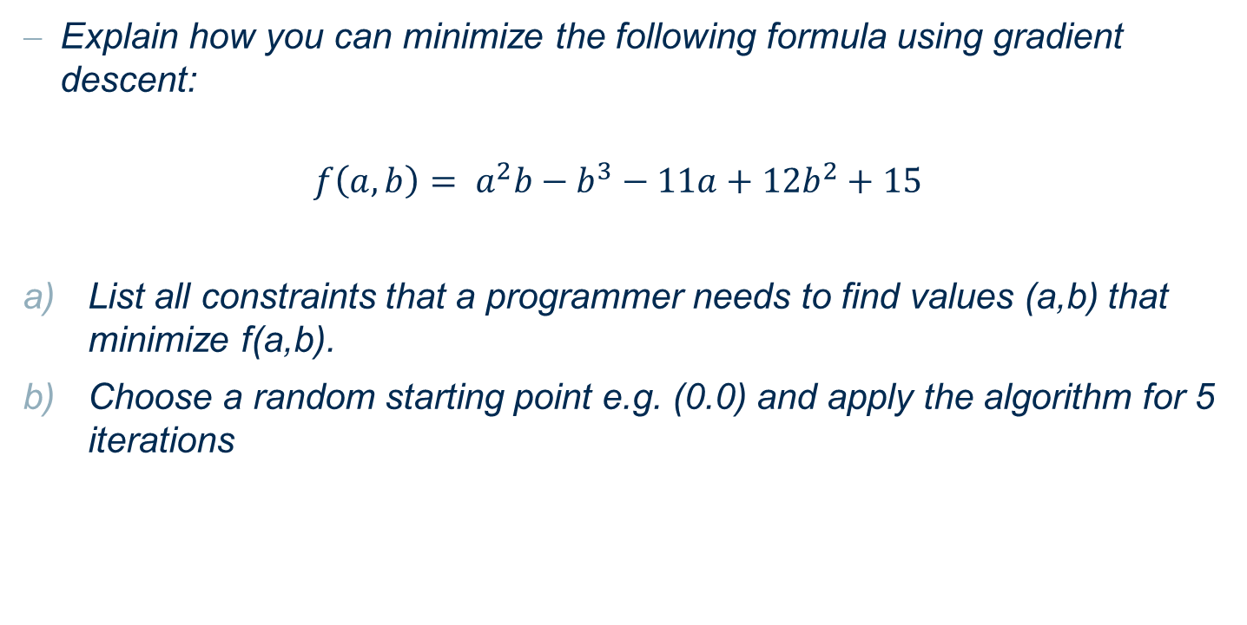
Gradient Descent
Explain how you can minimize the following formula using gradient descent:
$$f\left(a,b\right)= a^{2}b−b^{3}−11a+12b^{2}+15$$
List all constraints that a programmer needs to find values (a,b) that minimize f(a,b).
Choose a random starting point e.g. (0.0) and apply the algorithm for 5 iterations

Slide 28
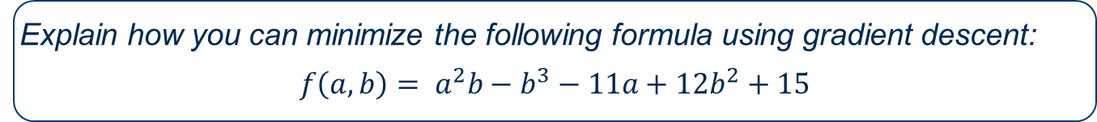
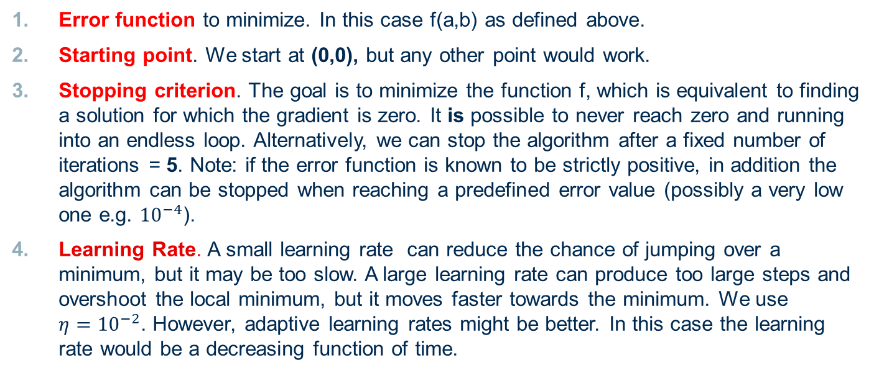
Gradient Descent
Explain how you can minimize the following formula using gradient descent:
$$f\left(a,b\right)= a^{2}b−b^{3}−11a+12b^{2}+15$$
Error function to minimize. In this case f(a,b) as defined above.
Starting point. We start at (0,0), but any other point would work.
Stopping criterion. The goal is to minimize the function f, which is equivalent to finding a solution for which the gradient is zero. It is possible to never reach zero and running into an endless loop. Alternatively, we can stop the algorithm after a fixed number of iterations = 5. Note: if the error function is known to be strictly positive, in addition the algorithm can be stopped when reaching a predefined error value (possibly a very low one e.g. ${10}^{−4}$).
Learning Rate. A small learning rate can reduce the chance of jumping over a minimum, but it may be too slow. A large learning rate can produce too large steps and overshoot the local minimum, but it moves faster towards the minimum. We use $η{=10}^{−2}$. However, adaptive learning rates might be better. In this case the learning rate would be a decreasing function of time.

Slide 29
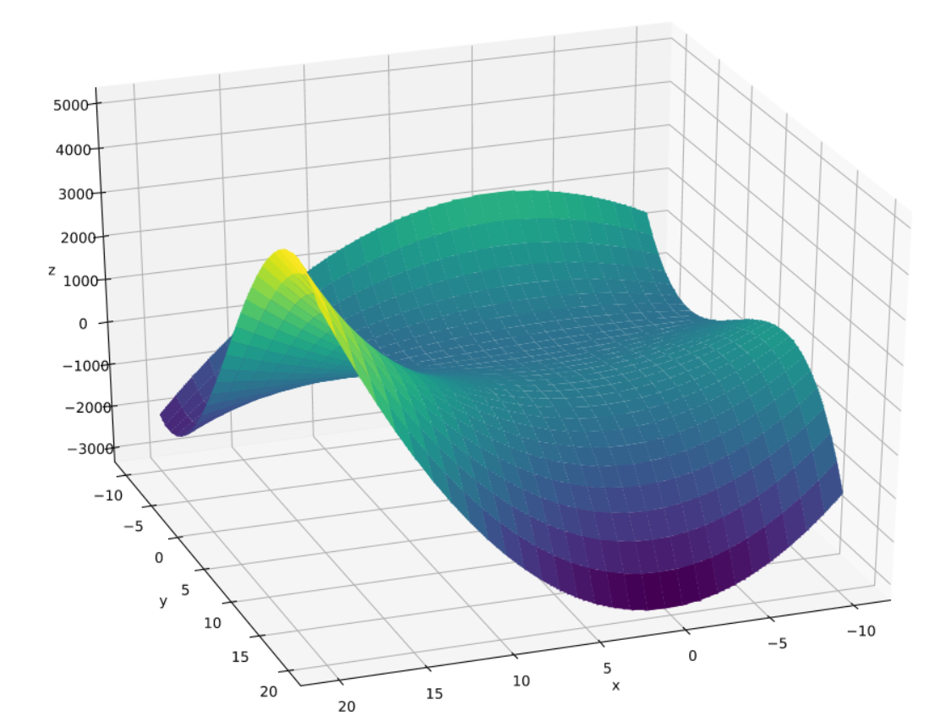
Gradient Descent
Explain how you can minimize the following formula using gradient descent:
$$f\left(a,b\right)= a^{2}b−b^{3}−11a+12b^{2}+15$$
Let‘s visualize the formula
Note that the global minimum is minus infinite.
Therefore we have to manually stop calculations after a fixed number of iterations

Slide 30
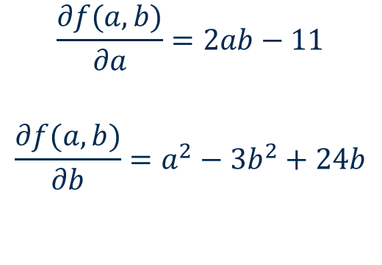
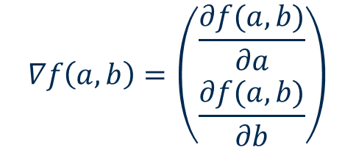
Gradient Descent
Explain how you can minimize the following formula using gradient descent:
$$f\left(a,b\right)= a^{2}b−b^{3}−11a+12b^{2}+15$$
In every step we move our position in the opposite direction of the gradient (The gradient is always showing towards the steepest ascent, hence we go in the opposite direction in the hope for a minimum).
Let’s calculate the gradient of f(a,b)
$$\frac{∂f(a,b)}{∂a}=2ab−11$$
$$\frac{∂f(a,b)}{∂b}=a^{2}−3b^{2}+24b$$
$$∇f\left(a,b\right)=\left(\begin{aligned}\frac{∂f(a,b)}{∂a} \\ \frac{∂f(a,b)}{∂b}\end{aligned}\right)$$

Slide 31

Gradient Descent
Explain how you can minimize the following formula using gradient descent:
$$f\left(a,b\right)= a^{2}b−b^{3}−11a+12b^{2}+15$$
Pseudocode for the developers:
$$a←0 \\ b←0$$
$$η←{10}^{−2} \\ for i=1…nrOfIterations do \\ newA←a−η∗\left(2ab−11\right) \\ newB←b−η∗\left(a^{2}−3b^{2}+24b\right) \\ a←newA \\ b←newB \\ end for$$

Slide 32
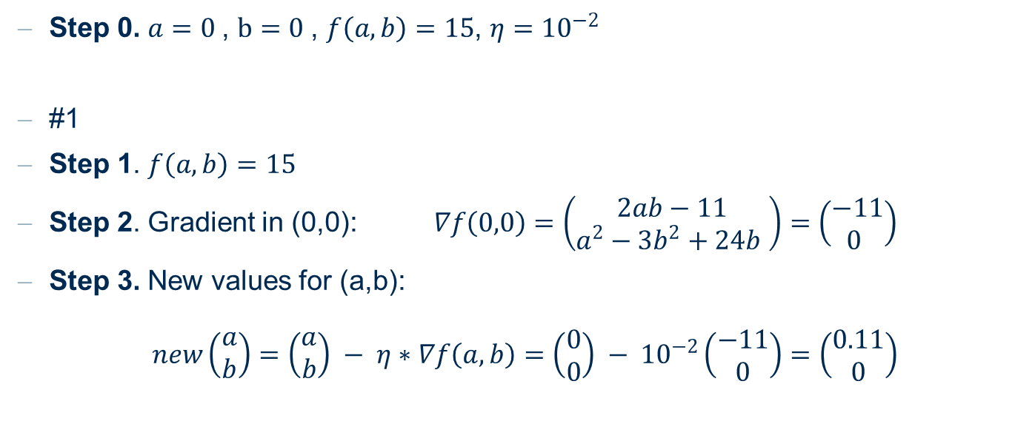
Gradient Descent
Explain how you can minimize the following formula using gradient descent:
$$f\left(a,b\right)= a^{2}b−b^{3}−11a+12b^{2}+15$$
Step 0. $a=0$, $b=0$, $f\left(a,b\right)=15$, $η{=10}^{−2}$
#1
Step 1. $f\left(a,b\right)=15$
Step 2. Gradient in (0,0): $∇f\left(0,0\right)=\left(\begin{aligned}2ab−11 \\ a^{2}−3b^{2}+24b \end{aligned}\right)=\left(\begin{aligned}−11 \\ 0 \end{aligned}\right)$
Step 3. New values for (a,b):
$$new\left(\begin{aligned}a \\ b\end{aligned}\right)=\left(\begin{aligned}a \\ b\end{aligned}\right) − η∗∇f\left(a,b\right)=\left(\begin{aligned}0 \\ 0\end{aligned}\right) − {10}^{−2}\left(\begin{aligned}−11 \\ 0\end{aligned}\right)=\left(\begin{aligned}0.11 \\ 0\end{aligned}\right)$$

Slide 33
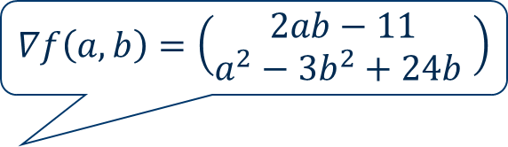
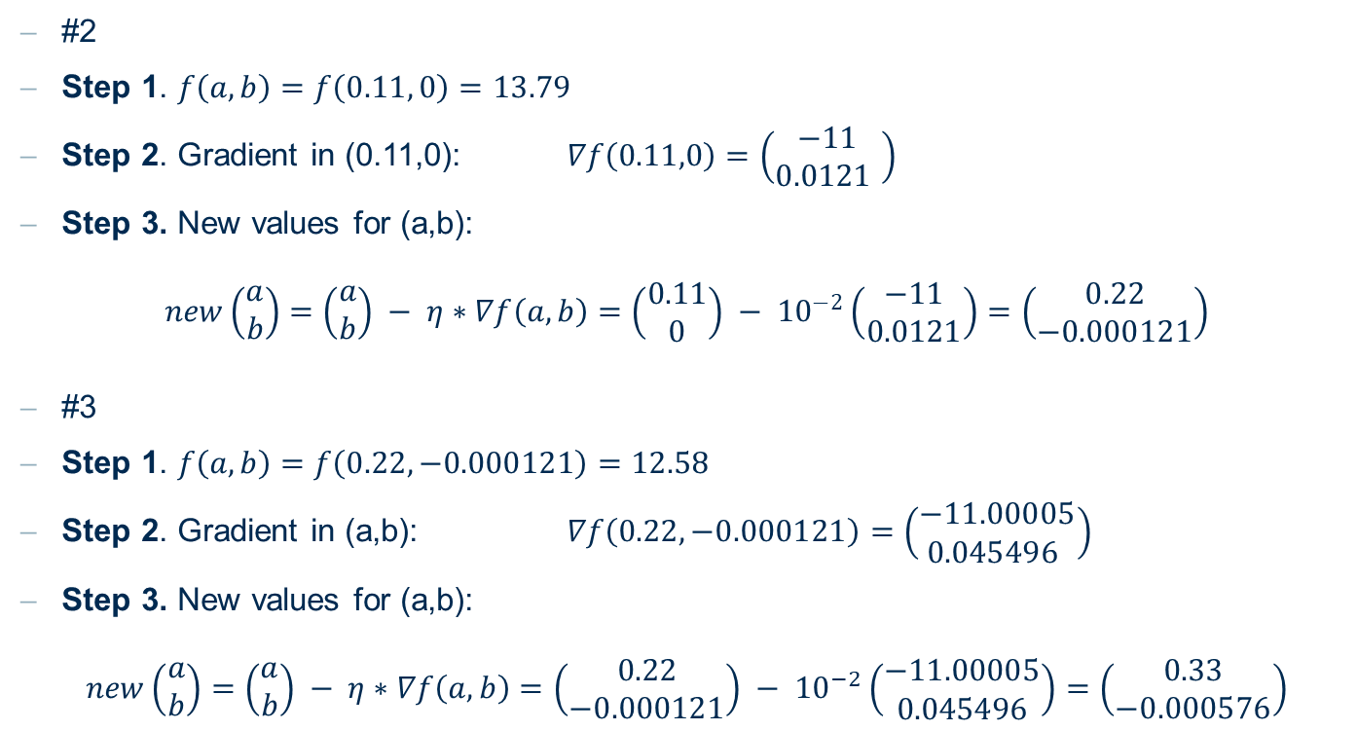
Gradient Descent
$$∇f\left(a,b\right)=\left(\begin{aligned}2ab−11 \\ a^{2}−3b^{2}+24b \end{aligned}\right)$$
#2
Step 1. $f\left(a,b\right)=f\left(0.11, 0\right)=13.79$
Step 2. Gradient in (0.11,0): $∇f\left(0.11,0\right)=\left(\begin{aligned}−11 \\ 0.0121 \end{aligned}\right)$
Step 3. New values for (a,b):
$$new\left(\begin{aligned}a \\ b\end{aligned}\right)=\left(\begin{aligned}a \\ b\end{aligned}\right) − η∗∇f\left(a,b\right)=\left(\begin{aligned}0.11 \\ 0\end{aligned}\right) − {10}^{−2}\left(\begin{aligned}−11 \\ 0.0121\end{aligned}\right)=\left(\begin{aligned}0.22 \\ −0.000121\end{aligned}\right)$$
#3
Step 1. $f\left(a,b\right)=f\left(0.22, −0.000121\right)=12.58$
Step 2. Gradient in (a,b): $∇f\left(0.22,−0.000121\right)=\left(\begin{aligned}−11.00005 \\ 0\text{.045496} \end{aligned}\right)$
Step 3. New values for (a,b):
$$new\left(\begin{aligned}a \\ b\end{aligned}\right)=\left(\begin{aligned}a \\ b\end{aligned}\right) − η∗∇f\left(a,b\right)=\left(\begin{aligned}0.22 \\ −0.000121\end{aligned}\right) − {10}^{−2}\left(\begin{aligned}−11.00005 \\ 0.045496\end{aligned}\right)=\left(\begin{aligned}0.33 \\ −0.000576\end{aligned}\right)$$

Slide 34
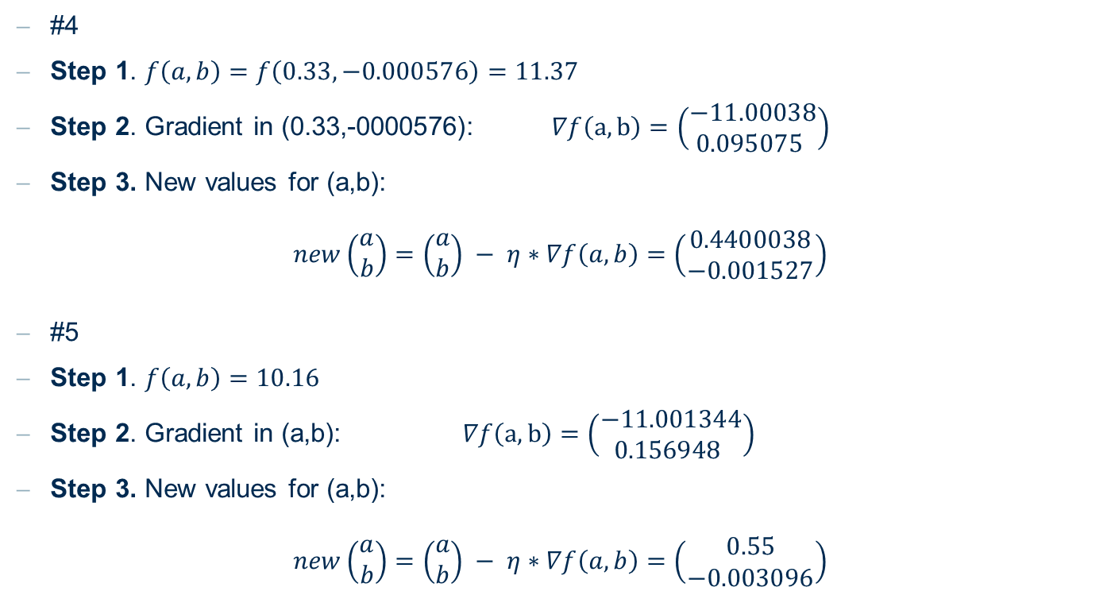
Gradient Descent
#4
Step 1. $f\left(a,b\right)=f\left(0.33, −0.000576\right)=11.37$
Step 2. Gradient in (0.33,-0000576): $∇f\left(a,b\right)=\left(\begin{aligned}−11.00038 \\ 0.0\text{95075} \end{aligned}\right)$
Step 3. New values for (a,b):
$$new\left(\begin{aligned}a \\ b\end{aligned}\right)=\left(\begin{aligned}a \\ b\end{aligned}\right) − η∗∇f\left(a,b\right)=\left(\begin{aligned}0.4400038 \\ −0.001527\end{aligned}\right)$$
#5
Step 1. $f\left(a,b\right)=10.16$
Step 2. Gradient in (a,b): $∇f\left(a,b\right)=\left(\begin{aligned}−11.001344 \\ 0\text{.156948} \end{aligned}\right)$
Step 3. New values for (a,b):
$$new\left(\begin{aligned}a \\ b\end{aligned}\right)=\left(\begin{aligned}a \\ b\end{aligned}\right) − η∗∇f\left(a,b\right)=\left(\begin{aligned}0.55 \\ −0.003096\end{aligned}\right)$$

Slide 35
Exercise 4 Overfitting

Slide 36
Overfitting
Explain the term overfitting
Name one example where overfitting can occur
How can you test if your results suffer from overfitting? (name one idea)
Name some techniques to avoid overfitting

Slide 37
Overfitting
Explain the term overfitting
When we say that the model overfits the data, it means that the learned model is fitting the training data too well, including noise and errors, and does not generalize to real-world new data: The model’s prediction error on new data from the same distribution will be higher than on the training data.
This happens when the model has too many free parameters with respect to the complexity of the data and can easily adjust them to all the particularities of the training set.

Slide 38
Overfitting
Name one example where overfitting can occur
I have a dataset with customer data, including the customer unique IDs, and I want the model to predict which customer will like a given product (customer propensity). Sometimes too big models learn to predict on the basis of the customer unique ID.
This datum will not be available in new data (every customer has a different unique ID). The model here has learned that customer 00102030 likes chocolate, not that any customer with similar characteristics to customer 00102030 might also like chocolate. It has rote-learned the particularities of the training set and cannot generalize to new data.

Slide 39
Overfitting
How can you test if your results suffer from overfitting? (name one idea)
Idea 1:
Split the data into multiple subsets and use only some to learn the model: if performances on different sets are not differing a lot, the model is probably not affected by overfitting
Idea 2 (not always applicable):
Ask an expert to take a look at your classificator

Slide 40
Overfitting
Name some techniques to avoid overfitting
Many techniques to avoid overfitting (basically by keeping the model small):
Regularization
Pruning
Use majority vote on different models trained on similar but not identical training sets
Insert randomness in training (dropout layer in deep learning networks)

Slide 41
Exercise 5 Training Set vs. Test set & Cross-validation

Slide 42
Training set vs Test set & Cross-Validation
In the lecture we explained that the data is mostly split in two parts (training and test data). Using the whole data maybe builds a better classifier.
Why is it a good idea to split the data? Which negative side effect could be reduced?
Explain what cross-validation is and why it is useful
Training Set
Evaluation Set*
Test Set
* sometimes

Slide 43
Training set vs Test set & Cross-Validation
Why is it a good idea to split the data into train and test set? Which negative side effect could be reduced?
Evaluating a model on a set of new data (test set) gives a more realistic measure of the model quality than evaluating it on the training data. Usually, the quality measure on the model is higher on the training set than on the test set.
Training set and test set should never overlap. If data are shared in between the two datasets, the measure of the model quality is not reliable anymore. This is known as the data leakage problem.

Slide 44
Training set vs Test set & Cross-Validation
Explain what cross-validation is and why it is useful
Cross-validation creates k subsets of roughly equal size from the original dataset. At each iteration, the model is trained on k-1 subsets and tested on the remaining subset. The test subset is always a different one.
The error mean gives us a realistic estimate of the model performance on data from this distribution. The error variance gives us a measure of the homogeneity of the dataset.

Slide 45
Exercise 6 Building a Model

Slide 46
Building a model
In this exercise we will go through the whole process of building a model.
Take a look at the following x-y data set.
The goal is to train a model that can predict y values for given x values.
Please consider the three following requirements
Model class
Score function
Algorithm for Model Fitting
x | -1.3 | 0.0 | 1.4 | 2.4 | 5.0 | 11.5 | 12.5 | 15.0
y | 14.0 | 10.0 | 6.2 | 4.0 | 0.0 | 2.0 | 4.0 | 10.0

Slide 47

Building a model
Model class: Our model can be described by a parable which maps the x value to the y value. The parable formula can be generalized to
$$y=0.2 \left(x−a\right)(x−b)$$

Slide 48
Building a model
Score function: Define the mean squared error E for the data set, with respect to the chosen model.
Algorithm for Model Fitting: Let’s use the gradient method
What is the most important assumption for the error function, to be able to apply the gradient descent method?
Explain the most important steps for the gradient descent methods.
Calculate the gradients used for our learning goal.
Write down the update functions for our learning goal.
Explain two possible problems with the usage of a constant step width in gradient descent. Give one example to resolve the step width problem.

Slide 49

Building a model
Score function: Define the mean squared error E for the data set, with respect to the chosen model.
$$MSE= \frac{1}{8}\sum_{i=1}^{8}{{(y_{i}−f(x_{i}))}^{2}=\frac{1}{8}\sum_{i=1}^{8}{{(y_{i}−0.2\left(x_{i}−a\right)\left(x_{i}−b\right))}^{2}}}$$

Slide 50
Building a model
Algorithm for Model Fitting: Gradient method
What is the most important assumption for the error function, to be able to apply the gradient descent method?
The error function has to be differentiable in the parameters a and b.

Slide 51
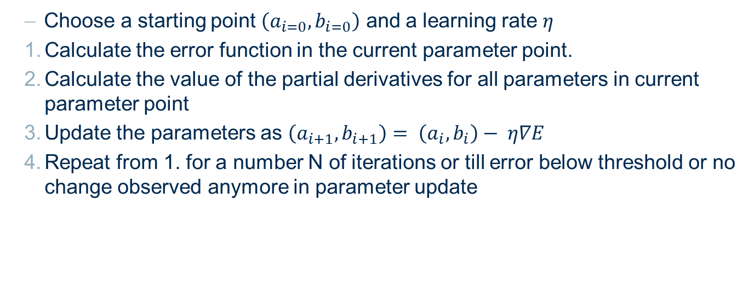
Building a model
Algorithm for Model Fitting: Gradient method
Explain the most important steps for the gradient descent methods.
Choose a starting point $\left(a_{i=0}, b_{i=0}\right)$ and a learning rate $η$
Calculate the error function in the current parameter point.
Calculate the value of the partial derivatives for all parameters in current parameter point
Update the parameters as $\left(a_{i+1}, b_{i+1}\right)= \left(a_{i}, b_{i}\right)− η∇E$
Repeat from 1. for a number N of iterations or till error below threshold or no change observed anymore in parameter update

Slide 52

Building a model
Algorithm for Model Fitting: Gradient method
Calculate the gradients used for our learning goal
$$\frac{∂MSE}{∂a}=\frac{2}{8}\sum_{i=1}^{8}{\left(f\left(x_{i}\right)−y_{i})0.2\left(−x_{i}+b\right)\right)}$$
$$\frac{∂MSE}{∂b}=\frac{2}{8}\sum_{i=1}^{8}{\left(f\left(x_{i}\right)−y_{i})0.2\left(−x_{i}+a\right)\right)}$$

Slide 53
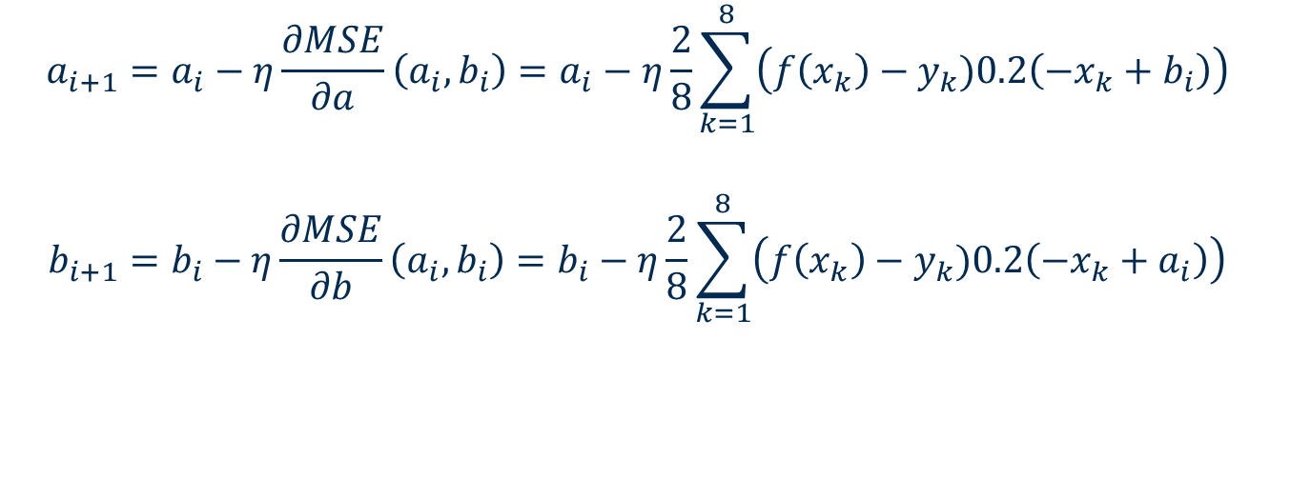
Building a model
Algorithm for Model Fitting: Gradient method
Write down the update functions for our learning goal.
$$a_{i+1}=a_{i}−η\frac{∂MSE}{∂a}\left(a_{i},b_{i}\right)=a_{i}−η\frac{2}{8}\sum_{k=1}^{8}{\left(f\left(x_{k}\right)−y_{k})0.2\left(−x_{k}+b_{i}\right)\right)}$$
$$b_{i+1}=b_{i}−η\frac{∂MSE}{∂b}\left(a_{i},b_{i}\right)=b_{i}−η\frac{2}{8}\sum_{k=1}^{8}{\left(f\left(x_{k}\right)−y_{k})0.2\left(−x_{k}+a_{i}\right)\right)}$$

Slide 54
Building a model
Algorithm for Model Fitting: Gradient method
Explain two possible problems with the usage of a constant step width in gradient descent. Give one example to resolve the step width problem.
If the step width is chosen too big, the minimum can be skipped. If it’s chosen too small the minimum can never be reached.
Method to resolve: Use an adaptive step width as a decreasing function of time.

Slide 55
Exercise 7 Search Strategies

Slide 56
Search Strategies
Describe the following optimization strategies for a function y=f(x)
Grid search
Random search
Hill climbing
Bayesian optimization

Slide 57
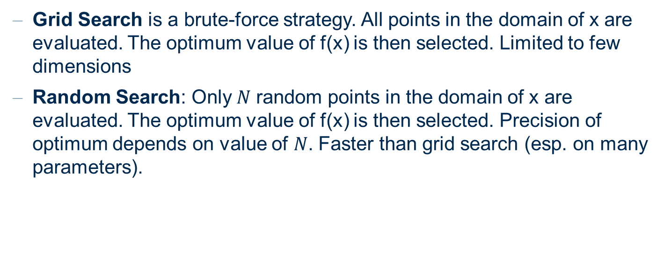
Search Strategies
Describe the following optimization strategies for a function y=f(x)
Grid Search is a brute-force strategy. All points in the domain of x are evaluated. The optimum value of f(x) is then selected. Limited to few dimensions
Random Search: Only$N$ random points in the domain of x are evaluated. The optimum value of f(x) is then selected. Precision of optimum depends on value of $N$. Faster than grid search (esp. on many parameters).

Slide 58
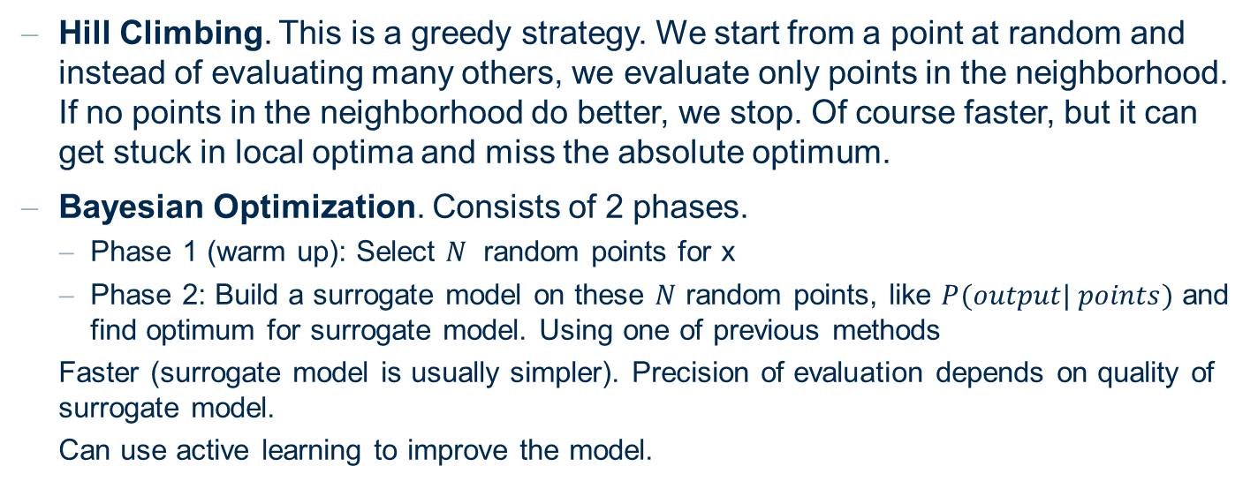
Search Strategies
Describe the following optimization strategies for a function y=f(x)
Hill Climbing. This is a greedy strategy. We start from a point at random and instead of evaluating many others, we evaluate only points in the neighborhood. If no points in the neighborhood do better, we stop. Of course faster, but it can get stuck in local optima and miss the absolute optimum.
Bayesian Optimization. Consists of 2 phases.
Phase 1 (warm up): Select $N$ random points for x
Phase 2: Build a surrogate model on these $N$ random points, like $P(output| points)$ and find optimum for surrogate model. Using one of previous methods
Faster (surrogate model is usually simpler). Precision of evaluation depends on quality of surrogate model.
Can use active learning to improve the model.

Slide 59
Exercise 8 Practice with KNIME

Slide 60
1. Confusion Matrix
Read data predicted_income.csv
The "income" column contains people’s actual income class values. The “Prediction (income)” column contains their predicted income class values produced by some classification model based on the other information available in the dataset. The income class has two values: “<=50K” and “>50K”
Evaluate the accuracy of the income class prediction using the Scorer (JavaScript) node.
Execute the node, and open the interactive view.
How many events are correctly classified in total?
How many events are wrongly classified in total?
Out of how many data rows in the dataset?
What is the overall accuracy of the model?
And Cohen’s kappa?
Open the configuration dialog of the Scorer (JavaScript) node and enable the displaying of the class statistics table.

Slide 61
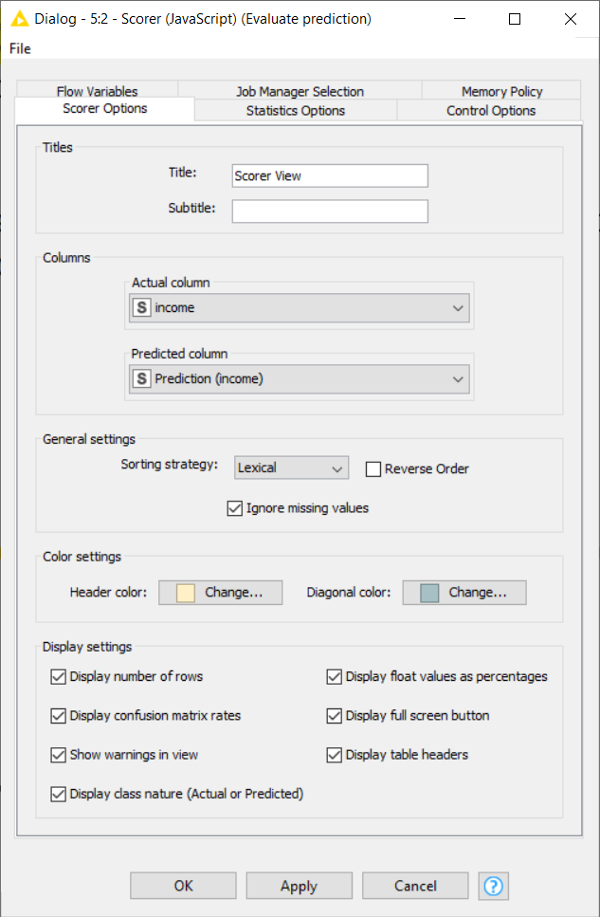
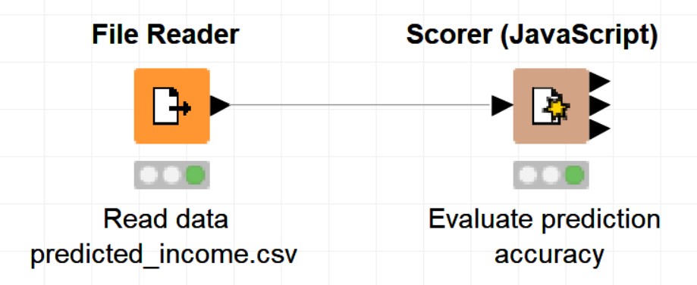
1. Confusion Matrix
Evaluate the accuracy of the income class prediction using the Scorer (JavaScript) node.

Slide 62
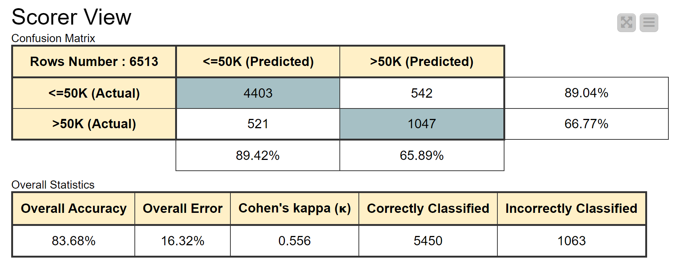
1. Confusion Matrix
How many events are correctly classified in total? 4403 + 1047 = 5450
How many events are wrongly classified in total? 521 + 542 = 1063
Out of how many data rows in the dataset? 6513
What is the overall accuracy of the model? 83.68%
And Cohen’s kappa? 0.556

Slide 63
2. ROC Curve
Read data predicted_gender.csv
The "sex" column contains people’s actual gender: Female or Male. The “Prediction (sex) ...” columns contain their gender values predicted by two different classification models - a decision tree (DT) and logistic regression model (LR). The “P(sex=Female)...” columns contain the predicted probabilities of being female produced by the two models.
Evaluate the performance of the decision tree model using ROC curve node
Set Class column, Positive class value, and Columns containing the positive class probabilities in the configuration dialog
Execute the node and open the interactive view
What is the area under the curve for the decision tree model?
Compare the performance of the decision tree and logistic regression models by plotting their ROC curves in the same graph
Open the configuration dialog of the ROC Curve node
Add the relevant columns to the Columns containing the positive class probabilities
Which of the models perform better?
What is the area under the curve for the logistic regression model?

Slide 64
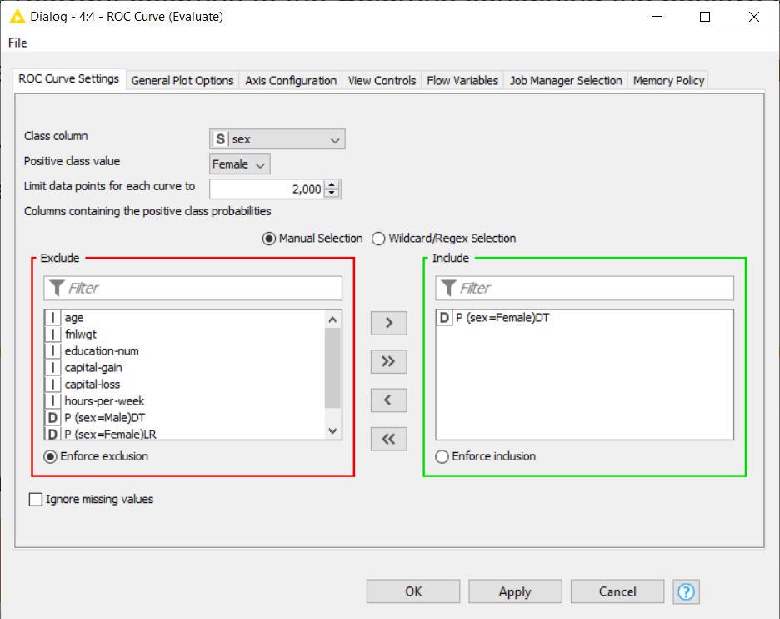
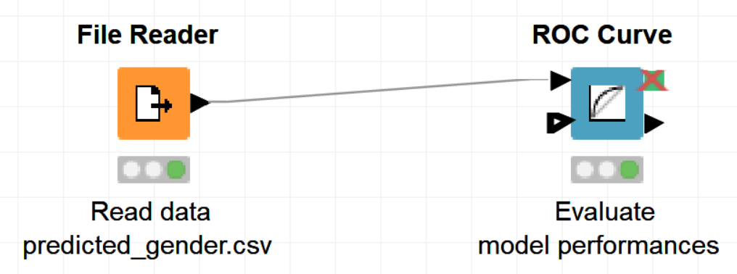
2. ROC Curve
Evaluate the performance of the decision tree model using ROC curve node

Slide 65
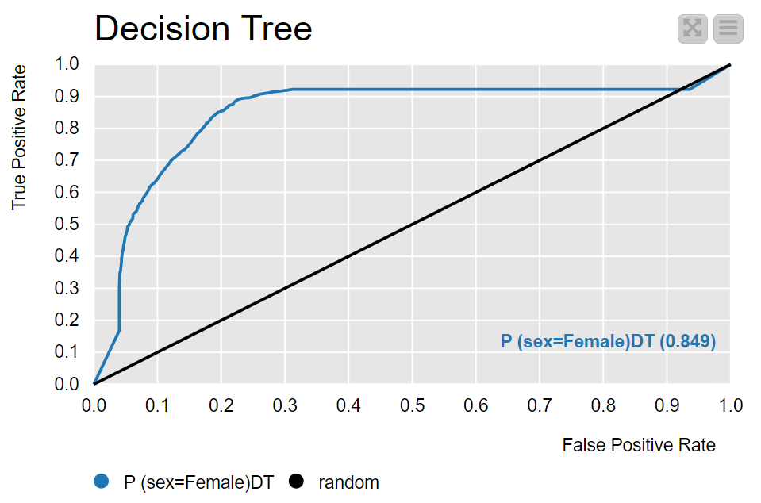
2. ROC Curve
What is the area under the curve for the decision tree model?
AUC Decision Tree: 0.849

Slide 66
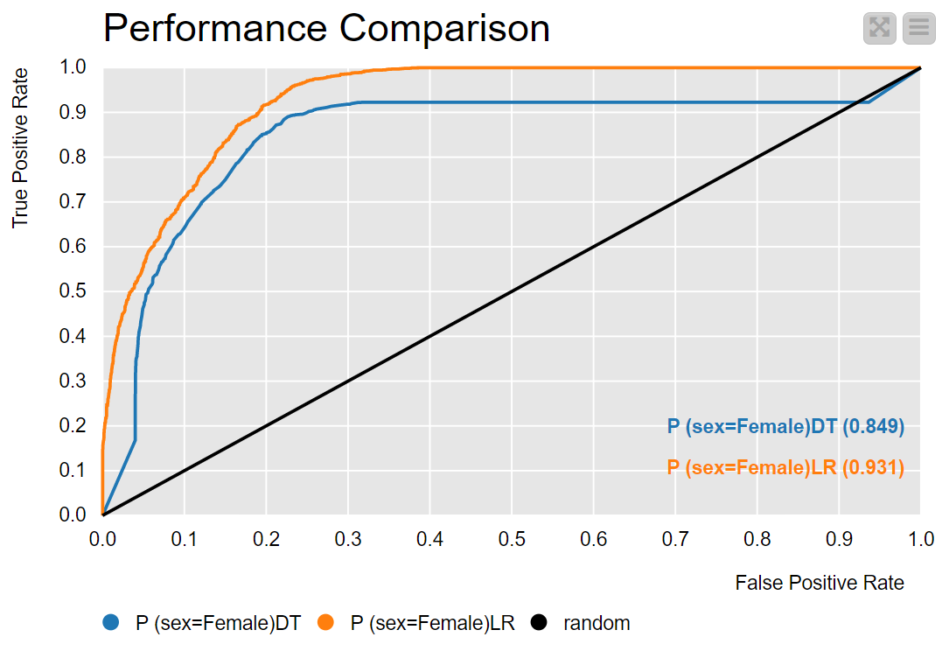
2. ROC Curve
Compare the performance of the decision tree and logistic regression models by plotting their ROC curves in the same graph
AUC Logistic Regression: 0.931
The logistic regression model performed better

Slide 67
3. Numeric Scorer
Read the dataset ames_predicted_saleprice.csv. It contains information about houses in Ames (Iowa, USA).
The "SalePrice" column contains the actual sale price.
The “Prediction (Saleprice)LR” column contains the price predicted by a Linear Regression model.
The “Prediction (Saleprice)PR” column contains the price predicted by a Polynomial Regression model.
Evaluate the accuracy of the two models. Use two Numeric Scorer nodes. Group the error measures in a single table using the Column Appender node
Which Error Measures are available?
Which model performed better and why?

Slide 68
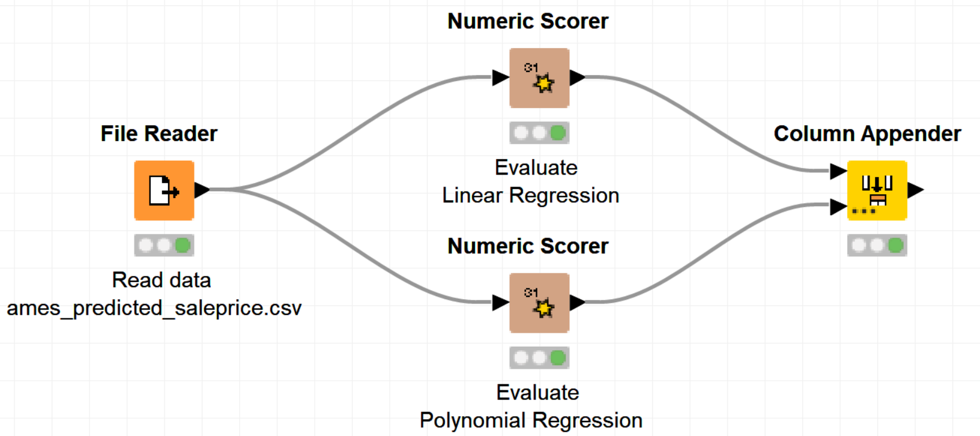
3. Numeric Scorer
Evaluate the accuracy of the two models. Use two Numeric Scorer nodes. Group the error measures in a single table using the Column Appender node

Slide 69
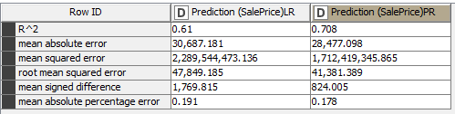
3. Numeric Scorer
Which Error Measures are available?
Which model performed better and why?
The PR model has better performance according to each measure

Slide 70
Thank you

