Slide 1
Recommendation Engines

Slide 2
Summary of this lesson
“We all make choices, but in the end our choices make us” -Ken Levine
Are there events that always happen together?
*This lesson refers to chapter 7 of the GIDS book

Slide 3
Content of this lesson
Association Rules
Itemset Mining
Generating Association Rules
Collaborative Filtering

Slide 4
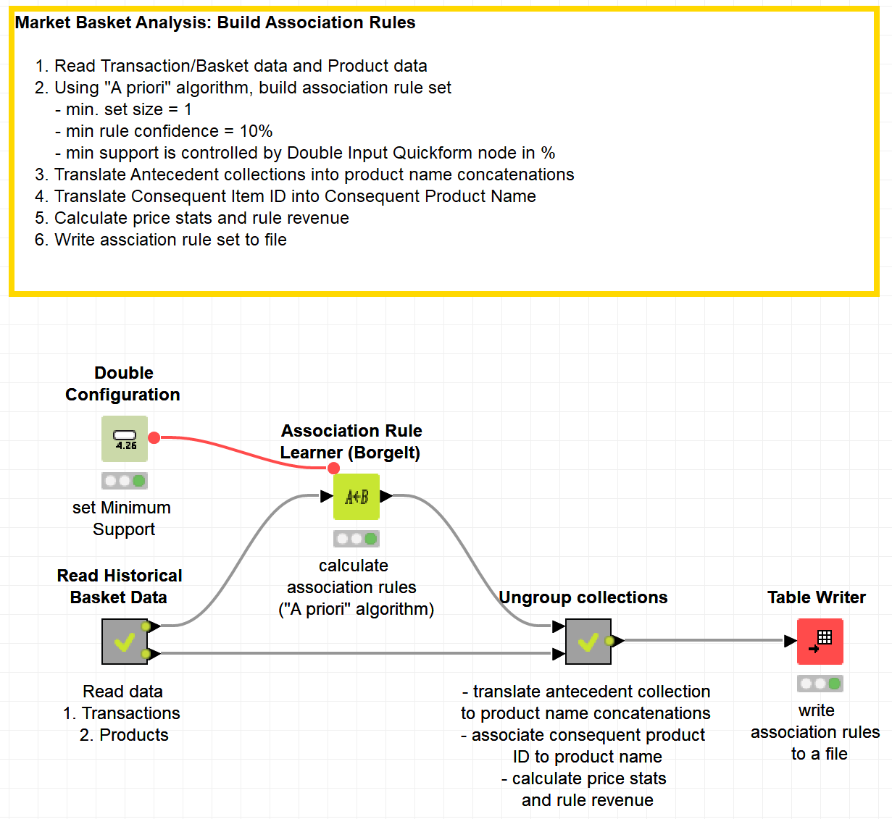
Datasets
Datasets used : transaction data & products data
Example Workflow:
„Association_Rules_for_MarketBasketAnalysis“ https://kni.me/w/fQ9yZLztzEUmAsQ0

Slide 5
Association Rules

Slide 6
Overview
Association Rules: Motivation
Item Set Mining
Breadth First Searching: The Apriori Algorithm
Depth First Searches: The Eclat Algorithm
(Compact) Representation of Itemsets
Finding Association Rules

Slide 7
Association Rule Mining
Association rule induction
Originally designed for market basket analysis.
Aims at finding patterns in the shopping behavior of customers of supermarkets, mail-order companies, on-line shops etc.
More specifically:
Find sets of products that are frequently bought together.
Example of an association rule:
IF a customer buys bread and wine,
THEN she/he will probably also buy cheese.

Slide 8
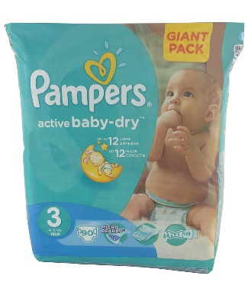
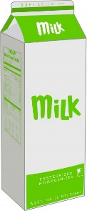
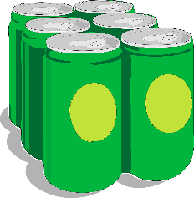
Association Rule: Example
IF
+
THEN
Antecedent
Consequent

Slide 9
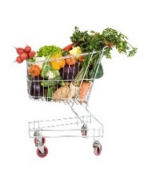
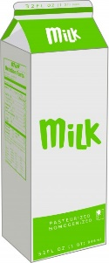
Market Basket Analysis
From the analysis of many
shopping baskets ...
A-priori algorithm
Recommendation
IF
+
THEN

Slide 10
Association Rule Mining
Possible applications of found association rules:
Improve arrangement of products in shelves, on a catalog’s pages.
Support of cross-selling (suggestion of other products), product bundling.
Fraud detection, technical dependence analysis.
Finding business rules and detection of data quality problems.
. . .

Slide 11
Association Rules
Two step implementation:
Find the frequent item sets (also called large item sets), i.e., the item sets that have at least a user-defined minimum support.
Form rules using the frequent item sets found and select those that have at least a user-defined minimum confidence.

Slide 12
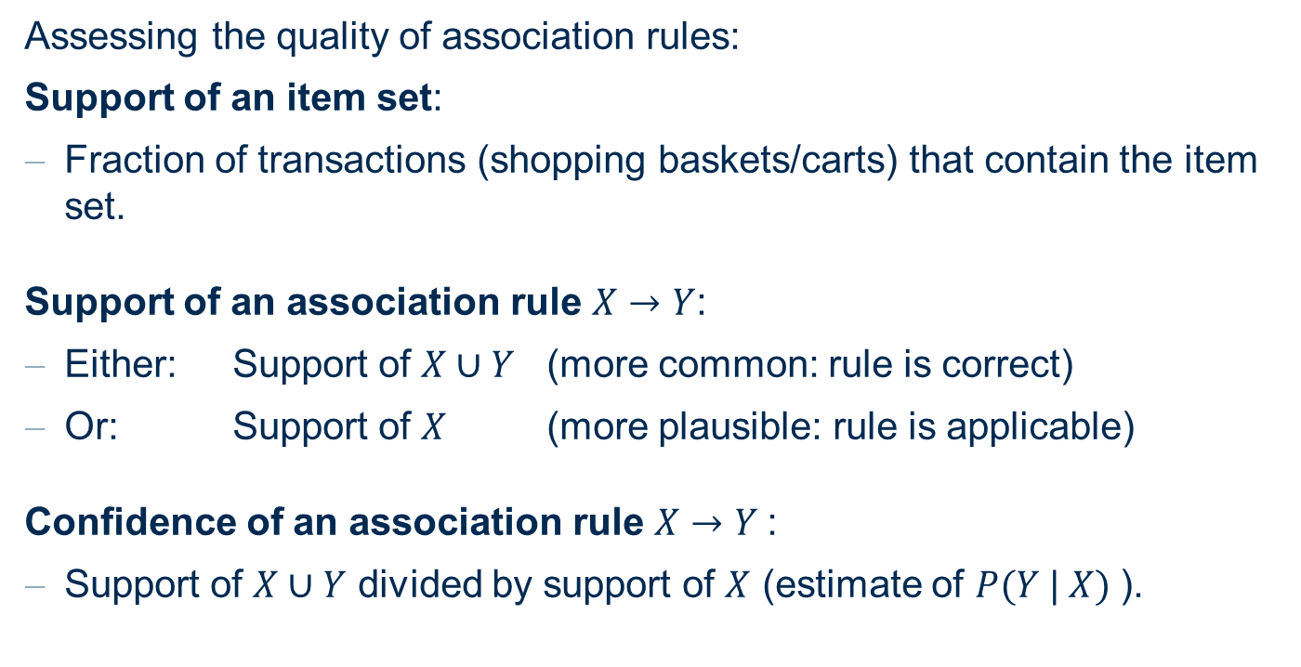
Association Rules
Assessing the quality of association rules:
Support of an item set:
Fraction of transactions (shopping baskets/carts) that contain the item set.
Support of an association rule $X→Y$:
Either: Support of $X∪Y$ (more common: rule is correct)
Or: Support of $X$ (more plausible: rule is applicable)
Confidence of an association rule $X→Y$:
Support of $X∪Y$ divided by support of $X$ (estimate of $P(Y | X)$).

Slide 13
Itemset Mining

Slide 14

Building the Association Rule
N shopping baskets
{A, B, F, H}
{A, B, C}
{B, C, H}
{D, E , F}
{D, E}
{A, B}
{A, C}
{H, F}
…
Search for
frequent itemsets

Slide 15
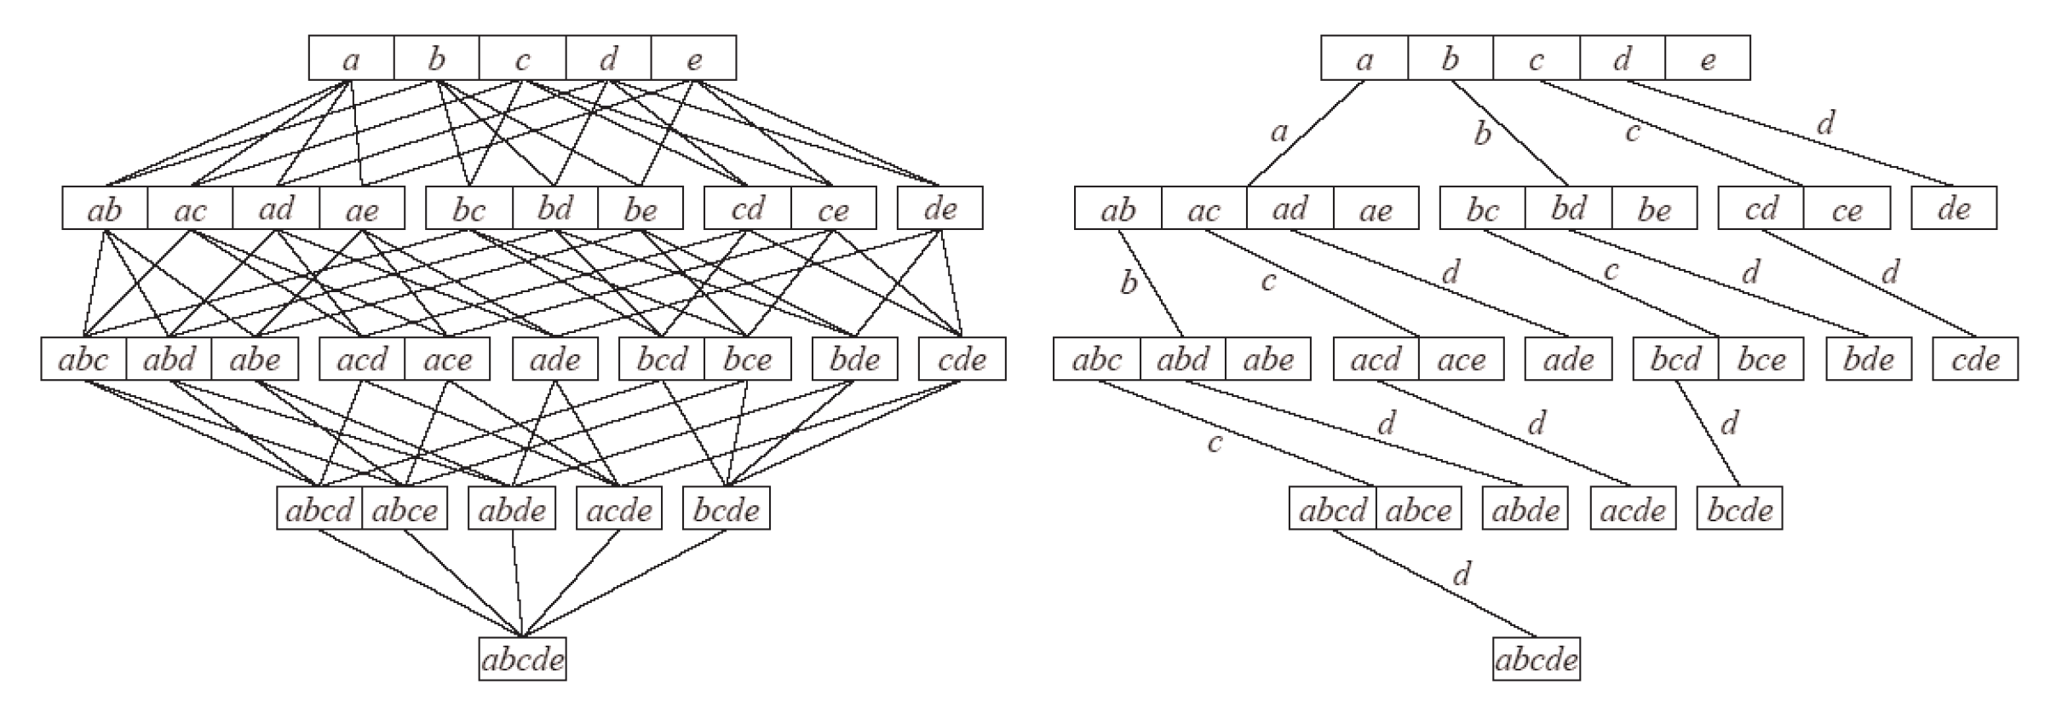
Finding frequent item sets
Subset lattice and a prefix tree for five items:
It is not possible to determine the support of all possible item sets, because their number grows exponentially with the number of items.
Efficient methods to search the subset lattice are needed.

Slide 16
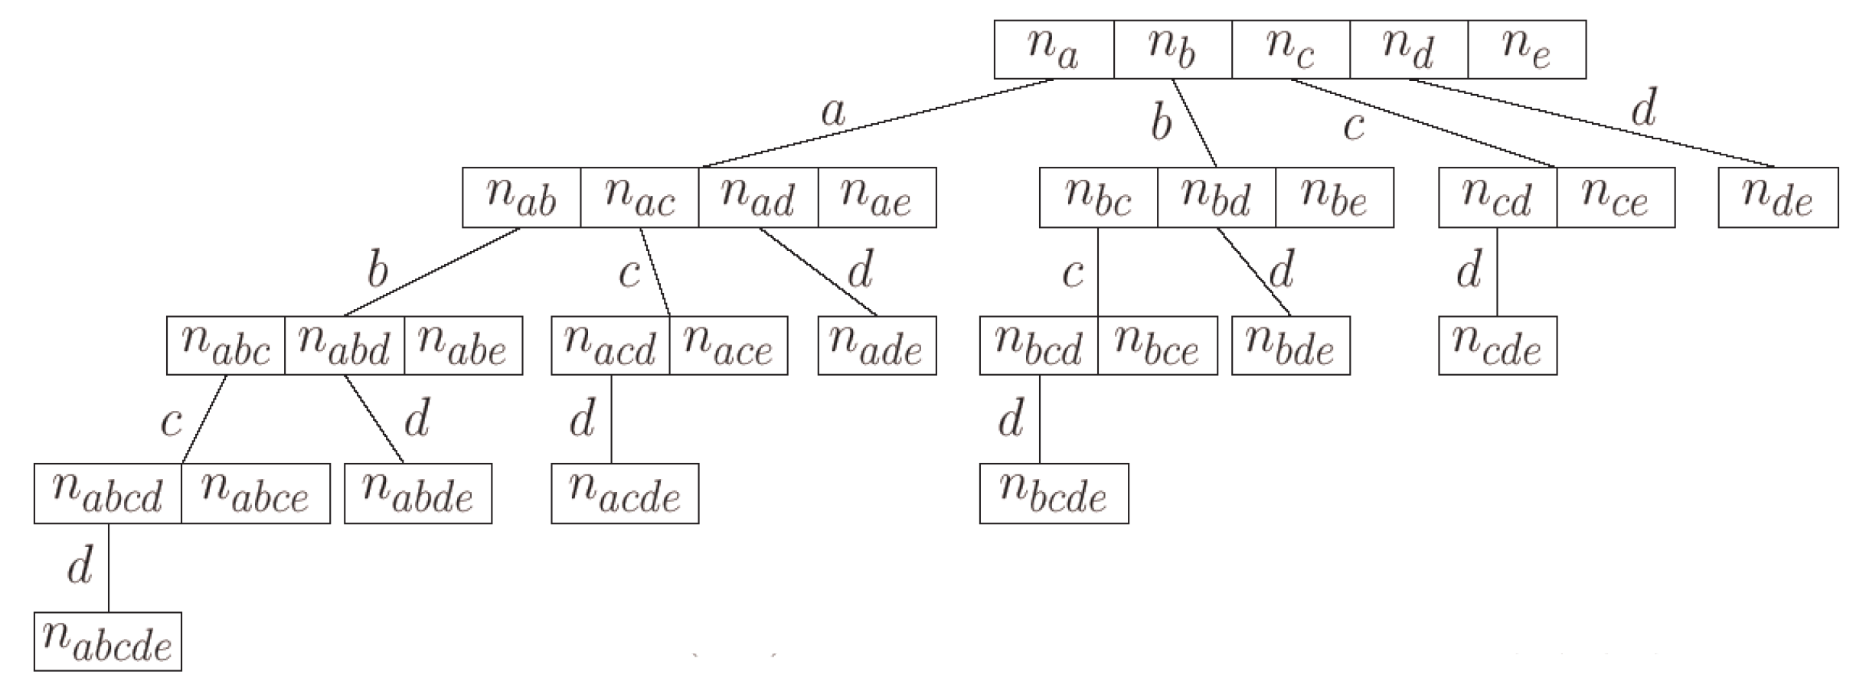
Item Set Trees
A (full) item set tree for the five items a, b, c, d, and e.
Based on a global order of the items.
The item sets counted in a node consist of all items labeling the edges to the node (common prefix) and one item following the last edge label.

Slide 17
Item Set Tree Pruning
In applications item set trees tend to get very large, so pruning is needed.
Structural Pruning:
Make sure that there is only one counter for each possible item set.
Explains the unbalanced structure of the full item set tree.
Size Based Pruning:
Prune the tree if a certain depth (a certain size of the item sets) is reached.
Idea: Rules with too many items are difficult to interpret.
Support Based Pruning:
No superset of an infrequent item set can be frequent.
No counters for item sets having an infrequent subset are needed

Slide 18
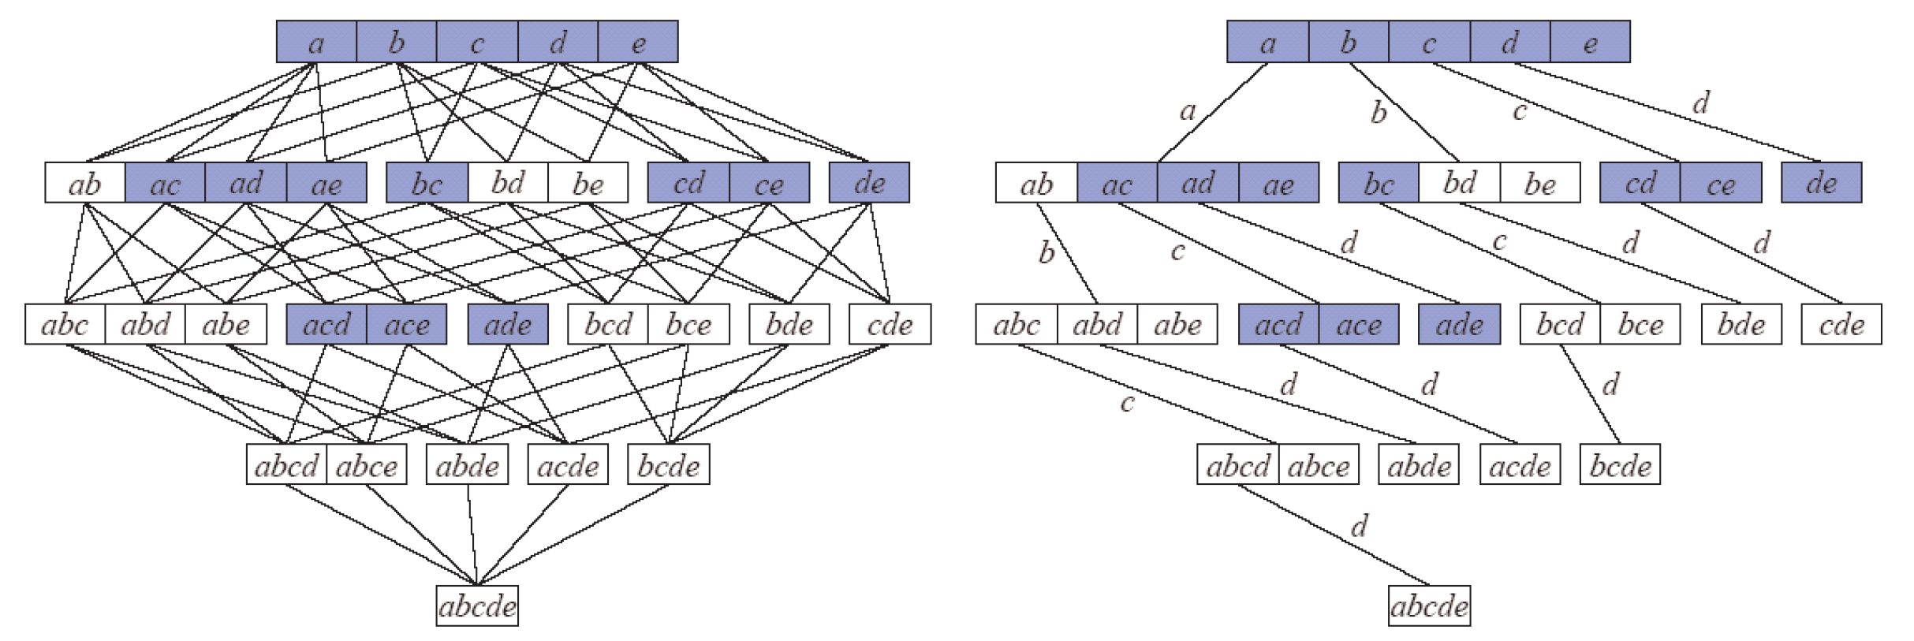
Searching the Subset Lattice
Boundary between frequent (blue) and infrequent (white) item sets:
Apriori: Breadth-first search (item sets of same size).
Eclat: Depth-first search (item sets with same prefix).

Slide 19
Apriori Breadth first Search
{a, d, e}
{b, c, d}
{a, c, e}
{a, c, d, e}
{a, e}
{a, c, d}
{b, c}
{a, c, d, e}
{c, b, e}
{a, d, e}
Example transaction database with 5 items { a,b,c,d,e } and 10 transactions.
Minimum support: 30%, i.e., at least 3 transactions must contain the item set.
All one item sets are frequent ➔ full second level is needed.
a: 7 | b: 3 | c: 7 | d: 6 | e: 7

Slide 20
Apriori Breadth first Search
{a, d, e}
{b, c, d}
{a, c, e}
{a, c, d, e}
{a, e}
{a, c, d}
{b, c}
{a, c, d, e}
{c, b, e}
{a, d, e}
Determining the support of item sets: For each item set traverse the database and count the transactions that contain it (highly inefficient).
Better: Traverse the tree for each transaction and find the item sets it contains (efficient: can be implemented as a simple double recursive procedure).
a: 7 | b: 3 | c: 7 | d: 6 | e: 7
a
d
c
b
b: 0 | c: 4 | d: 5 | e: 6
e: 4
c: 3 | d: 1 | e: 1
d: 4 | e: 4

Slide 21
Apriori Breadth first Search
{a, d, e}
{b, c, d}
{a, c, e}
{a, c, d, e}
{a, e}
{a, c, d}
{b, c}
{a, c, d, e}
{c, b, e}
{a, d, e}
Minimum support: 30%, i.e., at least 3 transactions must contain the item set.
Infrequent item sets: {a, b}, {b, d}, {b, e}.
The subtrees starting at these item sets can be pruned.
a: 7 | b: 3 | c: 7 | d: 6 | e: 7
a
d
c
b
b: 0 | c: 4 | d: 5 | e: 6
e: 4
c: 3 | d: 1 | e: 1
d: 4 | e: 4

Slide 22
Apriori Breadth first Search
{a, d, e}
{b, c, d}
{a, c, e}
{a, c, d, e}
{a, e}
{a, c, d}
{b, c}
{a, c, d, e}
{c, b, e}
{a, d, e}
Generate candidate item sets with 3 items (parents must be frequent).
a: 7 | b: 3 | c: 7 | d: 6 | e: 7
a
d
c
b
b: 0 | c: 4 | d: 5 | e: 6
e: 4
c
d
c: 3 | d: 1 | e: 1
d: 4 | e: 4
d: ? | e: ?
c
d
e: ?
d: ? | e: ?
e: ?

Slide 23
Apriori Breadth first Search
{a, d, e}
{b, c, d}
{a, c, e}
{a, c, d, e}
{a, e}
{a, c, d}
{b, c}
{a, c, d, e}
{c, b, e}
{a, d, e}
Before counting, check whether the candidates contain an infrequent item set.
An item set with k items has k subsets of size k − 1.
The parent is only one of these subsets
a: 7 | b: 3 | c: 7 | d: 6 | e: 7
a
d
c
b
b: 0 | c: 4 | d: 5 | e: 6
e: 4
c
d
c: 3 | d: 1 | e: 1
d: 4 | e: 4
d: ? | e: ?
c
d
e: ?
d: ? | e: ?
e: ?

Slide 24
Apriori Breadth first Search
{a, d, e}
{b, c, d}
{a, c, e}
{a, c, d, e}
{a, e}
{a, c, d}
{b, c}
{a, c, d, e}
{c, b, e}
{a, d, e}
The item sets {b, c, d} and {b, c, e} can be pruned, because
{b, c, d} contains the infrequent item set {b, d} and
{b, c, e} contains the infrequent item set {b, e}.
Only the remaining four item sets of size 3 are evaluated.
a: 7 | b: 3 | c: 7 | d: 6 | e: 7
a
d
c
b
b: 0 | c: 4 | d: 5 | e: 6
e: 4
c
d
c: 3 | d: 1 | e: 1
d: 4 | e: 4
d: ? | e: ?
c
d
e: ?
d: ? | e: ?
e: ?

Slide 25
Apriori Breadth first Search
{a, d, e}
{b, c, d}
{a, c, e}
{a, c, d, e}
{a, e}
{a, c, d}
{b, c}
{a, c, d, e}
{c, b, e}
{a, d, e}
Minimum support: 30%, i.e., at least 3 transactions must contain the item set.
Infrequent item set: {c, d, e}.
a: 7 | b: 3 | c: 7 | d: 6 | e: 7
a
d
c
b
b: 0 | c: 4 | d: 5 | e: 6
e: 4
c
d
c: 3 | d: 1 | e: 1
d: 4 | e: 4
d: ? | e: ?
c
d
e: ?
d: ? | e: ?
e: ?

Slide 26
Apriori Breadth first Search
{a, d, e}
{b, c, d}
{a, c, e}
{a, c, d, e}
{a, e}
{a, c, d}
{b, c}
{a, c, d, e}
{c, b, e}
{a, d, e}
Generate candidate item sets with 4 items (parents must be frequent).
Before counting, check whether the candidates contain an infrequent item set.
a: 7 | b: 3 | c: 7 | d: 6 | e: 7
a
d
c
b
b: 0 | c: 4 | d: 5 | e: 6
e: 4
c
d
c: 3 | d: 1 | e: 1
d: 4 | e: 4
d: ? | e: ?
c
d
d
e: ?
d: ? | e: ?
e: ?
e: ?

Slide 27
Apriori Breadth first Search
{a, d, e}
{b, c, d}
{a, c, e}
{a, c, d, e}
{a, e}
{a, c, d}
{b, c}
{a, c, d, e}
{c, b, e}
{a, d, e}
The item set {a,c,d,e} can be pruned, because it contains the infrequent item set {c, d, e}.
Consequence: No candidate item sets with four items. Stop.
a: 7 | b: 3 | c: 7 | d: 6 | e: 7
a
d
c
b
b: 0 | c: 4 | d: 5 | e: 6
e: 4
c
d
c: 3 | d: 1 | e: 1
d: 4 | e: 4
d: ? | e: ?
c
d
d
e: ?
d: ? | e: ?
e: ?
e: ?

Slide 28
Eclat Depth first Search
{a, d, e}
{b, c, d}
{a, c, e}
{a, c, d, e}
{a, e}
{a, c, d}
{b, c}
{a, c, d, e}
{c, b, e}
{a, d, e}
Form a transaction list for each item. Here: bit vector representation.
grey: item is contained in transaction
white: item is not contained in transaction
Transaction database is needed only once (for the single item transaction lists).
a: 7 | b: 3 | c: 7 | d: 6 | e: 7

Slide 29
Eclat Depth first Search
{a, d, e}
{b, c, d}
{a, c, e}
{a, c, d, e}
{a, e}
{a, c, d}
{b, c}
{a, c, d, e}
{c, b, e}
{a, d, e}
Intersect the transaction list for item a with the transaction lists of all other items.
Count the number of set bits (containing transactions).
The item set {a, b} is infrequent and can be pruned.
a: 7 | b: 3 | c: 7 | d: 6 | e: 7
a
b: 0 | c: 4 | d: 5 | e: 6

Slide 30

Eclat Depth first Search
{a, d, e}
{b, c, d}
{a, c, e}
{a, c, d, e}
{a, e}
{a, c, d}
{b, c}
{a, c, d, e}
{c, b, e}
{a, d, e}
Intersect the transaction list for {a, c} with the transaction lists of {a, x}, x $∈$ {d, e}.
Result: Transaction lists for the item sets {a, c, d} and {a, c, e}.
a: 7 | b: 3 | c: 7 | d: 6 | e: 7
a
b: 0 | c: 4 | d: 5 | e: 6
d: 3 | e: 3

Slide 31
Eclat Depth first Search
{a, d, e}
{b, c, d}
{a, c, e}
{a, c, d, e}
{a, e}
{a, c, d}
{b, c}
{a, c, d, e}
{c, b, e}
{a, d, e}
Intersect the transaction list for {a, c, d} and {a, c, e}.
Result: Transaction list for the item set {a, c, d, e}.
With Apriori this item set could be pruned before counting, because it was known that {c, d, e} is infrequent.
a: 7 | b: 3 | c: 7 | d: 6 | e: 7
a
b: 0 | c: 4 | d: 5 | e: 6
c
d: 3 | e: 3
d
e: 2

Slide 32
Eclat Depth first Search
{a, d, e}
{b, c, d}
{a, c, e}
{a, c, d, e}
{a, e}
{a, c, d}
{b, c}
{a, c, d, e}
{c, b, e}
{a, d, e}
Backtrack to the second level of the search tree and intersect the transaction list for {a, d} and {a, e}.
Result: Transaction list for {a, d, e}.
a: 7 | b: 3 | c: 7 | d: 6 | e: 7
a
b: 0 | c: 4 | d: 5 | e: 6
c
d
d: 3 | e: 3
e: 4
d
e: 2

Slide 33
Eclat Depth first Search
{a, d, e}
{b, c, d}
{a, c, e}
{a, c, d, e}
{a, e}
{a, c, d}
{b, c}
{a, c, d, e}
{c, b, e}
{a, d, e}
Backtrack to the first level of the search tree and intersect the transaction list for b with the transaction lists for c, d, and e.
Result: Transaction lists for the item sets {b, c}, {b, d}, and {b, e}.
Only one item set with sufficient support -> prune all subtrees.
a: 7 | b: 3 | c: 7 | d: 6 | e: 7
a
b
b: 0 | c: 4 | d: 5 | e: 6
c
d
c: 3 | d: 1 | e: 1
d: 3 | e: 3
e: 4
d
e: 2

Slide 34
Eclat Depth first Search
{a, d, e}
{b, c, d}
{a, c, e}
{a, c, d, e}
{a, e}
{a, c, d}
{b, c}
{a, c, d, e}
{c, b, e}
{a, d, e}
Backtrack to the first level of the search tree and intersect the transaction list for c with the transaction lists for d and e.
Result: Transaction lists for the item sets {c, d} and {c, e}.
a: 7 | b: 3 | c: 7 | d: 6 | e: 7
a
c
b
b: 0 | c: 4 | d: 5 | e: 6
c
d
c: 3 | d: 1 | e: 1
d: 4 | e: 4
d: 3 | e: 3
e: 4
d
e: 2

Slide 35
Eclat Depth first Search
{a, d, e}
{b, c, d}
{a, c, e}
{a, c, d, e}
{a, e}
{a, c, d}
{b, c}
{a, c, d, e}
{c, b, e}
{a, d, e}
Intersect the transaction list for {c, d} and {c, e}.
Result: Transaction list for {c, d, e}.
Infrequent item set: {c, d, e}.
a: 7 | b: 3 | c: 7 | d: 6 | e: 7
a
c
b
b: 0 | c: 4 | d: 5 | e: 6
c
d
c: 3 | d: 1 | e: 1
d: 4 | e: 4
d: 3 | e: 3
e: 4
d
d
e: 2
e: 2

Slide 36
Eclat Depth first Search
{a, d, e}
{b, c, d}
{a, c, e}
{a, c, d, e}
{a, e}
{a, c, d}
{b, c}
{a, c, d, e}
{c, b, e}
{a, d, e}
Backtrack to the first level of the search tree and intersect the transaction list for d with the transaction list for e.
Result: Transaction list for the item set {d, e}.
With this step the search is finished.
a: 7 | b: 3 | c: 7 | d: 6 | e: 7
a
c
b
d
b: 0 | c: 4 | d: 5 | e: 6
e: 4
c
d
c: 3 | d: 1 | e: 1
d: 4 | e: 4
d: 3 | e: 3
e: 4
d
d
e: 2
e: 2

Slide 37
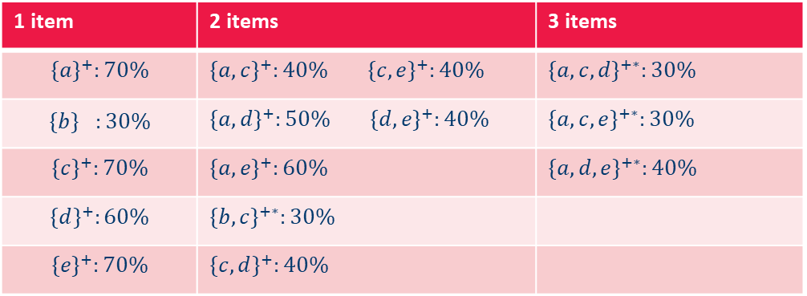
Frequent Item Sets
1 item | 2 items | 3 items
$${\{a\}}^{+}:70\%$$ | ${\{a,c\}}^{+}:40\%$ ${\{c,e\}}^{+}:40\%$ | ${\{a,c,d\}}^{+∗}:30\%$
$${\{b\}}^{}:30\%$$ | ${\{a,d\}}^{+}:50\%$ ${\{d,e\}}^{+}:40\%$ | ${\{a,c,e\}}^{+∗}:30\%$
$${\{c\}}^{+}:70\%$$ | ${\{a,e\}}^{+}:60\%$ | ${\{a,d, e\}}^{+∗}:40\%$
$${\{d\}}^{+}:60\%$$ | ${\{b,c\}}^{+∗}:30\%$
$${\{e\}}^{+}:70\%$$ | ${\{c,d\}}^{+}:40\%$
Types of frequent item sets
Free Item Set: Any frequent item set (support is higher than the minimal support).
Closed Item Set (marked with +): A frequent item set is called closed if no superset has the same support.
Maximal Item Set (marked with ): A frequent item set is called maximal if no superset is frequent.

Slide 38
Generating Association Rules

Slide 39
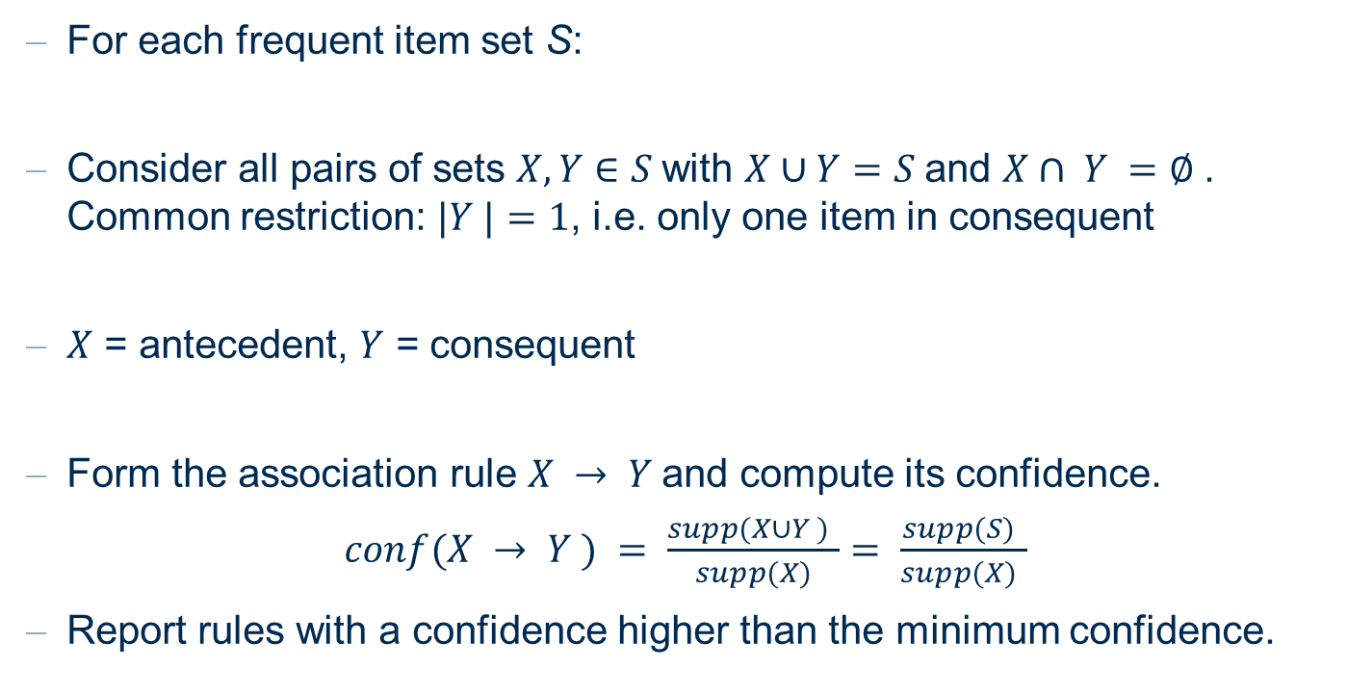
Generating Association Rules
For each frequent item set S:
Consider all pairs of sets $X, Y∈S$with $X∪Y=S$and $X∩ Y =∅$. Common restriction: $|Y |=1$, i.e. only one item in consequent
$X$ = antecedent, $Y$ = consequent
Form the association rule $X → Y$and compute its confidence.
$conf(X → Y ) = \frac{supp(X∪Y ) }{supp(X)}= \frac{supp(S) }{supp(X) }$
Report rules with a confidence higher than the minimum confidence.

Slide 40
From “Frequent Itemsets“ to “Rules“
{A, B, F} ➔ H
{A, B, H} ➔ F
{A, B, F, H}
{A, F, H} ➔ B
Which rules shall I choose?
{B, F, H} ➔ A

Slide 41
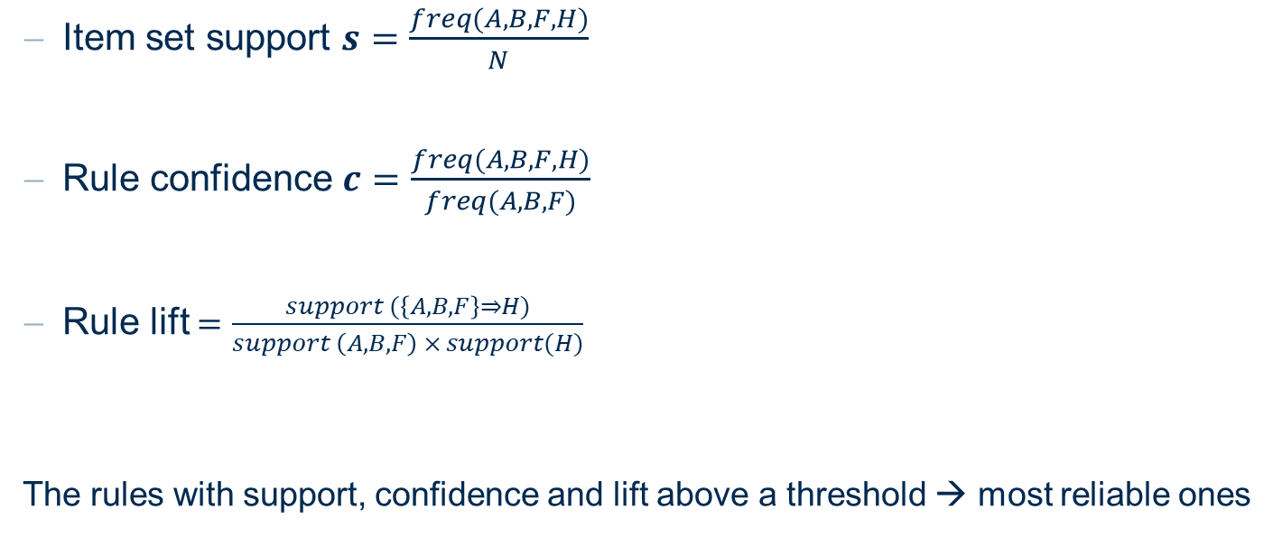
Support, Confidence, and Lift
{A, B, F} ➔ H
How often these items are found together
Item set support $s=\frac{freq(A,B,F,H)}{N}$
Rule confidence $c=\frac{freq(A,B,F,H)}{freq(A,B,F)}$
Rule lift $=\frac{support (\left\{A,B,F\right\}⇒H)}{support \left(A,B,F\right) × support(H)}$
The rules with support, confidence and lift above a threshold → most reliable ones
How often the antecedent
is together with the consequent
How often antecedent and consequent happen together compared with random chance

Slide 42
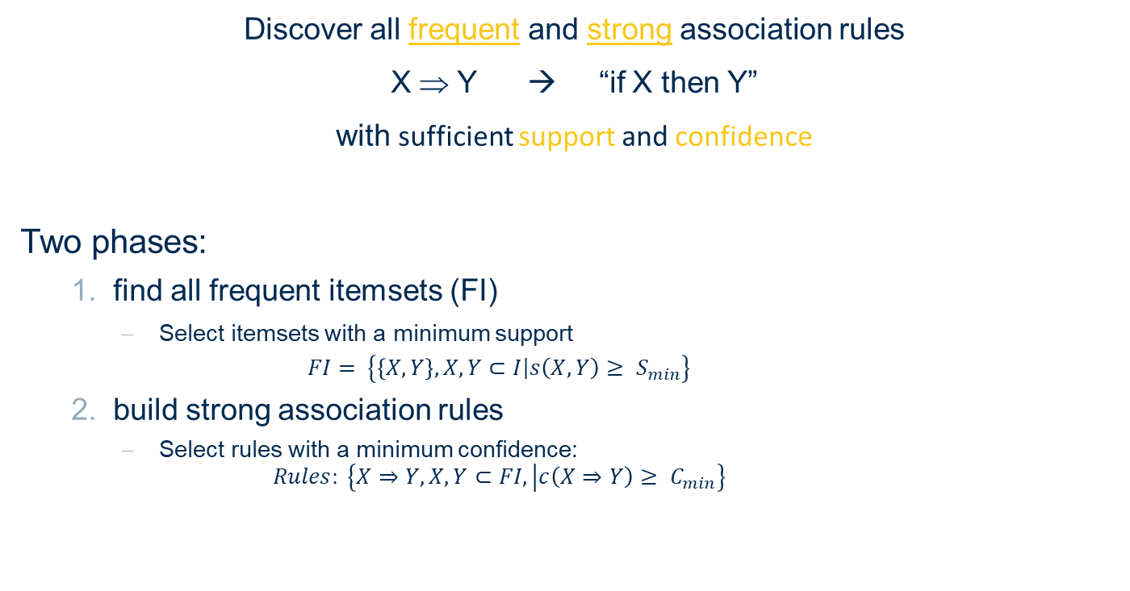
Association Rule Mining (ARM): Two Phases
Discover all frequent and strong association rules
X ⇒ Y → “if X then Y”
with sufficient support and confidence
Two phases:
find all frequent itemsets (FI)
Select itemsets with a minimum support
$$FI= \left\{\left\{X,Y\right\},X, Y⊂I\left|s\right.\left(X,Y\right)≥ S_{min}\right\}$$
build strong association rules
Select rules with a minimum confidence:
$$Rules: \left\{X⇒Y,X, Y⊂FI, \left|c\left(X⇒Y\right)≥ C_{min}\right.\right\}$$
← Most of the complexity
User parameters

Slide 43
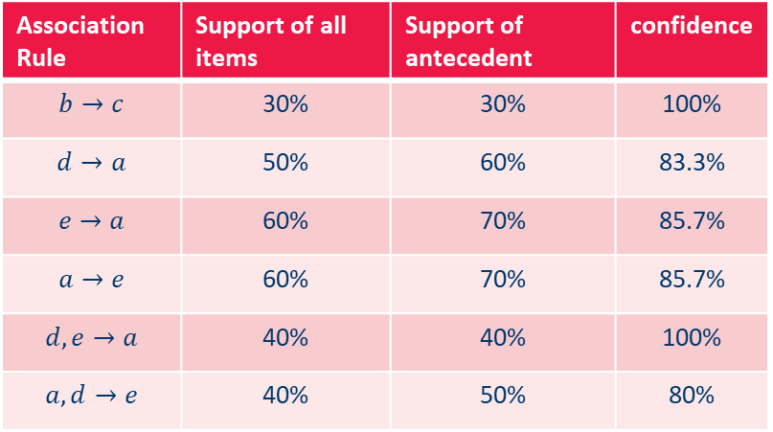

Generating Association Rules: Example
Example: $S = \left\{a, c, e\right\}, X = \left\{c, e\right\}, Y = \left\{a\right\}.$
$$conf(c, e → a) = \frac{supp(\{a, c, e\})}{supp(\{c, e\})}= \frac{30\%}{40\%}= 75\%$$
Minimum confidence: 80%
Association Rule | Support of all items | Support of antecedent | confidence
$$b→c$$ | 30% | 30% | 100%
$$d→a$$ | 50% | 60% | 83.3%
$$e→a$$ | 60% | 70% | 85.7%
$$a→e$$ | 60% | 70% | 85.7%
$$d,e→a$$ | 40% | 40% | 100%
$$a,d→e$$ | 40% | 50% | 80%

Slide 44


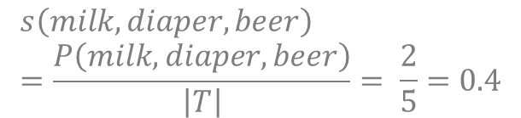
A-Priori Algorithm: Example
Let‘s consider milk, diaper, and beer: $\left\{milk, diaper\right\}⇒beer$
How often are they found together across all shopping baskets?
How often are they found together across all shopping baskets containing the antecedents?
support
TID | Transactions
1 | Bread, Milk
2 | Bread, Diaper, Beer, Eggs
3 | Milk, Diaper, Beer, Coke
4 | Bread, Milk, Diaper, Beer
5 | Bread, Milk, Diaper, Coke
$$s\left(milk, diaper, beer\right)=\frac{P\left(milk, diaper, beer\right)}{\left|T\right|}= \frac{2}{5}=0.4$$
$$c=\frac{P\left(milk, diaper, beer\right)}{P\left(milk, diaper\right)}= \frac{2}{3}=0.67$$
confidence

Slide 45
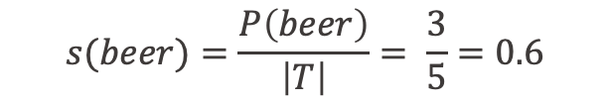

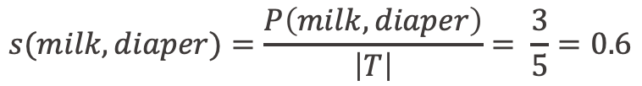
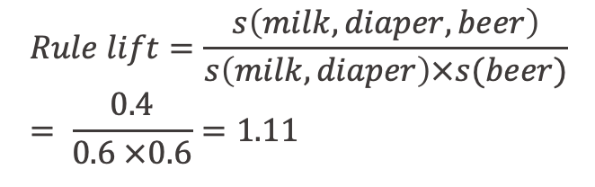
A-priori algorithm: an example
Let‘s consider milk, diaper, and beer: $\left\{milk, diaper\right\}⇒beer$
How often are they found together across all shooping baskets?
How often are they found together across all shopping baskets containing the antecedents?
$$s(milk, diaper)=\frac{P\left(milk, diaper\right)}{\left|T\right|}= \frac{3}{5}=0.6$$
TID | Transactions
1 | Bread, Milk
2 | Bread, Diaper, Beer, Eggs
3 | Milk, Diaper, Beer, Coke
4 | Bread, Milk, Diaper, Beer
5 | Bread, Milk, Diaper, Coke
$$s(beer)=\frac{P\left(beer\right)}{\left|T\right|}= \frac{3}{5}=0.6$$
$$Rule lift=\frac{s\left(milk, diaper, beer\right)}{s\left(milk, diaper\right)×s(beer)}= \frac{0.4}{0.6 ×0.6}=1.11$$

Slide 46
Summary Association Rules
Association Rule Induction is a Two Step Process
Find the frequent item sets (minimum support).
Form the relevant association rules (minimum confidence).
Finding the Frequent Item Sets
Top-down search in the subset lattice / item set tree.
Apriori: Breadth first search;
Eclat: Depth first search.
Other algorithms: FP-growth, H-Mine, LCM, Mafia, Relim etc.
Search Tree Pruning: No superset of an infrequent item set can be frequent.
Generating the Association Rules
Form all possible association rules from the frequent item sets.
Filter “interesting” association rules.

Slide 47
Collaborative Filtering

Slide 48
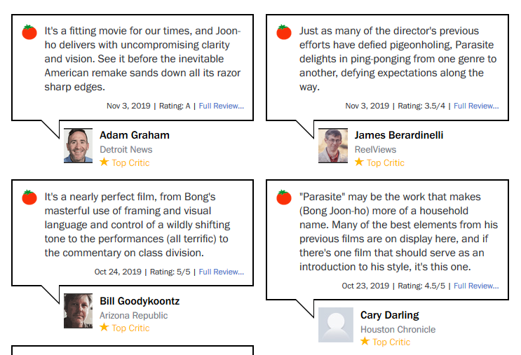

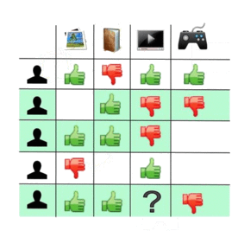
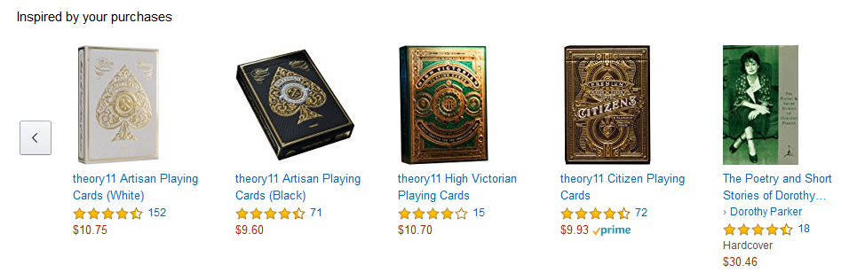
Recommendation Engines or Market Basket Analysis
From the analysis of the reactions
of many people to the same item ...
Recommendation
Collaborative Filtering
IF A has the same opinion as B on an item,
THEN A is more likely to have B's opinion on another item than that of a randomly chosen person

Slide 49

Collaborative Filtering (CF)
Collaborative filtering systems have many forms, but many common systems can be reduced to two steps:
Look for users who share the same rating patterns with the active user (the user whom the recommendation is for)
Use the ratings from those like-minded users found in step 1 to calculate a prediction for the active user
Implemented in Spark
https://www.knime.com/blog/movie-recommendations-with-spark-collaborative-filtering

Slide 50
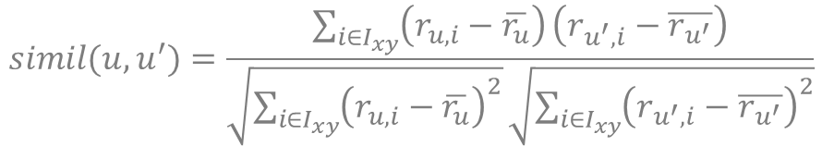

Collaborative Filtering: Memory based approach
User u to give recommendations to
U = set of top N users most similar to user u
Rating of user u on item i calculated as average of ratings of all similar users in U:
$r_{u,i}=\frac{1}{N}\sum_{u^{′}∈U}{{ r}_{u^{′}, i}}$ or weighted $r_{u,i}=\frac{1}{N}\sum_{u^{′}∈U}{{ simil\left(u,u^{′}\right) r}_{u^{′}, i}}$
Pearson correlation
$$simil(u,u^{′})=\frac{\sum_{i∈I_{xy}}{\left(r_{u,i}−\overline{r_{u}}\right)}\left(r_{u^{′},i}−\overline{r_{u^{′}}}\right)}{\sqrt{\sum_{i∈I_{xy}}{{\left(r_{u,i}−\overline{r_{u}}\right)}^{2}}}\sqrt{\sum_{i∈I_{xy}}{{\left(r_{u^{′},i}−\overline{r_{u^{′}}}\right)}^{2}}}}$$
Set of items rated by both user x and y

Slide 51
Practical Examples with KNIME Analytics Platform

Slide 52
KNIME Workflow

Slide 53
Thank you

