Slide 1
Bayes Classifiers: Exercise

Slide 2
Exercise 1 Bayes Theorem

Slide 3
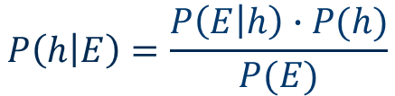
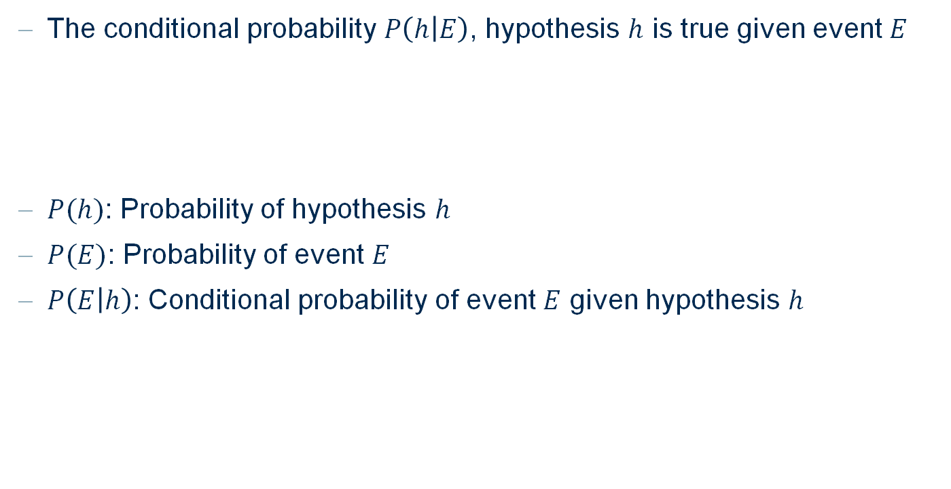
Bayes Theorem
The conditional probability $P\left(h | E\right)$, hypothesis $h$ is true given event $E$
$P(h)$: Probability of hypothesis $h$
$P(E)$: Probability of event $E$
$P\left(E | h\right)$: Conditional probability of event $E$ given hypothesis $h$
$$P\left(h | E\right)=\frac{P\left(E | h\right)∙P(h)}{P(E)}$$

Slide 4
Bayes Theorem
Answer the following questions and give an explanation of your answers.
2.6% of the total population is color-blind. On average, 5 out of 100 men and 25 out of 10000 women are color-blind. We assume that the number of men and women in the total population is equivalent. Now we choose a color-blind person from the population, what is the probability that this person is a man?
In a company, machine M1 produces 20% of the total production, machine M2 produces 30% and machine M3 produces 50%. On average, 2% of the production of M1, 4% of M2 and 7% of M3 is defective. We take out one defective part of the production, what is the probability that it has been produced by M1/M2/M3?
Your mailbox contains 100 unread emails. 80% of these mails are spam, 20% are non-spam. 25% of spam emails and 50% of non-spam emails contain the word ’urgent’. You open a random email and it contains the word ’urgent’. What is the probability that this is a spam email? What is the probability that this is not a spam email?

Slide 5
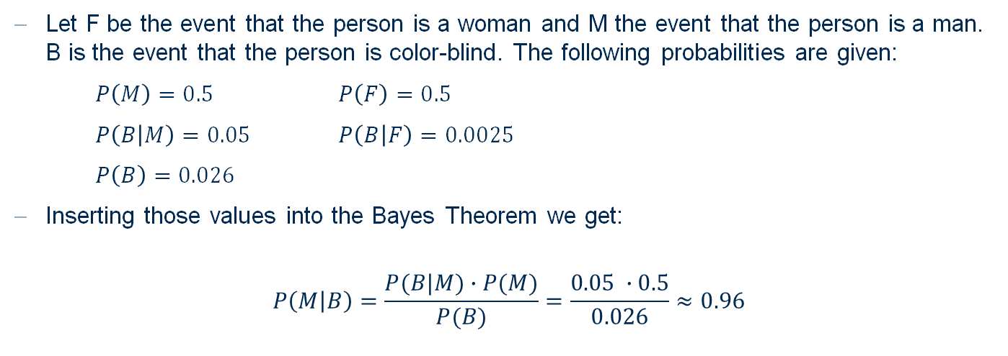
Bayes Theorem
2.6% of the total population is color-blind. On average, 5 out of 100 men and 25 out of 10000 women are color-blind. We assume that the number of men and women in the total population is equivalent. Now we choose a color-blind person from the population, what is the probability that this person is a man?
Let F be the event that the person is a woman and M the event that the person is a man. B is the event that the person is color-blind. The following probabilities are given:
$P\left(M\right)=0.5$ $P\left(F\right)=0.5$
$P\left(B | M\right)=0.05$ $P\left(B | F\right)=0.0025$
$P\left(B\right)=0.026$
Inserting those values into the Bayes Theorem we get:
$$P\left(M | B\right)=\frac{P(B|M)∙P(M)}{P(B)}=\frac{0.05 ∙0.5}{0.026}≈0.96$$

Slide 6
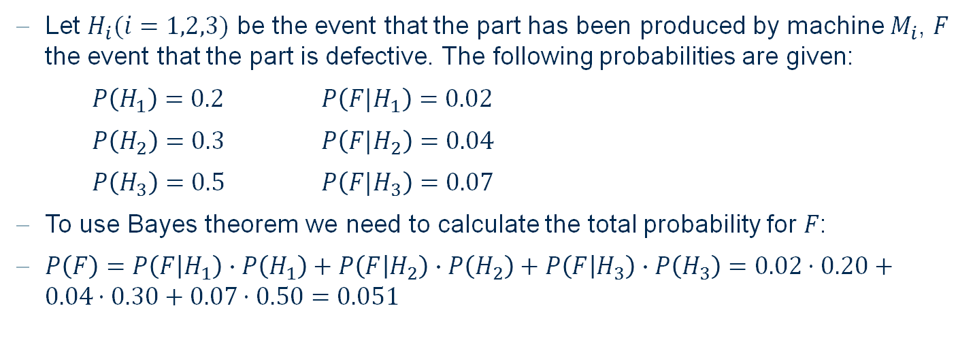
Bayes Theorem
In a company, machine M1 produces 20% of the total production, machine M2 produces 30% and machine M3 produces 50%. On average, 2% of the production of M1, 4% of M2 and 7% of M3 is defective. We take out one defective part of the production, what is the probability that it has been produced by M1/M2/M3?
Let $H_{i}(i=1,2,3)$ be the event that the part has been produced by machine $M_{i}$, $F$ the event that the part is defective. The following probabilities are given:
$P\left(H_{1}\right)=0.2$ $P\left({F|H}_{1}\right)=0.02$
$P\left(H_{2}\right)=0.3$ $P\left({F|H}_{2}\right)=0.04$
$P\left(H_{3}\right)=0.5$ $P\left({F|H}_{3}\right)=0.07$
To use Bayes theorem we need to calculate the total probability for $F$:
$P\left(F\right)=P\left(F | H_{1}\right)∙P\left(H_{1}\right)+P\left(F | H_{2}\right)∙P\left(H_{2}\right)+P\left(F | H_{3}\right)∙P\left(H_{3}\right)=0.02⋅0.20+0.04⋅0.30+0.07⋅0.50=0.051$

Slide 7
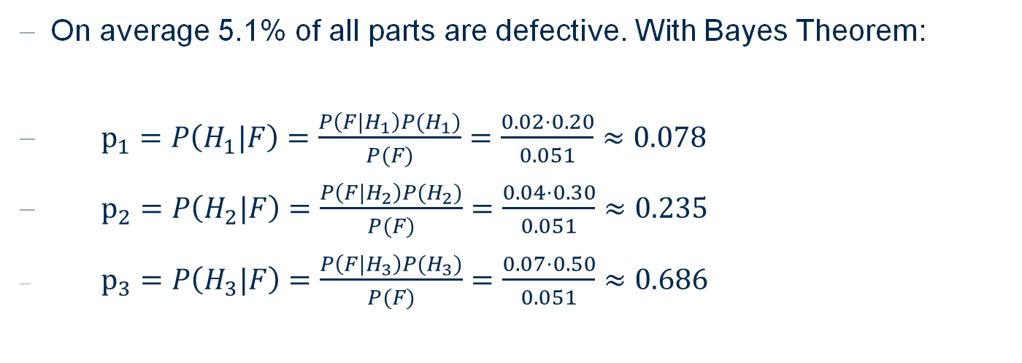
Bayes Theorem
In a company, machine M1 produces 20% of the total production, machine M2 produces 30% and machine M3 produces 50%. On average, 2% of the production of M1, 4% of M2 and 7% of M3 is defective. We take out one defective part of the production, what is the probability that it has been produced by M1/M2/M3?
On average 5.1% of all parts are defective. With Bayes Theorem:
$p_{1}=P\left(H_{1}|F\right)=\frac{P\left({F|H}_{1}\right)P(H_{1})}{P(F)}=\frac{0.02⋅0.20}{0.051}≈0.078$
$p_{2}=P\left(H_{2}|F\right)=\frac{P\left({F|H}_{2}\right)P(H_{2})}{P(F)}=\frac{0.04⋅0.30}{0.051}≈0.235$
$p_{3}=P\left(H_{3}|F\right)=\frac{P\left({F|H}_{3}\right)P(H_{3})}{P(F)}=\frac{0.07⋅0.50}{0.051}≈0.686$

Slide 8
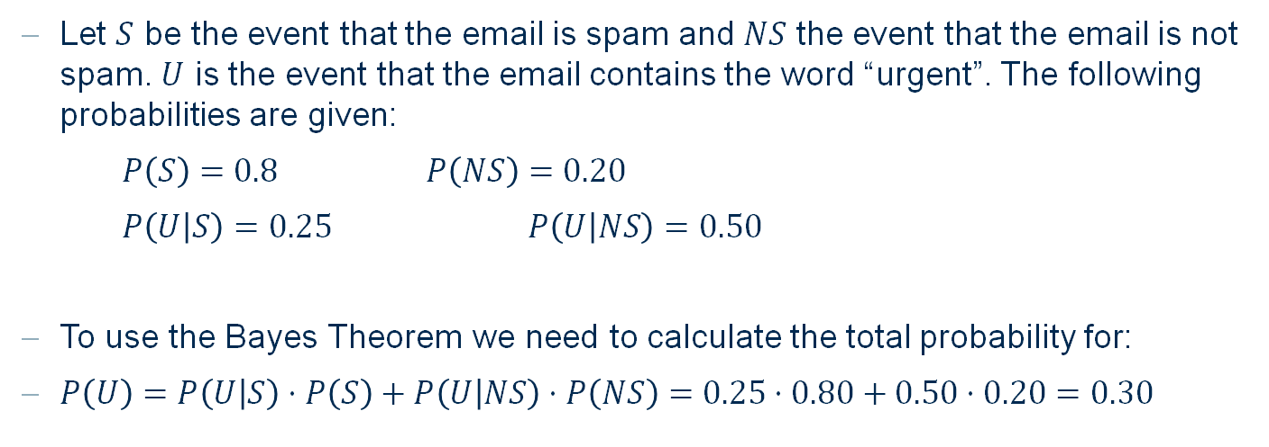
Bayes Theorem
Your mailbox contains 100 unread emails. 80% of these mails are spam, 20% are non-spam. 25% of spam emails and 50% of non-spam emails contain the word ’urgent’. You open a random email and it contains the word ’urgent’. What is the probability that this is a spam email? What is the probability that this is not spam?
Let $S$ be the event that the email is spam and $NS$ the event that the email is not spam. $U$ is the event that the email contains the word “urgent”. The following probabilities are given:
$P\left(S\right)=0.8$ $P\left(NS\right)=0.20$
$P\left(U | S\right)=0.25$ $P\left(U | NS\right)=0.50$
To use the Bayes Theorem we need to calculate the total probability for:
$P\left(U\right)=P\left(U | S\right)⋅P\left(S\right)+P\left(U | NS\right)⋅P\left(NS\right)=0.25⋅0.80+0.50⋅0.20=0.30$

Slide 9

Bayes Theorem
Your mailbox contains 100 unread emails. 80% of these mails are spam, 20% are non-spam. 25% of spam emails and 50% of non-spam emails contain the word ’urgent’. You open a random email and it contains the word ’urgent’. What is the probability that this is a spam email? What is the probability that this is not spam?
With Bayes Theorem:
$$P\left(S | U\right)=\frac{P\left(U|S\right)⋅P(S)}{P(U)}=\frac{0.25⋅0.8}{0.3}= \frac{2}{3}$$

Slide 10
Exercise 2 Naïve Bayes

Slide 11
Naïve Bayes
age | spec-prescrib | astigmatism | tear-prod-rate | contact lenses
young | myope | no | reduced | none
young | myope | no | normal | soft
young | myope | yes | reduced | none
young | myope | yes | normal | hard
young | hypermetrope | no | reduced | none
young | hypermetrope | no | normal | soft
young | hypermetrope | yes | normal | hard
pre-presbyopic | myope | no | reduced | none
pre-presbyopic | myope | yes | normal | hard
pre-presbyopic | hypermetrope | no | reduced | none
pre-presbyopic | hypermetrope | no | normal | soft
pre-presbyopic | hypermetrope | yes | reduced | none
pre-presbyopic | hypermetrope | yes | normal | none
presbyopic | myope | no | reduced | none
presbyopic | myope | no | normal | none
presbyopic | myope | yes | reduced | none
presbyopic | myope | yes | normal | hard
presbyopic | hypermetrope | no | reduced | none
presbyopic | hypermetrope | no | normal | soft
presbyopic | hypermetrope | yes | reduced | none
presbyopic | hypermetrope | yes | normal | none
The following database for fitting contact lenses is given. Based on the attributes age, spectacle prescription, astigmatism and tear production rate the task is to predict whether a patient should be fitted with hard contact lenses, soft contact lenses or not be fitted with contact lenses at all.

Slide 12
Naïve Bayes
Compute all probabilities that are necessary to predict the following instances with a Naïve Bayes classifier and classify them
age | spec-prescrib | astigmatism | tear-prod-rate
young | hypermetrope | yes | reduced
pre-presbyopic | myope | no | normal
pre-presbyopic | myope | yes | reduced

Slide 13
Naïve Bayes
The conditional probability tables for all attributes:
Class | hard | none | soft
Count | 4 | 13 | 4
Class/age | pre-presbyopic | presbyopic | young
hard | 1 | 1 | 2
none | 4 | 6 | 3
soft | 1 | 1 | 2
Class/astig. | no | yes
hard | 0 | 4
none | 7 | 6
soft | 4 | 0
Class/tear-prod-rate | normal | reduced
hard | 4 | 0
none | 3 | 10
soft | 4 | 0
Class/spec-prescrip | hypermetrope | myope
hard | 3 | 1
none | 7 | 6
soft | 3 | 1

Slide 14
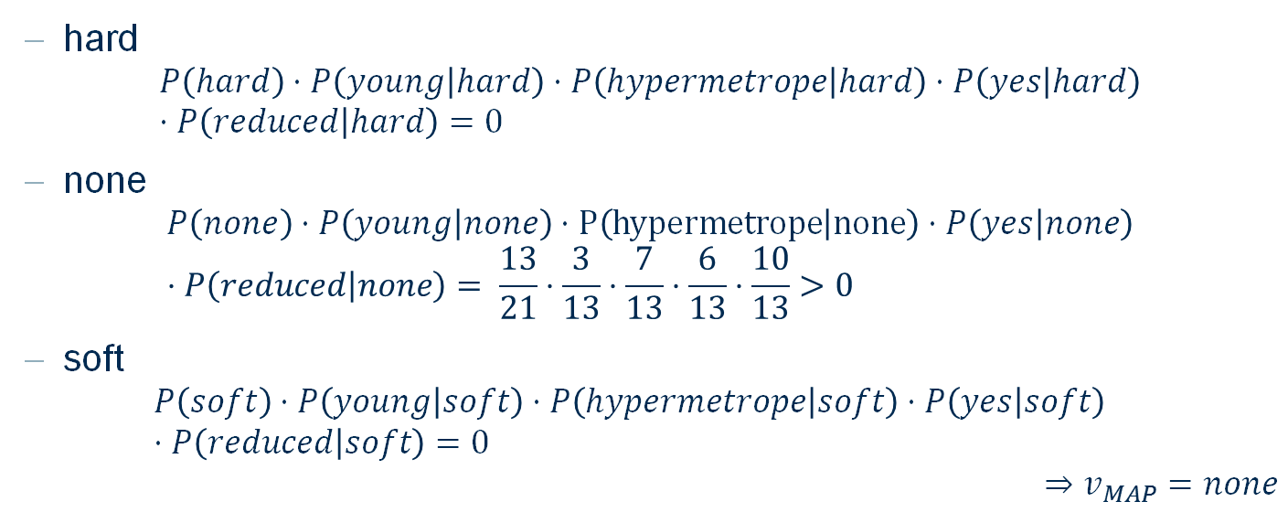
Naïve Bayes
age | spec-prescrib | astigmatism | tear-prod-rate
young | hypermetrope | yes | reduced
hard
$$P\left(hard\right)⋅P\left(young | hard\right)⋅P\left(hypermetrope | hard\right)⋅P\left(yes | hard\right)⋅P\left(reduced | hard\right)=0$$
none
$$P\left(none\right)⋅P\left(young | none\right)⋅P\left(hypermetrope | none\right)⋅P\left(yes | none\right)⋅P\left(reduced | none\right)= \frac{13}{21}⋅\frac{3}{13}⋅\frac{7}{13}⋅\frac{6}{13}⋅\frac{10}{13}>0$$
soft
$$P\left(soft\right)⋅P\left(young | soft\right)⋅P\left(hypermetrope | soft\right)⋅P\left(yes | soft\right) ⋅P\left(reduced | soft\right)=0$$
$$⇒v_{MAP}=none$$

Slide 15
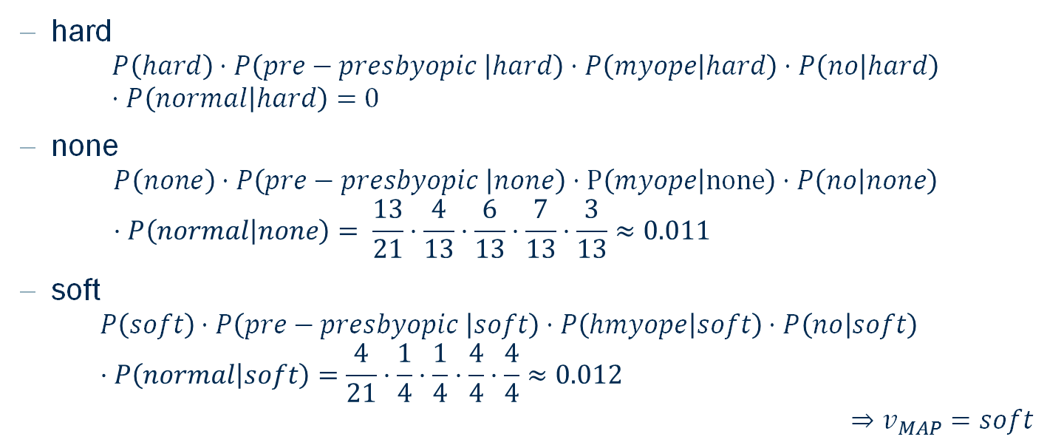
Naïve Bayes
age | spec-prescrib | astigmatism | tear-prod-rate
pre-presbyopic | myope | no | normal
hard
$$P\left(hard\right)⋅P\left(pre−presbyopic | hard\right)⋅P\left(myope | hard\right)⋅P\left(no | hard\right)⋅P\left(normal | hard\right)=0$$
none
$$P\left(none\right)⋅P\left(pre−presbyopic | none\right)⋅P\left(myope | none\right)⋅P\left(no | none\right)⋅P\left(normal | none\right)= \frac{13}{21}⋅\frac{4}{13}⋅\frac{6}{13}⋅\frac{7}{13}⋅\frac{3}{13}≈0.011$$
soft
$$P\left(soft\right)⋅P\left(pre−presbyopic | soft\right)⋅P\left(hmyope | soft\right)⋅P\left(no | soft\right) ⋅P\left(normal | soft\right)=\frac{4}{21}⋅\frac{1}{4}⋅\frac{1}{4}⋅\frac{4}{4}⋅\frac{4}{4}≈0.012$$
$$⇒v_{MAP}=soft$$

Slide 16
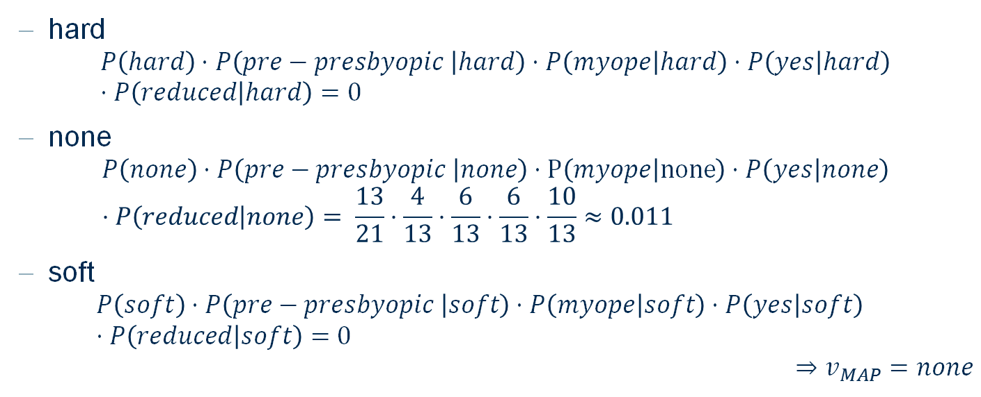
Naïve Bayes
age | spec-prescrib | astigmatism | tear-prod-rate
pre-presbyopic | myope | yes | reduced
hard
$$P\left(hard\right)⋅P\left(pre−presbyopic | hard\right)⋅P\left(myope | hard\right)⋅P\left(yes | hard\right)⋅P\left(reduced | hard\right)=0$$
none
$$P\left(none\right)⋅P\left(pre−presbyopic | none\right)⋅P\left(myope | none\right)⋅P\left(yes | none\right)⋅P\left(reduced | none\right)= \frac{13}{21}⋅\frac{4}{13}⋅\frac{6}{13}⋅\frac{6}{13}⋅\frac{10}{13}≈0.011$$
soft
$$P\left(soft\right)⋅P\left(pre−presbyopic | soft\right)⋅P\left(myope | soft\right)⋅P\left(yes | soft\right) ⋅P\left(reduced | soft\right)=0$$
$$⇒v_{MAP}=none$$

Slide 17
Thank you

