Slide 1
Regressions: Exercise

Slide 2
Exercise 1 Linear Regression

Slide 3
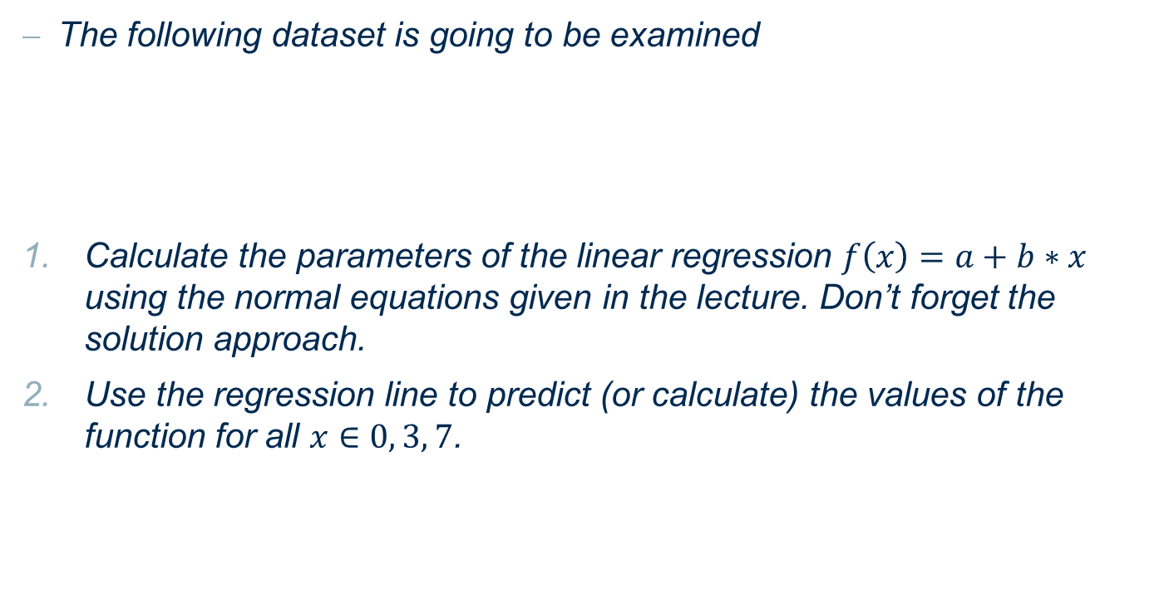
Linear Regression
The following dataset is going to be examined
Calculate the parameters of the linear regression $f\left(x\right)=a+b∗x$ using the normal equations given in the lecture. Don’t forget the solution approach.
Use the regression line to predict (or calculate) the values of the function for all $x∈0, 3, 7$.
x | 1 | 2 | 6 | 4 | 5
y | 1 | 2 | 4 | 3 | 3

Slide 4
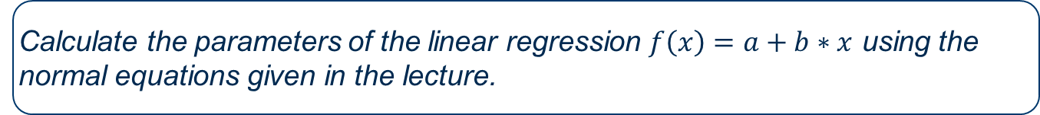
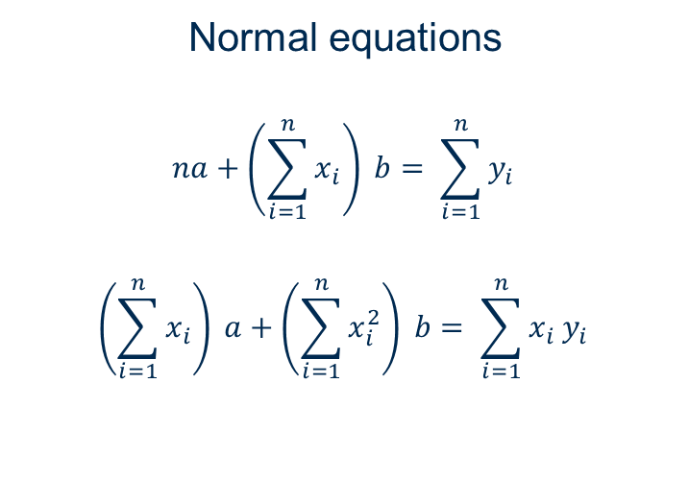
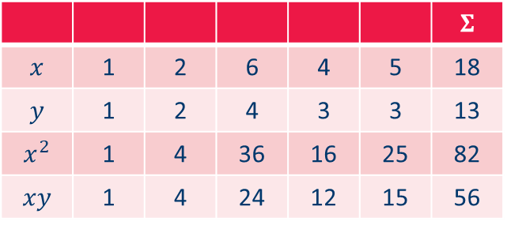
1. Parameter Estimation
Calculate the parameters of the linear regression $f\left(x\right)=a+b∗x$ using the normal equations given in the lecture.
Data
Normal equations
$$na+\left(\sum_{i=1}^{n}{x_{i}}\right) b= \sum_{i=1}^{n}{y_{i}}$$
$$\left(\sum_{i=1}^{n}{x_{i}}\right) a+\left(\sum_{i=1}^{n}{x_{i}^{2}}\right) b= \sum_{i=1}^{n}{x_{i} y_{i}}$$
 |  |  |  |  |  | $$Σ$$
$$x$$ | 1 | 2 | 6 | 4 | 5 | 18
$$y$$ | 1 | 2 | 4 | 3 | 3 | 13
$$x^{2}$$ | 1 | 4 | 36 | 16 | 25 | 82
$$xy$$ | 1 | 4 | 24 | 12 | 15 | 56

Slide 5








1. Parameter Estimation
Calculate the parameters of the linear regression $f\left(x\right)=a+b∗x$ using the normal equations given in the lecture.
$$a=\frac{56−82b}{18}$$
$$5a+18b=13$$
$$18a+82b=56$$
$$18a+82b=56$$
$$5\frac{56}{18}−5\frac{82b}{18}+18b=13$$
$$\frac{(324−410)b}{18}=\frac{234−280}{18}$$
$$b=\frac{46}{86}=0.5349$$
$$86b=46$$

Slide 6


1. Parameter Estimation
Calculate the parameters of the linear regression $f\left(x\right)=a+b∗x$ using the normal equations given in the lecture.
$$a=\frac{56−82b}{18}$$
$$a=\frac{56}{18}−\frac{82}{18}\frac{23}{43}=\frac{2408−1886}{774}=\frac{522}{774}=\frac{29}{43}=0.6744$$
Regression line
$$y=\frac{29}{43}+\frac{23}{43}x=0.6744+0.5349x$$

Slide 7
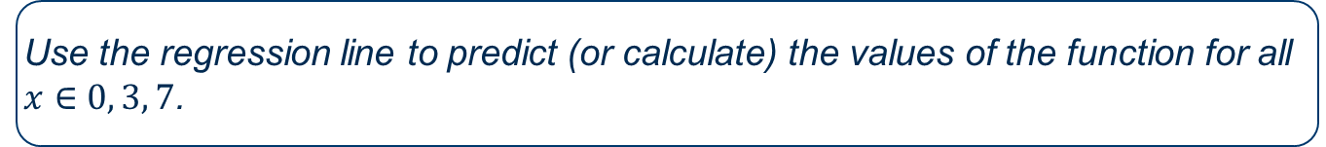

2. Prediction
Use the regression line to predict (or calculate) the values of the function for all $x∈0, 3, 7$.
Prediction at $x=0, 3,$and $7$
$$y=0.6744+0.5349∙0=0.6744$$
$$y=0.6744+0.5349∙3=2.2791$$
$$y=0.6744+0.5349∙7=4.4186$$

Slide 8
Exercise 2 Practice with KNIME

Slide 9
1. Linear Regression
Predict the price of an house in Ames (Iowa, USA) given a number of features (size, neighborhood, heating...) using Linear Regression.
Read dataset AmesHousing_simple.csv. It contains information about houses sold in Ames (only numerical values) as well as the SalePrice.
Add Partitioning node to File Reader output
Top port should have 70 % of the rows
Draw randomly such rows
Add Linear Regression Learner to top output port of Partitioning node
Select price column to be learned
Execute the node and open its scatter plot view. Which column is most correlated to the price (column selection tab)?
Add Regression Predictor
Predict test set (remaining 30% rows) by simply connecting the remaining unconnected output ports
Remove rows with missing prediction
Add Numeric Scorer to Regression Predictor Output
Reference Column: the column you learned
Predicted Column: the new column created by the predictor node

Slide 10
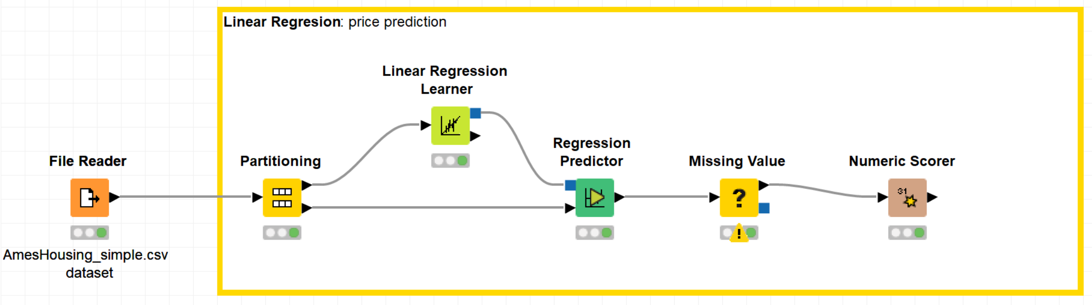
1. Linear Regression
Predict the price of an house in Ames (Iowa, USA) given a number of features (size, neighborhood, heating...) using Linear Regression.

Slide 11
2. Logistic Regression
Train a Logistic Regression model that predicts whether a wine is red or white.
Read data wine.csv (Hint: drag and drop)
Use the Normalizer (PMML) node to z normalize all numerical columns
Partition the dataset into a training set (80%) and a test set (20%).
Apply stratified sampling on the color column.
Train a logistic regression model on the training set, and apply the model to the test set
Use the Scorer node to evaluate the accuracy of the model

Slide 12
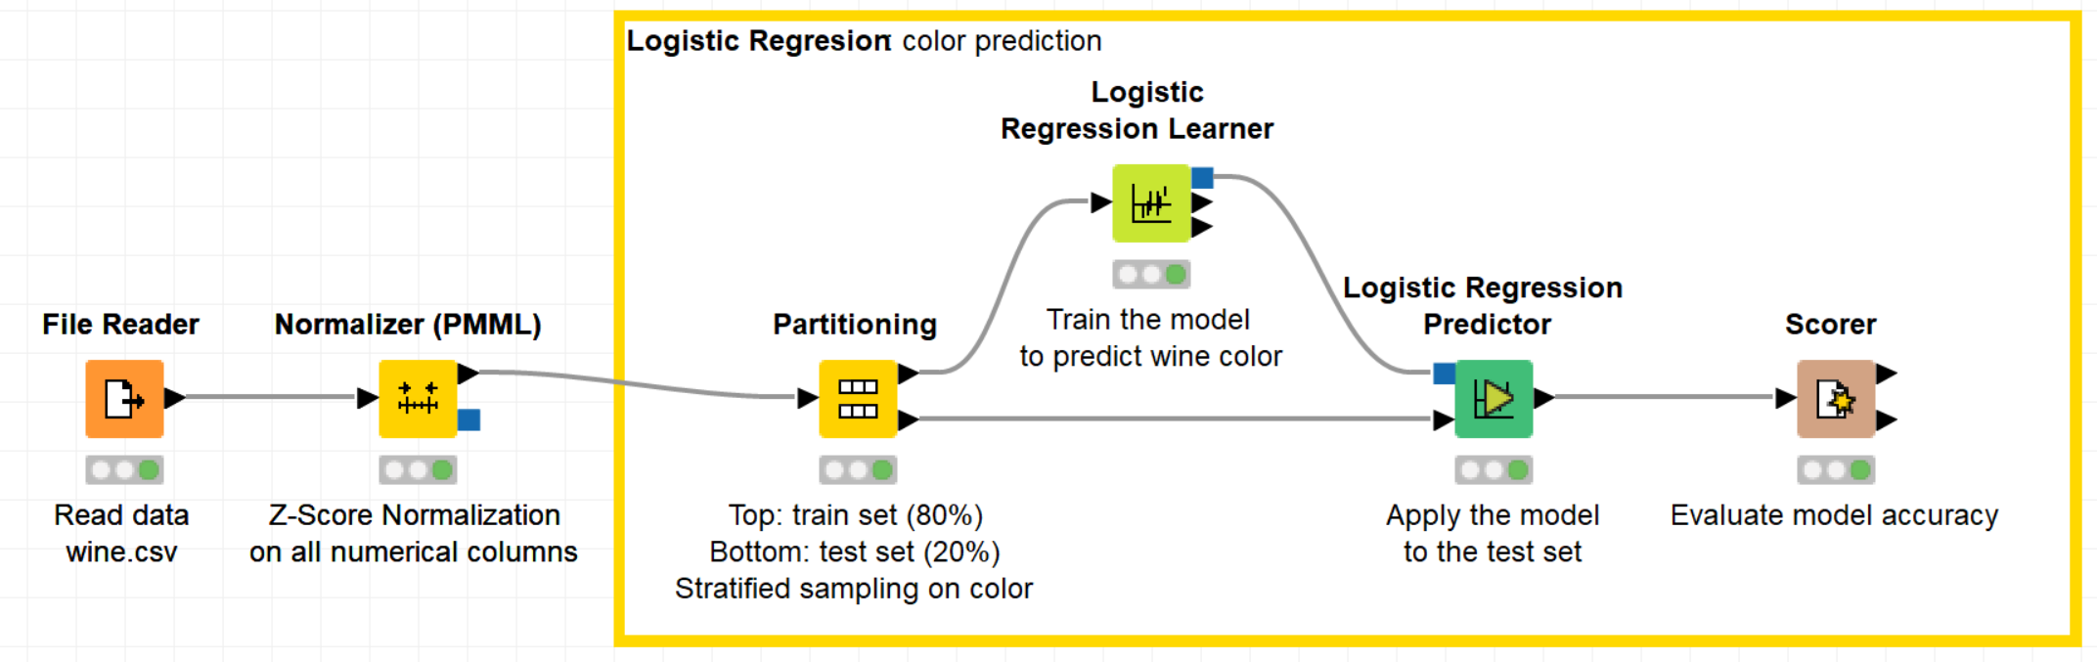
2. Logistic Regression
Train a Logistic Regression model that predicts whether a wine is red or white.

Slide 13
Thank you

