Slide 1
Ensemble Methods: Exercise

Slide 2
Exercise 1

Slide 3
Random Forests
Breiman first invented the theory of Bagging before he refined his idea to Random Forests. Describe the two main differences between Random Forests and Bagging using Decision Trees as Models
Only binary trees are built
Only m out of p attributes are used to select the best split

Slide 4
Exercise 2 AdaBoost

Slide 5
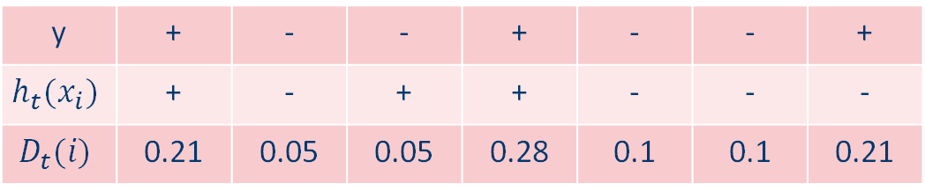

AdaBoost
Assume that we are trying to predict a binary outcome $y=y_{1}, y_{2}, …, y_{n}$. Each $C_{i}$ can take a value +1 or -1, denoted by “+” and “-“, respectively. An AdaBoost method has been applied to this data, and have been trained to step t. The predicted outcomes $h_{t}(x_{i})$, associated with input features $x_{i}$xi, are also listed below, as well as the corresponding weights$D_{t}(i)$.
y | + | - | - | + | - | - | +
$$h_{t}(x_{i})$$ | + | - | + | + | - | - | -
$$D_{t}(i)$$ | 0.21 | 0.05 | 0.05 | 0.28 | 0.1 | 0.1 | 0.21

Slide 6
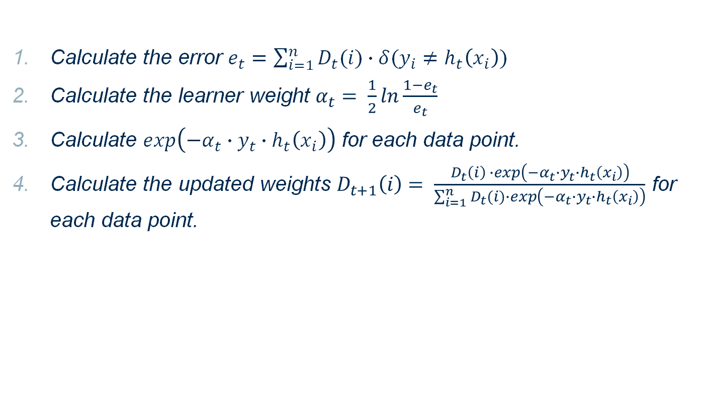
AdaBoost
Calculate the error $e_{t}=\sum_{i=1}^{n}{D_{t}(i)∙δ(y_{i}≠h_{t}\left(x_{i}\right))}$
Calculate the learner weight $α_{t}= \frac{1}{2}\ln{\frac{1−e_{t}}{e_{t}}}$
Calculate $\exp\left(−α_{t}∙y_{t}∙h_{t}\left(x_{i}\right)\right)$ for each data point.
Calculate the updated weights $D_{t+1}\left(i\right)= \frac{D_{t}\left(i\right) ∙\exp\left(−α_{t}∙y_{t}∙h_{t}\left(x_{i}\right)\right)}{\sum_{i=1}^{n}{D_{t}(i)∙\exp\left(−α_{t}∙y_{t}∙h_{t}\left(x_{i}\right)\right)}}$ for each data point.

Slide 7
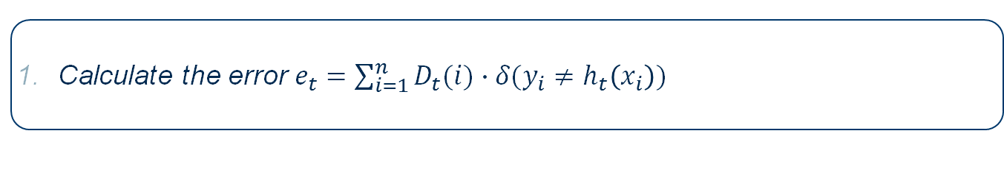
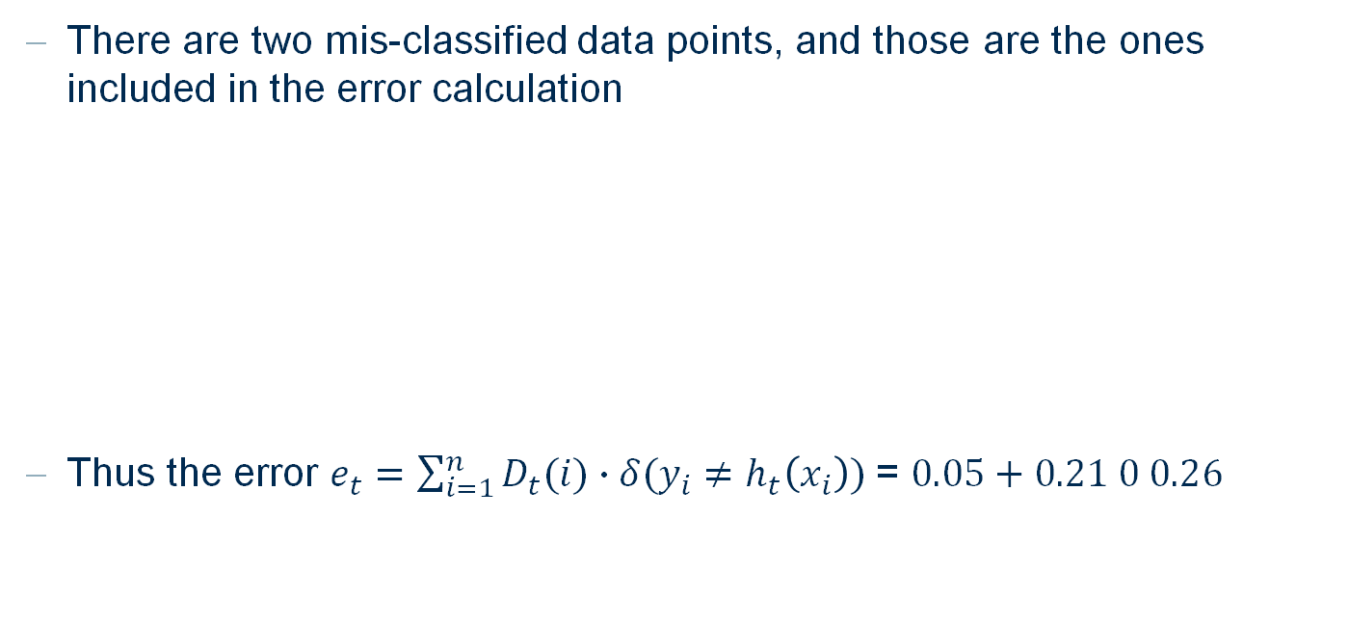
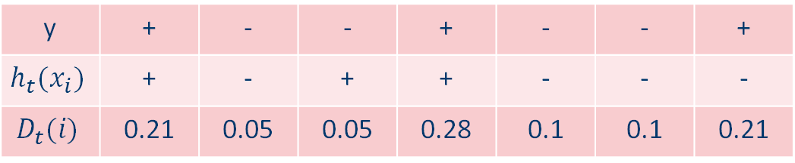
AdaBoost
Calculate the error $e_{t}=\sum_{i=1}^{n}{D_{t}(i)∙δ(y_{i}≠h_{t}\left(x_{i}\right))}$
There are two mis-classified data points, and those are the ones included in the error calculation
Thus the error $e_{t}=\sum_{i=1}^{n}{D_{t}(i)∙δ(y_{i}≠h_{t}\left(x_{i}\right))}$ = $0.05+0.21 0 0.26$
y | + | - | - | + | - | - | +
$$h_{t}(x_{i})$$ | + | - | + | + | - | - | -
$$D_{t}(i)$$ | 0.21 | 0.05 | 0.05 | 0.28 | 0.1 | 0.1 | 0.21

Slide 8
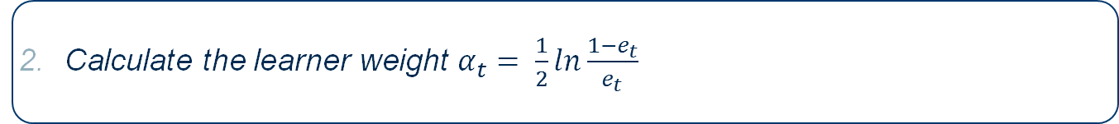

AdaBoost
Calculate the learner weight $α_{t}= \frac{1}{2}\ln{\frac{1−e_{t}}{e_{t}}}$
Based on the solution for the previous problem,
$$α_{t}= \frac{1}{2}\ln{\frac{1−e_{t}}{e_{t}}=0.52}$$

Slide 9
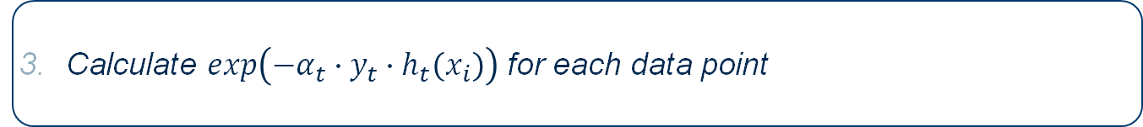

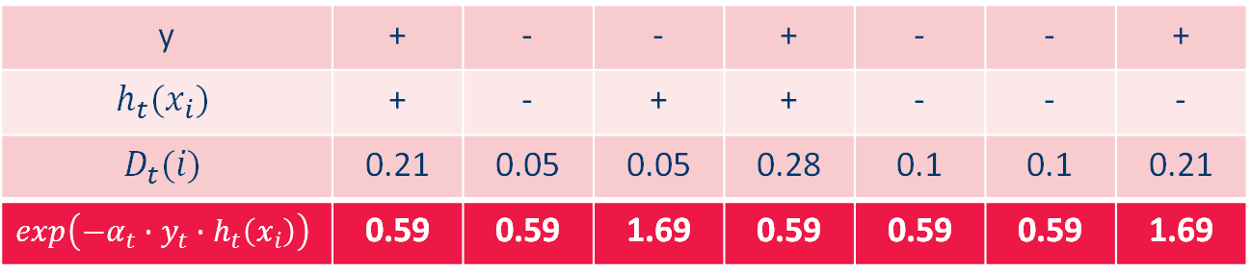
AdaBoost
Calculate $\exp\left(−α_{t}∙y_{t}∙h_{t}\left(x_{i}\right)\right)$ for each data point
With $α_{t}$ from the previous step, we have $\exp\left({−α}_{t}\right)=0.59$ for correctly classified data points, and $\exp\left(α_{t}\right)=1.69$ for incorrectly classified data points.
y | + | - | - | + | - | - | +
$$h_{t}(x_{i})$$ | + | - | + | + | - | - | -
$$D_{t}(i)$$ | 0.21 | 0.05 | 0.05 | 0.28 | 0.1 | 0.1 | 0.21
$$\exp\left(−α_{t}∙y_{t}∙h_{t}\left(x_{i}\right)\right)$$ | 0.59 | 0.59 | 1.69 | 0.59 | 0.59 | 0.59 | 1.69

Slide 10
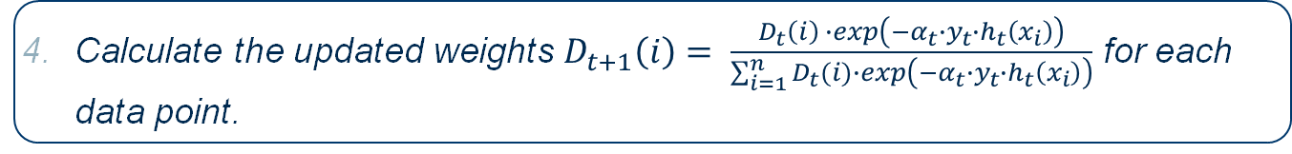

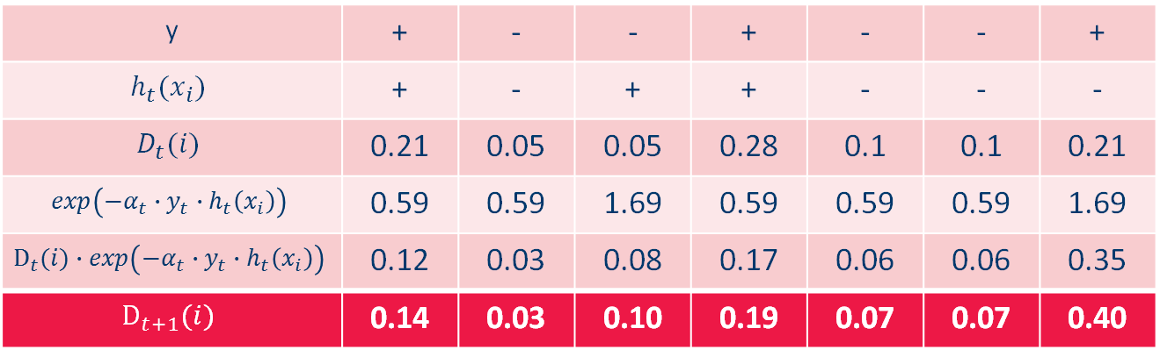
AdaBoost
Calculate the updated weights $D_{t+1}\left(i\right)= \frac{D_{t}\left(i\right) ∙\exp\left(−α_{t}∙y_{t}∙h_{t}\left(x_{i}\right)\right)}{\sum_{i=1}^{n}{D_{t}(i)∙\exp\left(−α_{t}∙y_{t}∙h_{t}\left(x_{i}\right)\right)}}$ for each data point.
First, we calculate $D_{t}\left(i\right) ∙\exp\left(−α_{t}∙y_{t}∙h_{t}\left(x_{i}\right)\right)$ for each data point. Then this is normalized with the sum (0.88)
y | + | - | - | + | - | - | +
$$h_{t}(x_{i})$$ | + | - | + | + | - | - | -
$$D_{t}(i)$$ | 0.21 | 0.05 | 0.05 | 0.28 | 0.1 | 0.1 | 0.21
$$\exp\left(−α_{t}∙y_{t}∙h_{t}\left(x_{i}\right)\right)$$ | 0.59 | 0.59 | 1.69 | 0.59 | 0.59 | 0.59 | 1.69
$$D_{t}(i)∙exp\left(−α_{t}∙y_{t}∙h_{t}\left(x_{i}\right)\right)$$ | 0.12 | 0.03 | 0.08 | 0.17 | 0.06 | 0.06 | 0.35
$$D_{t+1}(i)$$ | 0.14 | 0.03 | 0.10 | 0.19 | 0.07 | 0.07 | 0.40

Slide 11
Exercise 3 Practice with KNIME

Slide 12
Random Forest & Gradient Boosted trees
The dataset we use in this exercise describes the sale of individual residential properties in Ames, Iowa from 2006 to 2010. One of the columns is the overall condition ranking, with values between 1 and 10.
The goal of this exercise is to train a binary classification model, which can predict whether the overall condition is high or low. To do so, the workflow reads the data set and creates the class column based on overall condition ranking, which is called rank and has the values low if the overall condition is smaller or equal to 5, otherwise high.

Slide 13
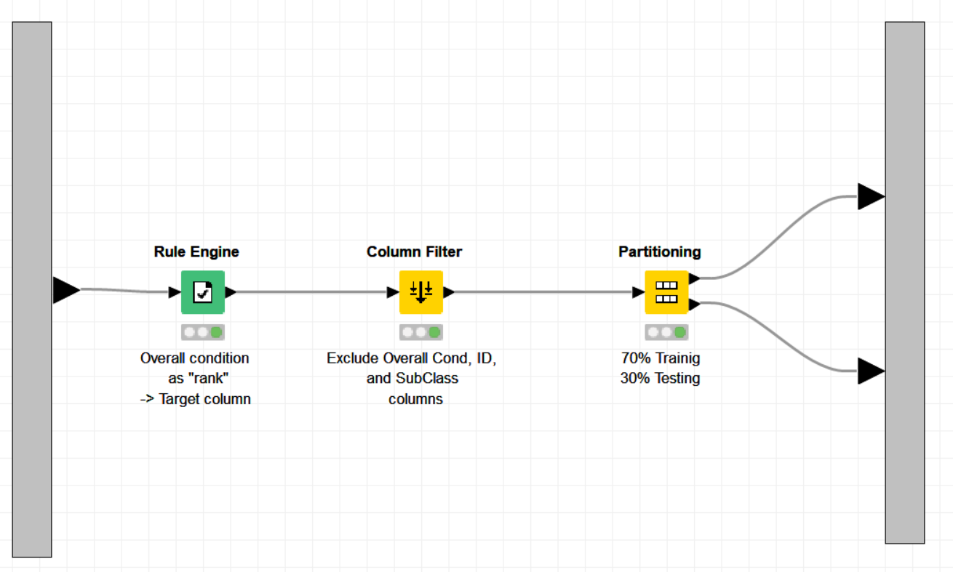
Random Forest & Gradient Boosted trees
Preprocessing:
Create binary target value “rank” (“High” or “Low”)
Eliminates some features
Partition the dataset

Slide 14
Random Forest & Gradient Boosted trees
Train a random forest model (Random Forest Learner) to predict the overall condition of a house (high/low), with the following settings:
Limit tree depth to 15
Limit the minimum node size to 10
The number of trees (i.e. models) to 100
Examine the output table “Attribute Statistics” generated by the learner node. It lists which features were chosen for the first 3 splits in different tree models. Features chosen first are likely informative in classification. Which of the features in this dataset are very informative? Justify your answer.
Use the trained model to predict (Random Forest Predictor) the rank of the houses in the test set, and evaluate the accuracy of the decision tree model (Scorer JavaScript). What is the accuracy of the model?

Slide 15
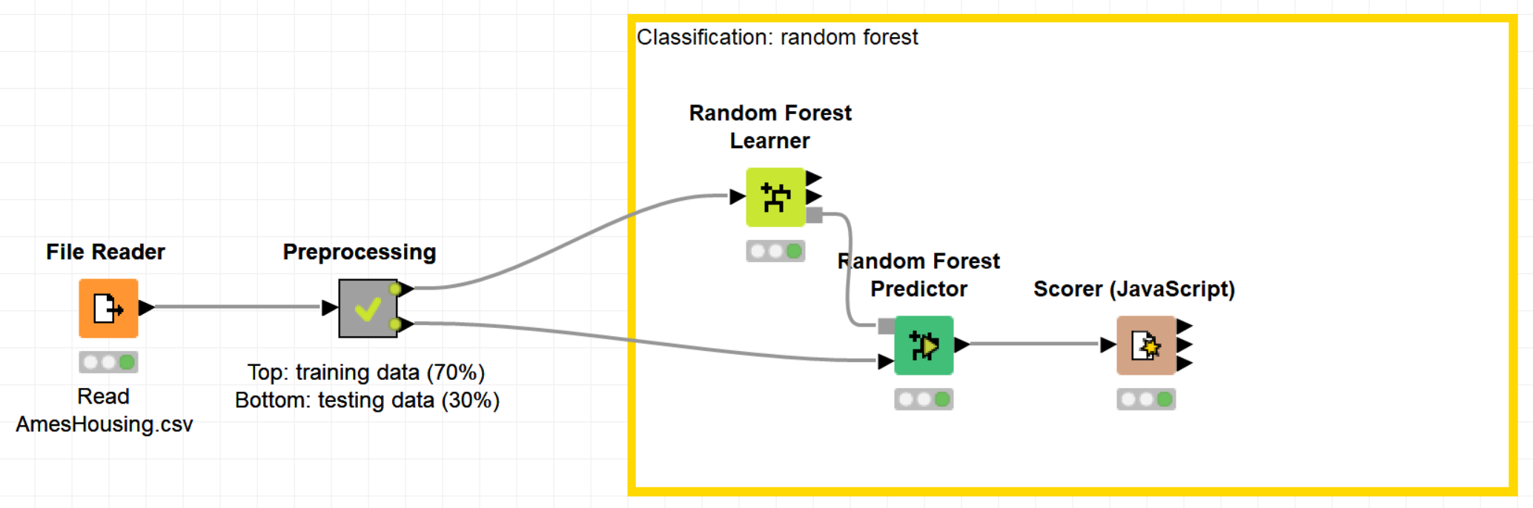
Random Forest

Slide 16
Random Forest & Gradient Boosted trees
Train a gradient boosted trees model to predict the overall condition of a house (high/low), with the following setting:
Limit the tree depth to 4
The number of models to 100
Use the trained model to predict the rank of the houses in the test set, and evaluate the accuracy of the decision tree model. What is the accuracy of the model?
(Optional) Use a parameter optimization loop to find the optimum tree depth to maximize the accuracy (use Scorer node, not Scorer JavaScript). Examine the tree depth of 1 to 10, with the step size of 1. Which tree depth produces the optimal result?

Slide 17
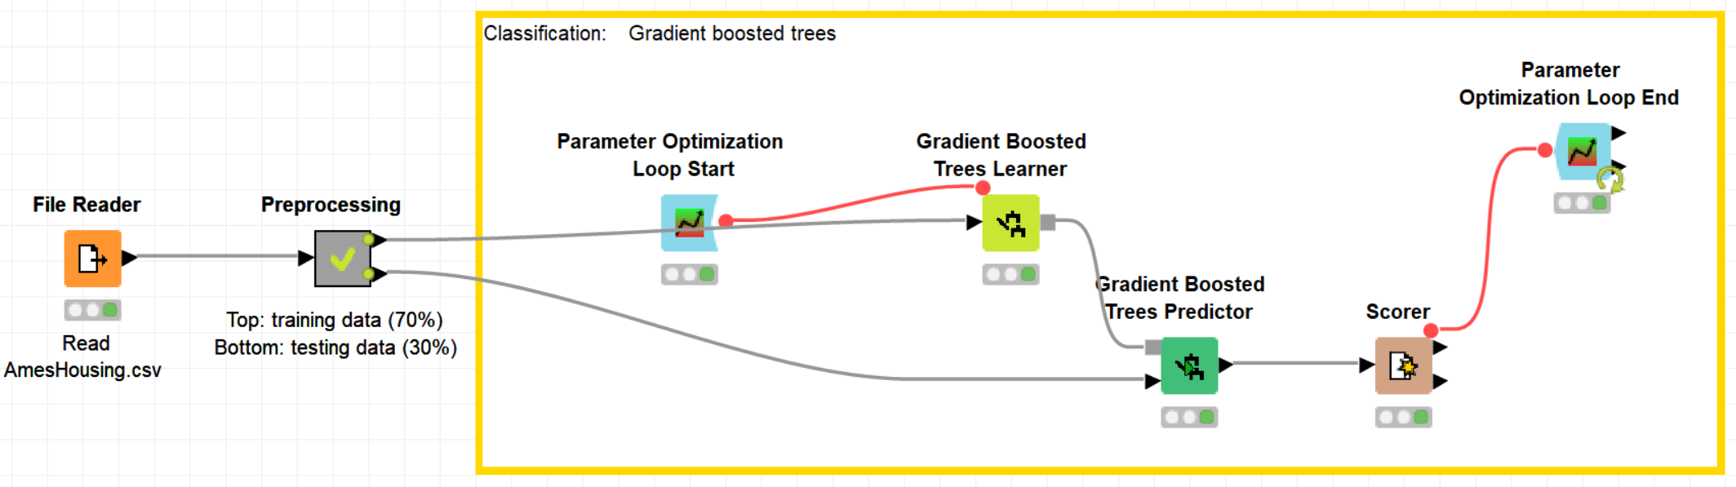
Gradient Boosted trees

Slide 18
Thank you

