Slide 1
Neural Networks: Exercise

Slide 2
Exercise 1 Theoretical Questions

Slide 3
Theoretical Questions
In which kind of applications can an autoencoder architecture be used?
What are commonly used activation functions? And what is the difference between them?
What is a multi layer perceptron?
Assume you have a layer with 5 inputs and one output neuron with activation sigmoid. How is the output of the layer calculated?
What is a fully connected feedforward network?
What is the idea of the momentum term?

Slide 4
Theoretical Questions
Q: In which kind of applications can an autoencoder architecture be used?
A: Dimensionality reduction and anomaly detection
Q: What are commonly used activation functions? And what is the difference between them?
A: Tanh, sigmoid, ReLU
• Sigmoid: S shaped with values between 0 and 1
• Tanh: S shaped with values between -1 and 1
• ReLU: 0 for negative values and the identity function for positive values.

Slide 5
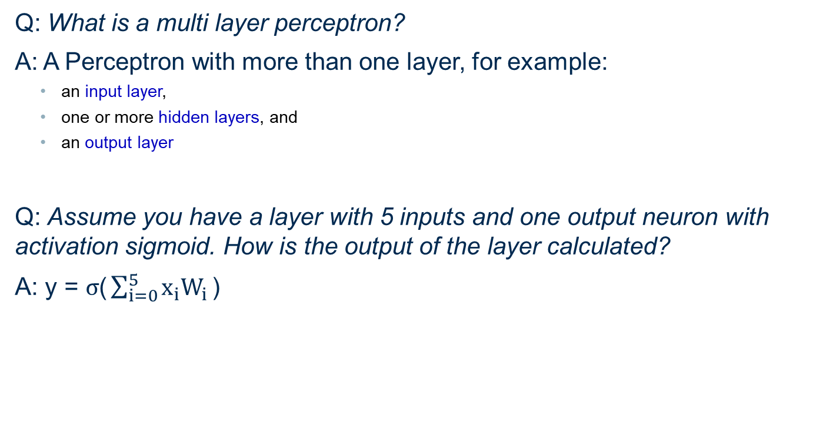
Theoretical Questions
Q: What is a multi layer perceptron?
A: A Perceptron with more than one layer, for example:
an input layer,
one or more hidden layers, and
an output layer
Q: Assume you have a layer with 5 inputs and one output neuron with activation sigmoid. How is the output of the layer calculated?
A: $\text{y}\text{ = }σ\text{(}\sum_{i=0}^{5}{x_{i}W_{i}}\text{)}$

Slide 6
Theoretical Questions
Q: What is a fully connected feedforward network?
A: A network architecture, where each neuron from the previous layer is connected to each neuron in the next layer.
Q: What is the idea of the momentum term?
A: The momentum term is a second term in the weight update, which depends on the gradient of the last iteration. If the weight is updated continuously in the same direction, the weight update increases, otherwise it decreases.

Slide 7
Exercise 2 Practice with KNIME

Slide 8
FFNN for binary classification
Build and train a Feedforward Neural Network using KNIME and the Keras integration to solve a binary classification problem on the Adult dataset. Follow the provided guided workflow:
01_Training
Define Network structure
Read and preprocess the data
Train and export the model
02_Deployment
Move a trained model to production and predict some unseen data.
In the data workflow group you can find all necessary data, as well as a pre-trained network ready to be deployed.
Part of the preprocessing steps has been automatized by using components: you can find them in the components workflow group and import them in your workflow when required.
Note: make sure that the KNIME Deep Learning - Keras integration is correctly installed

Slide 9
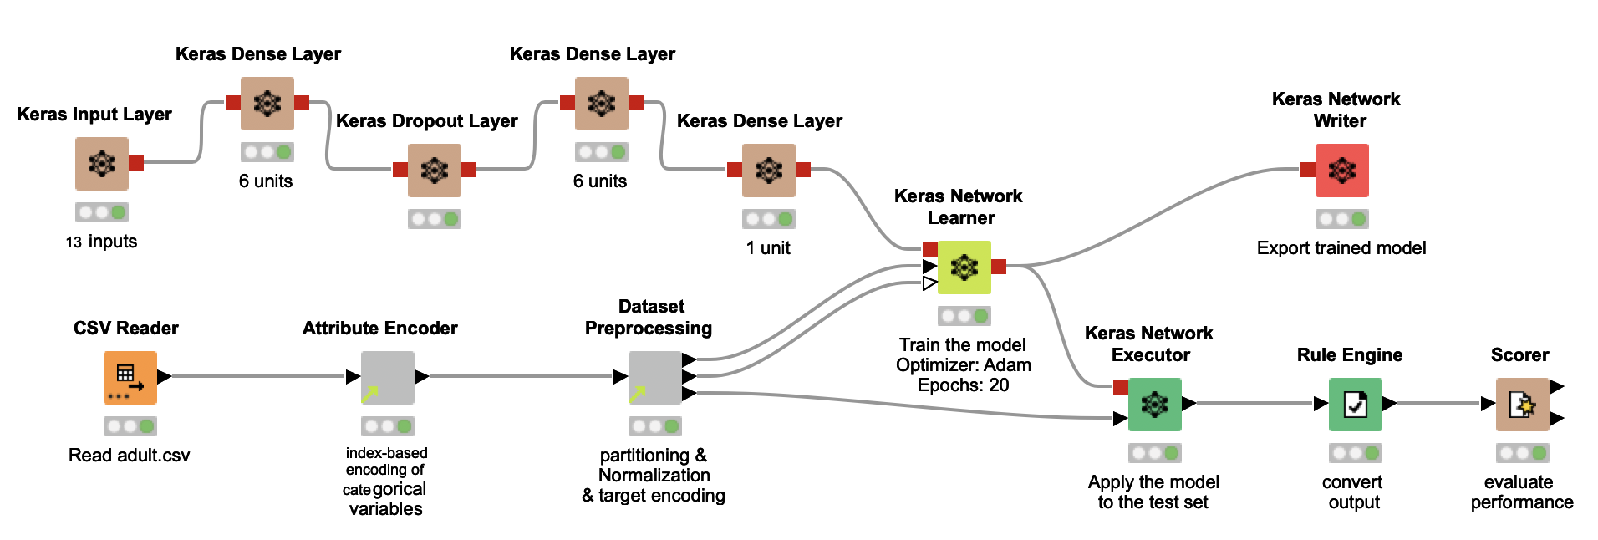
Training a fully connected feed forward network for binary classification

Slide 10
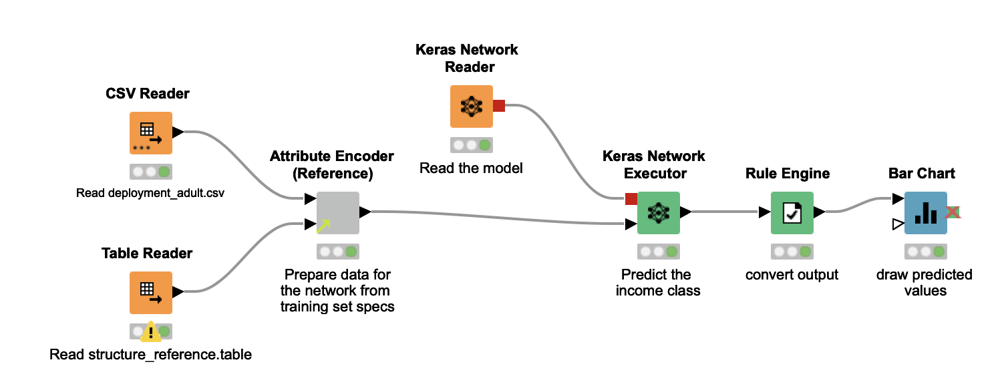
Deploying a fully connected feed forward network for binary classification

Slide 11
Thank you

