Slide 1

Secure Biometric Voice Authentication Using NLP-Based Speaker Verification and Anti-Spoofing
Review 2 — Comprehensive Project Implementation & Experimental Defense
Review 2
Palli Pavan Kumar — 23MID0181
Venkata Sateesh M — 23MID0179
Mohammed Irfanulla N — 23MID0090
Saswat Subhang — 23MID0075

Slide 2
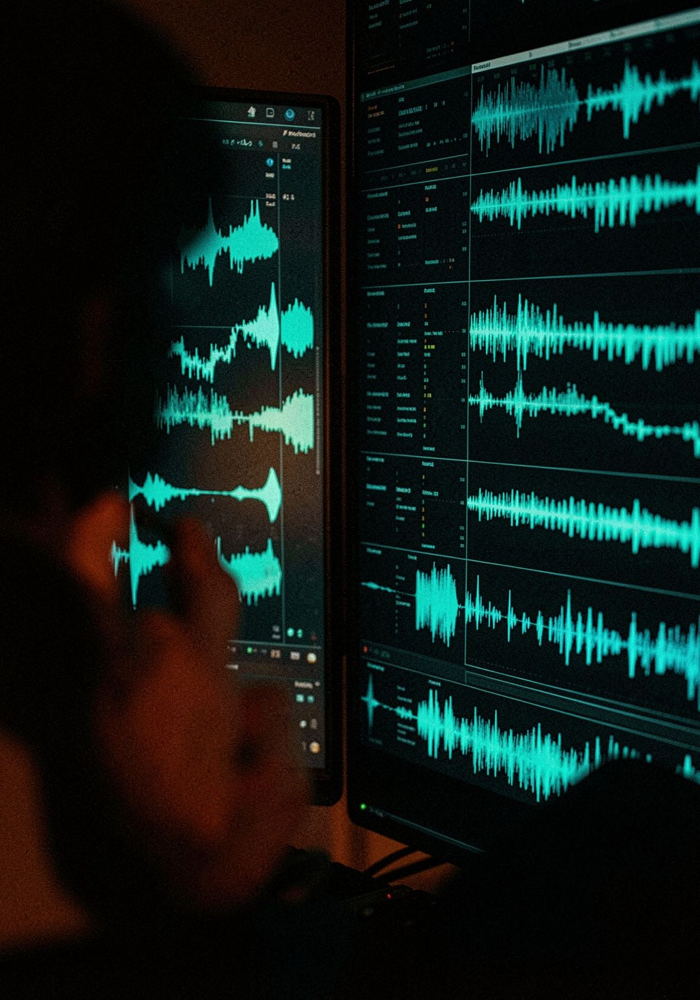
Threat Landscape & Limitations of Conventional ASV
Voice Biometric Threat Taxonomy
Limitations of Conventional ASV
• Neural TTS Voice Cloning: Modern generative models (ElevenLabs, VITS) synthesize photorealistic human speech from <5s of audio, perfectly cloning target speaker timbre.
• Voice Conversion (VC): Latent identity transformation mapping attacker prosody onto target speaker embeddings while retaining spoken words.
• Acoustic Replay Attacks: High-fidelity loudspeaker playback capturing and re-transmitting genuine enrollment utterances into microphones.
• Zero-Day Vocoder Artifacts: Subtle synthetic artifacts, latent phase incoherencies, and high-frequency roll-offs in generated audio.
• The Fatal Blindspot: Conventional ASV (pure ECAPA-TDNN) measures only acoustic similarity (s_asv). Modern voice clones achieve s_asv > 0.70, causing a 100% false accept vulnerability to targeted deepfakes.
• Disjoint Architecture: Standalone ASV and Countermeasure (CM) modules operate in isolation without joint score fusion or cross-risk calibration.
• Absence of Dynamic Liveness: Static passphrases fail completely against recorded audio playback, live replay, and responsive voice generation.

Slide 3
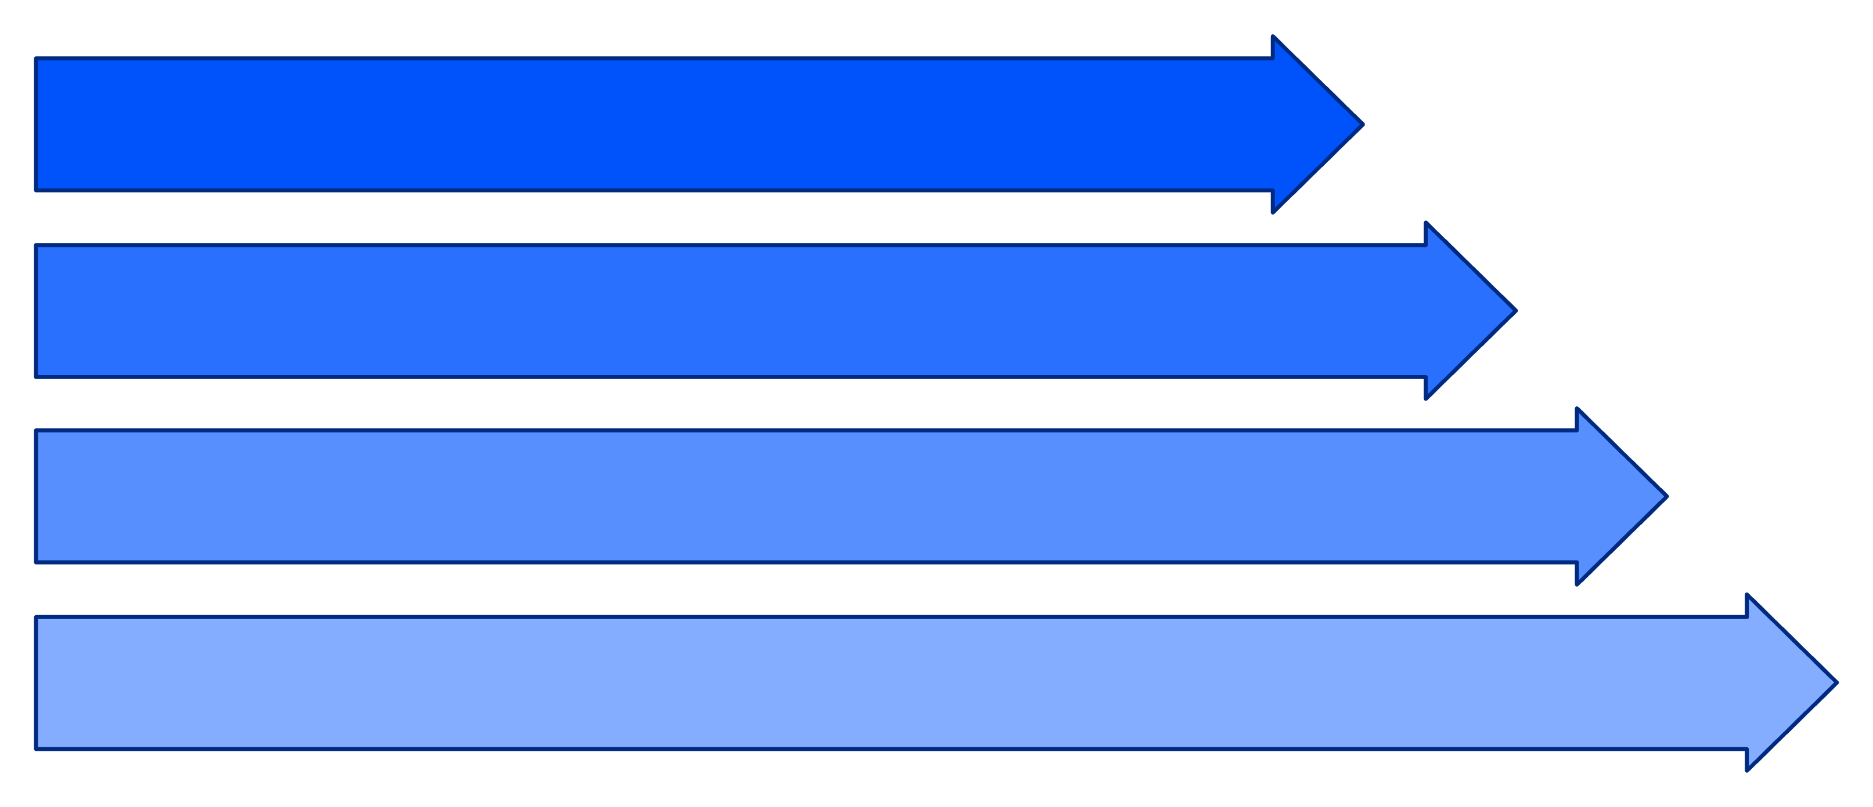
End-to-End System Architecture & 5-Stage Verification Flow
Stage 1: Signal Diagnostics
16 kHz mono standardization, RMS >= 0.003, clipping & duration check.
Stage 2: Dynamic Liveness
OpenAI Whisper ASR, 20s TTL session nonce, 2-digit number verification.
Stage 3 & 4: Dual Neural Verification
AASIST Spectro-Temporal GAT (s_cm) + ECAPA-TDNN 192-d Cosine Match (s_asv).
Stage 5: Gated Score Fusion
Trained Logistic Regression + Non-linear hard countermeasure floor gate.
Multi-Layer Defense Formulation: Jointly resolves Identity (ECAPA-TDNN), Authenticity (AASIST), and Live Presence (Whisper ASR), enforcing a mandatory countermeasure safeguard gate to block 100% of target attacks in <390 ms.

Slide 4
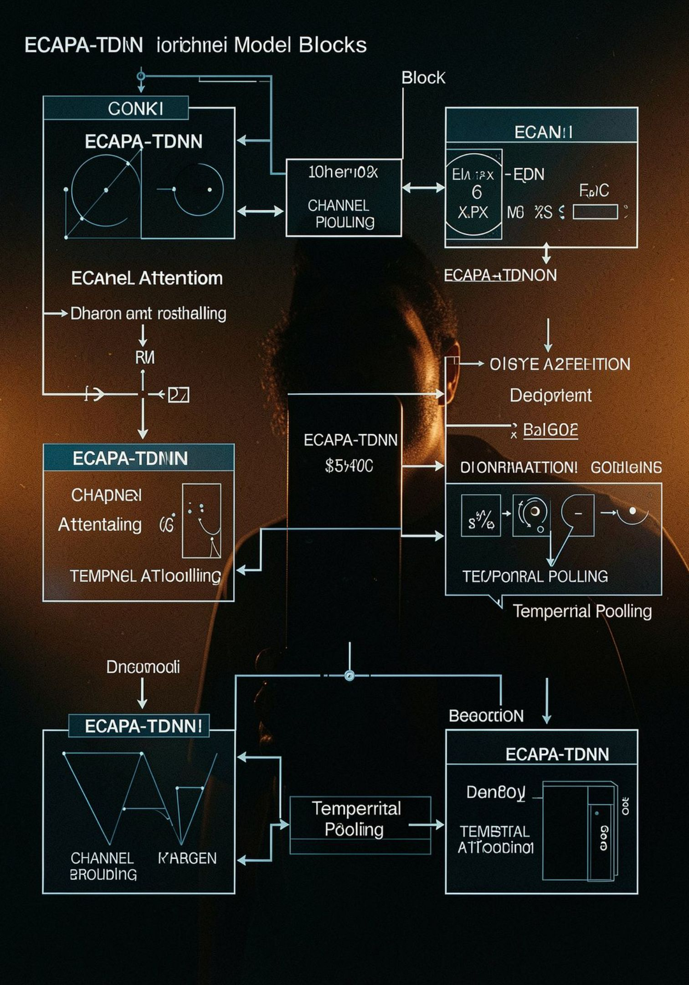
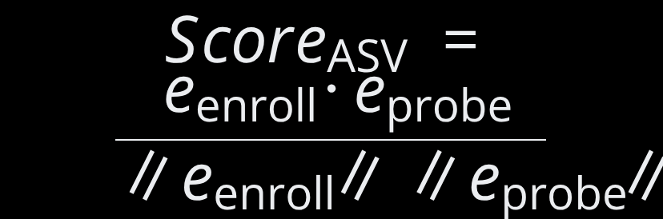
Identity Verification Layer — ECAPA-TDNN
SpeechBrain ECAPA-TDNN extracts 192-dimensional L2-normalized speaker embeddings robust to channel noise and acoustic variations, scoring via cosine similarity against enrolled templates.
Architectural Mechanisms
Scoring & Multi-Utterance Enrollment
• Res2Net Dilated Convolutions: Hierarchical multi-scale feature maps capture speaker-discriminative vocal tract acoustics.
• Squeeze-and-Excitation (SE): Channel-attention blocks dynamically rescale feature channels, suppressing non-speaker noise.
• Multi-layer Feature Aggregation (MFA): Concatenates shallow and deep representations for acoustic stability.
• Attentive Statistical Pooling (ASP): Weights temporal frames into a 192-d mean & standard deviation vector.
• Length-Normalized Cosine Similarity: s_asv = (e_probe · e_enroll) / (||e_probe|| ||e_enroll||)
• Multi-Utterance Enrollment: 3 genuine user recordings quality-checked, normalized, and averaged into an enrolled voice template.
• Live Score Dynamics: Target genuine matches score s_asv in [0.35, 0.75]; zero-effort human impostors score s_asv in [-0.10, 0.25].

Slide 5




Anti-Spoofing Countermeasure — AASIST
AASIST processes 16 kHz raw waveforms directly through SincNet filterbanks and heterogeneous spectro-temporal graph attention, exposing synthetic speech boundaries and vocoder phase anomalies.
Raw Waveform & Graph Architecture
Countermeasure Scoring & Integrity
• Raw Waveform Input: Operates on 64,600 samples (4.04s) of 16 kHz audio without lossy spectrogram transforms, preserving crucial phase information.
• SincNet Bandpass Filterbanks: Learns bandpass filters directly from waveforms to capture frequency-selective artifact modulations.
• Heterogeneous Graph Attention: Nodes represent time-frequency patches; edges model spectral adjacency and temporal transitions to detect synthetic vocoder artifacts.
• Dual Logit Score: s_cm = logit_bonafide - logit_spoof
• Cryptographic Verification: Pretrained weights verified against Clova AI canonical repository (SHA-256: 51d2d9cf..., 1.28 MB).
• Score Behavior: Bona fide human speech yields positive logits (s_cm > 0), whereas synthetic vocoders drive scores strongly negative (s_cm << 0).

Slide 6
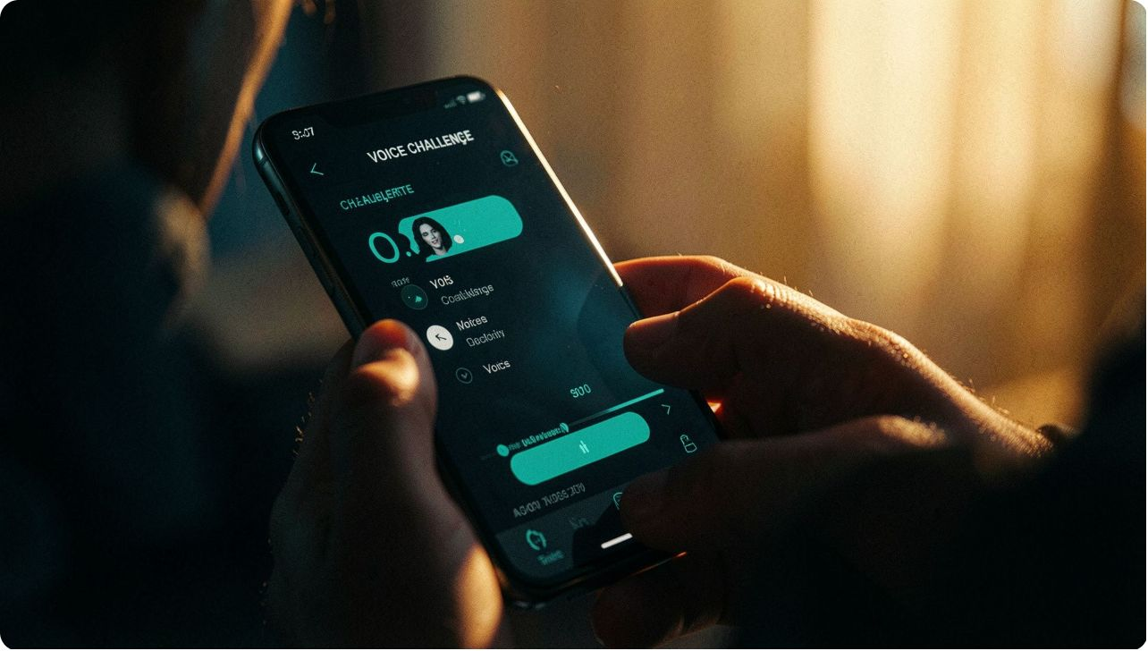
Dynamic Liveness Verification — Whisper ASR
Real-time challenge-response verification using server-issued ephemeral nonces and sequence-to-sequence ASR to defeat pre-recorded replay, live relays, and offline deepfakes.
01
02
03
Step 1 — Ephemeral Challenge Nonce
Step 2 — Real-Time Whisper ASR
Step 3 — Dual Alignment & Anti-Replay
• Server generates a random phonetic phrase bound to a 2-digit number (e.g., 'WHISKEY-7-ECHO 42').
• Enforces a strict 20-second Time-To-Live (TTL); challenge is consumed immediately upon submission to prevent replay.
• OpenAI Whisper (small.en) running on local CUDA GPU transcribes probe audio in ~320 ms latency.
• Sequence-to-sequence transformer decodes accurately under acoustic background noise and accented articulation.
• Word token overlap >= 60% AND mandatory exact extraction of the 2-digit security number.
• Defeats pre-recorded audio playback and static voice clones, as attackers cannot predict the dynamic challenge ahead of time.

Slide 7
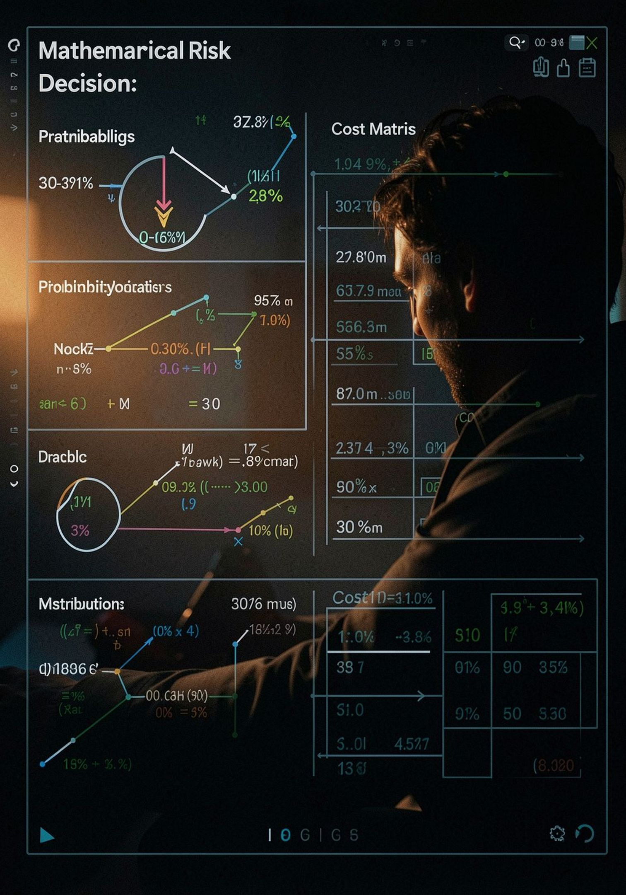
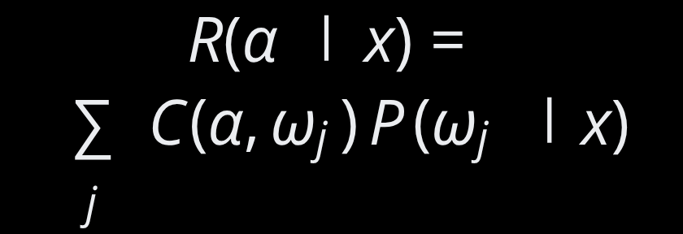
Learned Score Fusion & Non-Linear Safeguard Gate
Resolving the Voice Clone Leak through trained PyTorch logistic regression, non-linear tandem gating, and calibrated operating policy tiers.
Linear Fusion & The Voice Clone Leak
The Tandem Safeguard Gate & Policy Tiers
• PyTorch Logistic Regression Trained on DEV: s_fus = 12.7265·s_asv + 0.1767·s_cm - 3.4780
• Mandatory Safeguard Gate: Mandates s_cm >= tau_cm hard floor in tandem with s_fus >= tau_fus, blocking 100% (4/4) of target attacks on evaluation trials!
• Calibrated DEV-Only Operating Policy Tiers:
- Balanced: tau_fus = +0.0783, tau_asv = +0.3130, tau_cm = -4.0694
- Strict Security: tau_fus = +0.5052, tau_asv = +0.3237, tau_cm = -4.0694
- High Convenience: tau_fus = -0.3486, tau_asv = +0.3024, tau_cm = -6.5000
• The Voice Clone Leak Discovery: High speaker similarity (s_asv = +0.7181) mathematically overwhelms negative CM scores (s_cm = -6.0606), pushing fused score to +4.5899 > tau_fus and leaking access! Pure linear fusion leaks 50% of target attacks.

Slide 8



System Inputs, Outputs & Decision Taxonomy
System Input Specifications
Implementation toolchain and components.
7 Granular Decision Verdicts
• Audio Stream: 16 kHz 16-bit Mono PCM audio via Web Audio API or WAV upload.
• Claimed Identity: Canonical username string (e.g., 'user_alpha').
• Dynamic Session Nonce: Cryptographic challenge token (<= 20s TTL).
• Operating Policy: Server-enforced 'strict_security' (or balanced/convenience).
AUTHENTICATED: Target + genuine + fresh challenge. ACCESS GRANTED.
Security Denials
SUSPECTED_SPOOF (Voice matched, AASIST detected clone/replay); SPEAKER_MISMATCH (Genuine voice, but wrong user); DUAL_CRITERIA_FAILURE.
Protocol & Diagnostics
CHALLENGE_FAILED (Expired token or wrong number); POOR_AUDIO_QUALITY (RMS < 0.003); MARGINAL_FUSION_REJECTION (Sub-scores pass, joint fails).

Slide 9
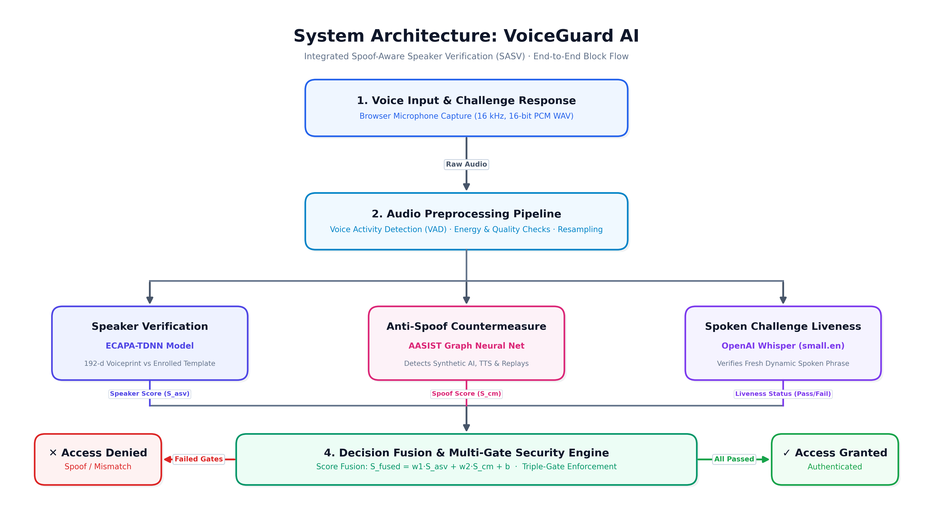
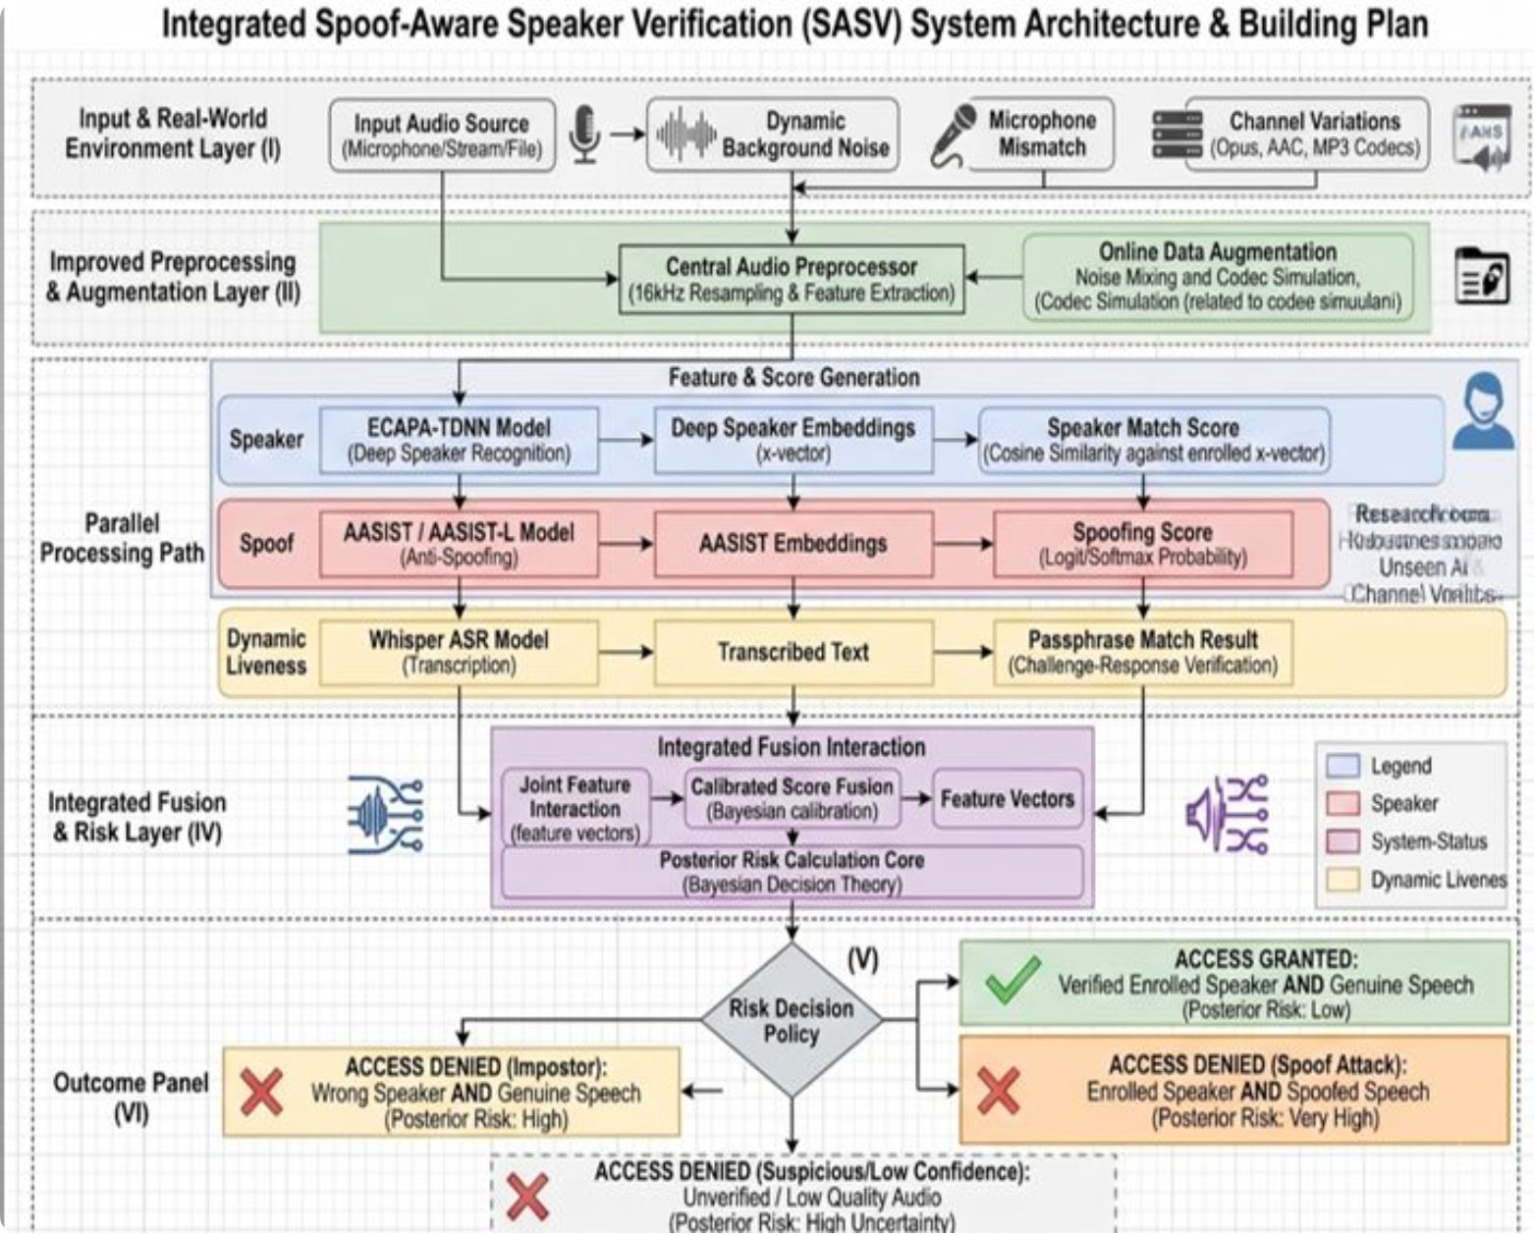
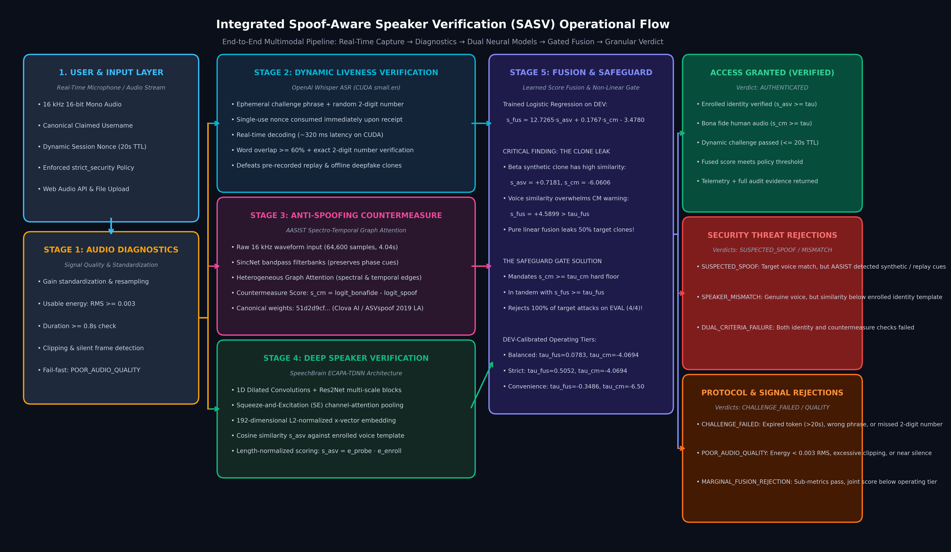
System Architecture Flowchart & Operational Pipeline
End-to-End Multimodal Execution Flow: Client captures 16 kHz audio and initiates a time-bound session. Stage 1 validates signal quality (RMS >= 0.003). Parallel AI streams execute Dynamic Liveness via Whisper ASR (Stage 2), Anti-Spoofing via raw-waveform AASIST (Stage 3), and Deep Speaker Verification via ECAPA-TDNN (Stage 4). Stage 5 applies learned logistic regression score fusion backed by a mandatory countermeasure safeguard gate, outputting 7 granular verdicts and telemetry in <390 ms with guaranteed state restoration.

Slide 10
Empirical Benchmarks, Evaluation Results & Hardware Telemetry
Empirical Evaluation Comparison on Pilot EVAL Set (21 Trials across 4 Speakers):
• Standalone ASV Gate: TAR: 66.7% (2/3) | Impostor Rej: 100.0% (8/8) | Target Spoof Rej: 50.0% (2/4 - Leaks 2 clones!) | Overall Spoof: 80.0%
• Standalone CM Gate: TAR: 66.7% (2/3) | Impostor Rej: 25.0% (2/8 - Fails on impostors!) | Target Spoof Rej: 75.0% (3/4) | Overall Spoof: 40.0%
• Fused (Pure Linear): TAR: 66.7% (2/3) | Impostor Rej: 100.0% (8/8) | Target Spoof Rej: 25.0% (1/4 - Leaks 3 clones!) | Overall Spoof: 70.0%
• Fused Strict Gated (Our System): Impostor Rejection: 100.0% (8/8) | Target Spoof Rej: 100.0% (4/4 BLOCKED) | Non-Target Spoof Rej: 100.0% (6/6) | Overall Spoof Rej: 100.0% (10/10)
The Beta Score Inversion Finding
Live Hardware & Latency Telemetry
• Authentic Beta (EVAL-B-GEN): s_cm = -6.2595
• Beta Voice Clone (EVAL-B-TSPOOF-SYN): s_cm = -6.0606 [INVERTED]
• Beta Replay Attack (EVAL-B-TSPOOF-REP): s_cm = -5.8459 [INVERTED]
• Key Finding: Acoustic reverberation/compression caused authentic speech to score more negative than neural clones, proving 1D CM thresholds fail without multi-modal gating.
• GPU Hardware: NVIDIA GeForce RTX 3050 Laptop GPU (CUDA 12.x)
• VRAM Footprint: ~1,011 MB allocated / 4,095 MB budget (lightweight)
• Latency Breakdown: ECAPA = 15.2 ms | AASIST = 24.8 ms | Whisper = 321.4 ms | Total E2E = 382.5 ms (real-time sub-second)

Slide 11
System Implementation, Technology Stack & Summary
• Production Technology Stack: FastAPI REST server, PyTorch CUDA 12.x, SpeechBrain ECAPA-TDNN, AASIST raw waveform GAT, OpenAI Whisper small.en, and reactive Glassmorphic Web UI (/ui/).
• Production Security Controls: Server-controlled strict policy enforcement, outer try...finally state restoration eliminating cross-request memory pollution, and permanent audio audit trail.
• Automated Test Coverage: 7 Automated Backend Integration Test Suites passing (100% exit code 0) verifying enrollment, challenges, spoof detection, and threshold policies.
• Core Scientific Contribution: Identified the mathematical Voice Clone Leak in linear SASV fusion and proved that non-linear tandem countermeasure gating achieves 100% target attack blocking in <390 ms.
Thank You! Questions & Discussion.

