Slide 1

Crop and Soil Fertility Prediction using Machine learning Techniques
Team members :
Name: H.T. No: 1. S. Satheesh 2005A41057 2. T. Keerthana 2005A41058 3. M. Ramana 2005A41008 4. G. Niranjan Varaprasad 2005A41032
Guided by:
Mr. S. Srinivas
Assistant Professor
Electronics and Communication Engineering Branch

Slide 2
Introduction:
Machine Learning uses technology to understand important things about the soil, like how much water it has, how hot or cold it is, and what kind of chemicals are present.
It also helps predict how much crop can be harvested, checks if the crops are healthy, and even spots any diseases or weeds that could harm the plants. In simple words, Machine Learning is a game-changer for farming, making it smarter and more efficient.
As farmers embrace these technological advancements, they're not just working harder; they're working smarter. ML's ability to analyze and predict things like harvest yields and potential problems with crops is transforming traditional farming practices. In essence, Machine Learning is revolutionizing the way we approach agriculture, ushering in a new era of precision and efficiency in farming practices.

Slide 3
Problem statement
As we know farmers struggle to adopt Machine Learning (ML) in farming due to limited knowledge and resources. They need easy tools for smart decisions and precise plant care. This limits ML's full potential, hindering farming transformation. Simplified technologies are vital for predicting harvests, evaluating crops, and detecting diseases. Developing user-friendly tools is crucial to empower farmers, promote ML adoption, and enhance agriculture.

Slide 4
LITERATURE REVIEW
S.NO. | Paper | Year | Approach
1 | Sujatha, M., and C. D. Jaidhar. “Machine learning-based approaches to enhance the soil fertility”[1] | Expert Systems with Applications : 122557. 2023 | This review addresses the importance of soil fertility in agricultural production. It discusses soil management's impact on crop yield and environmental pollution, highlighting the potential of machine learning in estimating soil nutrients.
2 | Folorunso, Olusegun, et al “Exploring machine learning models for soil nutrient properties prediction”[2] | Big Data and Cognitive Computing 7.2 2023 | This literature review explores machine learning applications for soil prediction, identifying challenges like inaccurate data and regional variations. Collaboration, resource allocation, and technological education are essential for effective implementation in developing nations.
3 | Yadav, Jagdeep, Shalu Chopra, and M. Vijayalakshmi “Soil analysis and crop fertility prediction using machine learning”[3] | Big Data and Cognitive Computing 7.2 2021 | Proposed model predicts soil fertility and crop yield in Indian regions using Artificial Neural Network (ANN), with high accuracy. Future goals involve integrating fertilizer data and expanding to cover more regions for increased reliability and efficiency.
4 | Wankhede, Disha S “Analysis and prediction of soil nutrients pH, N, P, K for crop using machine learning classifier”[4] | ICMCSI 2020. Springer International Publishing 2021 | This paper emphasizes machine learning, particularly Naive Bayes, in enhancing farmer decisions for crop yield and soil quality, showcasing effective predictions, especially with large datasets.
5 | Malik, Pranay, Sushmita Sengupta, and Jitendra Singh Jadon. “Comparative analysis of soil properties to predict fertility and crop yield using machine learning algorithms”[5] | IEEE 2021 | Agriculture, crucial for India's economy, relies on predicting crop yield influenced by factors like soil. This study uses machine learning for comparative analysis, focusing on tomato, potato, and chili crops.
6 | Janvier, N. I. Y. I. T. E. G. E. K. A., et al. “Machine Learning based Soil Fertility Prediction”[6] | International Journal of Innovative Science, Engineering & Technology 8.7 2021 | The study concludes that Artificial Neural Network and Random Forest are effective for predicting soil pH and calcium levels. However, predicting phosphorus levels requires additional features for improved accuracy.

Slide 5
7 | Van Klompenburg, Thomas, Ayalew Kassahun, and Cagatay Catal “Crop prediction using machine learning.”[7] | Computers and Electronics in Agriculture 177 2020 | Agriculture, vital to India's economy, faces challenges from climate change affecting crop yields. This research utilizes Naive Bayes, a supervised learning algorithm, to guide novice farmers in crop selection using collected seed data and parameters. An Android mobile application further facilitates user input for accurate crop prediction.
8 | Rajamanickam, Jayalakshmi. “Crop yield prediction using machine learning”[8] | INFOCOMP Journal of Computer Science 20.1 2020 | The study reviews publications on crop yield prediction using machine learning, highlighting varied features, scales, and algorithms. While no conclusive best model is identified, popular ones include random forest, neural networks, linear regression, and gradient boosting tree. Additionally, the study notes a growing use of deep learning algorithms, particularly CNN, LSTM, and DNN. The findings lay the groundwork for future research and the development of deep learning-based crop yield prediction models.
9 | Keerthan Kumar, T. G., C. and Shubha, and S. A. Sushma “Random forest algorithm for soil fertility prediction and grading using machine learning.”[9] | Int J Innov Technol Explor Eng 9.1 2019 | The system utilizes machine learning algorithms, such as Random Forest Classifier, to analyze soil properties, grade soil, and predict suitable crops. This helps farmers maximize yield, reducing their struggles and difficulties.

Slide 6




BLOCK DIAGRAM:
Soil
Characteristics
Data Pre- Processing
Machine Learning Algorithms
Trained Model
Environmental
Characteristics
Recommendation

Slide 7
objectives
Help farmers make better choices using Machine Learning as a helpful assistant. It shares important details about the soil, like water levels, temperature, and chemicals, for smarter decisions.
Give farmers the power to take good care of each crop with Machine Learning insights. This improves how they use resources and keeps their farming practices healthy.
Use Machine Learning to figure out and plan the harvests better. It gives farmers smart insights into how much they might harvest, helping them plan ahead.
Make traditional farming better by adding Machine Learning. It gives farmers ways to study, guess, and improve many parts of farming, making it work better and more accurately.

Slide 8
Proposed methodology
1. Data Exploration & Preprocessing:
- Perform EDA to understand data distribution, relationships, and address missing values.
- Visualize feature correlations using heatmaps and scale features using MinMaxScaler.
2. Model Selection & Evaluation:
- Utilize diverse classifiers like KNN, SVC with different kernels, Decision Tree, Random Forest, and Gradient Boosting.
- Train models and evaluate performance using accuracy metrics.
- Optimize hyperparameters for SVC using GridSearchCV.
3. KNN Classifier:
- Implement KNN Classifier and optimize by varying the number of neighbors.
4. SVC Optimization:
- Apply Decision Tree, Random Forest, and Gradient Boosting.
- Visualize feature importance for Decision Tree.
- Fine-tune Random Forest and evaluate using classification report.
- Train and assess Gradient Boosting Classifier.

Slide 9
PLANNING
Conceptualization and Design (January 2024):
Formulate project scope and objectives.
Design and finding of suitable algorithms.
Testing (February & March 2024):
Development of code and checking the accuracy.
Field Testing and Deployment (April & May 2024):
Implement system in real-time scenarios.
Gather user feedback and refine system based on observations.

Slide 10
Results and Discussion
In our Crop and Soil Fertility Prediction project employing machine learning techniques, we conducted data preprocessing on the Crop recommendation Dataset.
To assess model
performance, we utilized key metrics such as the Confusion Matrix, Precision, Recall, Accuracy, and F1 Score

Slide 11
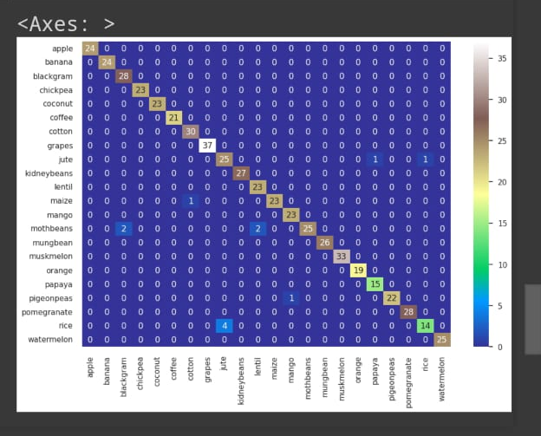
RESULTS and Discussion
A correlation matrix is used to summarize a large data set and to identify patterns and make a decision according to it

Slide 12
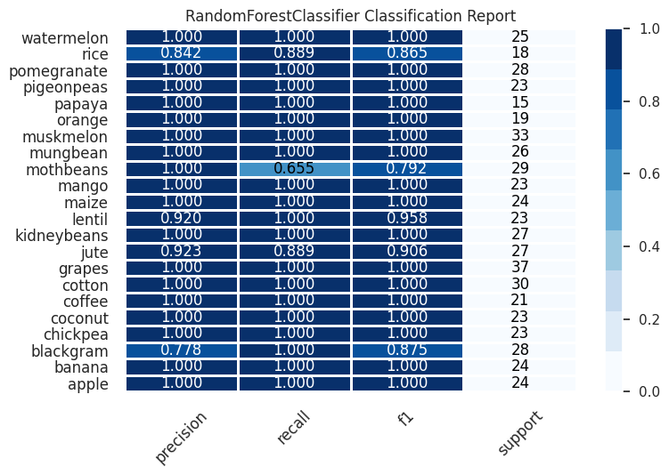
Results and Discussion
Classification report provides a detailed summary of a model’s performance, including precision, recall, F1-score, and support for each class. It helps evaluate how well the model predicts different classes in a multiclass problem.

Slide 13
Suggestions
Explain in detail
Do not use more information in ppt
Use no animations in ppt

Slide 14
references
[1] Keerthan Kumar, T. G., C. and Shubha, and S. A. Sushma. "Random forest algorithm for soil fertility prediction and grading using machine learning." Int J Innov Technol Explor Eng 9.1 (2019): 1301-1304.]
[2] Yadav, Jagdeep, Shalu Chopra, and M. Vijayalakshmi. "Soil analysis and crop fertility prediction using machine learning." Machine Learning 8.03 (2021).
[3]Al Masmoudi, Yassine, et al. "Use of machine learning in Moroccan soil fertility prediction as an alternative to laborious analyses." Modeling Earth Systems and Environment 8.3 (2022): 3707-3717.
[4] Al Masmoudi, Yassine, et al. "Use of machine learning in Moroccan soil fertility prediction as an alternative to laborious analyses." Modeling Earth Systems and Environment 8.3 (2022): 3707-3717.
[5] Sujatha, M., and C. D. Jaidhar. "Machine learning-based approaches to enhance the soil fertility—A review." Expert Systems with Applications (2023): 122557.
[6] Yadav, Jagdeep, Shalu Chopra, and M. Vijayalakshmi. "Soil analysis and crop fertility prediction using machine learning." Machine Learning 8.03 (2021).
[7] Van Klompenburg, Thomas, Ayalew Kassahun, and Cagatay Catal. "Crop yield prediction using machine learning: A systematic literature review." Computers and Electronics in Agriculture 177 (2020): 105709.
[8] Keerthan Kumar, T. G., C. and Shubha, and S. A. Sushma. "Random forest algorithm for soil fertility prediction and grading using machine learning." Int J Innov Technol Explor Eng 9.1 (2019): 1301-1304.
[9] Yadav, Jagdeep, Shalu Chopra, and M. Vijayalakshmi. "Soil analysis and crop fertility prediction using machine learning." Machine Learning 8.03 (2021).

Slide 15
Thank You

