Slide 1


DEPARTMENT OF COMPUTER SCIENCE AND ENGINEERING
CHATBOT FOR THE PUC BY USING RAG
Under the Guidance of
Dr.Ratna Kumari Challa
K.Satheesh(R190532)
K.Thriveni(R190533)

Slide 2

AGENDA
Abstract
Introduction
Literature
Motivation
Contribution
Modules
Module-1
Module-2
Module-3
Conclusion and Future Enhancements
References

Slide 3
ABSTRACT
CHATBOT FOR THE PUC BY USING RAG
In recent years, chatbots have emerged as a revolutionary tool in various sectors, leveraging advances in artificial intelligence (AI) and natural language processing (NLP). This project presents the development of a chatbot designed specifically for first and second-year biology intermediate students at our college. The motivation behind this project stems from the need to provide students with a reliable and accessible platform for addressing their academic queries. The chatbot aims to facilitate students in resolving their doubts efficiently, thereby enhancing their learning experience and academic performance. Leveraging cutting-edge generative AI technologies, including large language models (LLMs) and Retrieval-Augmented Generation (RAG), by using RAG It retrieves relevant documents and pieces of information from a vast corpus and uses this data to generate precise and contextually appropriate responses and also it enhances the chatbot's capabilities. To manage and access the vast amount of academic content. MongoDB Atlas is employed as the knowledge base. MongoDB Atlas provides a scalable and flexible platform to store and retrieve information efficiently. The implications of this project for the college students are substantial. By providing an accessible and efficient academic support tool the students can self-directed to learning, enabling students to explore and understand topics at their own pace.

Slide 4
ABSTRACT
CHATBOT FOR THE PUC BY USING RAG
The value of this project lies in its potential to transform the academic support landscape within the college. It serves as a scalable solution that can be extended to other subjects and departments, offering a versatile tool for academic assistance. Furthermore, the integration of advanced AI technologies such as LLM and RAG sets a precedent for future educational innovations, positioning the college at the forefront of educational technology adoption
Signature of the student Signature of the Guide
K.Satheesh Name: CH. Ratna Kumari
K.Thriveni

Slide 5

INTRODUCTION
In the realm of modern education, the integration of advanced technological solutions has become indispensable for fostering an enriching learning environment. One such innovation is the deployment of chatbots, which harness the power of artificial intelligence (AI) to provide instant and tailored support to students. This project undertakes the development of a sophisticated chatbot tailored specifically for first and second-year biology students at our institution, aimed at addressing their academic queries with unparalleled efficiency
The motivation for this project is to overcome the limitations of traditional educational support, which often cannot provide timely assistance to students outside of classroom hours.
By using advanced AI technologies, including Large Language Models (LLMs) and Retrieval-Augmented Generation (RAG) tools, this chatbot is designed to give accurate and contextually relevant answers, thus improving the learning experience.

Slide 6



.
Information present in the chatbots like ChatGPT and websites is scattered and may not be relevant to the user student sometimes even information overload takes place
LLM chatbot give accurate answers with out any overload of information. which is related through their context
The chatbot is trained with NCERT books. To give accurate answers

Slide 7
INTRODUCTION
. The objectives of this project are clear and ambitious. We aim to develop a robust, scalable platform that can handle a diverse array of queries, ranging from simple factual questions to complex conceptual clarifications. The chatbot is trained on a comprehensive dataset encompassing NCERT books and supplementary academic resources, ensuring an extensive coverage of the biology curriculum.
Additionally, the integration of MongoDB Atlas as the knowledge base provides a scalable and flexible framework for efficient data retrieval and management
This project not only aims to improve the academic support available to biology students but also serves as a model for future educational innovations. The implications of this project extend beyond immediate academic benefits, positioning our college at the forefront of educational technology and innovation

Slide 8




ADVANTAGES
Distracted by un wanted information at one place.
Conversational chatbot that will help student to answer their queries in a correct manner
Lets chat with LLM Chatbot for your queries and get accurate results
Generative AI future of the world. It's grows day by day t to solve different kind of problems

Slide 9
LITERATURE
Introduction:
The field of artificial intelligence (AI) has seen significant advancements in recent years, with applications spanning across various domains, including education. Chatbots, in particular, have garnered considerable attention for their potential to enhance educational experiences by providing instant and personalized support to students. This literature review explores the existing research and developments in the areas of chatbots, generative AI technologies, and their applications in educational contexts, with a specific focus on Large Language Models (LLMs), Retrieval-Augmented Generation (RAG) tools, and the utilization of MongoDB Atlas as a knowledge base.
Chatbots in Education
The deployment of chatbots in educational settings is not a novel concept; however, recent technological advancements have significantly augmented their capabilities and efficacy. Chatbots have been utilized to assist with administrative tasks, provide language learning support, and facilitate tutoring in various subjects. According to Winkler and Sollner (2018), chatbots can enhance student engagement and motivation by providing immediate feedback and fostering interactive learning environments. Furthermore, studies by Hill et al. (2015) highlight the effectiveness of chatbots in offering personalized learning experiences tailored to individual student needs.

Slide 10
LITERATURE
Large Language Models (LLMs)
Large Language Models, such as OpenAI's GPT-3, have revolutionized the field of natural language processing (NLP). These models are trained on vast datasets and possess the ability to generate human-like text based on given prompts. Research by Brown et al. (2020) demonstrates the versatility of LLMs in performing a wide array of language tasks, from translation to summarization and question answering. In the context of education, LLMs have shown promise in generating contextually relevant responses and explanations, thereby serving as effective tools for academic support
Retrieval-Augmented Generation (RAG) Tools
Retrieval-Augmented Generation (RAG) represents a sophisticated approach that combines the strengths of information retrieval and generative modelling. RAG models, as described by Lewis et al. (2020), first retrieve relevant documents from a corpus based on the input query and then generate a response using this retrieved information. This dual mechanism enhances the accuracy and contextual relevance of the responses, making RAG tools particularly valuable in educational applications where precise and contextually appropriate answers are crucial.

Slide 11
LITERATURE
MongoDB Atlas in Educational Applications
The use of robust database solutions is critical for managing the vast amounts of information required for effective educational support systems. MongoDB Atlas database offers scalability, flexibility, and efficient data retrieval capabilities. As noted by Chodorow (2013), MongoDB's schema-less architecture and powerful query capabilities make it an ideal choice for dynamic and data-intensive applications. In educational contexts, MongoDB Atlas has been employed to store and manage diverse educational content, enabling quick and reliable access to information.
Integration of AI Technologies in Educational Chatbots
The integration of LLMs, RAG tools, and MongoDB Atlas in educational chatbots represents a significant advancement in the field. Studies by Xie et al. (2021) and Rajpurkar et al. (2018) underscore the potential of these technologies to provide accurate and contextually enriched academic support. The combination of advanced AI models with efficient data management systems enhances the chatbot's ability to deliver timely and relevant assistance to students, thereby improving their learning outcomes.

Slide 12
MOTIVATION
The motivation behind this project stems from a profound understanding of the challenges faced by students in mastering complex biological concepts. Biology, with its intricate terminologies, processes, and interrelated systems, often poses significant learning hurdles for first-year and second-year students. Recognizing these difficulties, the need for an accessible, responsive, and intelligent academic support system became apparent.
Addressing Educational Gaps
Many students struggle to grasp the intricacies of biology due to limited access to personalized guidance and timely assistance. Traditional classroom settings and textbooks, while fundamental, may not always provide the individualized support that students require. This gap is especially pronounced in large class settings where one-on-one teacher-student interactions are minimal. The chatbot aims to bridge this gap by offering a readily available, round-the-clock virtual tutor that caters to the unique learning pace and style of each student.

Slide 13
MOTIVATION
Leveraging Technological Advancements
The rapid advancements in artificial intelligence (AI) and natural language processing (NLP) present an unparalleled opportunity to revolutionize educational tools. The integration of Large Language Models (LLMs) and Retrieval-Augmented Generation (RAG) techniques allows for the development of intelligent systems capable of understanding and generating human-like responses. By harnessing these technologies, the project seeks to create a sophisticated chatbot that not only answers queries accurately but also provides contextually relevant information, enhancing the overall learning experience.
the motivation for this project is driven by a desire to enhance the educational experience for biology students through innovative use of AI and NLP technologies. By providing a reliable, intelligent, and accessible academic assistant, the project seeks to address educational gaps, promote self-directed learning, and ensure equitable access to quality education

Slide 14
CONTRIBUTION
MongoClient: MongoClient is a class provided by the MongoDB driver that allows for connecting to a MongoDB database, handling CRUD operations, and managing database connections efficiently.
LangChain: LangChain is a framework designed to facilitate the development of applications that utilize large language models, offering tools for chaining together multiple prompts, managing context, and integrating external data sources.
Hugging Face: Hugging Face is a leading provider of natural language processing tools and models, offering a wide range of pre-trained transformers and a platform for sharing and fine-tuning AI models.
Groq: Groq is a technology company that develops advanced processors designed to accelerate AI and machine learning workloads, focusing on high performance and low latency.
Streamlit: Streamlit is an open-source framework that allows developers to quickly build and deploy interactive web applications and data dashboards using Python, with minimal effort and coding.

Slide 15
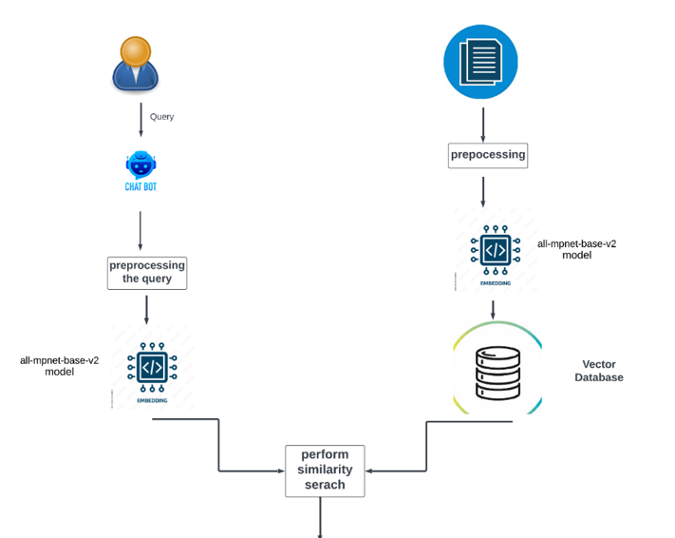
PROJECT MODULES

Slide 16
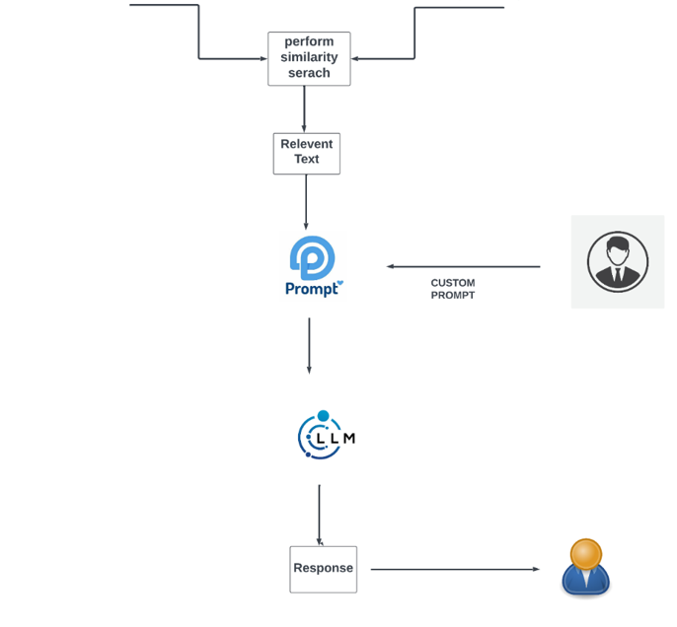
PROJECT MODULES

Slide 17
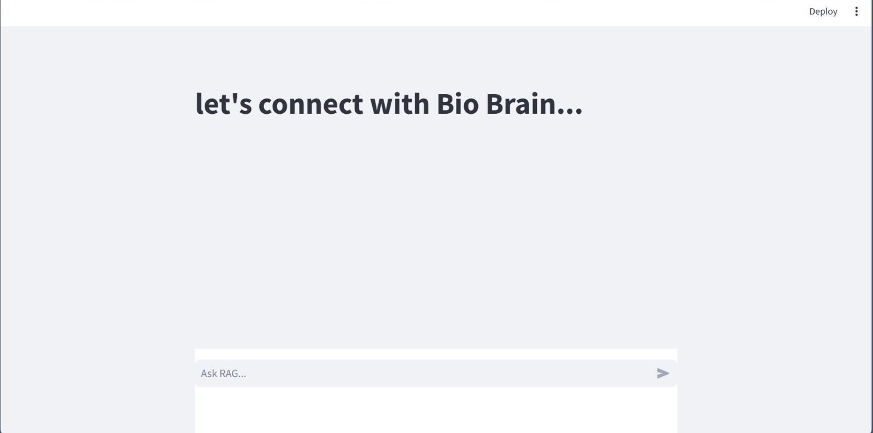
Module_1:Interface Overview

Slide 18
Module1-Processing the document in the backend
Module 1.1: Preprocessing the document by the preprocessor
Documents: The process begins with the collection of documents, which contain the relevant information and content needed for the chatbot.
Pre-process: These documents undergo a preprocessing stage where the text is cleaned, normalized, and formatted for further analysis. This may include steps such as removing special characters, correcting types, and tokenizing text into manageable units.

Slide 19
Module1-Processing the document in the backend
Sentence Transformers convert sentences and paragraphs into dense vector embeddings. These embeddings are high-dimensional vectors that encode the semantic meaning of the text, making them useful for tasks that require understanding the nuances of language.
Sentence Transformers come with several pre-trained models optimized for different tasks and datasets. The all-mpnet-base-v2 model, for instance, is known for its robust performance in generating high-quality embeddings for various application.
These models learn to map similar words to nearby points in a high-dimensional space based on their context in a large corpus of text. Embeddings are crucial for tasks such as text classification, sentiment analysis, and information retrieval, as they enable machines to understand and process human language more effectively.
They also facilitate transfer learning, where pre-trained embeddings can be fine-tuned for specific applications, enhancing performance with less training data
Module-1.2:Genarating the embeddings
.

Slide 20
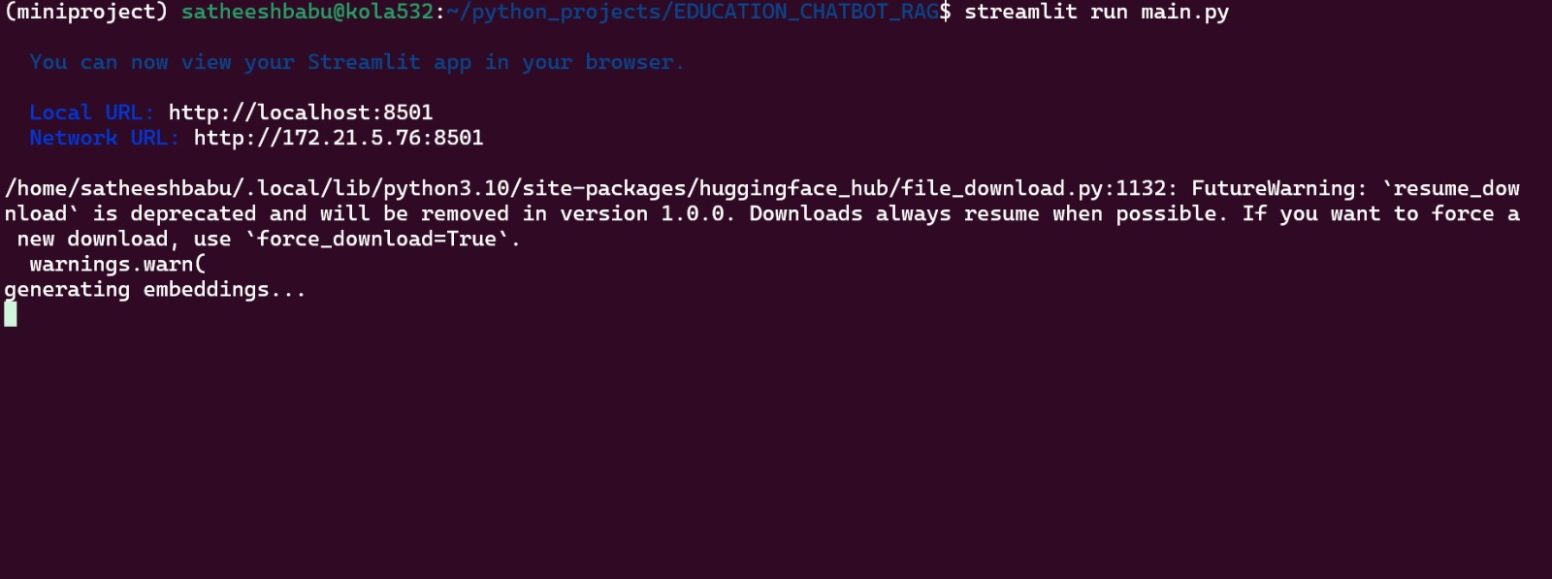
Module 1.2:Embedding Generation
Document Embedding Generation:
All documents and relevant texts are preprocessed and passed through the all-mpnet-base-v2 model to generate dense vector embeddings. These embeddings are stored in a vector database for efficient retrieval.
After processing the text through transformer layers, Sentence Transformers use pooling layers to aggregate the contextual information into a single fixed-size embedding. Common pooling strategies include mean-pooling, max-pooling, or using the CLS token's representation.
The output is a document embedding, represented as a vector (e.g., <0.1, 0.4, -0.2, ...>), which can be efficiently stored and retrieved.

Slide 21
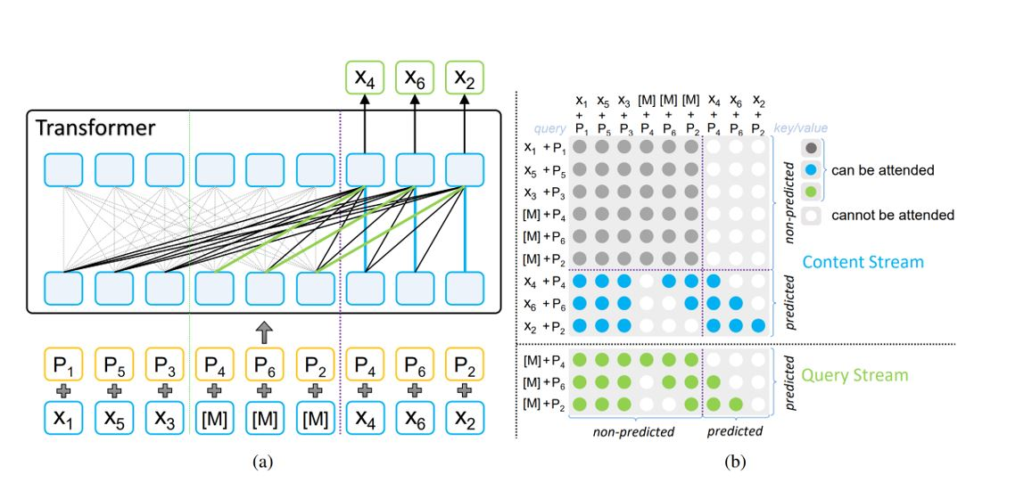
Module1.2: Embedding Generation
MPNET Embedding Architecture:
This is a pre-trained deep learning model used to create numerical representations (embeddings) of text. It analyzes the context of words and captures their semantic meaning and relationships.
In RAG, the MPNET model takes queries and document chunks as input and generates dense vectors for each. These vectors represent the meaning of the text in a high-dimensional space.
In the context of the MPNet architecture, the symbols x1, x2, x3, x4, x5, and x6 represent individual tokens or words within an input sentence. These tokens are the fundamental units of text that the model processes. The symbols p1, p2, p3, p4, p5, and p6 represent the positional embeddings associated with each token. Positional embeddings provide information about the location of each token in the sentence, which is crucial for the model to understand the order and relationships between words

Slide 22
Module1.2: Embedding Generation
Here's a breakdown of the flow:
1. Input: The input sentence is tokenized (split into individual words or sub words) and converted into embeddings (x1, x2,..., xn) along with their corresponding positional embeddings (p1, p2..... pn).
2. Permutation: The order of the tokens is randomly permuted (shuffled). This is a key aspect of MPNet, as it helps the model learn bidirectional relationships between words.
3. Masking: Some of the tokens in the permuted sequence are masked, meaning they are replaced with a special "[MASK]" token.
4. Two-Stream Processing: The masked sequence is then processed by two parallel streams:
Content Stream: This stream receives the entire permuted sequence, including both masked and non-masked tokens. It processes the full context of the sentence.
Query Stream: This stream receives the permuted sequence with masked tokens. It focuses on predicting the masked tokens based on the context provided by the content stream.

Slide 23
Module1.2: Embedding Generation
5. Self-Attention: Both streams use self-attention mechanisms to weigh the importance of different tokens in the sequence. The query stream attends to the non-masked tokens in the content stream to gather information for predicting the masked tokens
6. Position Compensation: The query stream also incorporates positional information to compensate for the fact that it cannot see the masked tokens directly. This helps maintain consistency between pre-training and fine-tuning.
7. Prediction: The query stream produces output probabilities for each possible token that could fill the masked positions. The model is trained to maximize the probability of predicting the correct masked tokens.
In essence, the arrows represent the flow of token and positional embeddings through the MPNet model, highlighting the interaction between the content and query streams, the role of self-attention, and the incorporation of positional information for accurate language understanding
.

Slide 24
Module_1.3-Vector Database Storage
Vector databases are designed to handle high-dimensional vector data, enabling efficient storage, retrieval, and similarity search. MongoDB Atlas, the cloud-based managed database service by MongoDB, has introduced features that support vector data, making it suitable for applications that require handling embeddings and performing similarity searches.
MongoDB allows the creation of specialized indexes to support fast vector search queries. These indexes can be used to accelerate the performance of similarity search operations.
Before storing vectors, the data (e.g., documents, images) is preprocessed to extract relevant features or embeddings using models like Sentence Transformers. The output is a high-dimensional vector that represents the semantic content of the data.

Slide 25
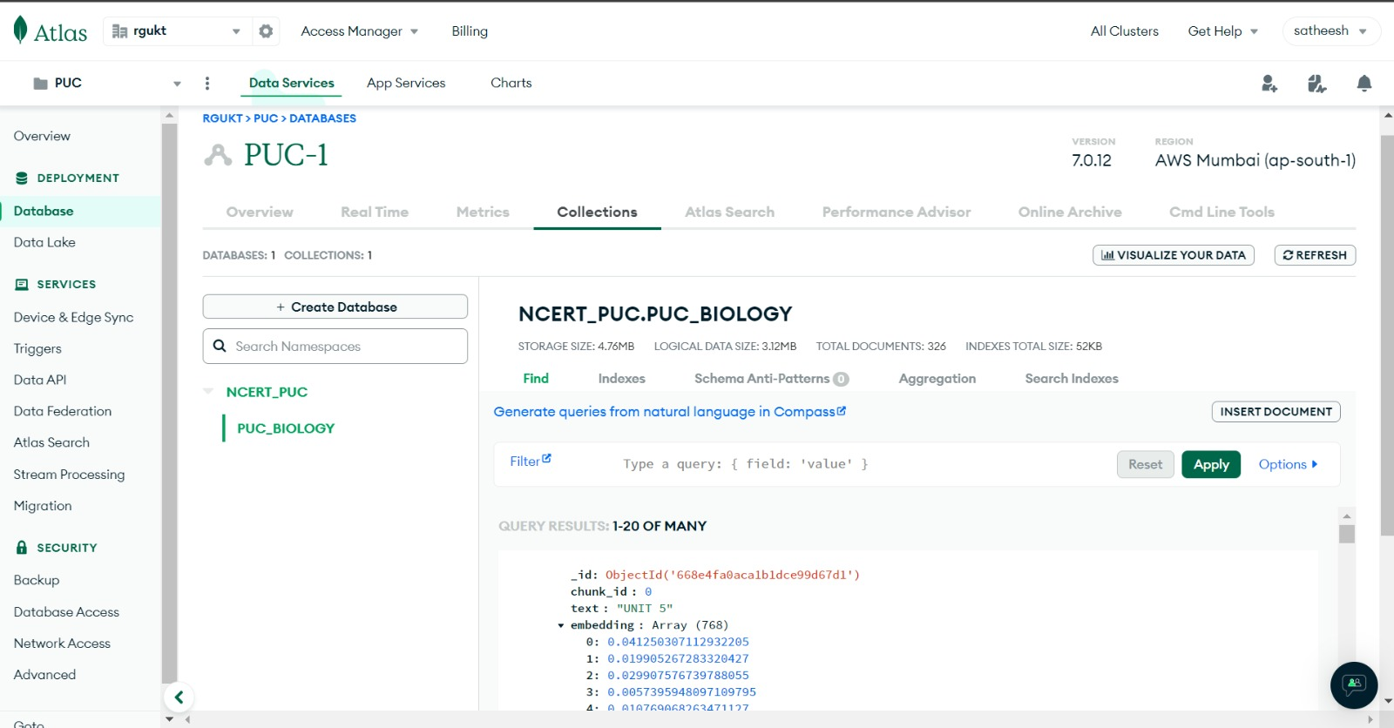
Module_1.3-Vector Database Storage
Document Structure:
Each document in MongoDB Atlas can include the original data (e.g., text, metadata) and the corresponding vector embedding.
These documents are inserted into a MongoDB collection. MongoDB’s flexible schema allows storing vectors as arrays within the document, ensuring all relevant information is stored together.

Slide 26
Module_2-User Query Submission and Processing
Module_2.1-User Query Submission
1.User Interface Interaction
The user interacts with a web-based interface that allows for seamless query submission. The interface is designed to be intuitive and user-friendly, ensuring that students can easily navigate and utilize the chatbot's features.
Text Input Field: A clearly marked text box where users can type their questions. This field supports natural language input, enabling users to phrase their questions as they would in a conversation.
2.Query Submission
Once the user has entered their query or uploaded an image, they initiate the submission process by clicking the "Submit" button. The interface captures the query data and sends it to the backend for processing

Slide 27
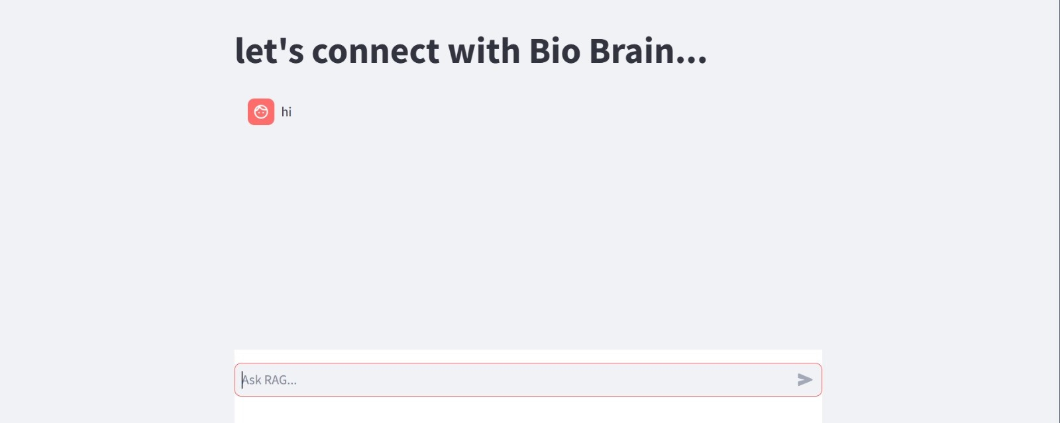
Module_2.1-User Query Submission

Slide 28
Module_2.2-Prepocessing the query
Data Handling and Preprocessing
Upon receiving the query, the backend performs initial data handling and preprocessing to ensure the input is in a suitable format for further processing.
Text Queries: The text input is cleaned and tokenized. Cleaning involves removing unnecessary whitespace, correcting common types, and normalizing text to a consistent format. Tokenization breaks the text into smaller units (tokens), which are easier for the AI models to process.

Slide 29
Module_2.2-Text to vectors
Query Embedding Generation:
When a user submits a query, it is similarly preprocessed and transformed into an embedding using the same all-mpnet-base-v2 model. This ensures that both document and query embeddings are in the same vector space, facilitating accurate similarity comparisons.
To facilitate efficient information retrieval and response generation, the preprocessed text or extracted text from images is converted into embeddings. Embeddings are dense vector representations of text that capture semantic meaning.

Slide 30
Module_2-Retriving Relevant information
The query embedding is used to search the vector database for relevant documents. The database retrieves documents whose embeddings are most similar to the query embedding, based on cosine similarity
Semantic and Similarity Techniques
Semantic Embeddings:
Semantic embeddings are dense vector representations of text (or other data) that capture the meaning and context of the content. These embeddings are generated using models like Sentence Transformers, which transform input text into high-dimensional vectors.
he core idea is that semantically similar pieces of text will have similar embeddings, meaning their vectors will be close to each other in the embedding space.
.

Slide 31
Module_2-Retriving Relevant information
Similarity Search:
Similarity search involves comparing the query embedding with embeddings stored in the database to find the closest matches. The measure of "closeness" or similarity can be computed using various mathematical techniques, with cosine similarity being one of the most common.
Cosine Similarity:
This is a mathematical metric used to compare the direction of two vectors. It measures how closely aligned the vectors are in the high-dimensional space.
In RAG, cosine similarity is applied to the dense vectors generated by the MPNet model for the query and each document chunk.
A higher cosine similarity score indicates the document chunk's vector is closer in direction to the query vector, suggesting greater semantic similarity between the document and the user's query.
Cosine similarity is a metric used to measure how similar two vectors are. It calculates the cosine of the angle between two vectors in a multidimensional space. The cosine similarity value ranges from -1 to 1

Slide 32
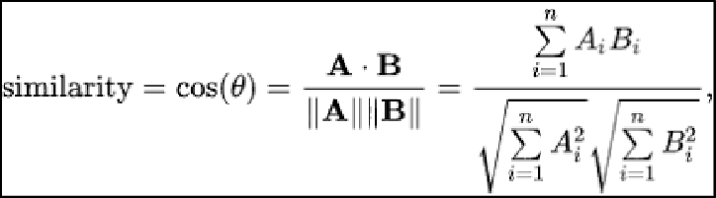
Module_2-Retriving Relevant information
The standard formula for cosine similarity
Dense Retriever:
This is a component in RAG responsible for retrieving relevant information based on the user's query.
It leverages the MPNet model and cosine similarity to identify document chunks that are semantically similar to the query.
The dense retriever ranks the document chunks based on their cosine similarity scores with the query. The top-ranked chunks are considered the most relevant and are then provided to the large language model (LLM) for the generation process.

Slide 33
Module_3-Prompt to LLM and response
Module 3.1: Feeding the Prompt to the LLM
Input the contextualized prompt into the LLM (e.g., LLaMA) to generate a response. LLAMA is a family of large language models developed by Meta AI. It’s designed to perform a wide range of natural language processing (NLP) tasks, including text generation, question answering, translation, and more.
Integrating LLAMA for Question Answering:
In this project, LLAMA is used as the core engine for generating responses to student queries. When a student asks a question, LLAMA processes the contextualized prompt created by the system and generates a detailed and accurate answer.
The use of LLAMA ensures that responses are coherent, contextually relevant, and informative, enhancing the learning experience for biology students.

Slide 34
Module_3-Prompt to LLM and Response
Handling Complex Queries:
LLAMA’s ability to understand and generate text based on complex prompts allows it to handle intricate and multi-faceted questions from students. This is particularly useful in subjects like biology, where concepts can be interrelated and require detailed explanations.
Model Architecture:
LLaMA uses a transformer-based architecture, characterized by its self-attention mechanism that enables the model to weigh the importance of different words in a sentence, capturing the context effectively.
The architecture includes multiple layers of attention and feedforward networks, allowing it to build complex representations of text.

Slide 35
Module_3-Prompt to LLM and Response
Supporting Multiple Languages and Formats:
Given its training on a diverse dataset, LLaMA can understand and respond to queries in multiple languages and formats. This versatility is beneficial in an educational setting where students may express their queries in various ways.
Key Features of LLaMA:
Scalability: LLaMA models are designed to scale efficiently, with versions containing billions of parameters, allowing them to understand and generate human-like text with high accuracy.
Pre-training on Diverse Data: These models are pre-trained on a diverse corpus of text from various sources, ensuring they have a broad understanding of language and knowledge across different domains.
Fine-tuning Capabilities: LLaMA can be fine-tuned on specific datasets to improve performance on particular tasks or domains, making it highly adaptable.

Slide 36
Module_3-Prompt to LLM and Response
Advantages of Using LLaMA
High Accuracy and Coherence:
LLaMA’s advanced architecture and extensive training ensure that its responses are accurate and coherent, providing students with reliable information.
Scalability:
The model’s ability to handle large-scale data and its efficiency in processing make it suitable for use in educational environments with potentially high query volumes.
Adaptability:
The fine-tuning capabilities of LLaMA allow it to be tailored to specific educational content, ensuring that the responses are directly relevant to the students’ curriculum.
Comprehensive Understanding:
LLaMA’s extensive training dataset means it has a broad understanding of language and knowledge, which is beneficial in providing comprehensive answers to diverse queries.

Slide 37
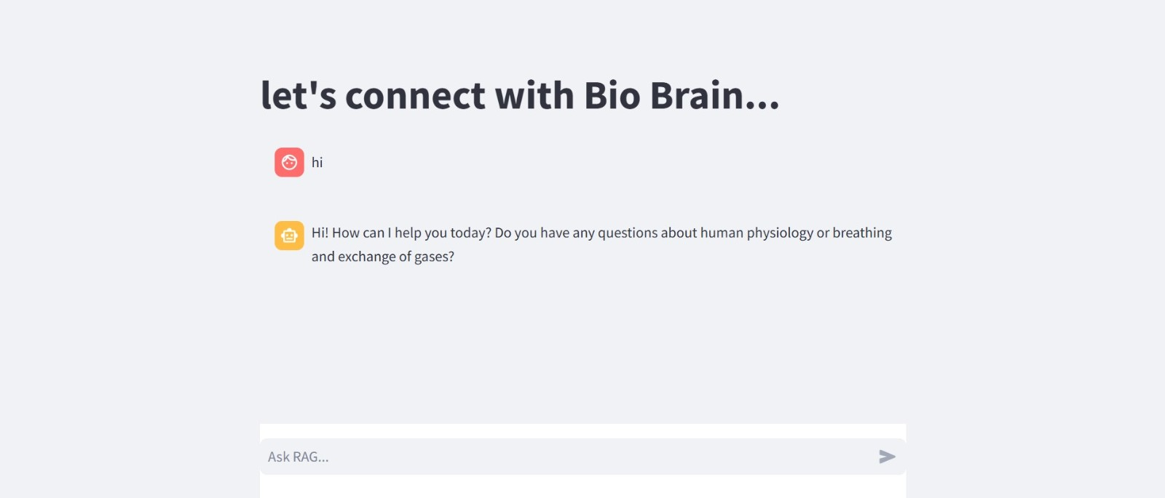
Module_3-Prompt to LLM and Response
Module_3.2: Response to user query
The generated response is sent back to the user, completing the interaction cycle. The user receives a detailed answer to their query, supported by the integrated information from the knowledge base and the LLM's generative capabilities.

Slide 38
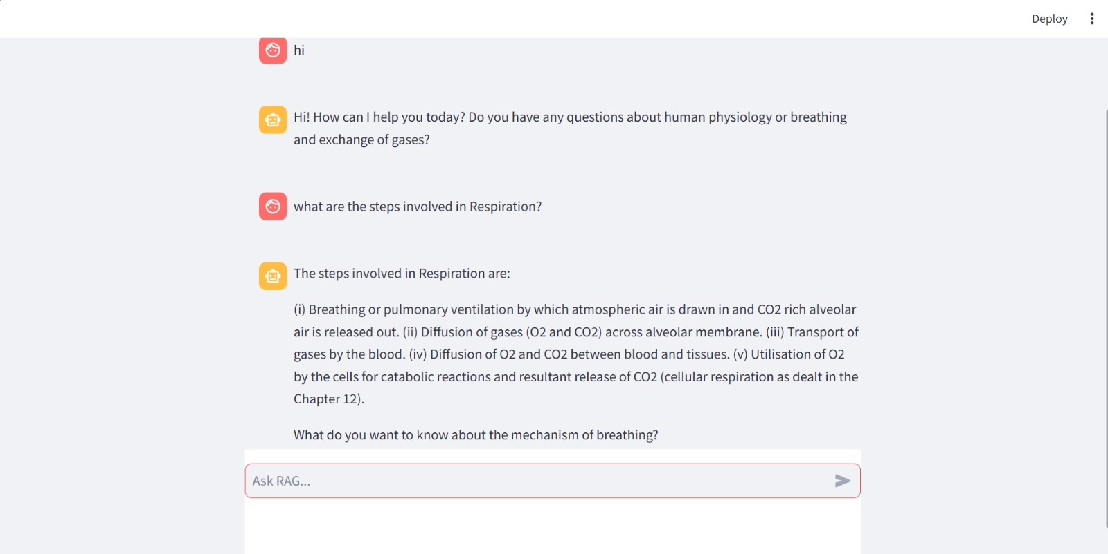
Module_3-Prompt to LLM and Response
Displaying Output:

Slide 39
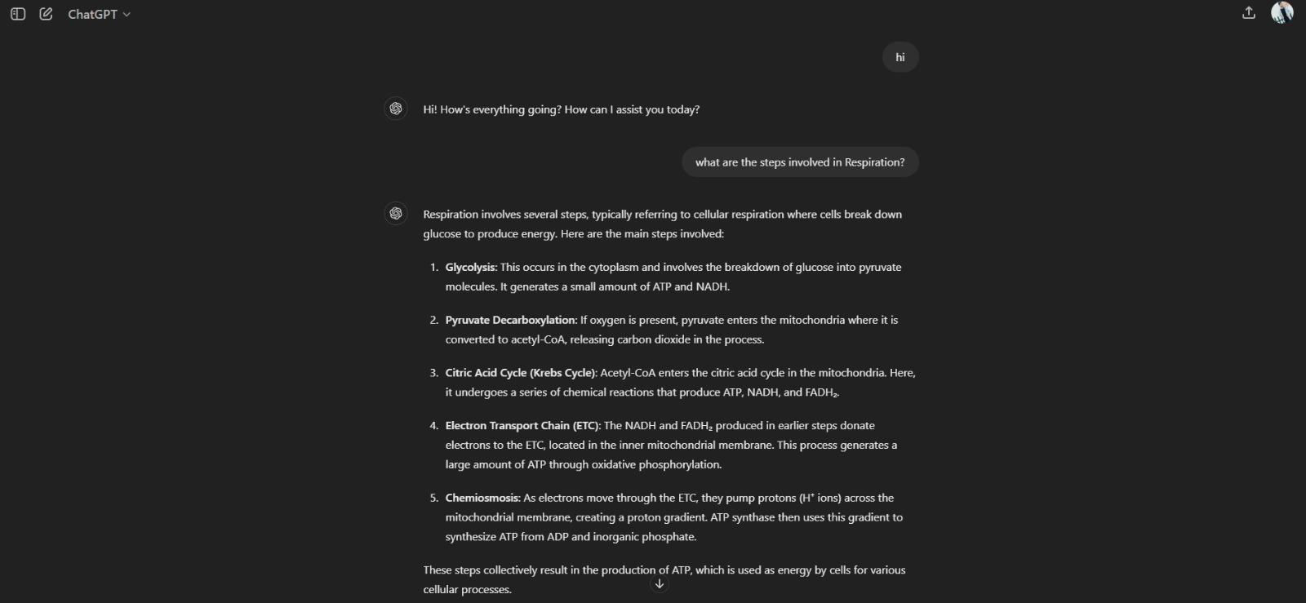
Response of chatgpt
Comparision between LLM and ChatGpt:

Slide 40
the student asked the query to the LLM chatbot and submit the query. Then the chatbot is responded to the query which is relevant to the NCERT textbook.
we clearly saw the difference between chatbot and ChatGPT. chatbot give the accurate and relevant answer to the query. ChatGPT. Gets the information from the worldwide content.
LLM chatbot helps to student to get the accurate answers to solve their doubts and get good grade in academics.

Slide 41
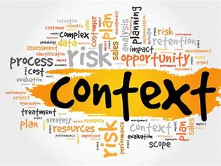

CONCLUSION AND FUTURE ENHANCEMENT
In conclusion, this project represents a significant advancement in the realm of educational technology, specifically tailored to support biology students in their academic pursuits. By leveraging the capabilities of Large Language Models (LLMs) like LLaMA and cutting-edge techniques such as Retrieval-Augmented Generation (RAG), the chatbot offers a robust platform for personalized learning and academic assistance. Through meticulous prompt designing, seamless integration of embedding models like Sentence Transformers, and the strategic utilization of a vector database such as MongoDB Atlas, this system ensures high accuracy and relevance in responding to student queries. The inclusion of features like semantic search, cosine similarity, and advanced contextual prompt creation further enhances the chatbot's ability to provide detailed, contextually appropriate answers.
The future scope of this project is expansive, with potential for multidisciplinary expansion, integration with educational platforms, enhanced interactivity, and continuous learning. By adopting adaptive learning algorithms, voice interaction, advanced NLU capabilities, and collaborative learning features, the chatbot can evolve into a comprehensive educational tool. Moreover, the focus on data analytics, gamification, scalability, and ethical AI practices positions this project to significantly impact modern education, fostering an engaging and equitable learning environment for all students.

Slide 42
REFERENCES
1 .Zhao, P., Zhang, H., Yu, Q., Wang, Z., Geng, Y., Fu, F., Yang, L., Zhang, W., Jiang, J., & Cui, B. (2024). Retrieval-Augmented Generation for AI-Generated Content: A Survey. arXiv preprint arXiv:2402.19473.
2.Song, K., Tan, X., Qin, T., Lu, J., & Liu, T.-Y. (2020). MPNet: Masked and Permuted Pre-training for Language Understanding. In Advances in Neural Information Processing Systems (NeurIPS 2020)
3.Karpukhin, V., Oğuz, B., Min, S., Lewis, P., Wu, L., Edunov, S., Chen, D., & Yih, W.-t. (2020). Dense Passage Retrieval for Open-Domain Question Answering. In Proceedings of the 2020 Conference on Empirical Methods in Natural Language Processing (EMNLP) (pp. 6769–6781).
4.Touvron, H., Lavril, T., Izacard, G., Martinet, X., Lachaux, M-A., Lacroix, T., ... Lample, G. (2023). LLaMA: Open and Efficient Foundation Language Models. arXiv preprint arXiv:2302.13971.

