Slide 1
8. Sarcasm Detection in Social Media
Presenter
Satheeshkumar Karuppusamy
Sumaya Satheesh

Slide 2
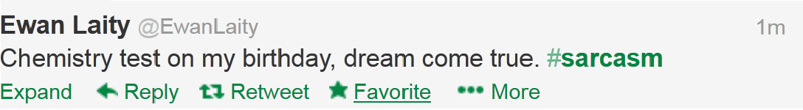
WHAT IS SARCASM?
The activity of saying or writing the opposite of what you intended to express

Slide 3
MOTIVATION1
Social Media – global hub for Opining Mining
opinion of the mass towards products, brands, events, people and so on
3% results of Product Review mining systems can be improved by handling negations especially expressions like Sarcasm
Sarcasm Identification System will improve the correctness of Sentiment Analysis, Brand Monitoring and Product Review Summarization Systems in Social media

Slide 4
MOTIVATION2
Analyzing the Sentiments of Trending Topics
Klout with positive/negative influence
#Sir Ravindra Jadeja, #Justin Beiber
Viral Nature of Social Media
Twitter Political Index(Topsy) analysis of 2013 election

Slide 5
Existing System
System1 [1]: Semi-Supervised Recognition of Sarcastic Sentences in Twitter and Amazon : Dmitry Davidov, Oren Tsur, Ari Rappoport
Main Focus
Pattern based features
Product reviews
[PRODUCT][COMPANY]
[TITLE]
DataSet Used
Amazon Reviews,Twitter data
DisAdvantages
Generating Patterns for non product reviews-tedious
Annotation requiers more labour

Slide 6
Existing System
System2 [2]: Unsupervised System
Main Focus
Syntactic Features :
1. Lexical Features - Unigrams
Pragmatic Features
1. LIWC
2. @REPLY
DataSet Used
Twitter data
2700 tweets with #sarcasm hash tag for training
Manually filtered
Very Small dataset

Slide 7
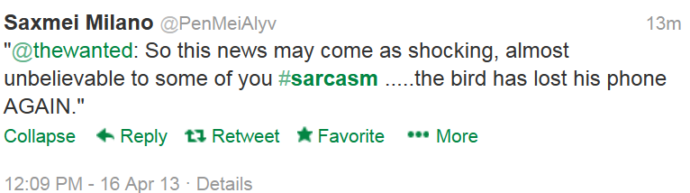
WHY IS IT SO DIFFICULT ..!?
Subjective
Restaurant X is running this $3 off deal again
Needs more context specific Information
Lack of Cues in written Text
Even humans themselves disagree with boundaries of sarcasm

Slide 8
PROPOSED WORK
Classification techniques are applied to classify Sarcastic content from Social Media data
Non-Sarcastic Tweets → Actual Positive and Negative Tweets
Sarcastic Tweets → Pseudo Positive and Pseudo Negative Tweets
SVM Learning Algorithm is applied
Binary Classifier s:
Sarcastic Tweets vs Positive Tweets
Sarcastic Tweets vs Negative Tweets
Sarcastic Tweets vs Non-Sarcastic Tweets
Multiclass Classifier:
Positive vs Negative vs Sarcastic Tweets
Evaluation Metric : F1Score, Accuracy of Classification

Slide 9
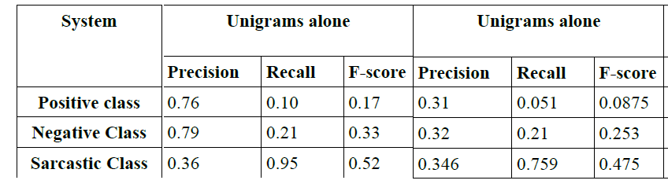
BASELINE SYSTEM
Positive vs Negative vs Sarcasm classification system with Unigrams, Bigrams and Trigrams features

Slide 10
DATA DESCRIPTION
Train Data
Tweets with #sarcasm, #sarcastic, #happy, #joy, #sad hash tags are collected using Twitter API
20K tweets are collected in each section
Filtered(tweets ending with #sarcasm alone are chosen) to 5K tweets of Positive, Negative and Sarcastic tweets each
Test Data
Tweets #sarcasm, #sarcastic, #happy, #joy, #sad hash tags are collected
1K tweets are prepared for each section Positive, Negative and Sarcasm classes
Sarcastic and Non-Sarcastic Facebook statuses of about 350 are collected

Slide 11
FEATURE SET DESCRIPTION
Lexical Features :
1. Unigrams
2. Bigrams
3. Trigrams
Pragmatic Features :
1. Binary features specifying whether a Tweet has '@' symbol
2. Presence of Exclamation marks and Question marks
3. Emoticon based features
4. Interjections(words like aah,boo,huraa,jeez,etc...)

Slide 12
FEATURE SET DESCRIPTION
Dictionary and Part of Speech Based Dictionary Features :
NRC-Emotion Lexicon Features
Count of each POS Tags in a tweet
Sum of Polarities across similar POS Tags
Sum of Polarities of all words in a tweet
Topic Based Features :
1. Topic distribution for each tweet predicted by Mallet

Slide 13
FEATURE SELECTION PROCESS
Find the best performing features for Postive vs Sarcasm Binary classifier and Negative vs Sarcasm Binary Classifier
Leave one out Cross Validation is performed for these binary classifiers and the best performing features are tuned based on decrease in Xi-Alpha estimates of error rate
Apply those features on the Positive vs Negative vs Sarcasm Classifier and Non-Sarcasm vs Sarcasm classifiers

Slide 14
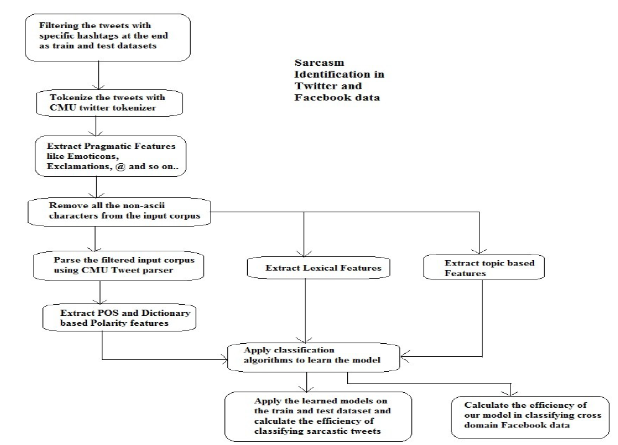
SYSTEM WORK FLOW

Slide 15
TOOLS USED
ARK CMU Twitter NLP Tools for tokenization and Part of Speech Tagging[5]
SVM Light, SVM Multi-class [4]
NRC-Emotion Lexicon Dictionary[6]
MALLET[7]
Twitter API

Slide 16
RESULTS(Positive vs Sarcasm)
Classifier | Unigram, Trigram, ReplyFeature, Positive Negative Polarity Feature(Dictionary based)
 | Precision | Recall | F Score | Accuracy
Positive Class(Train) | 0.624565469 | 0.8624 | 0.724462366
Sarcasm Class(Train) | 0.777777778 | 0.4816 | 0.59486166 | 0.672
Positive Class(Test) | 0.545217957 | 0.838 | 0.660622783
Sarcasm Class(Test) | 0.650107991 | 0.301 | 0.411483254 | 0.5695

Slide 17
RESULTS(Negative vs Sarcasm)
 | Unigram, Trigram, ReplyFeature, Positive Negative Polarity Feature(Dictionary based)
 | Precision | Recall | F Score | Accuracy
Negative Class(Train) | 0.713064713 | 0.584 | 0.64211105
Sarcasm Class(Train) | 0.647756139 | 0.765 | 0.701513067 | 0.6745
Negative Class(Test) | 0.6 | 0.588 | 0.593939394
Sarcasm Class(Test) | 0.596078431
 | 0.596078431373 | 0.608 | 0.598

Slide 18
RESULTS(positive vs negative vs sarcasm)
Classifier | Unigram, Trigram, ReplyFeature, Positive Negative Polarity Feature(Dictionary based)
 | Precision | Recall | F Score | Accuracy
Positive Class(Train) | 0.505203762 | 0.8058 | 0.621040462
Negative Class(Train) | 0.560040363 | 0.666 | 0.60844144
Sarcasm Class(Train) | 0.733666666667
 | 0.96570899 | 0.2884 | 0.342819543
Positive Class(Test) | 0.407224959 | 0.744 | 0.526353024
Negative Class(Test) | 0.48395967 | 0.528 | 0.505021521
Sarcasm Class(Test) | 0.487804878 | 0.26 | 0.339204175 | 0.666

Slide 19
RESULTS(sarcasm vs non-sarcasm)
Classifier | Unigram, Trigram, ReplyFeature, Positive Negative Polarity Feature(Dictionary based)
 | Precision | Recall | F Score | Accuracy
Non Sarcasm (Train) | 0.712734805 | 0.9979 | 0.831548685
Sarcasm Class(Train) | 0.978978979 | 0.3956 | 0.563494845 | 0.730466667
Non Sarcasm(Test) | 0.66950017 | 0.9845 | 0.797004655
Sarcasm Class(Test) | 0.474576271 | 0.28 | 0.352201258 | 0.598

Slide 20
PERFORMANCE ANALYSIS
@REPLY, Trigram features are the top performing features followed by unigram features occupies major role in sarcasm identification - Sarcasm(Pattern based)
With Smaller Dataset, topic modeling is not found to be that much helpful in Sarcasm Identification process.
Interjections occur in all kind of expressions - Positive, Negative and Sarcastic. No use of having a common Interjection feature
Polarity feature applied across tweet level works better than applying across individual words

Slide 21
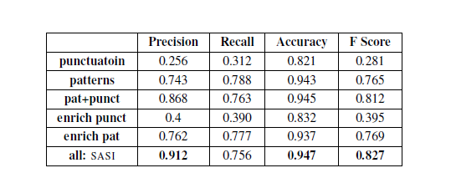
PERFORMANCE COMPARISON
System1[1]
System2[2]
System2 Classifier | Unigrams alone | With Dictionary Features
S-P-N (Unigrams) | 57.22 | 55.59
S-NS | 65.44 | 61.22

Slide 22
CONCLUSION and IMPACT
Automatic Data preparation and Annotation(‘#hashtag’ ) from Content rich Social Media like twitter, though noisy, provides promising results.
Can save annotation cost and human labor.
Paves way to develop Domain Independent Sarcasm Identification Systems – Not just product review systems
The effect of noisiness in annotation will be subsided with increase in the size of the dataset
Improvement in Sarcasm Identification Systems will definitely improve the Content Mining process in Social Media

Slide 23
QUESTIONS….!!!!

Slide 24
REFERENCES
[1] Identifying Sarcasm in Twitter: A Closer Look , Roberto González-Ibáñez,Smaranda Muresan, Nina Wacholder
[2] Semi-Supervised Recognition of Sarcastic Sentences
in Twitter and Amazon, Dmitry Davidov, Oren Tsur, Ari Rappoport
[3] Sentiment Analysis of Twitter Data, Apoorv Agarwal,Boyi Xie,Ilia Vovsha, Owen Rambow, Rebecca Passonneau

Slide 25
REFERENCES
[4] T. Joachims, Making large-Scale SVM Learning Practical. Advances in Kernel Methods - Support Vector Learning, B. Schölkopf and C. Burges and A. Smola (ed.), MIT-Press, 1999.
[5]Improved Part-of-Speech Tagging for Online Conversational Text with Word Clusters
[6]Saif Mohammad and Peter Turney, Crowdsourcing a Word-Emotion Association Lexicon
[7] McCallum, Andrew Kachites. "MALLET: A Machine Learning for Language Toolkit." http://mallet.cs.umass.edu. 2002.

Slide 26
THANKS FOR BEARING WITH ME…………!!!!!
HONESTLY ..! ☺

