Slide 1
Mission.me
Impact Investing for All
Group 6
Austin Avent
Sylvia Li
Satheesh Narasimman

Slide 2
EXECUTIVE SUMMARY
Impact Investing, aka Sustainable/Responsible/ESG Investing, seeks to deliver competitive financial returns while driving positive Environmental, Social and Governance (ESG) outcomes.
Impact investing is gaining significant momentum among asset managers, but very few outlets exist to address retail needs.
Our mission is to develop an investing tool to democratize impact investing: Mission.me
To achieve this goal, we need to find objective parameters to measure US ESG performance, and identify investment ideas to help investors incorporate these ESG missions into their investment strategies.
We carried out a Monte Carlo analysis to help investors vet investment ideas and build ESG portfolios, based on the ESG issue that concerns them the most.
Notes:
Sylvia Li

Slide 3
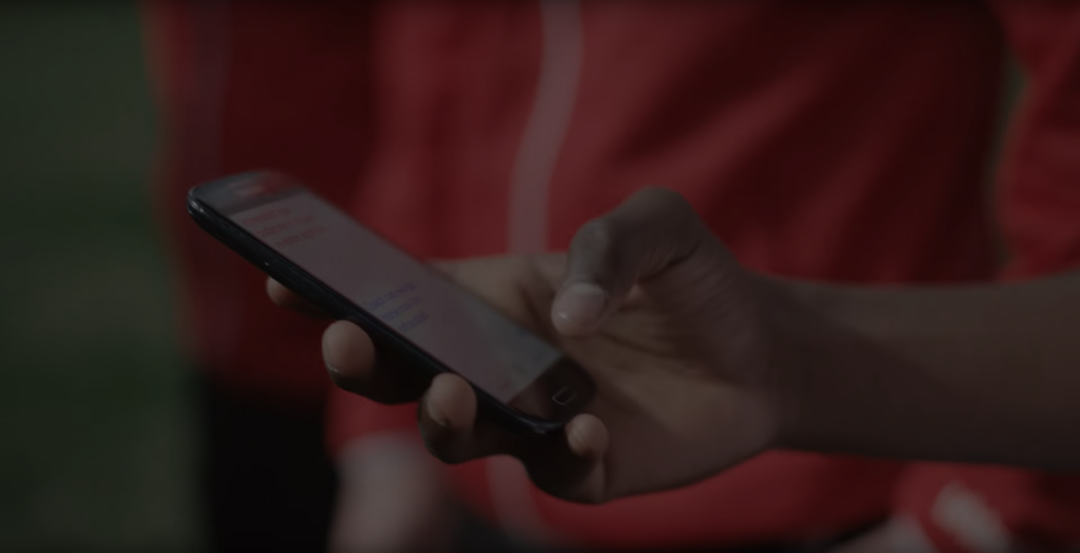



Meet Taylor
Age: 25
Pronouns: she/her/hers
Top ESG issue on her mind: Environment
Financial goal
Saving for a dream vacation in Spring 2022, she’s comfortable with equity ETF exposure
Why she Mission.me
“I always knew I wanted to do something positive but I didn’t really have a top ESG issue until I used the app. I love that the app shows me how US is performing against other countries on a variety of ESG indicators and that was when I realized I most care about the environment.
I use the app to see how I’m tracking towards my financial goal, and at the same time, what percentage of my investments is in companies helping reduce CO2 emissions.”
Story for illustration purposes only
Notes:
Sylvia Li

Slide 4

Meet Adam
Age: 35
Pronouns: they/them/their
Top ESG issue on their mind: healthcare, diversity
Financial goal
Adam just welcomed their first child and is looking to start saving for the child’s education
Why they Mission.me
“I can use the app to simulate my investment performance so I can visualize how this is tracking against my son’s expected education expenses. I also feel really good that it shows me a snapshot of how my investment is helping with causes to improve healthcare and diversity.
Not only I’m saving for my son’s future, I’m also helping build a better world for his generation.”
Story for illustration purposes only
Notes:
Sylvia Li

Slide 5
DATA PREPARATION AND CLEANUP
ESG Data
Exploration and cleanup process
Imported data as csv
Countries: we chose a list of 50 countries
Indicators: we selected 10 ESG indicators for a deep dive
Time: only the 2010s decade (10 years)
Insights you had while exploring the data that you didn't anticipate
We were pleasantly surprised to discover the quality and scope of ESG issues this database covers
Discuss any problems that arose after exploring the data, and how you resolved them
Missing data: missing year was removed and only available yearly data was analyzed
Some of the ESG indicators didn’t apply to developed countries, which were omitted
ETF Data
Exploration and cleanup process
Imported data as csv
Time: 5 years of historical data
Grouped ETFs under various ESG themes
Insights you had while exploring the data that you didn't anticipate
Financial performances of ESG ETFs vary, many of them didn’t outperform the S&P index
Discuss any problems that arose after exploring the data, and how you resolved them
While there are a lot of ESG-themed investments, there are still some main ESG issues that we couldn’t find actionable ETFs to address (such as income inequality). This shows the limitation of only considering ETF investments
The ETF database shows % of an ETF’s exposure to address ESG issues but no due diligence on whether portfolio holdings might cause other ESG risk
Notes:
Sylvia Li

Slide 6
ANALYSIS
How did we find an objective way of comparing ESG factors of U.S.A with other nations?
World Bank Sovereign ESG database here comprises of 67 indicators across 17 themes from three ESG pillars from 1961- 2019, which provides a transparent and balanced way of tracking ESG progress. It is widely adopted by policy makers and institutional investors
How did we find actionable ESG investment ideas for investors?
As passive investing is largely embraced by retail investors, we limited our scope to ETF investments.
ETFDB has a comprehensive list of ETFs across 35 ESG themes.
Added a few other ETFs (such as healthcare, biotech) that invest in companies to improve various ESG indicators.
Alpaca API was used to retrieve the historical financial performance of the ETFs.
Ran Monte Carlo simulation for each sector to project the cumulative return in 10 years.
Notes:
Sylvia Li

Slide 7
HIGH LEVEL VIEW OF TASKS
Monte Carlo simulation of future performance (10-year)
Trends of US ESG indicators over time (2010-2019)
Top 5 and Bottom 5 performers of an ESG Indicator
ESG Indicators |  |  |  | ESG ETFs
US relative performance to other countries
Cumulative returns distribution
Notes:
Satheesh

Slide 8
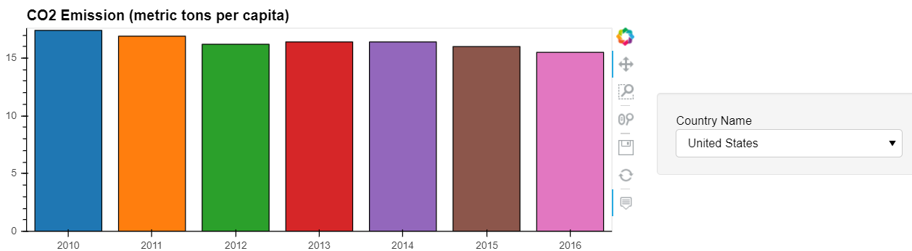
USA CO2 EMISSION
It has slowly reduced over the years
Notes:
Satheesh- Run through the graphs

Slide 9
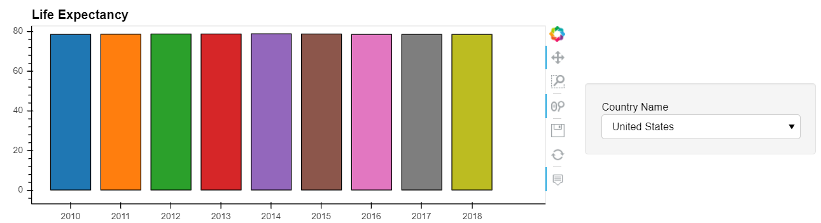
LIFE EXPECTANCY
USA has stayed almost steady with 78 years
Notes:
Satheesh

Slide 10
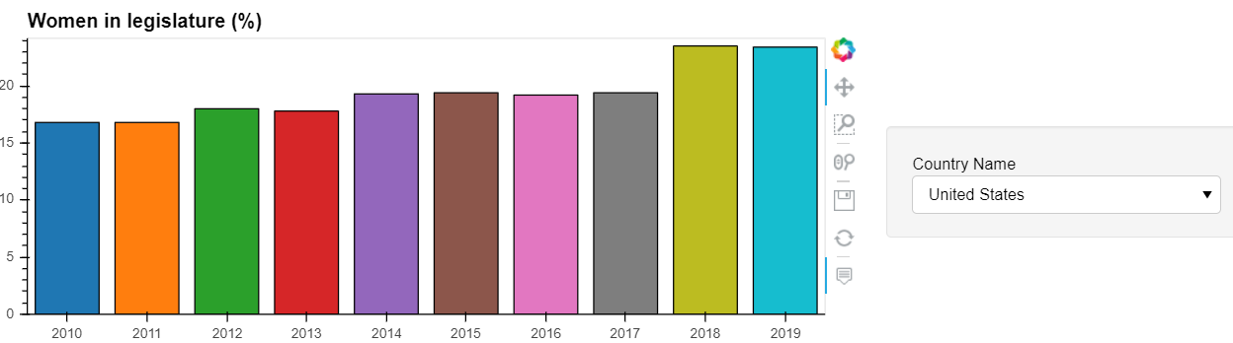
WOMEN IN LEGISLATURE
USA has seen a positive trend
Notes:
Satheesh

Slide 11
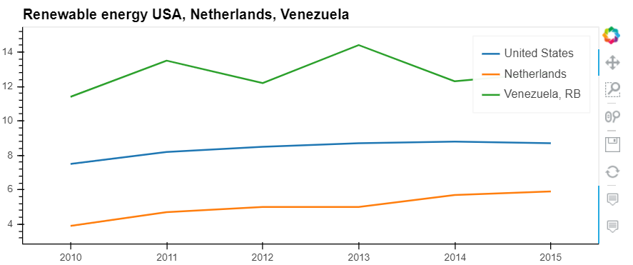
CLEAN ENERGY USAGE (%)
USA’s performance has been lackluster
Notes:
Satheesh

Slide 12
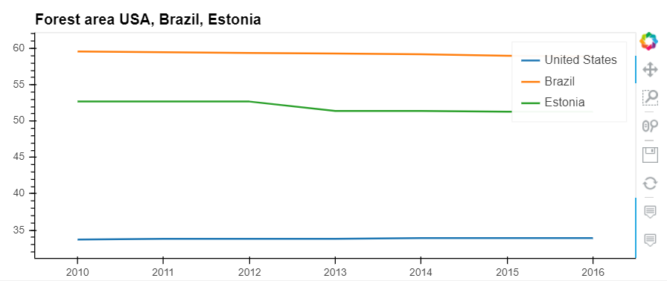
FOREST AREA (%)
USA is way below compared to Brazil and Estonia
Notes:
Satheesh

Slide 13
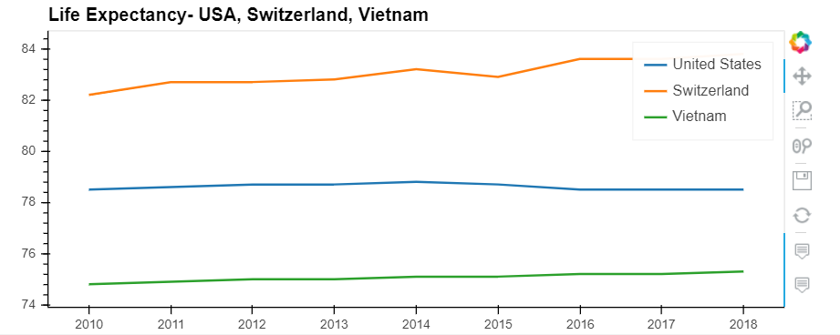
LIFE EXPECTANCY
USA’s curve is flat, it has not progressed in the last decade
Notes:
Satheesh

Slide 14
CUMULATIVE MEAN PERFORMANCE OF USA OVER THE 2010’s DECADE, AGAINST 50 OTHER COUNTRIES
Notes:
Satheesh

Slide 15
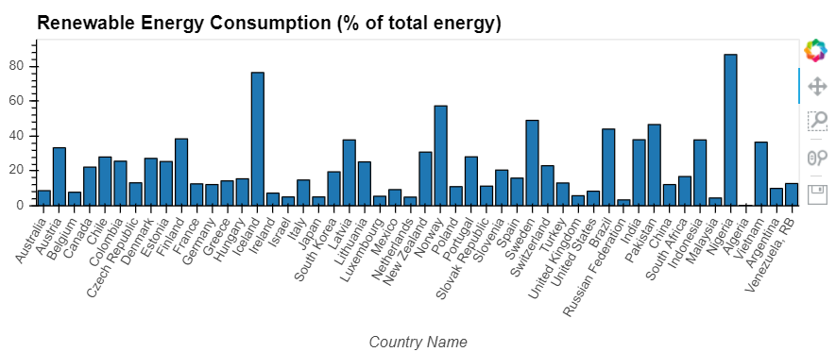
RENEWABLE ENERGY
US needs to improve on clean energy usage
Notes:
Satheesh

Slide 16
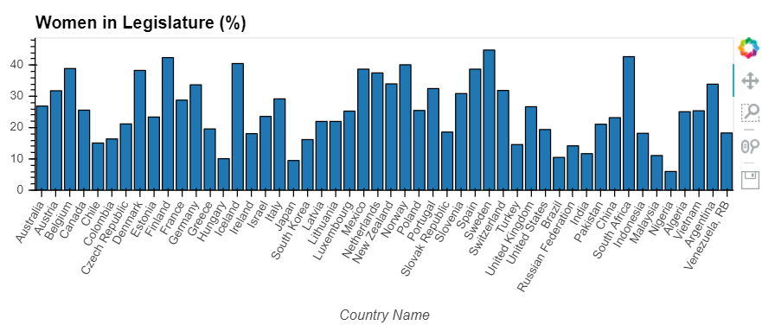
LEGISLATURE DIVERSITY
USA has improved over the years, but lags behind many countries
Notes:
Satheesh

Slide 17
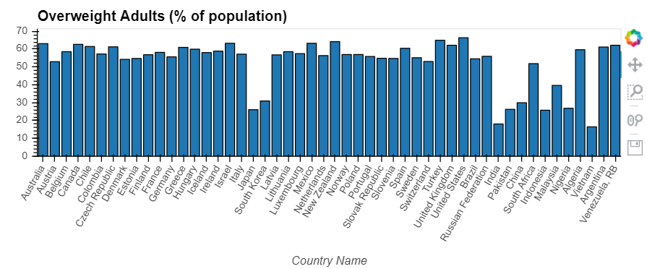
OVERWEIGHT ADULTS
US occupies the top position
Notes:
Satheesh

Slide 18
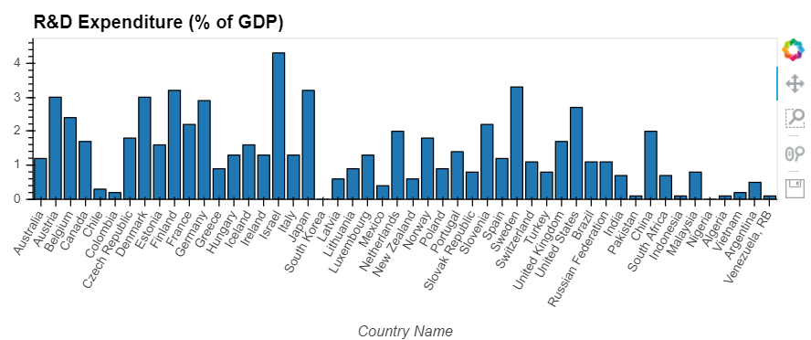
R&D EXPENDITURE
USA averaged 2.8%, whilst few countries are ahead
Notes:
Satheesh

Slide 19
CUMULATIVE RETURN DISTRIBUTION OF THE ETFs IN VARIOUS ESG SECTORS
Notes:
Austin- Run through the graphs

Slide 20
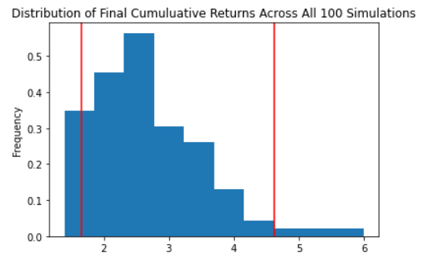
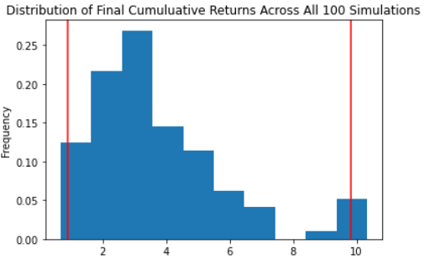
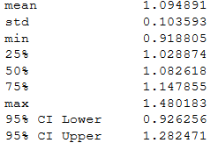
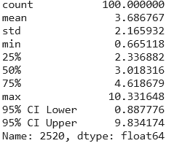
ESG ETF (Alternative Energy) vs S&P
Notes:
Austin

Slide 21
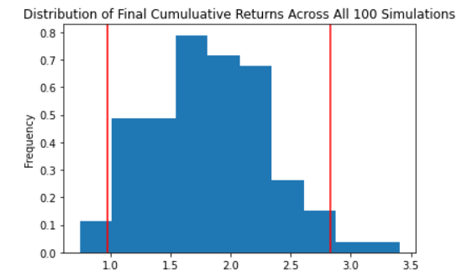
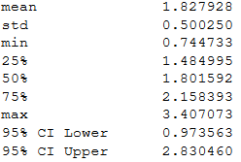
ESG ETF (Board Diversity) vs S&P
Notes:
Austin

Slide 22
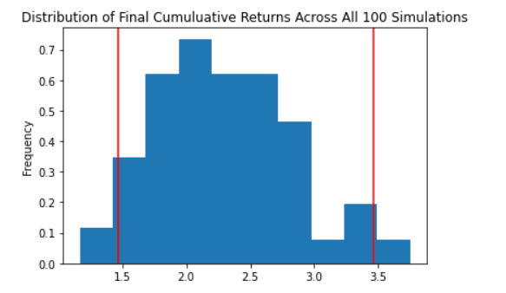
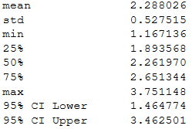
ESG ETF (Education) vs S&P
Notes:
Austin

Slide 23
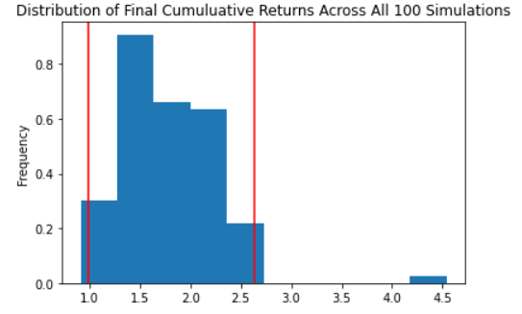
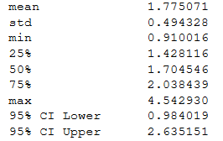
ESG ETF (Nuclear Power) vs S&P
Notes:
Austin

Slide 24
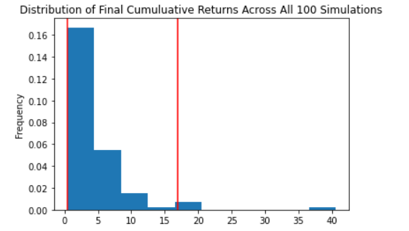
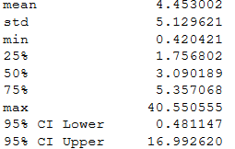
ESG ETF (Disease Treatment) vs S&P
Notes:
Austin

Slide 25
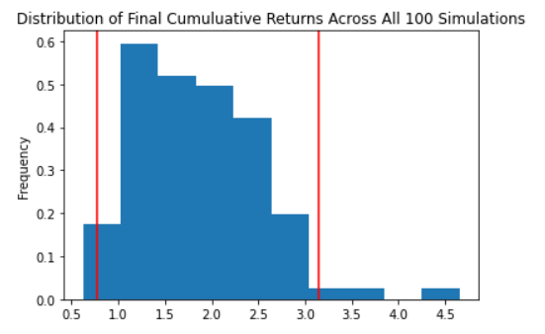
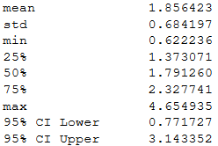
ESG ETF (Green Building) vs S&P
Notes:
Austin

Slide 26
CONCLUSION
We confirm our hypothesis that there is significant unmet need to help retail investors gain exposure to impact investing
We confirm our hypothesis that there is significant unmet need to help retail investors gain exposure to impact investing
There are a growing number of ESG ETFs but the measures of ESG scores/exposure of portfolio holdings are relatively limited
Future of portfolio analytics should include ESG scores to help investors track investment goals as well as how they are impacting the world
dd
On the whole, ETFs in many ESG themes severely underperform the S&P
What inferences or general conclusions can you draw from your analysis?
Large performance discrepancy amongst different ETFs so there is value to help investors choose better-performing funds while making the world better.
What inferences or general conclusions can you draw from your analysis?
We need to continue to enhance ESG investment framework and expand range of ESG investment options to retail investors
Notes:
AUSTIN/ SYLVIA

Slide 27

Retro
Unexpected difficulties
Lack of free high-quality ESG data, especially at the company level
Dashboard Panel formatting
If we had more time
Analyze and rank individual ETF performance within each ESG theme
Analyze specific company ESG scores and the correlation to their financial performance
Use Alpaca API to integrate trading capabilities

Slide 28
READY TO INVEST WITH MISSION.ME?
QUESTIONS WELCOME

