Slide 1



Shaping Future India

Slide 2
Real-Time People Counting & Queue
Management System
Team Member 1 : Rutvik Prajapati
Team Member 2 : Prarthi Patel
Team Member 3 : Dhruv P. Patel
Team Member 4 : Siddharth Hakani
Team Member 5 : Heril Shah
Target Industries: Retail | Events | Public Health

Slide 3
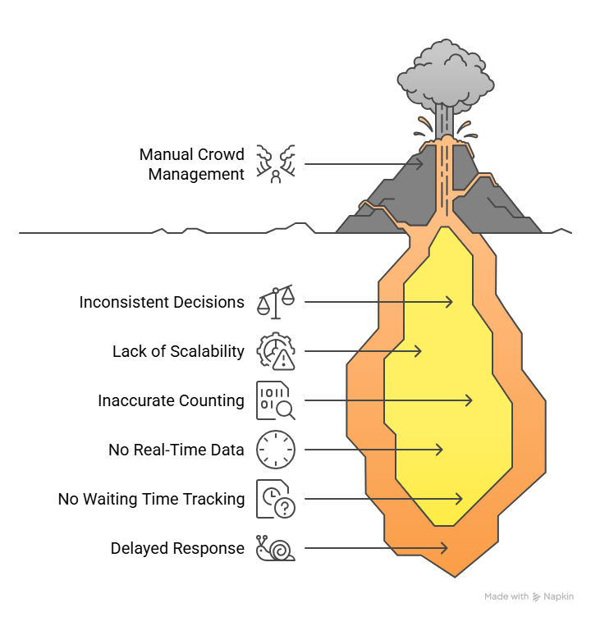
Problem Statement

Slide 4
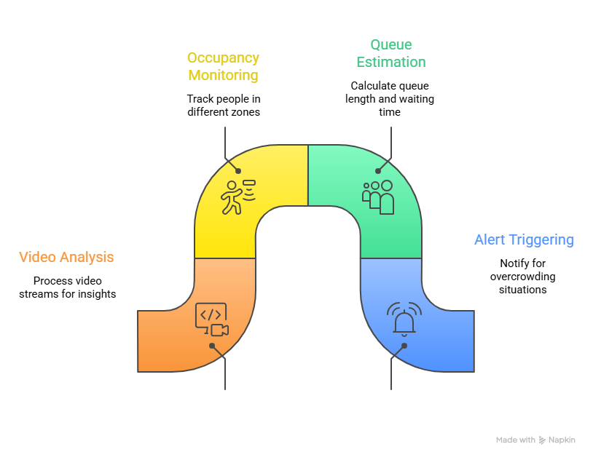

Objective of the Project
| Build a system that:
Need: Automated, real-time, data-driven system
(Video → Analytics)

Slide 5


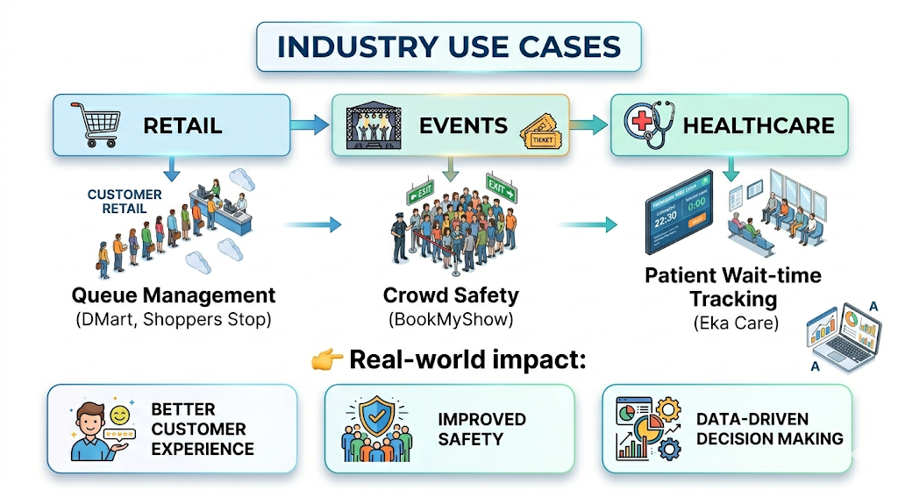
Industry Use Cases

Slide 6
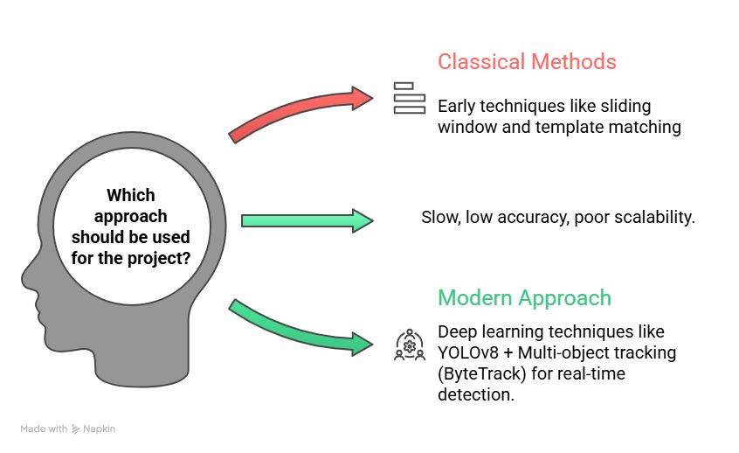

Literature / Approach Evolution
Limitation:

Slide 7
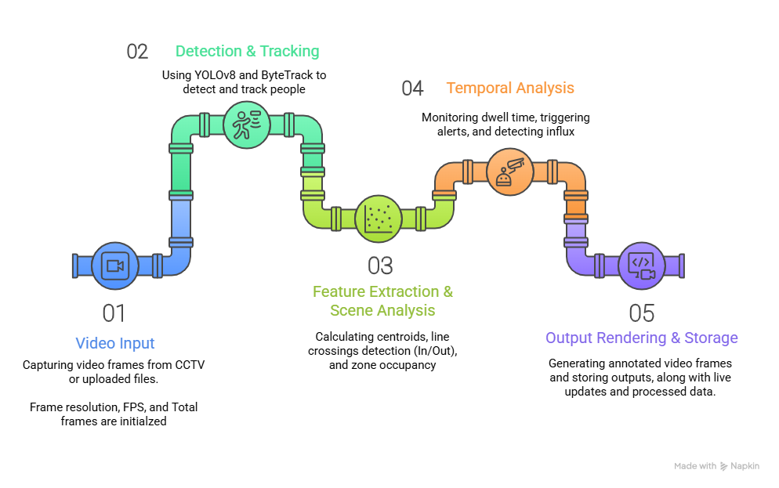
System Pipeline

Slide 8
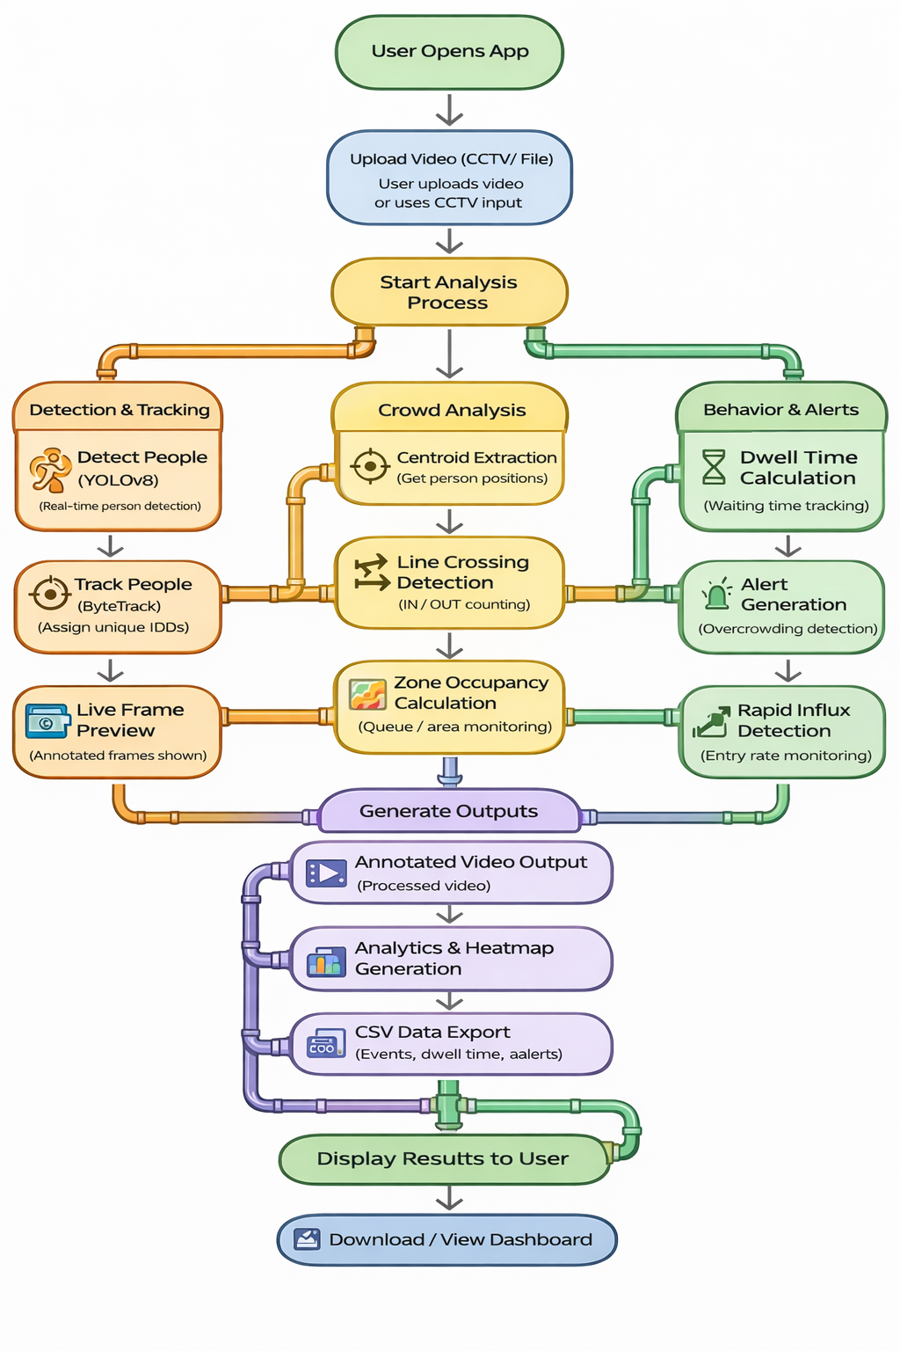

Solution Workflow

Slide 9
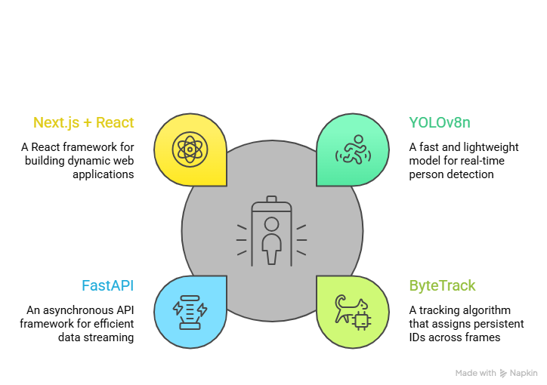
Technology Stack

Slide 10
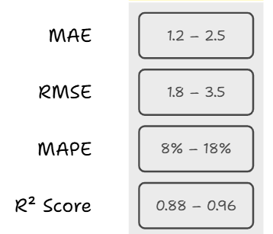
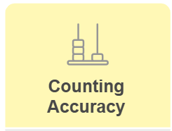

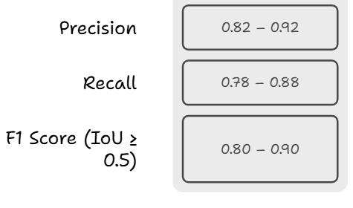
Evaluation Metrics

Slide 11
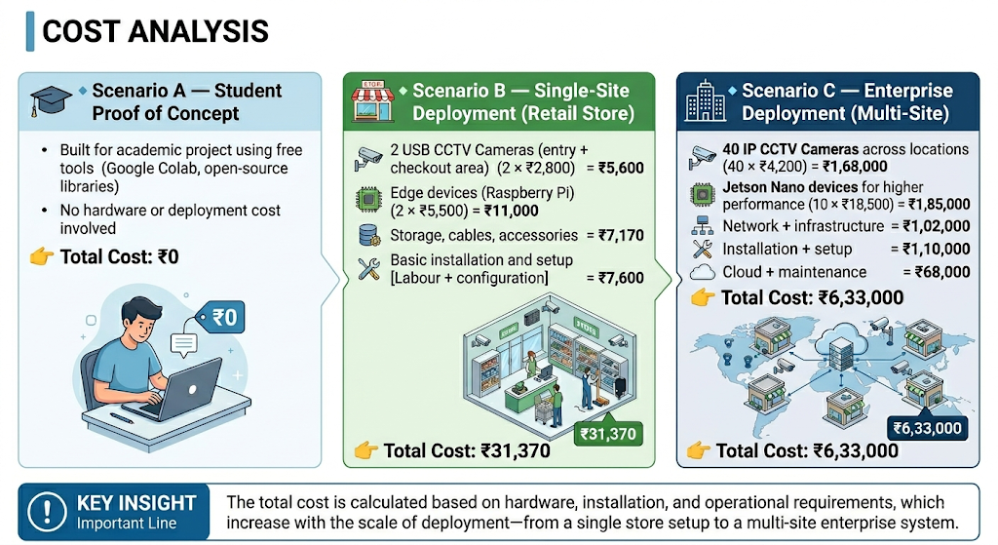
Cost Analysis

Slide 12
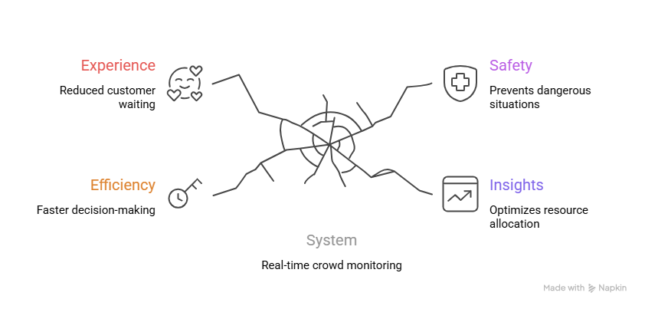
Business Impact

Slide 13
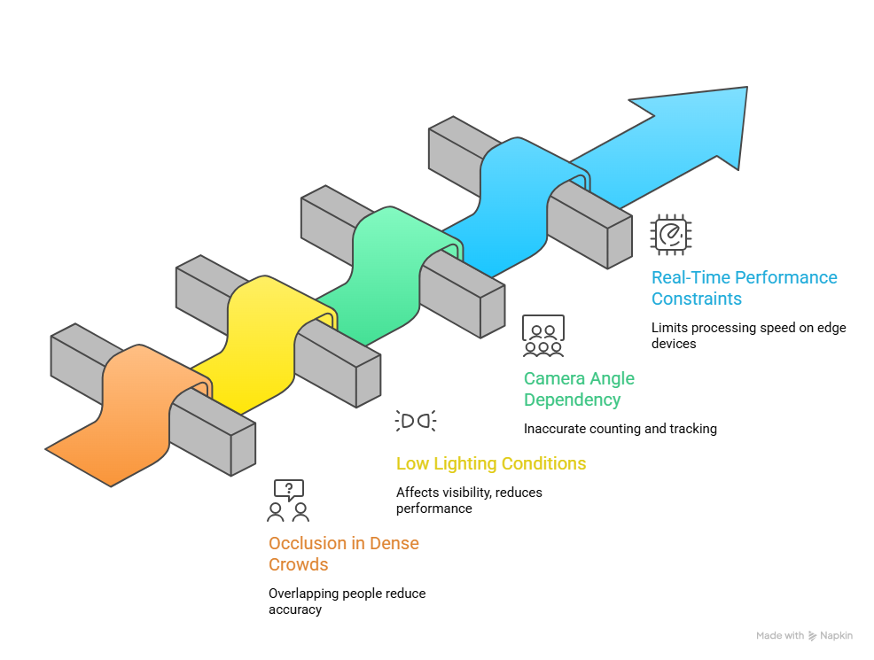
Challenges

Slide 14
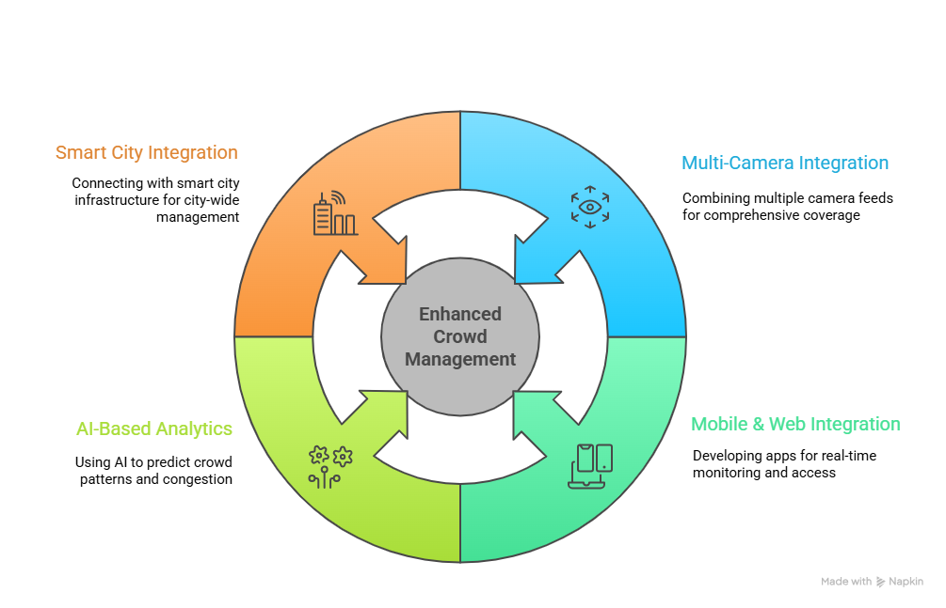
Future Scope

Slide 15
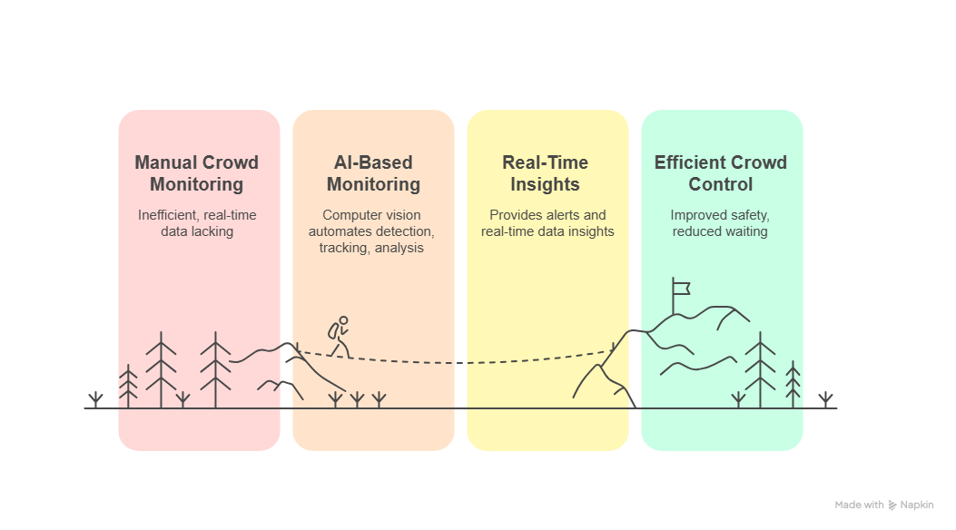
Why Our Solution Matters ?

Slide 16

Thank You
Thank You

