Slide 1
CODHER 25
AI POWERED TRAVEL PLANNER
TEAM NAME: INFO TRIO
PRESENTED BY:
NAZEEA N 6176AC23UIT037
MONISHA R 6176AC23UIT035
SARANYA M 6176AC23UIT046
SATHESH K 6176AC23UIT047

Slide 2


Slide 3
ABSTRACT
A travel planner is a comprehensive service or tool designed to assist individuals and groups in organizing and managing their travel experiences efficiently. It encompasses everything from destination selection and itinerary creation to booking flights, accommodations, transportation, and activities. By tailoring travel plans to the preferences, budget, and schedule of each traveler, a travel planner ensures a smooth, enjoyable, and stress-free journey. The goal is to save time, reduce travel-related hassles, and enhance the overall experience with expert advice, local insights, and continuous support. In a fast-paced world, a travel planner acts as a trusted partner, transforming travel dreams into memorable realities.

Slide 4

Travel Planner
Your Gateway to Seamless Adventures
WHY TO USE A TRAVEL PLANNER ?
Expert advice tailored to your interests
Saves time and avoids costly mistakes
Handles logistics, bookings, and special requests
24/7 support while you travel

Slide 5
Why choose a travel planner ?
FEATURE | DIY TRAVEL PLANNER | PROFESSIONAL TRAVEL PLANNER
Time spent planning | 10-20+hours | Minimal (we do the work)
Expertise & local insights | Limited | Extensive & updated
Custom itinernaries | Generic templates | Fully personalized
Support during trip | None | 24/7 assistance
Deal & discount access | Public rates only | Special partnerships
Handling emergencies | Self-managed | Professional backup
Peace of mind | Often stressful | Worry –free travel

Slide 6
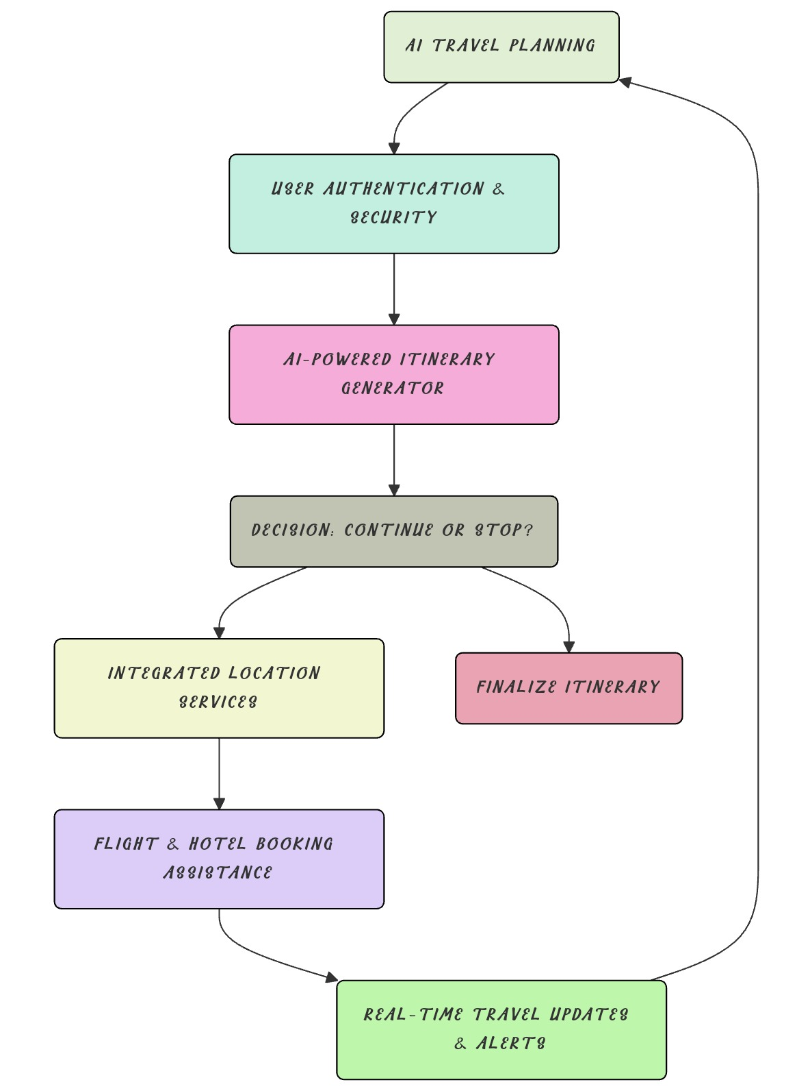
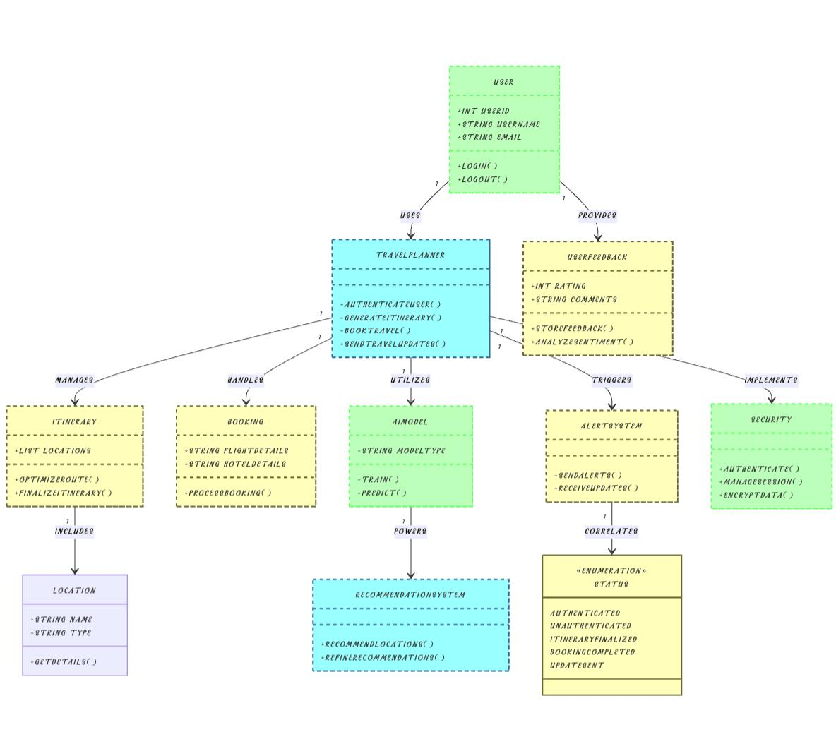
Basic implementation of our Idea:
Class Diagram of our implementation:

Slide 7
USED ALGORITHMS AND TECHNOLOGIES
Authentication & Security ✔ Firebase Auth (Google, Apple, Email) | MFA | AES Encryption ✔ JWT-based sessions | Flask security (CSRF & XSS protection)
AI-Powered Itinerary Generator ✔ Hybrid Recommendation (Collaborative + Content-Based Filtering) ✔ TensorFlow/Scikit-learn ML models | Flask API + SQLite
Location Services ✔ Flutter Geolocator | Google Places API | Offline Maps (flutter_map) ✔ Optimized Routing (Dijkstra’s Algorithm / A*)
Flight & Hotel Booking ✔ Skyscanner, Expedia, Booking.com APIs ✔ AI Fare Prediction (Random Forest/LSTM)
Real-Time Updates & Alerts ✔ FlightAware (Flight Tracking) | OpenWeather | Twilio (SMS Alerts) ✔ Dialogflow Chatbot for Assistance
Feedback & AI Optimization ✔ SQLite for Reviews | NLP-based Sentiment Analysis
Tech Stack Flutter (Frontend) | Flask (Backend) | SQLite | TensorFlow | Google APIs

Slide 8
CONCLUSION
AI TravelMate successfully integrates AI-driven personalization, real-time assistance, and secure authentication to create a seamless travel planning experience. By leveraging machine learning, predictive analytics, and automation, the system optimizes itineraries, enhances navigation, and streamlines bookings while ensuring data security. Its scalable and modular architecture allows for continuous improvements, making it a versatile and intelligent travel companion for users worldwide.
With its scalable, modular architecture, AI TravelMate delivers a secure, AI-enhanced travel planning experience, combining automation, predictive analytics, and real-time intelligence for effortless and efficient trip management.

Slide 9
THANK YOU

