Slide 1


N.B.K.R. INSTITUTE OF SCIENCE & TECHNOLOGY
Department of Computer Science & Engineering
QuickShare
Ephemeral Cross-Device File Sharing Platform
Zero-Login 6-Digit Transfers, Recipient Inboxes, Collaboration Groups & Personal Cloud Drive
PROJECT SUPERVISOR:
Dr. M. Sivapratap Reddy
Professor, Department of CSE
NBKRIST, Vidyanagar
PROJECT TEAM MEMBERS:
24KB1A05GP — S D Vara Prasad Reddy
24KB1A05HD — Shaik Arif
24KB1A05HW — Sk Mohammed Rasikh
24KB1A05JE — Shaik Rehan
24KB1A05NB — Veeravalli Syam Sundar

Slide 2
PROJECT OVERVIEW
Problem Statement & Engineering Objectives
Addressing the friction and privacy vulnerabilities of existing file transfer tools.
Current Limitations
• Mandatory accounts: Google Drive and OneDrive force permissions and logins.
• Heavy compression: Chat applications degrade photos and limit file sizes.
• Lingering cloud files: Abandoned links remain accessible indefinitely.
• OS barriers: AirDrop and Nearby Share fail across mixed platforms.
QuickShare Objectives
• Zero-login sharing: Transfer files instantly without creating accounts.
• Automated lifecycle: Scheduled file expiration and immediate physical purge.
• Cross-platform parity: Works across Android, iOS, Windows, Mac, and Linux.
• Zero hosting expense: Operates 100% on free cloud tiers with no credit cards.
Three Transfer Modes
• 6-Digit Quick Code: Instant pickup via a simple random code.
• Direct In-App Inbox: Transfer directly to registered usernames (@username).
• Encrypted Links & QR: Ephemeral URLs with camera QR code scanning.
Built for Security & Speed
• Bcrypt password protection and burn-on-download support.
• Owner-only secret 24-byte deletion key for early destruction.
• Automated background cleanup cron runs every 15 minutes.

Slide 3
SYSTEM ARCHITECTURE
Six-Tier Cloud Topology & Data Flow
A modular, scalable architecture operating entirely within free cloud quotas.
1. Client Browser
• React 18 + Vite SPA
• Responsive single-page application with dark/light mode and mobile navigation.
2. Edge CDN
• Vercel Global Edge
• High-speed frontend asset delivery with automatic SSL and edge caching.
3. REST API Service
• Node.js 22+ & Express
• Central controller for uploads, auth, rate limiting, and 6-digit code resolution.
4. Cloud Database
• TiDB Serverless
• Cloud MySQL 8 compatible database storing sessions, users, groups, and logs.
5. Object Storage
• Supabase S3 Bucket
• Secure binary repository with streaming downloads and streaming ZIP packaging.
6. Auto-Cleaner Cron
• Node-Cron Service
• Background task executing every 15 minutes to purge expired files from S3.

Slide 4
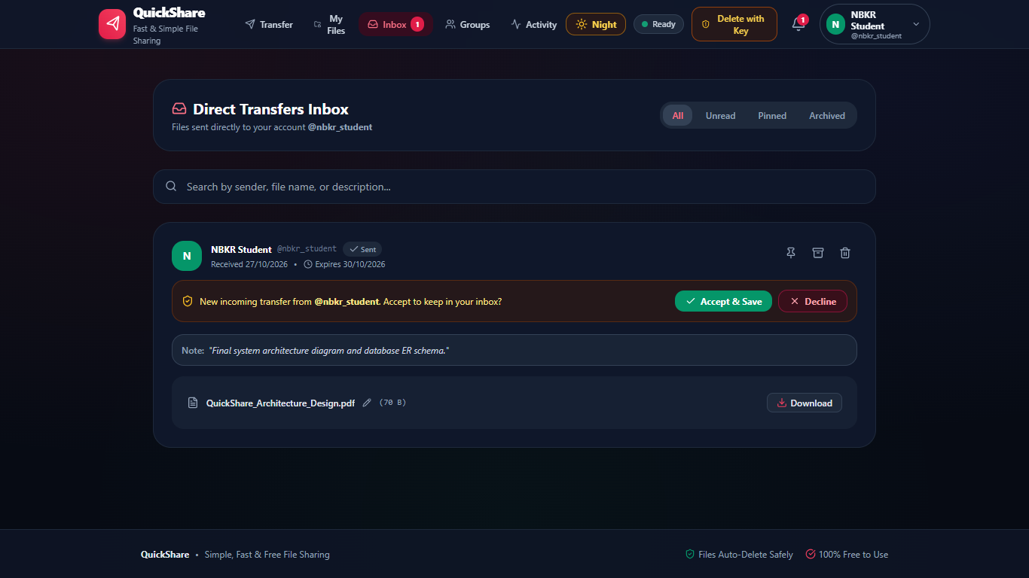
USER MANAGEMENT
Account Profile & Cloud Storage Quota
Live application screenshot of the authenticated student profile console.
Account & Quota Management
• Authenticated Identity: Displays verified student name, @username, and email.
• Real-Time Quota Meter: Live progress bar tracking usage out of 1024 MB free storage.
• Custom Avatar Theming: Visual identity styling for collaborative study groups.
• Credential Management: In-app password change secured by Bcrypt validation.
• Active Session Control: Instant logout and cryptographic JWT token revocation.
• Zero-Friction Access: One-click profile drawer accessible directly from the navbar.

Slide 5
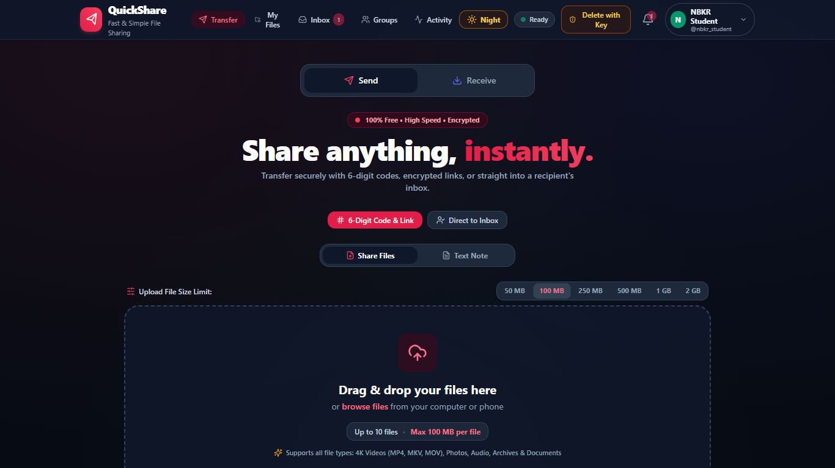
TRANSFER WORKSPACE
Transfer Dashboard: Primary Send Workspace
Live application screenshot of the drag & drop upload interface.
Send Functions & Controls
• Drag & drop upload zone supporting up to 10 files simultaneously.
• File size presets (10 MB, 25 MB, 50 MB) and live upload progress bars.
• Custom expiration timers: 1 Hour, 6 Hours, 24 Hours, 3 Days, or 7 Days.
• Bcrypt Password Protection: Optional password required before download.
• Burn-on-Download Mode: Files automatically delete after the 1st download.
• Direct Inbox Option: Senders can toggle direct user inbox delivery.

Slide 6
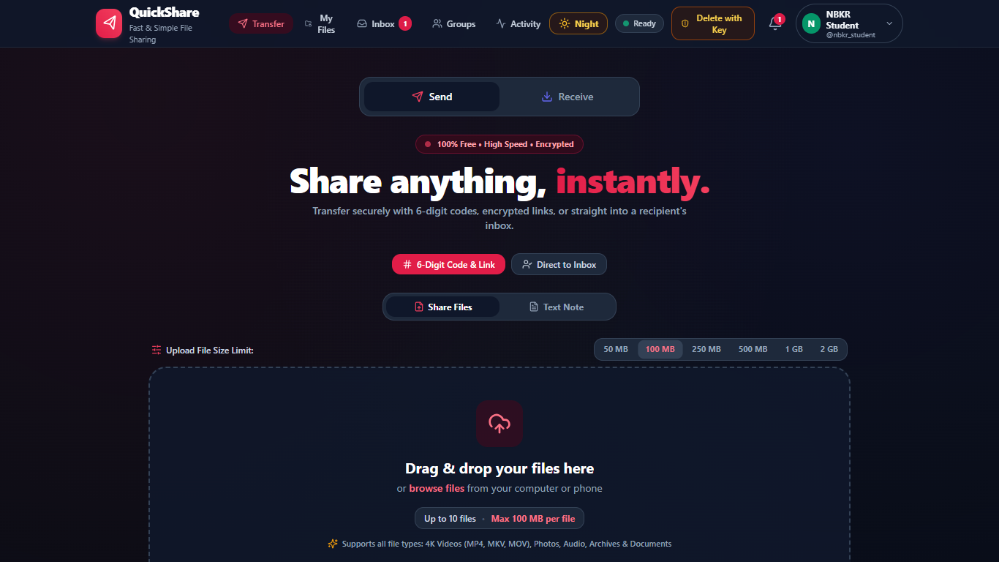
TRANSFER COMPLETION
Share Result Screen: Code, Links & Owner Key
Live application screenshot after completing a secure file upload.
Completion Screen Functions
• 6-Digit Quick Code Box: Receiver can enter this code to download immediately.
• Public Download URL: 1-Click copy of the 128-bit unguessable share link.
• QR Code Modal Button: Generates high-contrast camera QR code on demand.
• 1-Click Social Sharing: Direct buttons for WhatsApp, Telegram, and Email.
• Session Metadata Summary: Displays file count, total size, and time left.
• Secret 24-Byte Delete Key: Allows the owner to delete files early at any time.

Slide 7
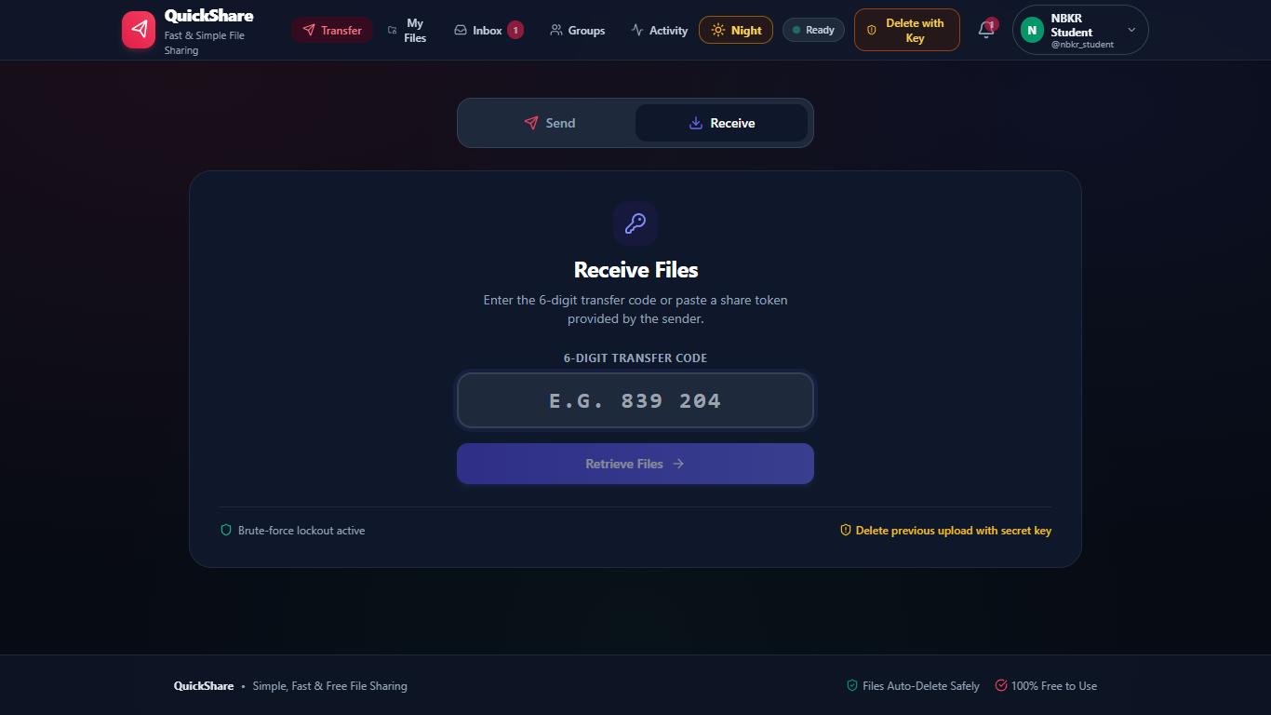
RECEIVER EXPERIENCE
Receive Interface: Instant 6-Digit Code Redemption
Live application screenshot of the receiver code input tab.
Zero-Login Receive Workflow
• Receiver enters a 6-digit transfer code (e.g., 839 204) to access files.
• No account creation, email confirmation, or password required.
• Download options: Single-file download or complete streaming ZIP archive.
• Password verification prompt displayed automatically for protected shares.
• Progressive rate-limiting protects against brute-force guessing attempts.
• Instant smartphone camera pickup available via high-contrast QR code.

Slide 8

DIRECT IN-APP TRANSFERS
Direct In-App Inbox & Delivery Audit Status
Live application screenshot of the recipient inbox management view.
Inbox Features & Audit Checkmarks
• Direct user-to-user dispatch: Send files directly to @username.
• WhatsApp-style delivery status checkmarks:
• • Single tick: Sent and encrypted on server
• • Double tick: Delivered to recipient's inbox queue
• • Double green tick: Recipient downloaded the files
• Sender notes: Senders can attach instructions or context to transfers.
• Inline file renaming: Recipients can customize file display names.
• Batch actions: Download individual items or download all as a ZIP file.

Slide 9
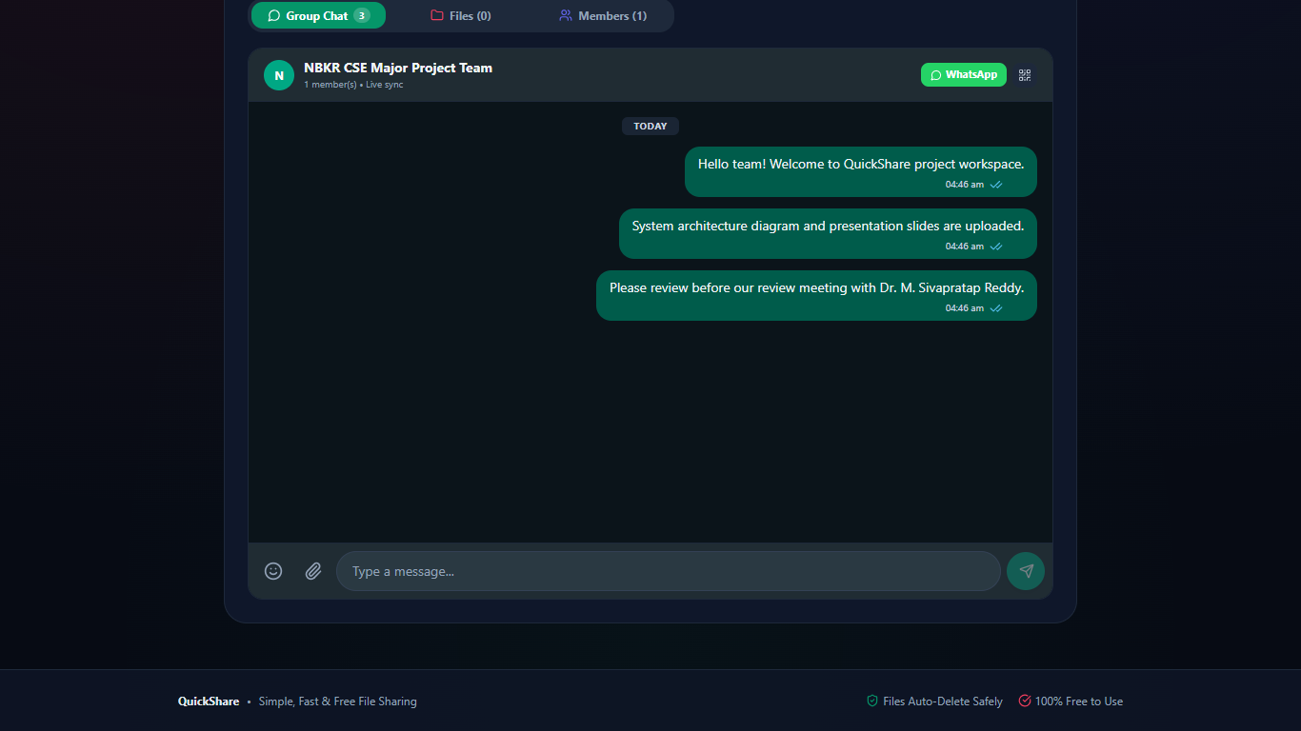
TEAM COLLABORATION
Study Groups & Real-Time Chat Collaboration
Live application screenshot of team group workspaces.
Group Collaboration Highlights
• Project workspaces: Create named groups for project teams and classes.
• Real-time chat: WhatsApp-style message bubbles with timestamps.
• File attachments: Attach files directly inside conversation streams.
• Staging drawer: Preview and rename files before sending them to the group.
• Dedicated Files Tab: Centralized repository for all group project files.
• Quick invites: 1-Click invite link sharing via WhatsApp and QR code.

Slide 10
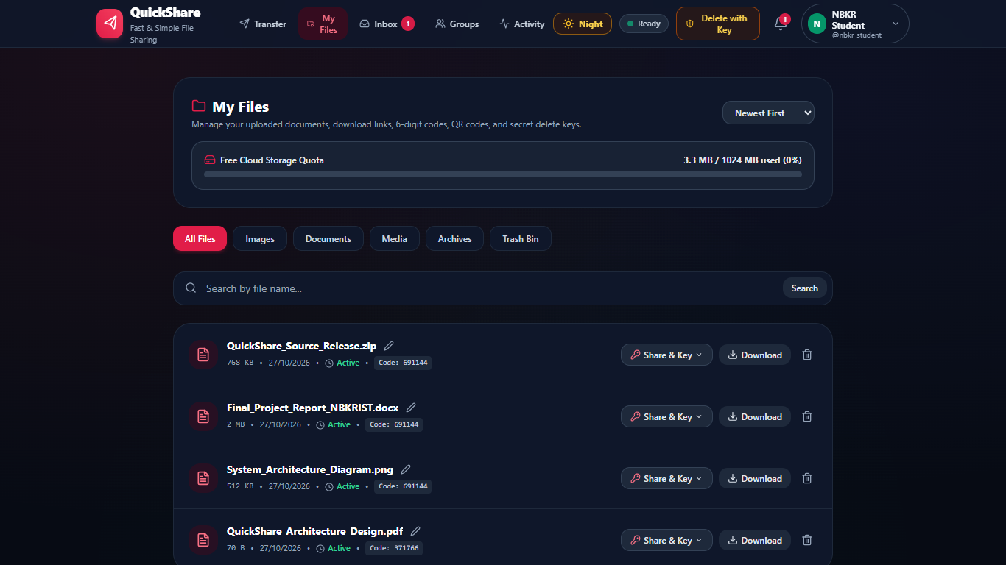
CLOUD FILE STORAGE
Personal Cloud Drive & Storage Lifecycle
Live application screenshot of the personal file management console.
File Management & Quota Tracking
• Free storage quota: Live progress bar tracking usage (1024 MB quota).
• Smart category filtering: All Files, Images, Documents, Media, and Archives.
• Trash Bin management: Soft-delete files with 1-click instant restoration.
• Inline rename: Edit file names directly without re-uploading.
• Secret owner delete key: 24-byte cryptographic token for immediate purge.
• Full audit details: View download counts, creation dates, and expiration times.

Slide 11
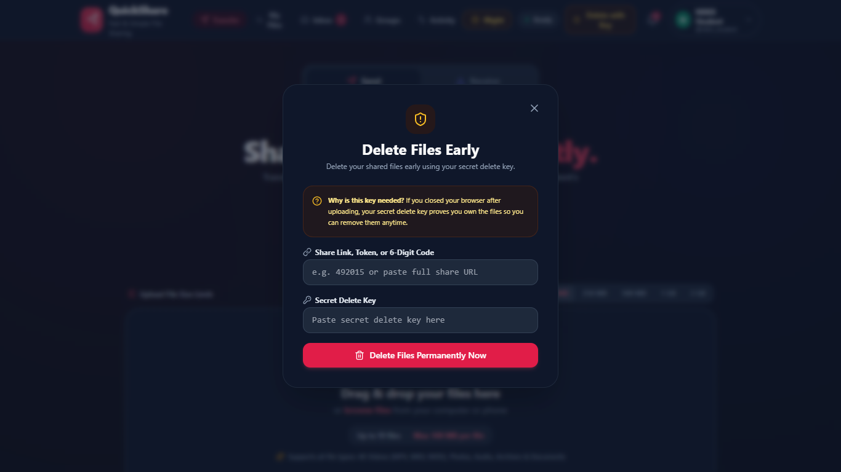
CONFIDENTIAL PURGE
Secret Key Deletion: Emergency File Purge
Live application screenshot of the Delete with Key modal.
Emergency Purge Workflow
• Private 24-Byte Token: Generated automatically during file upload.
• Cross-Device Deletion: Enter the key from any browser to destroy files early.
• Immediate S3 Purge: File binaries are immediately deleted from cloud storage.
• Session Revocation: Link is marked 410 Gone; cannot be accessed again.
• Zero-Residual Privacy: No logs or leftover files remain on the server.
• Protection Against Accidental Shares: Revoke files before recipients see them.

Slide 12
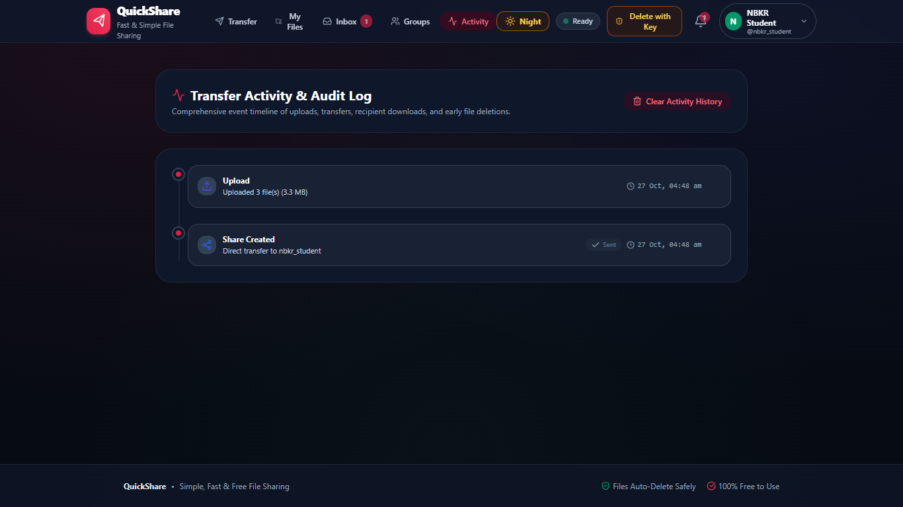
AUDIT & ACTIVITY
Transfer Activity Timeline & Audit Logs
Live application screenshot of the user activity timeline.
Audit Trail & Event Logging
• Chronological Event Feed: Real-time logs for all file transfers.
• Event Tracking: Logs file uploads, recipient inbox deliveries, and downloads.
• Revocation Tracking: Confirms timestamp when an owner purges a file.
• Privacy Protection: Users can clear their audit history with 1 click.
• Zero Layout Shift: Smooth responsive layout on desktop and mobile viewports.

Slide 13
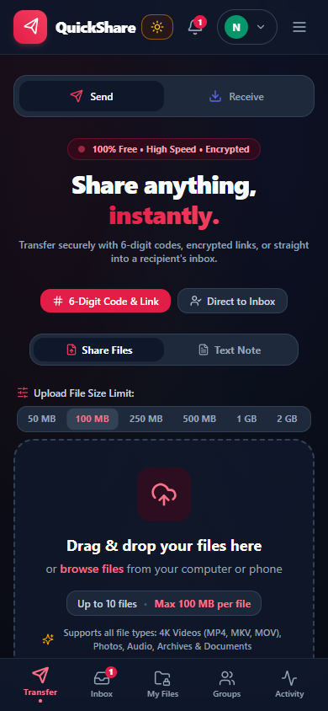
MOBILE RESPONSIVENESS
Mobile Design & Docked Bottom Navigation
Live mobile screenshot captured on modern smartphone viewport (390 x 844).
Mobile Ergonomics & Responsive Polish
• Docked bottom navigation bar: Thumb-friendly reach for all primary tabs.
• Instant navigation between Transfer, Inbox, My Files, Groups, and Activity.
• Live badge notification: Displays unread transfer count on the Inbox icon.
• Zero-clipping layout: Guaranteed full visibility on narrow 320px–420px screens.
• Touch-optimized buttons: Clean touch targets prevent accidental clicks.
• No layout shift: Smooth, instant transitions between desktop and mobile.

Slide 14

VISUAL ACCESSIBILITY
Light Mode (Day Theme) Interface
Live application screenshot showing the high-contrast daylight theme.
Daylight Usability & Interface Features
• Crisp daylight contrast: Pure white canvas and slate typography tuned for bright ambient lighting.
• Minimal visual distraction: High-contrast focus boundaries around dropzones and primary buttons.
• 1-Click theme switcher: Smooth instant transition between Day and Night modes without page reloads.
• Inter font typography: Clean, modern sans-serif type scales for fast code and file inspection.
• Consistent component styling: Uniform border radiuses, soft drop shadows, and clean input states.
• Daytime readability: Prevents glare and visual fatigue during morning lectures and lab sessions.

Slide 15

VISUAL ACCESSIBILITY
Night Mode (Dark Theme) Interface
Live application screenshot showing the ambient high-contrast dark theme.
Low-Light Ergonomics & Eye-Care Features
• Ambient radial canvas: Deep obsidian background with subtle indigo gradients.
• Reduced eye strain: Prevents glare during evening study hours and low-light environments.
• OLED power efficiency: Reduces battery draw on modern smartphone and laptop displays.
• High-contrast text tokens: Crisp white headers and neon accents ensure legible 6-digit codes.
• Persistent preference: Theme choice is automatically saved in browser local storage.
• Uniform dark elements: Perfectly styled modals, dialogs, dropdowns, and file cards.

Slide 16
ENGINEERING SPECIFICATIONS
Technology Stack & ₹0 Cloud Economics
Demonstrating modern architectural efficiency with zero financial overhead.
₹0 / Month
Total Hosting Cost
100% Free Forever
No credit card required
Production-ready SLA
100 GB
Vercel Edge CDN
React 18 & Vite SPA
Global edge caching
Automatic SSL & CI/CD
512 MB
Render API Service
Node.js 22+ & Express
REST API & WebSockets
750 free hours/month
5 GB
TiDB Serverless
Cloud MySQL 8 engine
50M Request Units/month
Dual SQLite dev driver
1 GB
Supabase S3 Storage
S3-compatible bucket
Streaming downloads
Automated purge cron

Slide 17
PRODUCTION VERIFICATION
Automated Testing & Live Deployment Proof
Validated through comprehensive test suites and active cloud deployment.
Automated Test Coverage
• 53 / 53 Jest automated platform tests passing (100%).
• Authentication: Registration, bcrypt hashing, JWT issuance.
• Upload engine: File sanitization, SHA-256 hashes, size quotas.
• 6-Digit codes: Code lookup, rate limiting, and expiry lockout.
• Direct inboxes: Delivery checkmarks and view updates.
• File drive: Inline rename, trash soft-delete, and restore.
• Group collaboration: Chat messages, roles, and file deletion.
Security Verification
• High-entropy tokens: 128-bit share tokens (crypto.randomBytes).
• Owner secret key: 192-bit private token for physical purge.
• Immediate physical purge: Revocation returns HTTP 410 Gone.
• File blocklist: Blocks .exe, .bat, .sh, .vbs, .msi, and .php.
• Parameterized queries: 100% protection against SQL injection.
• Path traversal protection: Strict resolution against upload roots.
Live Production Links
• Frontend Web Application:
• https://quickshare-nbkr.vercel.app/
•
• Backend REST API Service:
• https://share-api-0xvn.onrender.com/api
•
• API Health Check:
• https://share-api-0xvn.onrender.com/api/health
•
• GitHub Open-Source Repository:
• https://github.com/sathidevivaraprasadreddy/share

Slide 18
N.B.K.R. INSTITUTE OF SCIENCE & TECHNOLOGY
Department of Computer Science & Engineering
Thank You
Questions & Technical Discussion
S D Vara Prasad Reddy • Shaik Arif • Sk Mohammed Rasikh • Shaik Rehan • Veeravalli Syam Sundar
Live Web App: https://quickshare-nbkr.vercel.app/
GitHub: https://github.com/sathidevivaraprasadreddy/share

