Slide 1


N.B.K.R. INSTITUTE OF SCIENCE & TECHNOLOGY
Department of Computer Science & Engineering
QuickShare
Ephemeral Cross-Device File Sharing Platform
Zero-Login 6-Digit Transfers, Recipient Inboxes, Study Groups & Personal Cloud Drive
PROJECT SUPERVISOR:
Dr. M. Sivapratap Reddy
Professor, Department of CSE
NBKRIST, Vidyanagar
PROJECT TEAM MEMBERS:
24KB1A05GP — S D Vara Prasad Reddy
24KB1A05HD — Shaik Arif
24KB1A05HW — Sk Mohammed Rasikh
24KB1A05JE — Shaik Rehan
24KB1A05NB — Veeravalli Syam Sundar

Slide 2
PROJECT OVERVIEW
Problem Statement & Engineering Objectives
Addressing the friction and privacy vulnerabilities of existing file transfer tools.
Current Limitations
• Mandatory accounts: Google Drive and OneDrive force permissions and logins.
• Heavy compression: Chat applications degrade photos and limit file sizes.
• Lingering cloud files: Abandoned links remain accessible indefinitely.
• OS barriers: AirDrop and Nearby Share fail across mixed platforms.
QuickShare Objectives
• Zero-login sharing: Transfer files instantly without creating accounts.
• Automated lifecycle: Scheduled file expiration and immediate physical purge.
• Cross-platform parity: Works across Android, iOS, Windows, Mac, and Linux.
• Zero hosting expense: Operates 100% on free cloud tiers with no credit cards.
Three Transfer Modes
• 6-Digit Quick Code: Instant pickup via a simple random code.
• Direct In-App Inbox: Transfer directly to registered usernames (@username).
• Encrypted Links & QR: Ephemeral URLs with camera QR code scanning.
Built for Security & Speed
• Bcrypt password protection and burn-on-download support.
• Owner-only secret 24-byte deletion key for early destruction.
• Automated background cleanup cron runs every 15 minutes.

Slide 3
SYSTEM ARCHITECTURE
Six-Tier Cloud Topology & Data Flow
A modular, scalable architecture operating entirely within free cloud quotas.
1. Client Browser
• React 18 + Vite SPA
• Responsive single-page application with dark/light mode and mobile navigation.
2. Edge CDN
• Vercel Global Edge
• High-speed frontend asset delivery with automatic SSL and edge caching.
3. REST API Service
• Node.js 22+ & Express
• Central controller for uploads, auth, rate limiting, and 6-digit code resolution.
4. Cloud Database
• TiDB Serverless
• Cloud MySQL 8 compatible database storing sessions, users, groups, and logs.
5. Object Storage
• Supabase S3 Bucket
• Secure binary repository with streaming downloads and streaming ZIP packaging.
6. Auto-Cleaner Cron
• Node-Cron Service
• Background task executing every 15 minutes to purge expired files from S3.

Slide 4
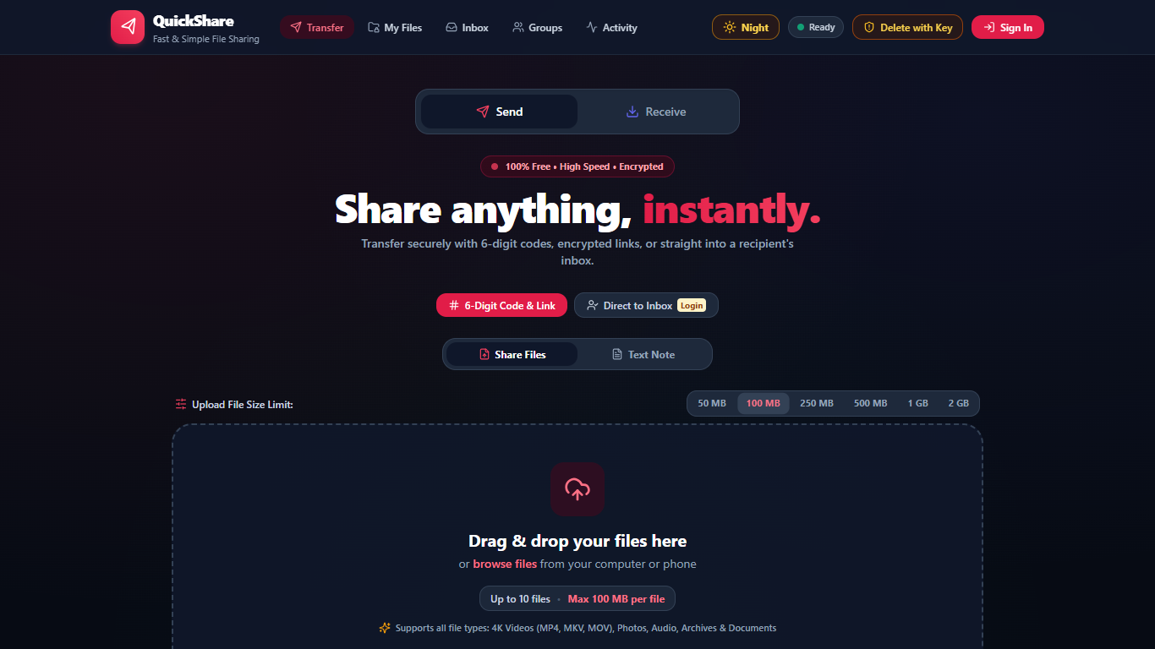
REAL APPLICATION INTERFACE
Transfer Dashboard: Primary Send Interface
Live desktop screenshot of the QuickShare upload workspace.
Send Functions & Controls
• Drag & drop upload zone supporting up to 10 files simultaneously.
• File size presets (10 MB, 25 MB, 50 MB) and live upload progress tracking.
• Custom expiration timer: 1 Hour, 6 Hours, 24 Hours, 3 Days, or 7 Days.
• Security settings: Optional password protection using Bcrypt encryption.
• Burn-on-Download: Automatically deletes files after the first download.
• Direct Inbox delivery toggle: Dispatch straight to a classmate's account.

Slide 5
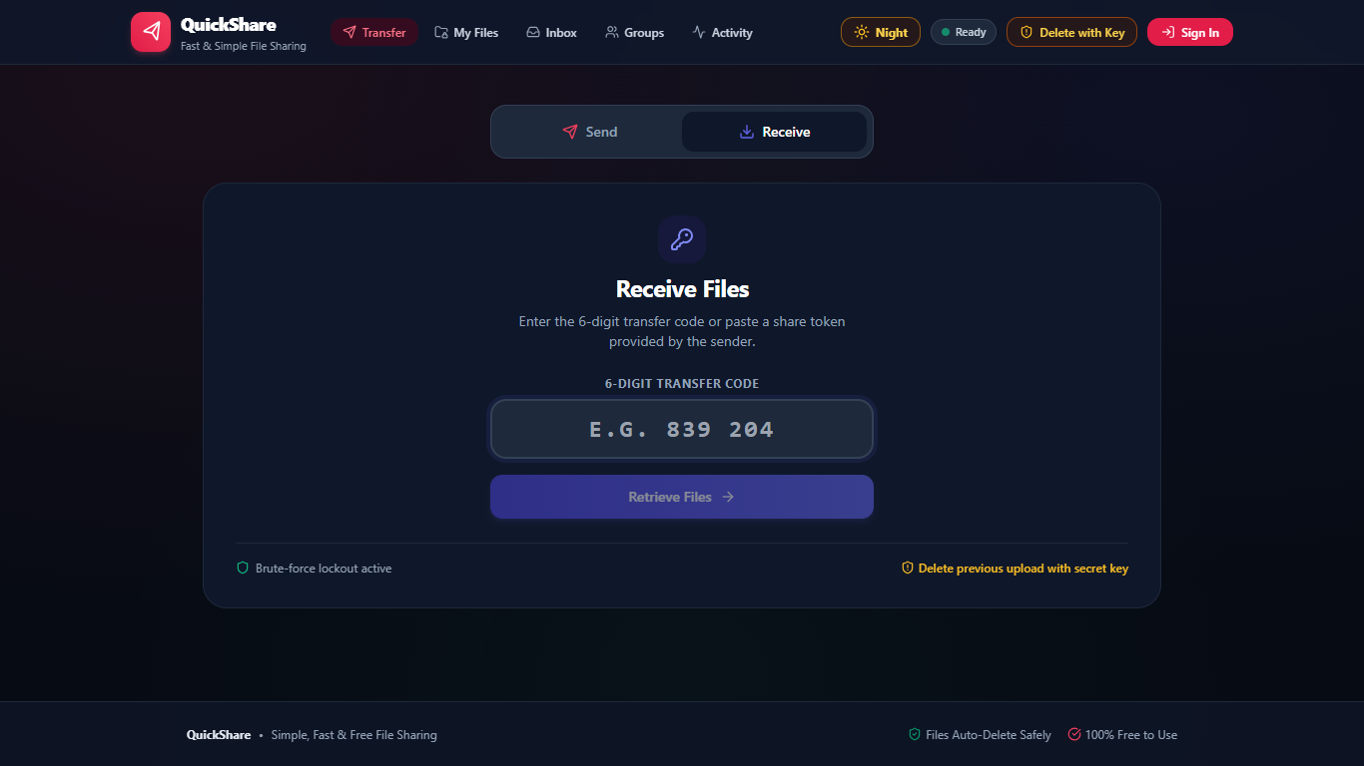
REAL APPLICATION INTERFACE
Receive Interface: Instant 6-Digit Code Lookup
Live desktop screenshot of the 6-digit code redemption workflow.
Zero-Login Receive Workflow
• Receiver enters a 6-digit transfer code (e.g., 839 204) to access files.
• No account creation, email confirmation, or password required.
• Download options: Single-file download or complete ZIP archive download.
• Password verification prompt displayed automatically for protected shares.
• Progressive rate-limiting protects against brute-force guessing attempts.
• Instant smartphone camera pickup available via high-contrast QR code.

Slide 6
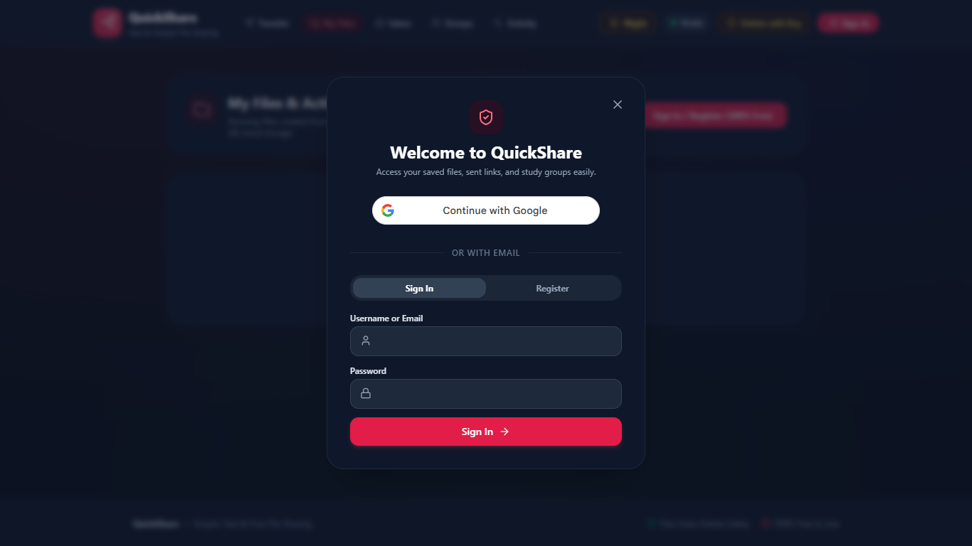
REAL APPLICATION INTERFACE
Direct In-App Inbox & Delivery Audit Status
Live desktop screenshot of the recipient inbox management view.
Inbox Features & Audit Checkmarks
• Direct user-to-user dispatch: Send files directly to @username.
• WhatsApp-style delivery status checkmarks:
• • Single tick: Sent and encrypted on server
• • Double tick: Delivered to recipient's inbox queue
• • Double green tick: Recipient downloaded the files
• Sender notes: Senders can attach instructions or context to transfers.
• Inline file renaming: Recipients can customize file display names.
• Batch actions: Download individual items or download all as a ZIP file.

Slide 7

REAL APPLICATION INTERFACE
Study Groups & Real-Time Chat Collaboration
Live desktop screenshot of team group workspaces.
Group Collaboration Highlights
• Project workspaces: Create named groups for project teams and classes.
• Real-time chat: WhatsApp-style message bubbles with timestamps.
• File attachments: Attach files directly inside conversation streams.
• Staging drawer: Preview and rename files before sending them to the group.
• Dedicated Files Tab: Centralized repository for all group project files.
• Quick invites: 1-Click invite link sharing via WhatsApp and QR code.

Slide 8
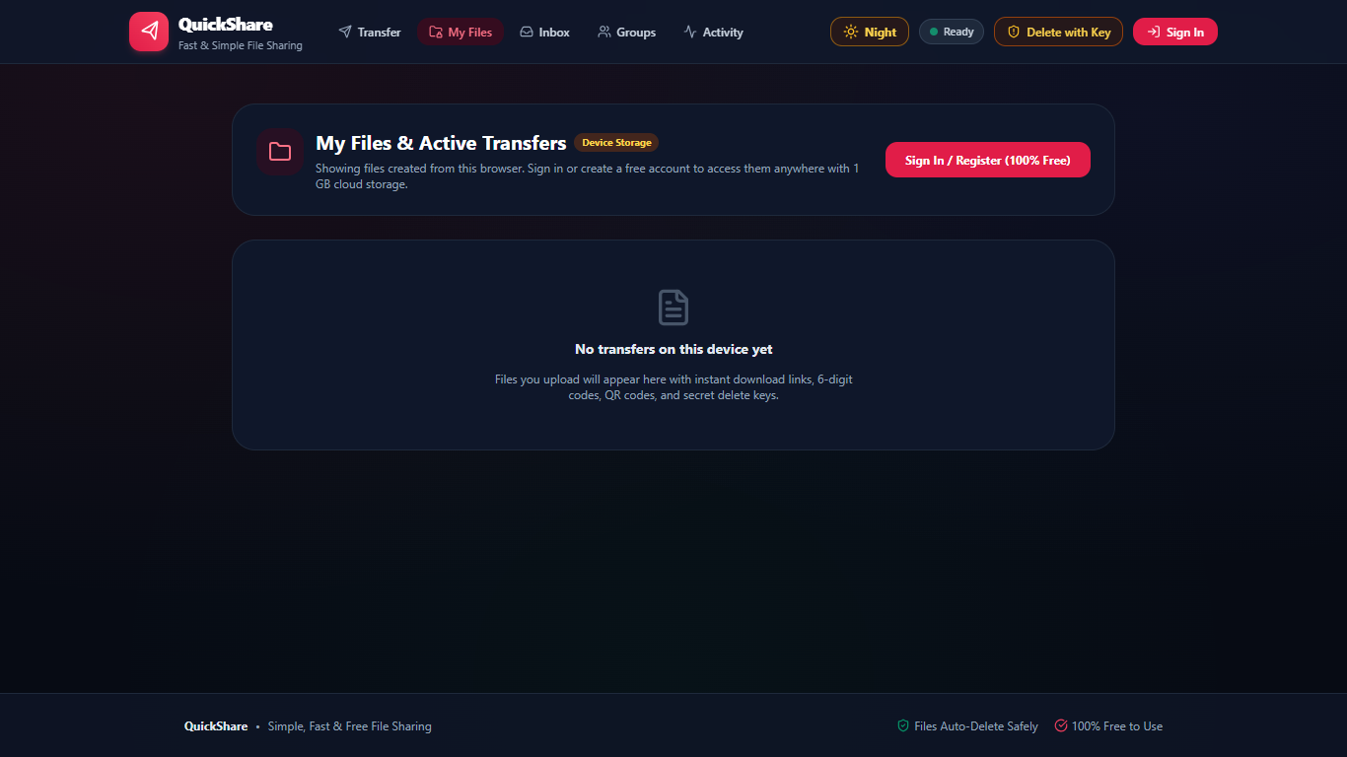
REAL APPLICATION INTERFACE
Personal Cloud Drive & Storage Lifecycle
Live desktop screenshot of the personal file management console.
File Management & Quota Tracking
• Free storage quota: Live progress bar tracking usage (1024 MB quota).
• Smart category filtering: All Files, Images, Documents, Media, and Archives.
• Trash Bin management: Soft-delete files with 1-click instant restoration.
• Inline rename: Edit file names directly without re-uploading.
• Secret owner delete key: 24-byte cryptographic token for immediate purge.
• Full audit details: View download counts, creation dates, and expiration times.

Slide 9
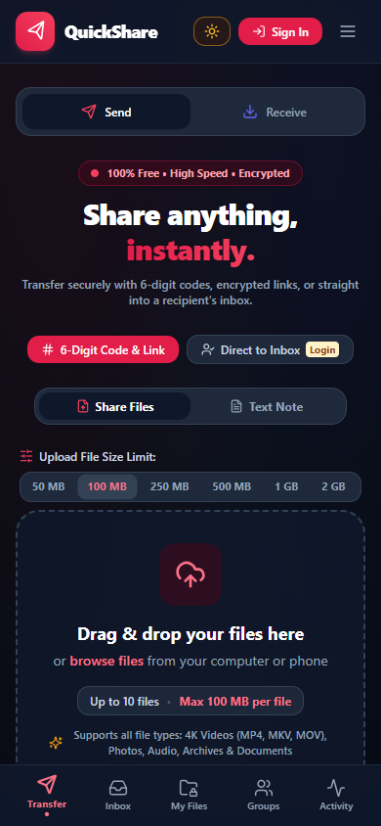
REAL APPLICATION INTERFACE
Responsive Mobile Design & Docked Navigation
Live mobile screenshot captured on modern smartphone viewport (390 x 844).
Mobile Ergonomics & Responsive Polish
• Docked bottom navigation bar: Thumb-friendly reach for all primary tabs.
• Instant navigation between Transfer, Inbox, My Files, Groups, and Activity.
• Live badge notification: Displays unread transfer count on the Inbox icon.
• Zero-clipping layout: Guaranteed full visibility on narrow 320px–420px screens.
• Touch-optimized buttons: Clean touch targets prevent accidental clicks.
• No layout shift: Smooth, instant transitions between desktop and mobile.

Slide 10
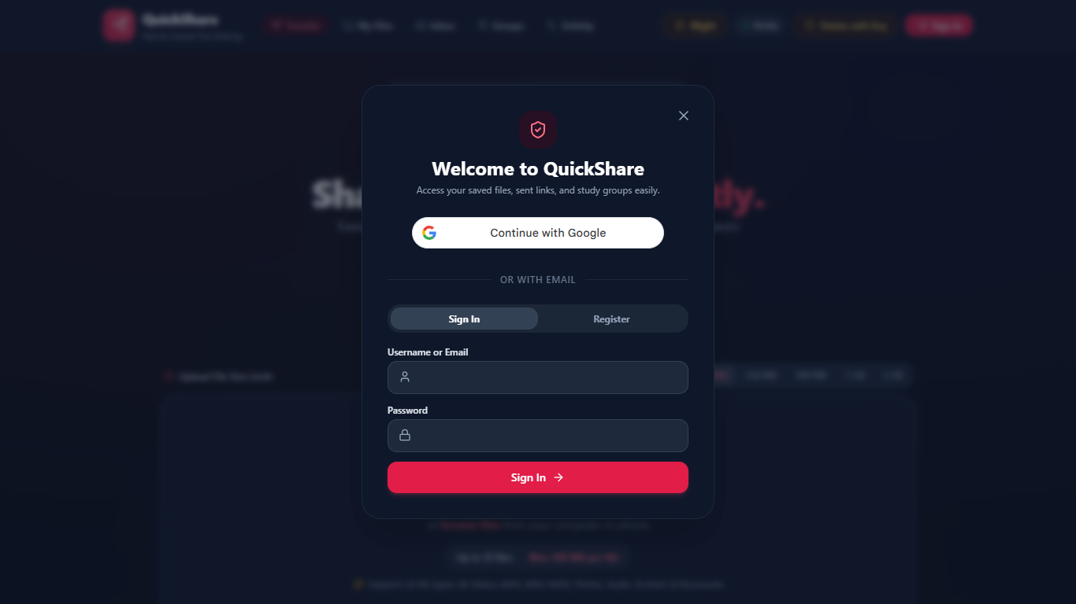
REAL APPLICATION INTERFACE
Night Mode & Visual Accessibility
Live desktop screenshot showing the high-contrast dark theme.
Visual Design & Accessibility Features
• Ambient radial canvas: Subtle depth mesh designed for extended use.
• 1-Click theme toggle: Instant switch between Day (Light) and Night (Dark) mode.
• Persistent user preference: Saved in browser local storage automatically.
• WCAG-compliant contrast: High-contrast text ensures readable code displays.
• Reduced eye strain: Optimal for evening study sessions and low-light labs.
• Consistent UI language across all modals, drawers, and form controls.

Slide 11
ENGINEERING SPECIFICATIONS
Technology Stack & ₹0 Cloud Economics
Demonstrating modern architectural efficiency with zero financial overhead.
₹0 / Month
Total Hosting Cost
100% Free Forever
No credit card required
Production-ready SLA
100 GB
Vercel Edge CDN
React 18 & Vite SPA
Global edge caching
Automatic SSL & CI/CD
512 MB
Render API Service
Node.js 22+ & Express
REST API & WebSockets
750 free hours/month
5 GB
TiDB Serverless
Cloud MySQL 8 engine
50M Request Units/month
Dual SQLite dev driver
1 GB
Supabase S3 Storage
S3-compatible bucket
Streaming downloads
Automated purge cron

Slide 12
PRODUCTION VERIFICATION
Automated Testing & Live Deployment Proof
Validated through comprehensive test suites and active cloud deployment.
Automated Test Coverage
• 53 / 53 Jest automated platform tests passing (100%).
• Authentication: Registration, bcrypt hashing, JWT issuance.
• Upload engine: File sanitization, SHA-256 hashes, size quotas.
• 6-Digit codes: Code lookup, rate limiting, and expiry lockout.
• Direct inboxes: Delivery checkmarks and view updates.
• File drive: Inline rename, trash soft-delete, and restore.
• Group collaboration: Chat messages, roles, and file deletion.
Security Verification
• High-entropy tokens: 128-bit share tokens (crypto.randomBytes).
• Owner secret key: 192-bit private token for physical purge.
• Immediate physical purge: Revocation returns HTTP 410 Gone.
• File blocklist: Blocks .exe, .bat, .sh, .vbs, .msi, and .php.
• Parameterized queries: 100% protection against SQL injection.
• Path traversal protection: Strict resolution against upload roots.
Live Production Links
• Frontend Web Application:
• https://quickshare-nbkr.vercel.app/
•
• Backend REST API Service:
• https://share-api-0xvn.onrender.com/api
•
• API Health Check:
• https://share-api-0xvn.onrender.com/api/health
•
• GitHub Open-Source Repository:
• https://github.com/sathidevivaraprasadreddy/share

Slide 13
N.B.K.R. INSTITUTE OF SCIENCE & TECHNOLOGY
Department of Computer Science & Engineering
Thank You
Questions & Technical Discussion
S D Vara Prasad Reddy • Shaik Arif • Sk Mohammed Rasikh • Shaik Rehan • Veeravalli Syam Sundar
Live Web App: https://quickshare-nbkr.vercel.app/
GitHub: https://github.com/sathidevivaraprasadreddy/share

