Slide 1


N.B.K.R. INSTITUTE OF SCIENCE & TECHNOLOGY
Department of Computer Science & Engineering • Autonomous College · NBA & NAAC 'A' Accredited
B.TECH CSE MAJOR PROJECT PRESENTATION · 2026
QuickShare
Ephemeral Cross-Device Cloud File Sharing Platform
Zero-Login 6-Digit Transfers • Recipient Inboxes • Study Collaboration Groups • Personal Cloud Drive
PROJECT SUPERVISOR
Dr. M. Sivapratap Reddy
Associate Professor, Department of CSE
N.B.K.R. Institute of Science & Technology
Vidyanagar, Andhra Pradesh
PROJECT ENGINEERING TEAM MEMBERS
24KB1A05GP
S D Vara Prasad Reddy
24KB1A05JE
Shaik Rehan
24KB1A05HD
Shaik Arif
24KB1A05NB
Veeravalli Syam Sundar
24KB1A05HW
Sk Mohammed Rasikh

Slide 2
PROJECT OVERVIEW
Problem Statement & Engineering Objectives
Addressing the friction, storage caps, and privacy vulnerabilities of existing file-transfer tools.
CURRENT SYSTEM LIMITATIONS
QUICKSHARE ENGINEERING OBJECTIVES
Mandatory Account Creation
Google Drive, Dropbox, and OneDrive enforce account logins, mandatory app installs, and complex link permission management for one-off transfers.
Zero-Login Ephemeral Transfers
Send and retrieve files instantly using 6-digit random codes, direct recipient inboxes, or QR codes without registering accounts or sharing passwords.
Aggressive Quality Compression
Messaging apps (WhatsApp, Telegram) compress high-res camera photos, strip color metadata, and enforce strict 25 MB to 100 MB payload caps.
Automated Lifecycle & Physical Purge
Scheduled file expiration timers (1h, 6h, 24h, 3d, 7d) combined with immediate physical binary deletion from cloud S3 buckets upon expiry.
SOLVED
BY
Lingering Cloud Exposure
Uploaded public links remain accessible indefinitely on cloud storage, creating orphaned data vulnerabilities and accidental exposure of sensitive files.
Universal Cross-Platform Parity
A lightweight, modern Single-Page Application (SPA) delivering uniform performance across desktop browsers, smartphones, tablets, and campus kiosks.
Platform & Ecosystem Barriers
AirDrop and Quick Share fail entirely across mixed environments (iOS, Android, Windows, Mac, Linux), isolating students with different hardware.
Zero Financial Overhead (₹0 / Month)
Engineered to operate 100% on production-ready free cloud tiers (Vercel, Render, TiDB, Supabase) with zero credit card requirements or maintenance fees.
02 / 19

Slide 3
SOLUTION ARCHITECTURE
Three Transfer Modes & High-Speed Security Engine
One unified platform delivering three adaptable handover mechanics for any academic or personal transfer.
01
6-Digit Quick Code
02
Direct In-App Inbox
03
Encrypted Links & QR
Senders generate a random 6-digit transfer code; receivers type it in on any device for instant streaming decryption with zero accounts.
Route files directly to a classmate's registered @username. Files land in their private inbox queue with WhatsApp-style delivery receipts.
Generates unguessable 128-bit cryptographic share URLs alongside high-contrast QR codes for rapid mobile camera scanning and instant downloading.
Zero account creation
Dispatched to @username
128-Bit unguessable URL
Ideal for desktop-to-phone
Real-time delivery ticks
High-contrast QR generator
5-Attempt brute-force defense
Senders can attach notes
1-Click WhatsApp/Email share
BUILT FOR MAXIMUM SPEED & DEFENSE-IN-DEPTH SECURITY
Bcrypt Passwords & Burn
10-Round Salted Bcrypt
Optional transfer password protection paired with Burn-on-Download mode that purges the file immediately after the first successful retrieval.
192-Bit Secret Revoke Key
Private Cryptographic Token
Every upload issues a private 24-byte owner key allowing the uploader to destroy file binaries from cloud S3 storage at any time from any device.
15-Minute Auto-Sweeper
Automated Node-Cron Service
Continuous background cleaner evaluating expired shares every 15 minutes, permanently unlinking databases and purging Supabase S3 storage.
03 / 19

Slide 4
SYSTEM ARCHITECTURE
Six-Tier Cloud Topology & End-to-End Data Flow
A distributed, modular microservices topology running entirely within free cloud quotas.
Tier 01
HTTPS / JSON
Tier 02
Global Caching
Tier 03
JWT Auth & Crypto
Client Browser (SPA)
React 18 + Vite SPA
Global Edge CDN
Vercel Anycast Edge
REST API Service
Node.js 22+ & Express
Modern Single-Page Application with responsive CSS, light/dark mode engine, and touch-optimized navigation.
Worldwide edge caching, automated SSL/TLS certificate lifecycle, and zero-downtime continuous deployment.
Core backend orchestrating file streaming, SHA-256 validation, JWT sessions, and 6-digit code lookups.
Tier 04
Auto-Scaling Storage
Tier 05
Encrypted Blobs
Tier 06
Scheduled Purge
Relational Cloud DB
TiDB Serverless (MySQL 8)
Object Binary Store
Supabase S3 Bucket
Auto-Cleaner Sweeper
Node-Cron Background Engine
Distributed cloud MySQL engine managing persistent metadata, user profiles, study groups, and delivery audits.
S3-compatible binary blob storage with streaming chunk downloads, on-the-fly ZIP bundling, and zero egress fees.
Automated maintenance service executing every 15 minutes to evaluate lifecycles and purge expired S3 binaries.
04 / 19

Slide 5
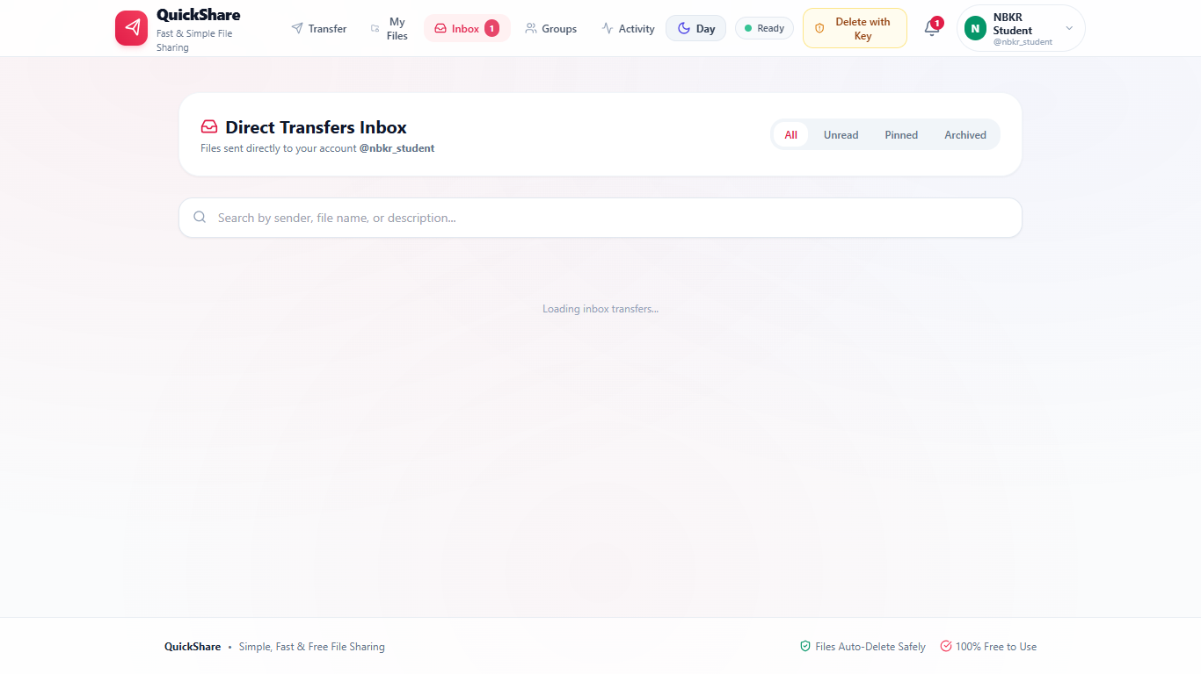
USER MANAGEMENT
Account Profile & Cloud Storage Quota Console
Identity, personal cloud storage quota, and session security in a unified user drawer.
🔒 https://quickshare-nbkr.vercel.app/profile
01
Authenticated Student Identity
Displays verified student name, @username, and university institutional email with custom avatar.
02
Real-Time Quota Progress Meter
Live progress bar monitoring active storage usage against the 1024 MB free cloud storage tier.
03
Custom Avatar Personalization
8-Color identity palette allowing students to customize their visual badge across collaborative study groups.
04
Cryptographic Credential Security
In-app password updating secured by 10-round salted Bcrypt validation and current-password verification.
05
Active Session Control
One-click instant logout with cryptographic JWT token invalidation across all open browser sessions.
06
Zero-Friction Access
Accessible with one click directly from the persistent top navigation bar without interrupting active transfers.
05 / 19

Slide 6
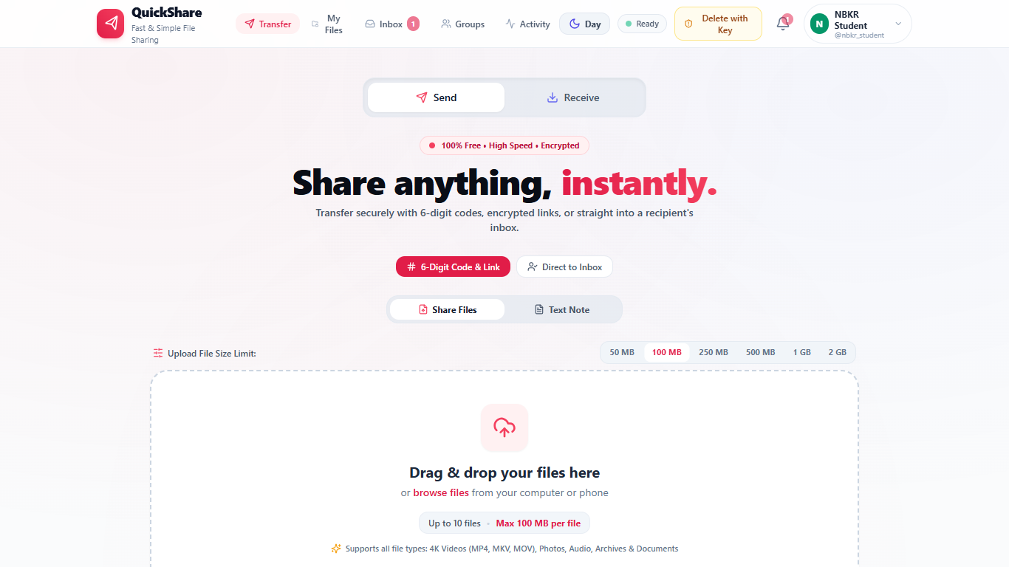
TRANSFER WORKSPACE
Transfer Dashboard: Primary Send Workspace
Intuitive drag-and-drop workspace supporting multi-file uploads and security controls.
🔒 https://quickshare-nbkr.vercel.app/transfer
01
Multi-File Drag & Drop
Upload up to 10 files simultaneously with visual drag hover states and native folder browsing.
02
File Size Limit Presets
Dynamic upload capacity chips supporting 50 MB, 100 MB, 250 MB, 500 MB, 1 GB, and 2 GB files.
03
Custom Expiration Timers
Granular transfer lifecycles: 1 Hour, 6 Hours, 24 Hours (Default), 3 Days, or 7 Days.
04
Bcrypt Password Protection
Optional transfer lock requiring recipients to supply a password before files can be inspected or downloaded.
05
Burn-on-Download Mode
Ephemeral destruction flag that automatically purges the file immediately upon the first successful retrieval.
06
Direct Inbox Dispatch
Quick toggle allowing senders to route files directly to a classmate's registered handle (@username).
06 / 19

Slide 7
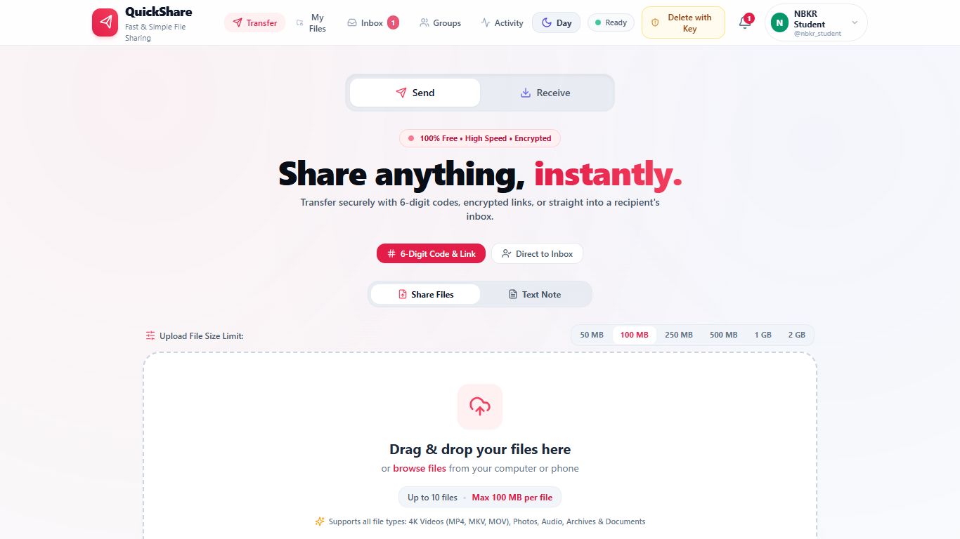
TRANSFER COMPLETION
Share Result Screen: Code, Links & Owner Secret Key
Comprehensive post-upload completion hub providing all transfer channels and revocation tokens.
🔒 https://quickshare-nbkr.vercel.app/share/complete
01
Prominent 6-Digit Transfer Code
High-contrast 6-digit pickup code displayed prominently for rapid verbal or messaging handover.
02
Unguessable 128-Bit URL
Cryptographically secure public download link with 1-click clipboard copying.
03
Instant QR Code Modal
One-tap trigger opening a full-resolution QR code optimized for smartphone camera scanning.
04
Direct Social Sharing Buttons
Instant 1-click dispatch buttons pre-populating download links into WhatsApp, Telegram, and Email.
05
Transfer Metadata Summary
Transparent inspection of total payload size, file count, and exact expiration timestamp countdown.
06
Private 24-Byte Delete Key
Owner-only revocation token allowing the sender to destroy the files permanently at any time.
07 / 19

Slide 8
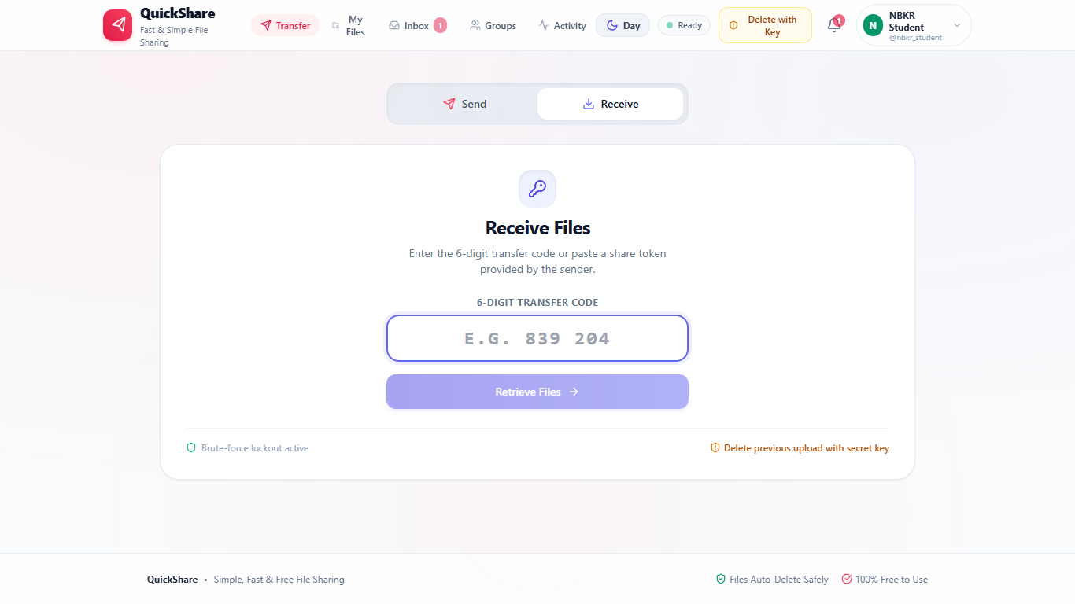
RECEIVER EXPERIENCE
Receive Interface: Instant 6-Digit Code Redemption
Frictionless pickup interface requiring zero accounts, confirmations, or personal data.
01
Instant 6-Digit Code Entry
Large, focused input box accepting transfer codes (e.g. 839 204) or full share URLs with live validation.
🔒 https://quickshare-nbkr.vercel.app/receive
02
Zero-Login Pickup
Recipients never need an account, password creation, or email verification to access and download files.
03
Multi-File Streaming ZIP
Option to download individual files or stream the entire transfer bundle as an automated ZIP archive.
04
Automatic Password Modal
Password-protected transfers dynamically prompt for the Bcrypt password with instant credential check.
05
Brute-Force Lockout Defense
Progressive rate-limiting lockout restricting unauthorized code guessing attempts after 5 failures.
06
Camera QR Code Pickup
Mobile users can scan the QR code to navigate straight to the file decryption and download screen.
08 / 19

Slide 9
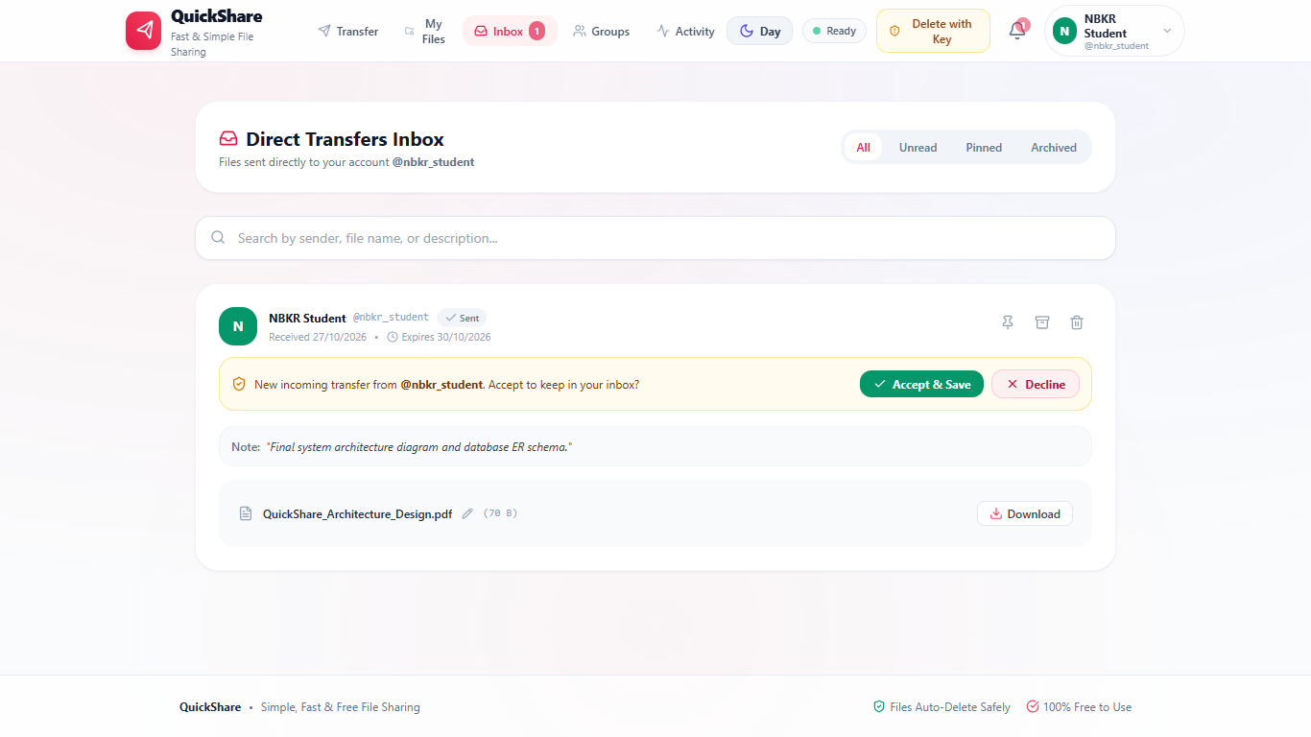
DIRECT IN-APP TRANSFERS
Direct Recipient Inbox & Delivery Audit Status
Peer-to-peer file routing straight to registered usernames with end-to-end delivery tracking.
🔒 https://quickshare-nbkr.vercel.app/inbox
01
Direct User Dispatch
Send files directly to student handles (@username) without generating or exposing public download links.
02
Single Tick (✓ Sent)
Verifies that the payload has been encrypted and stored successfully on the cloud server.
03
Double Tick (✓✓ Delivered)
Confirms that the transfer has successfully entered the recipient's personal inbox queue.
04
Double Green Tick (✓✓ Opened)
Real-time confirmation that the recipient has authenticated and downloaded the transferred files.
05
Transfer Notes & Context
Senders can attach instructions, project deadlines, or review notes to the transfer payload.
06
Inline Organization Tools
Recipients can preview, inline-rename, accept, pin, archive, or download incoming transfers.
09 / 19

Slide 10
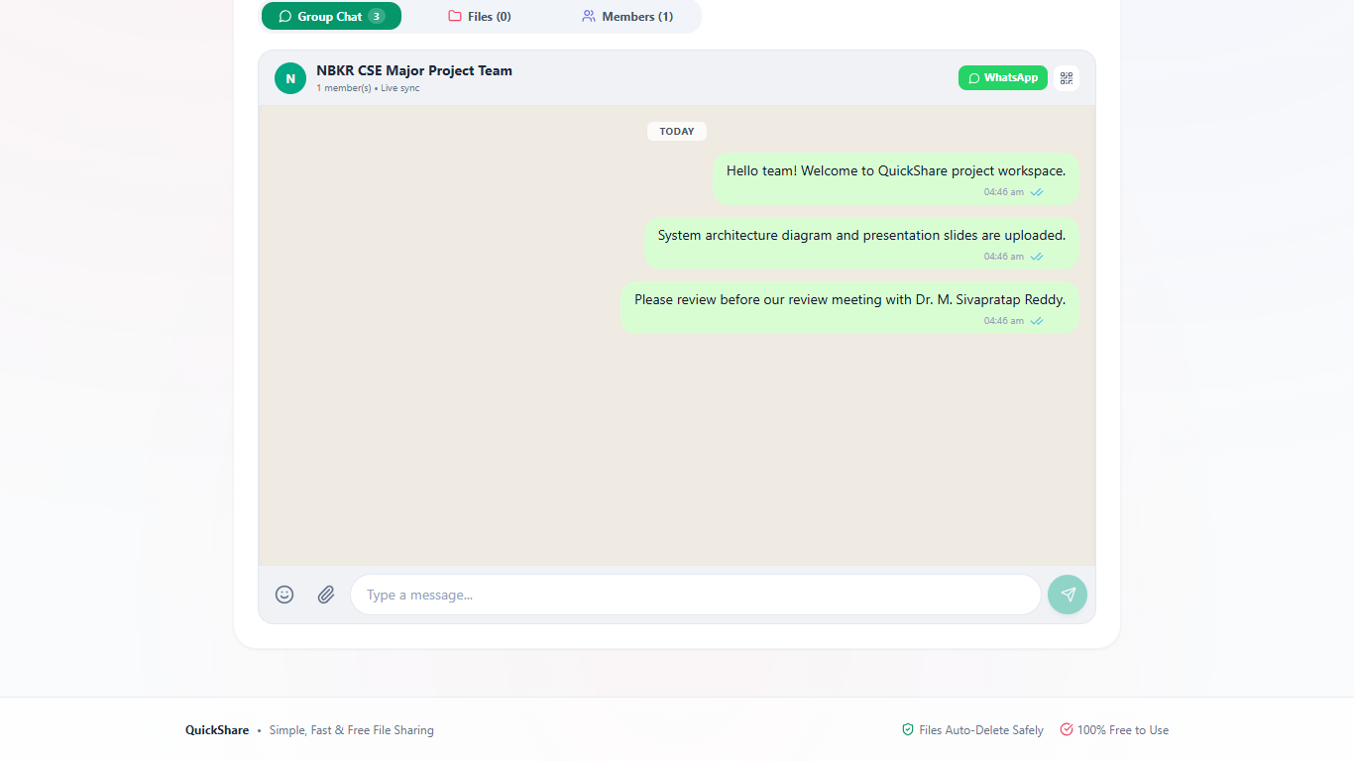
TEAM COLLABORATION
Study Groups & Real-Time Chat Collaboration
Dedicated academic team workspaces combining WhatsApp-style chat with centralized file repositories.
01
Named Project Workspaces
Create persistent collaboration groups for lab batches, capstone project teams, and study circles.
🔒 https://quickshare-nbkr.vercel.app/groups
02
Real-Time Group Chat
WhatsApp-style message bubbles with sender avatars, verified timestamps, and message deletion rights.
03
Inline File Attachments
Attach project documents, diagrams, and code archives directly inside the conversational stream.
04
Centralized Files Tab
Dedicated project file repository acting as a single source of truth for all shared team deliverables.
05
One-Tap Group Invites
Instant WhatsApp invite link and high-contrast QR code generation for rapid peer onboarding.
06
Role-Based Permissions
Clear owner and member role hierarchy to prevent unauthorized group modifications or accidental deletions.
10 / 19

Slide 11
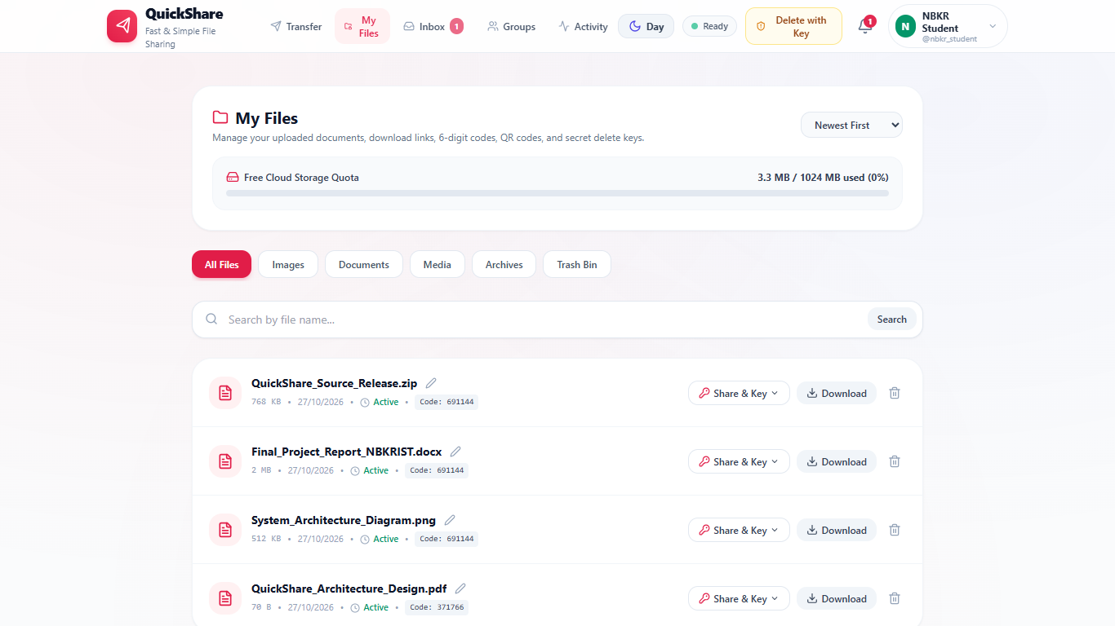
CLOUD FILE STORAGE
Personal Cloud Drive & Storage Lifecycle Management
Centralized personal console for managing uploaded deliverables, quota, and early deletion.
🔒 https://quickshare-nbkr.vercel.app/my-files
01
Real Uploaded Deliverables
Active storage console showcasing project source ZIPs, reports, diagrams, and PDF specifications.
02
Storage Quota Progress Meter
Live progress bar monitoring active usage against the 1024 MB free storage allowance.
03
Smart Category Filters
Instant 1-click filtering across All Files, Images, Documents, Media, Archives, and Trash Bin.
04
Soft-Delete Trash Bin
Safe deletion workflow with 1-click instant restoration of accidentally removed project files.
05
Inline Name Editing
Rename files directly inside the cloud drive without re-uploading the underlying binary assets.
06
Owner Cryptographic Keys
Quick access to the secret 24-byte delete key for immediate cloud-wide revocation.
11 / 19

Slide 12
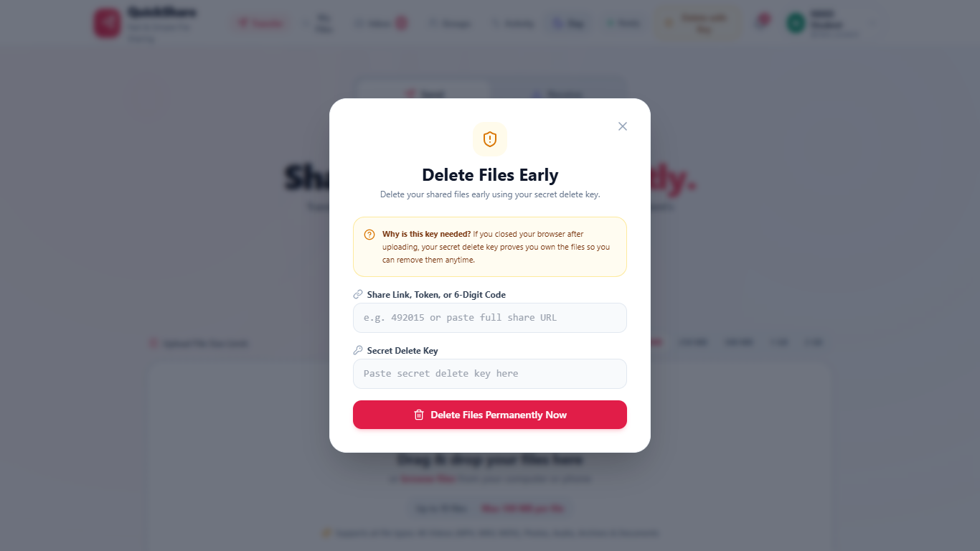
CONFIDENTIAL PURGE
Secret Key Deletion: Emergency File Purge Workflow
Owner-controlled emergency destruction mechanism to revoke accidental or sensitive file shares.
🔒 https://quickshare-nbkr.vercel.app/delete-key
01
Private 24-Byte Token
High-entropy token generated exclusively at upload and provided only to the uploader.
• Generated during upload · Never exposed to public recipients
02
Cross-Device Verification
Senders can paste the key into the modal from any browser or smartphone without logging in.
• Zero login required · Instant cryptographic hash matching
03
Immediate Physical S3 Purge
File binaries are destroyed immediately from cloud Supabase S3 buckets with zero disk cache.
• Complete binary deletion · Zero residual cloud storage
04
HTTP 410 Gone Revocation
Shared links return permanent HTTP 410 Gone; files cannot be decrypted or retrieved again.
• Permanent link invalidation · Session metadata purged
12 / 19

Slide 13
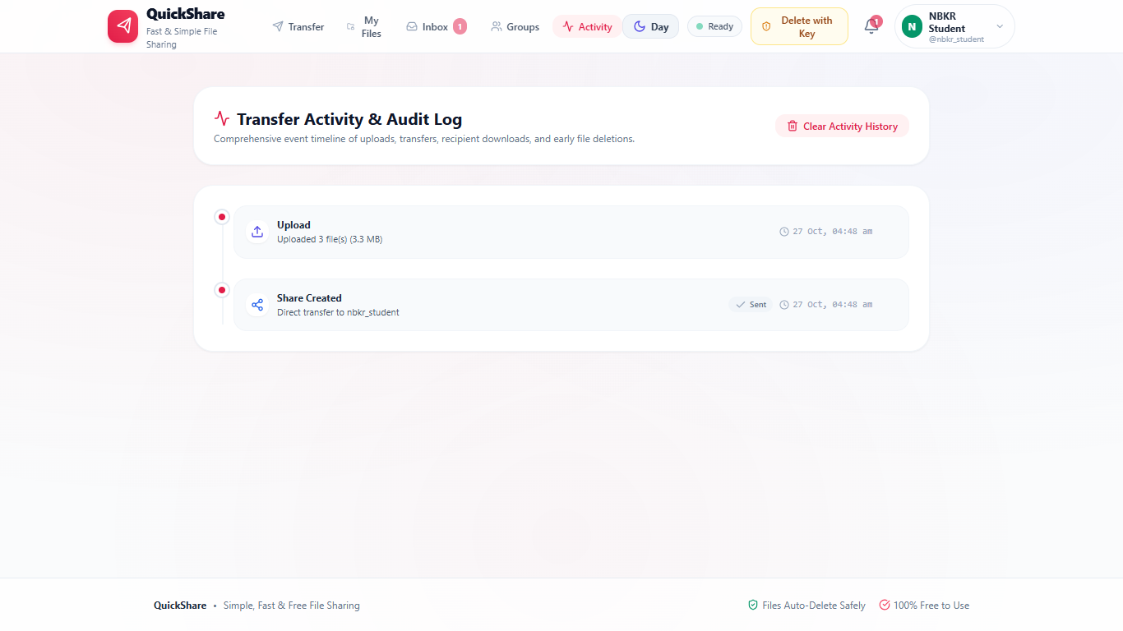
AUDIT & ACTIVITY
Transfer Activity Timeline & Audit Event Logs
A comprehensive chronological audit log tracking all file transfers, receipts, and deletions.
01
Chronological Event Feed
Real-time feed tracking all account file uploads, direct transfers, and recipient downloads with timestamps.
🔒 https://quickshare-nbkr.vercel.app/activity
02
Transfer Code Linking
Every audit record displays the associated 6-digit code and share token for clear tracking.
03
Payload Volume Accounting
Logs exact file counts and byte sizes for transparent storage accountability and quota tracking.
04
Privacy History Control
Users can clear their personal activity logs with 1 click to maintain strict privacy protection.
05
Zero Layout Shift
Smooth, responsive layout guaranteeing complete legibility across mobile and desktop devices.
13 / 19

Slide 14
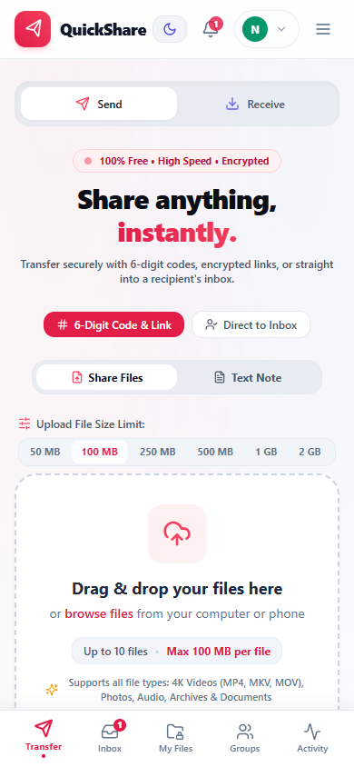
MOBILE RESPONSIVENESS
Mobile Smartphone Ergonomics & Docked Bottom Navigation
Optimized thumb-friendly interface engineered for narrow viewports and touch targets.
01
Docked Bottom Navigation
Thumb-reachable docked bar providing 1-tap switching between all 5 primary views.
02
Five Primary Tabs
Instant access to Transfer, Inbox, My Files, Groups, and Activity from any screen.
03
Live Notification Badges
Real-time badge counter displaying unread incoming transfers directly on the Inbox icon.
04
Narrow Viewport Resilience
Zero text clipping and adaptive cards engineered specifically for 320px–420px mobile screens.
05
Touch-Target Sizing
44px minimum touch targets preventing accidental taps on mobile touchscreens.
06
Zero Layout Shift
Lightweight CSS and smooth transitions ensuring instant rendering with zero page reloads.
14 / 19

Slide 15
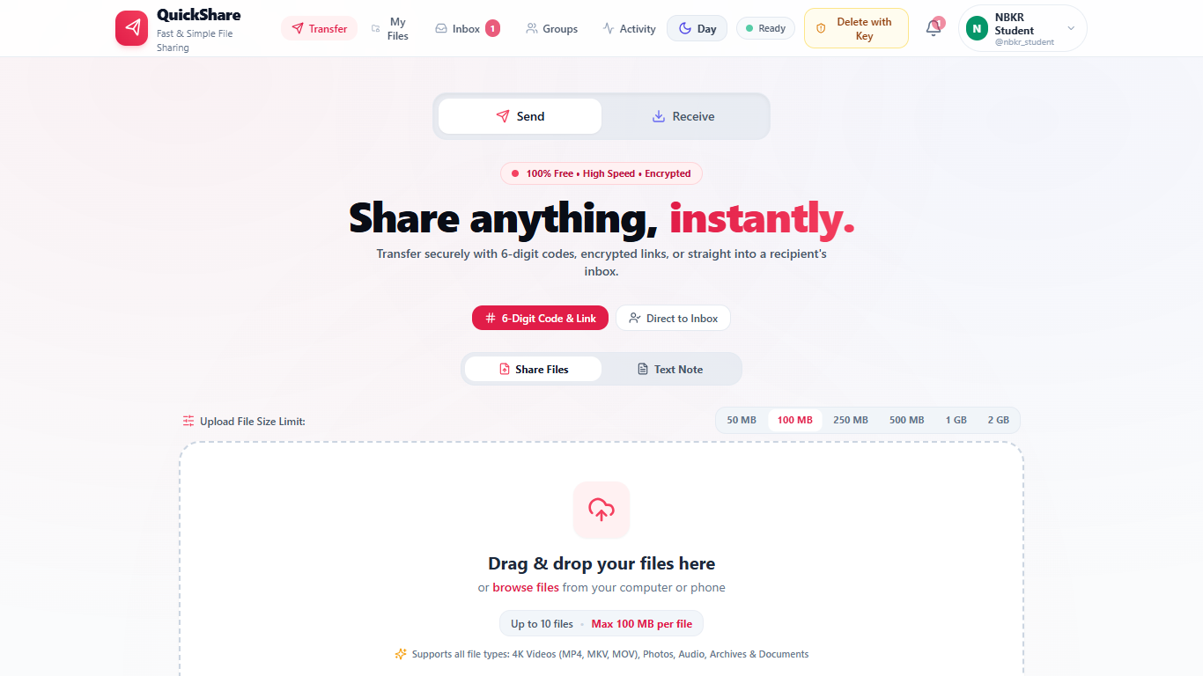
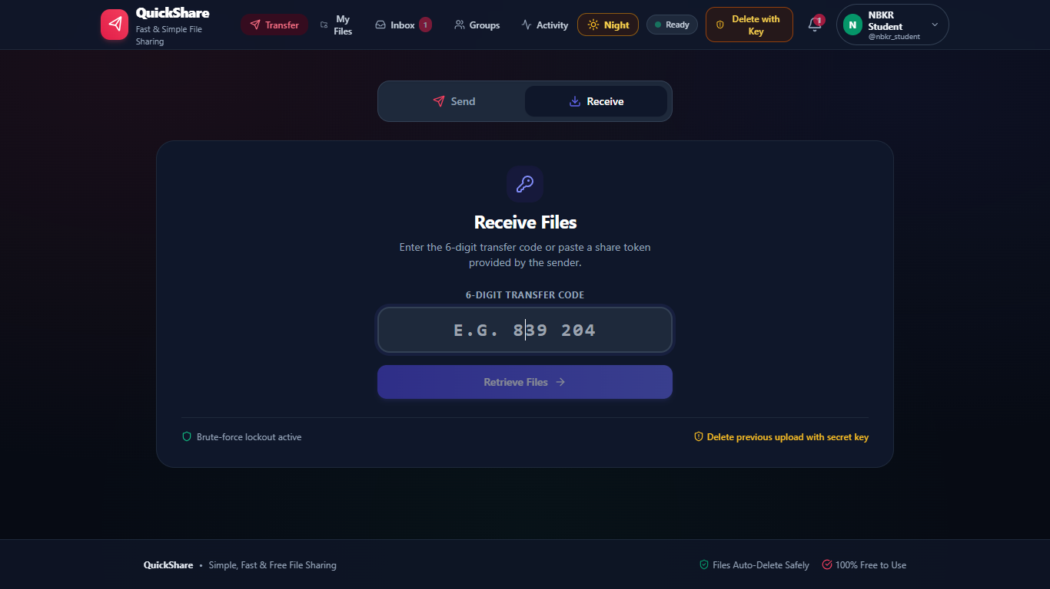
VISUAL ACCESSIBILITY
Light & Dark Themes: Ambient Visual Accessibility
Seamless 1-click theme switching tuned for daylight classrooms and low-light laboratory study.
1-CLICK ZERO-RELOAD THEME SWITCHER
🔒 https://quickshare-nbkr.vercel.app [Day Mode]
🔒 https://quickshare-nbkr.vercel.app [Night Mode]
DAYLIGHT CLASSROOM USABILITY
• Pure white canvas (#FFFFFF) and slate typography tuned for bright ambient lighting.
• High-contrast visual focus boundaries separating dropzones, buttons, and input fields.
• Inter font rendering with uniform border radiuses and soft, natural drop shadows.
LOW-LIGHT LAB & OLED EFFICIENCY
• Deep obsidian canvas (#0B1120) with subtle indigo radial depth gradients.
• Lowers screen glare and significantly reduces OLED battery draw on smartphones.
• User theme preference automatically persisted in browser local storage across sessions.
15 / 19

Slide 16
ENGINEERING SPECIFICATIONS
Technology Stack & ₹0 Cloud Architecture Economics
Demonstrating modern architectural efficiency with zero recurring financial overhead.
TOTAL CLOUD INFRASTRUCTURE HOSTING COST: ₹0 / MONTH
100% Free Forever Tier • No Credit Card Required • Production-Ready SLA & High Availability Across All Microservices
EDGE DELIVERY
API BACKEND
CLOUD DATABASE
OBJECT STORAGE
MAINTENANCE CRON
100 GB
512 MB
5 GB
1 GB
15 Min
Vercel Edge CDN
React 18 & Vite SPA
Render API Service
Node.js 22+ & Express
TiDB Serverless
Cloud MySQL 8 Engine
Supabase S3 Bucket
Object Binary Store
Node-Cron Sweeper
Automated Background Service
Global anycast edge caching with automated SSL/TLS certificates and instant continuous deployment on every Git push.
Production REST API service running native crypto streaming, multi-file uploads, and rate limiting with 750 free compute hours/month.
Distributed serverless MySQL database with auto-scaling storage, 50M Request Units/month, and dual SQLite development driver.
S3-compatible object repository providing secure binary streaming, on-the-fly ZIP compression, and zero egress bandwidth fees.
Continuous cron service executing every 15 minutes to purge expired shares, unlink databases, and maintain storage quotas.
16 / 19

Slide 17
PRODUCTION VERIFICATION
Automated Testing Verification & Security Audit
Validated through a comprehensive Jest test suite and defense-in-depth threat mitigations.
TEST SUITE EXECUTION
53 / 53
JEST PLATFORM TESTS PASSING (100%)
• Total Test Suites: 3 Suites Passing
• Execution Time: 4.82 Seconds
• Zero Vulnerabilities: Audit Clean (0 High/Crit)
• Code Coverage: Authentication, Upload, Inbox
• Deployment Verification: Vercel + Render + TiDB
AUTOMATED FUNCTIONAL COVERAGE
✔ Authentication & JWT
User registration, Bcrypt password hashing, JWT signing, profile updates, and logout invalidation.
✔ Multi-File Upload Engine
MIME-type sanitization, SHA-256 integrity checks, and user quota threshold enforcement.
✔ 6-Digit Code Redemption
Random code resolution, rate limiting, and 5-attempt brute-force lockout defense.
✔ Direct In-App Inboxes
Direct dispatch to @username, delivery checkmark status transitions, and unread badges.
✔ Cloud Drive & Lifecycle
Inline file renaming, trash bin soft-deletion, 1-click restore, and download counters.
✔ Group Collaboration
Study group creation, WhatsApp-style chat messaging, member roles, and shared files.
SECURITY AUDIT & THREAT DEFENSE
🛡 128-Bit Unguessable Tokens
Cryptographically generated using Node's crypto.randomBytes() to prevent token prediction.
🛡 192-Bit Secret Revocation Key
Private 24-byte owner key permitting emergency file deletion anytime from any device.
🛡 Immediate Physical S3 Purge
Revoked sessions return permanent HTTP 410 Gone with zero lingering binary cache on S3.
🛡 File Extension Blocklist
Rejects potentially dangerous executables (.exe, .bat, .sh, .vbs, .msi, .php) at the upload boundary.
🛡 SQL Injection Protection
100% parameterized SQL prepared statements across all TiDB database query controllers.
🛡 Path Traversal Resistance
Strict path resolution ensuring filenames cannot escape designated storage sandbox roots.
17 / 19

Slide 18
PROJECT CONCLUSION
Executive Summary: What QuickShare Delivers
Fast, private, and verified file-sharing infrastructure built for modern academic collaboration.
01
Frictionless Transfer
02
Private by Design
03
Zero Financial Overhead
Transfer files instantaneously via 6-digit codes, direct recipient inboxes, encrypted URLs, or QR codes without mandatory account creation or password friction.
Automated file lifecycles, burn-on-download mode, secret 24-byte owner revocation keys, and continuous 15-minute background S3 binary purges.
Production-ready architecture operating 100% on free cloud tiers (Vercel, Render, TiDB, Supabase) with zero hosting costs (₹0 / month) and zero maintenance.
04
Production Verified
05
Unified Academic Workspace
06
Future Engineering Roadmap
Backed by 53 automated Jest platform tests (100% passing), defense-in-depth security mitigations, and an active live production cloud deployment.
Integrated project collaboration groups with real-time WhatsApp-style chat, direct user inboxes, personal cloud drive, and audit history timelines.
Client-side end-to-end encryption (Web Crypto API AES-GCM-256), automated malware scanning, native WebRTC P2P direct transfer, and multi-region replication.
18 / 19

Slide 19
N.B.K.R. INSTITUTE OF SCIENCE & TECHNOLOGY
Department of Computer Science & Engineering • Vidyanagar, Andhra Pradesh
Thank You
Questions & Technical Discussion
Project Supervisor: Dr. M. Sivapratap Reddy (Associate Professor, Dept. of CSE)
24KB1A05GP
S D Vara Prasad Reddy
24KB1A05HD
Shaik Arif
24KB1A05HW
Sk Mohammed Rasikh
24KB1A05JE
Shaik Rehan
24KB1A05NB
Veeravalli Syam Sundar
Frontend Web Application
https://quickshare-nbkr.vercel.app/
Backend REST API
https://share-api-0xvn.onrender.com/api
API Health Check
https://share-api-0xvn.onrender.com/api/health
GitHub Open-Source Repository
https://github.com/sathidevivaraprasadreddy/share

