Slide 1
Location CheckList for Photographers

Slide 2
ABC company –Events
ABC company in Toronto is organizing events for Photographers
Event for 7 days for photographers all over the world
ABC company’s purpose is to make a list of places of landscape in Toronto

Slide 3
Location for Photographers
A hotel of residence
A hall for meetings
Places of landscape to visit,
Stores for shopping
Restaurants and cafes

Slide 4
Data acquisition and cleaning
Retriving Data from Foursquare Location data
Information about restaurants, cafes, and stores which in this area
Data –Grouped by Landscape area and other areas
Using Json – Dataframe is created

Slide 5
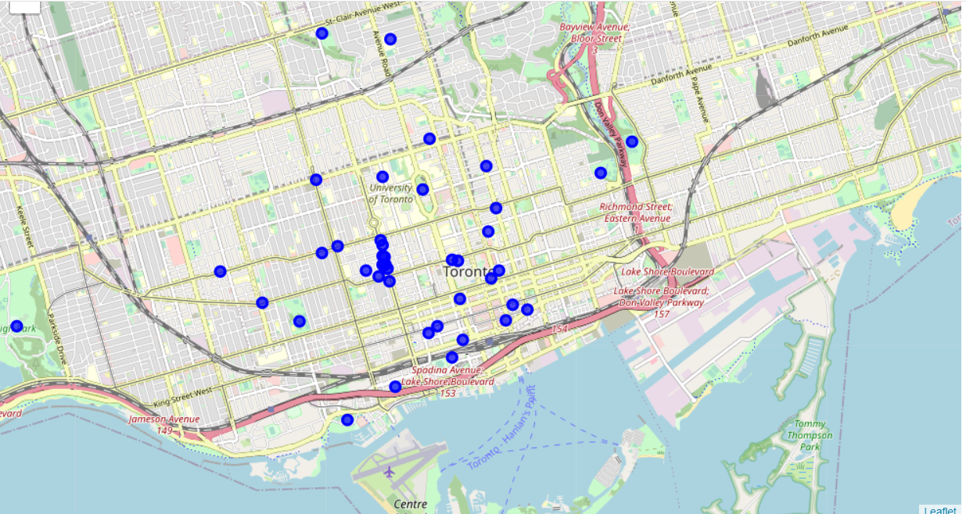
Location for Photograhers in Toronto

Slide 6
Conclusion
We got the Location for photographers in map using Foursquare Location Data
ABC company successfully organized an event for Photographers all over the world

