Slide 1



SMART MERCHANT SUPPORT PLATFORM FOR AGENCY BANKING AND PROCUREMENT
R26-IT-139

Slide 2

Introduction
Research Gap
    No existing solution integrates financial ledgering, inventory control, agency banking, and procurement decision support into a single platform tailored for rural micro-merchants. Current tools fall into three separate, disconnected categories:
    Accounting/inventory apps → not integrated with banking
    Digital banking/agency apps → online-only, not linked to merchant inventory or procurement
    Generic POS systems → not designed for FIFO costing, rural connectivity, or low-literacy users
    Research Objectives
    Implement digital ledger & income statements.
    Develop FIFO inventory & supplier tracking.
    Simulate agency banking with ML-based security alerts to the merchant.
    Build smart procurement decision support.

Slide 3
PP1 Comment
PP1 Comment | Way we Address
The current work presented by the group does not sufficiently demonstrate the characteristics of a research project. At present, the implementation mainly consists of visualizing dummy data through a web application, without showing a clear research problem, technical contribution, experimentation, or analytical depth expected from a year-long research project. Data visualization alone is not considered a research contribution unless it is supported by meaningful analysis, intelligent processing, novel methodologies, predictive modeling, or experimentally validated outcomes. The group needs to clearly identify what the actual research component of the project is and how the proposed work contributes beyond basic application development and visualization. | Clear Research Problem: Addressed the lack of a unified platform for rural micro-merchants. Technical Contribution: Integrated multiple systems—financial ledger, inventory management, agency banking, and procurement—into a single platform. Intelligent Processing:Implemented intelligent features including Credit Score Prediction Sales Forecasting Buy-or-Wait Recommendation Account Activity State Prediction Analytical Component: Uses transaction, sales, inventory, and account activity data to generate data-driven insights and recommendations. Research Validation: Evaluating the developed intelligent models and system through performance, accuracy, usability, and low-connectivity testing. Beyond Visualization: The system goes beyond dummy-data visualization by incorporating ML-based prediction, decision support, and integrated financial/inventory processing.

Slide 4


Proposed Solution
Digital Agency Banking & Smart Procurement Support System: a single platform that replaces notebooks, memory, and physical bank visits with four connected digital modules, built to work reliably:
    Digital Financial Ledger: every sale/expense auto-generates a live income statement (no manual bookkeeping)
    Offline Inventory & Supplier Management: FIFO stock batches with accurate costing, tracked and editable without internet
    Simulated agency banking deposits and withdrawals, backed by ML-driven liquidity forecasting and anomaly detection
    Smart Procurement Decision Support: supplier recommendations based on distance (Haversine formula), lead time, and price

Slide 5
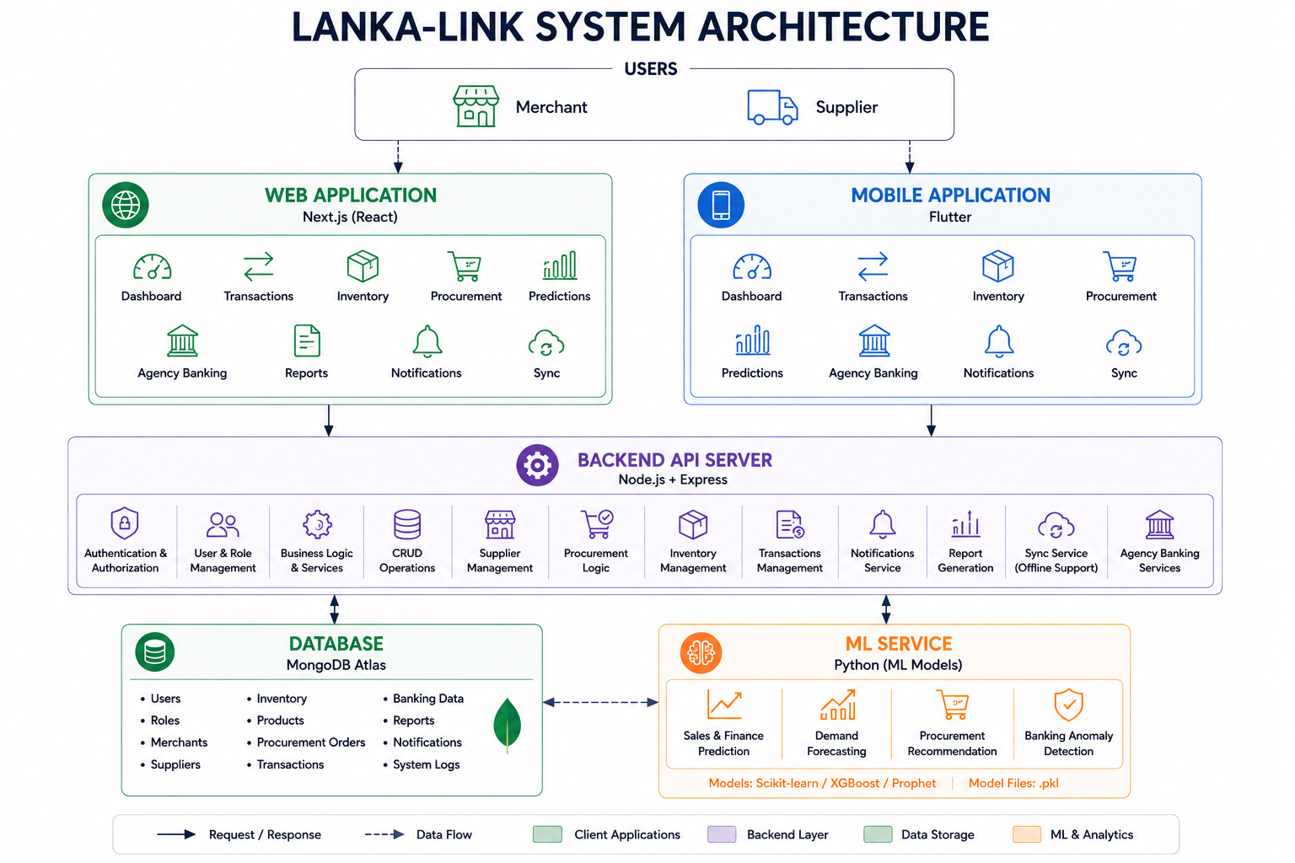

Slide 6
Non- Functional Requirements
    Performance: core actions (sale entry, inventory update) respond in under 2 seconds
    Usability: interface usable by merchants with minimal digital literacy, in the local language
    Security: encrypted local storage; authenticated access via Supabase Auth
    Availability: full core functionality (sales, inventory, ledger) usable fully offline
    Scalability: modular backend structure supports multi-shop/franchise expansion

Slide 7
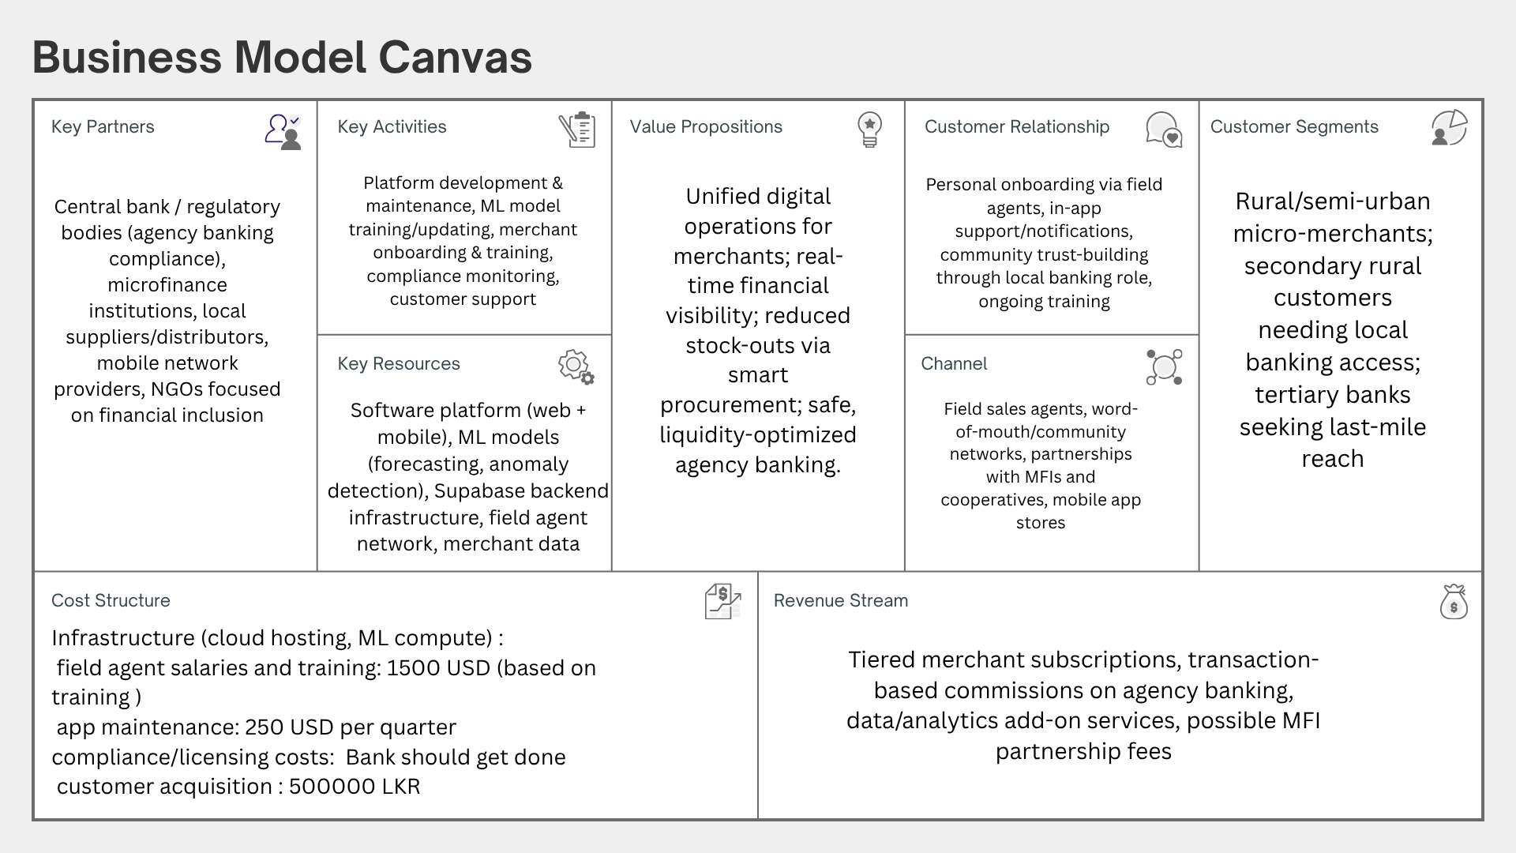

Slide 8
Thank you !

